Slide 1
Final Project – DCT Design
M0921025 顏郁霖

Slide 2
設計
Traditional DCT
DCT of Matrix Simplification
DA-DCT
CORDIC-Based DCT
Comparison

Slide 3
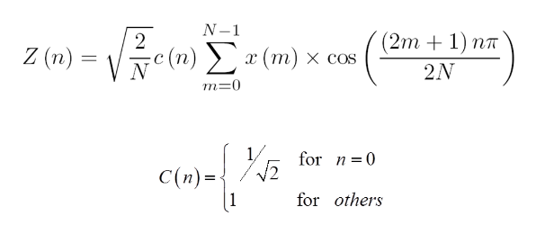
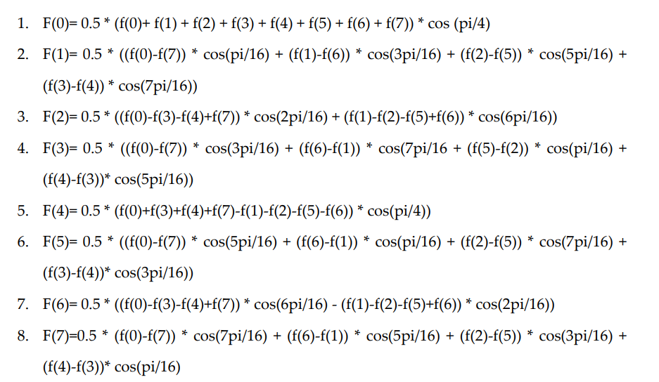
DCT

Slide 4
矩陣化簡

Slide 5
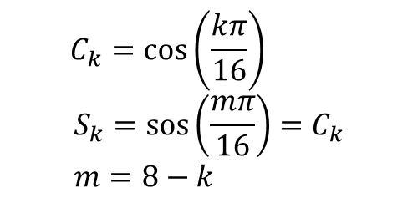
矩陣化簡
$$C_{k}=\cos\left(\frac{kπ}{16}\right)$$
$$S_{k}=\operatorname{sos}\left(\frac{mπ}{16}\right)=C_{k} \\ m=8−k$$

Slide 6
DA
C4 | -S4 | S4 | C4 |  | C6 | -S6 | S6 | C6 |  | C7 | S7 | -S7 | C7 |  | C3 | S3 | -S3 | C3 |  | C3 | -S3 | S3 | C3 |  | C1 | S1 | -S1 | C1
0 | 1 | 0 | 0 | 4 | 0 | 1 | 0 | 0 | 4 | 0 | 0 | 1 | 0 | 2 | 0 | 0 | 1 | 0 | 2 | 0 | 1 | 0 | 0 | 4 | 0 | 0 | 1 | 0 | 2
1 | 0 | 1 | 1 | 11 | 0 | 0 | 1 | 0 | 2 | 0 | 1 | 0 | 0 | 4 | 1 | 1 | 0 | 1 | 13 | 1 | 0 | 1 | 1 | 11 | 1 | 0 | 1 | 1 | 11
0 | 1 | 0 | 0 | 4 | 1 | 0 | 1 | 1 | 11 | 0 | 1 | 0 | 0 | 4 | 1 | 0 | 1 | 1 | 11 | 1 | 1 | 0 | 1 | 13 | 1 | 0 | 1 | 1 | 11
1 | 0 | 1 | 1 | 11 | 1 | 0 | 1 | 1 | 11 | 1 | 1 | 0 | 1 | 13 | 0 | 1 | 0 | 0 | 4 | 0 | 0 | 1 | 0 | 2 | 1 | 1 | 0 | 1 | 13
1 | 0 | 1 | 1 | 11 | 0 | 1 | 0 | 0 | 4 | 1 | 1 | 0 | 1 | 13 | 1 | 1 | 0 | 1 | 13 | 1 | 0 | 1 | 1 | 11 | 1 | 1 | 0 | 1 | 13
0 | 1 | 0 | 0 | 4 | 0 | 0 | 1 | 0 | 2 | 0 | 1 | 0 | 0 | 4 | 0 | 1 | 0 | 0 | 4 | 0 | 0 | 1 | 0 | 2 | 1 | 0 | 1 | 1 | 11
1 | 0 | 1 | 1 | 11 | 0 | 0 | 1 | 0 | 2 | 0 | 0 | 1 | 0 | 2 | 1 | 0 | 1 | 1 | 13 | 1 | 1 | 0 | 1 | 13 | 0 | 0 | 1 | 0 | 2
0 | 1 | 0 | 0 | 4 | 0 | 1 | 0 | 0 | 4 | 1 | 1 | 0 | 1 | 13 | 0 | 0 | 1 | 0 | 2 | 0 | 1 | 0 | 0 | 4 | 1 | 1 | 1 | 1 | 15
1 | 1 | 1 | 1 | 11 | 1 | 1 | 0 | 1 | 13 | 0 | 1 | 1 | 0 | 6 | 0 | 1 | 1 | 0 | 6 | 0 | 1 | 1 | 0 | 6 | 1 | 0 | 0 | 1 | 9
0 | 0 | 0 | 0 | 0 | 1 | 1 | 1 | 1 | 15 | 0 | 0 | 0 | 0 | 0 | 1 | 0 | 0 | 1 | 9 | 1 | 0 | 0 | 1 | 9 | 0 | 0 | 0 | 0 | 0
0 | 0 | 0 | 0 | 0 | 1 | 0 | 0 | 1 | 9 | 0 | 0 | 0 | 0 | 0 | 1 | 0 | 0 | 1 | 9 | 1 | 0 | 0 | 1 | 9 | 0 | 0 | 0 | 0 | 0
0 | 0 | 0 | 0 | 0 | 1 | 0 | 0 | 1 | 9 | 0 | 0 | 0 | 0 | 0 | 1 | 0 | 0 | 1 | 9 | 1 | 0 | 0 | 1 | 9 | 0 | 0 | 0 | 0 | 0

Slide 7
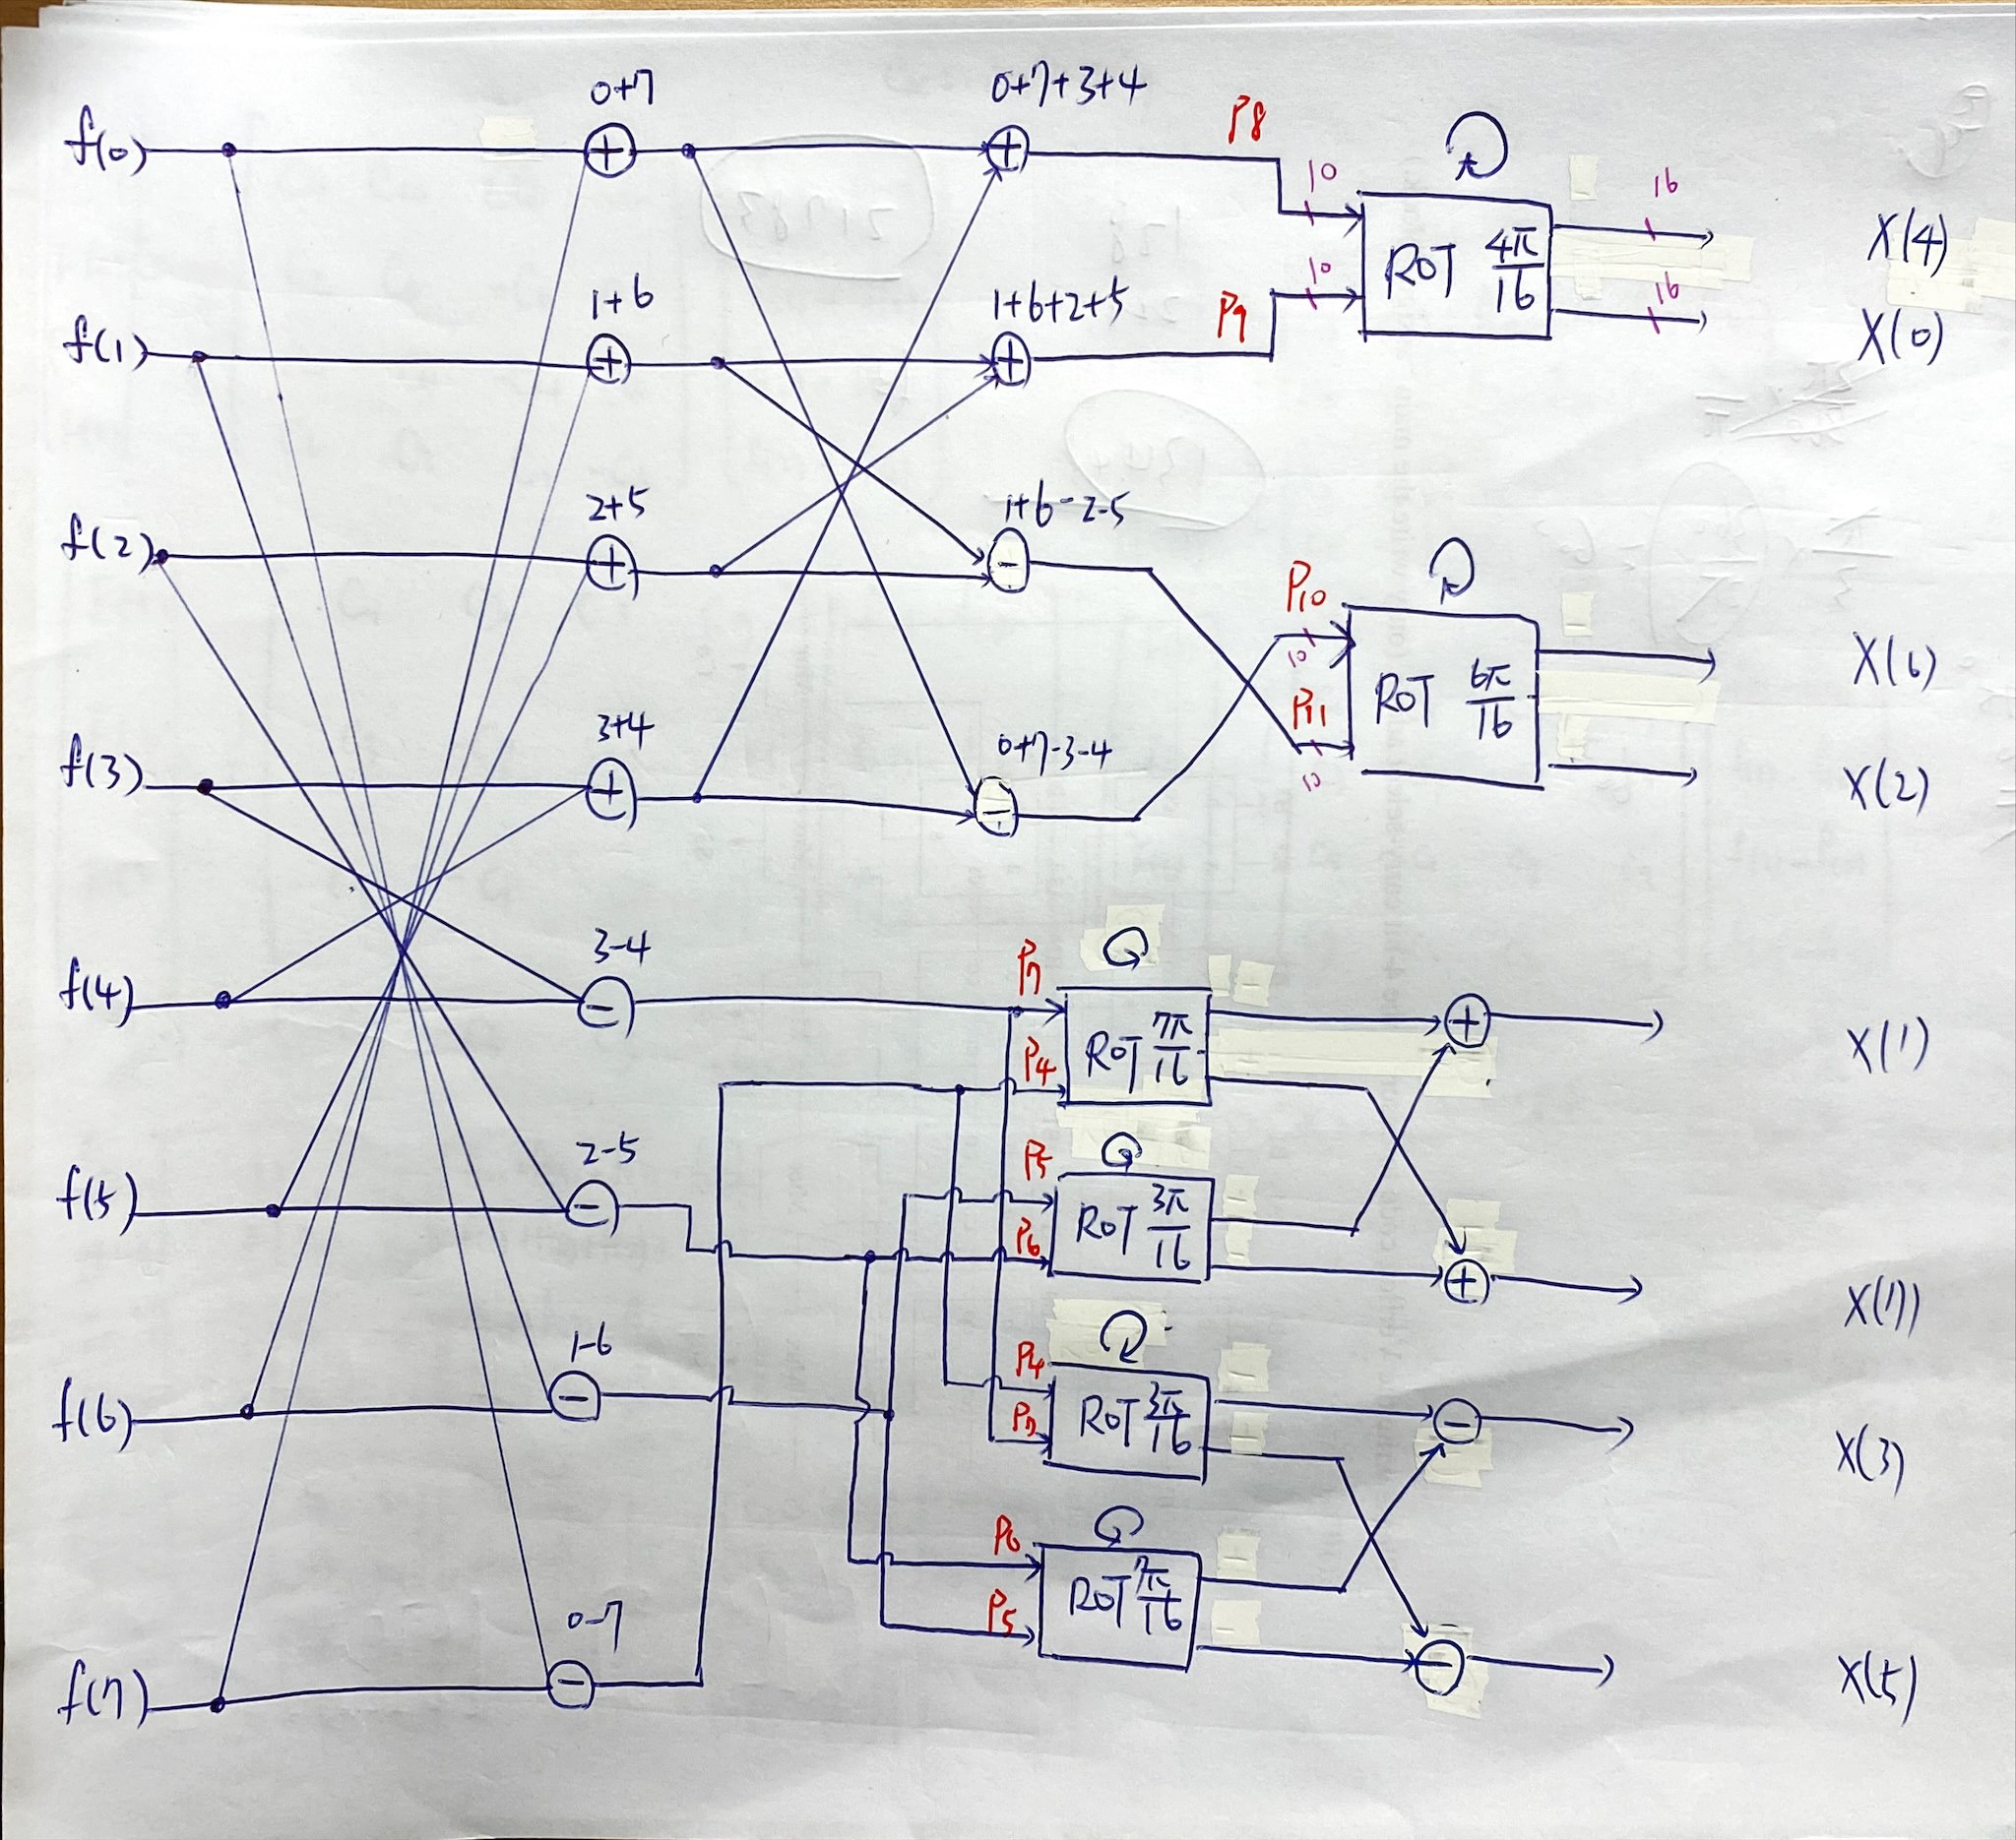
CORDIC-Based DCT
ROT為CORDIC電路
進行10次iteration
內有10級管線

Slide 8
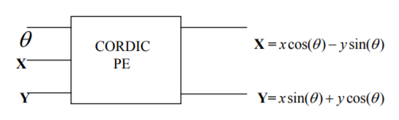
CORDIC-Based DCT

Slide 9
比較
Methods | Freq. |  | Slack | Area |  | Static Power | Dynamic Power
Traditional DCT | 100Mhz 10ns | Setup time | 1.5 | LUT | 2254 | 0.108W 31% | 0.235W 69%
 |  |  |  | FF | 815
 |  | Hold time | 0.079
 |  |  |  | IO | 251
Matrix Simplification | 100Mhz 10ns | Setup time | 0.513 | LUT | 1976 | 0.108W 31% | 0.241W 69%
 |  | Hold time | 0.079 | FF | 728
 |  |  |  | IO | 267
DA-DCT | 83.3Mhz 12ns | Setup time | 0.131 | LUT | 3055 | 0.108W 31% | 0.230W 69%
 |  |  |  | FF | 277
 |  | Hold time | 0.079
 |  |  |  | IO | 289
CORDIC-Based DCT | 142.8Mhz 7ns | Setup time | 0.522 | LUT | 23058 | 0.109W 25% | 0.321W 75%
 |  |  |  | FF | 3490
 |  | Hold time | 0.079
 |  |  |  | IO | 204

Slide 10
結論
使用DA技術的功耗最低
使用CODRIC速度最快，但電路成本最高
未來可以在CORDIC對應的電路上利用更多的技術研究改量

