Slide 1

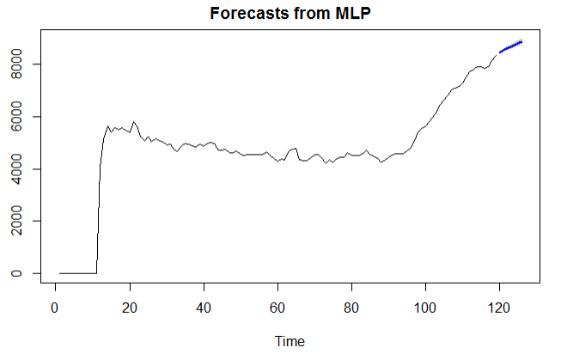
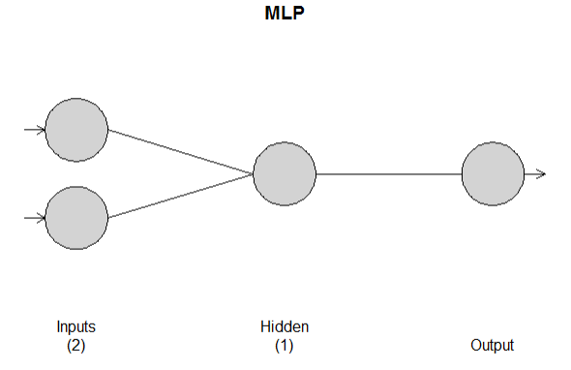
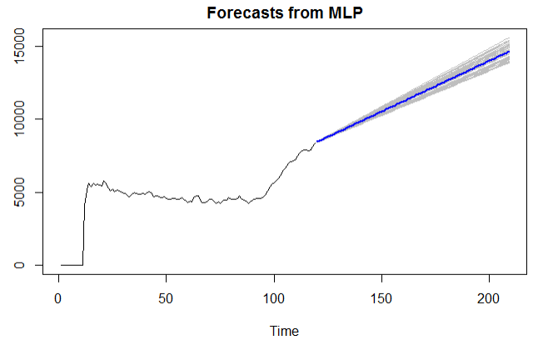

CA Univariate MLP MOdel analysis
Hyper tuned parameters neural network model
Windowed ASE: 92,395
Notes:
Josh: 7 sec
We followed the same procedure for the MLP with the California data. To little surprise, it generated a straight line function for the forecast.

