Slide 1
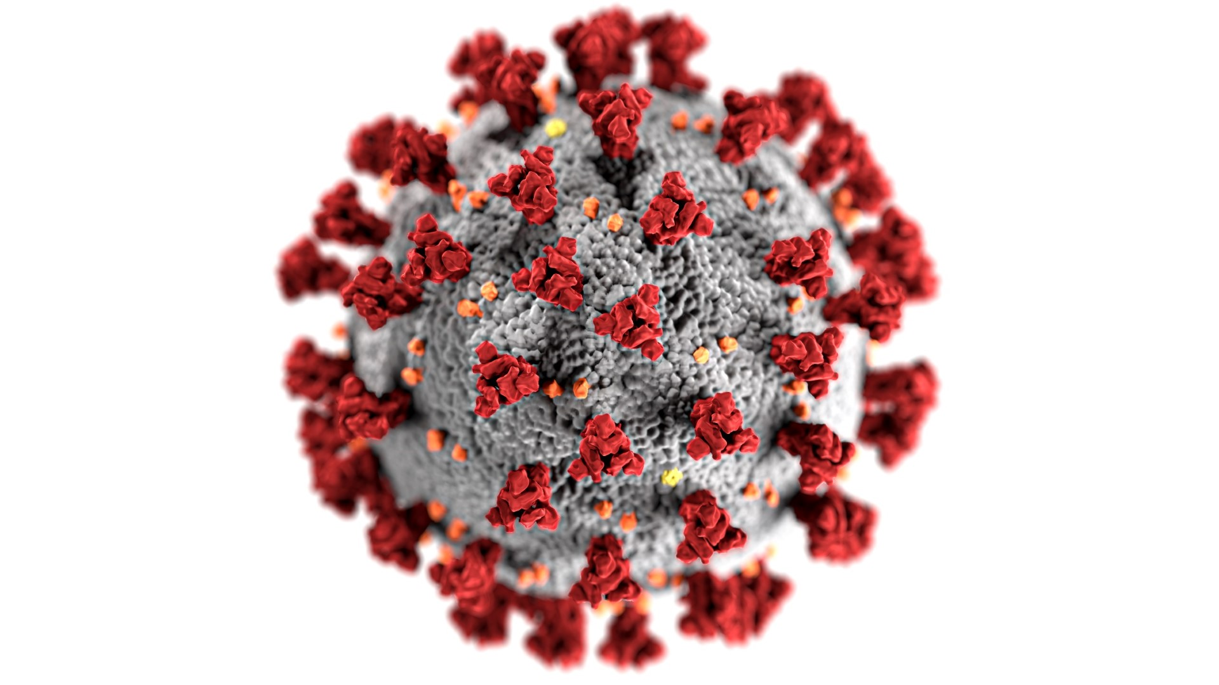
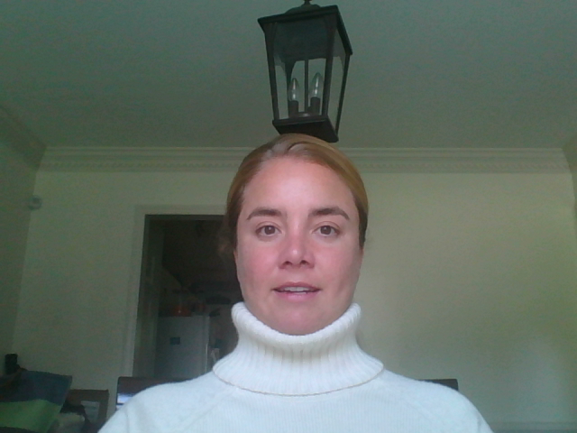
Complete codebooks can be found on our Github.
#covid19
Notes:
Thank you for working through our COVID analysis with us today.

