Slide 1
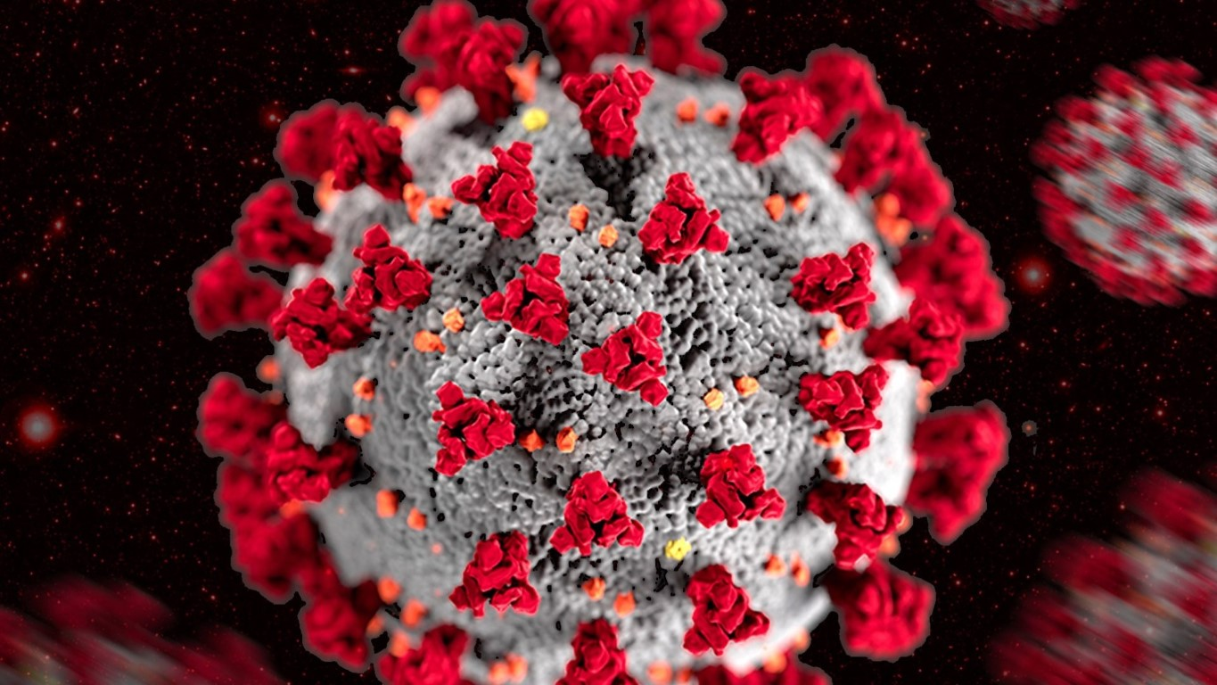
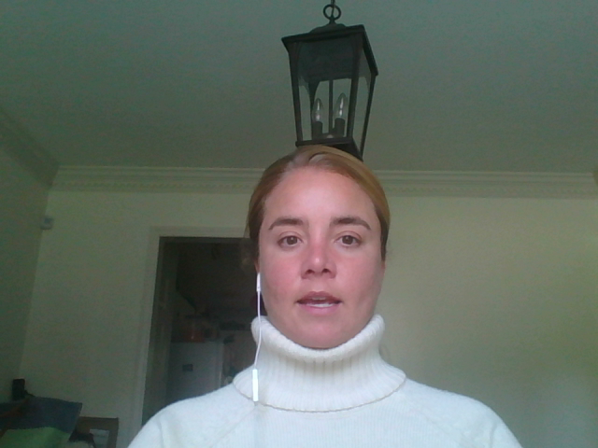
1.ARMA v ARIMA Candidate Models
U.S. & California
COVID-19
Jaclyn Coate
Josh Eysenbach
Final Presentation
Summer 2020 Time Series 6373
Notes:
Jaclyn
Time: 7 seconds
I’m Jaclyn Coate. Josh Eysenbach and I are here to present part 2 of our COVID analysis for the US and California.

