Slide 1
What Is NLP?
Introduction to Natural Language Processing

Slide 2

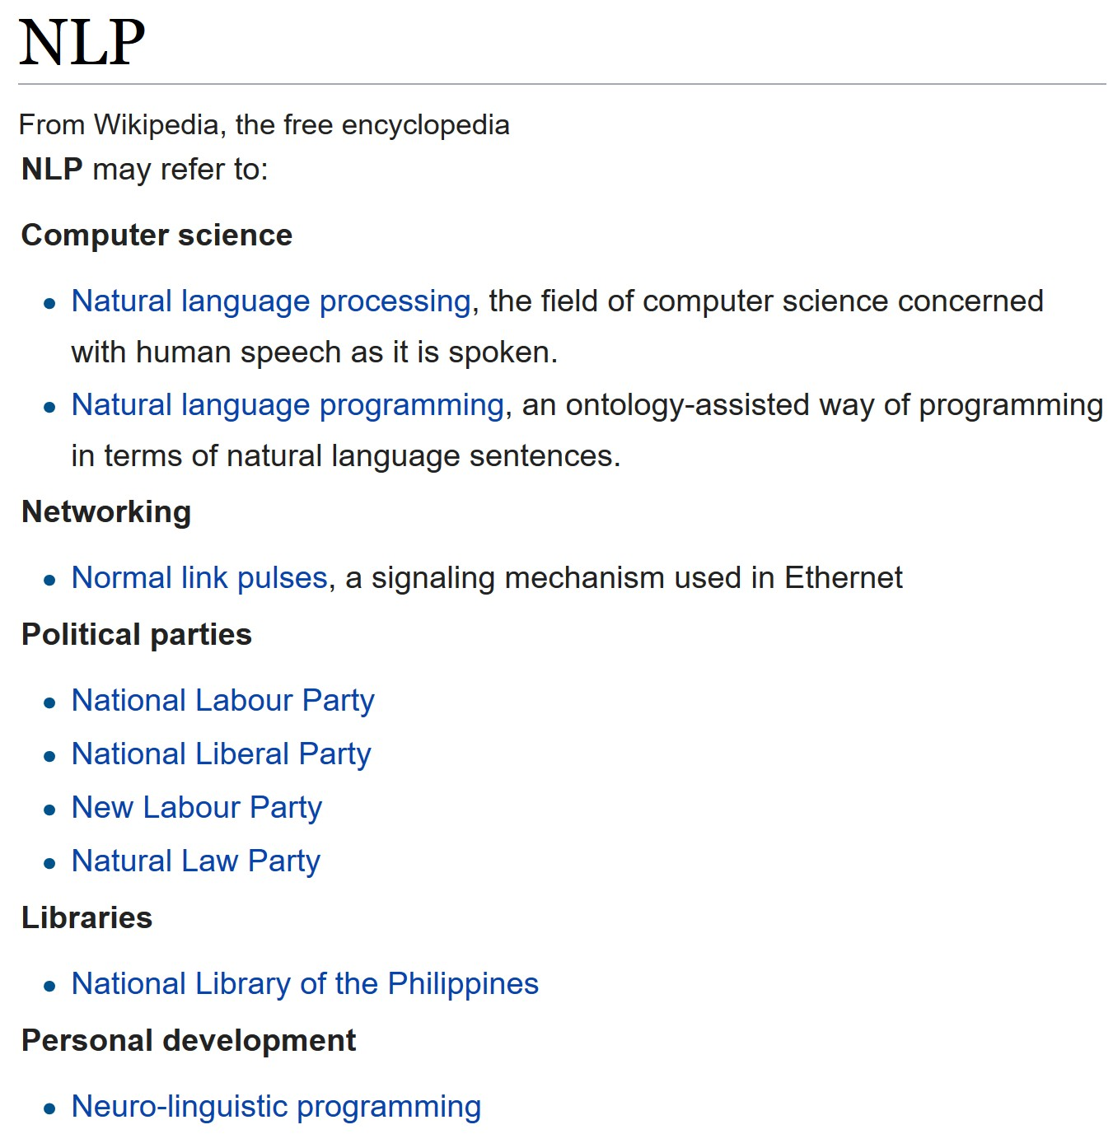
What Is NLP?
In computer science, NLP typically refers to the development and use of machine-based methods to process content in natural language.
So what is meant by a “natural language”?
We say that to distinguish it from an artificial language. What’s the difference between those?

Slide 3






Natural vs. Artificial Languages
Natural languages are those that evolved or emerged gradually over time, largely unconsciously.
Artificial languages are those that were designed, crafted, or invented with conscious purpose, largely all at once and not gradually.
Morgenstund hat Gold im Mund.
for i := 0 to NumPhrases do
if Pos(Phrases[i],CombinedStr) <> 0 then Score := Score+((1-Score)*DTG_Bonus);
VS.
The early bird catches the worm.

Slide 4
Examples
Every person in this class is competent in at least one natural language and at least one artificial language—the same two languages, shared by everyone in this class.
Can you name them?

Slide 5


Slide 6


Examples
Every person in this class is competent in at least one natural language and at least one artificial language—the same two languages, shared by everyone in this class.
Can you name them?
That’s right:
and

Slide 7
Examples of Natural Languages
English
Chinese
German
Japanese
Latin
Hebrew
Greek
Russian
Sanskrit
Arabic
French
Italian
Spanish

Slide 8
Examples of Artificial Languages
LISP
Prolog
C/C++
Java
Javascript
Scala
Python
Perl
Pascal
Ruby

Slide 9
Examples of Artificial Languages
But wait!
Those are all programming languages.
Does “artificial language” just mean “programming language”?
No. There are other types of very famous artificial languages. Can you think of some? We’ll go over that in the next segment.

Slide 11
Natural vs. Artificial Languages
Introduction to Natural Language Processing

Slide 12
Natural vs. Artificial Languages
English
Chinese
German
Japanese
Latin
Hebrew
Greek
Russian
Sanskrit
Arabic
LISP
Prolog
C/C++
Java
Javascript
Scala
Python
Perl
Pascal
Ruby

Slide 13
Examples of Artificial Languages
Can you think of some more artificial languages that are not computer languages?

Slide 15

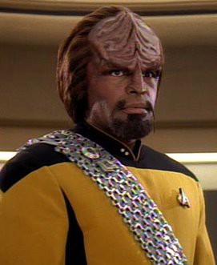
Examples of Artificial Languages
outside of Computer Programming
Fiction:
Elvish (J. R. R. Tolkien)
Klingon (Marc Okrand)

Slide 16
Examples of Artificial Languages
outside of Computer Programming
International communication:
Esperanto (L. L. Zamenhof)
Interlingua (Alice Vanderbilt Morris)

Slide 17
Examples of Artificial Languages
outside of Computer Programming
Language games (or for secrecy):
Pig Latin (based on English)
Verlan (based on French)

Slide 18
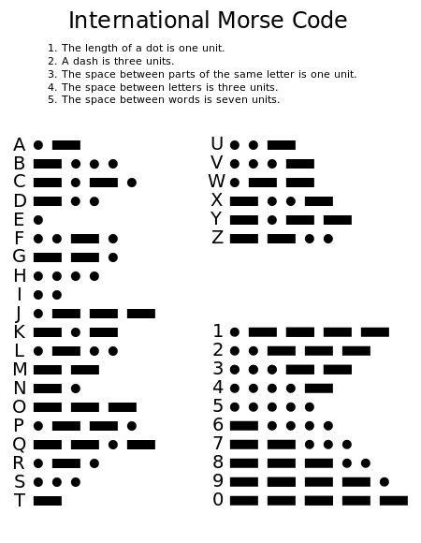
Clarify the Distinction
Q: Is Morse code an artificial language?
A: No, because it is just a code for the alphabet and numerals.

Slide 19

Clarify the Distinction
Q: Is flag semaphore an artificial language? A: No, because, like Morse code, it is just a code for the alphabet and numerals.

Slide 20

Clarify the Distinction
Q: Is Braille an artificial language?
A: No, because, like Morse code, it is just a code for the alphabet and numerals.

Slide 21

Clarify the Distinction
Q: Is ASL (American Sign Language) an artificial language?
A: No. Even though much of it was constructed, the core of ASL traces back to “Old French Sign Language,” which had developed naturally among a community of about 200 deaf persons in Paris by the 18th century.

Slide 22
Why Do Us CompSci People
Love Artificial Languages?
Because they are usually designed to be:
Concise
Readily parsed
Unambiguous
Subject to regular, consistent rules of interpretation

Slide 23
Why Do Natural Languages Drive Us
CompSci People Crazy Sometimes?
Because we have to deal with:
Large vocabulary
Complex syntax
Irregularities
Ambiguous semantics
Even more problems such as humor, irony, metaphor, connotation, neologisms

Slide 24
What This Means
The foregoing problems in natural language can be taken to indicate that the very notion of “NLP” is almost an oxymoron:
NLP is “natural language processing (by machine),” but natural languages were not designed to be processed by machine!
And yet, it can be done.

Slide 26
Two Sides of NLP
Introduction to Natural Language Processing

Slide 27
Two Sides of NLP
The “P” in “NLP” just means processing, but there are different kinds of processing.
NLP
NLU
NLG

Slide 28

Two Sides of NLP
NLU: natural language understanding
We try to get the machine to understand some inputted natural language.
Usually, NLU is demonstrated by production of a structured interpretation of the input.

Slide 29
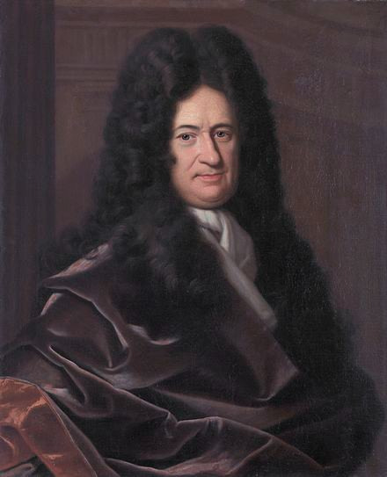
Wait…
Strictly speaking, does NLU really exist?
Could a machine really “understand” natural language? That’s a philosophical question that gives even geniuses like Leibniz here a hard time.

Slide 30
Wait…
Strictly speaking, does NLU really exist?
Regardless of the answer, we can make machines output a representation of inputted text, where that representation indicates to us humans something meaningful about the text. So the understanding may be always ours, not the machine’s. And that’s OK.

Slide 31
Two Sides of NLP
So let’s go back and revise our working definition of
NLU: natural language understanding.
We try to get the machine to produce a useful representation of some inputted natural language.
That will do just fine.

Slide 32

Two Sides of NLP
The other side of NLP is
NLG: natural language generation.
We try to get the machine to produce usable, natural language output that is not just identical to its input.
Similarly, we can put aside the question of whether the machine “understands” or “intends” the content it produces by way of NLG.

Slide 33
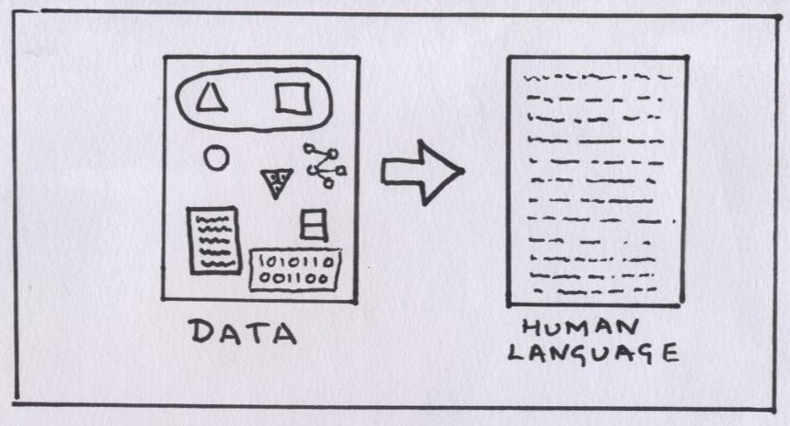
Two Sides of NLP
With NLG we create natural-seeming language from structured data.

Slide 34

Observation:
Rhetoric in the Industry Today
You will sometimes hear people throw around the acronym NLP as though it means just NLU. Why might that be?
Perhaps because, in data science we do utilize NLU a lot more than we do NLG.
This is because our chief use case of NLP, as data scientists, is to glean manipulable data from a pile of unstructured text. And it is NLU, not NLG, that does that for us.
So because of our preoccupation with NLU, we sometimes forget about NLG and use the terms NLP and NLU interchangeably.
That’s OK, but we must remember that NLP on the whole encompasses both NLU and NLG.
Blah blah NLP blabbity blab buzzword data science NLP blah blah and NLP with NLP!

Slide 36
Applications of NLU
Introduction to Natural Language Processing

Slide 37
Two Sides of NLP
Let’s look at applications of the first side of NLP, which is NLU:
natural language understanding.
NLP
NLU
NLG

Slide 38
Two Sides of NLP
Let’s look at applications of the first side of NLP, which is NLU:
natural language understanding.
NLP
NLU
NLG

Slide 39
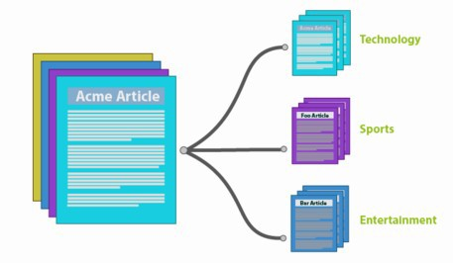
Applications of NLU
Text annotation
Tagging
Metadata extraction/generation
Classification
Document summarization
CLASSIFICATION

Slide 40
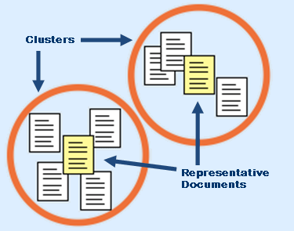
Applications of NLU
Corpus analytics
Theme extraction
Clustering
Taxonomy mapping
Sentiment analysis
CLUSTERING

Slide 41
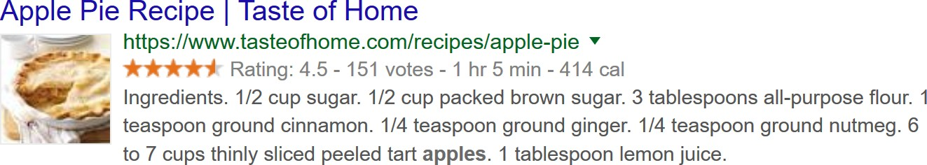
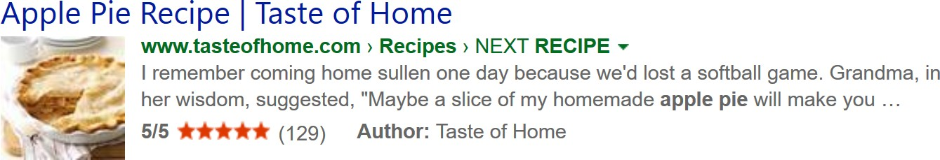
Applications of NLU
Search applications
Query repair
Query refinement
Results postprocessing, e.g., ranking, clustering, encapsulation (as below)
GOOGLE:
vs. BING:

Slide 42

Applications of NLU
Advanced applications
Machine translation
Knowledge discovery
Question handling
Question typing/routing
Question-FAQ approximate matching
FAQ
How do I…
Where is the…
What is the…
When do I…
Do you have a…

Slide 44
Applications of NLG
Introduction to Natural Language Processing

Slide 45
Two Sides of NLP
Now let’s look at applications of the second side of NLP, which is NLG:
natural language generation.
NLP
NLU
NLG

Slide 46
Two Sides of NLP
Now let’s look at applications of the second side of NLP, which is NLG:
natural language generation.
NLP
NLU
NLG

Slide 47
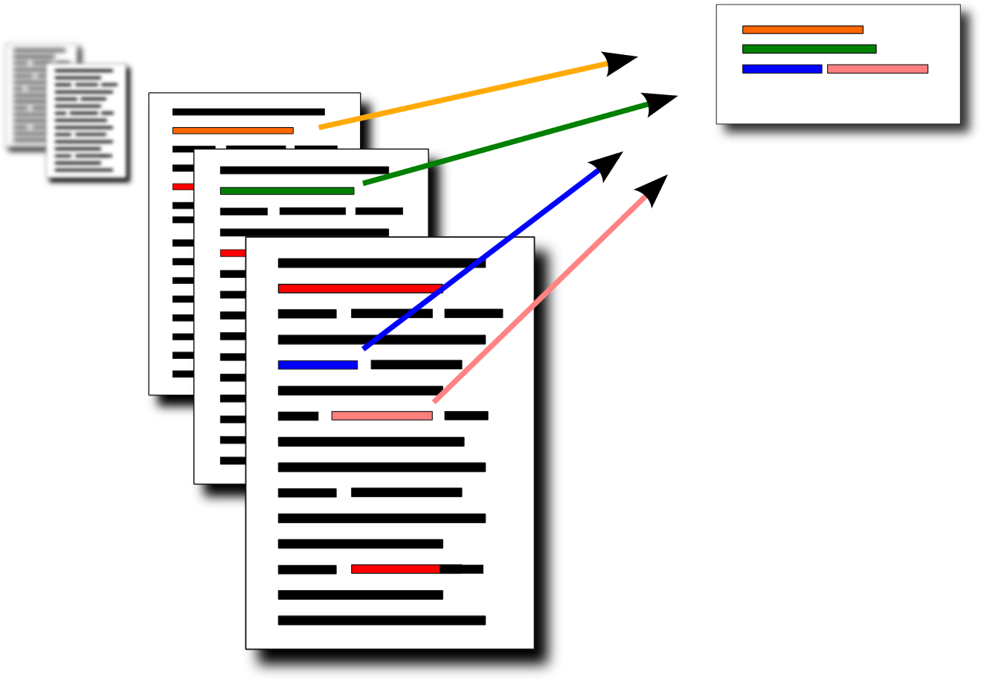
Applications of NLG
Text annotation
Document summarization
Generation of callouts/headlines

Slide 48
Applications of NLG
Corpus analytics
Labelling of clusters
Synopsizing of corpus-wide topic and/or sentiment trends
Label: “SPICY RECIPES”
Label: “CHEESEY RECIPES”

Slide 49
Applications of NLG
Search applications
Advanced capsule generation
(summarization modified to fit the query)
Advanced query refinement
(next-gen version of “did you mean?” for disambiguation of query’s meaning)
QUERY: “review of the hobbit”
RESPONSE: Do you mean the movie or the book?

Slide 50
Applications of NLG
Advanced applications
Machine translation
(construction in target language)
Knowledge discovery
(human-friendly presentation)
Question handling
Question refinement
Question answering
Where’s a good place with a view of the Golden Gate Bridge?
SYSTEM
Do you want a vista point, a hotel, or a restaurant with such a view?
USER

