Slide 1

Calories counter
Group members:
Jessen dasilva
Jacob Norris
Budhi cahyadi

Slide 2
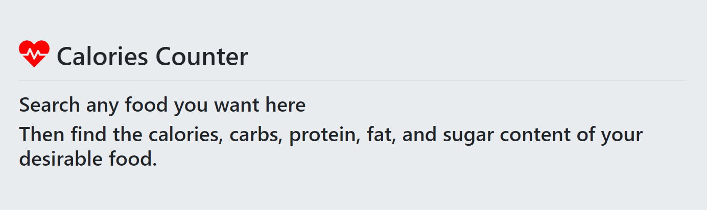
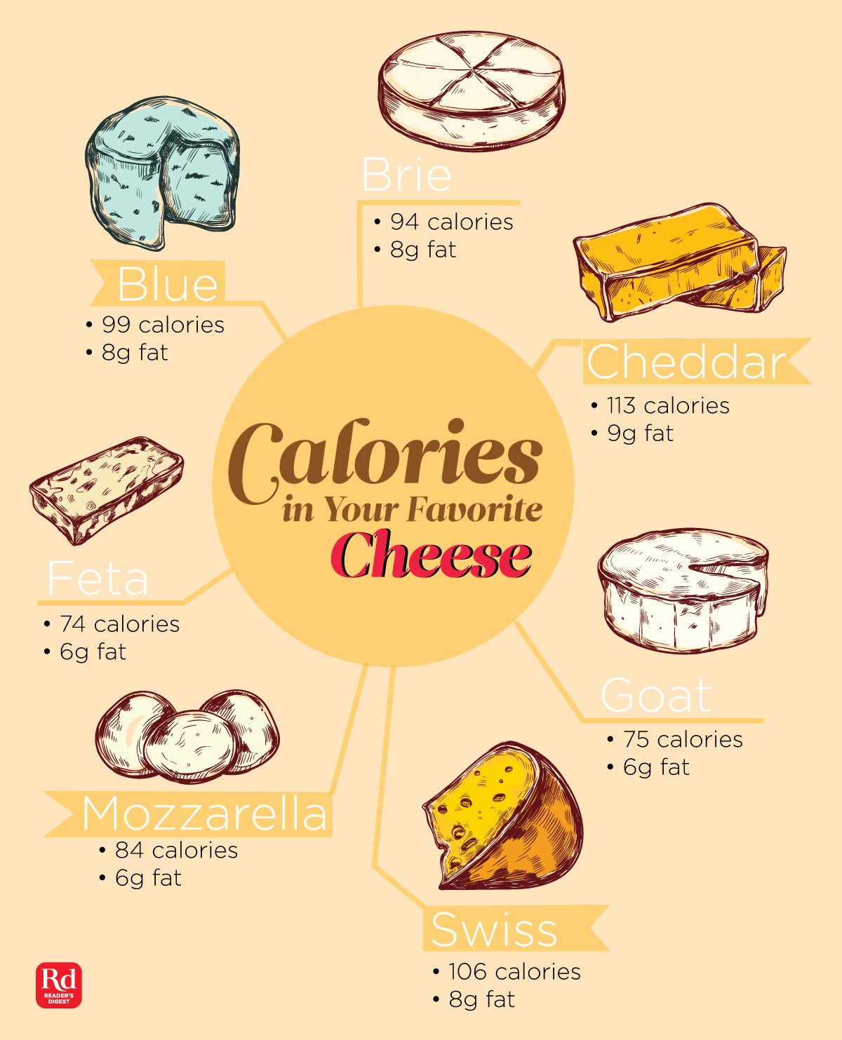
Nutrition info
From this user input data, users will be able to do the followings:
search various food items like goat cheese
see various processed food that contains almond
see a chart of these food items in terms of calories, protein, sugar, fat, and carbs

Slide 3
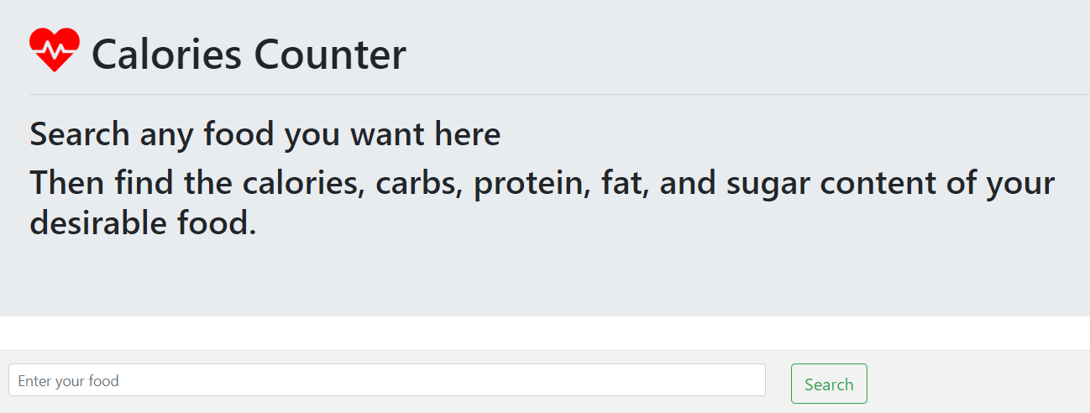
Our process

Slide 4
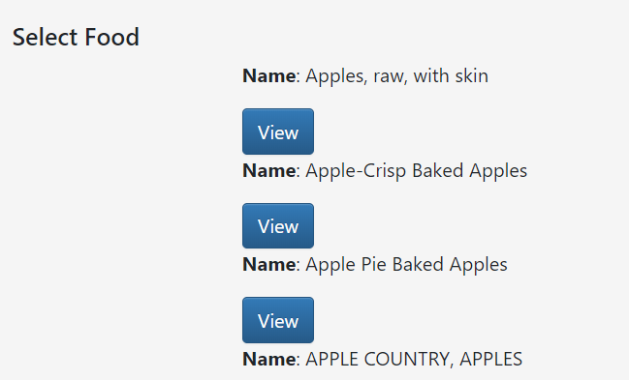
Search results

Slide 5
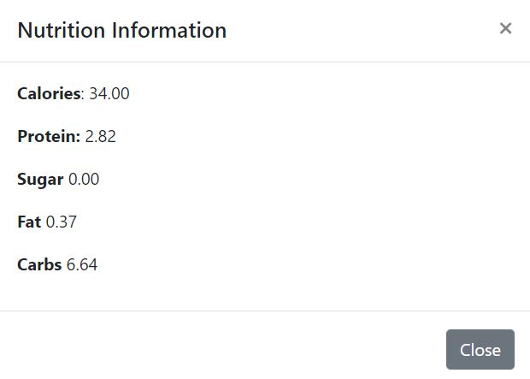
Detailed results

Slide 6
Dietary information
Chart.js

Slide 7
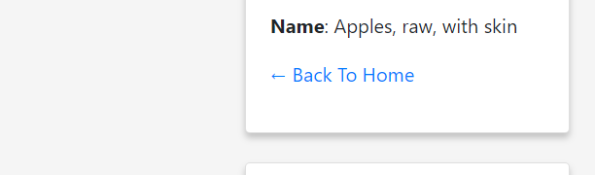
Recent Searches

Slide 8
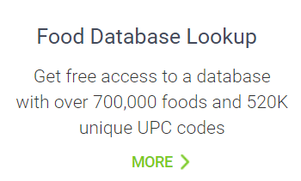
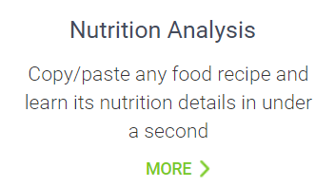
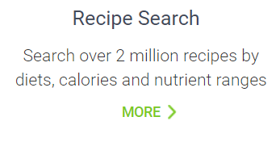
Food api
Food Database API Documentation:
https://developer.edamam.com/

Slide 9
Food api
requirements
Use a Node and Express Web Server
Be backed by a MySQL Database an ORM (not necessarily Sequelize)
Have both GET and POST routes for retrieving and adding new data
Be deployed using Heroku (with Data)
Utilize at least one new library, package, or technology that we haven’t discussed
Have a polished frontend / UI
Have folder structure that meets MVC Paradigm
Meet good quality coding standards (indentation, scoping, naming)
Must not expose sensitive API key information on the server, see Protecting-API-Keys-In-Node.md

Slide 10

Thank you!
someone@example.com

