Slide 1
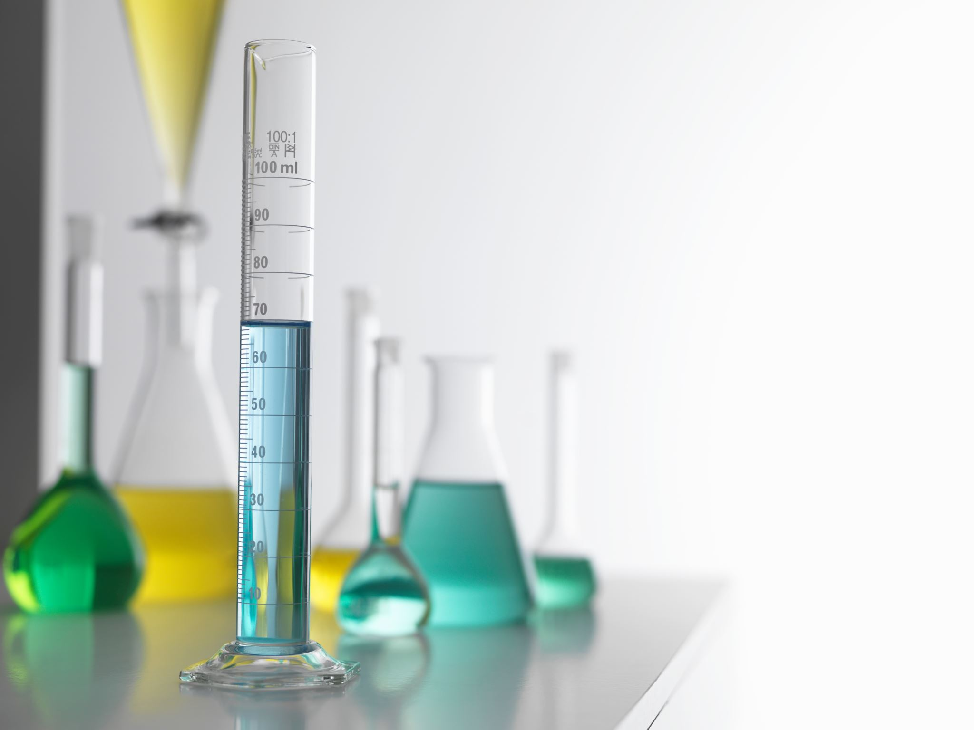
AI/ML at TU Spring ML Workshop 2025
Reinforcement Learning Day 1

Slide 2
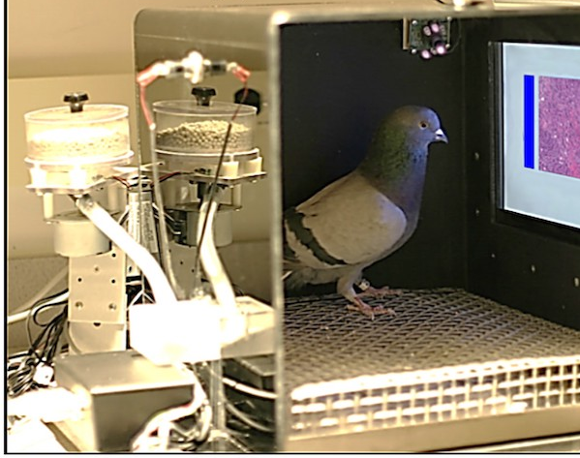
What is Reinforcement Learning Really?

Slide 3
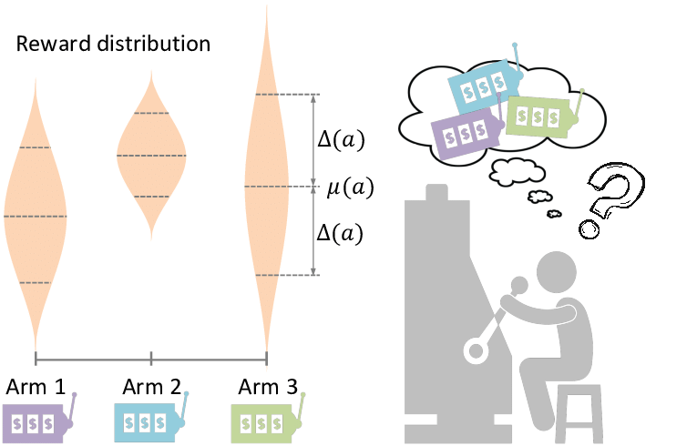
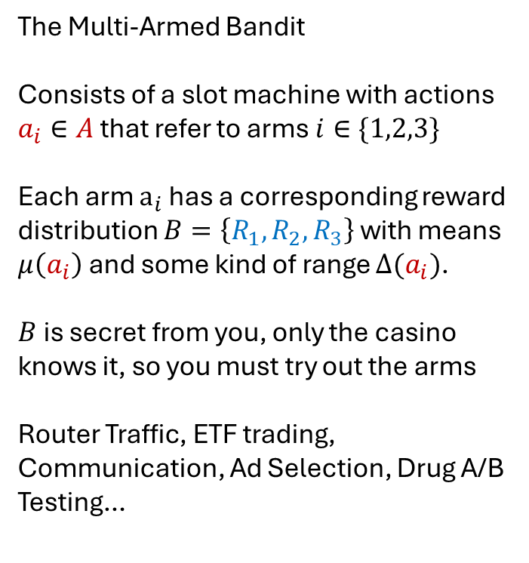
First, a Simpler Problem
The Multi-Armed Bandit
Consists of a slot machine with actions $a_{i}∈A$ that refer to arms $i∈\{1,2,3\}$
Each arm $a_{i}$ has a corresponding reward distribution $B=\left\{R_{1},R_{2},R_{3}\right\}$ with means $μ\left(a_{i}\right)$ and some kind of range $Δ(a_{i})$.
$B$ is secret from you, only the casino knows it, so you must try out the arms
Router Traffic, ETF trading, Communication, Ad Selection, Drug A/B Testing…
Gao, Chongming & Lei, Wenqiang & He, Xiangnan & Rijke, Maarten & Chua, Tat-Seng. (2021). Advances and Challenges in Conversational Recommender Systems: A Survey. 10.48550/arXiv.2101.09459.

Slide 4
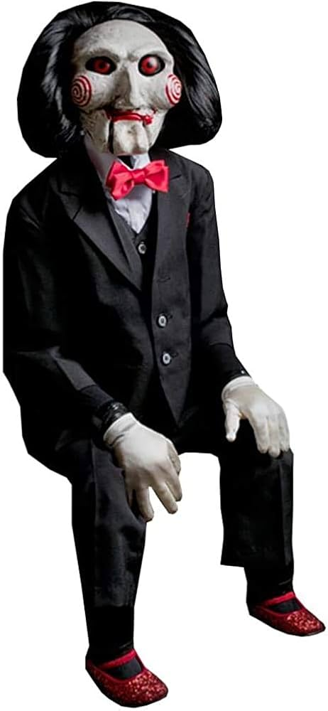
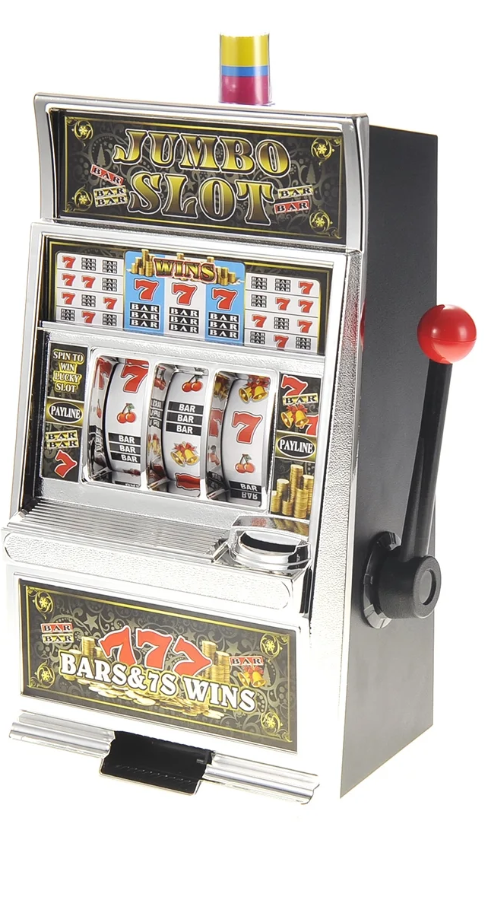
What is The Challenge?
Exploration vs Exploitation (Similar to BV tradeoff)
Red or Green?
Let’s Play a Game

Slide 5
What is The Challenge?
Exploration vs Exploitation (Similar to BV tradeoff)
Let’s Play a Game
10% chance of $100.00
100% chance of $1.00

Slide 6





What if we have information? (Contextual Bandit)
7/10
10/10
5/10
8/10
5/10
1/10

Slide 7
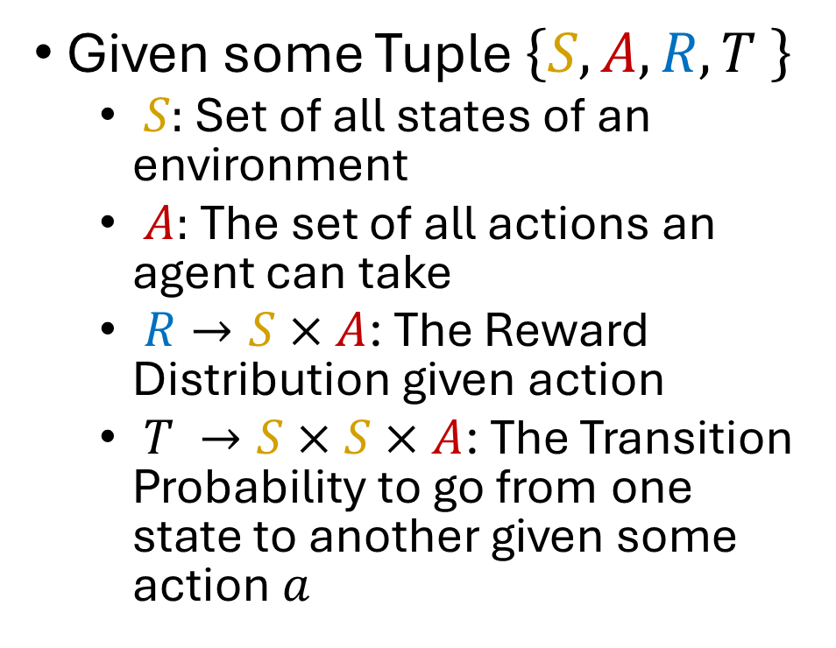
The Markov Decision Process
Given some Tuple $\left\{S,A,R,T \right\}$
$S:$ Set of all states of an environment
$A:$ The set of all actions an agent can take
$R→S×A$: The Reward Distribution given action
$T →S×S×A$: The Transition Probability to go from one state to another given some action $a$
7/10
10/10
Does bringing and umbrella change the weather?

Slide 8
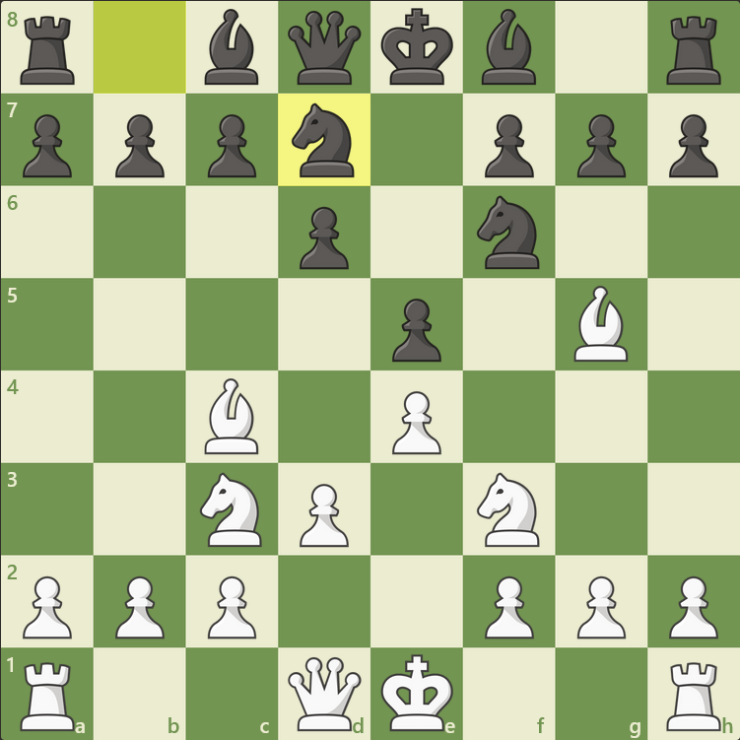
What is MDP Then?
White is to move,
R = Piece Value Captured
P=1, K=3, B=3, R=5, Q=9
What would a contextual bandit do?
What is the best move?

Slide 9
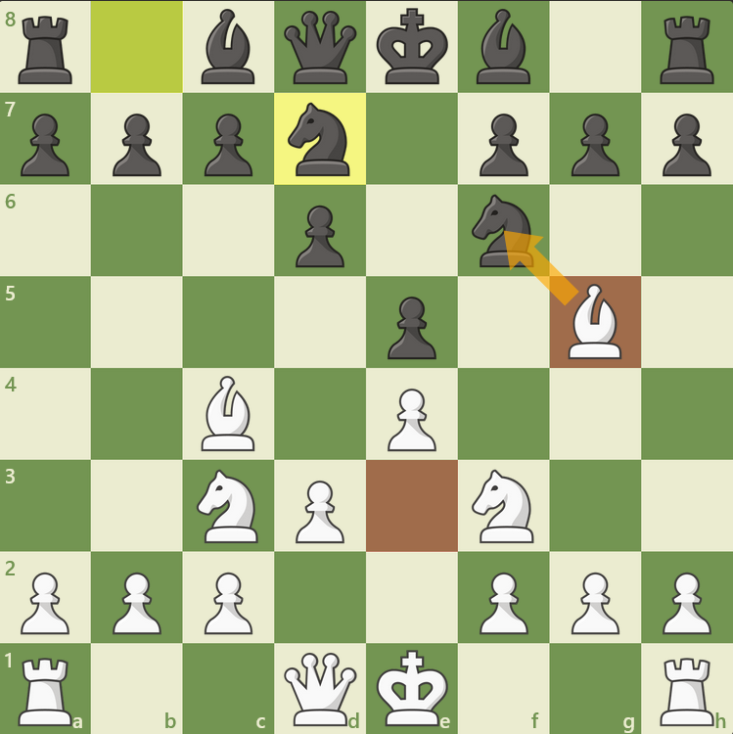
What is RL Then?
White is to move,
R = Piece Value Captured
P=1, K=3, B=3, R=5, Q=9
What would a contextual bandit do?
What is the best move?

Slide 10
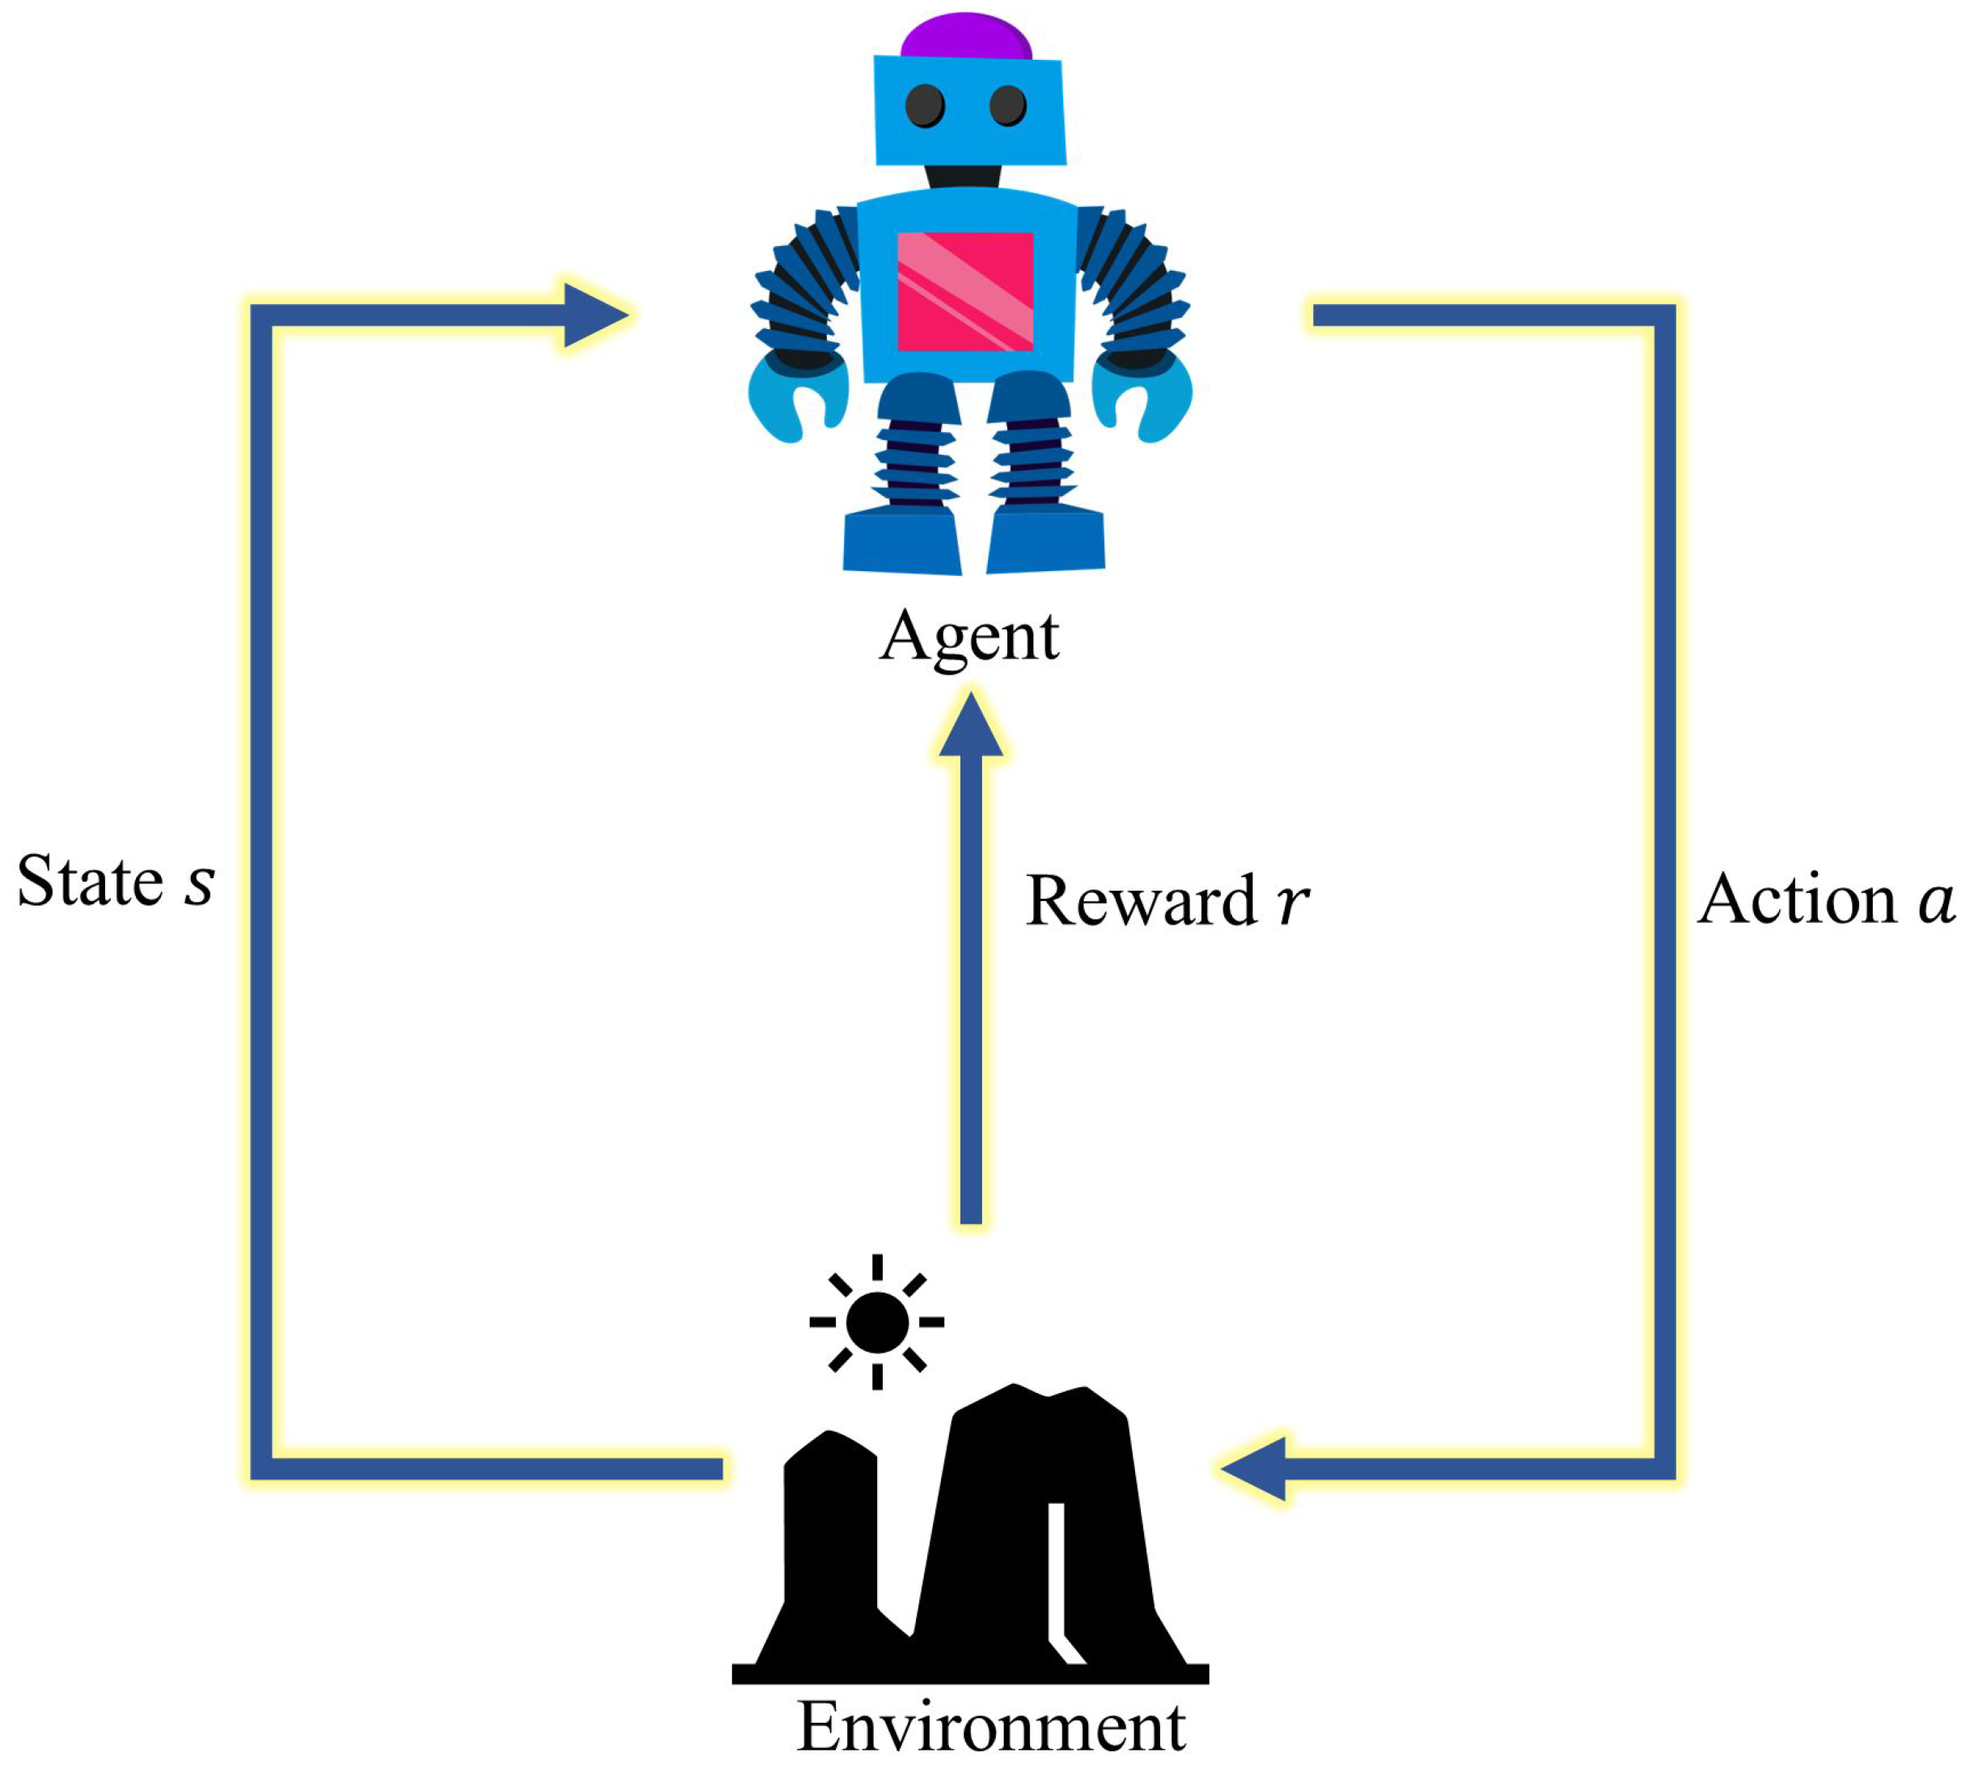
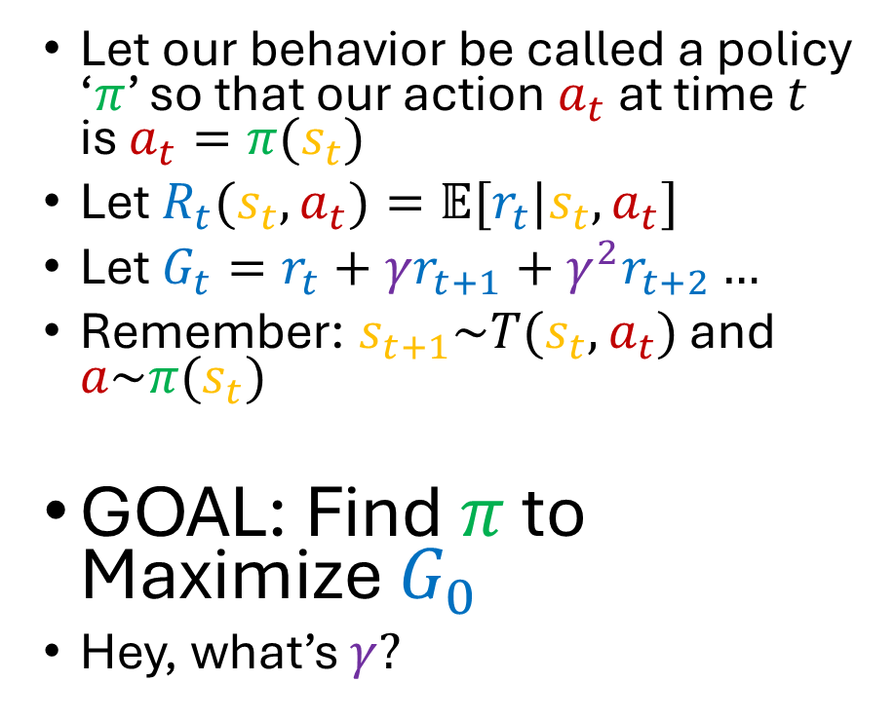
What is The Goal of RL?
Let our behavior be called a policy ‘$π$’ so that our action $a_{t}$ at time $t$ is $a_{t}=π(s_{t})$
Let $R_{t}(s_{t},a_{t})=𝔼[r_{t}|s_{t},a_{t}]$
Let $G_{t}=r_{t}+γr_{t+1}+γ^{2}r_{t+2}…$
Remember: $s_{t+1}\sim T(s_{t},a_{t})$ and $a\sim π(s_{t})$
GOAL: Find $π$ to Maximize $G_{0}$
Hey, what’s $γ?$

Slide 11
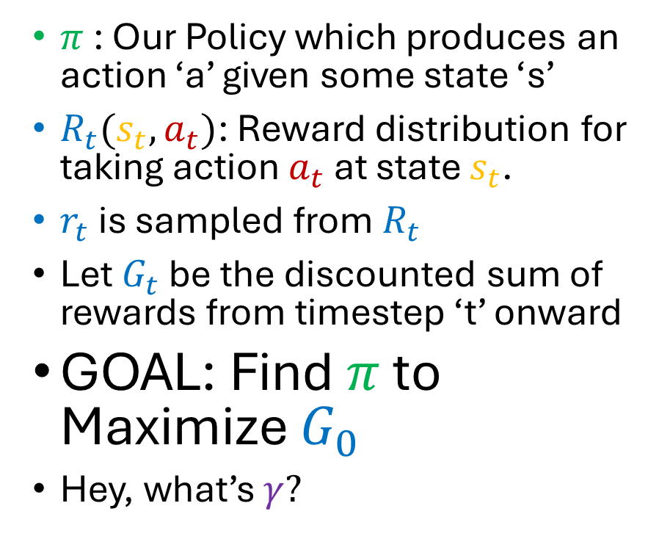
What is The Goal of RL?
$π$: Our Policy which produces an action ‘a’ given some state ‘s’
$R_{t}(s_{t},a_{t})$: Reward distribution for taking action $a_{t}$ at state $s_{t}$.
$r_{t}$ is sampled from $R_{t}$
Let $G_{t}$ be the discounted sum of rewards from timestep ‘t’ onward
GOAL: Find $π$ to Maximize $G_{0}$
Hey, what’s $γ?$

Slide 12
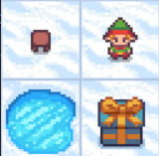

Example Time: Frozen Lake
Elf starts top left
$A=\left\{0:up, 1:down,2:left, 3:right\right\}$
Elf moves in desired direction 1/3 or left 1/3 right 1/3
$S=[0:top left, 1:top right,$ $2:bottom left, 3:bottom right]$
r$\left(s, a\right)=1 if s==3, else 0$
If $s==2$, the game ends
0
1
2
3

Slide 13

Example Time: Frozen Lake
What is the value of each state given a random player rolling a 4 sided die?
$π_{rand}=[\frac{1}{4},\frac{1}{4},\frac{1}{4},\frac{1}{4}]$ for all states
What is the value of each action at a given state?
$$V_{π}(s_{t})=𝔼[G_{t}|π,s_{t}]$$
$$Q_{π}(s_{t},a_{t})=𝔼[G_{t}|π,s_{t},a_{t}]$$
Let’s look at calculating these together for Frozen Lake
0
1
2
3

Slide 14





Example Time: Frozen Lake
$π_{rand}=[\frac{1}{4},\frac{1}{4},\frac{1}{4},\frac{1}{4}]$ for all states
$$V_{π}(s_{t})=𝔼[G_{t}|π,s_{t}]$$
$$Q_{π}(s_{t},a_{t})=𝔼[G_{t}|π,s_{t},a_{t}]$$
$$V_{π}\left(2\right)=0, V_{π}\left(3\right)=0$$
$$V_{π}\left(1\right)=\frac{1}{4}\left(\frac{1}{3}\left(0+V_{π}\left(0\right)\right)+\frac{2}{3}\left(0+V_{π}\left(1\right)\right)\right)+\frac{1}{4}\left(\frac{1}{3}\left(0+V_{π}\left(1\right)\right)+\frac{1}{3}\left(1+V_{π}\left(3\right)\right)+\frac{1}{3}\left(0+V_{π}\left(0\right)\right)\right)$$
$$…$$
$$0→??$$
$$1→??$$
$$3→0$$
$$2→0$$

Slide 15


Example Time: Frozen Lake (Gotta be another way)
$π_{rand}=[\frac{1}{4},\frac{1}{4},\frac{1}{4},\frac{1}{4}]$ for all states
$$V_{π}(s_{t})=𝔼[G_{t}|π,s_{t}]$$
$$Q_{π}(s_{t},a_{t})=𝔼[G_{t}|π,s_{t},a_{t}]$$
$$V_{π}\left(2\right)=0, V_{π}\left(3\right)=0, γ=1.0$$
$$V_{π}\left(1\right)=\frac{1}{4}\left(\frac{1}{3}\left(0+V_{π}\left(0\right)\right)+\frac{2}{3}\left(0+V_{π}\left(1\right)\right)\right)+\frac{1}{4}\left(\frac{1}{3}\left(0+V_{π}\left(1\right)\right)+\frac{1}{3}\left(1+V_{π}\left(3\right)\right)+\frac{1}{3}\left(0+V_{π}\left(0\right)\right)\right)$$
$$…$$
$$0→??$$
$$1→??$$
$$3→1$$
$$2→0$$

Slide 16

Back to Gambling!! Monte-Carlo
$π_{rand}=[\frac{1}{4},\frac{1}{4},\frac{1}{4},\frac{1}{4}]$ for all states
$$V_{π}(s_{t})=𝔼[G_{t}|π,s_{t}]$$
$$Q_{π}(s_{t},a_{t})=𝔼[G_{t}|π,s_{t},a_{t}]$$
How about we play 1,000 episodes of frozen lake and just see what the reward was from each state?
$$G_{t}=r_{t}+γr_{t+1}+γ^{2}r_{t+2}…$$
Say we observe: $\{0:right,1:up,0:right,1:down,3:up\}$
With rewards: $\{0:0, 1:0, 0:0, 1:1, 3:0\}$
We are left with returns: $\{0:γ^{3}1, 1:γ^{2}1, 0:γ1, 1:1, 3:0\}$
What can we do with that?
$$0→??$$
$$1→??$$
$$3→1$$
$$2→0$$

Slide 17
Back to Gambling!! Monte-Carlo
Lets run it 10k times

