Slide 1

Slang Embedded Systems Interfacing
Jacob Legg
Advisor: Dr. Hatcliff

Slide 2
Project Introduction
Allow SAnToS Lab’s high assurance tools to be run with physical embedded systems
Provide a tool to interface into embedded systems for research and educational purposes

Slide 3
Project Requirements
MVP
Low-Level GPIO Interfaces
Generalized board control in Slang
General basic GPIO Devices
Create board examples
Version 1.0
Simplify Code Libraries
Extend list of compatible GPIO devices
Standardize tool for educational devices
Create Basic Documentation

Slide 4


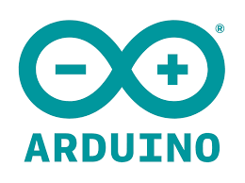
Project Tools
Sireum
Slang
Firmata4j
Java Abstract Window Toolkit
Arduino
Scala

Slide 5
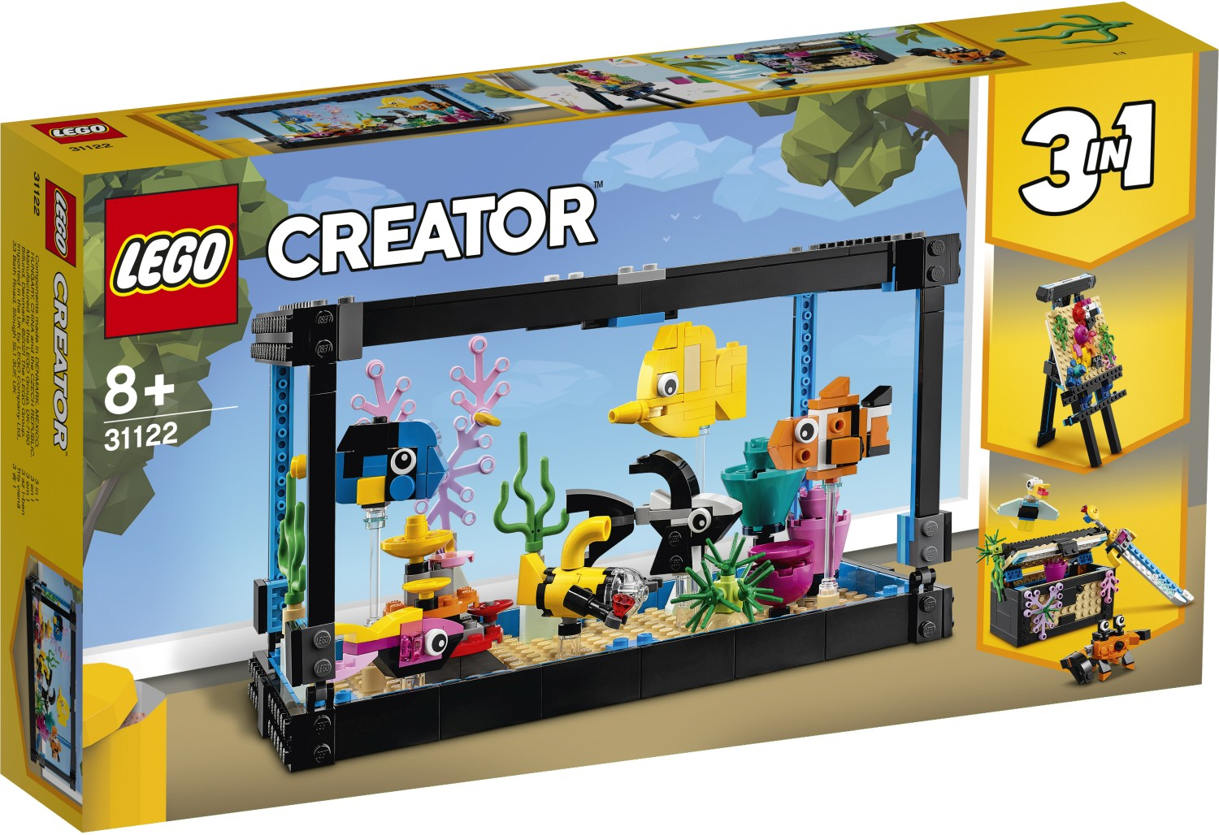
LEGO 3-in-1 Sets

Slide 6
Product Family Design

Slide 7
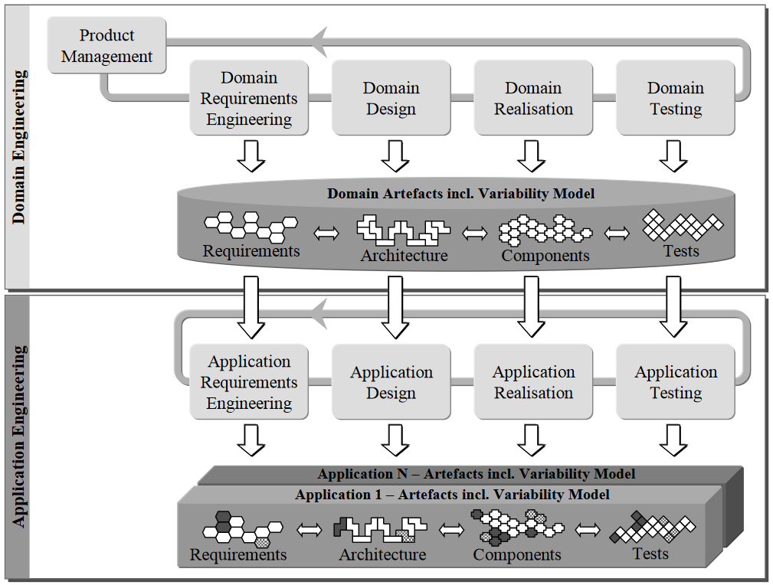
(Klaus Pohl, Figure 2-1: The software product line engineering framework, Software Product Line Engineering: Foundations, Principles, and Techniques)
Notes:
Story from legos to programming

Slide 8
Artefacts

Slide 9
Platform

Slide 10
Applications

Slide 11
Domain Engineering

Slide 12
Application Engineering

Slide 13
Product Family

Slide 14
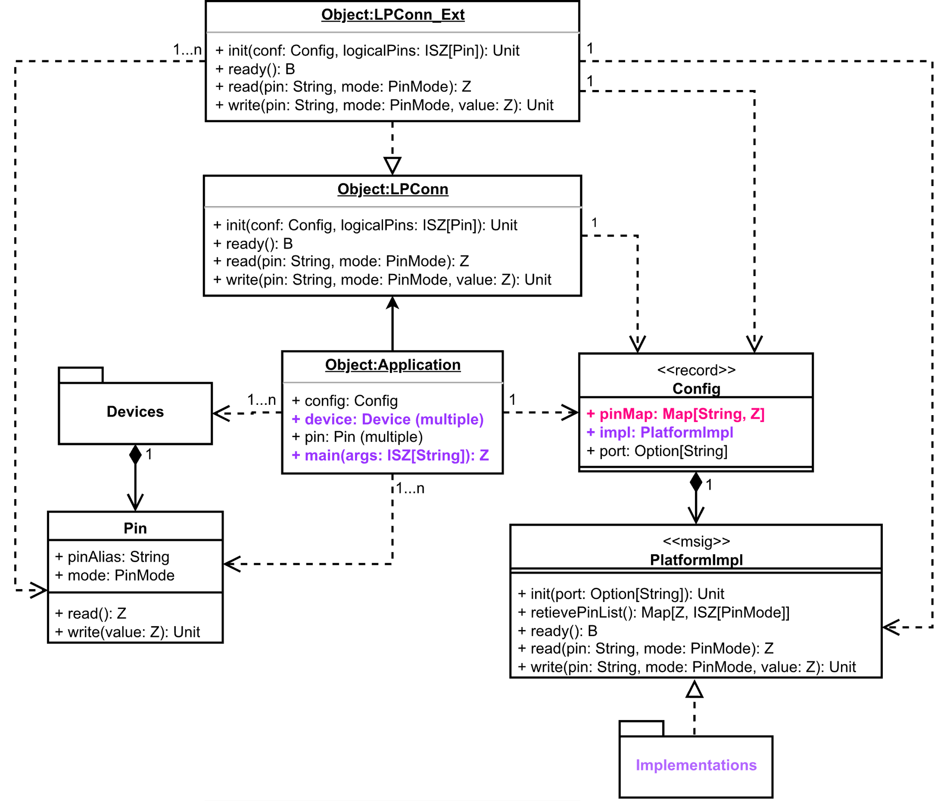
Reference Architecture Diagram

Slide 15
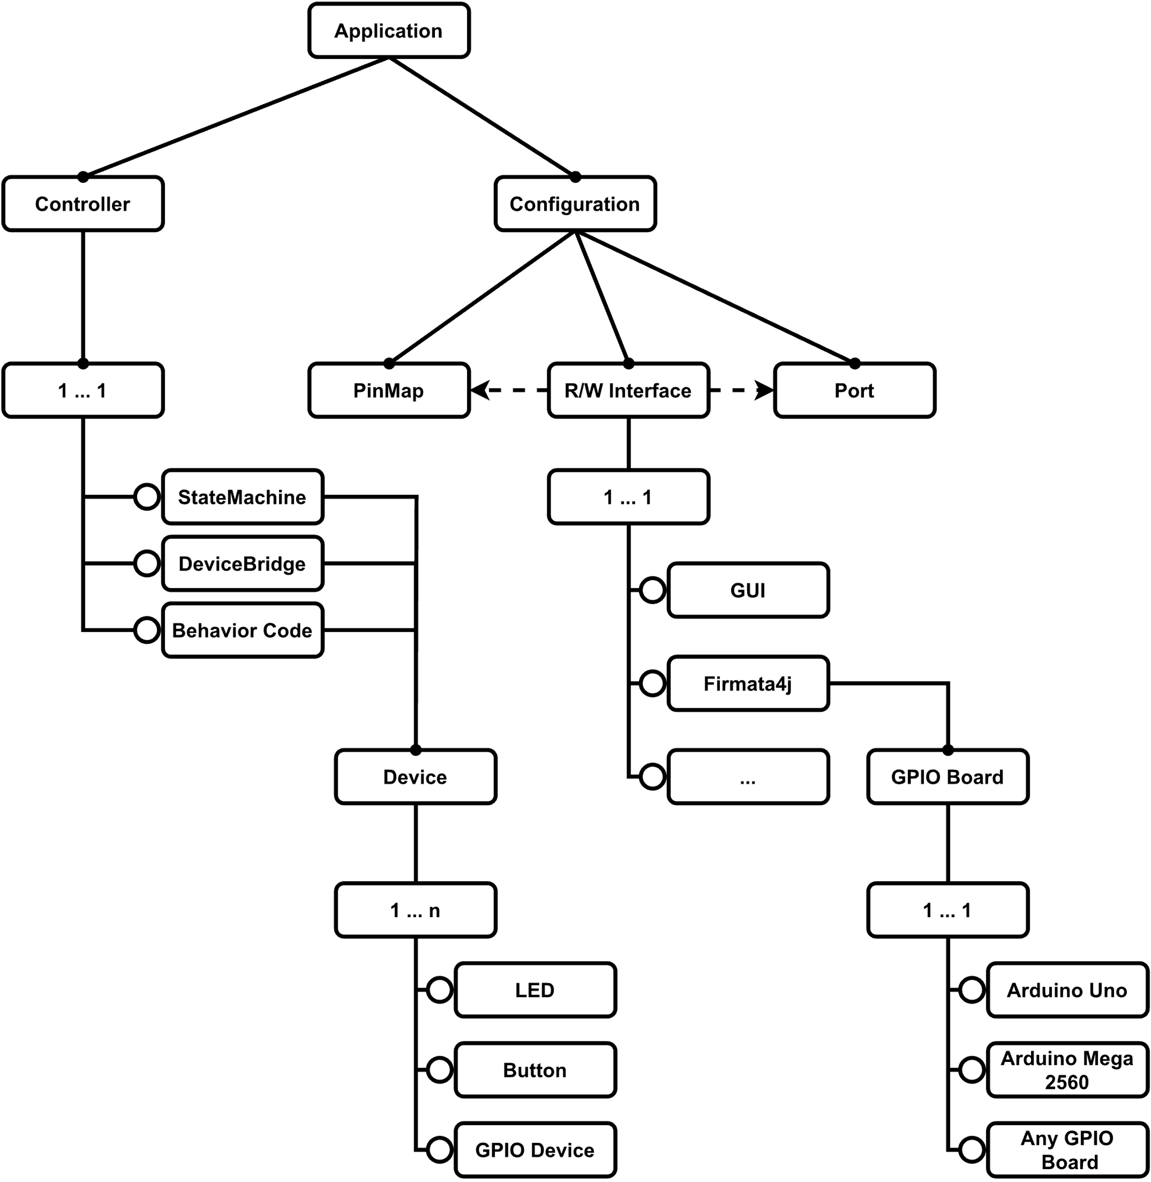
Feature Model

Slide 16
Realizing the Feature Model

Slide 17
Testing a realization
Challenges
Product lines are hard to test
Architecture only interacts with physical environments
Not enough time to create standard testing procedure
Exercising the code

Slide 18
Exercising Code
Multiple realizations
Assignments that were done by other assignments
Notes:
Had other people

Slide 19

DEMO TIME

Slide 20
DEMO 1

Slide 22
DEMO 2
val pinMap: Map[String, Z] = Map.empty ++ ISZ( “redLed” ~> 1, “greenLed” ~> 2, “blueLed ~> 3,
“button” ~> 4, )
object implGetter_Ext { def getImpl(pinMap: Map[String, Z]): PlatformImpl = { return GUIExampleImpl(pinMap) } }
val pinMap: Map[String, Z] = Map.empty ++ ISZ( “redLed” ~> 13, “greenLed” ~> 12, “blueLed ~> 11,
“button” ~> 2, )
object implGetter_Ext { def getImpl(pinMap: Map[String, Z]): PlatformImpl = { return Firmata(pinMap) } }

Slide 24
DEMO 3
@record class RGBLED(pinR: Pin, pinG: Pin, pinB: Pin) { def setColor(r: Z, g: Z, b: Z): Unit = { pinR.write(r) pinG.write(g) pinB.write(b) } } object RGBLED { def createDevice(pinR: Pin, pinG: Pin, pinB: Pin): RGBLED = { assert(pinR.mode == PinMode.PWM, "Invalid pinMode for Red Channel") assert(pinG.mode == PinMode.PWM, "Invalid pinMode for Green Channel") assert(pinB.mode == PinMode.PWM, "Invalid pinMode for Blue Channel") return RGBLED(pinR, pinG, pinB) } }

Slide 25
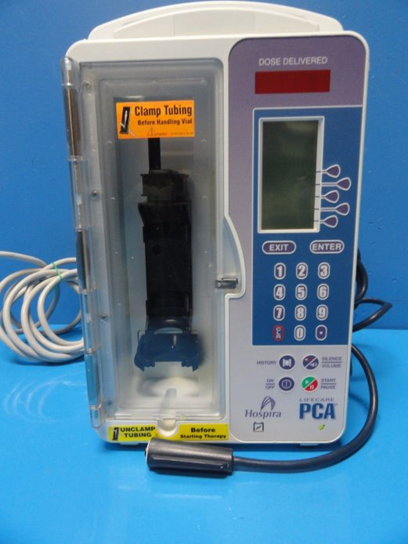
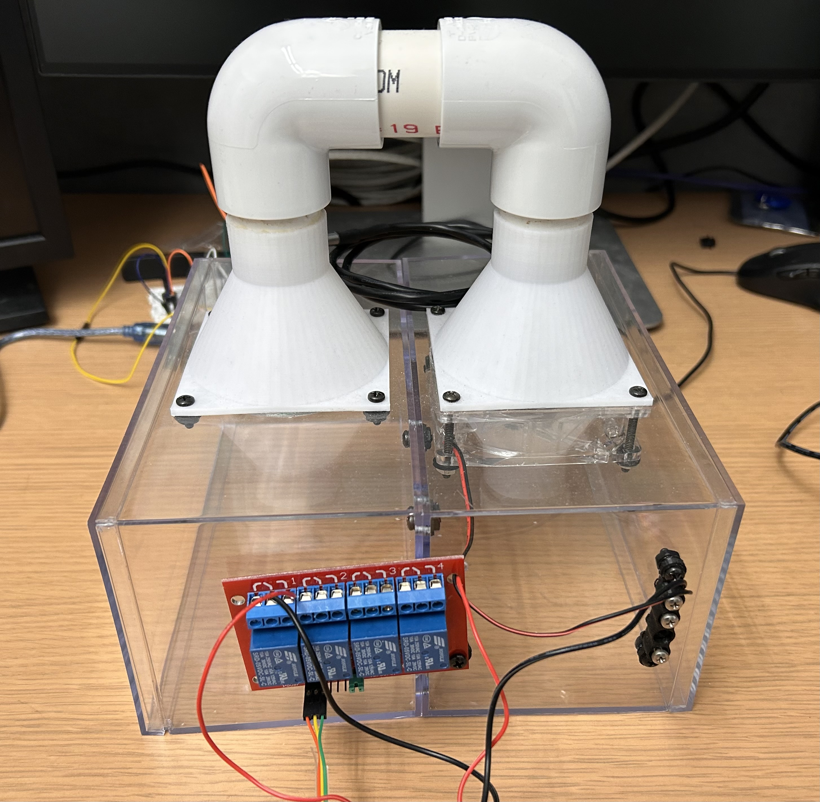
Impact
Allow for research actives in the SAnToS Lab
PCA Pump
heat controller
Provide a tool teaching embedded systems concepts

Slide 26

Future Work
Add HAMR Integration
Make Framework Transpilable to C
Standardize the Code For Industry Usage
Create Documentation
Allow For Multiple Devices
Systematic testing approach

Slide 27
Questions
Topics
Product Family Design
Overall Architecture
Reference Diagram
Feature Model
Demos
Notes:
Talk about what you learned
If asked say you do research for automated property based testing

