Slide 1
Visualization and Pre-Processing of Intensive Care Unit Data Using Python Data Science Tools
Jacob Barhak
Norfolk, Virginia • April 24-26, 2018

Slide 2
Introduction
Medical data availability is increasing:
  Electronic Medical Records (EMR)
  Various databases such as ClinicalTrails.Gov
  Wearable devices
This work deals with Intensive Care Unit (ICU) data
  Specifically Data from the UCI, Machine Learning Repository :https://archive.ics.uci.edu/ml/datasets/ICU
  Single patient data from Flowsheet, Lab data and Monitor data
Norfolk, Virginia • April 24-26, 2018

Slide 3
Analysis Constraints
Data is for a single patient
  Meaning that no training data exists for deep learning
No medical expert pointed significant data
  Meaning that no supervised learning
Data provided “as is”
  No clarifications or further information
Computational Modeler Perspective
  Feedback is invited
Norfolk, Virginia • April 24-26, 2018

Slide 4
How Can a Machine Help Here?
Load Data
  Standardize and merge data such as units
Visualize Data
  Show as much data as possible to the viewer
Data Analysis
  Outlier detection
Provide The Expert Some Visual Cues
Norfolk, Virginia • April 24-26, 2018

Slide 5
Tools Used
Python Tools:
  Jupyter Notebook – rapid prototyping
  Pandas – for a data frame
  Bokeh – visualization
  Scikit-Learn – for machine learning algorithms
This is Free Software Installed with the Anaconda Python Distribution
Norfolk, Virginia • April 24-26, 2018

Slide 6
Code Made Free
Code is available on Github on:
  https://github.com/Jacob-Barhak/VisICU
  Code available under General Public License
  The data from the UCI, Machine Learning Repository was attributed on Github as well after minor modifications to allow easier loading
Graphical output is available on:
  http://sites.google.com/site/jacobbarhak/home/VisualICU.html
Norfolk, Virginia • April 24-26, 2018

Slide 7
Load Data
Merge all data in the same dataframe:
  Unify time frame
  FlowSheet Data
  Monitor Data
    Merge with unit description
    Code data organized
  Lab Data
    Merge with unit description
    Clean up units
Norfolk, Virginia • April 24-26, 2018

Slide 8
Visualize Data
Show as much data as possible in one location
Show the time series in the same scale
Help viewer with visual cues
Add interactive features
  Use color as visual cues
  Present analysis with interactive legend
  Add hover tool to allow focusing on a data point
Aggregate smaller data in Flowsheet, Monitor, and Lab plots
Norfolk, Virginia • April 24-26, 2018

Slide 9
Analyze Data
Detect outliers using a vote by multiple analysis method
      Unsupervised Machine Learning Techniques
        Gaussian Process
        Support Vector Machine (SVM)
        DBSCAN
        Agglomerative Clustering
        Local Outlier Factor
      Other Computational Techniques
        K Nearest Neighbors
        Filtering using a Window
Norfolk, Virginia • April 24-26, 2018

Slide 10
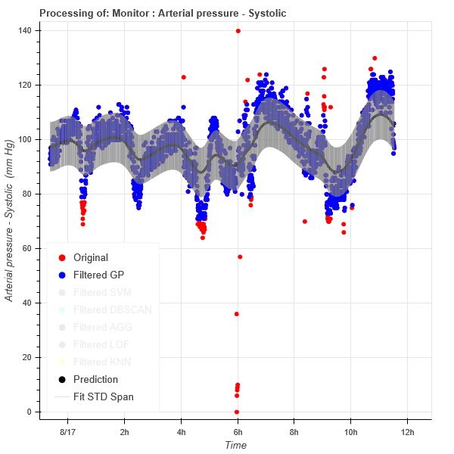
Gaussian Process
Statistical Regression Technique
Measures similarity between points assuming normal distribution
A kernel function controls behavior and has noise component
Output for each sample point:
  Mean prediction
  Standard deviation – used as a local threshold for outlier detection
Norfolk, Virginia • April 24-26, 2018

Slide 11
Support Vector Machine (SVM)
Classification technique that finds the widest region separating classes
Uses a Kernel function to transform space to allow non linear solutions
In this work a single class SVM variation is used
Specify the upper bound of proportion of training errors – the assumption is that this is rare, therefore 1% was chosen
Norfolk, Virginia • April 24-26, 2018

Slide 12
DBSCAN
Clustering algorithm that is density sensitive
Incrementally grows clusters from high density regions
Epsilon - maximal distance between samples for same cluster
To avoid separation of data to left,right clusters due to missing point by Loop:
    Clusters = DBSCAN (Epsilon)
    Epsilon = Epsilon *2
    If Number of Clusters <=3 then Stop
Outliers = Size(Cluster)<0.02*NumberOfSamples
Norfolk, Virginia • April 24-26, 2018

Slide 13
Agglomerative Clustering
Hierarchical clustering
Each cluster starts with a single sample
Clusters are merged according to a linkage criteria
Outliers = Size(Cluster)<0.1*NumberOfSamples
Norfolk, Virginia • April 24-26, 2018

Slide 14
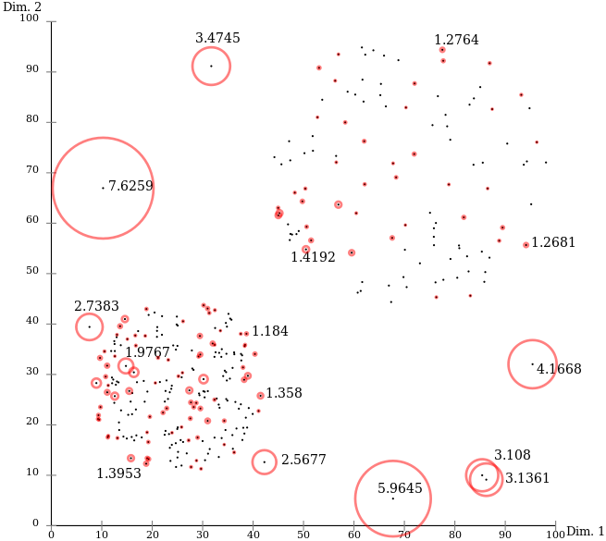
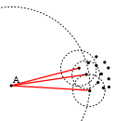
Local Outlier Factor
Unsupervised learning technique based on sample density
Trying to isolate low density points as outliers
Uses spacial data structures to speed computation
The contamination parameter defines number of expected outliers
In this work contamination = 0.01 assuming very low noise
Images are public domain
Extracted from Wikipedia
Norfolk, Virginia • April 24-26, 2018

Slide 15
K Nearest Neighbors
For each sample return the distance of the K nearest neighbors
Can be efficiently implemented using kd-tree or ball tree
In matrix form – easy to extract sum k neighbor distance ~ row sum
Calculate Mean,STD for row sum
Outlier = row sum deviates from 3 STD from Mean
0 | 1 | 2 | 3 | 0 | 0
1 | 0 | 3 | 4 | 0 | 0
2 | 3 | 0 | 1 | 0 | 0
3 | 4 | 1 | 0 | 0 | 0
6,5 | 5.5 | 8 | 0 | 0 | 0
7 | 6 | 9 | 0 | 0 | 0
1
3
2
Sum distance of 3 nearest neighbors is 6
Nearest 3 Neighbor Distance Matrix has exactly 3 non zero elements per row
Norfolk, Virginia • April 24-26, 2018

Slide 16
Filtering Using a Window
Local Heuristic method
Look back 10 points on the X axis
Outlier = Y value deviates more than 6 STD than of window point
Heuristic performs nice in many cases, yet has issues with many spikes and min/max points
Norfolk, Virginia • April 24-26, 2018

Slide 17
Voting
If a sample point was detected as outlier by any method add 1 to vote
So vote of 0 means the point is not an outlier
And vote of 7 means definite outlier
Visualize number of votes in different color
Norfolk, Virginia • April 24-26, 2018

Slide 18
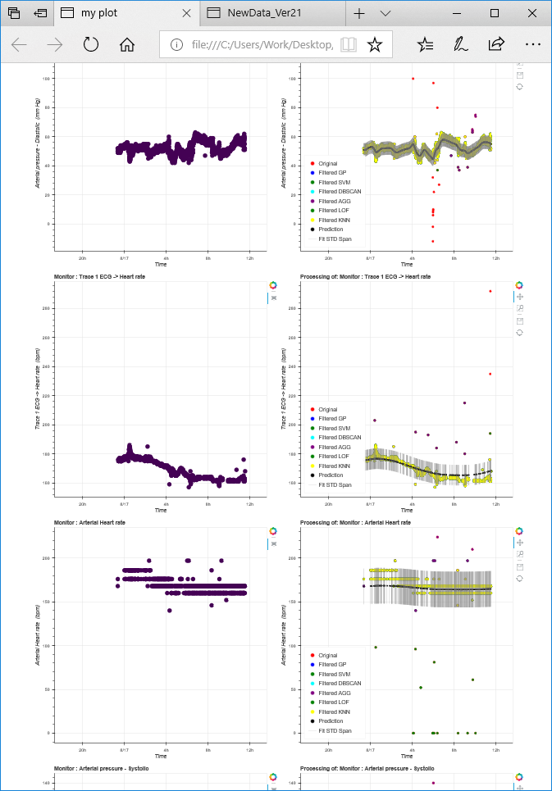
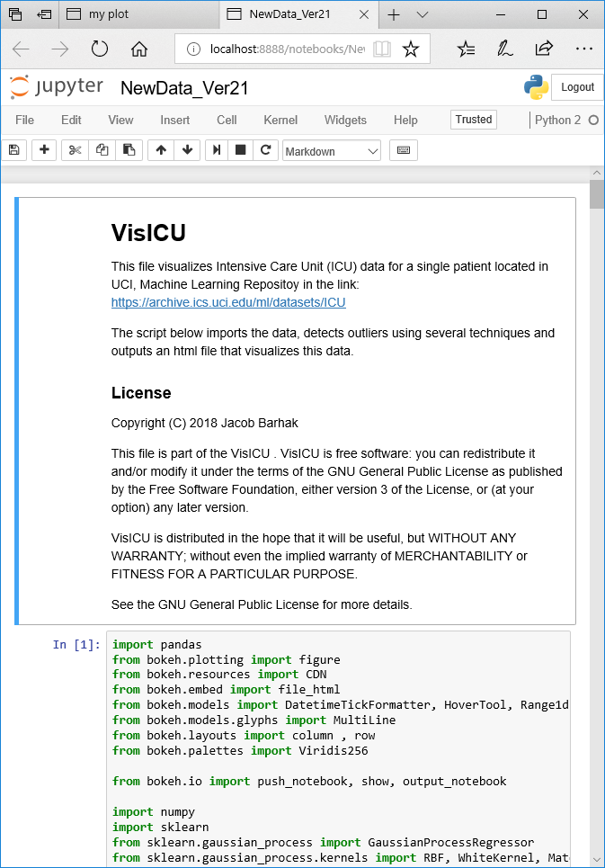
Results
Jupyter Notebook code
Visualization
Results
Norfolk, Virginia • April 24-26, 2018

Slide 19
Conclusions
Amount of information even for one patient is too large for one view
Humans need support to efficiently process such data
If feedback is provided, it would be possible to learn expert preference
Human will still be in the loop for the foreseeable future
Possible future work:
  Correlating data between different measurements
  Attempting to predict patient deterioration
Norfolk, Virginia • April 24-26, 2018

Slide 20
Acknowledgments
Thanks to Tadashi Kamio for the email correspondence that resulted in this work.
Norfolk, Virginia • April 24-26, 2018

