Slide 1
Using Computing Power to Aid Chronic Disease Modeling
Jacob Barhak
Mount Hood #6-2012
7 June 2012

Slide 2
Analogy to Disease Modeling
1
2
3
4
Modeling =
Find the function?
5
6
Outcome
Initial conditions

Slide 3
Chronic Disease Models At a Glance
The model applies a function to an initial cohort
Markov model
Differential equation
Hybrid functions
Returns results at different time periods
Yearly
Semi yearly
Specific times
Results are validated against known outcomes

Slide 4
Chronic Disease Models Implementation
Requires repetition for multiple individuals in a cohort
Governed by population size
Typically counted in 1000s
Monte Carlo simulations require repetitions of simulation
Depends on variance of phenomena
Depends on accuracy desired
Typically counted in 10s
Model parameters require calibration:
Depends on model parameter space
Possibly a number of populations to validate against
Typically 100s of variations
Interaction between individuals not required

Slide 5
How Much Computation?
Serial
Parallel
Time = CNMK = O(NMK)
Where:
Time to compute a single individual < C constant
Cohort Size = N
Monte Carlo Repetitions = M
Calibration Repetitions = K
With numbers
C = 1 second ; N=1,000 ; M=10 ; K=100
100,000s individuals altogether
Time ~ 1.2 Days
Time measured in days
These are independent computations per individual
Hence the name Embarrassingly Parallel

Slide 6
Parallel Computing Speed Up
If there are U computing units available
Time = CNMK/U = O(NMK/U)
With numbers, for a single computer
U = 8 ; C = 1 second ; N=1,000 ; M=10 ; K=100
Time ~ 0.15 Days ~ 3.5 hours
Can finish overnight
With numbers, for multiple computers
U = 100 ; C = 1 second ; N=1,000 ; M=10 ; K=100
Time ~ 0.01 Days ~ 0.3 hours ~ 17 minutes
Can finish in a coffee break

Slide 7
Benefits
With sufficient computing power:
Days can become minutes or less
It is possible to test many more hypothesis/variations
Possible to validate against more populations
Improve accuracy
Faster model development by shortening the design cycle
Design
Implement
Execute
Validate

Slide 8
How to Run in Parallel on a Single PC? The Simplest Way: Multiple Processes
If we have two scripts/batch files:
sim1
sim2
To run these serially use the && operator:
sim1 && sim2
On a PC with windows OS using the cmd prompt:
To run these in parallel use the start command:
start sim1 && start sim2
On a PC with a Linux OS such as Ubuntu from the terminal:
To run these in parallel use the & operator:
sim1 &
sim2 &
Very simple method that works on any operating system
Speed up if Number of Processes <= number of CPU cores

Slide 9
How to Run in Parallel on a Single PC? Multiple Processes Limitations
If we have 1000 scripts/batch files:
sim1, sim2, … sim1000
Running all processes together is a bad idea:
The computer will slow down and become unresponsive
Memory limit may be exceeded
We still want to launch them all
Yet we want to balance the load:
only a few processes run parallel at the same time
Solution: Use a Batch Queue

Slide 10
How to Run in Parallel on a Single PC? Using a Batch Queue
Batch Queue with 2 CPU cores
If we have 1000 scripts/batch files:
sim1, sim2, … sim1000
On a PC with a Linux OS such as Ubuntu from the terminal:
Declare load and batch parameters using the atd command
atd -l8 -b30
Run a script that uses the batch command to launch these
batch sim1
batch sim2
…
batch sim1000
Monitor progress using the atq command
atq
Allows optimal speedup for a single machine for a single user
Automatically manages the queue according to the load

Slide 11
How to Run in Parallel on a Single PC? Using a Batch Queue - Limitations
If we have 1000 scripts/batch files:
sim1, sim2, … sim1000
Maximum speedup is limited by the number of cores
Not suitable for sharing with other users
The user is responsible for tune up
We want more computing power/parallelization
We want to share resources among people
We have resources and a system administrator
Solution: Use a computer cluster

Slide 12
How to Run in Parallel on a Cluster? Using a Cluster Management System
If we have 1000 scripts/batch files:
sim1, sim2, … sim1000
On a cluster running SLURM :
Write a Script that uses the srun command to launch these
srun sim1
srun sim2
…
srun sim1000
Launch the Script to the cluster using the sbatch command
sbatch Script
Monitor progress using the squeue command
squeue
Scalable - allows maximum speedup for resources
Costs are reduced and capabilities improve if resources are shared

Slide 13
Other Technology
Other cluster implementations:
PBS/Torque - another cluster management system
Mosix - distributed operating system
Apache Hadoop: cluster management based on Map/Reduce
Cloud Solutions:
Amazon EC2 - Elastic Compute Cloud
Allows renting computers with desired configuration
Star Cluster by MIT
Software to create and manage a cluster on Amazon EC2
Open source
YouTube has demo videos demonstrating this software

Slide 14
Possible Bottlenecks
OS limitations
Memory
Number of CPU cores
Memory
Consider number of cores to find limit
Disk space
More repetitions consume disk space quicker
Disk I/O
Redirection of output from many processes
Copying Giga Bytes of data takes time
Even opening a folder with 60K files on screen takes time
Network Bandwidth
Cluster communication between computers requires attention

Slide 15
Control Tips
Write logs and errors to disk
Monitor runs
Enumerate processes yourself and keep a log of process IDs
Allow recovery from interrupted runs?

Slide 16
Why Now?
Multi core CPUs allow powerful desktops:
8 cores are currently high end desktops
64 core workstations are available
Price:
Roughly ~$100 to buy a CPU core
Rent at $0.02-$2.97 / Hour per virtual machine
Inexpensive computing power:
Better predictions are possible
Let the computer work for you

Slide 17
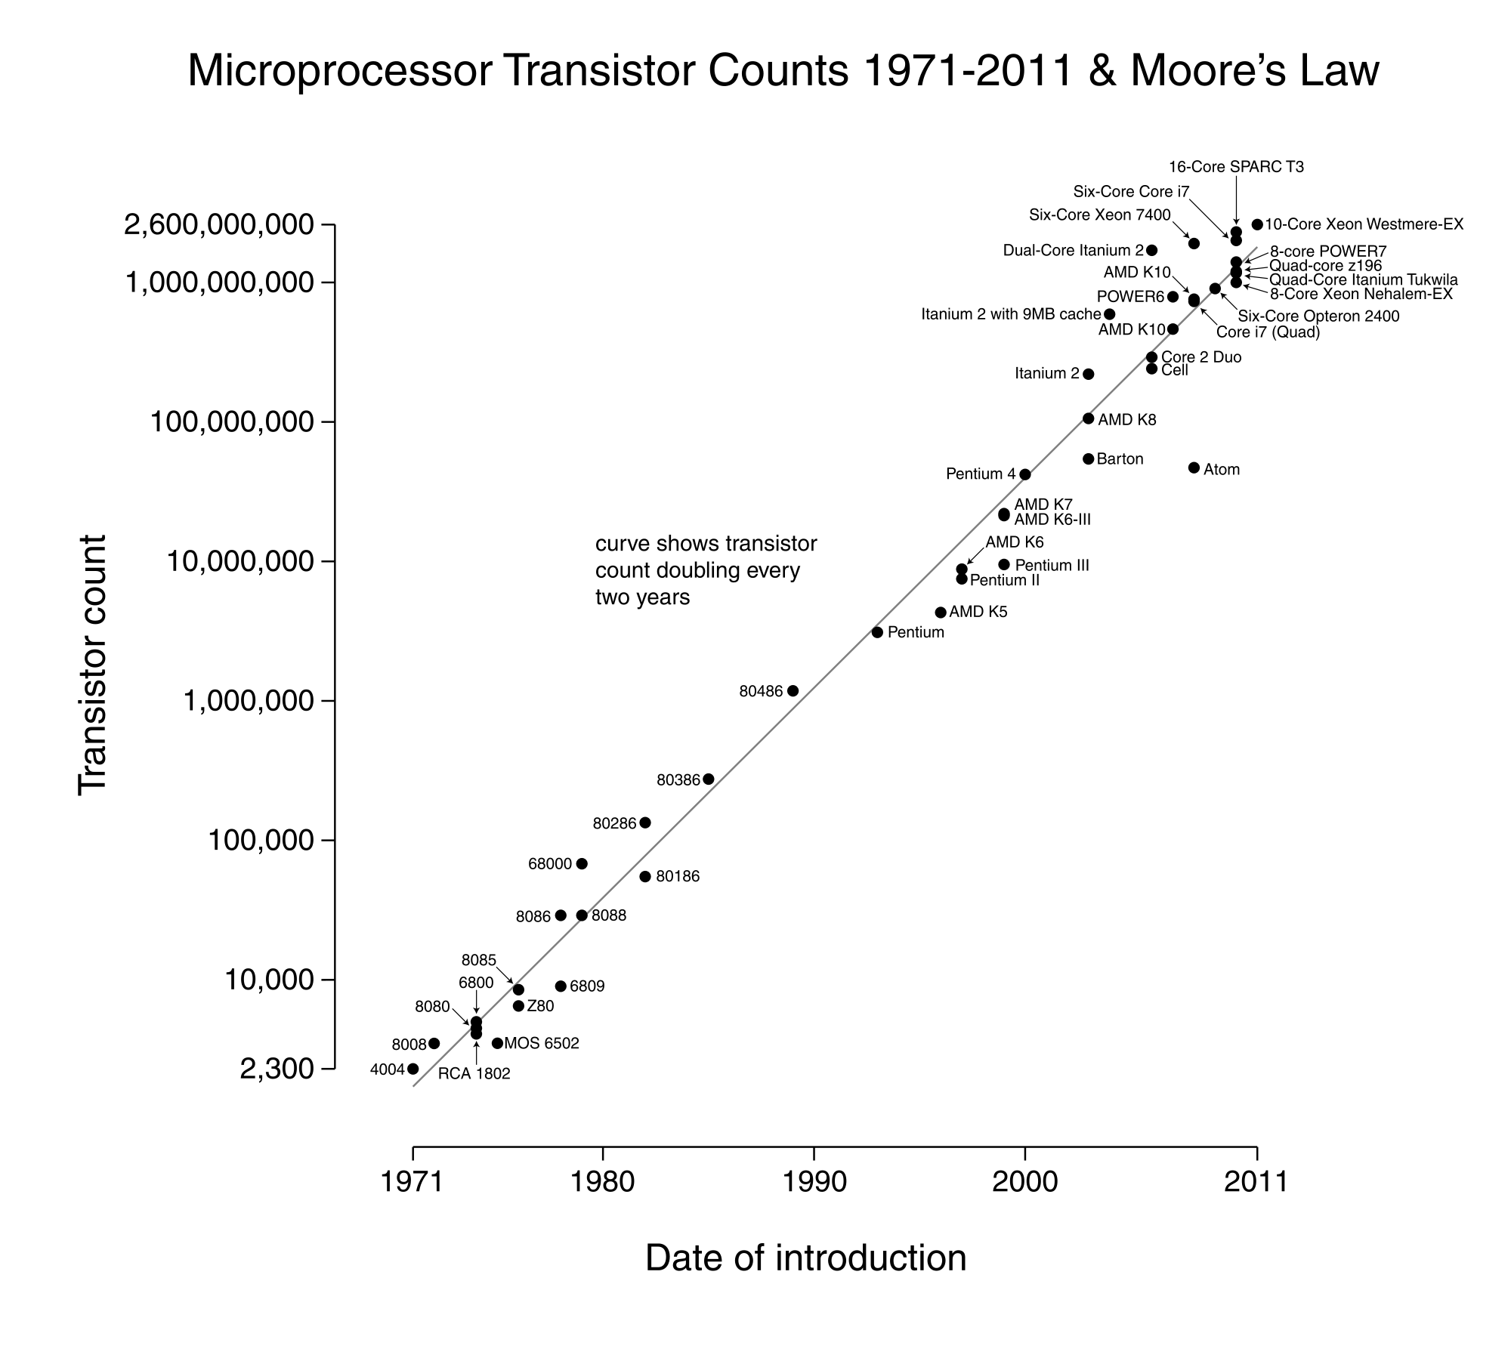
Moore’s Law
Source: Wikipedia
If the trend continues:
Larger problems could be solved each year
Exponential speedup

Slide 18
Acknowledgments
The very capable cluster builder & sys admin:
Chris Scheller
CAC / Cyber Infrastructure Team at U of M
Michigan Python Users Group
Wikipedia
All the people who developed Linux and cluster OS and made them freely available

Slide 19
More Terminology
Hyper Threading - HT
Distinguish from software threads
The OS sees two virtual cores for each physical core
It is less computing power than having an actual computing core
Virtualization:
Allows a computer to emulate another
Allows much flexibility:
Multiple operating systems
Save computer snapshot – continue elsewhere
Possible to replicate virtual computers
Will be slower than a native OS

Slide 20
Risk Equations from the Literature Blinded
Bio-Markers
 | 1 | 2 | 3 | 4 | 5 | 6 | 7 | 8 | 9 | 10 | 11 | 12 | 13 | 14 | 15 | 16 | 17 | 18 | 19 | 20 | 21 | 22 | 23 | 24
1 | * |  |  | * | * |  |  | * | * | * | * |  | *
2 | * |  | * | * | * | * |  | * |  | * | * |  | * |  |  |  |  | * | * | * | *
3 |  |  |  | * |  |  | * |  |  |  | * | * | * |  | * | *
4 |  |  | * | * |  | * | * | * | * |  | * |  | * | * |  |  |  |  | * |  |  | * | * | *
5 |  |  | * |  | * |  |  | * |  | * | * |  | *
6 | * |  | * |  | * |  |  | * |  | * | * |  | * |  | *
7 | * | * |  | * |  |  |  |  |  |  |  |  |  |  |  |  |  |  |  | *
8 | * |  |  | * | * |  |  |  |  |  |  |  | *
9 |  |  |  |  |  |  |  |  |  |  |  |  | * |  |  |  |  |  |  |  | *
Risk Equations
Smoke

Slide 21
Example Reference Model Calibration
Calibration requires computing power:
48 equation variations
16 cohorts with known outcomes
20 repetitions of 1000 individuals for 10 years
15360 processes = 48x16x20
4.5 days of commutation on a single 8 core desktop PC
Scalable
Easy to add cohorts/equations
Improves with more information

