Slide 1




Population Generation from Statistics Using Genetic Algorithms with MIST + INSPYRED
Jacob Barhak
Freelancer
Austin, Texas
Aaron Garrett
Jacksonville State University
Jacksonville, Alabama
MODSIM World 2014 Conference & Expo
Hampton Roads VA, USA
16 April 2014

Slide 2
Background
The First Table in a Clinical Trial publication typically contains Population Statistics
Summary Data Only: Mean (SD) / Median (IQR)
Limited information about distribution
Inclusion/exclusion criteria skew the distribution
Example: Excerpt from Table 1 in UKPDS 33
 | Control | Intervention
Age | 53.3 (8.6) | 53.2 (8.6)
% Male | 61.9% | 59.3%
Smoke | 31% | 30%
Systolic Blood Pressure (mmHg) | 135(20) | 135(20)
Total Cholesterol (mmol/L) | 5.4 (1.02) | 5.4(1.12)

Slide 3
Goal
Generate a Mock Population Composed of Individuals from the Published Statistics
Individual population is restricted
Table 1 is typically public
Generate a mock population for further study
Population 1
Population 2
Population N
Table 1
Population 2
Table 1
Population3
Table 1

Slide 4
INSPYRED Basics
Bio Inspired computation Python library
Evolutionary Computation
Swarm Intelligence
Neural Networks
Developed and Maintained by Aaron Garrett

Slide 5
MIST Basics
MIST stands for MIcro-Simulation Tool
In a nutshell it is a Monte-Carlo simulation compiler
Offers a Domain Specific Language
Reproducible simulations
MIST Supports Population Generation
Generating functions
Optimization towards objectives
Evolutionary computation with INSPYRED
MIST runs over the cloud!
And on Sun Grid Engine (SGE) clusters

Slide 6
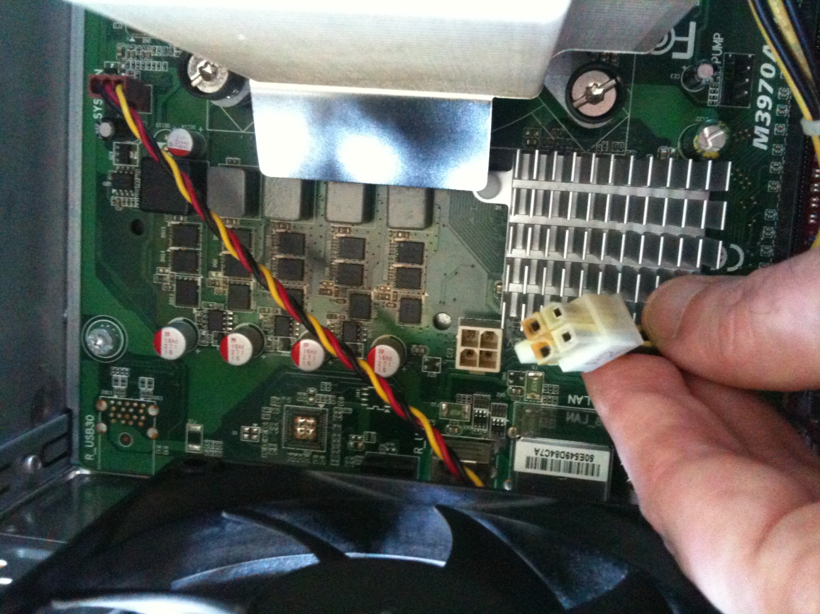
MIST Uses Computing Power Here is Proof!
Fried after two year of extensive use

Slide 7
MIST Runs Over the Cloud!
Anaconda drives MIST to run over the Amazon cloud!
Batch mode MIST utilities allow:
Submitting jobs to Sun Grid Engine (SGE)
Running simulations
Generating reports
Combining reports from multiple repetitions/scenarios
Star Cluster creates an SGE cluster on the Amazon Elastic Compute Cloud
The Anaconda Amazon Machine Image (AMI) is used for the cluster master / nodes
Good for:
Cutting down computation time by renting computing power
Saving initial and maintenance costs associated with a cluster
MIST
Cloud

Slide 8
INSPYRED Evolutionary Computation: Population Generation & Objectives
Generation Expressions:
Define how to generate a single individual
Test if individual fits the inclusion/exclusion criteria
Define ties and correlations between characteristics
Objectives:
Define aggregate targets for the entire population
Reduce random generation error
Handle skewed distributions to fit target
INSPYRED
MIST
Expression Compiler
Evolutionary Computation
Monte Carlo
Selection
Result
Result Population
Converges to
Objectives

Slide 9
INSPYRED Evolutionary Computation
Candidates
Generator
Evaluator
3.1
7.5
4.2
5.2
Selector
+
=
→
Generations / Epocs
Variators
Repeat
Parents
Crossover
Mutation
Terminator
Best Solution

Slide 10
Population Generation Example Skewed by Inclusion/Exclusion
Generate 10 people with:
Inclusion criteria is 45< Age <90
The base population distribution is:
Age for Male: Mean 53 SD 10
Age for Female: Mean 52 SD 7
Male: 50%
Generation Functions (Implementation):
Age ~ Iif (Male,Gaussian(53,10) ,Gaussian(52,7))
Male ~ Bernoulli(0.5)
Assert = And(Gr(Age,45),Ls(Age,90))
Notes:
May not represent well what was intended
Assertion drops non qualifying candidates
The resulting Age is skewed
Age | Male
48.85785535 | 0
59.94741744 | 0
56.19039096 | 1
64.40825341 | 0
49.77582796 | 1
60.29975596 | 1
51.27571792 | 1
72.13820388 | 1
55.51746037 | 0
58.72574003 | 0
Design is Subject to Constraints
Final population that would have been reported in Table 1:
Age Mean: 57.71366233
Age SD: 7.115024093
Male Mean: 0.5
Result to be Published

Slide 11
Population Generation Example With Objectives
Generate 10 people with objectives:
Base distribution & Inclusion criteria as before
Age : Mean 50, SD 5
Male: 60%
Objectives (Implementation):
Age Mean: 50 , Weight 1
Age SD: 5 , Weight 1
Male: 0.6 , Weight 10
Notes:
Design matches results as much as possible
The designer can study effect of constraints
Table 1 can now be planned ahead!
Age | Male
50.8953429 | 0
53.71135174 | 1
52.86278825 | 0
46.021901 | 1
48.36662032 | 1
47.87355499 | 1
45.11370607 | 1
62.15347882 | 1
47.48350736 | 0
45.93131347 | 0
Design = Desired + Constraints
Final population selected out of 1000 generated candidates:
Age Mean: 50.04135649
Age SD: 5.166548964
Male Mean: 0.6
Result to be Published

Slide 12
Summary
INSPYRED MIST can regenerate mock populations from Table 1 in clinical trials
MIST and INSPYRED are free and available on GitHub:
https://github.com/Jacob-Barhak/MIST
https://github.com/inspyred/inspyred
INSPYRED
Table 1
MIST
Generate

Slide 13
This Modeling Technology Opens Possibilities
The Reference Model for Disease Progression
Uses MIST
Reduced Monte Carlo error
Reduced User Error
Unexplored Future Potential:
Planning Recruitment Efforts?
Clinical Trials?
Other Recruitment Efforts?

Slide 14
Acknowledgments
Deanna J.M. Isaman - who is the spirit behind the great ideas. She taught me my first steps in disease modeling
Morton Brown & William H. Herman – for guidance, critical feedback, and growth environment
All those who developed free software used: including Python, Anaconda, Python(x,y), numpy, SciPy, nose, winpdb, Star Cluster, Ubuntu, Sun Grid Engine
The legacy IEST modeling framework was supported by the Biostatistics and Economic Modeling Core of the MDRTC (P60DK020572) and by the Methods and Measurement Core of the MCDTR (P30DK092926), both funded by the National Institute of Diabetes and Digestive and Kidney Diseases. The modeling framework was initially defined as GPL and was funded by Chronic Disease Modeling for Clinical Research Innovations grant (R21DK075077) from the same institute. MIST is based on IEST.
The Reference Model and MIST were developed independently without financial support

Slide 15


Questions
MIST INSPYRED
https://github.com/Jacob-Barhak/MIST
https://github.com/inspyred/inspyred

Slide 16
INSPYRED Evolutionary Computation
INSPYRED elements provided by MIST:
Evaluator: Score a specific sub-population = Fitness function
Generator: Generates a sub-population from candidate population
Random generator: Control random numbers: Allows Reproducibility
Variators:
Cross Over: method to create a sub populations from two others
Mutation: Method to change a sub-population
Terminators:
Max Eval: stop when computation is too long
Max Stable: Stop when result Is stable
Additional parameters: Population Size, Sub-population Size, etc.
Selector: Standard INSPYRED Tournament
Observer: Standard INSPYRED statistic observer

Slide 17
Simulation Language / Compiler
Strict Expression language – a subset of Python with extensions:
Supported Types: Integer, Number, Expression, State Indicator, System Option
Comparison: Eq, Ne, Gr, Ge, Ls, Le
Boolean operators: Or, And, Not, IsTrue
Special math: Inf, NaN, IsInvalidNumber, IsInfiniteNumber, IsFiniteNumber
Mathematical functions: Exp, Log, Ln, Log10, Pow, Sqrt, Pi
Other functions: Mod, Abs, Floor, Ceil, Max, Min
Statistical: Bernoulli, Binomial, Geometric, Uniform, Gaussian
Control and Data Access: Iif, Table
Application specific: CostWizard
Features:
Compiles into Python
Syntax check upon expression definition
Runtime Bound Checks
Runtime recalculation due to out of bounds random error
MIST
Model/ Population
Python Script
Compile
Run
Results

Slide 18
Monte Carlo Initialization: Distribution to Population Generation
The system:
Compiles distributions into initialization code before simulation
Automatically resolves calculation order
Can handle interdependencies
Evolutionary Computation towards user defined objectives
Example with no objectives:
Age ~ 61+8.2*CappedGaussian3
Male ~ Bernoulli(803/1199)
SBP ~ 133.4+16.4*CappedGaussian3
AgeAtDiagnosisOfDiabetes ~ Age - 8
Good for:
Using published aggregate data from clinical trial publications
Avoiding using individual data that is typically restricted
Allowing access to more population information
Age | Male | SBP | AgeAtDiagnosisOfDiabetes
65.51415 | 1 | 129.1721 | 57.51415
53.76856 | 1 | 137.4234 | 45.76856
73.71445 | 0 | 132.8542 | 65.71445
45.79667 | 1 | 147.5537 | 37.79667
57.21742 | 1 | 122.68 | 49.21742

Slide 19
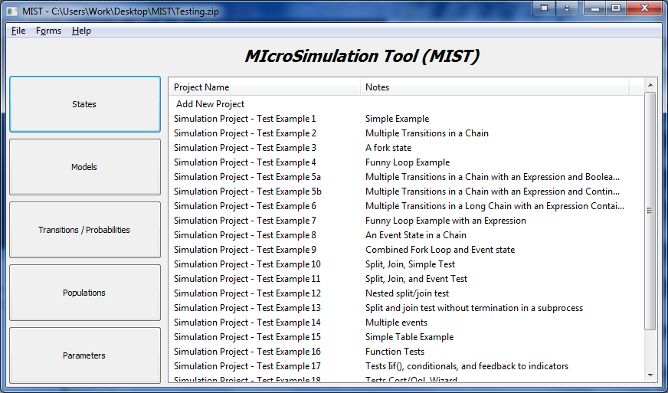
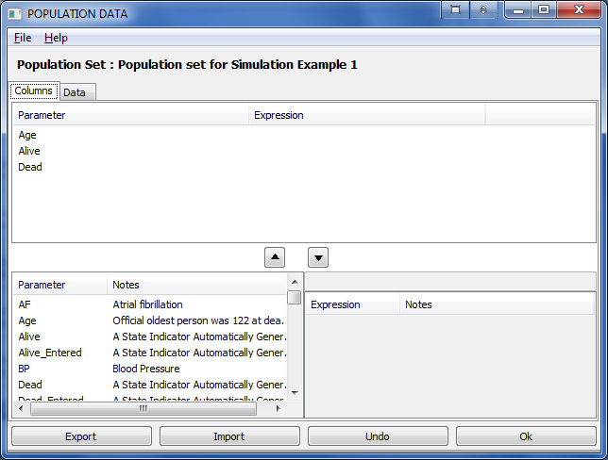
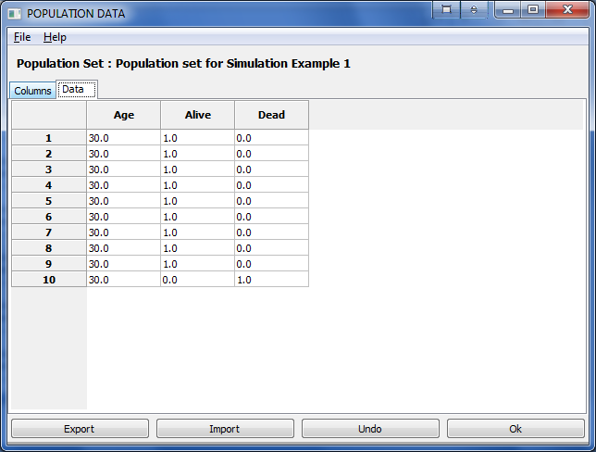
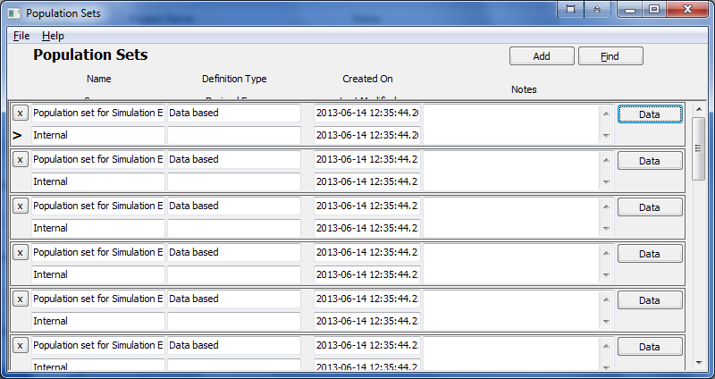
Form Based User Interface

Slide 20
Monte Carlo Simulation
Pop
If random < OccurrenceProbability:
AffectedParameter = DefinedExpression
If random < OccurrenceProbability:
AffectedParameter = DefinedExpression
Init
Rules
Mutli-Process State Transitions
Process
CHD
No CHD
MI
Survive MI
CHD Death
Pre
State Transition Rules
Process
Stroke
Post
State Transition Rules
Death
No Stroke
Stroke
Survive Stroke
Stroke Death
Process
Competing Mortality
Alive
Other Death
Cost QoL
Biomarkers
Repeat Simulation Step

Slide 21
Reproducibility
MIST stores random state of each simulation
MIST can recreate a simulation from Trace Back upon request
MIST records additional traceability information in compiled simulation files to help debugging
Good For:
Saving storage space
Debugging
Distributing results & publication

Slide 22
The Reference Model for Disease Progression
Simple - Low Resolution
Based on secondary data:
Published Risk Equations
Published Clinical Trials, i.e. no real individual data
Other publications
Relies on computing power/techniques
Parallel processing / High Performance Computing
Competition among alternative equation/hypothesis combinations
Cross validation - One click validation
Ranks results according to fitness - Fitness Engine
Accumulates knowledge

