Slide 1
The Reference Model: A Decade of Healthcare Predictive Analytics with Python
The Reference Model: A Decade of Healthcare Projective Analytics with Python
Jacob Barhak
Austin, Texas
PyTexas 2017
November 18-19, 2017
Galvanize,
Austin, TX, USA

Slide 2
Python Enablers Over a Decade
numpy – math and statistics
scipy – optimization functions
sympy – symbolic math
parser – creating a modeling language
WxPython – User Interface
matplotlib - visualization
MIST – MIcro Simulation Tool
StarCluster – virtual cluster on the cloud
Inspyred – Evolutionary Computation
xmllib – parsing XML data
Bokeh – Visualization
libsbml – Systems Biology Markup Language
Earlier work from 2007-2012
More recent work from 2012-2017
future work

Slide 3
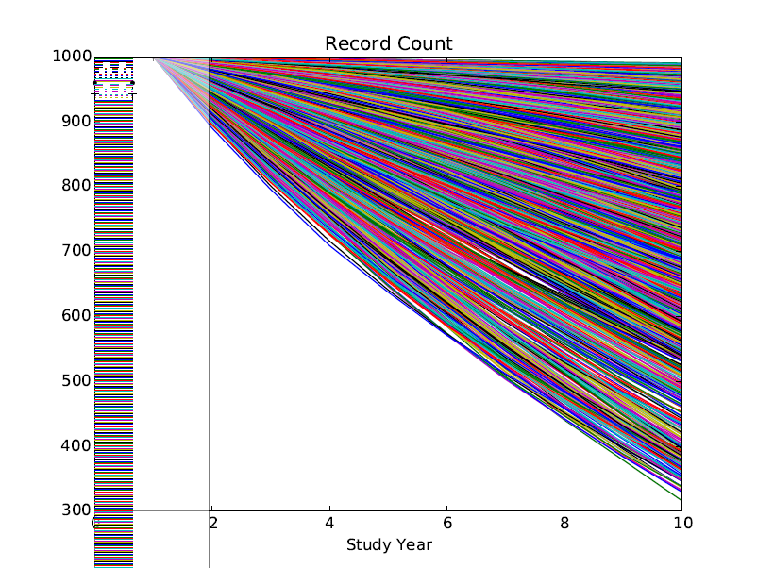
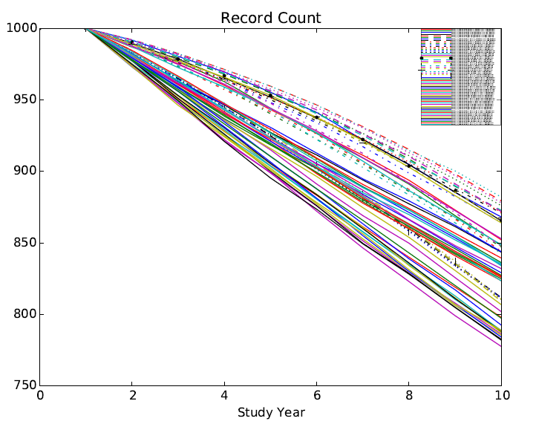
Predicting Disease Progression Challenges Visualized using MatPlotLib
Trajectories from 64 model combinations for a single cohort
4352 trajectories from 64 model combinations & 68=34x2 cohorts
The end point number represents survival after 10 years from 1000 people
So much information that even the legend wont fit
So much variability amongst existing models and different conditions
MIST_RefModel_2014_03_03_MATRIX_TraceBack.zip

Slide 4
The Reference Model Accumulates Knowledge
Knowledge = Observed Data & Assumptions / Models
Raw Models
BioMarker Correction
Biomarkers Independent
Fully Correlated
Unexplained
8 Populations = 40 cohorts x 2
Biomarkers Independent
Best Model
Fully Correlated
Date Correction
Date+BioMarker Correction
50 Models x 4 Assumptions
Version 22 - MIST_RefModel_2014_04_29_MATRIX_TraceBack.zip

Slide 5
The Reference Model Historical Evolution
2012 – Start
2013 – High Performance Computing and Cloud Computing
2014 – Evolutionary Computation for Population Generation
2015 – Object Oriented Population Generation
2016 – Assumption Engine / Model Cooperation
2017 – Interface to ClinicalTrials.Gov
Continuous Model Space = Infinite Model Combinations

Slide 6
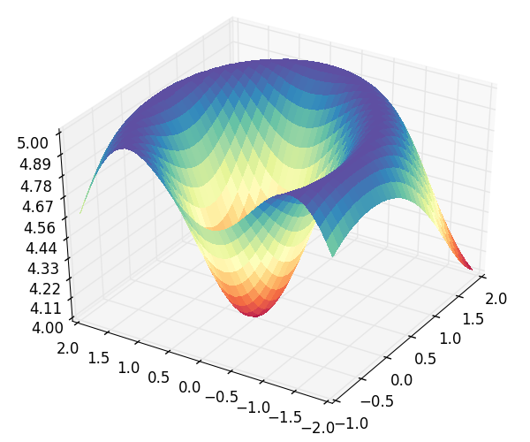
The Reference Model Now Employs Model Competition and Cooperation
A
B
Process CHD
Ensemble model where models cooperate
Calculates fitness of multiple models to multiple population sets
Uses and Assumption Engine to handles different competing assumptions
Uses High Performance Computing
aA+bB+cC+dD
Eq EH | E | E | E | E | …
Eq AD | A | B | C | D | …
Pop 1 | 4 | 6 | 2 | 1 | …
Pop 2 | 2 | 4 | 6 | 1 | …
Pop 3 | 2 | 3 | 9 | 2 | …
… | … | … | … | … | …
Pop 3
D
C
No CHD
MI
Survive MI
CHD Death
Pop 2
Pop 1
E
F
eE+fF+gG+hH
Process Stroke
Death
No Stroke
H
G
Stroke
Survive Stroke
Stroke Death
Discrete Fitness Matrix
Process Competing Mortality
Alive
Other Death
Continuous Fitness Space

Slide 7
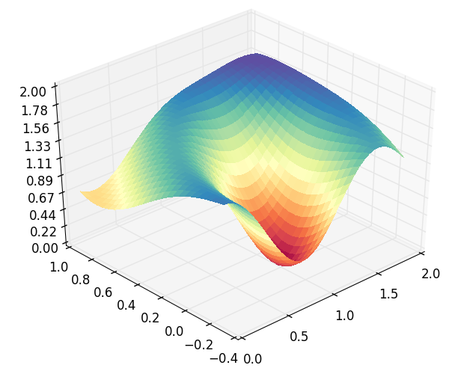
The Reference Model Assumption Engine
The Assumption Engine allows us to “throw” assumptions at it
A model is an assumption!
It figures out which assumptions work well together to fit observed data
Points to significant models
Rejects incompatible models
Fitness (s)
Equation Coefficient (t₂=b)
Equation Coefficient (t₁=a)

Slide 8
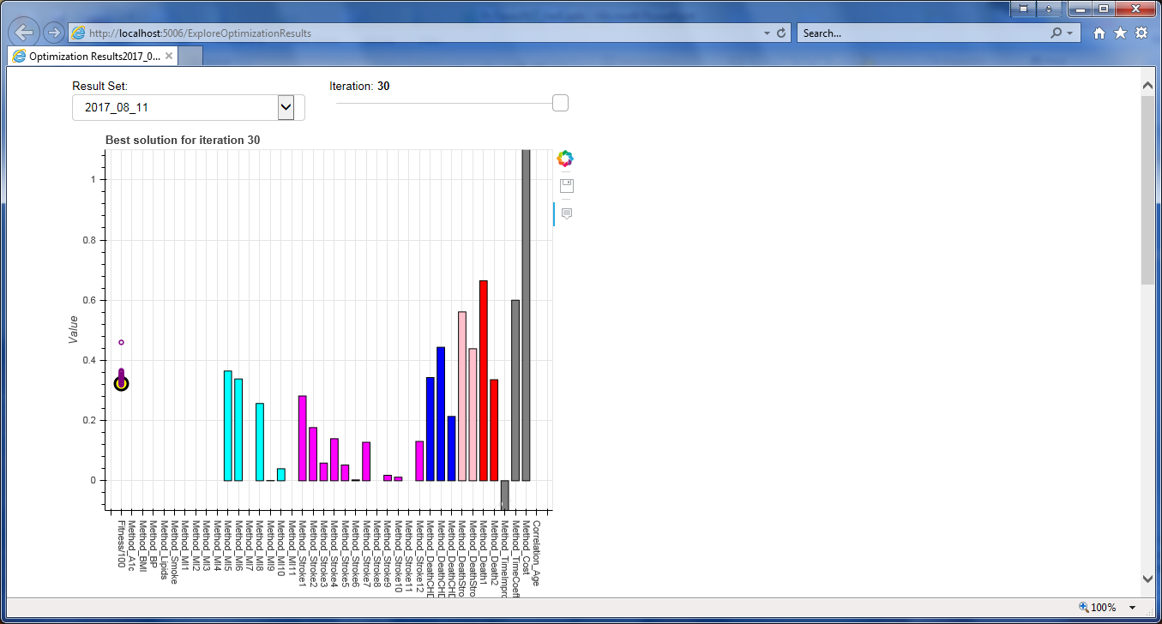
Optimization Visualized with Bokeh Simple

Slide 9
How Fast Medical Practice Improves?
Data and model from 3 decades
Multiple models were used with model stamps ranging from 1978.5 to 2007.05
Validated against 9 populations included in the period ranging from 1977 to 2010
The assumption engine was asked to calculate the best fit:
Significance of each model used
The yearly improvement coefficient
The prevention coefficient = indicating if improvement is pre event or post event
This correction term accounts for model outdate
Model Data Time Interval
Simulated
Time Stamp
Time
Adjustment Time

Slide 10
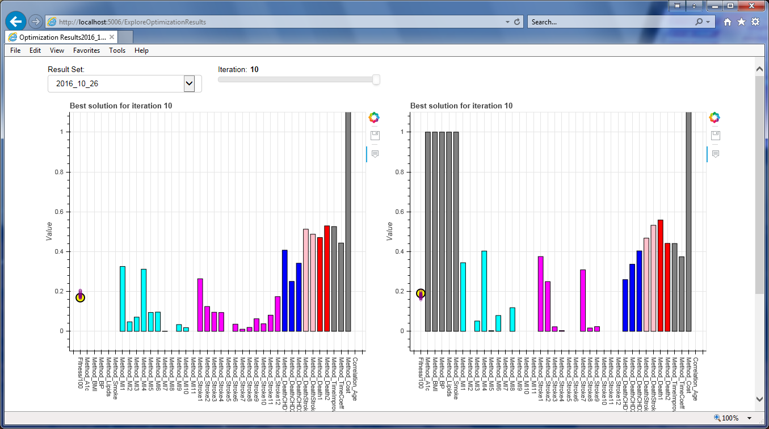
Optimization Visualized with Bokeh Complex with Temporal Correction

Slide 11
Equivalent to Moore’s Law for improvement for Diabetic Cardiovascular Disease Mortality
Correcting models for medical practice improvement creates a better model mixture.
Optimal Yearly Temporal Correction CVD Coefficient was η=0.86/0.87
The Prevention coefficient ϕ=0.43/0.53
CVD death probability halved every 5 years
Moore’s Law: Number of transistors doubles every year
Prevention/Treatment improved equally

Slide 12
Life Expectancy – Assuming Future = Past
 |  | Smoke? | Non Smoking |  |  |  |  |  |  |  |  |  |  |  |  |  |  |  |  |  | Smoking |  |  |  |  |  |  |  |  |  |  |  |  |  |  |  |  | Smoke?
 |  | A1c | 6 |  |  |  |  |  | 8 |  |  |  |  |  | 10 |  |  |  |  |  | 6 |  |  |  |  |  | 8 |  |  |  |  |  | 10 |  |  |  |  | A1c
 |  | Lipid Ratio | 4 | 5 | 6 | 7 | 8 |  | 4 | 5 | 6 | 7 | 8 |  | 4 | 5 | 6 | 7 | 8 |  | 4 | 5 | 6 | 7 | 8 |  | 4 | 5 | 6 | 7 | 8 |  | 4 | 5 | 6 | 7 | 8 | Lipid Ratio
Gender | Age | SBP |  |  |  |  |  |  |  |  |  |  |  |  |  |  |  |  |  |  |  |  |  |  |  |  |  |  |  |  |  |  |  |  |  |  |  | SBP | Age | Gender
Male | 45 | 120 | 31.9 | 31.1 | 30.1 | 29.1 | 28.3 |  | 31.4 | 30.5 | 29.2 | 28.5 | 27.9 |  | 31.0 | 29.9 | 29.1 | 28.1 | 27.2 |  | 28.7 | 27.6 | 26.8 | 25.6 | 24.7 |  | 28.1 | 27.0 | 26.2 | 25.3 | 24.1 |  | 27.7 | 26.5 | 25.5 | 24.8 | 23.5 | 120 | 45 | Male
 |  | 140 | 30.1 | 28.8 | 27.8 | 26.7 | 25.9 |  | 29.6 | 28.4 | 27.6 | 26.3 | 25.1 |  | 29.1 | 27.9 | 27.0 | 25.5 | 24.4 |  | 26.3 | 25.2 | 24.1 | 22.9 | 21.7 |  | 26.1 | 24.7 | 23.3 | 22.3 | 21.1 |  | 25.8 | 24.2 | 23.1 | 21.8 | 20.6 | 140
 |  | 160 | 29.4 | 27.8 | 26.7 | 25.7 | 24.4 |  | 28.6 | 27.3 | 26.2 | 25.1 | 23.7 |  | 28.2 | 26.9 | 25.8 | 24.6 | 23.5 |  | 25.4 | 23.9 | 22.6 | 21.7 | 20.5 |  | 25.0 | 23.3 | 22.5 | 21.1 | 19.8 |  | 24.7 | 23.0 | 21.7 | 20.4 | 19.2 | 160
 |  | 180 | 28.2 | 26.9 | 26.0 | 24.4 | 23.4 |  | 27.7 | 26.4 | 25.2 | 24.1 | 22.7 |  | 27.3 | 25.8 | 24.5 | 23.3 | 22.3 |  | 24.3 | 22.8 | 21.6 | 20.4 | 19.1 |  | 23.9 | 22.5 | 21.2 | 19.7 | 18.6 |  | 23.1 | 22.0 | 20.6 | 19.3 | 18.0 | 180
 | 55 | 120 | 24.0 | 23.2 | 22.6 | 21.8 | 21.2 |  | 23.7 | 22.8 | 22.1 | 21.4 | 20.7 |  | 23.5 | 22.5 | 21.8 | 20.9 | 20.3 |  | 21.5 | 20.5 | 19.8 | 19.1 | 18.2 |  | 21.2 | 20.1 | 19.5 | 18.4 | 17.9 |  | 20.5 | 19.6 | 19.1 | 18.2 | 17.3 | 120 | 55
 |  | 140 | 22.6 | 22.0 | 20.9 | 20.1 | 19.3 |  | 22.4 | 21.4 | 20.5 | 19.7 | 18.8 |  | 22.0 | 21.0 | 20.1 | 19.2 | 18.4 |  | 20.0 | 18.8 | 18.0 | 17.0 | 16.1 |  | 19.4 | 18.4 | 17.5 | 16.8 | 15.6 |  | 19.2 | 18.1 | 17.2 | 16.0 | 15.5 | 140
 |  | 160 | 22.0 | 21.0 | 20.1 | 19.3 | 18.4 |  | 21.9 | 20.8 | 19.8 | 18.9 | 17.8 |  | 21.2 | 20.2 | 19.2 | 18.4 | 17.5 |  | 19.1 | 18.0 | 17.1 | 16.1 | 15.4 |  | 18.8 | 17.7 | 16.7 | 15.7 | 14.9 |  | 18.4 | 17.4 | 16.4 | 15.3 | 14.3 | 160
 |  | 180 | 21.5 | 20.3 | 19.4 | 18.5 | 17.7 |  | 21.1 | 20.0 | 19.0 | 18.1 | 17.0 |  | 20.6 | 19.5 | 18.6 | 17.7 | 16.6 |  | 18.4 | 17.4 | 16.3 | 15.3 | 14.4 |  | 18.1 | 16.9 | 15.9 | 15.0 | 14.0 |  | 17.5 | 16.4 | 15.6 | 14.4 | 13.7 | 180
 | 65 | 120 | 16.9 | 16.5 | 15.8 | 15.3 | 14.6 |  | 16.9 | 16.1 | 15.6 | 14.9 | 14.4 |  | 16.5 | 15.8 | 15.3 | 14.7 | 14.1 |  | 14.7 | 14.3 | 13.8 | 13.2 | 12.5 |  | 14.7 | 13.8 | 13.3 | 12.9 | 12.2 |  | 14.3 | 13.7 | 13.1 | 12.4 | 11.8 | 120 | 65
 |  | 140 | 16.1 | 15.4 | 14.9 | 14.2 | 13.5 |  | 16.1 | 15.2 | 14.5 | 13.9 | 13.3 |  | 15.8 | 14.9 | 14.2 | 13.7 | 12.9 |  | 13.9 | 13.3 | 12.7 | 11.9 | 11.4 |  | 13.8 | 12.9 | 12.3 | 11.7 | 10.8 |  | 13.5 | 12.8 | 12.0 | 11.3 | 10.7 | 140
 |  | 160 | 15.7 | 15.1 | 14.4 | 13.5 | 13.0 |  | 15.5 | 14.7 | 14.0 | 13.4 | 12.7 |  | 15.2 | 14.5 | 13.9 | 13.1 | 12.3 |  | 13.5 | 12.8 | 12.2 | 11.4 | 10.7 |  | 13.3 | 12.6 | 11.8 | 11.0 | 10.5 |  | 13.0 | 12.3 | 11.6 | 10.8 | 10.2 | 160
 |  | 180 | 15.4 | 14.6 | 13.8 | 13.2 | 12.5 |  | 15.1 | 14.2 | 13.5 | 12.8 | 12.1 |  | 15.0 | 14.2 | 13.2 | 12.6 | 11.9 |  | 13.1 | 12.3 | 11.7 | 10.9 | 10.2 |  | 12.8 | 12.1 | 11.3 | 10.6 | 9.9 |  | 12.6 | 11.6 | 11.0 | 10.3 | 9.7 | 180
 | 75 | 120 | 11.2 | 10.7 | 10.3 | 10.0 | 9.6 |  | 11.0 | 10.5 | 10.1 | 9.8 | 9.3 |  | 10.8 | 10.3 | 10.0 | 9.5 | 9.1 |  | 9.7 | 9.1 | 8.8 | 8.4 | 8.1 |  | 9.5 | 9.0 | 8.7 | 8.3 | 7.9 |  | 9.3 | 8.9 | 8.4 | 8.0 | 7.7 | 120 | 75
 |  | 140 | 10.7 | 10.2 | 9.7 | 9.4 | 8.9 |  | 10.5 | 10.0 | 9.6 | 9.1 | 8.7 |  | 10.3 | 9.8 | 9.4 | 8.9 | 8.4 |  | 9.1 | 8.6 | 8.3 | 7.8 | 7.3 |  | 8.9 | 8.4 | 8.1 | 7.6 | 7.2 |  | 8.8 | 8.3 | 7.8 | 7.4 | 7.0 | 140
 |  | 160 | 10.3 | 10.0 | 9.4 | 9.0 | 8.5 |  | 10.2 | 9.6 | 9.2 | 8.9 | 8.5 |  | 10.2 | 9.6 | 9.1 | 8.6 | 8.1 |  | 8.9 | 8.4 | 8.0 | 7.5 | 7.1 |  | 8.7 | 8.2 | 7.8 | 7.4 | 7.0 |  | 8.5 | 8.0 | 7.5 | 7.1 | 6.7 | 160
 |  | 180 | 10.2 | 9.8 | 9.2 | 8.8 | 8.3 |  | 10.2 | 9.5 | 9.0 | 8.5 | 8.1 |  | 9.9 | 9.2 | 8.7 | 8.3 | 7.9 |  | 8.6 | 8.1 | 7.7 | 7.2 | 6.9 |  | 8.4 | 8.0 | 7.5 | 7.1 | 6.7 |  | 8.3 | 7.6 | 7.4 | 6.8 | 6.4 | 180
Female | 45 | 120 | 34.8 | 34.2 | 33.3 | 32.8 | 31.9 |  | 34.5 | 33.6 | 32.8 | 32.2 | 31.2 |  | 34.0 | 33.5 | 32.5 | 31.8 | 31.1 |  | 31.8 | 30.9 | 29.9 | 29.3 | 28.4 |  | 31.3 | 30.6 | 29.6 | 29.1 | 27.6 |  | 31.2 | 30.2 | 29.2 | 28.3 | 27.4 | 120 | 45 | Female
 |  | 140 | 33.2 | 32.4 | 31.6 | 30.9 | 29.9 |  | 32.9 | 32.1 | 31.0 | 30.4 | 29.4 |  | 32.6 | 31.7 | 30.6 | 29.7 | 28.7 |  | 29.5 | 28.8 | 27.7 | 26.9 | 25.7 |  | 29.2 | 28.2 | 27.3 | 26.5 | 25.4 |  | 28.8 | 27.8 | 26.6 | 26.0 | 24.7 | 140
 |  | 160 | 32.0 | 31.3 | 30.2 | 29.5 | 28.4 |  | 31.9 | 30.9 | 29.8 | 29.0 | 27.9 |  | 31.4 | 30.5 | 29.3 | 28.5 | 27.5 |  | 28.3 | 27.3 | 26.2 | 25.5 | 24.2 |  | 28.0 | 27.0 | 25.7 | 24.9 | 23.7 |  | 27.7 | 26.5 | 25.4 | 24.5 | 23.3 | 160
 |  | 180 | 31.5 | 30.3 | 29.3 | 28.3 | 27.2 |  | 30.9 | 29.9 | 29.0 | 27.8 | 26.8 |  | 30.5 | 29.4 | 28.2 | 27.2 | 25.9 |  | 27.4 | 26.3 | 24.9 | 23.9 | 22.9 |  | 26.9 | 25.8 | 24.5 | 23.6 | 22.2 |  | 26.5 | 25.3 | 23.9 | 23.2 | 21.7 | 180
 | 55 | 120 | 26.6 | 26.0 | 25.4 | 24.8 | 24.2 |  | 26.2 | 25.7 | 25.0 | 24.5 | 23.7 |  | 26.2 | 25.5 | 24.6 | 24.1 | 23.3 |  | 23.7 | 23.3 | 22.6 | 21.8 | 21.1 |  | 23.5 | 22.8 | 22.0 | 21.5 | 20.8 |  | 23.3 | 22.5 | 21.8 | 20.9 | 20.5 | 120 | 55
 |  | 140 | 25.3 | 24.8 | 24.0 | 23.2 | 22.3 |  | 25.2 | 24.5 | 23.4 | 22.9 | 22.1 |  | 24.8 | 24.3 | 23.3 | 22.7 | 21.7 |  | 22.3 | 21.7 | 21.0 | 20.2 | 19.2 |  | 22.3 | 21.3 | 20.6 | 19.9 | 19.1 |  | 21.8 | 20.9 | 20.3 | 19.5 | 18.5 | 140
 |  | 160 | 24.7 | 24.0 | 23.2 | 22.5 | 21.8 |  | 24.3 | 23.8 | 22.9 | 22.0 | 21.2 |  | 24.1 | 23.3 | 22.3 | 21.6 | 20.7 |  | 21.7 | 20.7 | 19.9 | 19.1 | 18.2 |  | 21.4 | 20.7 | 19.8 | 18.8 | 17.9 |  | 21.0 | 20.1 | 19.3 | 18.4 | 17.4 | 160
 |  | 180 | 24.0 | 23.2 | 22.4 | 21.6 | 20.6 |  | 23.8 | 22.8 | 22.1 | 21.1 | 20.3 |  | 23.4 | 22.5 | 21.6 | 20.9 | 19.8 |  | 20.8 | 20.0 | 19.2 | 18.4 | 17.2 |  | 20.6 | 19.6 | 18.8 | 17.7 | 16.9 |  | 20.0 | 19.2 | 18.3 | 17.6 | 16.6 | 180
 | 65 | 120 | 19.0 | 18.5 | 18.0 | 17.8 | 17.0 |  | 18.7 | 18.2 | 17.7 | 17.4 | 16.8 |  | 18.6 | 18.1 | 17.5 | 17.0 | 16.5 |  | 16.7 | 16.4 | 15.7 | 15.3 | 14.7 |  | 16.7 | 16.2 | 15.8 | 15.1 | 14.6 |  | 16.3 | 15.9 | 15.3 | 14.9 | 14.1 | 120 | 65
 |  | 140 | 18.2 | 17.8 | 17.2 | 16.6 | 16.1 |  | 18.2 | 17.4 | 16.9 | 16.4 | 15.8 |  | 17.8 | 17.1 | 16.6 | 16.0 | 15.4 |  | 15.9 | 15.4 | 14.8 | 14.3 | 13.7 |  | 15.6 | 15.2 | 14.6 | 13.9 | 13.4 |  | 15.4 | 14.9 | 14.3 | 13.8 | 13.1 | 140
 |  | 160 | 17.8 | 17.3 | 16.8 | 16.1 | 15.6 |  | 17.6 | 17.0 | 16.5 | 15.9 | 15.2 |  | 17.4 | 16.8 | 16.0 | 15.5 | 15.0 |  | 15.4 | 14.8 | 14.4 | 13.8 | 13.0 |  | 15.3 | 14.5 | 13.9 | 13.3 | 12.8 |  | 15.1 | 14.4 | 13.7 | 13.1 | 12.5 | 160
 |  | 180 | 17.4 | 16.8 | 16.1 | 15.5 | 14.8 |  | 17.2 | 16.4 | 15.9 | 15.2 | 14.6 |  | 16.9 | 16.3 | 15.7 | 15.0 | 14.3 |  | 15.0 | 14.4 | 13.7 | 13.2 | 12.5 |  | 14.9 | 14.0 | 13.4 | 12.8 | 12.2 |  | 14.6 | 13.7 | 13.1 | 12.4 | 11.9 | 180
 | 75 | 120 | 12.5 | 12.3 | 12.0 | 11.4 | 11.3 |  | 12.4 | 12.0 | 11.6 | 11.3 | 11.0 |  | 12.2 | 11.8 | 11.5 | 11.2 | 10.8 |  | 10.9 | 10.6 | 10.3 | 9.9 | 9.5 |  | 10.7 | 10.4 | 10.0 | 9.8 | 9.4 |  | 10.7 | 10.2 | 10.0 | 9.6 | 9.2 | 120 | 75
 |  | 140 | 12.1 | 11.7 | 11.3 | 11.0 | 10.6 |  | 11.9 | 11.5 | 11.2 | 10.9 | 10.5 |  | 11.9 | 11.5 | 10.9 | 10.5 | 10.2 |  | 10.5 | 10.0 | 9.7 | 9.3 | 9.0 |  | 10.3 | 9.8 | 9.5 | 9.1 | 8.7 |  | 10.2 | 9.8 | 9.3 | 9.1 | 8.5 | 140
 |  | 160 | 11.8 | 11.5 | 11.1 | 10.6 | 10.3 |  | 11.7 | 11.3 | 10.9 | 10.5 | 10.1 |  | 11.5 | 11.2 | 10.7 | 10.3 | 9.7 |  | 10.2 | 9.8 | 9.4 | 9.0 | 8.6 |  | 10.0 | 9.6 | 9.1 | 8.9 | 8.4 |  | 9.9 | 9.5 | 9.0 | 8.6 | 8.1 | 160
 |  | 180 | 11.6 | 11.2 | 10.8 | 10.4 | 10.0 |  | 11.3 | 11.0 | 10.5 | 10.2 | 9.8 |  | 11.3 | 10.9 | 10.4 | 10.0 | 9.6 |  | 10.0 | 9.5 | 9.0 | 8.7 | 8.3 |  | 9.6 | 9.3 | 8.9 | 8.5 | 8.2 |  | 9.7 | 9.1 | 8.8 | 8.4 | 7.9 | 180
Gender | Age | SBP |  |  |  |  |  |  |  |  |  |  |  |  |  |  |  |  |  |  |  |  |  |  |  |  |  |  |  |  |  |  |  |  |  |  |  | SBP | Age | Gender
 |  | Lipid Ratio | 4 | 5 | 6 | 7 | 8 |  | 4 | 5 | 6 | 7 | 8 |  | 4 | 5 | 6 | 7 | 8 |  | 4 | 5 | 6 | 7 | 8 |  | 4 | 5 | 6 | 7 | 8 |  | 4 | 5 | 6 | 7 | 8 | Lipid Ratio
 |  | A1c | 6 |  |  |  |  |  | 8 |  |  |  |  |  | 10 |  |  |  |  |  | 6 |  |  |  |  |  | 8 |  |  |  |  |  | 10 |  |  |  |  | A1c
 |  | Smoke? | Non Smoking |  |  |  |  |  |  |  |  |  |  |  |  |  |  |  |  |  | Smoking |  |  |  |  |  |  |  |  |  |  |  |  |  |  |  |  | Smoke?
Reproducibility Info:
MIST_RefModel_2017_01_02_MODSIM2017.zip using model version 45

Slide 13
Life Expectancy – Temporal Correction
 |  | Smoke? | Non Smoking |  |  |  |  |  |  |  |  |  |  |  |  |  |  |  |  |  | Smoking |  |  |  |  |  |  |  |  |  |  |  |  |  |  |  |  | Smoke?
 |  | A1c | 6 |  |  |  |  |  | 8 |  |  |  |  |  | 10 |  |  |  |  |  | 6 |  |  |  |  |  | 8 |  |  |  |  |  | 10 |  |  |  |  | A1c
 |  | Lipid Ratio | 4 | 5 | 6 | 7 | 8 |  | 4 | 5 | 6 | 7 | 8 |  | 4 | 5 | 6 | 7 | 8 |  | 4 | 5 | 6 | 7 | 8 |  | 4 | 5 | 6 | 7 | 8 |  | 4 | 5 | 6 | 7 | 8 | Lipid Ratio
Gender | Age | SBP |  |  |  |  |  |  |  |  |  |  |  |  |  |  |  |  |  |  |  |  |  |  |  |  |  |  |  |  |  |  |  |  |  |  |  | SBP | Age | Gender
Male | 45 | 120 | 37.7 | 37.6 | 37.6 | 37.5 | 37.5 |  | 37.6 | 37.7 | 37.4 | 37.7 | 37.4 |  | 37.5 | 37.5 | 37.3 | 37.5 | 37.4 |  | 35.6 | 35.4 | 35.4 | 35.4 | 35.3 |  | 35.5 | 35.2 | 35.5 | 35.6 | 35.2 |  | 35.4 | 35.5 | 35.2 | 35.3 | 35.5 | 120 | 45 | Male
 |  | 140 | 37.6 | 37.5 | 37.4 | 37.6 | 37.7 |  | 37.7 | 37.7 | 37.5 | 37.8 | 37.4 |  | 37.5 | 37.4 | 37.6 | 37.6 | 37.2 |  | 35.4 | 35.3 | 35.2 | 35.3 | 35.0 |  | 35.5 | 35.2 | 35.2 | 35.3 | 35.2 |  | 35.3 | 35.1 | 35.2 | 35.2 | 35.2 | 140
 |  | 160 | 37.7 | 37.7 | 37.5 | 37.5 | 37.5 |  | 37.5 | 37.5 | 37.7 | 37.5 | 37.5 |  | 37.8 | 37.4 | 37.6 | 37.5 | 37.4 |  | 35.4 | 35.4 | 35.2 | 35.2 | 35.2 |  | 35.3 | 35.1 | 35.3 | 35.1 | 35.1 |  | 35.2 | 35.2 | 35.2 | 35.0 | 35.0 | 160
 |  | 180 | 37.6 | 37.7 | 37.7 | 37.6 | 37.4 |  | 37.2 | 37.4 | 37.3 | 37.6 | 37.5 |  | 37.5 | 37.6 | 37.5 | 37.4 | 37.2 |  | 35.6 | 35.3 | 35.2 | 34.8 | 35.1 |  | 35.3 | 35.3 | 35.3 | 35.1 | 35.2 |  | 35.4 | 35.1 | 35.0 | 35.0 | 34.8 | 180
 | 55 | 120 | 28.8 | 28.6 | 28.7 | 28.9 | 28.5 |  | 28.9 | 28.6 | 28.7 | 28.7 | 28.6 |  | 28.6 | 28.7 | 28.6 | 28.6 | 28.3 |  | 26.7 | 26.5 | 26.4 | 26.5 | 26.6 |  | 26.6 | 26.5 | 26.3 | 26.5 | 26.5 |  | 26.7 | 26.6 | 26.3 | 26.5 | 26.5 | 120 | 55
 |  | 140 | 28.7 | 28.6 | 28.6 | 28.8 | 28.5 |  | 28.5 | 28.5 | 28.5 | 28.7 | 28.6 |  | 28.8 | 28.6 | 28.6 | 28.6 | 28.6 |  | 26.5 | 26.3 | 26.4 | 26.3 | 26.4 |  | 26.5 | 26.6 | 26.3 | 26.6 | 26.3 |  | 26.6 | 26.4 | 26.3 | 26.4 | 26.2 | 140
 |  | 160 | 28.7 | 28.5 | 28.6 | 28.4 | 28.6 |  | 28.5 | 28.6 | 28.4 | 28.5 | 28.5 |  | 28.6 | 28.6 | 28.2 | 28.5 | 28.5 |  | 26.5 | 26.2 | 26.2 | 26.3 | 26.3 |  | 26.4 | 26.3 | 26.4 | 26.4 | 26.3 |  | 26.6 | 26.4 | 26.3 | 26.2 | 26.4 | 160
 |  | 180 | 28.7 | 28.5 | 28.7 | 28.6 | 28.3 |  | 28.7 | 28.5 | 28.5 | 28.6 | 28.3 |  | 28.6 | 28.4 | 28.5 | 28.3 | 28.4 |  | 26.6 | 26.5 | 26.3 | 26.4 | 26.4 |  | 26.3 | 26.4 | 26.3 | 26.3 | 26.0 |  | 26.3 | 26.2 | 26.2 | 26.2 | 26.1 | 180
 | 65 | 120 | 20.5 | 20.2 | 20.6 | 20.3 | 20.2 |  | 20.5 | 20.5 | 20.4 | 20.2 | 20.6 |  | 20.5 | 20.2 | 20.4 | 20.4 | 20.3 |  | 18.4 | 18.5 | 18.5 | 18.5 | 18.4 |  | 18.4 | 18.5 | 18.4 | 18.5 | 18.4 |  | 18.6 | 18.6 | 18.4 | 18.5 | 18.4 | 120 | 65
 |  | 140 | 20.4 | 20.6 | 20.3 | 20.3 | 20.3 |  | 20.5 | 20.3 | 20.2 | 20.2 | 20.2 |  | 20.5 | 20.5 | 20.3 | 20.3 | 20.3 |  | 18.6 | 18.4 | 18.6 | 18.5 | 18.4 |  | 18.4 | 18.4 | 18.4 | 18.3 | 18.3 |  | 18.4 | 18.4 | 18.4 | 18.3 | 18.2 | 140
 |  | 160 | 20.4 | 20.4 | 20.3 | 20.3 | 20.2 |  | 20.4 | 20.5 | 20.4 | 20.1 | 20.2 |  | 20.3 | 20.3 | 20.0 | 20.1 | 20.1 |  | 18.4 | 18.5 | 18.5 | 18.4 | 18.3 |  | 18.4 | 18.4 | 18.4 | 18.4 | 18.2 |  | 18.6 | 18.3 | 18.3 | 18.3 | 18.2 | 160
 |  | 180 | 20.5 | 20.4 | 20.3 | 20.1 | 20.2 |  | 20.5 | 20.3 | 20.3 | 20.1 | 20.2 |  | 20.2 | 20.4 | 20.2 | 20.2 | 20.2 |  | 18.5 | 18.5 | 18.5 | 18.3 | 18.2 |  | 18.6 | 18.3 | 18.1 | 18.3 | 18.2 |  | 18.6 | 18.4 | 18.5 | 18.3 | 18.1 | 180
 | 75 | 120 | 13.3 | 13.2 | 13.3 | 13.3 | 13.2 |  | 13.4 | 13.2 | 13.3 | 13.4 | 13.3 |  | 13.4 | 13.4 | 13.4 | 13.2 | 13.2 |  | 11.9 | 12.0 | 11.8 | 11.9 | 11.6 |  | 12.0 | 11.8 | 11.8 | 11.8 | 11.9 |  | 11.8 | 11.9 | 11.7 | 11.7 | 11.8 | 120 | 75
 |  | 140 | 13.3 | 13.3 | 13.3 | 13.4 | 13.2 |  | 13.3 | 13.4 | 13.2 | 13.2 | 13.2 |  | 13.4 | 13.3 | 13.3 | 13.3 | 13.3 |  | 11.9 | 12.0 | 11.8 | 11.7 | 11.6 |  | 11.9 | 11.8 | 11.7 | 11.7 | 11.7 |  | 11.7 | 11.9 | 11.8 | 11.7 | 11.7 | 140
 |  | 160 | 13.4 | 13.4 | 13.3 | 13.3 | 13.1 |  | 13.3 | 13.4 | 13.2 | 13.2 | 13.2 |  | 13.3 | 13.3 | 13.2 | 13.2 | 13.2 |  | 11.8 | 11.8 | 11.7 | 11.7 | 11.6 |  | 11.7 | 11.7 | 11.7 | 11.7 | 11.7 |  | 11.7 | 11.6 | 11.8 | 11.6 | 11.6 | 160
 |  | 180 | 13.4 | 13.3 | 13.2 | 13.1 | 13.2 |  | 13.3 | 13.3 | 13.3 | 13.2 | 13.2 |  | 13.4 | 13.3 | 13.2 | 13.2 | 13.1 |  | 11.8 | 11.9 | 11.7 | 11.7 | 11.6 |  | 11.9 | 11.8 | 11.7 | 11.8 | 11.7 |  | 11.8 | 11.7 | 11.7 | 11.7 | 11.7 | 180
Female | 45 | 120 | 39.8 | 40.0 | 40.0 | 40.0 | 39.8 |  | 39.9 | 40.1 | 39.9 | 39.9 | 40.0 |  | 39.7 | 40.0 | 40.0 | 39.9 | 39.7 |  | 37.7 | 38.0 | 37.5 | 37.6 | 37.4 |  | 37.8 | 37.7 | 37.6 | 37.8 | 37.6 |  | 37.6 | 37.6 | 37.7 | 37.7 | 37.5 | 120 | 45 | Female
 |  | 140 | 39.7 | 39.9 | 40.1 | 39.9 | 39.8 |  | 40.2 | 39.9 | 40.0 | 39.9 | 39.6 |  | 40.2 | 40.1 | 39.9 | 39.9 | 39.9 |  | 37.9 | 37.7 | 37.6 | 37.8 | 37.5 |  | 37.7 | 37.7 | 37.6 | 37.5 | 37.6 |  | 37.8 | 37.7 | 37.5 | 37.6 | 37.7 | 140
 |  | 160 | 40.0 | 40.0 | 39.9 | 39.9 | 39.8 |  | 39.8 | 39.8 | 39.6 | 40.0 | 39.6 |  | 39.8 | 39.9 | 39.8 | 40.0 | 39.7 |  | 37.6 | 37.7 | 37.6 | 37.5 | 37.4 |  | 37.5 | 37.4 | 37.5 | 37.7 | 37.5 |  | 37.7 | 37.6 | 37.7 | 37.4 | 37.5 | 160
 |  | 180 | 40.0 | 39.7 | 39.7 | 39.8 | 39.6 |  | 39.9 | 40.0 | 39.8 | 39.8 | 39.8 |  | 39.9 | 39.7 | 39.9 | 39.8 | 39.8 |  | 37.6 | 37.4 | 37.6 | 37.6 | 37.4 |  | 37.7 | 37.7 | 37.5 | 37.4 | 37.4 |  | 37.7 | 37.6 | 37.6 | 37.4 | 37.3 | 180
 | 55 | 120 | 30.8 | 30.7 | 30.6 | 30.8 | 30.8 |  | 30.9 | 30.8 | 30.8 | 30.8 | 30.7 |  | 31.0 | 30.7 | 30.7 | 30.8 | 30.7 |  | 28.6 | 28.5 | 28.6 | 28.8 | 28.5 |  | 28.6 | 28.8 | 28.5 | 28.5 | 28.4 |  | 28.7 | 28.8 | 28.4 | 28.8 | 28.4 | 120 | 55
 |  | 140 | 30.8 | 30.7 | 30.8 | 30.8 | 30.7 |  | 30.7 | 30.8 | 30.6 | 30.5 | 30.4 |  | 30.8 | 30.7 | 30.5 | 30.8 | 30.6 |  | 28.6 | 28.6 | 28.4 | 28.7 | 28.4 |  | 28.4 | 28.6 | 28.7 | 28.6 | 28.5 |  | 28.7 | 28.7 | 28.3 | 28.6 | 28.5 | 140
 |  | 160 | 30.6 | 30.8 | 30.5 | 30.7 | 30.7 |  | 30.8 | 30.7 | 30.4 | 30.9 | 30.5 |  | 30.8 | 30.8 | 30.5 | 30.5 | 30.6 |  | 28.7 | 28.5 | 28.4 | 28.5 | 28.6 |  | 28.9 | 28.6 | 28.4 | 28.4 | 28.2 |  | 28.7 | 28.4 | 28.2 | 28.3 | 28.3 | 160
 |  | 180 | 30.7 | 30.5 | 30.6 | 30.5 | 30.8 |  | 30.6 | 30.6 | 30.6 | 30.8 | 30.4 |  | 30.8 | 30.6 | 30.6 | 30.4 | 30.5 |  | 28.6 | 28.4 | 28.4 | 28.4 | 28.4 |  | 28.5 | 28.6 | 28.3 | 28.6 | 28.3 |  | 28.4 | 28.6 | 28.5 | 28.3 | 28.1 | 180
 | 65 | 120 | 22.1 | 22.1 | 22.2 | 22.1 | 22.3 |  | 22.3 | 22.3 | 22.0 | 22.0 | 22.1 |  | 22.3 | 22.1 | 22.2 | 22.1 | 22.1 |  | 20.3 | 20.4 | 20.1 | 20.3 | 20.4 |  | 20.4 | 20.2 | 20.1 | 20.2 | 20.1 |  | 20.2 | 20.3 | 20.2 | 20.2 | 20.1 | 120 | 65
 |  | 140 | 22.1 | 22.0 | 22.2 | 22.1 | 21.9 |  | 22.3 | 22.2 | 22.1 | 22.1 | 22.3 |  | 22.2 | 22.2 | 21.8 | 22.1 | 22.1 |  | 20.3 | 20.3 | 20.2 | 20.1 | 20.0 |  | 20.3 | 20.0 | 20.2 | 20.1 | 20.0 |  | 20.2 | 20.3 | 20.2 | 20.1 | 20.0 | 140
 |  | 160 | 22.4 | 22.1 | 22.1 | 22.2 | 22.1 |  | 22.1 | 22.1 | 22.0 | 21.9 | 22.0 |  | 22.3 | 22.1 | 22.0 | 22.1 | 21.9 |  | 20.2 | 20.3 | 20.2 | 20.2 | 20.1 |  | 20.0 | 20.2 | 20.2 | 20.1 | 20.0 |  | 20.1 | 20.3 | 20.1 | 20.0 | 20.0 | 160
 |  | 180 | 22.0 | 22.2 | 22.2 | 22.0 | 21.9 |  | 22.2 | 22.2 | 22.1 | 21.9 | 22.1 |  | 22.1 | 22.1 | 22.0 | 21.8 | 21.9 |  | 20.2 | 20.2 | 20.2 | 20.1 | 20.1 |  | 20.2 | 20.0 | 20.1 | 20.1 | 20.0 |  | 20.1 | 20.1 | 20.0 | 20.0 | 19.9 | 180
 | 75 | 120 | 14.7 | 14.9 | 14.7 | 14.8 | 14.7 |  | 14.8 | 14.8 | 14.7 | 14.6 | 14.7 |  | 14.7 | 14.6 | 14.7 | 14.8 | 14.7 |  | 13.2 | 13.4 | 13.2 | 13.1 | 13.1 |  | 13.2 | 13.1 | 13.1 | 13.1 | 13.1 |  | 13.2 | 13.2 | 13.2 | 13.0 | 13.1 | 120 | 75
 |  | 140 | 14.7 | 14.8 | 14.5 | 14.6 | 14.7 |  | 14.7 | 14.6 | 14.7 | 14.6 | 14.6 |  | 14.8 | 14.8 | 14.7 | 14.7 | 14.6 |  | 13.2 | 13.2 | 13.1 | 13.2 | 13.1 |  | 13.2 | 13.1 | 13.2 | 13.2 | 13.1 |  | 13.3 | 13.2 | 13.2 | 13.1 | 13.0 | 140
 |  | 160 | 14.8 | 14.8 | 14.7 | 14.7 | 14.6 |  | 14.7 | 14.6 | 14.7 | 14.6 | 14.5 |  | 14.8 | 14.7 | 14.6 | 14.7 | 14.7 |  | 13.1 | 13.0 | 13.2 | 13.1 | 13.0 |  | 13.2 | 13.2 | 13.1 | 13.1 | 13.1 |  | 13.1 | 13.2 | 13.0 | 13.1 | 13.1 | 160
 |  | 180 | 14.7 | 14.6 | 14.7 | 14.7 | 14.5 |  | 14.8 | 14.6 | 14.7 | 14.6 | 14.5 |  | 14.7 | 14.7 | 14.5 | 14.6 | 14.5 |  | 13.1 | 13.2 | 13.0 | 13.0 | 12.9 |  | 13.3 | 13.1 | 13.0 | 13.1 | 13.1 |  | 13.3 | 13.1 | 12.9 | 13.0 | 12.9 | 180
Gender | Age | SBP |  |  |  |  |  |  |  |  |  |  |  |  |  |  |  |  |  |  |  |  |  |  |  |  |  |  |  |  |  |  |  |  |  |  |  | SBP | Age | Gender
 |  | Lipid Ratio | 4 | 5 | 6 | 7 | 8 |  | 4 | 5 | 6 | 7 | 8 |  | 4 | 5 | 6 | 7 | 8 |  | 4 | 5 | 6 | 7 | 8 |  | 4 | 5 | 6 | 7 | 8 |  | 4 | 5 | 6 | 7 | 8 | Lipid Ratio
 |  | A1c | 6 |  |  |  |  |  | 8 |  |  |  |  |  | 10 |  |  |  |  |  | 6 |  |  |  |  |  | 8 |  |  |  |  |  | 10 |  |  |  |  | A1c
 |  | Smoke? | Non Smoking |  |  |  |  |  |  |  |  |  |  |  |  |  |  |  |  |  | Smoking |  |  |  |  |  |  |  |  |  |  |  |  |  |  |  |  | Smoke?
Reproducibility Info:
MIST_RefModel_2016_11_17_MODSIM2017.zip using model version 45

Slide 14
The Reference Model Data Sources
The Reference Model accumulates knowledge from public data sources:
Population data = observed evidence based data
Summary statistics are published in clinical trial reports
Demographics
Trial outcomes
Risk Equations = models / assumptions
Published in the literature as equations
In some cases actual code is published
Summary Data is Public
Whereas Individual Data is Restricted
Using public data provides a wider view

Slide 15
Population Generation Process
Object Oriented Population Generation
Inheritance
Code reusability
Defining defaults
Defining hypotheses
Generation Rules:
Define how to generate a single individual
Test if individual fits the inclusion/exclusion criteria
Define ties and correlations between characteristics
Objectives:
Define aggregate targets for the entire population
Reduce random generation error
Handle skewed distributions to fit target
INSPYRED
MIST
Expression Compiler
Evolutionary Computation
Monte Carlo
Selection
Result
Result Population
Converges to
Objectives

Slide 16
ClinicalTrials.Gov
National Institutes of Health (NIH) Project
Accumulates Clinical Trial Data
Many Studies are Now Required to Register
International
Grows Rapidly
Date | Number of Trials | Studies with Results
3-Nov-2017 | 258,046 | 28,785
12-Feb-2017 | 236,687 | 24,251
27-Sep-2016 | 226,460 | 22,614
7-Apr-2015 | 187,653 | Not collected

Slide 17
The Reference Model Populations
Reduced import effort from days to hours
Study Abbreviation | ClinicalTrials.Gov ID / Existed before | Number of cohorts modeled | Population Size
ASPEN | Existed | 7 | 2,410
ADVANCE | Existed | 9 | 11,140
ACCORD (BP) | Existed | 3 | 4,733
UKPDS (33) | Existed | 3 | 3,867
KP | Existed | 6 | 29,247
NDR | Existed | 6 | 29,034
Look AHEAD | Existed | 3 | 5,145
ADDITION | Existed | 3 | 3,057
CARDS | Existed | 7 | 2,838
ACCORD (Glycimaia) | NCT00000620 | 3 | 10,251
BARI2D | NCT00006305 | 5 | 2,368
ORIGIN | NCT00069784 | 3 | 12,537
TREAT | NCT00093015 | 3 | 4,038
IONM | NCT00191282 | 3 | 1,115
RECORD | NCT00379769 | 5 | 4,447
HPS2-THRIVE | NCT00461630 | 3 | 25,673
ALTITUDE | NCT00549757 | 3 | 8,561
TECOS | NCT00790205 | 3 | 14,671
EXAMINE | NCT00968708 | 3 | 5,380
SAVOR-TIMI 53 | NCT01107886 | 3 | 16,492
EMPA-REG OUTCOME | NCT01131676 | 4 | 7,020
ELIXA | NCT01147250 | 3 | 6,068
 | TOTAL | 91 | 210,092
Before Import
9 populations
47 Cohorts
New import from
ClinicalTrials.Gov
13 populations
44 Cohorts
Using ClinicalTrials.Gov roughly doubled information

Slide 18
Issues Handled During Import
Summary of Import Module
Better view for human
Automates error prone tasks
Writes actual modeling code
Reproducible and traceable
Systematic review
Organizing results in tabular human readable format
Population generation
Code generation for individuals
Code inclusion/exclusion criteria
Code generation of objectives
Name matching
Unit conversion – context sensitive
Race/Ethnicity conversion using user defined dictionary
Time extraction from free text
Outcome Conversion
Outcomes scaling to same reference
Cohort mapping
Calculation of missing full cohort outcomes

Slide 19
What’s Next?
Enhancing reproducibility by model sharing
Systems Biology Markup Language (SBML)
Using SBML Array within libsbml python package
Work in progress with Leandro Watanabe and Chris Myers from Utah
Capturing a snapshot of the clinical mind
Interpretation of ambiguous data as the medical expert sees it
Merging human and machine understanding
Mapping Clinical Trials
Explorers need maps

Slide 20
Acknowledgments
Deanna J.M. Isaman - who is the spirit behind the great ideas. She taught me my first steps in disease modeling.
Morton Brown & William H. Herman – for guidance, critical feedback, and growth environment.
Continuum Analytics / Anaconda and specifically:
Benjamin Zeitler for creating the cloud AMI
Ilan Schnell for his work on Anaconda
Bryan Van de Ven for work and support with bokeh
Travis Oliphant for numpy and forging the connection
Aaron Garrett and Drew Pruett for support and advice while implementing computational components
All those who developed free software used and supported it: including Python, Anaconda, Spyder, numpy, SciPy, nose, winpdb, Star Cluster, MatplotLib, Ubuntu, Sun Grid Engine, Bokeh.
Nick Ide for help with initial steps of interfacing with ClinicalTrials.Gov
The legacy IEST modeling framework was supported by the Biostatistics and Economic Modeling Core of the MDRTC (P60DK020572) and by the Methods and Measurement Core of the MCDTR (P30DK092926), both funded by the National Institute of Diabetes and Digestive and Kidney Diseases. The modeling framework was initially defined as GPL and was funded by Chronic Disease Modeling for Clinical Research Innovations grant (R21DK075077) from the same institute. MIST is based on IEST.
The Reference Model and MIST were developed independently without financial support !

Slide 21

Questions?
Jacob Barhak
http://sites.google.com/site/jacobbarhak/

Slide 22
Population Generation Goal
Generate synthetic population to mimic statistics
Heterogeneity = generate individuals
Multiple characteristics per individual
Allow correlations
Allow restrictions
Correlated
IndividualID | Male | Age | BP | …
0 | 0 | 50 | 140 | …
1 | 1 | 45 | 135 | …
2 | 0 | 22 | 120 | …
3 | 1 | 85 | 145 | …
4 | 1 | 14 | 125 | …
IndividualID | Male | Age | BP | …
0 | 0 | 50 | 140 | …
1 | 1 | 45 | 135 | …
2 | 0 | 22 | 120 | …
3 | 1 | 85 | 145 | …
4 | 1 | 14 | 125 | …
Generation Code / Equations
Restrict Age

Slide 23
INSPYRED Evolutionary Computation
Candidates
Generator
Evaluator
3.1
7.5
4.2
5.2
Selector
+
=
Generations / Epocs
→
Variators
Repeat
Parents
Crossover
Mutation
Terminator
Best Solution

Slide 24
Import Work Flow from ClinicalTrials.Gov
Systematic Review
Import Populations
Import Outcomes
ClinicalTrials.Gov
Import Instruction DSL Files
Systematic Review & Selection of Trials
G
A
B
F
XML File Archive
Clinical Trial Import Module
Output CSV Files
MIcro Simulation Tool (MIST)
C
E
H
J
I
D
Template CSV Files
The Reference Model
Outcome Query
Baseline Population

Slide 25
How Reliable Are These Results?
Probably stable enough - enough data was accumulated
Noise
Data
Monte Carlo
Data
Limited number of populations
Are models representative?
Missing data – estimated dates
Human Error
These results do contain human entry error
Model Assumptions
Improvement rate Formulation
Ensemble model formulation
Optimization
Multiple possible solutions
Arbitrary stopping criteria
Similar results reported in the past so probably not far from the truth

Slide 26
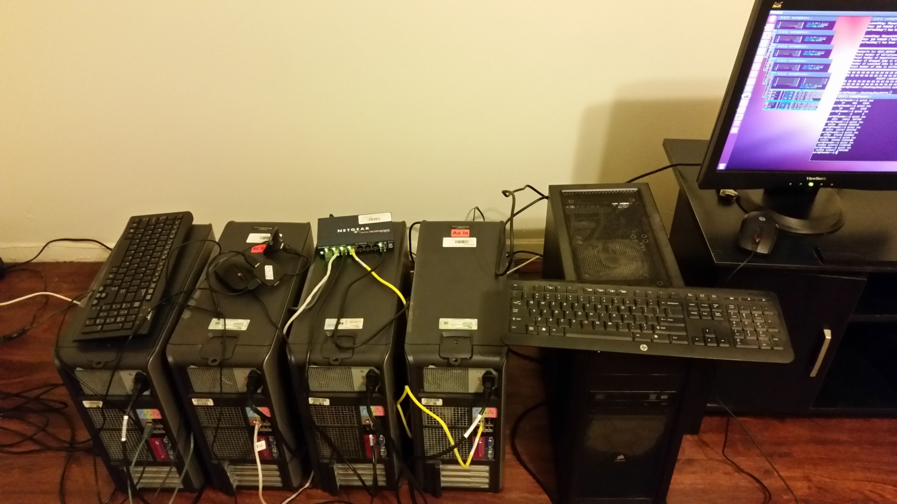
The Reference Model uses MIST from 2012
MIST = MIcro Simulation Tool
Free Software:
https://simtk.org/projects/mist
https://github.com/Jacob-Barhak/MIST
Uses High Performance Computing
MIST Runs over the Cloud !!!
MIST
Cloud

Slide 27
Reproducibility Info:
Control: MIST_RefModel_2017_01_02_MODSIM2017.zip using model version 45
Temporal Correction: MIST_RefModel_2016_11_17_MODSIM2017.zip using model version 45

Slide 28
Conclusions
The Reference Model continues to accumulate knowledge to get a wider view of global phenomena
It can now extract such data from ClinicalTrials.Gov
The import is traceable and reproducible
One small step towards machines comprehending medical knowledge
Explain the past
Project onto the future
Powered by Python
Instead of
Predictive Analytics
use
Projective Analytics

