Slide 1
Healthcare Data and Models Need Standards
18F-SIW-23
Jacob Barhak, Jacob Barhak, USA
Chris Myers, University of Utah, USA
Leandro Watanabe, University of Utah, USA
Lucian Smith, Caltech, USA
Maciek Jacek Swat, Simcyp Ltd. (Certara), UK

Slide 2
Overview: Some Examples of Medical Simulations
Epidemiology and Public Health : Disease models describe progression of disease and its outcomes
Managing Disease Spread : Infection disease models predicting contagious spread
Resource Planning : Simulations of service queues and of costs to improve efficiency or match capacity
Predicting Drug Effects: Pharmacokinetics / pharmacodynamics models to help determine dosage
The above topics are a subset of examples described by the Population Modeling Working Group in:
Population Modeling Working Group Portal on SimTK : https://simtk.org/projects/popmodwkgrpimag
Population Modeling Working Group, Population Modeling by Examples (WIP) - SpringSim 2015 , April 12 - 15, Alexandria, VA, USA
Population Modeling Working Group, Population Modeling by Examples II - SummerSim 2016 , July 24 - 27, Montreal, CA.
Population Modeling Working Group, Population Modeling by Examples III - SummerSim 2017 , July 9 - 12, Bellevue, WA, USA.

Slide 3
Medical Knowledge Map and Access Difficulties
Electronic Medical Records (EMR)
Public datasets and databases:
ClinicalTrials.Gov
Physionet
Many others ...
Publications
Medical journals in electronic form
Web sites
Printed
Knowledge held by physicians
Restricted and splintered
New and needs standardization
Fast Growing – supported by law
Multiple datasets
Assorted
Free Text – not standardized
Many require payment, made for humans
Unorganized non centralized data
Assorted and hard to access
Not Accessible – requires collection
Goal: Make Accumulated Medical Data Machine Comprehensible

Slide 4
Existing Medical Related Specifications
Data
Unified Medical Language System (UMLS)
Snomed CT
Clinical Data Interchange Standards Consortium (CDISC):
Foundational: PRM, SEND, CDASH, SDTM, SDTMIG, SDTMIG-Pgx, ADaM, QRS
Data Exchange: CTR-XML, ODM-XML, SDM-XML, Define-XML, DataSet-XML, LAB, RDF
Therapeutic Areas – 27 areas including Alzheimer's, Diabetes, Cardiovascular, Influenza, Cancers
CDISC Share
Semantics
Domain information Model
Intentional Classification of Diseases (ICD)
HL7 Fast Healthcare Interoperability Resources Specification (FHIR®)
The Unified Code for Units of Measure - (UCUM)
Models
Systems Biology Markup Language (SBML)
Drug Disease Model Resources (DDMoRe)
Pharmacometrics Markup Language – PharmML
Model Description Language (MDL)
So many specifications!
However,
- So much data is still not interchangeable
- Medical models are not reproducible
More work is needed!

Slide 5
Current Efforts of Authors
Effort A: Build Models from CinicalTrials.Gov data
New work in progress
J. Barhak, The Reference Model Models ClinicalTrials.Gov. SummerSim 2017 July 9-12, Bellevue, WA. Paper: https://doi.org/10.22360/SummerSim
Effort B: Exchange Disease Models
L. Smith, M. J. Swat, J.Barhak . Sharing Formats for Disease Models. SummerSim 2016 24-27 July, Montreal, CA. Paper: https://doi.org/10.22360/SummerSim.2016.SCSC.010
L. Watanabe, J. Barhak, C. Myers. Towards Reproducible Disease Models using the Systems Biology Markup Language. Simulation, accepted for publication
Supporting code for both located in: https://github.com/Jacob-Barhak/

Slide 6
Effort A: About ClinicalTrials.Gov
Now many clinical trials are required to Register in this data base by law:
PUBLIC LAW 110–85—SEPT. 27, 2007 - TITLE VIII—CLINICAL TRIAL DATABASES . Section 801 of the Food and Drug Administration Amendments Act of 2007. Online: https://www.gpo.gov/fdsys/pkg/PLAW-110publ85/pdf/PLAW-110publ85.pdf#page=82
Fast growing database
On 20 Apr 2018:
271,510 Trials downloaded
30,763 Trials with Results
Containing 21,094 Different Units
Requires
Standardization

Slide 7
Effort A: From ClinicalTrails.Gov to a Computational Model
ClinicalTrials.Gov
Import Instruction DSL Files
Systematic Review & Selection of Trials
Systematic Review
- Human Selection
Import Populations
- Synthetic Population Generation
Import Outcomes
- Model Validation
XML File Archive
Clinical Trial Import Module
Output CSV Files
MIcro Simulation Tool (MIST)
Template CSV Files
The Reference Model
Outcome Query
Baseline Population

Slide 8
Effort A: Issues for Converting Medical Data to a Model
Systematic review
Organizing results in tabular human readable format
Extracting meaningful numbers from convoluted free text
Population generation
Code generation from data
Name matching
Unit conversion – context sensitive
Time extraction from free text
Outcome conversion
Scaling numbers to similar reference
Cohort matching
Calculation of missing outcomes for full trial
The human natural language used in
ClinicalTrials.Gov makes the data
harder for machines to understand
and process!

Slide 9
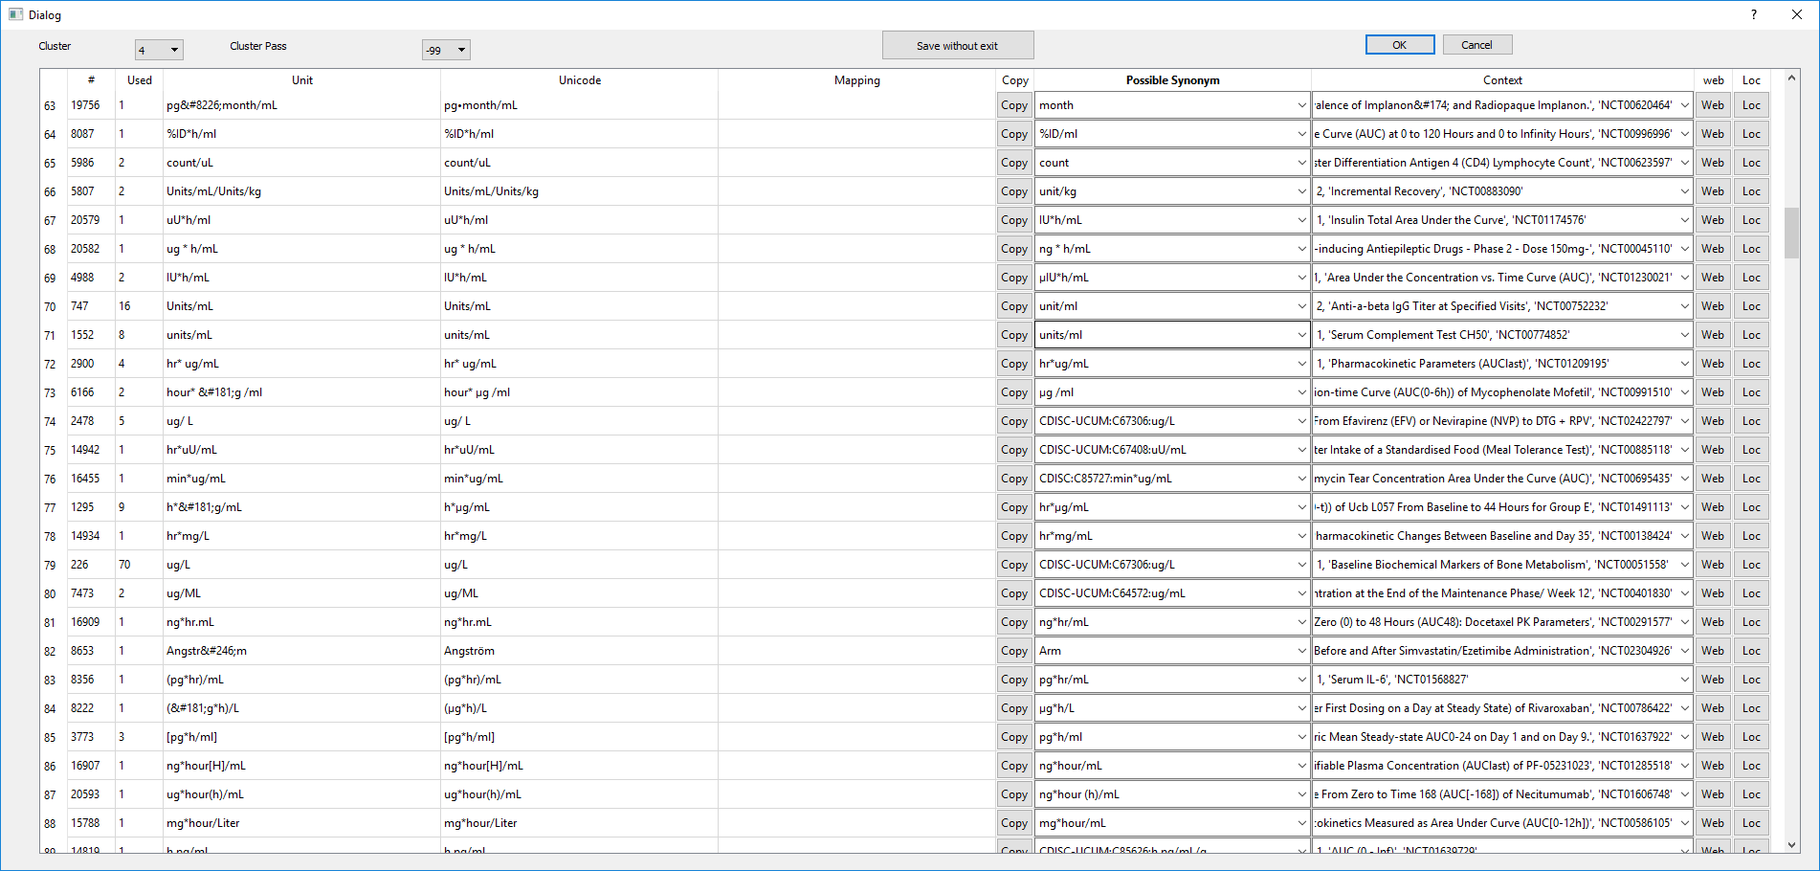
Effort A: A Tool to Help Organize Units Towards Standardization
Live Demo

Slide 10
Effort B: Disease Model Example Implemented by Multiple Tools
A simple abstract disease model:
Numbers represent the
probability to step from
state to state each year
Multiple implementation are available through GitHub:
MIST : https://github.com/Jacob-Barhak/SharingDiseaseModels/blob/master/Example3.zip
Tellurium : https://github.com/Jacob-Barhak/SharingDiseaseModels/blob/master/Example3.py
Rule Bender : https://github.com/Jacob-Barhak/SharingDiseaseModels/blob/master/Example3.bngl
iBioSim : https://github.com/Jacob-Barhak/DiseaseModelsSBML/blob/master/iBioSim/Disease.omex
PharmML : https://github.com/Jacob-Barhak/SharingDiseaseModels/blob/master/categorical_MARKOV3.xml
SBML : https://github.com/Jacob-Barhak/SharingDiseaseModels/blob/master/Example3.xml
SBML Arrays : https://github.com/Jacob-Barhak/DiseaseModelsSBML/blob/master/iBioSim/SBML/Example3.xml
0.01
0.2 Male / 0.1 Female
Healthy
Sick
0.3
Dead
0.1

Slide 11
Effort B: The Systems Biology Markup Language (SBML)
SBML is a machine-readable format for representing models
Web site: http://sbml.org
XML based exchange format
Releases specifications
Has editors that manage extension proposals
Allows extensions in the form of packages such as: SBML Arrays
As of 2017-05-07 it has about 290 reported tools using SBML
Supported by 16 mailing lists with active discussions
As of 2018-07-3 there were 8460 SBML models in http://biomodels.net
SBML is a widely accepted specification - not yet a standard!
For now, it is may be the best mechanism to support model reproducibility

Slide 12
Future Work
In the Foreseeable Future:
Standardizing units from ClinicalTrials.Gov into into CDISC and UMLS
Expanding SBML support so more tools can describe disease models
Reaching out to modeling community to adopt SBML
Aggregate models and accumulate knowledge
Model repository using SBML or other agreed upon standard
The Reference Model is an ensemble model that can accumulate knowledge
In the Much Farther Future:
Towards computer comprehension of clinical data for applications such as:
Personal computerized medical adviser
Preventative medical predictor

Slide 13
Acknowledgments
Thanks to the population modeling working group for mapping of models
Thanks to the SBML community and DDMoRe consortium
Thanks to CDISC consortium help
Thanks to Michael Marron-Stearns for introduction to Snomed CT
Thanks to NIH persons who helped and specifically to:
Nick Ide from NLM ClinicalTrials.Gov team on advice to process the site
Erin E Muhlbradt from NCI for advice on CDISC unit data
Parts of this presentation recites work that previously supported some authors:
Utah Authors: National Science Foundation under Grants CCF-1218095 and CCF-1748200
Utah Authors: Google Summer of Code 2014
Swat, DDMoRe project which produced PharmML was funded by Innovative Medicines Initiative, EU public-private partnership
Ut

