Slide 1


The Reference Model uses Object Oriented Population Generation
Jacob Barhak
Austin, Texas
http://sites.google.com/site/jacobbarhak/
SummerSim 2015
Chicago, IL
27 July 2015

Slide 2
The Reference Model for Disease Progression
Built from literature references and hence the name: The Reference Model
Compares equations to populations from multiple studies /clinical trials
A League / Consumers Report for disease models
Current version deals with diabetic populations
A
B
Process CHD
Pop 3
D
C
No CHD
MI
Survive MI
CHD Death
Pop 2
Pop 1
E
F
Process Stroke
Death
No Stroke
H
G
Stroke
Survive Stroke
Stroke Death
Eq EH | E | E | E | E | …
Eq AD | A | B | C | D | …
Pop 1 | 4 | 6 | 2 | 1 | …
Pop 2 | 2 | 4 | 6 | 1 | …
Pop 3 | 2 | 3 | 9 | 2 | …
… | … | … | … | … | …
Process Competing Mortality
Alive
Other Death
Fitness Matrix

Slide 3
Population Generation Goal
Generate synthetic population to mimic statistics
Heterogeneity = generate individuals
Multiple characteristics per individual
Allow correlations
Allow restrictions
Correlated
IndividualID | Male | Age | BP | …
0 | 0 | 50 | 140 | …
1 | 1 | 45 | 135 | …
2 | 0 | 22 | 120 | …
3 | 1 | 85 | 145 | …
4 | 1 | 14 | 125 | …
IndividualID | Male | Age | BP | …
0 | 0 | 50 | 140 | …
1 | 1 | 45 | 135 | …
2 | 0 | 22 | 120 | …
3 | 1 | 85 | 145 | …
4 | 1 | 14 | 125 | …
Generation Code / Equations
Restrict Age

Slide 4
Clinical Trial Populations
The First Table in a Clinical Trial publication typically contains Population Statistics
Summary Data Only: Mean (SD) / Median (IQR)
Limited information about distribution
Inclusion/exclusion criteria skew the distribution
Example: Excerpt from Table 1 in UKPDS 33
 | Control | Intervention
Age | 53.3 (8.6) | 53.2 (8.6)
% Male | 61.9% | 59.3%
Smoke | 31% | 30%
Systolic Blood Pressure (mmHg) | 135(20) | 135(20)
Total Cholesterol (mmol/L) | 5.4 (1.02) | 5.4(1.12)

Slide 5
Population Generation Using INSPYRED MIST
INSPYRED MIST can regenerate mock populations from Table 1 in clinical trials
Only publicly available summary data is used
No need to have access to restricted data
INSPYRED
Bio Inspired Computation
Table 1
by Aaron Garrett
MIST
MIcro Simulation Tool
Generate
by Jacob Barhak

Slide 6
Population Generation Methodology
Generation Expressions:
Define how to generate a single individual
Test if individual fits the inclusion/exclusion criteria
Define ties and correlations between characteristics
Objectives:
Define aggregate targets for the entire population
Reduce random generation error
Handle skewed distributions to fit target
INSPYRED =
Bio Inspired Computation
by Aaron Garrett
MIST = MIcro Simulation Tool
by Jacob Barhak
Expression Compiler
Evolutionary Computation
Monte Carlo
Selection
Result
Result Population
Converges to
Objectives

Slide 7
INSPYRED Evolutionary Computation
Candidates
Generator
Evaluator
3.1
7.5
4.2
5.2
Selector
+
=
→
Generations / Epocs
Variators
Repeat
Parents
Crossover
Mutation
Terminator
Best Solution

Slide 8
Object Oriented Population Generation Motivation
Populations defined in reusable blocks of code
These code blocks can be
Inherited
Combined
Used to override
Why Object Oriented?
US Diabetics
US
Diabetics

Slide 9
Object Oriented Population Generation Implementation
Code Reusability
Linking rather than copying rules/objectives
Missing Information
Default Values
Derived equations
Hypothesis handling
Variations of unknowns
Towards Big Data
Future Preparation
Handling Individual data
Default Diabetic
ACR changes with Albuminuria
UKPDS Full
KP Full
NDR Full
CARDS Full
UKPDS Conventional
UKPDS Intensive

Slide 10
Benefits
Code Reusability
Future error chances reduced
Efficiency:
Code was reduced from 47k to 16k elements
Future modeling capabilities
Allows on the fly population combinations for easy testing of hypothesis
Data inheritance may be possible in the farther future

Slide 11
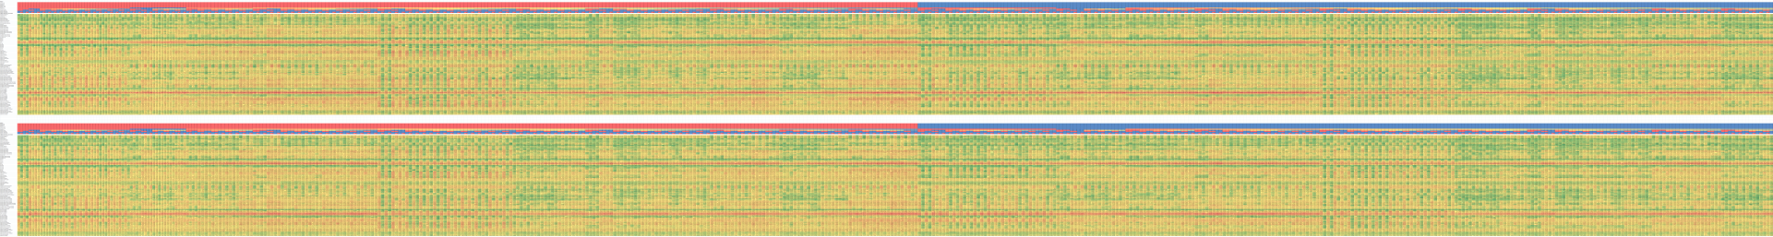
Results
Validating results :
With Object Oriented population generation (Top)
Without Object Oriented population generation (Bottom)
Rows represent 47x2 cohorts
Columns represent 544 model variations
The big picture did not change
Looking at details in small variations can be noticed
Version 28 - MIST_RefModel_2015_04_17_MATRIX_TraceBack.zip MIST 0.93.0.0
Version 27 - MIST_RefModel_2014_10_21_MATRIX_TraceBack.zip MIST 0.92.0.0

Slide 12
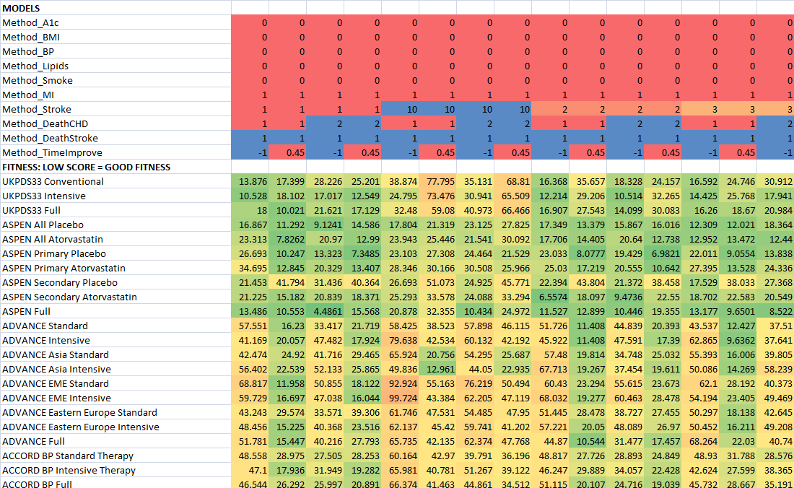
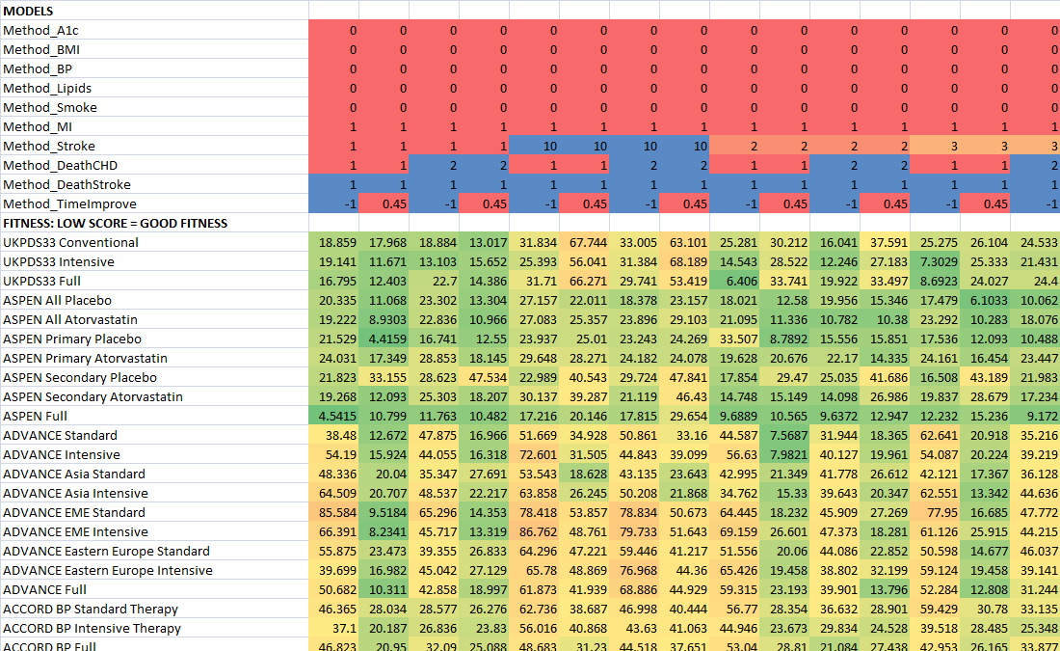
Results Zoomed In
NEW
OLD
Version 28 - MIST_RefModel_2015_04_17_MATRIX_TraceBack.zip MIST 0.93.0.0
Version 27 - MIST_RefModel_2014_10_21_MATRIX_TraceBack.zip MIST 0.92.0.0

Slide 13
Acknowledgments
Deanna J.M. Isaman - who is the spirit behind the great ideas. She taught me my first steps in disease modeling
Morton Brown & William H. Herman – for guidance, critical feedback, and growth environment
Aaron Garrett – for his responsiveness and help with starting with Inspyred – he saved me at least a months work if not two by sending me solution code within one day.
Continuum Analytics and specifically:
Benjamin Zeitler for creating the cloud AMI
Ilan Schnell for his work on Anaconda.
All those who developed free software used and supported it: including Python, Anaconda, Spyder, numpy, SciPy, nose, winpdb, Star Cluster, Ubuntu, Sun Grid Engine
The legacy IEST modeling framework was supported by the Biostatistics and Economic Modeling Core of the MDRTC (P60DK020572) and by the Methods and Measurement Core of the MCDTR (P30DK092926), both funded by the National Institute of Diabetes and Digestive and Kidney Diseases. The modeling framework was initially defined as GPL and was funded by Chronic Disease Modeling for Clinical Research Innovations grant (R21DK075077) from the same institute. MIST is based on IEST.
The Reference Model and MIST were developed independently without financial support

Slide 14
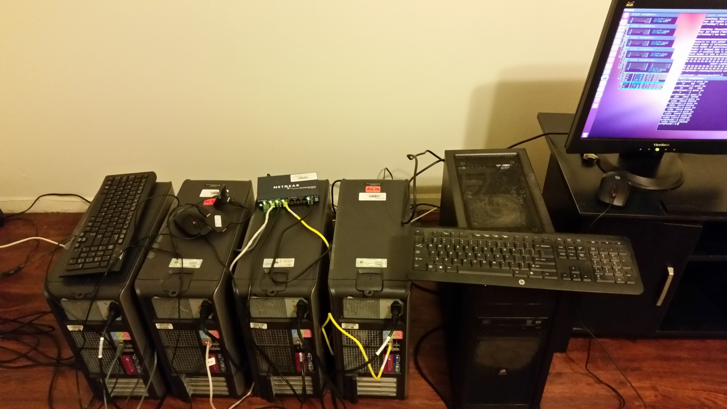
Towards Big Data
MIST Supports:
Local Cluster
SGE
Possibly low cost
Requires expertise
MIST Runs Over the Cloud!
StarCluster
Amazon EC2 – Elastic Compute Cloud
Anaconda AMI - Amazon Machine Image
MIST
Cloud

Slide 15
Advantages of Object Oriented Population Generation
Code Reusability
Linking rather than copying rules/objectives
Population building blocks enable Modular Modeling
Using overrides
Missing Information
Default Values
Derived equations
Hypothesis handling
Adding variations for unknowns
Towards Big Data
Handling Individual data
Data inheritance
UK
Non Diabetics
US Diabetics
US Non Diabetics
UK Diabetics
UK Non Diabetics
4 combinations
US
Diabetics

Slide 16
Questions?
Jacob Barhak
http://sites.google.com/site/jacobbarhak/

Slide 17
MIST Runs Over the Cloud!
Anaconda drives MIST to run over the Amazon cloud!
Star Cluster creates a Sun Grid Engine (SGE) cluster on the Amazon Elastic Compute Cloud
The Anaconda Amazon Machine Image (AMI) is used for the cluster master / nodes
Running the simulation on a cluster a Mock Mini simulation is executed to:
Test equations
Test population generation
Test execution environment
MIST
Cloud

Slide 18
The Reference Model Fitness Matrix – Selected Models
No Correlation - Independent
Fully Correlated
Without
With BioMarker Correction
Without
With BioMarker Correction
MODELS
Method_A1c | 0 | 0 | 0 | 0 | 0 | 0 | 0 | 0 | 1 | 1 | 1 | 1 | 1 | 1 | 1 | 1 | 1 | 1 | 1 | 1 | 1 | 1 | 1 | 1 | 1 | 1 |  | 0 | 0 | 0 | 0 | 0 | 0 | 0 | 0 | 1 | 1 | 1 | 1 | 1 | 1 | 1 | 1 | 1 | 1 | 1 | 1 | 1 | 1 | 1 | 1 | 1 | 1
Method_BMI | 0 | 0 | 0 | 0 | 0 | 0 | 0 | 0 | 1 | 1 | 1 | 1 | 1 | 1 | 1 | 1 | 1 | 1 | 1 | 1 | 1 | 1 | 1 | 1 | 1 | 1 |  | 0 | 0 | 0 | 0 | 0 | 0 | 0 | 0 | 1 | 1 | 1 | 1 | 1 | 1 | 1 | 1 | 1 | 1 | 1 | 1 | 1 | 1 | 1 | 1 | 1 | 1
Method_BP | 0 | 0 | 0 | 0 | 0 | 0 | 0 | 0 | 1 | 1 | 1 | 1 | 1 | 1 | 1 | 1 | 1 | 1 | 1 | 1 | 1 | 1 | 1 | 1 | 1 | 1 |  | 0 | 0 | 0 | 0 | 0 | 0 | 0 | 0 | 1 | 1 | 1 | 1 | 1 | 1 | 1 | 1 | 1 | 1 | 1 | 1 | 1 | 1 | 1 | 1 | 1 | 1
Method_Lipids | 0 | 0 | 0 | 0 | 0 | 0 | 0 | 0 | 1 | 1 | 1 | 1 | 1 | 1 | 1 | 1 | 1 | 1 | 1 | 1 | 1 | 1 | 1 | 1 | 1 | 1 |  | 0 | 0 | 0 | 0 | 0 | 0 | 0 | 0 | 1 | 1 | 1 | 1 | 1 | 1 | 1 | 1 | 1 | 1 | 1 | 1 | 1 | 1 | 1 | 1 | 1 | 1
Method_Smoke | 0 | 0 | 0 | 0 | 0 | 0 | 0 | 0 | 1 | 1 | 1 | 1 | 1 | 1 | 1 | 1 | 1 | 1 | 1 | 1 | 1 | 1 | 1 | 1 | 1 | 1 |  | 0 | 0 | 0 | 0 | 0 | 0 | 0 | 0 | 1 | 1 | 1 | 1 | 1 | 1 | 1 | 1 | 1 | 1 | 1 | 1 | 1 | 1 | 1 | 1 | 1 | 1
Method_MI | 4 | 4 | 4 | 4 | 4 | 4 | 4 | 8 | 1 | 10 | 2 | 3 | 4 | 4 | 4 | 4 | 4 | 4 | 4 | 4 | 4 | 5 | 6 | 6 | 7 | 9 |  | 4 | 4 | 4 | 4 | 4 | 4 | 4 | 8 | 1 | 10 | 2 | 3 | 4 | 4 | 4 | 4 | 4 | 4 | 4 | 4 | 4 | 5 | 6 | 6 | 7 | 9
Method_Stroke | 1 | 1 | 4 | 4 | 7 | 8 | 9 | 1 | 1 | 1 | 1 | 1 | 1 | 1 | 10 | 2 | 2 | 3 | 4 | 5 | 6 | 1 | 1 | 2 | 1 | 1 |  | 1 | 1 | 4 | 4 | 7 | 8 | 9 | 1 | 1 | 1 | 1 | 1 | 1 | 1 | 10 | 2 | 2 | 3 | 4 | 5 | 6 | 1 | 1 | 2 | 1 | 1
Method_DeathCHD | 1 | 2 | 1 | 2 | 2 | 1 | 1 | 1 | 1 | 2 | 2 | 1 | 1 | 2 | 1 | 1 | 2 | 2 | 1 | 1 | 2 | 2 | 1 | 2 | 2 | 2 |  | 1 | 2 | 1 | 2 | 2 | 1 | 1 | 1 | 1 | 2 | 2 | 1 | 1 | 2 | 1 | 1 | 2 | 2 | 1 | 1 | 2 | 2 | 1 | 2 | 2 | 2
Method_DeathStroke | 1 | 1 | 1 | 1 | 1 | 1 | 1 | 1 | 1 | 1 | 1 | 1 | 1 | 1 | 1 | 1 | 1 | 1 | 1 | 1 | 1 | 1 | 1 | 1 | 1 | 1 |  | 1 | 1 | 1 | 1 | 1 | 1 | 1 | 1 | 1 | 1 | 1 | 1 | 1 | 1 | 1 | 1 | 1 | 1 | 1 | 1 | 1 | 1 | 1 | 1 | 1 | 1
Method_TimeImprove | 0.45 | 0.45 | 0.45 | 0.45 | 0.45 | 0.45 | 0.45 | 0.45 | 0.45 | -1 | 0.45 | 0.45 | 0.45 | 0.45 | 0.45 | 0.45 | 0.45 | 0.45 | 0.45 | 0.45 | 0.45 | 0.45 | 0.45 | -1 | 0.45 | -1 |  | 0.45 | 0.45 | 0.45 | 0.45 | 0.45 | 0.45 | 0.45 | 0.45 | 0.45 | -1 | 0.45 | 0.45 | 0.45 | 0.45 | 0.45 | 0.45 | 0.45 | 0.45 | 0.45 | 0.45 | 0.45 | 0.45 | 0.45 | -1 | 0.45 | -1
FITNESS: LOW SCORE = GOOD FITNESS
UKPDS33 Conventional | 8.709 | 11.552 | 19.512 | 22.592 | 36.034 | 58.595 | 45.394 | 29.86 | 14.933 | 23.171 | 35.828 | 17.239 | 11.181 | 13.446 | 69.142 | 30.162 | 31.542 | 24.874 | 22.369 | 48.073 | 39.68 | 16.107 | 10.97 | 42.592 | 42.617 | 16.032 |  | 31.711 | 17.713 | 38.402 | 30.31 | 44.604 | 77.157 | 61.35 | 49.787 | 38.279 | 14.453 | 48.377 | 54.692 | 32.284 | 18.606 | 84.552 | 46.742 | 41.819 | 38.772 | 32.916 | 67.319 | 59.013 | 29.361 | 27.968 | 34.257 | 67.302 | 19.067
UKPDS33 Intensive | 13.985 | 17.059 | 24.066 | 22.307 | 33.458 | 53.53 | 41.977 | 38.708 | 11.801 | 19.673 | 38.449 | 29.589 | 13.722 | 14.266 | 63.46 | 29.793 | 30.876 | 22.521 | 20.53 | 43.537 | 38.526 | 25.38 | 16.473 | 35.6 | 57.108 | 16.73 |  | 35.434 | 29.999 | 40.111 | 35.191 | 52.447 | 77.77 | 62.743 | 59.411 | 48.736 | 16.019 | 61.467 | 60.919 | 36.226 | 30.046 | 87.562 | 51.099 | 45.985 | 41.7 | 43.722 | 66.444 | 59.855 | 41.727 | 39.683 | 23.106 | 76.038 | 27.807
UKPDS33 Full | 13.307 | 15.576 | 21.834 | 22.782 | 33.737 | 54.903 | 41.172 | 32.252 | 11.115 | 23.303 | 39.549 | 29.451 | 12.013 | 13.977 | 64.716 | 29.506 | 27.828 | 21.553 | 19.729 | 46.961 | 39.293 | 23.766 | 15.499 | 34.006 | 50.959 | 13.555 |  | 38.812 | 26.915 | 41.772 | 34.795 | 53.022 | 79.948 | 64.356 | 59.876 | 46.447 | 13.046 | 60.085 | 56.836 | 37.279 | 26.249 | 88.29 | 49.69 | 48.342 | 44.694 | 43.335 | 68.719 | 61.278 | 37.717 | 38.953 | 28.035 | 74.075 | 24.669
ASPEN All Placebo | 10.37 | 13.946 | 11.301 | 13.218 | 13.83 | 24.831 | 15.785 | 17.367 | 10.156 | 10.711 | 22.187 | 20.533 | 10.518 | 13.541 | 24.3 | 12.406 | 14.915 | 14.635 | 11.635 | 18.693 | 18.12 | 11.523 | 12.919 | 6.6134 | 25.412 | 16.345 |  | 6.9486 | 11.46 | 9.7912 | 11.218 | 15.638 | 27.156 | 18.8 | 26.024 | 18.942 | 17.015 | 28.079 | 35.165 | 10.235 | 10.229 | 33.484 | 12.417 | 13.95 | 15.021 | 12.185 | 24.307 | 25.88 | 19.62 | 20.524 | 12.109 | 36.898 | 31.227
ASPEN All Atorvastatin | 9.911 | 11.324 | 11.206 | 12.288 | 14.955 | 20.047 | 14.042 | 22.545 | 10.397 | 11.864 | 24.09 | 23.572 | 10.477 | 14.129 | 24.257 | 11.826 | 13.216 | 13.253 | 13.098 | 15.923 | 18.436 | 17.178 | 15.375 | 9.866 | 29.271 | 19.733 |  | 11.814 | 12.937 | 13.166 | 14.106 | 19.858 | 30.467 | 22.204 | 31.861 | 18.185 | 20.173 | 32.761 | 37.68 | 9.7037 | 12.248 | 30.655 | 13.482 | 14.445 | 15.797 | 10.983 | 20.487 | 24.295 | 21.099 | 27.625 | 14.264 | 32.918 | 30.473
ASPEN Primary Placebo | 10.111 | 9.3667 | 9.8931 | 10.588 | 11.583 | 19.07 | 12.869 | 23.358 | 10.585 | 18.221 | 27.669 | 22.854 | 9.9821 | 9.9598 | 22.942 | 9.5978 | 12.11 | 9.8709 | 8.2846 | 18.404 | 14.79 | 17.397 | 16.224 | 11.025 | 35.198 | 25.651 |  | 14.069 | 14.187 | 14.183 | 14.297 | 16.831 | 28.74 | 21.887 | 32.498 | 28.758 | 27.008 | 35.777 | 38.745 | 14.879 | 13.526 | 34.873 | 18.168 | 17.538 | 13.778 | 14.696 | 23.247 | 23.177 | 25.749 | 24.623 | 13.702 | 40.578 | 36.921
ASPEN Primary Atorvastatin | 12.828 | 13.89 | 10.838 | 11.125 | 15.467 | 20.288 | 15.624 | 27.134 | 11.304 | 17.584 | 27.328 | 24.274 | 10.837 | 13.232 | 19.901 | 11.345 | 13.899 | 13.273 | 12.69 | 16.508 | 15.589 | 18.592 | 16.757 | 12.664 | 34.085 | 19.671 |  | 17.931 | 15.923 | 15.55 | 15.67 | 18.909 | 32.081 | 23.424 | 34.975 | 23.007 | 23.298 | 34.912 | 35.339 | 13.771 | 13.973 | 29.246 | 14.745 | 16.145 | 15.144 | 14.249 | 21.495 | 21.671 | 25.185 | 23.669 | 16.121 | 36.233 | 30.582
ASPEN Secondary Placebo | 42.624 | 45.077 | 46.115 | 46.628 | 49.429 | 51.228 | 46.136 | 15.671 | 32.024 | 31.212 | 19.137 | 22.564 | 46.377 | 47.314 | 52.569 | 44.796 | 49.391 | 51.997 | 47.918 | 50.571 | 58.83 | 26.042 | 7.6405 | 21.259 | 14.037 | 20.079 |  | 38.089 | 41.79 | 38.317 | 42.277 | 41.71 | 46.784 | 40.812 | 14.386 | 16.516 | 26.743 | 15.754 | 41.454 | 39.281 | 40.455 | 52.605 | 42.106 | 43.023 | 47.519 | 38.364 | 45.789 | 61.405 | 23.068 | 18.553 | 15.114 | 18.492 | 21.333
ASPEN Secondary Atorvastatin | 21.216 | 25.375 | 26.064 | 29.485 | 28.928 | 35.599 | 26.96 | 10.23 | 20.715 | 16.063 | 15.516 | 37.002 | 27.26 | 29.286 | 41.201 | 29.342 | 30.512 | 36.474 | 31.162 | 35.066 | 46.034 | 14.095 | 17.22 | 7.0509 | 20.388 | 12.236 |  | 17.654 | 22.412 | 19.827 | 24.865 | 26.813 | 39.468 | 29.341 | 22.539 | 10.154 | 18.735 | 21.184 | 54.785 | 21.005 | 26.632 | 40.955 | 22.498 | 25.724 | 35.716 | 25.936 | 33.612 | 52.796 | 16 | 34.928 | 12.77 | 24.149 | 22.796
ASPEN Full | 14.056 | 18.441 | 14.209 | 17.048 | 18.593 | 23.28 | 16.836 | 9.2007 | 11.136 | 7.112 | 16.74 | 21.594 | 15.509 | 17.846 | 24.776 | 15.623 | 18.269 | 16.709 | 14.76 | 22.45 | 23.413 | 10.139 | 9.1958 | 9.8755 | 23.905 | 11.77 |  | 8.0719 | 11.735 | 9.2729 | 12.286 | 17.208 | 26.849 | 18.757 | 18.616 | 10.954 | 15.374 | 25.017 | 32.716 | 8.6289 | 13.451 | 31.14 | 13.256 | 15.647 | 16.027 | 10.159 | 24.578 | 24.793 | 14.524 | 19.506 | 9.8395 | 29.119 | 25.195
ADVANCE Standard | 15.338 | 19.604 | 12.667 | 16.856 | 17.296 | 23.027 | 12.08 | 17.181 | 17.713 | 16.711 | 29.798 | 26.152 | 18.367 | 21.11 | 28.38 | 13.075 | 17.642 | 18.635 | 13.506 | 19.958 | 22.793 | 20.107 | 16.226 | 11.368 | 34.522 | 31.791 |  | 9.015 | 17.635 | 11.726 | 17.832 | 18.012 | 24.627 | 11.953 | 16.28 | 11.764 | 20.267 | 31.807 | 33.549 | 14.735 | 20.229 | 28.07 | 12.076 | 19.35 | 16.565 | 12.38 | 18.228 | 26.913 | 18.192 | 16.558 | 12.243 | 32.066 | 34.145
ADVANCE Intensive | 11.921 | 16.031 | 9.347 | 14.871 | 14.169 | 24.718 | 12.441 | 19.931 | 13.648 | 16.853 | 30.214 | 29.576 | 16.49 | 21.467 | 26.014 | 12.516 | 14.481 | 14.863 | 11.182 | 18.805 | 19.963 | 19.152 | 15.326 | 10.842 | 36.936 | 35.321 |  | 7.4382 | 12.251 | 10.265 | 13.281 | 16.579 | 26.802 | 13.101 | 19.772 | 8.1237 | 21.674 | 30.028 | 31.467 | 11.643 | 16.437 | 26.703 | 11.394 | 14.675 | 13.984 | 11.368 | 17.747 | 25.537 | 17.116 | 16.887 | 11.162 | 35.572 | 42.367
ADVANCE Asia Standard | 24.377 | 30.772 | 13.913 | 17.72 | 25.18 | 12.97 | 18.479 | 23.502 | 24.782 | 15.013 | 28.453 | 31.915 | 28.826 | 33.089 | 14.254 | 24.223 | 26.355 | 23.159 | 18.243 | 17.811 | 18.155 | 28.489 | 25.101 | 19.364 | 29.327 | 20.361 |  | 18.057 | 24.464 | 14.7 | 19.997 | 23.234 | 11.707 | 15.389 | 19.038 | 22.057 | 11.855 | 26.115 | 36.298 | 24.065 | 26.009 | 11.44 | 24.425 | 27.188 | 20.628 | 15.803 | 14.099 | 20.357 | 24.59 | 22.555 | 19.779 | 26.999 | 22.786
ADVANCE Asia Intensive | 19.577 | 24.111 | 11.442 | 14.082 | 19.643 | 9.8749 | 11.688 | 19.675 | 22.381 | 13.017 | 23.885 | 30.071 | 21.898 | 26.482 | 10.341 | 17.395 | 21.972 | 15.758 | 13.883 | 10.873 | 12.344 | 24.608 | 22.072 | 16.675 | 24.806 | 24.189 |  | 12.738 | 19.361 | 10.89 | 14.392 | 18.219 | 9.7794 | 9.8068 | 14.929 | 18.842 | 12.547 | 22.77 | 37.067 | 17.601 | 19.886 | 9.9829 | 15.929 | 20.665 | 15.664 | 9.3387 | 10.605 | 15.083 | 20.595 | 22.204 | 21.063 | 23.411 | 25.757
ADVANCE EME Standard | 12.57 | 17.039 | 18.596 | 18.237 | 24.151 | 41.666 | 23.635 | 26.287 | 11.12 | 30.439 | 33.949 | 31.294 | 20.275 | 17.126 | 41.225 | 18.892 | 21.078 | 21.542 | 17.597 | 30.256 | 29.628 | 16.633 | 15.022 | 23.134 | 38.821 | 53.565 |  | 11.699 | 16.453 | 15.489 | 20.664 | 22.364 | 43.749 | 21.924 | 24.568 | 7.9355 | 34.922 | 29.71 | 34.876 | 15.497 | 20.736 | 37.58 | 19.702 | 20.749 | 22.733 | 18.325 | 30.52 | 34.77 | 15.671 | 18.558 | 20.589 | 38.246 | 50.844
ADVANCE EME Intensive | 11.123 | 12.254 | 17.846 | 18.228 | 22.03 | 40.598 | 26.535 | 33.729 | 12.314 | 36.854 | 32.382 | 25.43 | 15.566 | 17.215 | 35.985 | 18.145 | 17.162 | 16.838 | 16.783 | 29.947 | 27.647 | 18.008 | 16.186 | 20.934 | 45.114 | 52.521 |  | 10.621 | 12.796 | 14.222 | 16.633 | 19.945 | 42.285 | 22.193 | 36.403 | 10.339 | 37.22 | 34.575 | 34.42 | 14.027 | 16.208 | 37.963 | 14.743 | 17.512 | 17.809 | 14.925 | 28.729 | 28.812 | 18.566 | 17.853 | 21.247 | 47.372 | 54.661
ADVANCE Eastern Europe Standard | 25.373 | 29.481 | 22.018 | 29.847 | 29.529 | 34.936 | 22.758 | 25.023 | 24.294 | 19.752 | 36.838 | 27.727 | 31.594 | 38.952 | 33.979 | 25.154 | 28.785 | 32.59 | 27.622 | 29.313 | 32.857 | 28.222 | 20.277 | 16.745 | 38.189 | 39.872 |  | 21.187 | 26.763 | 22.21 | 29.612 | 30.266 | 32.007 | 24.895 | 23.943 | 15.617 | 26.923 | 35.894 | 32.236 | 27.872 | 34.595 | 37.124 | 24.856 | 30.889 | 30.184 | 26.465 | 31.498 | 35.049 | 27.289 | 18.739 | 17.736 | 42.38 | 44.359
ADVANCE Eastern Europe Intensive | 20.736 | 29.926 | 21.442 | 24.79 | 27.447 | 34.625 | 22.361 | 24.476 | 23.876 | 21.622 | 35.067 | 24.366 | 28.401 | 33.071 | 36.055 | 23.33 | 26.937 | 27.714 | 24.748 | 28.722 | 30.131 | 25.651 | 16.921 | 12.982 | 41.559 | 38.706 |  | 18.209 | 26.823 | 19.578 | 25.954 | 26.493 | 37.027 | 27.696 | 23.077 | 11.782 | 30.337 | 37.798 | 28.744 | 25.21 | 27.895 | 36.039 | 22.415 | 27.963 | 27.373 | 23.946 | 28.682 | 33.938 | 24.81 | 17.22 | 13.991 | 37.433 | 46.454
ADVANCE Full | 14.379 | 18.419 | 11.36 | 17.128 | 16.802 | 33.206 | 17.747 | 29.805 | 13.296 | 26.714 | 38.984 | 37.961 | 18.573 | 22.406 | 33.813 | 12.432 | 17.366 | 16.253 | 11.059 | 23.439 | 25.688 | 26.888 | 22.346 | 19.011 | 43.075 | 43.138 |  | 5.7747 | 15.338 | 12.515 | 16.345 | 21.835 | 37.445 | 20.369 | 36.496 | 19.907 | 41.796 | 47.23 | 52.193 | 7.8963 | 14.102 | 41.639 | 10.552 | 16.344 | 18.116 | 9.7147 | 28.771 | 38.154 | 29.551 | 31.729 | 28.422 | 51.072 | 56.501
ACCORD BP Standard Therapy | 30.663 | 28.982 | 30.435 | 31.619 | 30.098 | 38.003 | 30.999 | 17.425 | 25.84 | 23.117 | 14.129 | 27.944 | 31.689 | 31.776 | 42.391 | 33.528 | 31.877 | 32.293 | 32.687 | 35.664 | 42.476 | 17.394 | 17.721 | 27.012 | 16.558 | 32.462 |  | 29.006 | 26.164 | 29.24 | 26.084 | 29.244 | 39.392 | 31.641 | 20.408 | 22.122 | 27.855 | 19.779 | 34.773 | 29.438 | 28.316 | 45.944 | 30.753 | 28.296 | 31.162 | 28.851 | 39.743 | 49.682 | 16.814 | 23.689 | 30.611 | 25.656 | 40.463
ACCORD BP Intensive Therapy | 30.062 | 28.762 | 29.627 | 27.54 | 29.163 | 38.778 | 33.534 | 13.551 | 25.647 | 18.835 | 11.31 | 15.669 | 34.415 | 34.508 | 41.324 | 35.137 | 34.827 | 34.88 | 34.828 | 38.179 | 42.504 | 18.465 | 12.033 | 22.575 | 11.882 | 22.562 |  | 25.2 | 24.221 | 25.27 | 26.006 | 29.111 | 39.155 | 31.273 | 17.999 | 19.127 | 28.243 | 15.337 | 25.645 | 31.108 | 32.114 | 46.146 | 30.622 | 31.664 | 36.764 | 32.006 | 40.701 | 49.62 | 14.707 | 13.969 | 28.997 | 18.409 | 36.505
ACCORD BP Full | 28.95 | 26.773 | 30.17 | 28.93 | 28.263 | 36.773 | 30.985 | 15.792 | 22.478 | 20.997 | 11.652 | 18.678 | 35.52 | 34.63 | 41.8 | 33.438 | 32.808 | 34.77 | 32.996 | 37.926 | 43.133 | 18.181 | 12.71 | 23.945 | 13.632 | 23.808 |  | 28.41 | 25.373 | 27.94 | 23.789 | 28.36 | 41.298 | 33.682 | 19.375 | 18.438 | 28.741 | 17.311 | 36.09 | 30.512 | 29.784 | 47.539 | 34.15 | 30.102 | 37.515 | 30.753 | 40.491 | 46.788 | 14.105 | 18.516 | 29.996 | 20.3 | 39.156
KP 20-34 | 5.4312 | 4.833 | 6.52 | 7.1356 | 6.5656 | 7.9726 | 8.4202 | 9.325 | 6.4572 | 11.853 | 6.6165 | 10.667 | 5.5756 | 4.4379 | 7.8323 | 6.9005 | 6.8978 | 8.0909 | 7.7727 | 6.6562 | 7.1134 | 7.9914 | 12.032 | 13.936 | 8.7433 | 10.768 |  | 5.6147 | 6.551 | 7.1751 | 7.9439 | 7.9108 | 7.7372 | 8.9669 | 8.9391 | 9.2878 | 13.304 | 8.4385 | 13.488 | 5.4243 | 5.9487 | 8.265 | 7.6565 | 8.0745 | 9.6663 | 8.0689 | 7.7037 | 8.5735 | 8.2964 | 13.161 | 17.189 | 9.741 | 11.947
KP 35-50 | 8.5425 | 7.6613 | 11.909 | 12.05 | 13.462 | 13.001 | 14.2 | 19.035 | 6.8454 | 27.468 | 17.878 | 17.977 | 8.8037 | 8.186 | 13.507 | 12.065 | 10.782 | 12.479 | 10.436 | 12.653 | 12.109 | 17.526 | 19.787 | 24.535 | 19.762 | 26.877 |  | 12.613 | 12.917 | 17.123 | 18.42 | 22.871 | 25.699 | 22.835 | 27.419 | 18.393 | 38.436 | 28.666 | 24.505 | 12.619 | 13.294 | 26.768 | 21.508 | 19.525 | 24.239 | 18.134 | 19.626 | 19.814 | 26.527 | 24.079 | 33.145 | 30.427 | 33.922
KP 50-65 | 15.697 | 16.876 | 23.155 | 26.586 | 26.476 | 33.944 | 29.342 | 29.849 | 15.806 | 36.571 | 36.718 | 38.23 | 17.002 | 18.689 | 40.578 | 24.614 | 25.965 | 26.223 | 23.783 | 30.409 | 33.221 | 28.616 | 28.55 | 39.556 | 38.667 | 49.88 |  | 23.256 | 25.975 | 29.629 | 31.427 | 37.932 | 49.167 | 38.794 | 41.097 | 32.265 | 51.154 | 48.77 | 54.835 | 22.297 | 24.383 | 51.499 | 33.446 | 36.448 | 38.721 | 29.422 | 45.167 | 47.773 | 37.241 | 36.24 | 51.528 | 52.343 | 66.259
KP 65-75 | 33.585 | 38.254 | 48.432 | 50.909 | 47.506 | 59.545 | 45.892 | 52.332 | 38.739 | 68.674 | 68.959 | 73.159 | 34.497 | 38.37 | 66.491 | 42.092 | 43.323 | 44.462 | 50.598 | 56.249 | 65.835 | 51.609 | 53.691 | 68.294 | 71.622 | 94.997 |  | 34.493 | 39.502 | 50.749 | 52.894 | 49.827 | 66.392 | 52.819 | 63.908 | 54.412 | 89.785 | 78.63 | 89.252 | 36.203 | 40.169 | 72.902 | 47.349 | 46.232 | 50.808 | 50.891 | 60.468 | 73.443 | 62.283 | 66.151 | 78.67 | 85.226 | 113
KP 75+ | 97.844 | 99.022 | 114.6 | 119.54 | 98.313 | 106.02 | 99.556 | 115.72 | 98.025 | 143.77 | 133.07 | 146.09 | 92.417 | 95.927 | 117.85 | 95.392 | 100.04 | 102.45 | 116.04 | 108.83 | 115.74 | 118.66 | 121.96 | 126.21 | 143.83 | 159.67 |  | 91.333 | 95.03 | 115.16 | 115.47 | 104.61 | 115.35 | 101.48 | 118.52 | 106.58 | 156.94 | 140.26 | 157.17 | 91.748 | 98.084 | 121.51 | 89.811 | 98.614 | 101.34 | 109.51 | 108.27 | 126.66 | 126.77 | 136.43 | 140.75 | 154.17 | 181.86
KP Total | 29.371 | 28.169 | 38.435 | 39.99 | 37.941 | 49.156 | 39.542 | 47.513 | 32.201 | 59.356 | 56.781 | 56.199 | 28.525 | 30.38 | 49.283 | 34.324 | 35.844 | 36.613 | 37.998 | 43.458 | 46.739 | 42.055 | 40.559 | 57.4 | 58.466 | 71.53 |  | 38.821 | 41.483 | 46.272 | 47.956 | 49.356 | 60.452 | 52.878 | 65.354 | 64.531 | 89.782 | 71.37 | 82.437 | 38.026 | 39.545 | 74.995 | 44.362 | 47.258 | 49.259 | 45.765 | 58.368 | 68.795 | 61.224 | 69.268 | 76.301 | 80.568 | 108.37
NDR 20-34 | 8.5276 | 7.8746 | 7.7798 | 7.9812 | 9.4882 | 8.5071 | 9.5971 | 15.572 | 6.8884 | 20.806 | 12.818 | 11.816 | 8.1056 | 7.0292 | 8.9378 | 9.787 | 9.5425 | 9.1501 | 9.4244 | 9.5189 | 9.6853 | 15.169 | 13.454 | 14.55 | 14.654 | 16.303 |  | 9.1129 | 9.0139 | 9.0125 | 10.519 | 13.413 | 12.149 | 15.886 | 24.752 | 9.7245 | 27.476 | 18.472 | 14.812 | 9.0028 | 9.1304 | 12.002 | 12.467 | 11.807 | 10.933 | 9.363 | 10.072 | 10.269 | 21.018 | 16.423 | 18.505 | 20.73 | 25.225
NDR 35-50 | 2.7832 | 4.4691 | 5.3442 | 6.4331 | 12.429 | 8.3422 | 12.569 | 20.497 | 3.2956 | 22.757 | 15.772 | 14.743 | 4.7101 | 2.5618 | 12.232 | 10.184 | 9.8872 | 8.0094 | 8.233 | 9.2797 | 5.5479 | 19.359 | 13.145 | 14.203 | 21.332 | 17.567 |  | 9.9912 | 8.1561 | 11.665 | 11.394 | 20.209 | 21.089 | 23.958 | 30.217 | 10.311 | 34.723 | 29.508 | 18.561 | 8.3909 | 9.6285 | 23.043 | 18.247 | 17.937 | 13.29 | 10.409 | 17.062 | 14.716 | 28.093 | 17.912 | 22.743 | 33.68 | 33.407
NDR 50-65 | 12.896 | 12.945 | 11.708 | 12.803 | 16.423 | 29.94 | 16.958 | 30.562 | 12.001 | 34.84 | 38.46 | 33.621 | 12.725 | 11.939 | 31.442 | 12.687 | 13.335 | 13.213 | 9.5743 | 23.972 | 20.885 | 28.802 | 22.828 | 21.08 | 46.393 | 45.452 |  | 13.305 | 17.507 | 16.374 | 15.126 | 22.675 | 34.018 | 24.26 | 37.082 | 21.969 | 39.675 | 47.792 | 42.79 | 13.612 | 15.737 | 41.457 | 18.386 | 16.639 | 18.271 | 16.89 | 32.248 | 30.736 | 29.71 | 29.7 | 24.505 | 52.607 | 50.208
NDR 65-75 | 11.328 | 12.049 | 6.0398 | 7.997 | 11.882 | 35.089 | 13.262 | 37.999 | 16.827 | 37.12 | 48.944 | 54.187 | 12.096 | 12.669 | 38.706 | 6.4294 | 5.4786 | 6.1062 | 8.7895 | 27.978 | 29.015 | 30.764 | 35.355 | 26.215 | 63.86 | 66.534 |  | 3.5013 | 5.5014 | 6.7829 | 9.9765 | 14.293 | 46.341 | 21.309 | 50.134 | 40.8 | 58.342 | 64.481 | 67.734 | 5.2232 | 6.9508 | 53.955 | 9.2642 | 11.193 | 14.241 | 8.8422 | 34.065 | 40.428 | 42.223 | 40.933 | 39.056 | 72.121 | 83.219
NDR 75+ | 36.296 | 35.772 | 37.03 | 38.119 | 36.552 | 47.736 | 36.821 | 37.595 | 6.6617 | 60.452 | 50.132 | 72.517 | 34.006 | 34.422 | 57.587 | 34.009 | 35.142 | 33.821 | 40.667 | 38.396 | 50.788 | 24.169 | 39.959 | 32.79 | 62.676 | 87.291 |  | 40.782 | 41.491 | 34.131 | 34.812 | 30.381 | 45.816 | 35.805 | 44.995 | 43.046 | 89.092 | 64.317 | 87.537 | 37.452 | 40.145 | 64.145 | 33.423 | 29.019 | 32.308 | 34.251 | 34.513 | 59.666 | 44.826 | 56.377 | 43.347 | 70.574 | 108.64
NDR Total | 9.6036 | 9.6575 | 7.8028 | 9.3708 | 10.179 | 28.022 | 13.819 | 35.985 | 14.888 | 35.688 | 44.368 | 40.959 | 8.095 | 9.9382 | 34.862 | 6.7202 | 6.0898 | 6.2001 | 8.2592 | 23.509 | 21.912 | 26.804 | 27.524 | 21.2 | 57.444 | 57.322 |  | 14.303 | 13.167 | 10.341 | 8.4687 | 21.116 | 43.891 | 31.218 | 47.461 | 55.971 | 68.897 | 57.868 | 66.396 | 12.233 | 13.241 | 51.922 | 14.636 | 14.017 | 16.2 | 7.891 | 35.781 | 45.426 | 40.598 | 45.878 | 41.134 | 72.058 | 87.483
AHEAD Control | 18.285 | 15.446 | 24.919 | 21.125 | 19.895 | 35.799 | 25.384 | 23.836 | 21.635 | 39.946 | 28.399 | 37.689 | 21.881 | 21.15 | 34.378 | 21.714 | 19.982 | 22.018 | 25.264 | 30.656 | 32.144 | 16.112 | 26.928 | 41.944 | 32.74 | 52.839 |  | 18.843 | 19.35 | 26.53 | 22.869 | 20.484 | 34.297 | 23.826 | 19.097 | 21.38 | 38.251 | 27.178 | 42.606 | 24.262 | 21.648 | 35.323 | 21.802 | 21.839 | 22.97 | 24.793 | 28.595 | 35.21 | 13.166 | 31.144 | 37.354 | 30.288 | 52.865
AHEAD Intervention | 21.216 | 17.434 | 23.625 | 22.953 | 21.068 | 37.237 | 24.765 | 30.5 | 22.543 | 39.23 | 32.135 | 42.569 | 21.729 | 20.738 | 35.511 | 20.183 | 18.428 | 21.224 | 25.265 | 26.606 | 32.185 | 20.254 | 30.879 | 41.31 | 37.26 | 57.206 |  | 21.733 | 18.112 | 23.263 | 22.608 | 20.595 | 32.708 | 24.269 | 28.199 | 22.232 | 40.653 | 31.459 | 47.366 | 24.144 | 19.989 | 32.366 | 19.886 | 17.832 | 22.305 | 23.745 | 25.968 | 29.084 | 19.079 | 27.952 | 44.399 | 31.829 | 55.614
AHEAD Full | 19.793 | 16.342 | 24.11 | 23.655 | 22.295 | 35.648 | 27.188 | 28.207 | 19.463 | 40.795 | 30.74 | 34.268 | 23.498 | 18.769 | 35.393 | 21.883 | 18.697 | 20.79 | 23.556 | 29.478 | 30.166 | 17.86 | 27.269 | 41.228 | 35.039 | 57.792 |  | 19.643 | 16.848 | 24.528 | 21.119 | 18.856 | 33.683 | 23.352 | 26.139 | 22.743 | 38.561 | 24.906 | 45.935 | 23.322 | 22.339 | 33.537 | 20.672 | 19.349 | 21.671 | 25.44 | 27.15 | 30.521 | 16.939 | 25.894 | 44.907 | 29.53 | 52.229
ADDITION Routine | 18.545 | 19.255 | 20.791 | 21.149 | 26.031 | 34.475 | 27.229 | 33.169 | 9.1463 | 27.055 | 27.509 | 17.604 | 11.505 | 14.294 | 27.921 | 16.315 | 16.03 | 13.204 | 13.471 | 22.704 | 16.727 | 20.261 | 13.987 | 16.994 | 32.69 | 36.2 |  | 18.855 | 16.968 | 18.579 | 17.905 | 23.69 | 35.405 | 26.195 | 31.114 | 11.22 | 27.299 | 28.754 | 20.49 | 10.328 | 10.719 | 29.22 | 14.537 | 14.837 | 16.001 | 13.246 | 22.124 | 21.372 | 16.887 | 13.587 | 17.446 | 34.022 | 41.262
ADDITION Intensive | 20.55 | 18.915 | 23.262 | 22.315 | 27.731 | 36.649 | 28.662 | 33.898 | 9.3433 | 32.03 | 31.982 | 22.61 | 12.58 | 13.483 | 29.76 | 17.921 | 16.603 | 14.538 | 15.476 | 22.549 | 18.43 | 23.764 | 14.982 | 23.599 | 40.967 | 41.658 |  | 21.075 | 19.005 | 21.536 | 22.586 | 27.016 | 37.937 | 28.357 | 35.117 | 11.539 | 34.223 | 30.451 | 25.962 | 9.3818 | 11.825 | 30.115 | 17.774 | 18.691 | 15.178 | 16.069 | 27.068 | 21.807 | 21.255 | 18.908 | 24.953 | 34.408 | 43.618
ADDITION Full | 18.761 | 19.908 | 21.949 | 21.166 | 26.766 | 36.038 | 27.246 | 34.892 | 10.318 | 31.741 | 30.137 | 20.008 | 12.776 | 11.328 | 28.982 | 15.525 | 15.99 | 15.969 | 13.253 | 23.679 | 19.412 | 22.633 | 14.631 | 18.899 | 37.029 | 42.642 |  | 17.656 | 17.534 | 21.62 | 20.247 | 26.152 | 35.256 | 24.686 | 30.482 | 10.613 | 33.849 | 28.225 | 25.11 | 10.688 | 12.107 | 31.121 | 14.002 | 15.879 | 16.372 | 15.481 | 23.008 | 20.104 | 23.02 | 17.204 | 22.726 | 37.86 | 44.737
8 Populations = 40 cohorts x 2
Best Model
Unexplained
26 Best Representative Models selected from 544
Best Model Ranking Worst
OVERALL MODEL RANKING RESULTS
Method_A1c | 0 | 1 | 0 | 1 | 1 | 1 | 0 | 1 | 1 | 0 | 1 | 0 | 0 | 1 | 1 | 1 | 1 | 0 | 1 | 0 | 1 | 1 | 1 | 1 | 1 | 1
Method_BMI | 0 | 1 | 0 | 1 | 1 | 1 | 0 | 1 | 1 | 0 | 1 | 0 | 0 | 1 | 1 | 1 | 1 | 0 | 1 | 0 | 1 | 1 | 1 | 1 | 1 | 1
Method_BP | 0 | 1 | 0 | 1 | 1 | 1 | 0 | 1 | 1 | 0 | 1 | 0 | 0 | 1 | 1 | 1 | 1 | 0 | 1 | 0 | 1 | 1 | 1 | 1 | 1 | 1
Method_Lipids | 0 | 1 | 0 | 1 | 1 | 1 | 0 | 1 | 1 | 0 | 1 | 0 | 0 | 1 | 1 | 1 | 1 | 0 | 1 | 0 | 1 | 1 | 1 | 1 | 1 | 1
Method_Smoke | 0 | 1 | 0 | 1 | 1 | 1 | 0 | 1 | 1 | 0 | 1 | 0 | 0 | 1 | 1 | 1 | 1 | 0 | 1 | 0 | 1 | 1 | 1 | 1 | 1 | 1
Method_MI | 4 | 4 | 4 | 4 | 4 | 1 | 4 | 4 | 4 | 4 | 4 | 4 | 4 | 5 | 6 | 4 | 6 | 8 | 4 | 4 | 10 | 2 | 4 | 3 | 7 | 9
Method_Stroke | 1 | 1 | 1 | 1 | 2 | 1 | 4 | 4 | 2 | 4 | 3 | 7 | 9 | 1 | 1 | 5 | 2 | 1 | 6 | 8 | 1 | 1 | 10 | 1 | 1 | 1
Method_DeathCHD | 1 | 1 | 2 | 2 | 1 | 1 | 1 | 1 | 2 | 2 | 2 | 2 | 1 | 2 | 1 | 1 | 2 | 1 | 2 | 1 | 2 | 2 | 1 | 1 | 2 | 2
Method_DeathStroke | 1 | 1 | 1 | 1 | 1 | 1 | 1 | 1 | 1 | 1 | 1 | 1 | 1 | 1 | 1 | 1 | 1 | 1 | 1 | 1 | 1 | 1 | 1 | 1 | 1 | 1
Method_TimeImprove | 0.45 | 0.45 | 0.45 | 0.45 | 0.45 | 0.45 | 0.45 | 0.45 | 0.45 | 0.45 | 0.45 | 0.45 | 0.45 | 0.45 | 0.45 | 0.45 | -1 | 0.45 | 0.45 | 0.45 | -1 | 0.45 | 0.45 | 0.45 | 0.45 | -1
Weighted Mean | 22.041 | 22.561 | 23.155 | 23.549 | 25.964 | 25.998 | 26.143 | 26.298 | 26.523 | 27.028 | 27.142 | 29.243 | 31.262 | 32.831 | 33.92 | 36.041 | 37.493 | 37.846 | 39.159 | 42.126 | 44.039 | 45.045 | 46.083 | 48.607 | 51.565 | 58.127
Very few models without
Date Correction behave well
Version 24 - MIST_RefModel_2014_05_23_BEST_REPEAT_TraceBack.zip

Slide 19
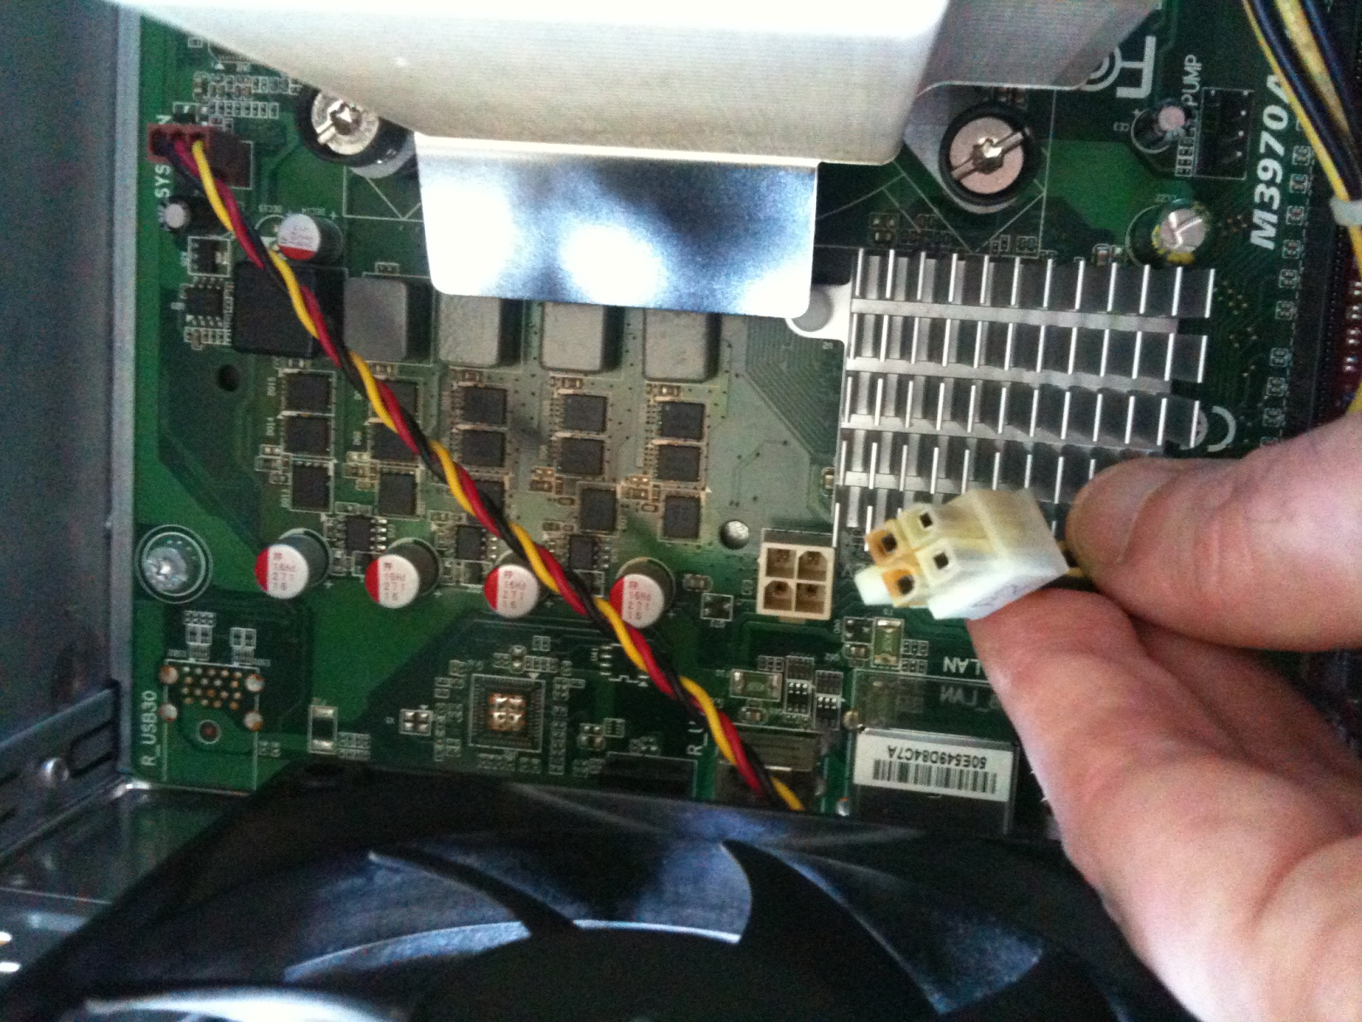
MIST Uses Computing Power Here is Proof!
Fried after two year of extensive use

Slide 20
INSPYRED Evolutionary Computation
INSPYRED elements provided by MIST:
Evaluator: Score a specific sub-population = Fitness function
Generator: Generates a sub-population from candidate population
Random generator: Control random numbers: Allows Reproducibility
Variators:
Cross Over: method to create a sub populations from two others
Mutation: Method to change a sub-population
Terminators:
Max Eval: stop when computation is too long
Max Stable: Stop when result Is stable
Additional parameters: Population Size, Sub-population Size, etc.
Selector: Standard INSPYRED Tournament
Observer: Standard INSPYRED statistic observer

Slide 21
Simulation Language / Compiler
Strict Expression language – a subset of Python with extensions:
Supported Types: Integer, Number, Expression, State Indicator, System Option
Comparison: Eq, Ne, Gr, Ge, Ls, Le
Boolean operators: Or, And, Not, IsTrue
Special math: Inf, NaN, IsInvalidNumber, IsInfiniteNumber, IsFiniteNumber
Mathematical functions: Exp, Log, Ln, Log10, Pow, Sqrt, Pi
Other functions: Mod, Abs, Floor, Ceil, Max, Min
Statistical: Bernoulli, Binomial, Geometric, Uniform, Gaussian
Control and Data Access: Iif, Table
Application specific: CostWizard
Features:
Compiles into Python
Syntax check upon expression definition
Runtime Bound Checks
Runtime recalculation due to out of bounds random error
MIST
Model/ Population
Python Script
Compile
Run
Results

Slide 22
Monte Carlo Initialization: Distribution to Population Generation
The system:
Compiles distributions into initialization code before simulation
Automatically resolves calculation order
Can handle interdependencies
Evolutionary Computation towards user defined objectives
Example with no objectives:
Age ~ 61+8.2*CappedGaussian3
Male ~ Bernoulli(803/1199)
SBP ~ 133.4+16.4*CappedGaussian3
AgeAtDiagnosisOfDiabetes ~ Age - 8
Good for:
Using published aggregate data from clinical trial publications
Avoiding using individual data that is typically restricted
Allowing access to more population information
Age | Male | SBP | AgeAtDiagnosisOfDiabetes
65.51415 | 1 | 129.1721 | 57.51415
53.76856 | 1 | 137.4234 | 45.76856
73.71445 | 0 | 132.8542 | 65.71445
45.79667 | 1 | 147.5537 | 37.79667
57.21742 | 1 | 122.68 | 49.21742

Slide 23
Population Generation Example Skewed by Inclusion/Exclusion
Generate 10 people with:
Inclusion criteria is 45< Age <90
The base population distribution is:
Age for Male: Mean 53 SD 10
Age for Female: Mean 52 SD 7
Male: 50%
Generation Functions (Implementation):
Age ~ Iif (Male,Gaussian(53,10) ,Gaussian(52,7))
Male ~ Bernoulli(0.5)
Assert = And(Gr(Age,45),Ls(Age,90))
Notes:
May not represent well what was intended
Assertion drops non qualifying candidates
The resulting Age is skewed
Age | Male
48.85785535 | 0
59.94741744 | 0
56.19039096 | 1
64.40825341 | 0
49.77582796 | 1
60.29975596 | 1
51.27571792 | 1
72.13820388 | 1
55.51746037 | 0
58.72574003 | 0
Design is Subject to Constraints
Final population that would have been reported in Table 1:
Age Mean: 57.71366233
Age SD: 7.115024093
Male Mean: 0.5
Result to be Published

Slide 24
Population Generation Example With Objectives & INSPYRED
Generate 10 people with objectives:
Base distribution & Inclusion criteria as before
Age : Mean 50, SD 5
Male: 60%
Objectives (Implementation):
Age Mean: 50 , Weight 1
Age SD: 5 , Weight 1
Male: 0.6 , Weight 10
Notes:
Design matches results as much as possible
The designer can study effect of constraints
Table 1 can now be planned ahead!
Age | Male
50.8953429 | 0
53.71135174 | 1
52.86278825 | 0
46.021901 | 1
48.36662032 | 1
47.87355499 | 1
45.11370607 | 1
62.15347882 | 1
47.48350736 | 0
45.93131347 | 0
Design = Desired + Constraints
Final population selected out of 1000 generated candidates:
Age Mean: 50.04135649
Age SD: 5.166548964
Male Mean: 0.6
Result to be Published

Slide 25
Rules Example
Out of Order execution:
Calculation order is different than definition order
Calculation Order
Population A:
Rules:
Age ~ Gaussian (50 + 2*Male,5)
Male ~ Bernoulli (0.5)
Height ~ Gaussian(1.7+0.1*Male,0.1)
Weight ~ (Age+Uniform(0,20))*(Height-0.75)
Male
Age
Height
Weight

Slide 26
Objectives Example
Population C:
Objectives:
Objective #1:
Filter Criteria: 1
Statistics Expression: Weight/Height**2
Function: MEAN
Target Value: 25
Weight:1
In Simple Words:
Ask for the Mean BMI to be 25 for the entire population

Slide 27
Object Oriented
Inheriting
Rules
Objectives
Data
Inheritance from
Multiple populations
Multiple levels build an inheritance tree
Override possible

Slide 28
Simple Inheritance Example
Population D
Inheritance:
(Population A, Rules)
(Population C, Objectives)
Pop D:
Age (A)
Male (A)
Height (A)
Weight (A)
Objective 1 (C)
Rules
Objectives
Result:
Population with Age, Weight, Height characteristics where the mean BMI ~ 25
Pop A:
Age (A)
Male (A)
Height (A)
Weight (A)
Pop C:
Objective 1 (C)

Slide 29
Data Inheritance is Different
Similar to prototype inheritance in other languages
Data inheritance forces generation
Invoked before inheritance
Objectives and rules are not inherited
The generated data is converted to rules
Aimed at handling real data in the future
Electronic Medical Records (EMR)
Previous simulation data can be reintroduces

Slide 30
Simple Example
Population B:
Rules:
Age ~ Table ([[Mod(IndividualID,3),[]]], [50,60,40])
Equivalent to the following data table:
Individual ID | Age
0 | 50
1 | 60
2 | 40

Slide 31
Data Inheritance Example
Generate
Pop E:
Age (Data D)
Male (Data D)
Height (Data D)
Weight (Data D)
Pop E:
Age (B)
Male (Data D)
Height (Data D)
Weight (Data D)
Population E
Inheritance:
(Population D, Data)
(Population B, Rules)
Data
Rules
Pop D:
Age (A)
Male (A)
Height (A)
Weight (A)
Objective 1 (C)
Pop B:
Age (B)
Generate
Pop B:
Age (B)
After Generation:
E looks like D with Age override from B
Rules
Objectives
Pop A:
Age (A)
Male (A)
Height (A)
Weight (A)
Pop C:
Objective 1 (C)

