Slide 1
Sharing Formats for Disease Models
Lucian Smith California Institute of Technology Seattle, WA | Maciej J. Swat EMBL-European Bioinformatics Institute Hinxton, Cambridgeshire, UK | Jacob Barhak Austin TX
SummerSim 2016
Montreal, Canada
26 Jul 2016

Slide 2
Disease Models at a Glance
Describe phenomenon observed in past studies
Attempt to predict future disease progression
Used to predict Costs / Quality of Life
Disease models apply a function to an initial cohort
Markov model
Differential equation
Hybrid functions
Simulation can be at:
The cohort level
Individual level = microsimulation
Normal
Sick
Dead

Slide 3
Motivation
Disease modelers develop separately
Models are based on restricted data
Published disease models are:
Rarely published as code
Suffer reproducibility / documentation issues
Collaboration is limited to comparison through:
Challenges such as the Mount Hood Diabetes Challenge
Validation of one model on another dataset
Other modeling fields have adopted model exchange standards:
SBML : Systems Biology Markup Language
PharmML : Pharmacometrics Markup Language

Slide 4
Aim of this work
Identify tools / exchange standard for modeling disease models
Implement examples in several tools
Show capabilities
Explore limitations
Exchange standards we explored:
SBML
PharmML
Tools we used:
MIcro Simualtion Tool (MIST)
RuleBender / BioNetGen : Supports SBML
Tellurium / RoadRunner / Antimoney : Supports SBML

Slide 5
SBML Basics
Stands for Systems Biology Markup Language
SBML is a machine-readable format for representing models
XML based exchange format
Has about 60 reported implementation that include:
RuleBender / BioNetGen
Tellurium / RoadRunner / Antimoney
Web Site:
http://sbml.org/Main_Page

Slide 6
SBML Extensions
SBML is aimed at the Model
The model represents truths we modeled
Allow annotations
The pure SMBL exchange standard does not deal with simulation
SBML has extensions:
SED-ML : simulation language
SBML-Multi : multi-state multi-component models

Slide 7
PharmML Basics
Stands for Pharmacometrics Markup Language
Supported by DDMoRe (Drug Disease Model Resources) from 2011
Starting Goal:
“…We will provide the specifications of a set of interoperable markup languages (MLs) able to encode the different types of models used in pharmacology (empirical, mechanistic and statistical models) as well as the different steps of modelling and simulation… “
Web site:
http://www.pharmml.org/

Slide 8
Scope Model Definition
Bi-directional converter
SBML ←→PharmML
PharmML

Slide 9
Scope Trial Design
Dataset sourced
Dataset definition
Column/model element mapping
Column transformations (dose scaling)
Explicit design
Interventions
Administrations – bolus/infusion
dose amount/time
Actions – washout/reset
Lookup table
Individual administrations
Interventions combinations
Observations
(Individual) Observation
Lookup table
Observations combinations
Covariates
Covariate model
Individual covariates
Occasions – start/end points
Design spaces
Arms
datasets

Slide 10
Scope Modelling Steps
Simulation Step
Observations
Observations
Operation
Property/Algorithm
Estimation
Dataset/Observation reference
Parameter estimation
initial estimates
lower/upper bound
Operation
Property/Algorithm
Design Evaluation/Optimisation
FIM
Optimize on
Method
Compute
Cost
Prior estimation
Software settings

Slide 11
SBML Implementation Tools Tested
RuleBender
http://visualizlab.org/rulebender/
Initially aimed at intercellular dynamics and intercellular biochemistry
Tellurium
http://tellurium.analogmachine.org/
Initially describes reactions of species

Slide 12
MIST Basics
MIST stands for MIcro-Simulation Tool
MIST is a Python framework that supports chronic disease modeling using High Performance Computing
MIST is free and available on GitHub: https://github.com/Jacob-Barhak/MIST
The SimTk project web site is: https://simtk.org/home/mist

Slide 13
MIST Main Features
Form based User Interface
Simulation language / compiler
Monte Carlo Simulation
Multi-Process State Transition Models
Simulation Rules
Initialization : Population Generation from Distributions
Evolutionary Computation Support
Report Generator
Documentation, Examples, and Support
Free Open Source Software under GPL license
Reproducibility
MIST Runs Over the Cloud!

Slide 14
MIST Simulation Language / Compiler
Strict Expression language – a subset of Python with extensions:
Supported Types: Integer, Number, Expression, State Indicator, System Option
Comparison: Eq, Ne, Gr, Ge, Ls, Le
Boolean operators: Or, And, Not, IsTrue
Special math: Inf, NaN, IsInvalidNumber, IsInfiniteNumber, IsFiniteNumber
Mathematical functions: Exp, Log, Ln, Log10, Pow, Sqrt, Pi
Other functions: Mod, Abs, Floor, Ceil, Max, Min
Statistical: Bernoulli, Binomial, Geometric, Uniform, Gaussian
Control and Data Access: Iif, Table
Application specific: CostWizard
Features:
Compiles into Python
Syntax check upon expression definition
Runtime Bound Checks
Runtime recalculation due to out of bounds random error
MIST
Model
Python Script
Compile
Run
Results

Slide 15
Example 1 – Simple Markov Model
2 disease states: Alive and Dead.
The yearly probability of transition between state Alive and state Dead is: 0.05
Initial conditions: 100 people start in state Alive, none are Dead.
Output requested: Number of people in each state for years 1–10.
Implementation available through GitHub in:
MIST : https://github.com/Jacob-Barhak/SharingDiseaseModels/blob/master/Example1.zip
Tellurium : https://github.com/Jacob-Barhak/SharingDiseaseModels/blob/master/Example1.py
Rule Bender: https://github.com/Jacob-Barhak/SharingDiseaseModels/blob/master/Example1.bngl
PharmML https://github.com/Jacob-Barhak/SharingDiseaseModels/blob/master/categorical_MARKOV1.xml
SBML https://github.com/Jacob-Barhak/SharingDiseaseModels/blob/master/Example1.xml
Alive
0.05
Dead

Slide 16
Example 2 – 3 State Markov Model
0.01
Healthy to Dead: 0.01.
Healthy to Sick: 0.2.
Sick to Healthy: 0.1.
Sick to Dead: 0.3.
Initial conditions: 100 people start in state Alive, none are Sick or Dead.
Output requested: How many individuals in each disease state for each of the first 10 years?
Implementation available through GitHub in:
MIST : https://github.com/Jacob-Barhak/SharingDiseaseModels/blob/master/Example2.zip
Tellurium : https://github.com/Jacob-Barhak/SharingDiseaseModels/blob/master/Example2.py
Rule Bender: https://github.com/Jacob-Barhak/SharingDiseaseModels/blob/master/Example2.bngl
PharmML https://github.com/Jacob-Barhak/SharingDiseaseModels/blob/master/categorical_MARKOV2.xml
SBML https://github.com/Jacob-Barhak/SharingDiseaseModels/blob/master/Example2.xml
0.2
Healthy
Sick
0.3
Dead
0.1

Slide 17
Example 3 – Stratified Markov Model
0.01
Healthy to Dead: 0.01.
Healthy to Sick: 0.2 for Male, 0.1 for Female.
Sick to Healthy: 0.1.
Sick to Dead: 0.3.
Initial conditions: Healthy = (50 Male, 50 Female), Sick = (0,0) and Dead = (0,0).
Output requested: How many men / women are in each disease state for each of the first 10 years?
Implementation available through GitHub in:
MIST : https://github.com/Jacob-Barhak/SharingDiseaseModels/blob/master/Example3.zip
Tellurium : https://github.com/Jacob-Barhak/SharingDiseaseModels/blob/master/Example3.py
Rule Bender: https://github.com/Jacob-Barhak/SharingDiseaseModels/blob/master/Example3.bngl
PharmML https://github.com/Jacob-Barhak/SharingDiseaseModels/blob/master/categorical_MARKOV3.xml
SBML https://github.com/Jacob-Barhak/SharingDiseaseModels/blob/master/Example3.xml
0.2 M / 0.1F
Healthy
Sick
0.3
Dead
0.1

Slide 18
Conclusions
Simple disease models can be implemented and shared using multiple formats
More complicated Micro-Simulation models are not yet fully supported by implementations:
Workaround allows describing as a plurality of models
Future development promises solutions
Reproducibility is an important issue
Especially with more complicated models
Exchange standards are still developing, yet promising

Slide 19
Acknowledgments
The authors want to thank all the participants in the discussions. Here is the list in no particular order: Robert Phair, Lukas Endler, Gareth Smith, Nicolas Le Novere, Jose Juan Tapia, Jim Sluka, Leonard Harris, Fengkai Zhang, Nick Holford, Mike K Smith, Sarah Keating, Herbert Sauro, Michael Hucka, Kyle Medley.
Additional thanks for public reviews by
Robert Smith?: https://groups.google.com/forum/#!topic/public-scientific-reviews/8SCxed6KhlU
Peppino Fazio: https://groups.google.com/forum/#!topic/public-scientific-reviews/qJSJ4FEoDrw
This paper used the MIcro Simulation Tool (MIST) that is based on IEST. The IEST GPL disease-modeling framework was initially supported by the Biostatistics and Economic Modeling Core of the MDRTC (P60DK020572) and by the Methods and Measurement Core of the MCDTR (P30DK092926), both funded by the National Institute of Diabetes and Digestive and Kidney Diseases. The modeling framework was initially defined as GPL and was funded by Chronic Disease Modeling for Clinical Research Innovations grant (R21DK075077) from the same institute. MIST, however, was developed without financial support.
MIST was developed independently without financial support

Slide 20
Markov models - example 1
E.g. zombie attack models

Slide 21
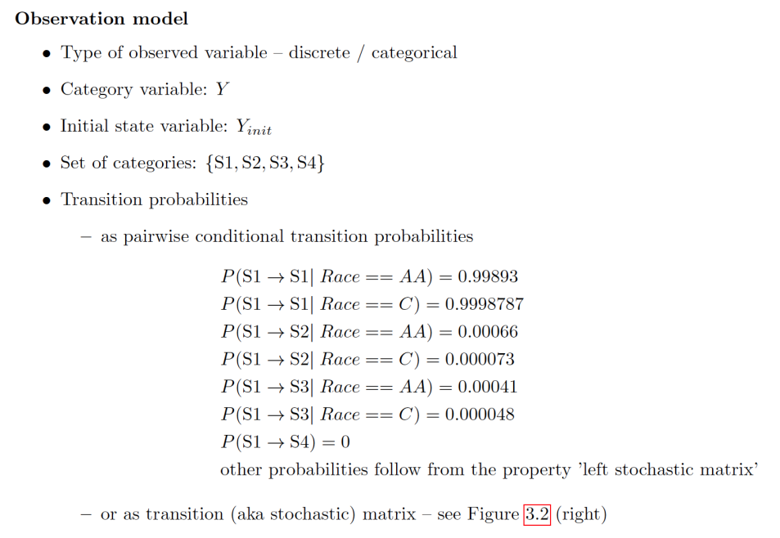
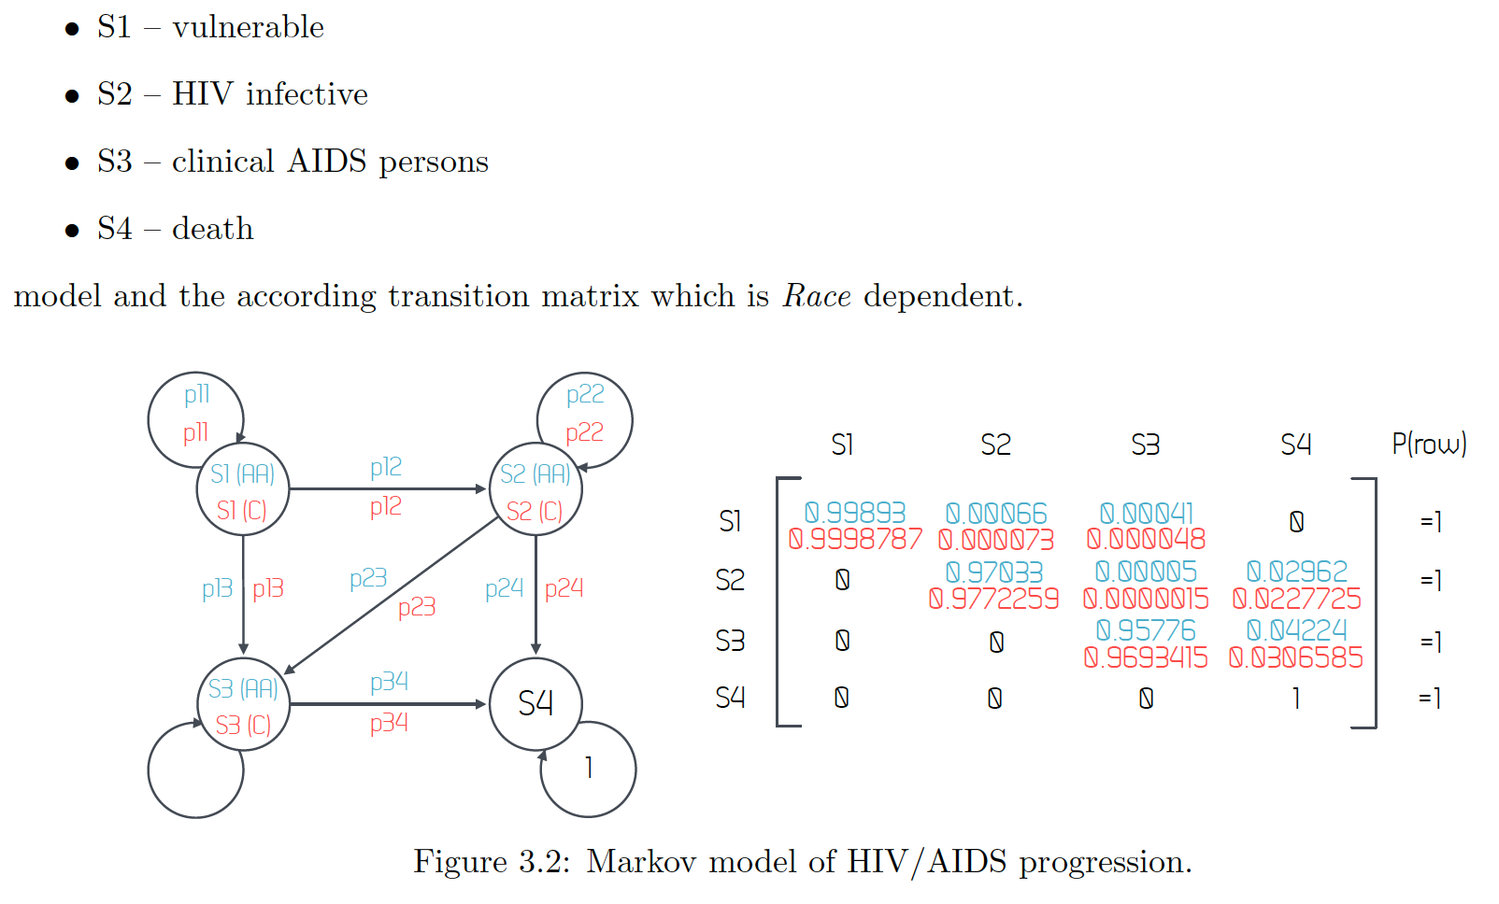
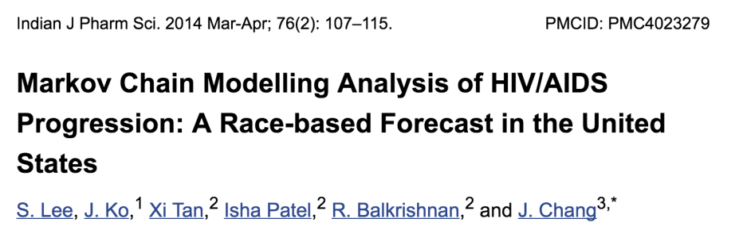
PharmML – Markov models – another example
E.g. real-life disease models

