Slide 1
The Reference Model Models ClinicalTrials.Gov
Jacob Barhak
Austin, Texas
SummerSim 2017
July 9-12, 2017 Bellevue, Washington, USA

Slide 2
ClinicalTrials.Gov
An NIH Project
Accumulates Clinical Trial Data
Many Studies are Now Required to Register
International
Grows Rapidly
Date | Number of Trials | Studies with Results
12-Feb-2017 | 236,687 | 24,251
27-Sep-2016 | 226,460 | 22,614
7-Apr-2015 | 187,653 | Not collected

Slide 3
Medical Knowledge
Based on Evidence:
Clinical Trials / Other published studies
Medical Records
Assumptions / Deductions / Analytics:
Guidelines
Models Locked in Physicians Mind
Computational Disease Models
How to make a machine read and comprehend this knowledge?
Google Fusion Tables
IBM Watson
The Reference Model for Disease Progression
Accumulates Knowledge:
Baseline Populations
Outcomes
Assumptions/Models

Slide 4
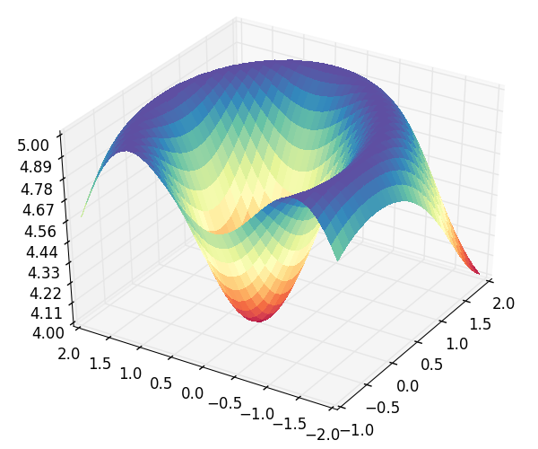
The Reference Model Employs Model Competition and Cooperation
A
B
Process CHD
Ensemble model where models cooperate
Calculates fitness of multiple models to multiple population sets
Uses and Assumption Engine to handles different competing assumptions
Uses High Performance Computing
aA+bB+cC+dD
Eq EH | E | E | E | E | …
Eq AD | A | B | C | D | …
Pop 1 | 4 | 6 | 2 | 1 | …
Pop 2 | 2 | 4 | 6 | 1 | …
Pop 3 | 2 | 3 | 9 | 2 | …
… | … | … | … | … | …
Pop 3
D
C
No CHD
MI
Survive MI
CHD Death
Pop 2
Pop 1
E
F
eE+fF+gG+hH
Process Stroke
Death
No Stroke
H
G
Stroke
Survive Stroke
Stroke Death
Discrete Fitness Matrix
Process Competing Mortality
Alive
Other Death
Continuous Fitness Space

Slide 5
The Reference Model Historical Evolution
2012 – Start
2013 – High Performance Computing and Cloud Computing
2014 – Evolutionary Computation for Population Generation
2015 – Object Oriented Population Generation
2016 – Assumption Engine / Model Cooperation
2017 – Interface to ClinicalTrials.Gov
Continuous Model Space = Infinite Model Combinations

Slide 6
Population Generation Goal
Generate synthetic population to mimic statistics
Heterogeneity = generate individuals
Multiple characteristics per individual
Allow correlations
Allow restrictions
Correlated
IndividualID | Male | Age | BP | …
0 | 0 | 50 | 140 | …
1 | 1 | 45 | 135 | …
2 | 0 | 22 | 120 | …
3 | 1 | 85 | 145 | …
4 | 1 | 14 | 125 | …
IndividualID | Male | Age | BP | …
0 | 0 | 50 | 140 | …
1 | 1 | 45 | 135 | …
2 | 0 | 22 | 120 | …
3 | 1 | 85 | 145 | …
4 | 1 | 14 | 125 | …
Generation Code / Equations
Restrict Age

Slide 7
Population Generation Process
Object Oriented Population Generation
Inheritance
Code reusability
Defining defaults
Defining hypotheses
Generation Rules:
Define how to generate a single individual
Test if individual fits the inclusion/exclusion criteria
Define ties and correlations between characteristics
Objectives:
Define aggregate targets for the entire population
Reduce random generation error
Handle skewed distributions to fit target
INSPYRED
MIST
Expression Compiler
Evolutionary Computation
Monte Carlo
Selection
Result
Result Population
Converges to
Objectives

Slide 8
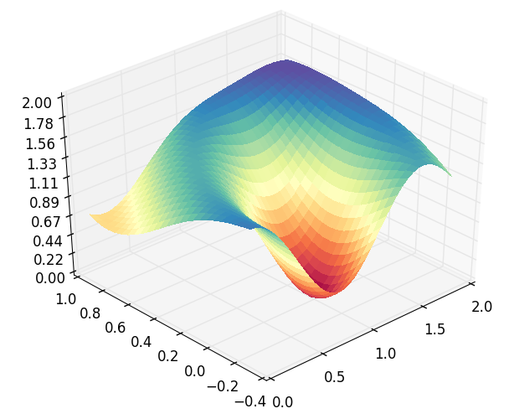
The Assumption Engine
The Assumption Engine allows us to “throw” assumptions at it
A model is an assumption!
It figures out which assumptions work well together to fit observed data
Points to significant models
Rejects incompatible models
Fitness (s)
Equation Coefficient (t₂=b)
Equation Coefficient (t₁=a)

Slide 9
The Assumption Engine Results
Dominant equations
Minor
difference
Dominant equations
Dominant equations
Dominant equations
Rejected equation
MI
Stroke
Other
Death
MI
Death
Better Fitness After Import from ClinicalTrials.Gov
Stroke
Death
Reproducibility Info:
MIST_RefModel_2017_02_19_OPTIMIZE.zip using model version 46
MIST_RefModel_2016_12_17_OPTIMIZE.zip using model version 45

Slide 10
Import Work Flow
Systematic Review
Import Populations
Import Outcomes
ClinicalTrials.Gov
Import Instruction DSL Files
Systematic Review & Selection of Trials
G
A
B
F
XML File Archive
Clinical Trial Import Module
Output CSV Files
MIcro Simulation Tool (MIST)
C
E
H
J
I
D
Template CSV Files
The Reference Model
Outcome Query
Baseline Population

Slide 11
The Reference Model Populations
Study Abbreviation | ClinicalTrials.Gov ID / Existed before | Number of cohorts modeled | Population Size
ASPEN | Existed | 7 | 2,410
ADVANCE | Existed | 9 | 11,140
ACCORD (BP) | Existed | 3 | 4,733
UKPDS (33) | Existed | 3 | 3,867
KP | Existed | 6 | 29,247
NDR | Existed | 6 | 29,034
Look AHEAD | Existed | 3 | 5,145
ADDITION | Existed | 3 | 3,057
CARDS | Existed | 7 | 2,838
ACCORD (Glycimaia) | NCT00000620 | 3 | 10,251
BARI2D | NCT00006305 | 5 | 2,368
ORIGIN | NCT00069784 | 3 | 12,537
TREAT | NCT00093015 | 3 | 4,038
IONM | NCT00191282 | 3 | 1,115
RECORD | NCT00379769 | 5 | 4,447
HPS2-THRIVE | NCT00461630 | 3 | 25,673
ALTITUDE | NCT00549757 | 3 | 8,561
TECOS | NCT00790205 | 3 | 14,671
EXAMINE | NCT00968708 | 3 | 5,380
SAVOR-TIMI 53 | NCT01107886 | 3 | 16,492
EMPA-REG OUTCOME | NCT01131676 | 4 | 7,020
ELIXA | NCT01147250 | 3 | 6,068
 | TOTAL | 91 | 210,092
Before Import
9 populations
47 Cohorts
Newly imported from
ClinicalTrials.Gov
13 populations
44 Cohorts

Slide 12
Issues Handled During Import
Systematic review
Organizing results in tabular human readable format
Population generation
Code generation for individuals
Code inclusion/exclusion criteria
Code generation of objectives
Name matching
Unit conversion – context sensitive
Race/Ethnicity conversion using user defined dictionary
Time extraction from free text
Outcome Conversion
Outcomes scaling to same reference
Cohort mapping
Calculation of missing full cohort outcomes

Slide 13
Conclusions
The Reference Model continues to accumulate knowledge to get a wider view of global phenomena
It can now extract such data from ClinicalTrials.Gov
The import is traceable and reproducible
It is possible now to apply this technology to other disease processes using similar technology
One small step towards machines comprehending medical knowledge

Slide 14
How to Access Evidence Data?
Electronic Medical Records
Restricted
Cannot be merged
Publications
Tools to read publications have not yet matured
Manually convert to modeling code
Time consuming = about 1 week per publication
ClinicalTrials.Gov Database
This work focuses on how to make this machine readable

Slide 15
Acknowledgments
Deanna J.M. Isaman - who is the spirit behind the great ideas. She taught me my first steps in disease modeling
Morton Brown & William H. Herman – for guidance, critical feedback, and growth environment
Continuum Analytics and specifically:
Benjamin Zeitler for creating the cloud AMI
Ilan Schnell for his work on Anaconda.
All those who developed free software used and supported it: including Python, Anaconda, Spyder, numpy, SciPy, nose, winpdb, Star Cluster, Ubuntu, Sun Grid Engine
The legacy IEST modeling framework was supported by the Biostatistics and Economic Modeling Core of the MDRTC (P60DK020572) and by the Methods and Measurement Core of the MCDTR (P30DK092926), both funded by the National Institute of Diabetes and Digestive and Kidney Diseases. The modeling framework was initially defined as GPL and was funded by Chronic Disease Modeling for Clinical Research Innovations grant (R21DK075077) from the same institute. MIST is based on IEST.
The Reference Model and MIST were developed independently without financial support

Slide 16
Object Oriented Population Generation
Code Reusability
Linking rather than copying rules/objectives
Missing Information
Default Values
Derived equations
Hypothesis handling
Variations of unknowns
Towards Big Data
Future Preparation
Handling Individual data
Default Diabetic
ACR changes with Albuminuria
KP Full
NDR Full
CARDS Full
UKPDS Full
UKPDS Conventional
UKPDS Intensive

Slide 17

Questions?
Jacob Barhak
http://sites.google.com/site/jacobbarhak/

Slide 18
The Reference Model Data
Baseline Population Statistics
e.g. Age ~ 40 (5) , 50% Male, BP ~ 120(5)
Outcomes
e.g. 3% dead after 5 years
Existing Models – Risk Equations
Such as UKPDS risk equation for Stroke
In the past this data was manually extracted from publications
The first two data elements can now be extracted from ClinicalTrials.Gov

Slide 19
The Reference Model Accumulates Models/Assumptions
Bio-Markers
 | 1 | 2 | 3 | 4 | 5 | 6 | 7 | 8 | 9 | 10 | 11 | 12 | 13 | 14 | 15 | 16 | 17 | 18 | 19 | 20 | 21 | 22 | 23 | 24
1 | * |  |  | * | * |  |  | * | * | * | * |  | *
2 | * |  | * | * | * | * |  | * |  | * | * |  | * |  |  |  |  | * | * | * | *
3 |  |  |  | * |  |  | * |  |  |  | * | * | * |  | * | *
4 |  |  | * | * |  | * | * | * | * |  | * |  | * | * |  |  |  |  | * |  |  | * | * | *
5 |  |  | * |  | * |  |  | * |  | * | * |  | *
6 | * |  | * |  | * |  |  | * |  | * | * |  | * |  | *
7 | * | * |  | * |  |  |  |  |  |  |  |  |  |  |  |  |  |  |  | *
8 | * |  |  | * | * |  |  |  |  |  |  |  | *
9 |  |  |  |  |  |  |  |  |  |  |  |  | * |  |  |  |  |  |  |  | *
How to merge such information?
Risk Equations
Which behave better?
Are models up to date?
Smoke

Slide 20
How Reliable Are These Results?
Probably stable enough - enough data was accumulated
Noise
Data
Monte Carlo
Data
Limited number of populations
Are models representative?
Missing data – estimated dates
Human Error
These results do contain human entry error
Model Assumptions
Improvement rate Formulation
Ensemble model formulation
Optimization
Multiple possible solutions
Arbitrary stopping criteria
Similar results reported in the past so probably not far from the truth

Slide 21
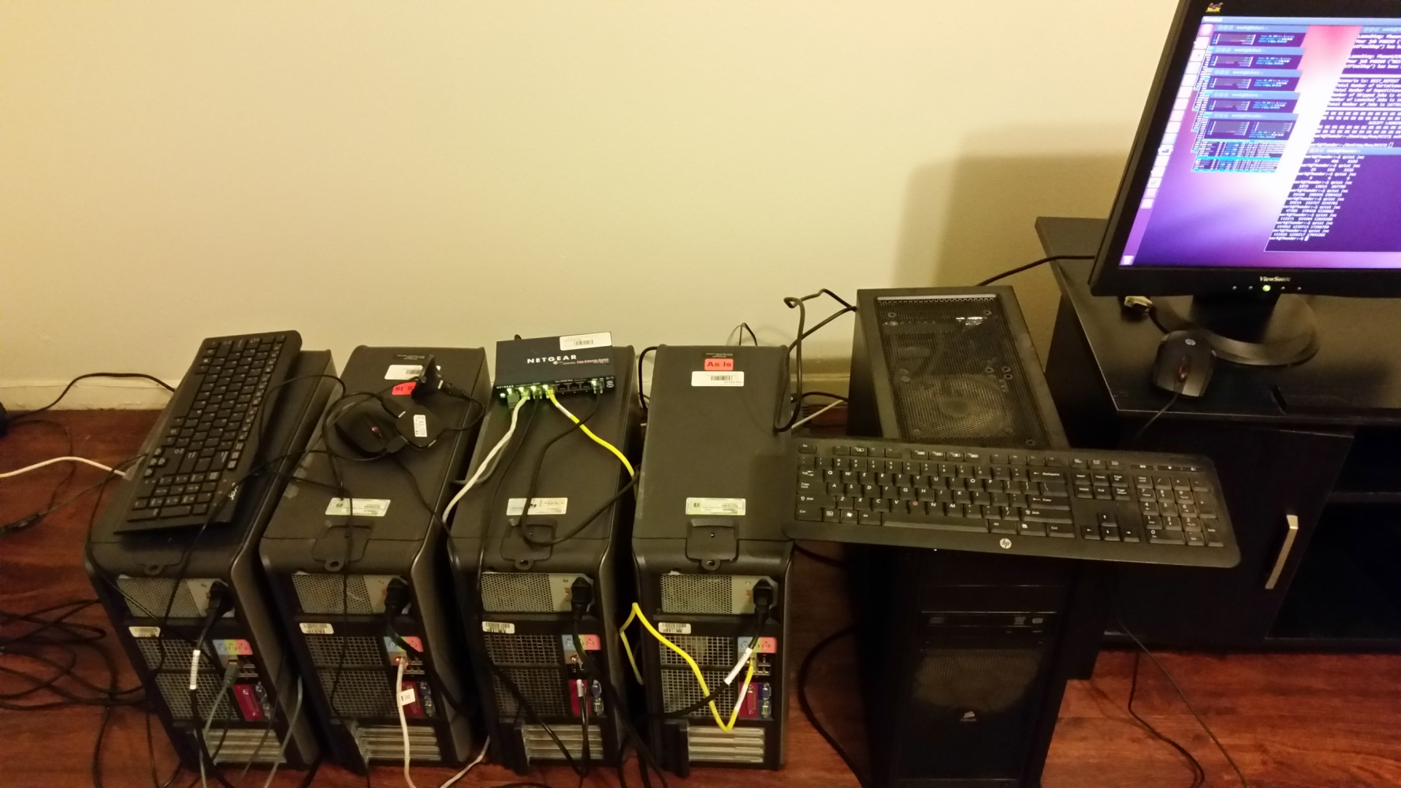
The Reference Model is Powered by MIST
MIST = MIcro Simulation Tool
Free Software:
https://simtk.org/projects/mist
https://github.com/Jacob-Barhak/MIST
Uses High Performance Computing
MIST Runs over the Cloud !!!
MIST
Cloud

Slide 22
Results 2014
Raw Models
BioMarker Correction
Biomarkers Independent
Fully Correlated
Unexplained
8 Populations = 40 cohorts x 2
Biomarkers Independent
Best Model
Fully Correlated
Date Correction
Date+BioMarker Correction
50 Models x 4 Assumptions
Version 22 - MIST_RefModel_2014_04_29_MATRIX_TraceBack.zip

