Slide 1
Open Source and Sustainability
Jacob Barhak
Sole Proprietor
Software Developer
& Computational Disease Modeler
COMBINE 2020 October 5-9

Slide 2
I Benefited From Open Source
I left an institution and continued develop open source after I left
I developed:
  The MIcro Simulation Tool (MIST) as a modeling engine under GPL
  https://simtk.org/projects/mist
  The Reference Model for Disease Progression as a proprietary model using MIST
  https://simtk.org/projects/therefmodel
I reached a point where:
  The Reference Model is the most validated diabetes model known worldwide
  The work connected with SBML towards model sharing: http://dx.doi.org/10.1177/0037549718793214
  The work spilled into standardization of medical data:
  https://clinicalunitmapping.com/

Slide 3
Open Source & Proprietary
MIST
  is Open Source
I coordinated with the institution about developing this code further
  I verified addition of my copyright
  Gave credit for development for years
  Coordinated when making major transformation to code to to make sure license was not violated
The Reference Model
  is proprietary
I protected my investment
  I made sure to distinguish licenses
  Kept a record of development
  Filed for US patents:
    Received a U.S. patent in 2018
    Another patent is pending
  The Reference model was recently applied to COVID-19

Slide 4
So Why am I here?
Investing in open source is not sustainable
  Funding prefers larger organizations
  Some potential users prefer
    Commercial solutions
    Develop their own
  Eventually control issues appear

Slide 5
What Control Issues?
Opens source code is mostly governed by Copyright law
The original owner of the code has some control over the code and can release or deny the code under a different license
Modified work therefore depends on agreement between contributors
What happens in case of a disagreement?

Slide 6
Issue #1: Over Interpretation
In 2017 I asked the institution where the original MIST GPL code was developed to:
  Release other code that started from some documentation examples used by MIST under a different license
    There was no code overlap of the new code
The request was denied
  There was no good reason for denial since there was no code overlap or reuse of GPL code.
I reached an agreement to release under LGPL

Slide 7
Issue #2: Abandoned Code
In 2019 I found out that GPL code was abandoned
  According to a 3rd party, the institution chose to use a different engine
  In fact, abandonment may have happened long before:
    to the best of my knowledge, the institution did not release an update for 7 years
  I was the only maintainer for a many years
In 2020 when started work on COVID-19:
  I asked for ownership transfer
    I was denied - One argument was "that is a large ask"
  I asked for a different license like CC0
    I was denied
Therefore, one contributor for the code can:
  Deny incentive from any other by abandoning code and not transferring ownership
  This remove incentive to improve the code or even maintain it

Slide 8
Issue #3: Restrictions
In 2020 I started modeling COVID-19
Infectious disease modeling should be regulated
If released as open source, the code can be potentially misused
An open source license may need restrictions to prevent misuse
However, open source licenses typically discuss only permissive parts

Slide 9
Some Say Patents are Evil
Who is More Evil?
 | Patents | GPL
Duration | Up to 20 years / ~ 1 generation | ~70+ years / ~ lifetime
Restrictions | Per Country - Owner responsible to abide law | Copy Left / viral, Requires abiding to license - not necessarily local law
Maintenance | Fee at application, 3/7/11 years | None
Screening | Patent examiner scrutiny takes years | None
Ownership | Private, public upon expiration | Communal? Contributors?
Incentives | Owner can trade / sell license | Anyone can sell, yet sale looses value
Regulation | Government / Archived | FSF / Distributed
Summary | Hard to get, short term private ownership, provides incentives | Easy to get, communal ownership with long term restrictions, little incentive

Slide 10
Is This Why GPL is Used Less?
GPL usage has dropped compared to other licenses:
  https://opensource.com/article/17/2/decline-gpl
Is the public becoming aware of the long term stagnation effects of GPL?
  Software generation is shorter than human generation - More compatible with patent restriction time
  Abandoned code cannot really be re-purposed
Getting communal support to change a license once released as GPL becomes difficult
  All contributors to a version must agree?
  The more contributors the harder it gets.
  When in the last time you saw a parliament vote unanimously?

Slide 11
Specifically for Disease Modeling
I personally called for publishing modeling code openly in a large forum:
  My calls were ignored and not documented
  Different entities look at this topic differently
A group of Scientists published a call for transparency:
https://doi.org/10.1126/science.abb8637
I called for public discussion on ways to make it possible:
  https://forum.comses.net/t/issues-with-regard-to-call-for-transparency-of-covid-19-models/8433
  One major argument was that government funded research should benefit the public

Slide 12
Should Government Fund
Open Source?
Here are some previous signs in that direction where government wants reuse of products:
Fair Access to Science and Technology Research (FASTR) Act: https://www.cornyn.senate.gov/content/news/cornyn-wyden-introduce-bill-increase-access-taxpayer-funded-research
  Focuses on publication
  Recognizes patents and national security as exceptions
Previous US administration policy:
http://blogs.nature.com/news/2013/02/us-white-house-announces-open-access-policy.html
  Focuses on mostly publication
NIH Strategic Plan For Data Science https://datascience.nih.gov/sites/default/files/NIH_Strategic_Plan_for_Data_Science_Final_508.pdf
  Mentions the word open over a dozen times with regards to data and software

Slide 13
Suggested Solution
Funding bodies should embrace the following strategy:
  Ask software products of research to be released as open source license for the duration of funding
  The license should include explicit restrictions
  When research/development is abandoned code should be released to public domain
    For example Creative Commons Zero: https://creativecommons.org/share-your-work/public-domain/cc0/
    This will provide incentive for future development by private / public entities

Slide 14
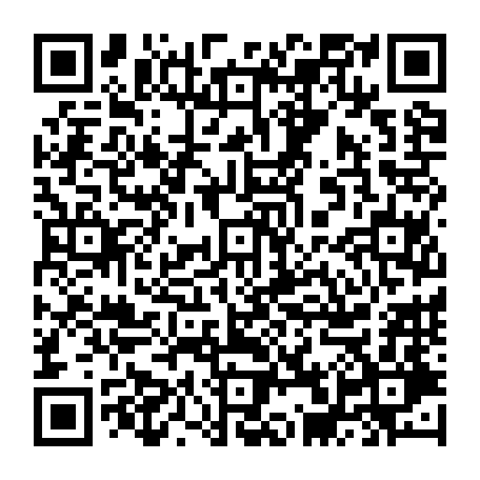
Thank You
Feel free to contact:
Jacob Barhak
jacob.barhak@gmail.com
https://sites.google.com/view/jacob-barhak/home

