Slide 1
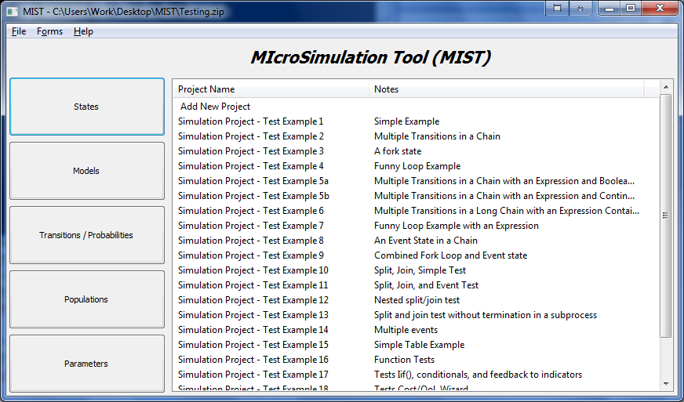
B
A
C
D
E
F

Slide 2
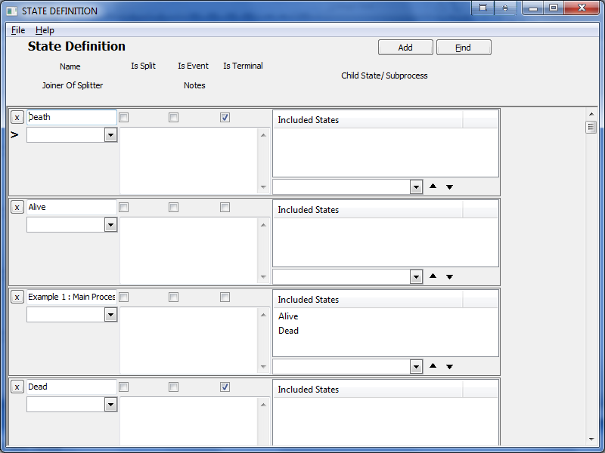
A
B
C
D
E
K
F
I
J
G

Slide 3
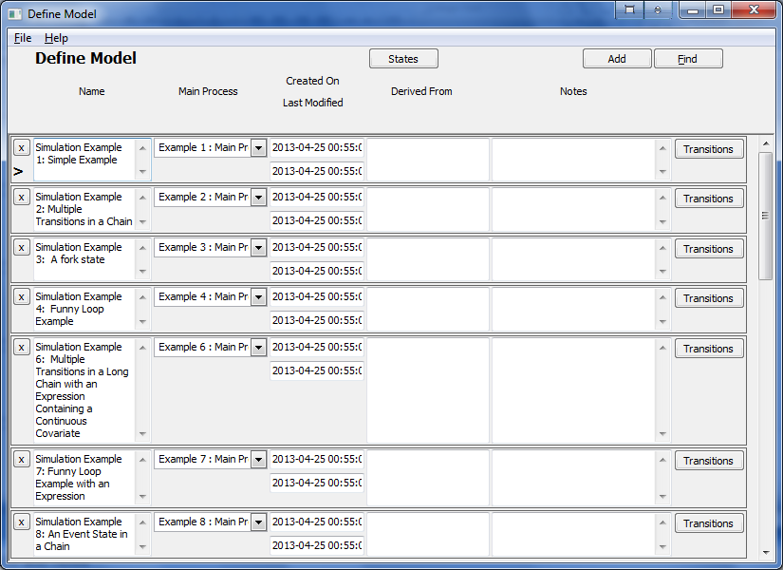
A
E
C
B

Slide 4
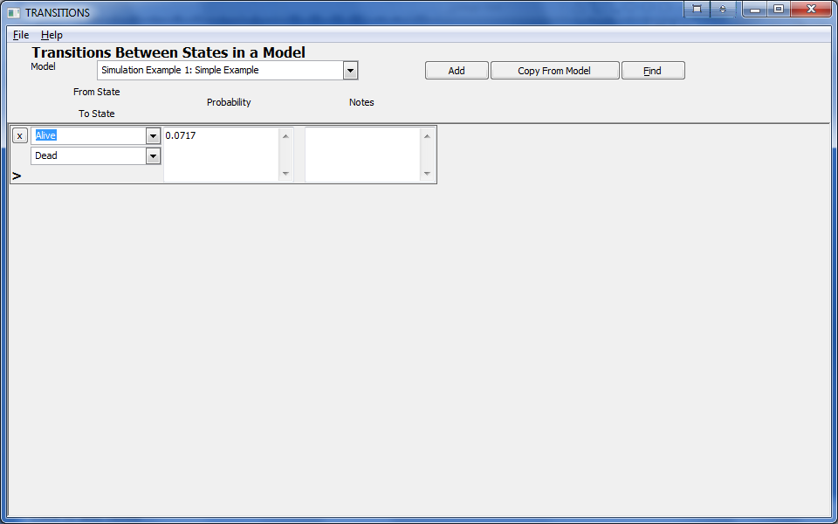
A
B
K
C
D
E
J

Slide 5
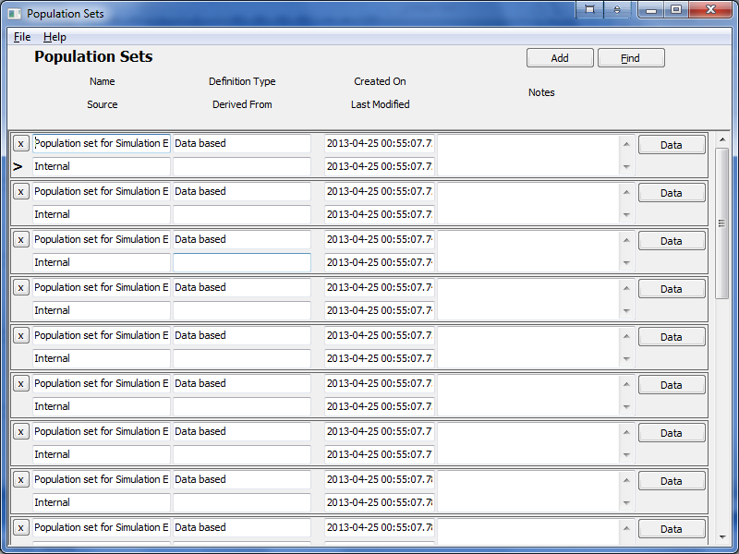
A
B
C
D
F
E
G

Slide 6
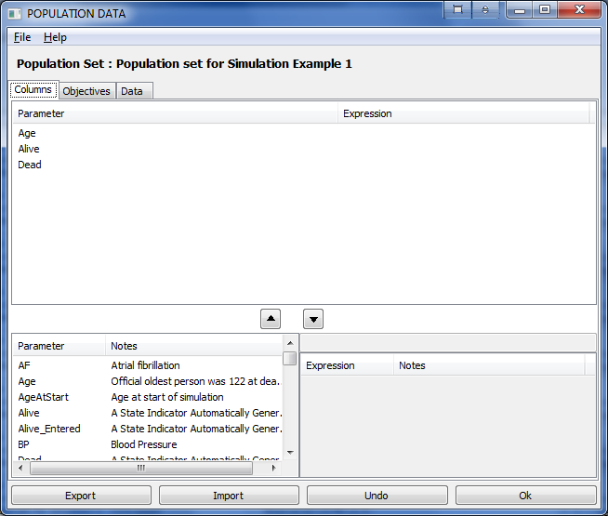
H
G
A
B
C
E
D
F

Slide 7
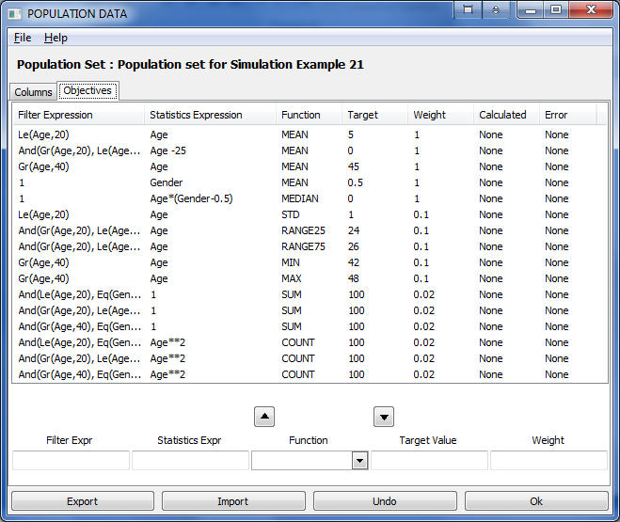
H
P
I
J
K
L
M
N
O

Slide 8
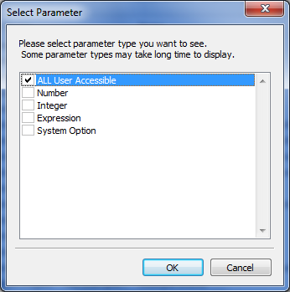

Slide 9
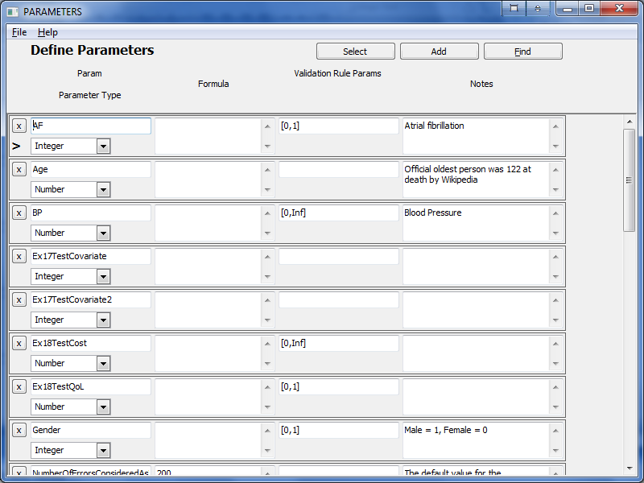
A
B
C
E
G
D

Slide 10
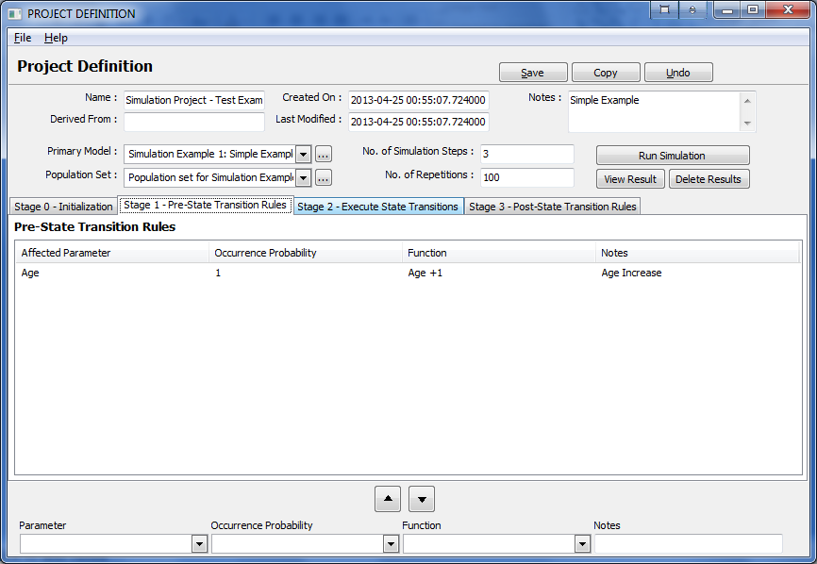
A
B
D
C
E
L
J
K
F
G
H
I

Slide 11
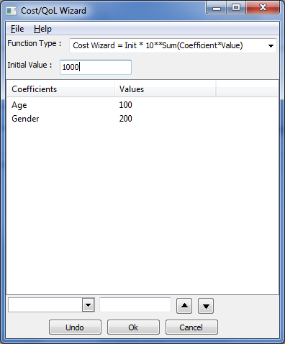
A
B
C
F
G
D
E

Slide 12
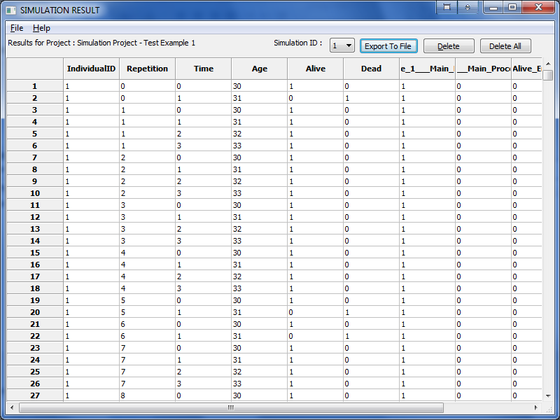
A
B
C
D

Slide 13
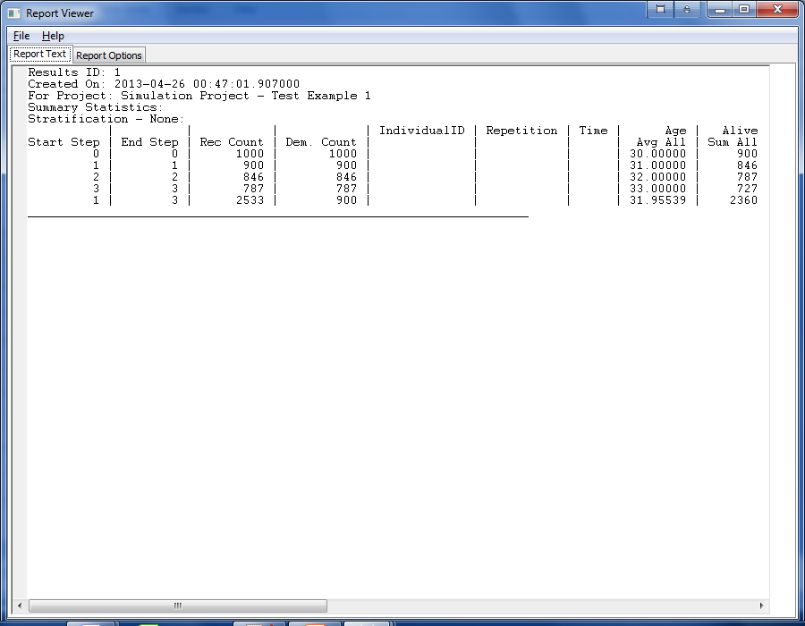
A
B

Slide 14
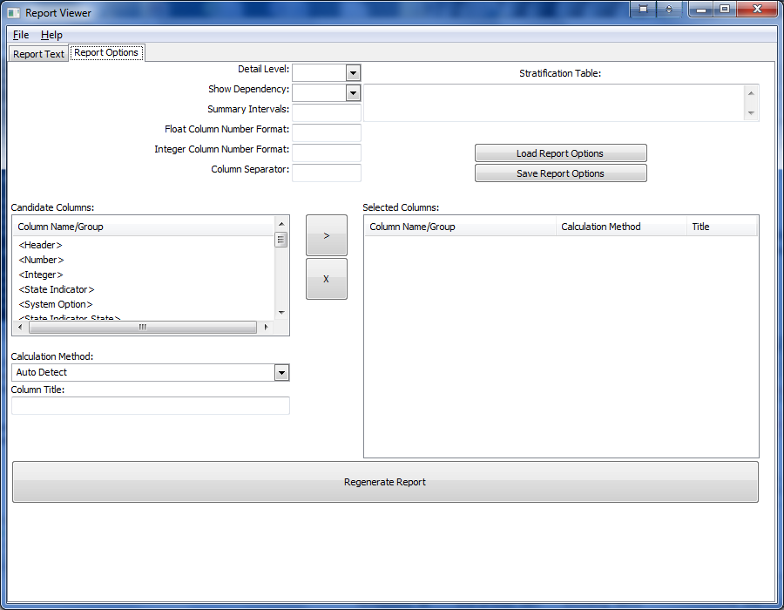
A
B
M
C
D
E
O
F
P
J
G
K
L
H
I
N

Slide 15
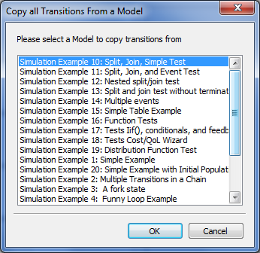

Slide 16
Sub-process 1
State 1
P₁
State 2
P₂
State 0
P₀
State 5
State 3
State 4
P₄
P₃
Sub-process 2

