Slide 1
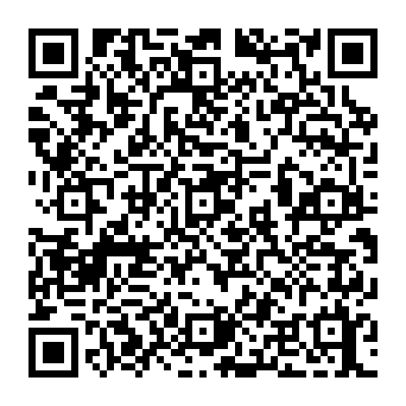
Open Source, Sustainability, and CC0
Jacob Barhak
Sole Proprietor
Software Developer &
Computational Disease Modeler
August Penguin
2023 March 3
Tel-Aviv, Israel

Slide 2
Conflict of Interest
Payment/services info: Dr. Barhak reports non-financial support and other from Rescale, and MIDAS Network, other from Amazon AWS, Microsoft Azure, MIDAS network, other from The COVID tracking project at the Atlantic, other from John Rice and Jered Hodges,
Financial relationships: Jacob Barhak declare(s) employment from MacroFab, United Solutions, B. Well Connected health. The author had a contract with U.S. Bank / Apexon, MacroFab, United Solutions, and B. Well during the work. However, none of these companies had influence on the work reported here.
Jacob Barhak declare(s) employment and Technical Support from Anaconda. The author contracted with Anaconda in the past and uses their free open source software tools. Also the Author received free support from Anaconda Holoviz team and Dask teams.
Intellectual property info: Dr. Barhak has a patent US Patent 9,858,390 - Reference model for disease progression issued to Jacob Barhak, and a patent US patent Utility application #15466535 - Analysis and Verification of Models Derived from Clinical Trials Data Extracted from a Database.
Other relationships: personal fees from United Solutions, personal fees from B. Well Connected health, personal fees and non-financial support from Anaconda.
Also, from 2006-2012 Jacob Barhak was paid by the University of Michigan to develop software licensed under GPL license.
However, despite all support, Dr. Barhak is solely responsible for contents of this publication.

Slide 3
I Benefited From Open Source
I left an institution and continued develop open source after I left
I developed:
  The MIcro Simulation Tool (MIST) as a modeling engine under GPL
  https://simtk.org/projects/mist
  The Reference Model for Disease Progression as a proprietary model using MIST
  https://simtk.org/projects/therefmodel
Some achievements:
  The Reference Model is the most validated diabetes model known worldwide
  The Reference Model is the first multi-scale ensemble model for COVID-19
  The work connected with SBML towards model sharing: http://dx.doi.org/10.1177/0037549718793214
  Awarded United States Patent 9,858,390, January 2, 2018
  Awarded United States Patent 10,923,234, February 16, 2021

Slide 4
So Why am I here?
Investing in open source is not sustainable!
  Funding prefers larger organizations
  Some potential users prefer
    Commercial solutions
    Develop their own
  Eventually control issues appear

Slide 5
What Control Issues?
Opens source code is mostly governed by Copyright law
The original owner of the code has some control over the code and can release or deny the code under a different license
Modified work therefore depends on agreement between contributors
What happens in case of a disagreement?

Slide 6
Issue #1: Over Interpretation
In 2017 I asked the institution where the original MIST GPL code was developed to:
  Release other code that started from some documentation examples used by MIST under a different license
    There was no code overlap of the new code
The request was denied
  There was no good reason for denial since there was no code overlap or reuse of GPL code.
I reached an agreement to use LGPL

Slide 7
Issue #2: Abandoned Code
In 2019 I found out that GPL code was abandoned
  According to a 3rd party, the institution chose to use a different engine
  In fact, abandonment may have happened long before:
    to the best of my knowledge, the institution did not release an update for 7 years
  I was the only maintainer for a many years
In 2020 when started work on COVID-19:
  I asked for ownership transfer
    I was denied - One argument was "that is a large ask"
  I asked for a different license like CC0
    I was denied
Therefore, one contributor for the code can:
  Deny incentive from any other by abandoning code and not transferring ownership
  This remove incentive to improve the code or even maintain it

Slide 8
Some Say Patents are Evil
What is More Evil?
 | Patents | GPL
Duration | Up to 20 years / ~ 1 generation | ~70+ years / ~ lifetime
Restrictions | Per Country - Owner responsible to abide law | Copy Left / viral, Requires abiding to license - not necessarily local law
Maintenance | Fee at application, 3/7/11 years | None
Screening | Patent examiner scrutiny takes years | None
Ownership | Private, public upon expiration | Communal? Contributors?
Incentives | Owner can trade / sell license | Anyone can sell, yet sale looses value
Registration | Government / Archived | FSF / Distributed
Summary | Hard to get, private ownership and short term, provides incentives | Easy to get, communal ownership with long term restrictions, little incentive

Slide 9
Is This Why GPL is Used Less?
GPL usage has dropped compared to other licenses:
  https://opensource.com/article/17/2/decline-gpl
Is the public becoming aware of the long term stagnation effects of GPL?
  Software generation is shorter than human generation - More compatible with patent restriction time
  Abandoned code cannot be re-purposed efficiently
Getting communal support to change a license once released as GPL becomes difficult
  All contributors to a version must agree?
  The more contributors the harder it gets.
  When in the last time you saw a parliament vote unanimously?

Slide 10
Creative Commons Zero - CC0 and Public Domain
In 2010 Creative Commons released the CC0 license:
  https://creativecommons.org/share-your-work/public-domain/cc0/
  https://en.wikipedia.org/wiki/Creative_Commons_license
The basic idea is “No Rights Reserved”
  In lay terms it attempts to remove copyright and put the work in public domain
  No copyleft or attribution needed
The license is honest:
  The license is aware of restrictions like patents and warns the creator before releasing the work
At of 26-Feb-2023 there were 421 projects on PyPi with CC0 license:
  https://pypi.org/search/?c=License+%3A%3A+CC0+1.0+Universal+%28CC0+1.0%29+Public+Domain+Dedication

Slide 11
Recent Issues with Open Source and CC0
The Journal of Open Source (JOSS) decided against including CC0 in its license sets
  https://github.com/openjournals/joss/issues/889
NumFocus has decided against adopting CC licenses in a confusing manner:
  Discussion links:
    https://groups.google.com/g/numfocus/c/2PoF-n2OT2Q/m/sG1ZR6AYCAAJ
    https://groups.google.com/a/numfocus.org/g/licensing/c/naKouplSf5Q
    https://groups.google.com/a/numfocus.org/g/licensing/c/lM0Kk7bWlUU
Open Source Initiative (OSI) did not approve CC0:
  https://opensource.org/faq/#cc-zero
JOSS related to NumFocus which related to OSI - they followed OSI decision without investigating the issue seriously.
Should there be an entity that defines what is open that confines other entities?

Slide 12
Recent Developments in Biological Modeling
BioModels - a repository of many biological models recommends the CC0 license:
  https://www.ebi.ac.uk/licencing
The a group of researchers who met at the viral pandemic working group published a paper discussing licenses has published a paper supporting CC0 as a solution.
  Karr Jonathan, Malik-Sheriff Rahuman S., Osborne James, Gonzalez-Parra Gilberto, Forgoston Eric, Bowness Ruth, Liu Yaling, Thompson Robin, Garira Winston, Barhak Jacob, Rice John, Torres Marcella, Dobrovolny Hana M., Tang Tingting, Waites William, Glazier James A., Faeder James R., Kulesza Alexander. Model Integration in Computational Biology: The Role of Reproducibility, Credibility and Utility. Frontiers in Systems Biology, Vol 2. 2022. https://doi.org/10.3389/fsysb.2022.822606
  Discussion 1: https://lists.simtk.org/pipermail/vp-integration-subgroup/2021-January/000022.html
  Discussion 2: https://lists.simtk.org/pipermail/vp-integration-subgroup/2021-May/000210.html
Important Reasoning:
  CC0 allows combinations of models
  Supports reproducibility, integration, traceability, transparency, and even commercialization if needed.

Slide 13
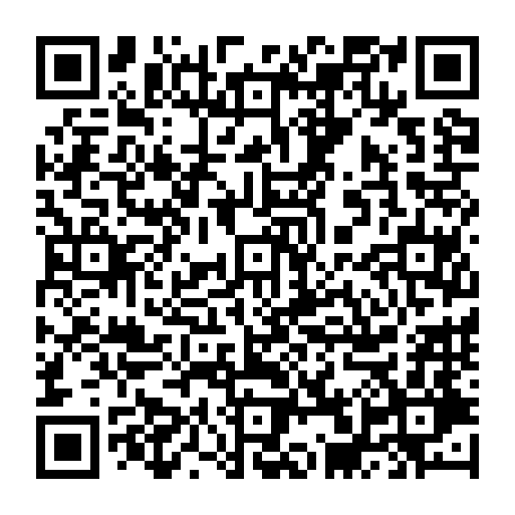
Thank You
Feel free to contact:
Jacob Barhak
jacob.barhak@gmail.com
https://sites.google.com/view/jacob-barhak/home

Slide 14
Issue #3: Restrictions
Some software may need some regulation:
  Examples include:
    some biological modeling that can be potentially dangerous
    security tools that can be used to break laws to compromise privacy
If released as open source, the code can be potentially misused
An open source license may need restrictions to prevent misuse
However, open source licenses typically discuss only permissive parts
  This may mislead naive young developers

Slide 15
Specifically for Disease Modeling
I personally called for publishing modeling code openly in a large forum:
  My calls were ignored and not documented
  Different entities look at this topic differently
A group of Scientists published a call for transparency:
https://doi.org/10.1126/science.abb8637
I called for public discussion on ways to make it possible:
  https://forum.comses.net/t/issues-with-regard-to-call-for-transparency-of-covid-19-models/8433
  One major argument was that government funded research should benefit the public

Slide 16
Should Government Fund
Open Source?
Here are some previous signs in that direction where government wants reuse of products:
Fair Access to Science and Technology Research (FASTR) Act: https://www.cornyn.senate.gov/content/news/cornyn-wyden-introduce-bill-increase-access-taxpayer-funded-research
  Focuses on publication
  Recognizes patents and national security as exceptions
Previous US administration policy:
http://blogs.nature.com/news/2013/02/us-white-house-announces-open-access-policy.html
  Focuses on mostly publication
NIH Strategic Plan For Data Science https://datascience.nih.gov/sites/default/files/NIH_Strategic_Plan_for_Data_Science_Final_508.pdf
  Mentions the word open over a dozen times with regards to data and software
However, to date NIH still allows funded bodies to retain ownership:
  https://grants.nih.gov/policy/intell-property.htm

Slide 17
Suggested Solution for
Funding Bodies and Research
Entities that fund open source should embrace the following strategy:
  The definition of open source should include licenses like CC0
  Ask software products of research to be released as open source license for the duration of funding
  The work and license should include explicit restrictions
  When research/development is abandoned, code should be released to public domain
    For example Creative Commons Zero:
    This will provide incentive for future development by private / public entities

