Slide 1


The MIcro Simulation Tool (MIST) used for Disease Modeling and Population Generation
Jacob Barhak
https://sites.google.com/view/jacob-barhak/home
2021 MIDAS Network Annual Meeting
Online: https://midas2021.exordo.com
10 - 13 May 2021

Slide 2
Disease Models at a Glance
Describe phenomenon observed in past studies
Attempt to predict future disease progression
Used to predict Costs / Quality of Life
Disease models apply a function to an initial cohort
  Markov model
  Differential equation
  Hybrid functions
Simulation can be at:
  The cohort level
  Individual level = microsimulation
Normal
Sick
Dead

Slide 3
The Basics
MIST stands for MIcro-Simulation Tool
MIST is a Python framework that supports chronic disease modeling using High Performance Computing
Some versions of MIST are free and available on GitHub:
https://github.com/Jacob-Barhak/MIST
The SimTk project web site is: https://simtk.org/home/mist
Support Mailing List:
Email address: mist-support@simtk.org
Archives: https://simtk.org/pipermail/mist-support/

Slide 4
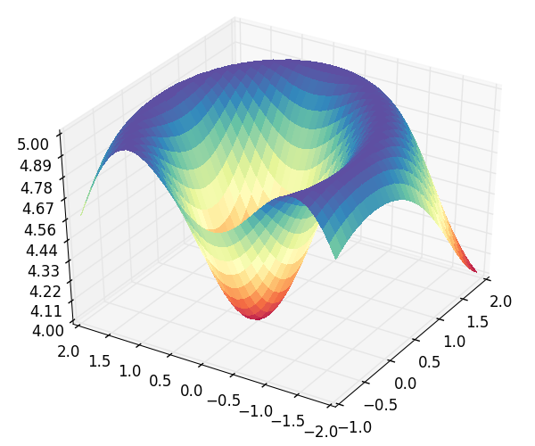
Examples of MIST Use:
Diabetes
Process CHD
Eq EH | E | E | E | E | …
Eq AD | A | B | C | D | …
Pop 1 | 4 | 6 | 2 | 1 | …
Pop 2 | 2 | 4 | 6 | 1 | …
Pop 3 | 2 | 3 | 9 | 2 | …
… | … | … | … | … | …
The Reference Model for Disease Progression
  The most validated diabetes model known
  https://simtk.org/projects/therefmodel/
aA+bB+cC+dD
Pop 3
No CHD
MI
Survive MI
CHD Death
Pop 2
Pop 1
eE+fF+gG+hH
Process Stroke
Death
No Stroke
Stroke
Survive Stroke
Stroke Death
Process Competing Mortality
Alive
Other Death

Slide 5
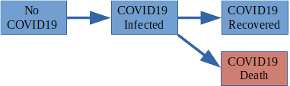
Examples of MIST Use:
COVID-19
Barhak J , The Reference Model Initial Use Case for COVID-19. Cureus 2020. http://dx.doi.org/10.7759/cureus.9455 . PMCID: PMC7392354 , PMID: 32760637 , Interactive Results available in this link
Now it is the first multi-scale ensemble model of COVID-19

Slide 6
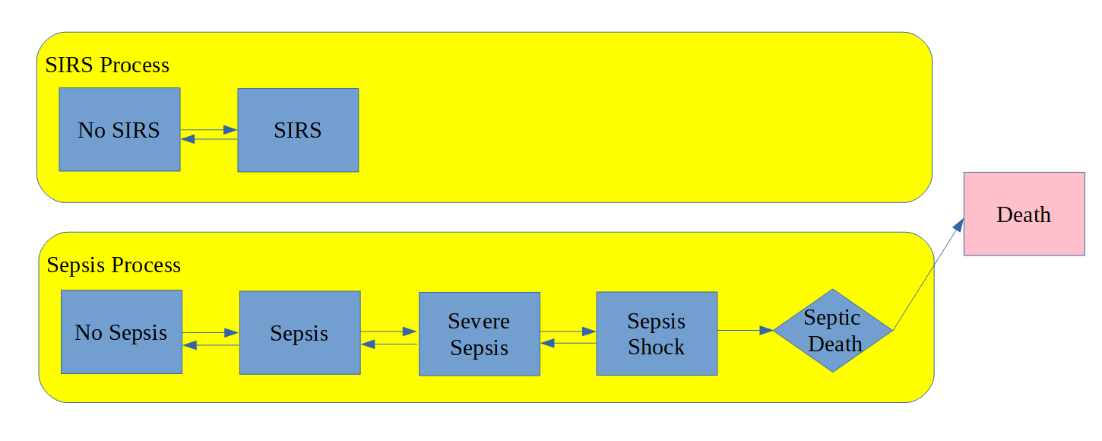
Examples of MIST Use:
Sepsis
J. Barhak, The Reference Model and Associated Technologies Towards Computational Accumulation of Medical Knowledge, GE Healthcare Sepsis Journal Club 20th August 2019.
Presentation:
https://jacob-barhak.github.io/Presentation_GE_Healthcare2019.html
Video:
https://zoom.us/recording/share/Ccr2V6Z7hFfIXUAQOHfBODFbAVRDWD4ZEThkVYa0LcywIumekTziMw

Slide 7
MIST Main Features
Form based User Interface
Domain Specific Language (DSL) for Simulation / compiler
Monte Carlo Simulation
  Multi-Process State Transition Models
  Simulation Rules
  Initialization : Population Generation from Distributions
    Evolutionary Computation Support
Report Generator
Documentation, Examples, and Support
Free Open Source Software under GPL license
Reproducibility
MIST Runs Over the Cloud!

Slide 8
How to Install
MIST works on Ubuntu Linux and on Windows
Install Anaconda distribution using python 2.7:
  Windows:
  https://repo.anaconda.com/archive/Anaconda2-2019.10-Windows-x86_64.exe
  Linux:
  https://repo.anaconda.com/archive/Anaconda2-2019.10-Linux-x86_64.sh
  It is possible to use other Anaconda distributions, yet make sure the environment is set to python 2.7 and all dependencies are installed. It is just easier with Anaconda.
Open a command line and type:
conda install mist -c jacob-barhak

Slide 9
Activate
Copy the MIST sub-directory in anaconda to a new working directory
Change directory to your working directory, e.g.
cd Desktop\MIST
To test installation on your machine type:
python TestCode.py
To launch the GUI type:
python MISTGUI.py

Slide 10
A Very Simple Disease Model
2 disease states: Alive and Dead.
The yearly probability of transition between state Alive and state Dead is: 0.05
Initial conditions: 100 people start in state Alive, none are Dead.
Output requested: Number of people in each state for years 1–10.
Implementation available through GitHub in:
https://github.com/Jacob-Barhak/Presentations/tree/master/MIDAS2021_MIST/MIST_Tutorial_Example1.zip
Alive
0.05
Dead

Slide 11
A Covariate in a Model
0.01
Healthy to Dead: 0.01
Healthy to Sick: 0.2 for Male, 0.1 for Female
Sick to Healthy: 0.1
Sick to Dead: 0.3
Initial conditions: Healthy = (50 Male, 50 Female), Sick = (0,0) and Dead = (0,0).
Output requested: How many men / women are in each disease state for each of the first 10 years?
Implementation available through GitHub in:
https://github.com/Jacob-Barhak/Presentations/tree/master/MIDAS2021_MIST/MIST_Tutorial_Example2.zip
0.2 M / 0.1F
Healthy
Sick
0.3
Dead
0.1

Slide 12
Monte Carlo Simulation
Pop
If random < OccurrenceProbability:
AffectedParameter = DefinedExpression
If random < OccurrenceProbability:
AffectedParameter = DefinedExpression
Init
Rules
Mutli-Process State Transitions
Process
CHD
No CHD
MI
Survive MI
CHD Death
Pre
State Transition Rules
Process
Stroke
Post
State Transition Rules
Death
No Stroke
Stroke
Survive Stroke
Stroke Death
Process
Competing Mortality
Alive
Other Death
Cost QoL
Biomarkers
Repeat Simulation Step

Slide 13
Simulation Language / Compiler
Strict Expression language – a subset of Python with extensions:
  Supported Types: Integer, Number, Expression, State Indicator, System Option
  Comparison: Eq, Ne, Gr, Ge, Ls, Le
  Boolean operators: Or, And, Not, IsTrue
  Special math: Inf, NaN, IsInvalidNumber, IsInfiniteNumber, IsFiniteNumber
  Mathematical functions: Exp, Log, Ln, Log10, Pow, Sqrt, Pi
  Other functions: Mod, Abs, Floor, Ceil, Max, Min
  Statistical: Bernoulli, Binomial, Geometric, Uniform, Gaussian
  Control and Data Access: Iif, Table
  Application specific: CostWizard
Features:
  Compiles into Python
  Syntax check upon expression definition
  Runtime Bound Checks
  Runtime recalculation due to out of bounds random error
MIST
Model
Python Script
Compile
Run
Results

Slide 14
Clinical Trial Populations: Background
The First Table in a Clinical Trial publication typically contains Population Statistics
  Summary Data Only: Mean (SD) / Median (IQR)
  Limited information about distribution
  Inclusion/exclusion criteria skew the distribution
Here is how it may look like:
Here is an example of one actual examples from COVID-19:
https://clinicaltrials.gov/ct2/show/results/NCT04280705
 | Control | Intervention
Age | 55 (9) | 54 (8)
% Male | 62% | 59%
Smoke | 33% | 31%
SBP | 134(19) | 137(19)

Slide 15
Population Generation Goal
The Micro Simulation Tool (MIST) supports
generation of synthetic population to mimic statistics
  Heterogeneity = generate individuals
  Multiple characteristics per individual
  Allow correlations
  Allow restrictions
Correlated
IndividualID | Male | Age | BP | …
0 | 0 | 50 | 140 | …
1 | 1 | 45 | 135 | …
2 | 0 | 22 | 120 | …
3 | 1 | 85 | 145 | …
4 | 1 | 14 | 125 | …
IndividualID | Male | Age | BP | …
0 | 0 | 50 | 140 | …
1 | 1 | 45 | 135 | …
2 | 0 | 22 | 120 | …
3 | 1 | 85 | 145 | …
4 | 1 | 14 | 125 | …
Generation Code / Equations
Restrict Age

Slide 16
Monte Carlo Initialization:
Distribution to Population Generation
The system:
  Compiles distributions into initialization code before simulation
  Automatically resolves calculation order
  Can handle inter-dependencies more complicated than statistical functions
Example:
Age ~ 61+8.2*CappedGaussian3
Male ~ Bernoulli(803/1199)
SBP ~ 133.4+16.4*CappedGaussian3
AgeAtDiagnosisOfDiabetes ~ Age - 8
Good for:
  Using published aggregate data from clinical trial publications
  Avoiding using individual data that is typically restricted
  Allowing access to more population information
Age | Male | SBP | AgeAtDiagnosisOfDiabetes
65.51415 | 1 | 129.1721 | 57.51415
53.76856 | 1 | 137.4234 | 45.76856
73.71445 | 0 | 132.8542 | 65.71445
45.79667 | 1 | 147.5537 | 37.79667
57.21742 | 1 | 122.68 | 49.21742

Slide 17
INSPYRED MIST
INSPYRED MIST can regenerate mock populations from Table 1 in clinical trials
Only publicly available summary data is used
No need to have access to restricted data
INSPYRED
Bio Inspired Computation
Table 1
by Aaron Garrett
MIST
MIcro Simulation Tool
Generate
by Jacob Barhak

Slide 18
Population Generation Process
Generation Rules:
  Define how to generate a single individual
  Test if individual fits the inclusion/exclusion criteria
  Define ties and correlations between characteristics
Objectives:
  Define aggregate targets for the entire population
  Reduce random generation error
  Handle skewed distributions to fit target
INSPYRED
MIST
Expression Compiler
Evolutionary Computation
Monte Carlo
Selection
Result
Result Population
Converges to
Objectives

Slide 19
INSPYRED Evolutionary Computation
Candidates
Generator
Evaluator
3.1
7.5
4.2
5.2
Selector
+
=
→
Generations / Epocs
Variators
Repeat
Parents
Crossover
Mutation
Terminator
Best Solution

Slide 20
Covariates Use
0.002*Age
Age increases each year by 1
Yearly cost is 100*Age +500*Sick
Starting Population
  Male ~60% , selected from Male ~50%
  Age = 50 (5) selected from Male 53(10), Female 52(7)
  Inclusion criteria is 45< Age <90
How much this disease will cost for 10 years?
Implementation available through GitHub in:
https://github.com/Jacob-Barhak/Presentations/tree/master/MIDAS2021_MIST/MIST_Tutorial_Example3.zip
0.2 M / 0.1F+Age*0.002
Healthy
Sick
0.3
Dead
0.1

Slide 21
Population Generation Example
Skewed by Inclusion/Exclusion
Age | Male
48.85785535 | 0
59.94741744 | 0
56.19039096 | 1
64.40825341 | 0
49.77582796 | 1
60.29975596 | 1
51.27571792 | 1
72.13820388 | 1
55.51746037 | 0
58.72574003 | 0
Generate 10 people with:
  Inclusion criteria is 45< Age <90
  The base population distribution is:
    Age for Male: Mean 53 SD 10
    Age for Female: Mean 52 SD 7
    Male: 50%
Generation Functions (Implementation):
Age ~ Iif (Male,Gaussian(53,10) ,Gaussian(52,7))
Male ~ Bernoulli(0.5)
Assert = And(Gr(Age,45),Ls(Age,90))
Notes:
  May not represent well what was intended
  Assertion drops non qualifying candidates
  The resulting Age is skewed
Design is Subject to Constraints
Final population has skewed distribution we cannot control:
Age Mean: 57.71366233
Age SD: 7.115024093
Male Mean: 0.5
Constraints skew distribution

Slide 22
Population Generation Example
With Objectives & INSPYRED
Age | Male
50.8953429 | 0
53.71135174 | 1
52.86278825 | 0
46.021901 | 1
48.36662032 | 1
47.87355499 | 1
45.11370607 | 1
62.15347882 | 1
47.48350736 | 0
45.93131347 | 0
Generate 10 people with objectives:
  Base distribution & Inclusion criteria as before:
  Age ~ M:53(10) F:52(7) 45< Age<90 , 50% Male
  Age Objective: Mean 50, SD 5
  Male Objective: 60%
Objectives (Implementation):
Age Mean: 50 , Weight 1
Age SD: 5 , Weight 1
Male: 0.6 , Weight 10
Notes:
  Population distributions is skewed to match objectives
  Useful for generating populations, e.g. clinical trials
Final population selected from 1000 generated candidates:
Age Mean: 50.04135649
Age SD: 5.166548964
Male Mean: 0.6

Slide 23
Reproducibility
MIST stores random state of each simulation
MIST can recreate a simulation from Trace Back upon request
MIST records additional traceability information in compiled simulation files to help debugging
Good For:
  Saving storage space
  Debugging
  Distributing results & publication

Slide 24
MIST Runs Over the Cloud!
Anaconda and StarCluster drive MIST to run over the Amazon cloud!
Demo available in: https://youtu.be/wpfw8POx-wI?t=1500
Batch mode MIST utilities allow:
  Submitting jobs to Sun Grid Engine (SGE)
  Running simulations
  Generating reports
  Combining reports from multiple repetitions/scenarios
Star Cluster creates an SGE cluster on the Amazon Elastic Compute Cloud
The Anaconda Amazon Machine Image (AMI) are used
Good for:
  Cutting down computation time by renting computing power
  Saving initial and maintenance costs associated with a cluster
MIST
Cloud

Slide 25
Summary & Points to Remember
MIST stands for MIcro Simulation Tool
MIST is designed to support disease modeling
MIST supports population generation
MIST runs over the cloud!
MIST is free and available on GitHub: https://github.com/Jacob-Barhak/MIST

Slide 26
Acknowledgments
Deanna J.M. Isaman - who is the spirit behind the great ideas. She taught me my first steps in disease modeling
Aaron Garrett – for his responsiveness and help with starting with Inspyred – he saved me at least a months work if not two by sending me solution code within one day.
All those who developed free software used and supported it: including Python, Anaconda, Spyder, numpy, SciPy, nose, winpdb, Star Cluster, Ubuntu, Sun Grid Engine
The legacy IEST modeling framework was supported by the Biostatistics and Economic Modeling Core of the MDRTC (P60DK020572) and by the Methods and Measurement Core of the MCDTR (P30DK092926), both funded by the National Institute of Diabetes and Digestive and Kidney Diseases. The modeling framework was initially defined as GPL and was funded by Chronic Disease Modeling for Clinical Research Innovations grant (R21DK075077) from the same institute. MIST is based on IEST.
The Reference Model and MIST were developed independently without financial support

Slide 27
Questions?
Jacob Barhak
https://sites.google.com/view/jacob-barhak/home

