Slide 1
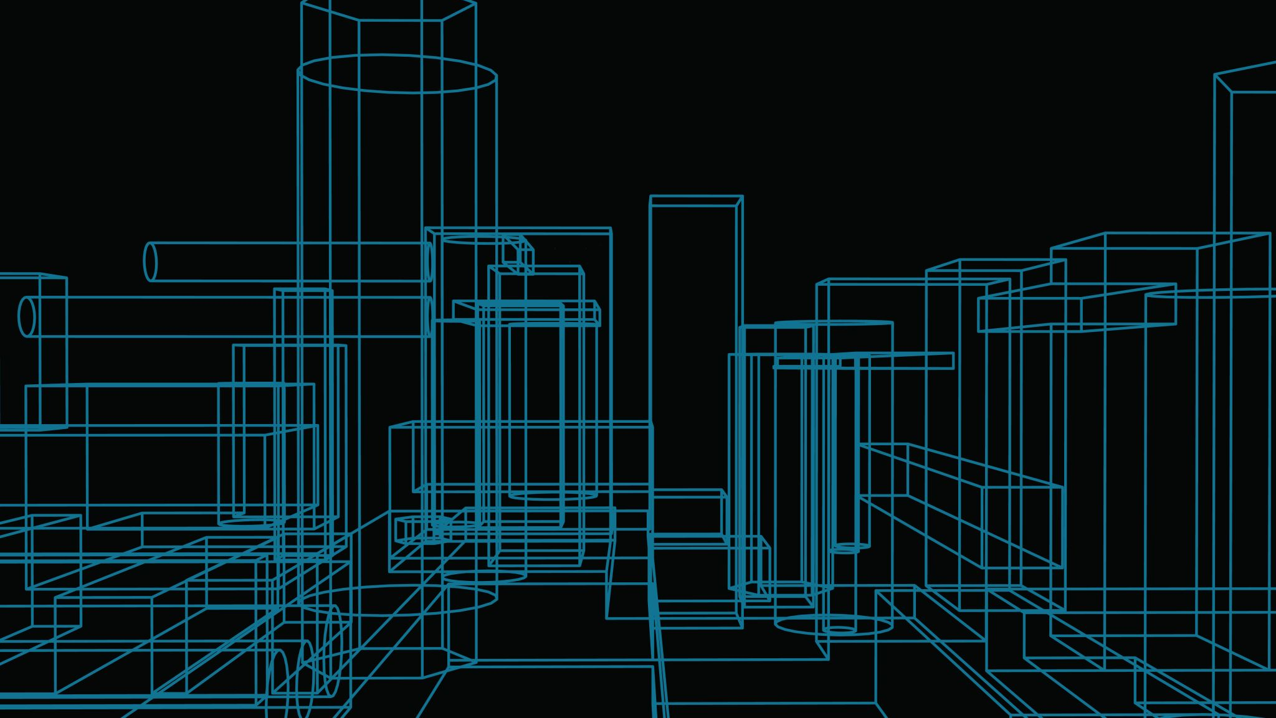
Pocket Chef Retrospective
By PocketChef.Inc

Slide 2
Backlog
Android Framework
Remote Database
Local Database
Appealing GUI
Phone to Remote communication
RemoteDB Input Form
Multiple Frames
Local & Remote Queries
Camera Access
GUI Concept
App to local Communication
Barcode Response

Slide 3
Ricardo
Jacob
Android Framework
Remote Database
Local Database
Appealing GUI
Phone to Remote communication
RemoteDB Input Form
Multiple Frames
Local & Remote Queries
Camera Access
GUI Concept
App to local Communication
Jhamon
Kyle
Barcode Response
Lihn

Slide 4
Ricardo
Jacob
Remote Database
Android Framework
Phone to Remote communication
Multiple Frames
Barcode Response
Appealing GUI
GUI Concept
Local Database
Kyle
Jhamon
Local & Remote Queries
Camera Access
RemoteDB Input Form
App to local Communication
Lihn

Slide 5
Commits & Velocity
Total Number of Stories: 12
Total Number of Story Points: 26

