Slide 1
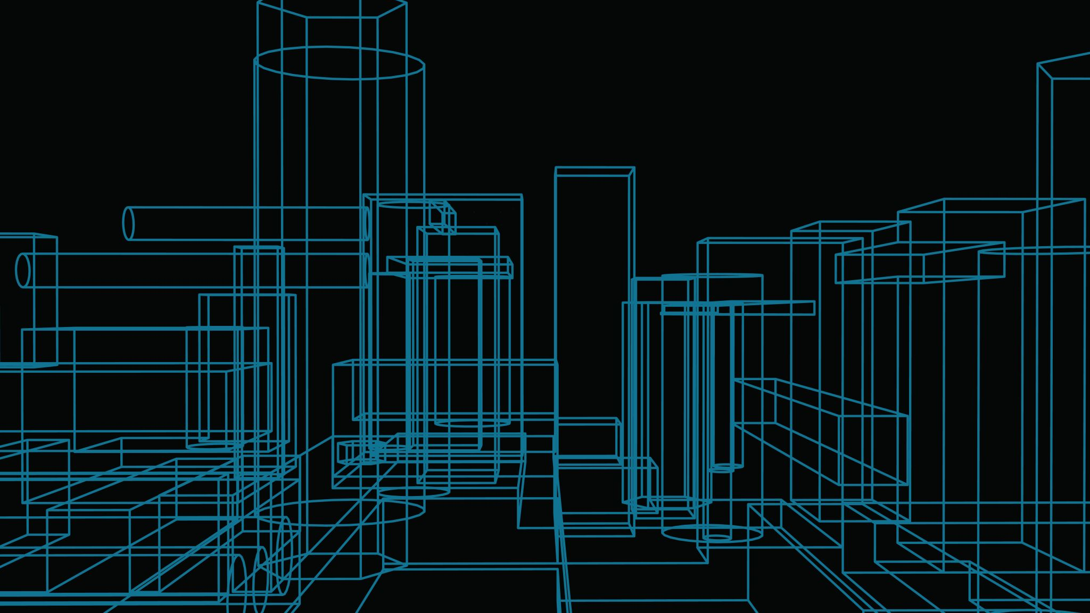
Pocket Chef Retrospective
By PocketChef.Inc

Slide 2
Backlog
Android Framework
Remote Database
Local Database
Appealing GUI
Phone to Remote communication
RemoteDB Input Form
App Navigation
Local & Remote Queries
Camera Access
GUI Concept
App to local Communication
Card View

Slide 3
Ricardo
Jacob
Android Framework
Remote Database
Local Database
Appealing GUI
Phone to Remote communication
RemoteDB Input Form
App Navigation
Local & Remote Queries
Camera Access
GUI Concept
App to local Communication
Jhamon
Kyle
Card View
Linh

Slide 4
Card View
Ricardo
Jacob
Remote Database
Android Framework
Phone to Remote communication
App Navigation
Appealing GUI
GUI Concept
Local Database
Kyle
Camera Access
Jhamon
Local & Remote Queries
RemoteDB Input Form
App to local Communication
Linh

Slide 5
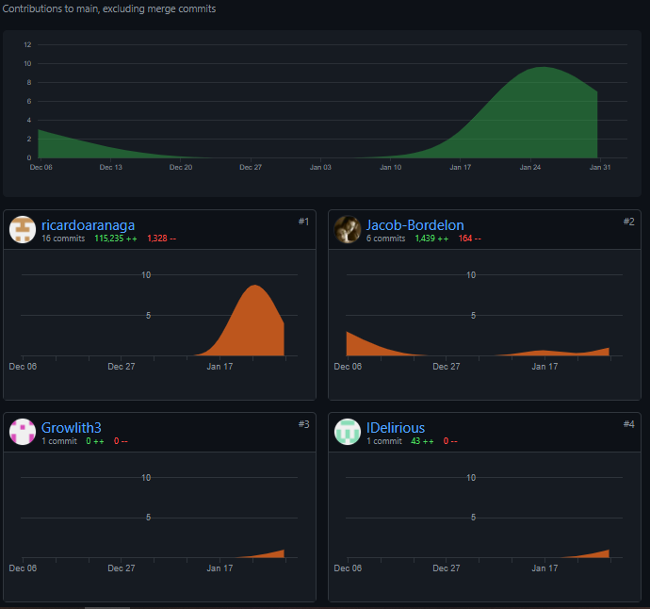
Github Commits
Object | Total
Commits | 45
Merges | 2
Pull requests | 1
*** WE SCREWED UP THE CONTRIBUTIONS STATISTICS***
- Everyone Contributed, we squashed commits then pushed rather than opening pull requests.

Slide 6
Sprint Velocity
Estimate | User Stories | Story Points | Velocity (Pts/Sprint)
Overall Project | 28 | 131 | 26.2
Sprint 1 | 12 | 36 | 36
Actual | User Stories | Story Points | Velocity (Pts/Sprint)
Sprint 1 (Complete) | 10 | 19 | 19
Adjusted | User Stories | Story Points | Velocity (Pts/Sprint)
Sprints 2-5 | 18 | 112 | 28

Slide 7
What We Learned
Open Pull Request instead of squashing
We learned about android studio and working with the emulator
REST API’s and communication between live servers
We learned standups are important
Its important that we are on the same page

Slide 8
What we will do next sprint
Implement Github actions to automate build and testing of the app before deployment
Implement fail safes, custom error codes, and troubleshoot procedures
Implement a style to the app
Implement a card style visual to the app
Input items using barcode scanner
Access the camera
Be assigned tasks rather than picking your own

