Slide 1

Pocket Chef Retrospective
By PocketChef.Inc

Slide 2
Backlog
Automated test
Remote Database
tests
Local database
Input and retrieval
Appealing GUI
Manual test
Send recipes to server
Camera Access
Image Recog Research
Card View
redesign the upload screen

Slide 3
Ricardo
Jacob
Automated test
Remote Database
tests
Local database
Input and retrieval
Local database
Input and retrieval
Appealing GUI
Manual test
Send recipes to server
Camera Access
Image Recog Research
Card View
Jhamon
Kyle
Card View
redesign the upload screen
Linh

Slide 4
Card View
Ricardo
Jacob
Remote Database
tests
Automated test
Local database
Input and retrieval
Manual test
Appealing GUI
Card View
Local database
Input and retrieval
Kyle
Image Recog Research
Jhamon
Camera Access
Send recipes to server
redesign the upload screen
Linh

Slide 5
How were standups held?
Date | Discussed | Status
^{February 5} | * Manual testing programs through Espresso * Uploading recipes to the remote database from phone | Complete Complete
^{February 8} | * Github automated testing program * Remote database testing program | Complete Complete
^{February 10} | ^{* Bug fixes} ^{* Configuring local database} ^{* Reformatting upload form} | Complete Complete Complete
^{February 12} | ^{* Card view layout} ^{* GUI appearance} | Complete Incomplete
^{February 22} | ^{* Accessing camera} ^{* Sprint deliverable} | Incomplete Complete

Slide 6
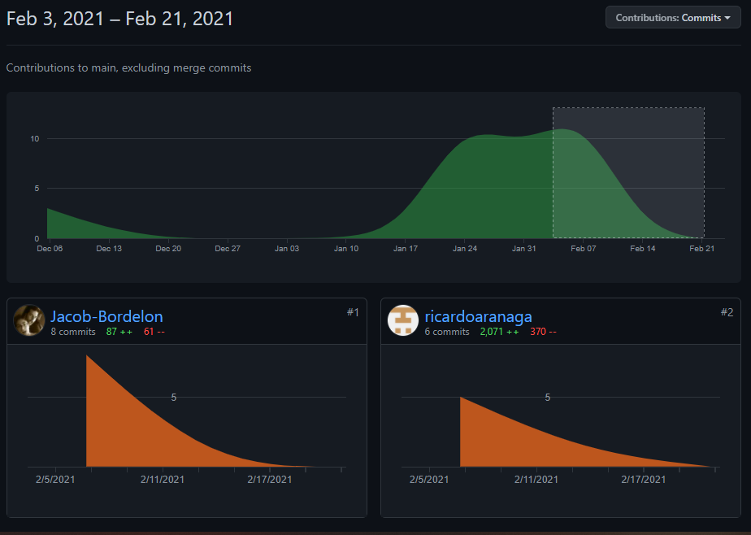
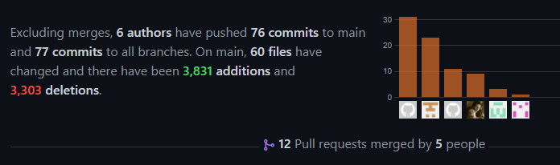
Github Commits
Object | Total
Commits | 76
Merges | 20
Pull requests | 16
Note: We are still having issues with our Github. Every member did contribute even if not displayed in the graph

Slide 7

Sprint Velocity

Slide 8
What We Learned
How to configure automated tests in Github through Github actions
How to configure behavior tests through Espresso
How to configure remote server infrastructure tests
How to store items locally on the device
How to design and layout fragments
How to connect data between fragments
How to design and operate the recycler and card view
How to upload and retrieve data from the remote database

Slide 9
What we will do next sprint
Figure out how to properly manage the contributions graph on github
Access the camera
Add functionality to the cards
Implement a card view to both the generate and pantry
Begin designing the image recognition system
Research the limitations of remote databases
Research and manage the resources (battery, memory, etc)

