Slide 1
Research Questions
How do projected post-2050 increases in monthly aggregated maximum near-surface air temperature (TREFMXAV_U) vary across scenario and season, and does Manchester follow the wider regional pattern?
Which covariates appear most important for predicting TREFMXAV_U?
Group 2
Members: Jacob Woodland, Yuhui Duan, Ruiqi Huang
Date: 22/4/2026

Slide 2
Study Area
These unique geographic features mean:
Manchester (53.48°N, 2.24°W) is a major urban center in northwest England with a maritime temperate climate (influenced by the North Atlantic Oscillation, urban heat island (UHI) effects, and proximity to the Irish Sea).
1
TREFMXAV_U is sensitive to coastal air masses and wind patterns.
Urbanization amplifies baseline temperatures, so climate variables linked to UHI interact with global climate drivers in this region.
2

Slide 3
Reproducibility and GitHub Management
Workflow
Repository structure
eds_project2/
|___ README.md
|___ environment.yml
|___ LICENSE
|___ tests
| |___ test_evaluation.py
| |___ test_holdout.py
|___ data/
| |___ raw/
| |___ processed/
| |___ interim/
|___ notebooks/
| |___ 03_modelling_xgboost.ipynb
| |___ 04_post2050_predictions.ipynb
|___ scripts/
| |___ make_monthly_dataset.py
|___ src/
| |___ config.py
| |___ data_loading.py
| |___ preprocessing.py
| |___ features.py
| |___ holdout.py
| |___ evaluation.py
|___ outputs/
| |___ figures/
| |___ tables/
|___ presentation/
|___ trefmxavu_post2050_presentation.pptx
Raw NetCDF data
Preprocessing / monthly aggregation
Validate models on pre-2050 folds
Fit final model on all pre-2050 data
Evaluate on post-2050 holdout
Interpret scenario / season / spatial / Manchester-focused patterns
Notes:
Structured to be reproducible
Defined workflow and repo organised into clear folders
Two main notebooks separate model development from post-2050 evaluation and analysis = clean workflow

Slide 4
Reproducibility and GitHub Management
Reproducibility features
Version control example
1
Structured GitHub repository with separate folders for data, notebooks, scripts, outputs, and source code.
The small extract of the Git flow graph below demonstrates the use of branches and merges back into main to ensure a clean project history.
* e9755c0 (main) Final presentation updates
* 30753c1 Merge branch 'analysis/spatial-prediction-maps'
|\
| * 7dc739e (analysis/spatial-prediction-maps) Spatial mapping edits
* | 22ec4ad (analysis/feature-importance-finalise) Feature importance analysis
|/
* 6bfd8a2 Start post-2050 analysis
2
Environment captured in environment.yml to support reproducible setup.
3
Version control with multiple branches for ablation analysis, spatial mapping, feature-importance analysis, and final research-question analysis.
4
Notebooks and scripts organised by workflow stage to separate model development from post-2050 evaluation and analysis.
Notes:
Project workflow designed to be reproducible from the start
Dedicated environment which is clearly recorded
Used branches for different analysis strands
Before merging back to main
Separate tasks could be worked on without breaking main project history

Slide 5
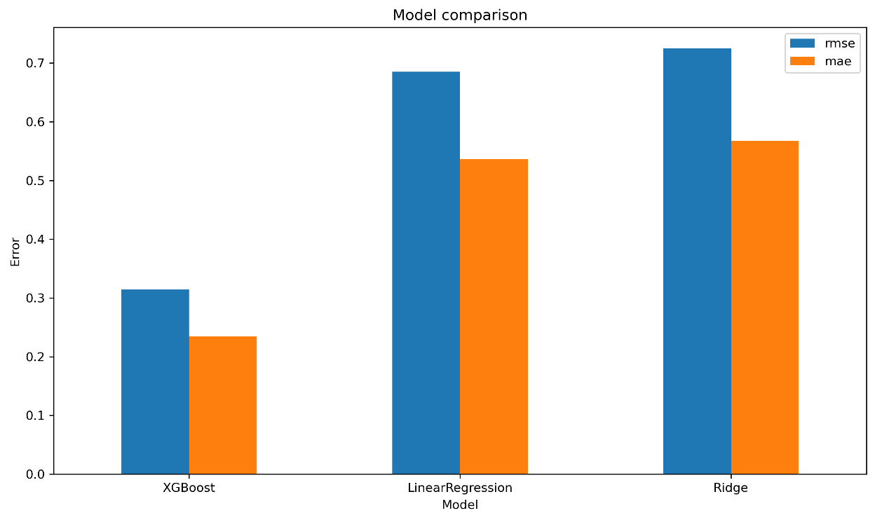
Modelling Approach
2
Selected model: XGBoost.
Model comparison: XGBoost vs linear regression vs ridge regression
Cross-validation strategy: expanding windows with pre-2050 validation periods.
Compared against: linear regression and ridge regression benchmarks.
Supporting analyses: feature importance and TREFHT ablation.
1
Cross-validation folds
Fold number | Training period | Validation period
1 | 2006 - 2029 | 2030 - 2034
2 | 2006 - 2034 | 2035 - 2039
3 | 2006 - 2039 | 2040 - 2044
4 | 2006 - 2044 | 2045 - 2049
XGBoost strongly outperformed linear baselines.
Justifying the use of a modelling approach that can handle non-linear relationships.
Notes:
Main approach xgboost – compared with linear and ridge baselines
Target = monthly mean of maximum ref height urban temp – avoid daily noise and see long-term trends
Xgboost since we thought climate relationships were likely to be non-linear
Expanding window cv = max. utilisation of data, prevents leakage
Key result is that xgboost clearly outperformed baselines, justifying its use in later analyses

Slide 6
Feature Engineering
1
What went into the model
2
How features were engineered
Climate predictors
Daily climate variables aggregated to monthly scale.
TREFHT, FLNS, FSNS, PRECT, PRSN, QBOT, UBOT, VBOT.
Derived predictor
Temperature and radiation variables represented by monthly means.
Wind speed from UBOT and VBOT.
Time features
Precipitation and snowfall represented by monthly totals.
Year, cyclical month encoding (month_sin, month_cos).
Context features
Lagged predictors added to capture short-term temporal memory.
Scenario, latitude/longitude.
Goal: represent seasonal structure, spatial variation, scenario differences, and short-term persistence in TREFMXAV_U
Notes:
We built the model from a mix of climate, time, and spatial features
Climate variables inc temp, radiation, precipitation, humidity, wind components, snowfall-related inputs
Derived wind speed from components
Added year and cyclical month encoding to capture seasonality
Lat/lon/scenario added so model could learn spatial and scenario-level differences
Daily values agg to monthly scale – means for temp/radiation, sums for precipitation/snowfall
Lagged features added to capture short-term temporal memory e.g. the previous month’s climate variables may play an important role
Feature set designed to represent a good variety of covariates

Slide 7
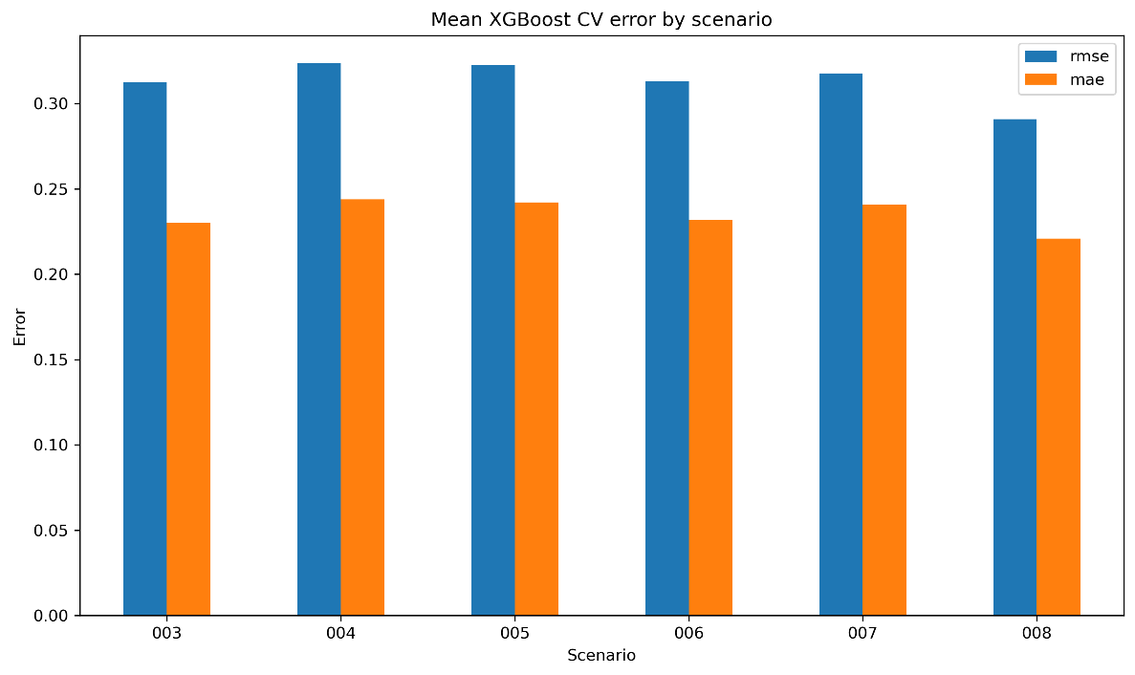
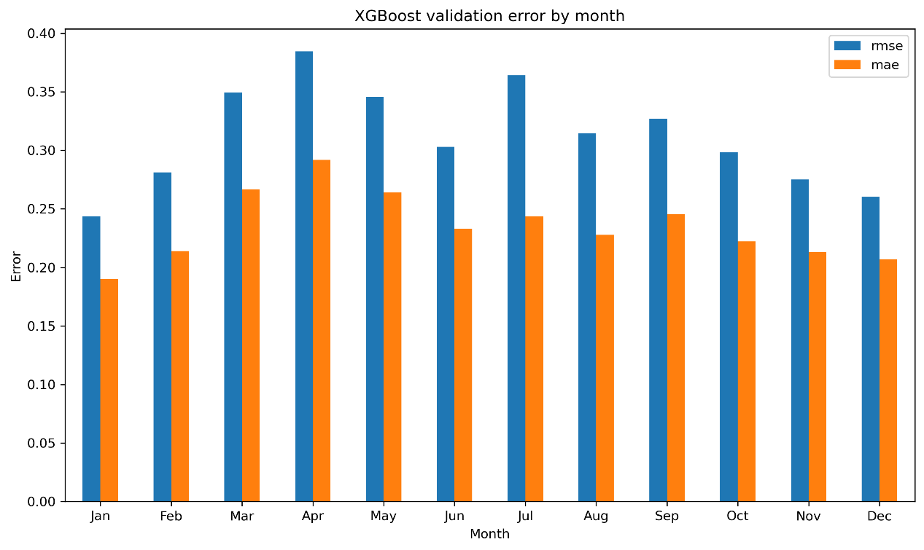
Model Performance
1
2
Model performance across scenarios
Model performance across months
Model performance is broadly consistent across scenarios.
Scenario 008 appears easiest to predict, while 004 and 005 are slightly harder.
RMSE is consistently higher than MAE.
The gap between RMSE and MAE remains similar across scenarios.
Model performs well overall, but accuracy is not uniform across the year.
Errors are lowest in winter and rise and peak in spring.
Second weaker performance peak in summer.
RMSE rises more sharply than MAE in the harder months.
Pre-2050 CV shows strong model skill; final model was then checked on true post-2050 holdout data.
Notes:
Shows how xgboost performed in pre-2050 cv
Consistent across scenarios
RMSE > MAE indicates that the model likely makes a few larger errors within each scenario.
Similar gap suggests the overall error structure is stable across scenarios.
Sharper RMSE rise in harder months indicates not just higher average error but some larger misses or outliers in those periods.
This is only first step – then checked final model against true holdout post-2050 data
Before that holdout check, we also examined which predictors were most important for the model

Slide 8
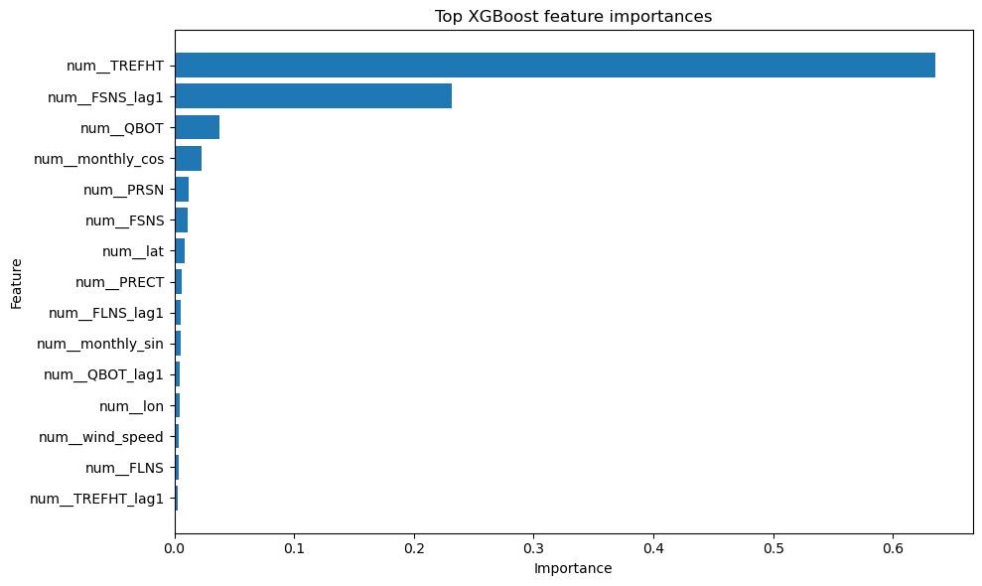
Feature Importance
Ranked feature importances for the full XGBoost model
Interpretation
TREFHT is the dominant predictor by a large margin (importance ~0.64).
FSNS_lag1 is the second most important feature, suggesting that shortwave energy input from the previous month also contributes meaningfully to prediction (importance ~0.23).
Most remaining variables have much smaller importances, implying the model’s predictive skill is concentrated in a small set of key predictors.
This motivated an ablation test to assess how strongly model skill depended on TREFHT.
Notes:
The standout result is reference height temperature is by far the most dominant predictor
Previous month shortwave radiation also matters
Many other variables contribute much less – predictive skill concentrated in small no of inputs
Raised Q – how dependent is model skill on TREFHT?

Slide 9
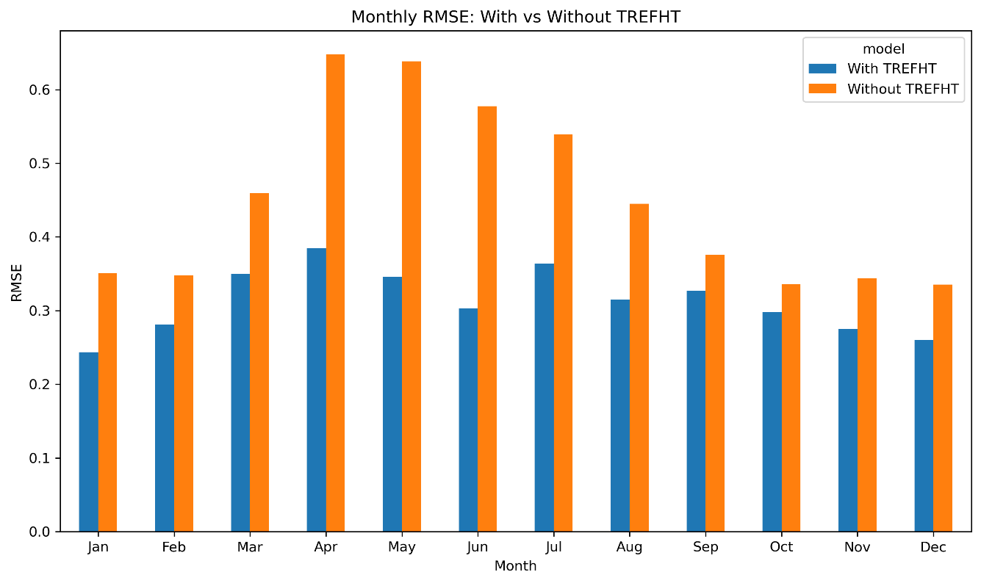
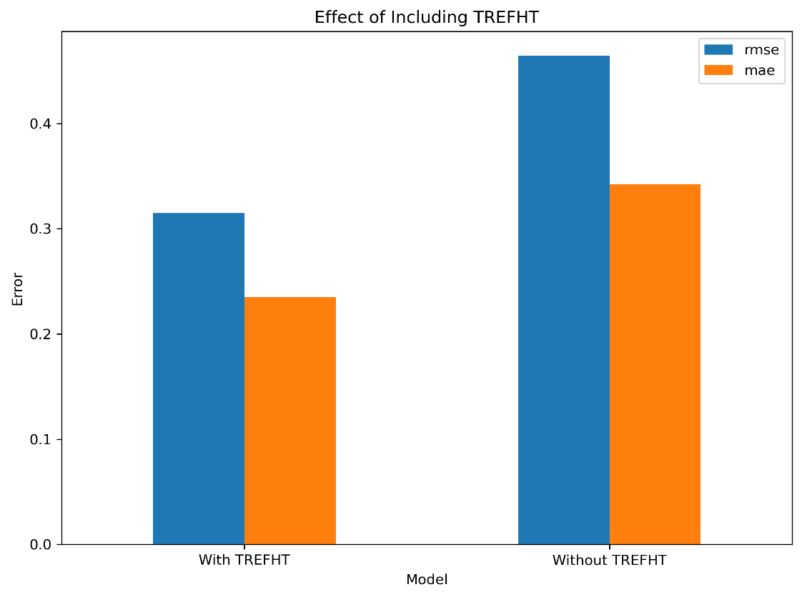
TREFHT Ablation
2
Removed features: TREFHT and TREFHT_lag1.
Seasonal impact of removing TREFHT
1
Largest deterioration
Overall impact of removing TREFHT
Removing TREFHT substantially worsens model performance overall.
The largest deterioration occurs in spring and summer.
TREFHT carries a major share of predictive signal, particularly in the months that are already hardest to model.
Without TREFHT:
RMSE rises from ~0.31 to ~0.46.
MAE rises from ~0.23 to ~0.32.
Notes:
Removed TREFHT and its lagged version
Performance worsened substantially
Biggest deterioration in spring/summer which were already hardest seasons
Confirms that TREFHT carries large share of predictive signal
Finally, once selected, tested model on true post-2050 holdout period

Slide 10
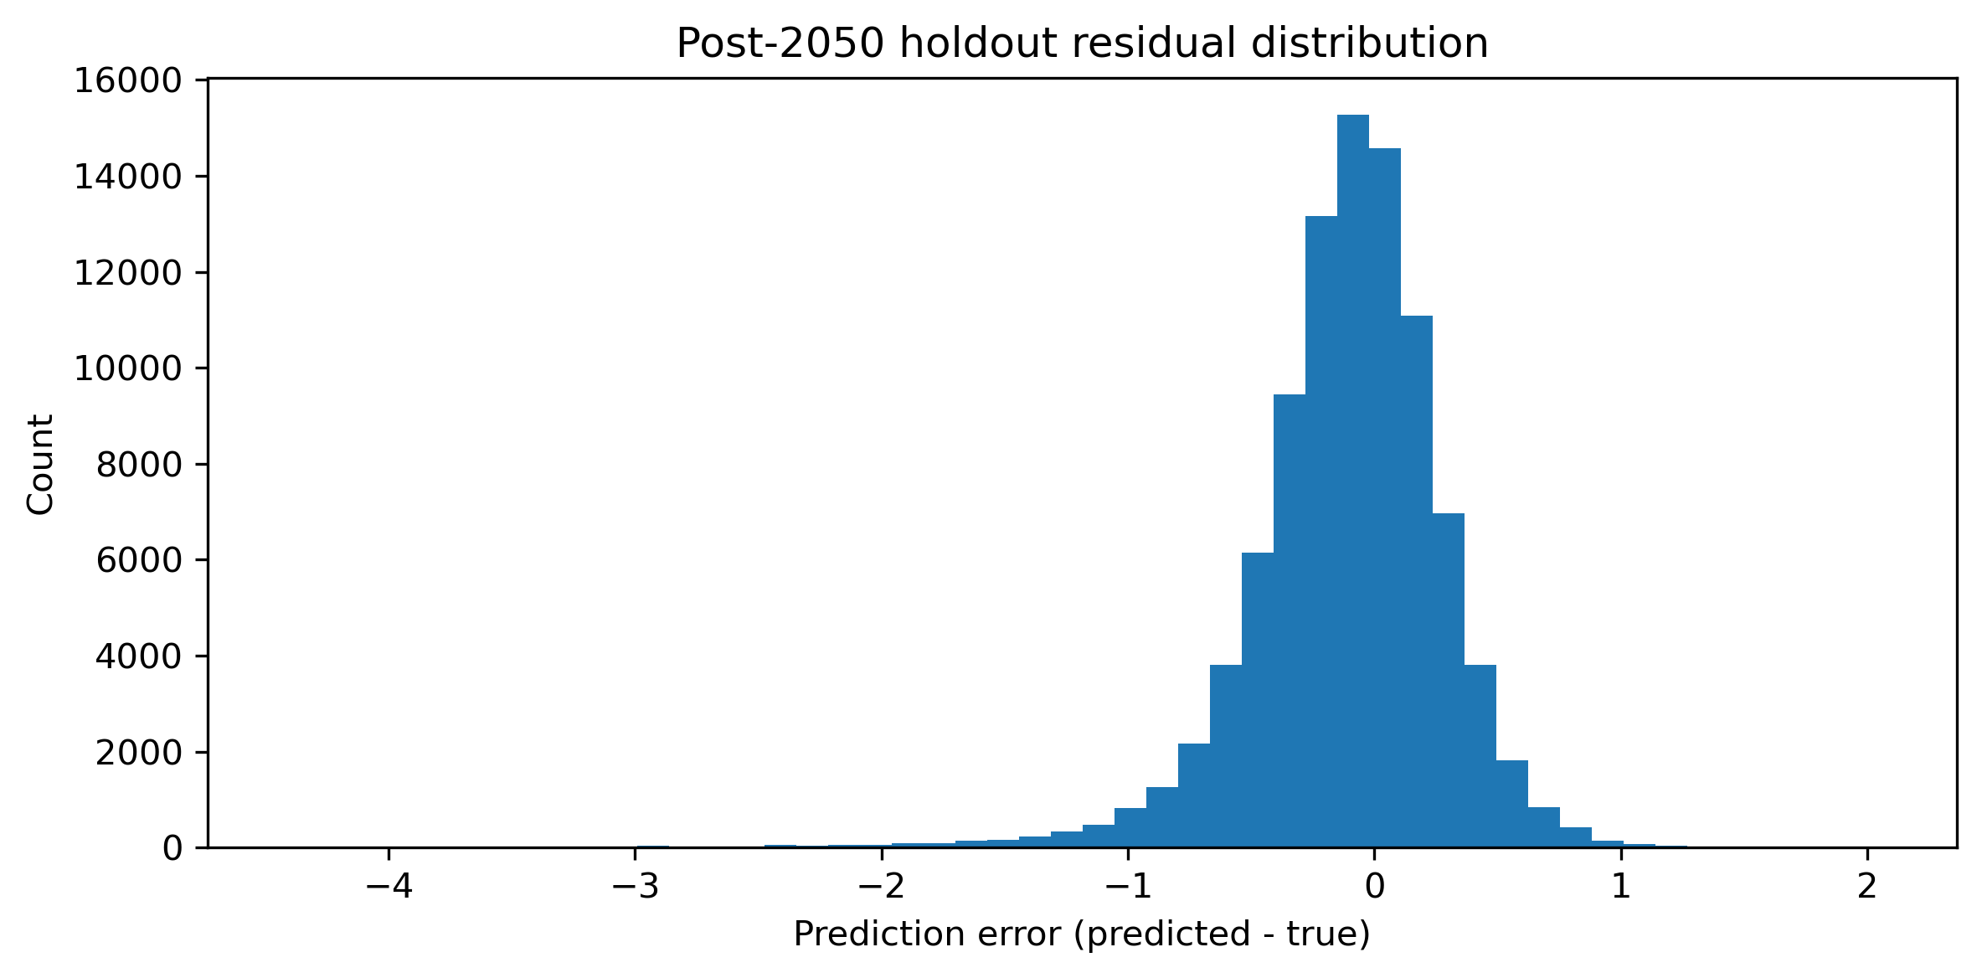
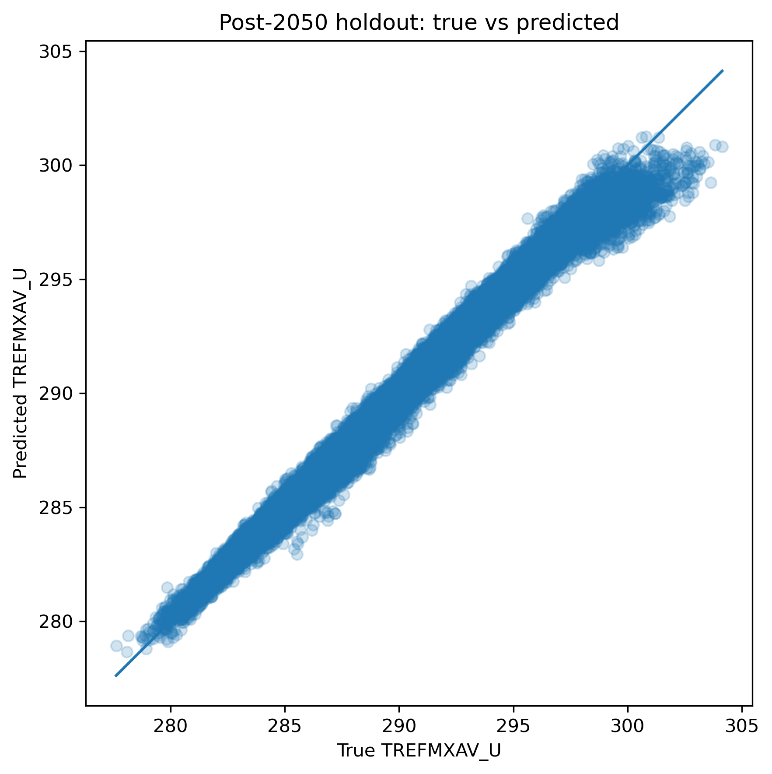
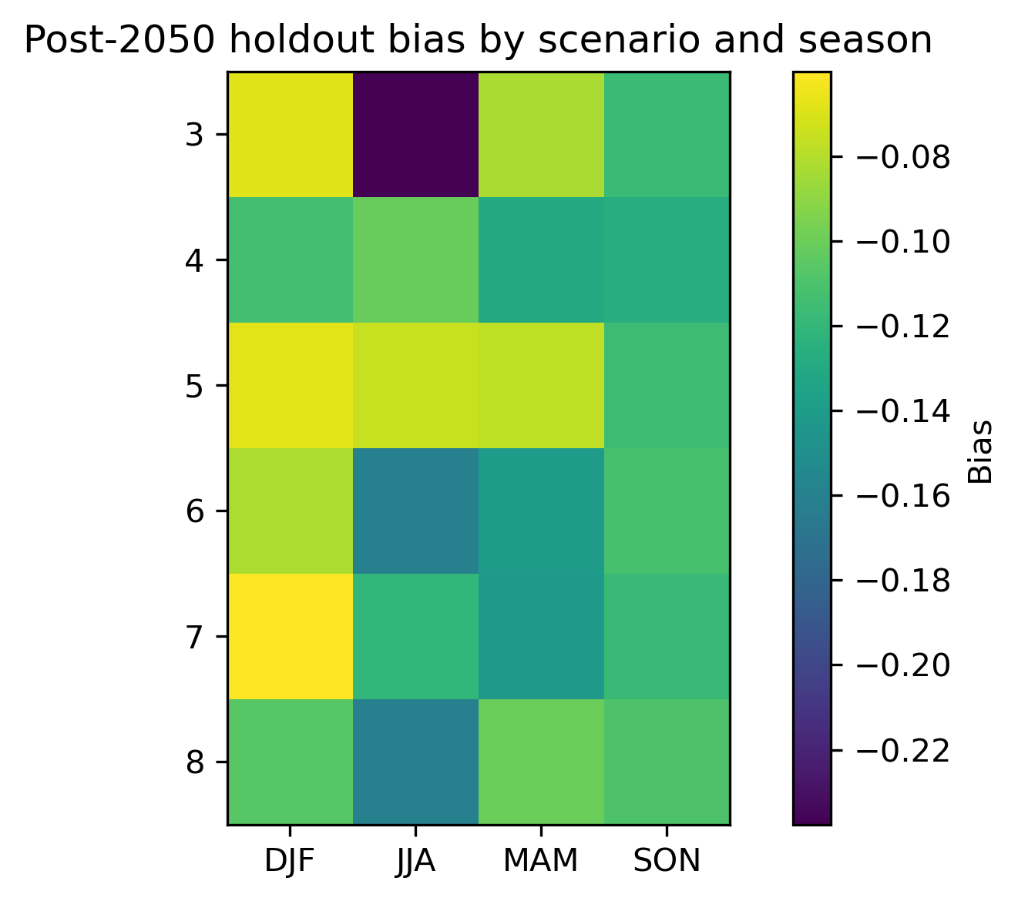
Post-2050 Holdout Evaluation
1
2
Predicted vs actual values
Overall holdout skill remained strong:
RMSE = 0.413
MAE = 0.291
R² = 0.992
bias = -0.113
Scenario performance remained stable (0.380 ≤ RMSE ≤ 0.448)
Seasonal difficulty remained uneven
3
Notes:
This is the key bridge between model development and the climate interpretation slides
Overall holdout performance remained strong
Stable performance across scenarios
Seasonal difficulty remained uneven but this is consistent with cv
This gave confidence that post-2050 scenario and seasonal patterns are meaningful rather than unchecked extrapolation
Hand over to now interpret those post-2050 prediction patterns

Slide 11
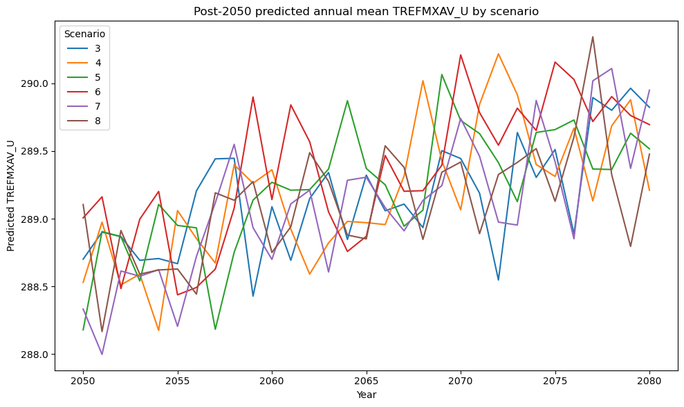
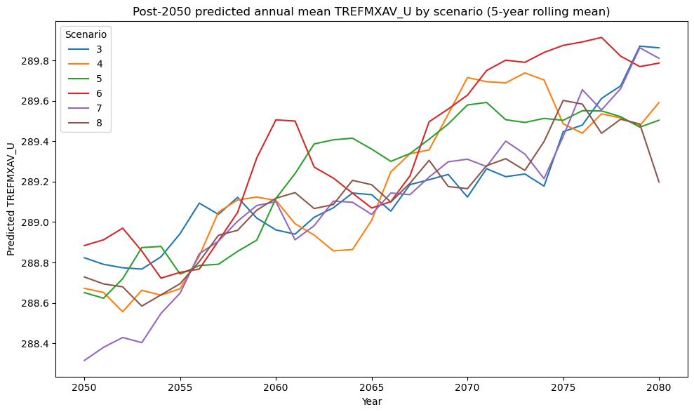
Annual Prediction Trajectories by Scenario
1
Post-2050 predicted annual mean TREFMXAV_U by scenario
2
Post-2050 predicted annual mean TREFMXAV_U by scenario (5-year rolling mean)
Remove noise
Smoothed trend
All scenarios exhibit strong inter-annual variability.
The upward trend in TREFMXAV_U across all scenarios becomes clear, confirming consistent warming over the 30-year period.
All scenarios exhibit an upward trend overall.

Slide 12
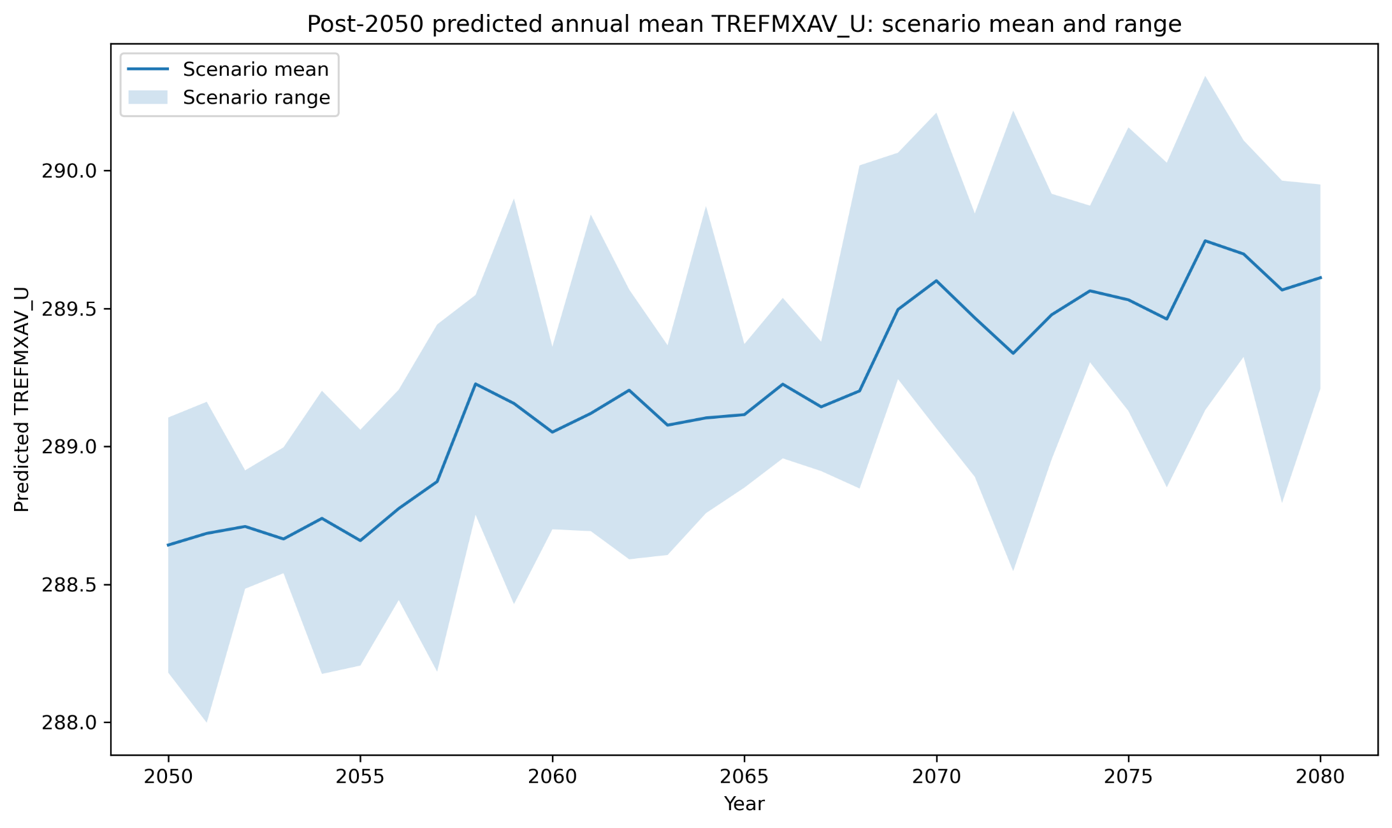
Predicted Annual Mean TREFMXAV_U
1
2

Slide 13
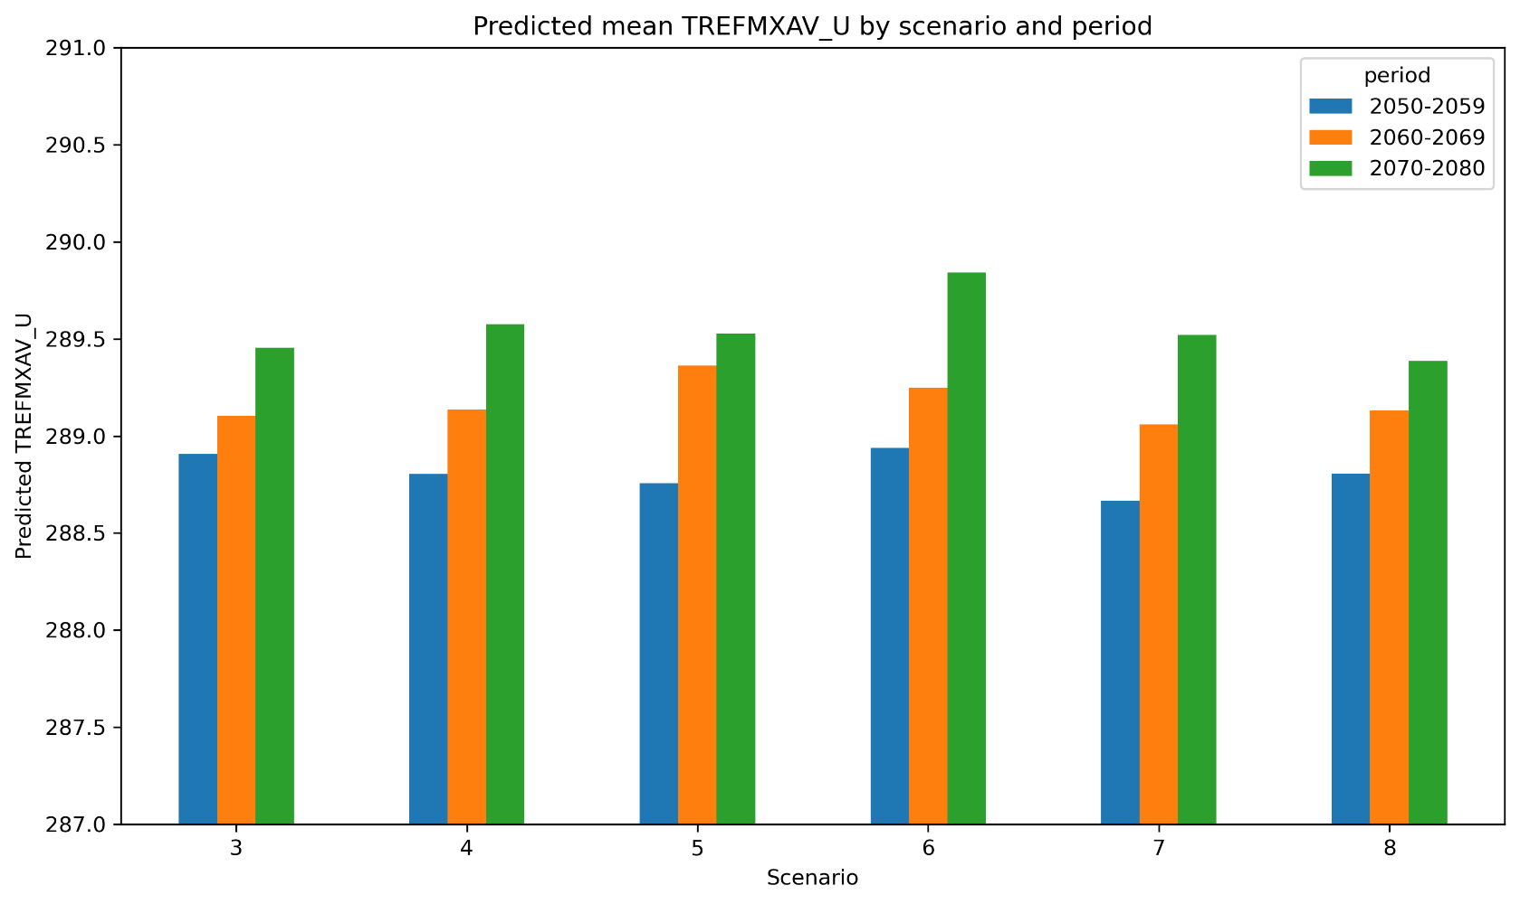
Predictions by Scenario and Period
This bar chart aggregates TREFMXAV_U into three periods (2050-2059, 2060-2069, 2070-2080)
2050-2059
2060-2069
2070-2080
For all scenarios, the mean TREFMXAV_U increases across periods:
2050-2059 < 2060-2069 < 2070-2080
2050-2059 shows the smallest cross-scenario differences, while 2070-2080 shows the largest, indicating divergent warming trajectories across scenarios over time.
Confirming the long-term warming trend

Slide 14
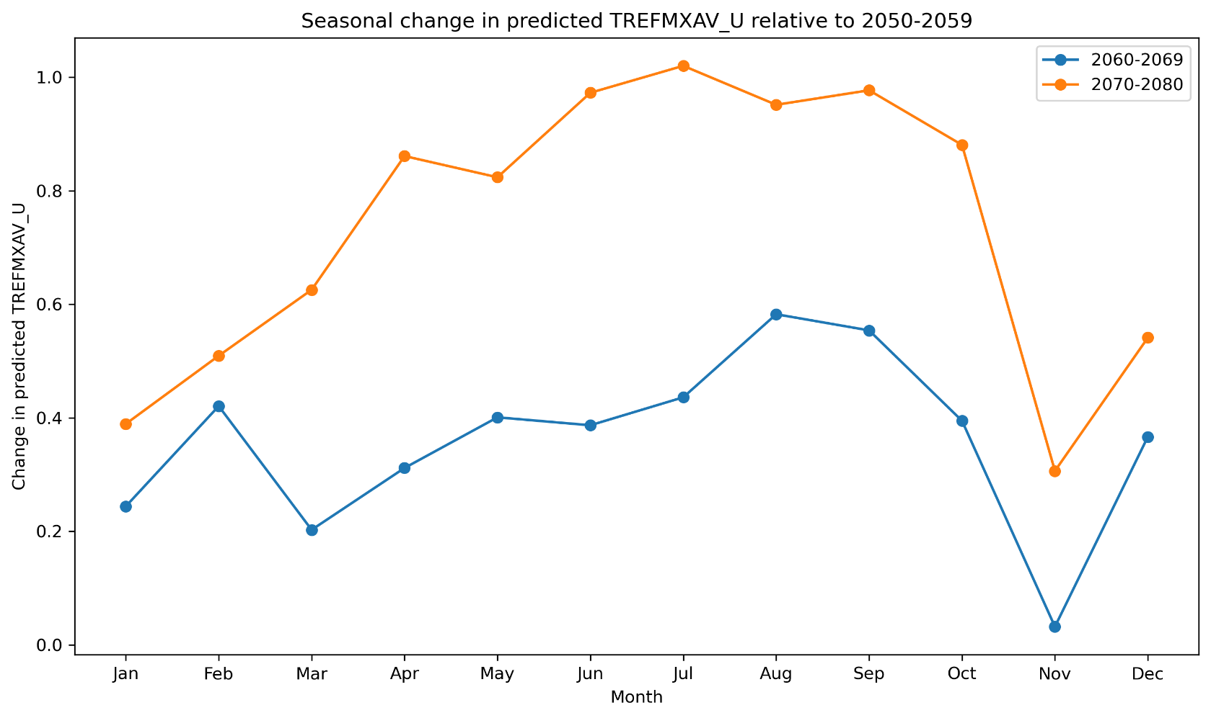
Seasonal Amplification
This line graph demonstrates the changing seasonality of TREFMXAV_U compared to a baseline period (2050-2059)
Projections for 2070–2080 show larger increases relative to the baseline across all months than those for 2060–2069.
All months exhibit warming.
However, the seasonality of TREFMXAV_U predictions changes across periods:
The warm season appears to lengthen later in the century.
Warm- vs cold-season variation becomes more extreme later in the century.
Baseline: 2050-2059
Notes:
Holdout errors are low overall and so this can be interpreted with confidence.
However, if there were a part to treat with caution, it’s the warm-season since those errors are larger.

Slide 15
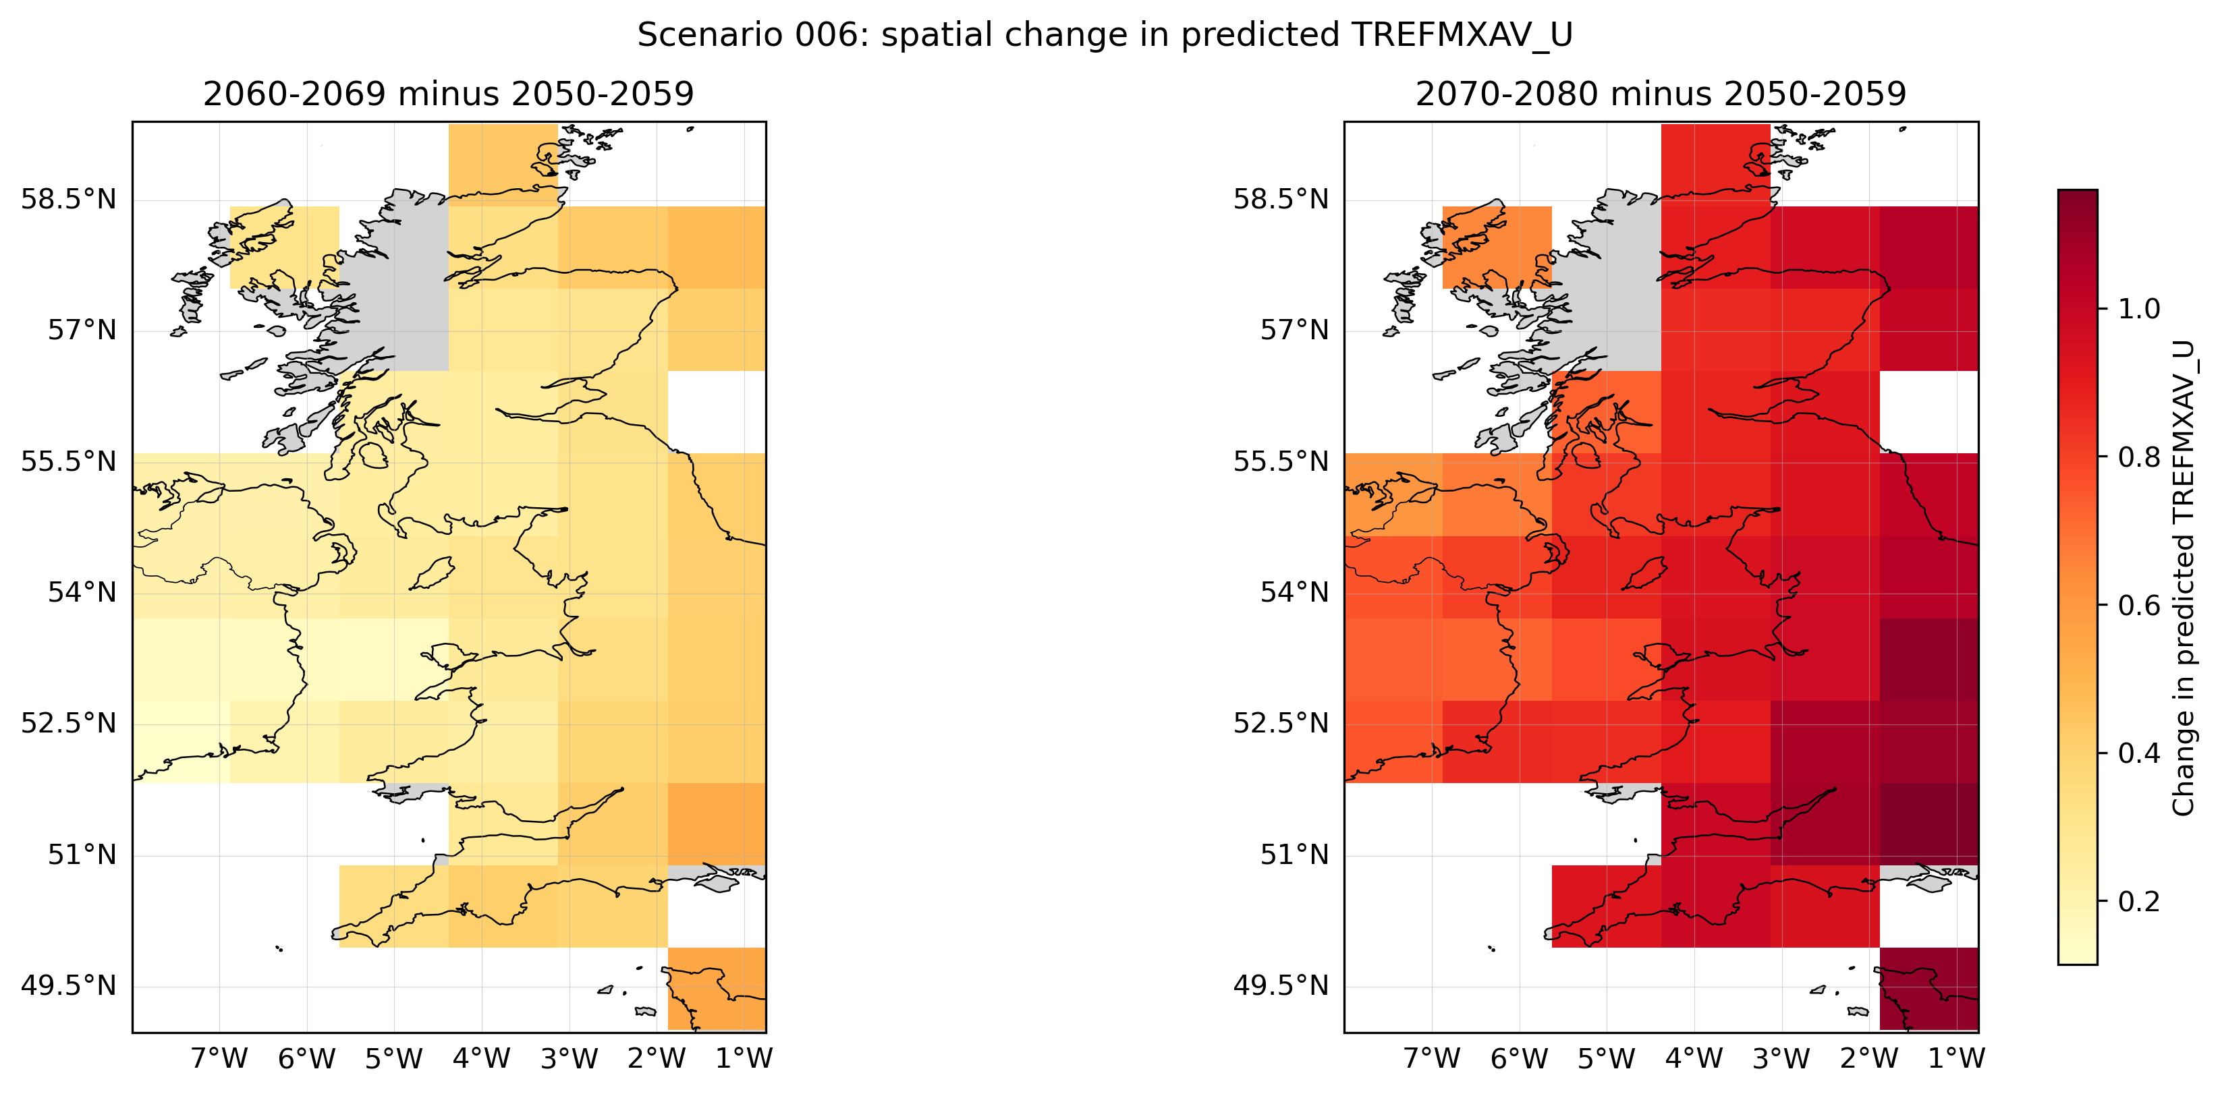
Spatial Analysis of Predictions: Scenario 6
Scenario 006: Spatial change in predicted TREFMXAV_U
Projected warming is not uniform
vs
2070–2080 minus 2050-2059
2060-69 minus 2050-2059
1
The 2050s serve as a reference point
This allows us to measure relative change, not absolute temperature.
2
Possible spatial gradient
North-to-south and west-to-east warming gradients.
3
Reflects the UK’s maritime climate
Coastal areas (like northwest England) appear to warm slightly more slowly than inland regions. This may be due to the moderating effect of the Irish Sea.
Highlight
The spatial analysis of Scenario 006 reveals a progressive intensification of warming

Slide 16
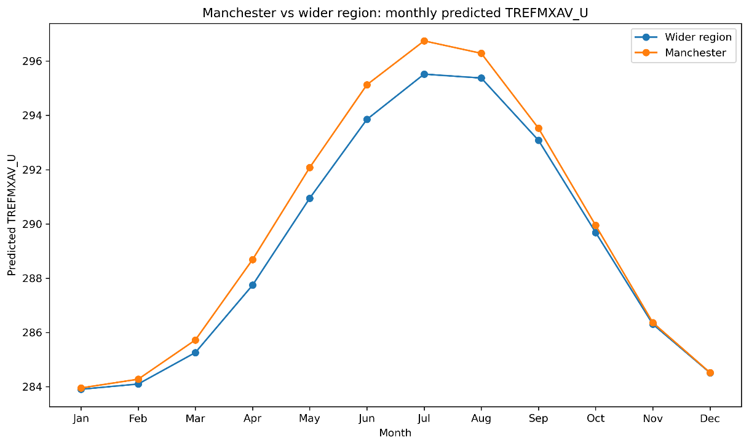
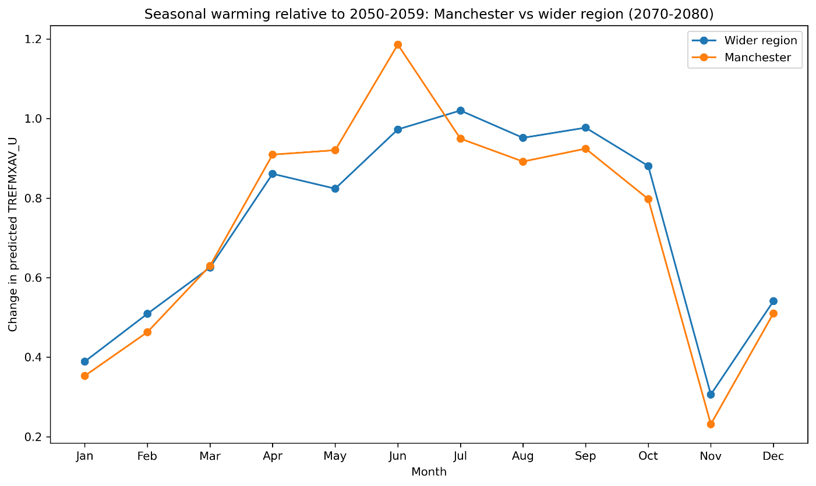
Holdout validation of predictions was also strong for Manchester only region:
RMSE 0.369, MAE 0.268, R² 0.994
Manchester vs Wider Region
1
2
Overall average TREFMXAV_U predictions across months.
Seasonal changes relative to 2050-2059 baseline.
The Manchester grid cell is consistently warmer on average than the wider study region for post-2050 predictions.
Manchester is predicted to follow the same broad warming trend as the full study area, but at slightly higher absolute temperature.
The seasonal warming in Manchester for 2070-2080, relative to the baseline period, is broadly consistent with the wider region, but not identical.
In 2070-2080, Manchester shows:
greater warming than the full region in April, May, and June - especially June

Slide 17

Possible Physical Interpretation: Radiation
Increased net radiation adds surface energy
Higher daytime temperatures increase TREFMXAV_U
Positive Albedo Feedback amplifies warming
Mechanism

Slide 18
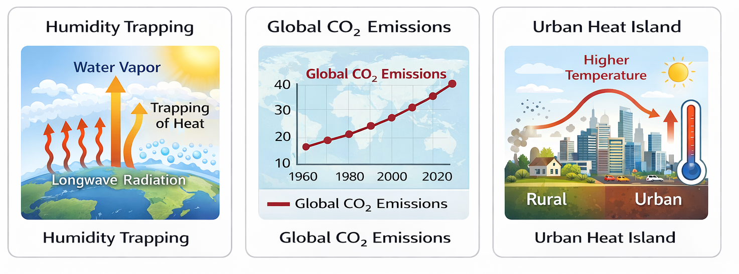
Possible Physical Interpretation: Humidity + GHG + UHI
Atmospheric: Higher humidity reduces cooling efficiency
Global: Rising greenhouse gas concentrations intensify baseline warming
Local: Urban Heat Island stores heat through buildings and surfaces

Slide 19
Conclusions
Questions
Key findings
Post-2050 holdout evaluation showed high agreement between predictions and true values, supporting the interpretation of the scenario and seasonal patterns.
TREFMXAV_U increases after 2050 across all scenarios.
Warming is seasonally uneven, with stronger warm-season amplification by 2070-2080.
Manchester follows the wider regional pattern but remains warmer and shows some seasonal differences.
How do projected post-2050 increases in monthly aggregated maximum near-surface air temperature (TREFMXAV_U) vary across scenario and season, and does Manchester follow the wider regional pattern?
Which covariates are most important for predicting TREFMXAV_U?
TREFHT is a major predictor, but other climate variables – like FSNS – and time features – like monthly encoding – also contribute meaningfully.
Plausible physical interpretations linked to the projections
Radiation and humidity directly influence temperature rise
Global greenhouse forcing drives background warming
Urban Heat Island amplifies local warming

