Slide 1

COMP 5120 Term Project
By Jacob Galanopoulos, Kevin Hubbard, and Karl Sprayberry

Slide 2
Database Tables
db_book
db_customer
db_Employee
db_Order
* marks a Primary Key
** marks a Foreign Key
BookID* | Title | UnitPrice | Author | Quantity | SupplierID** | SubjectID**
CustomerID* | LastName | FirstName | Phone
EmployeeID* | LastName | FirstName
OrderID* | CustomerID** | EmployeeID** | OrderDate | ShippedDate | ShipperID**

Slide 3
Database Tables (cont.)
db_Order_Detail
db_Shipper
db_Subject
db_Supplier
* marks a Primary Key
** marks a Foreign Key
BookID** | OrderID** | Quantity
ShipperID* | ShipperName
SubjectID* | CategoryName
SupplierID* | CompanyName | ContactLastName | ContactFirstName | Phone

Slide 4
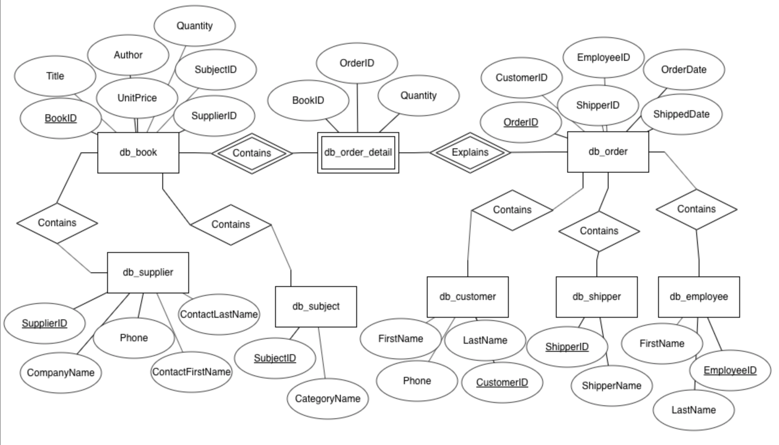
ER Diagram

Slide 5
Create Table Queries
CREATE TABLE db_supplier (
SupplierID INT UNSIGNED AUTO_INCREMENT PRIMARY KEY,
CompanyName VARCHAR(256),
ContactLastName VARCHAR(256),
ContactFirstName VARCHAR(256),
Phone VARCHAR(12)
);
CREATE TABLE db_subject (
SubjectID INT UNSIGNED AUTO_INCREMENT PRIMARY KEY,
CategoryName VARCHAR(256)
);
CREATE TABLE db_customer (
CustomerID INT UNSIGNED AUTO_INCREMENT PRIMARY KEY,
LastName VARCHAR(256),
FirstName VARCHAR(256),
Phone VARCHAR(24)
);
CREATE TABLE db_shipper (
ShipperID INT UNSIGNED AUTO_INCREMENT PRIMARY KEY,
ShipperName VARCHAR(256)
);

Slide 6
Create Table Queries (Cont.)
CREATE TABLE db_employee (
EmployeeID INT UNSIGNED AUTO_INCREMENT PRIMARY KEY,
LastName VARCHAR(256),
FirstName VARCHAR(256)
);
CREATE TABLE db_book (
BookID INT UNSIGNED AUTO_INCREMENT PRIMARY KEY,
Title VARCHAR(256),
UnitPrice FLOAT,
Author VARCHAR(256),
Quantity INT,
SupplierID INT NOT NULL,
SubjectID INT NOT NULL,
INDEX (SupplierID),
INDEX (SubjectID),
FOREIGN KEY (SupplierID) REFERENCES db_supplier(SupplierID),
FOREIGN KEY (SubjectID) REFERENCES db_subject(SubjectID)
);

Slide 7
Create Table Queries (cont.)
CREATE TABLE db_order (
OrderID INT UNSIGNED AUTO_INCREMENT PRIMARY KEY,
CustomerID INT NOT NULL,
EmployeeID INT NOT NULL,
OrderDate DATETIME NOT NULL,
ShippedDate DATETIME,
ShipperID INT,
INDEX (CustomerID),
INDEX (EmployeeID),
INDEX (ShipperID),
FOREIGN KEY (CustomerID) REFERENCES db_customer(CustomerID),
FOREIGN KEY (EmployeeID) REFERENCES db_employee(EmployeeID),
FOREIGN KEY (ShipperID) REFERENCES db_shipper(ShipperID)
);
CREATE TABLE db_order_detail (
BookID INT NOT NULL,
OrderID INT NOT NULL,
Quantity INT NOT NULL,
INDEX (BookID),
INDEX (OrderID),
FOREIGN KEY (BookID) REFERENCES db_book(BookID),
FOREIGN KEY (OrderID) REFERENCES db_order(OrderID)
);

Slide 8
Run Queries Examples
1. Show the subject names of books supplied by *supplier2*.
SELECT db_subject.CategoryName FROM db_book
LEFT JOIN db_subject ON db_book.SUBJECT_ID = db_subject.SUBJECT_ID
WHERE db_book.SupplierID = 2;
2. Show the name and price of the most expensive book supplied by *supplier3*.
SELECT B.SupplierID, MAX(B.UnitPrice) FROM db_book B WHERE B.SupplierID = 3 GROUP BY B.SupplierID;
3. Show the unique names of all books ordered by *lastname1 firstname1*.
SELECT Distinct(db_book.Title) FROM db_book
LEFT JOIN db_order_detail ON db_book.BookID = db_order_detail.BookID
LEFT JOIN db_order ON db_order_detail.OrderID = db_order.OrderID
Left JOIN db_customer ON db_order.CustomerID = db_customer.CustomerID
WHERE db_customer.FirstName = "firstname1" AND db_customer.LastName = "lastname1";

Slide 9
Run Queries Examples (cont.)
4. Show the title of books which have more than 10 units in stock.
SELECT Title from db_book WHERE Quantity > 10;
5. Show the total price *lastname1 firstname1* has paid for the books.
SELECT SUM(db_book.UnitPrice * db_order_detail.Quantity) AS "Total Price" FROM db_book
LEFT JOIN db_order_detail ON db_book.BookID = db_order_detail.BookID
LEFT JOIN db_order ON db_order_detail.OrderID = db_order.OrderID
Left JOIN db_customer ON db_order.CustomerID = db_customer.CustomerID
WHERE db_customer.FirstName = "firstname1" AND db_customer.LastName = "lastname1";
7. Show the name of books supplied by *supplier2*.
SELECT db_book.Title FROM db_book LEFT JOIN db_supplier ON db_book.SupplierID = db_supplier.SupplierID WHERE db_supplier.CompanyName = "supplier2";

