Slide 1

CSE3666-Introduction to Computer Architecture Lab 4
Binary Search

Slide 2
Extra Support
Jacob.gerow@uconn.edu
Find me in class discord
Office Hours: 11:15am-12:15pm Wednesday
BEACH (ITE 360) Drop-in Hours **Subject to change**:
Tuesday 6:00pm-8:00pm
Thursday 4:00pm-8:00pm
Friday 6:00pm-8:00pm

Slide 3
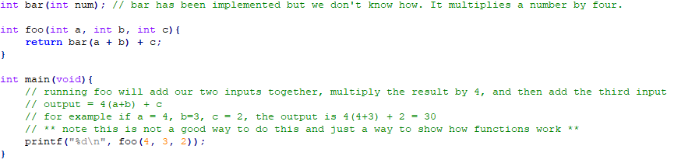
Foo, Bar example

Slide 4
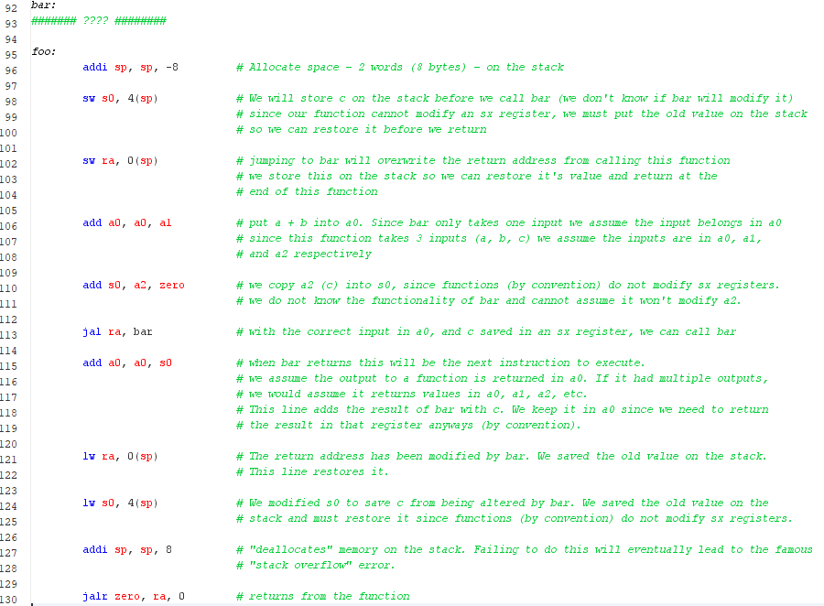
Foo, Bar, continued
*text is here to explain everything in-depth if needed, not necessary to read each part

Slide 5
When Branching to a function you will be returning from
Any sx registers must be saved (if modified by your code) by convention
Return address register (ra) must be saved
Any values you want to use on return (not in a sx register) must be saved

Slide 6
Important Resources
Discord (must join, change name to first and last, and set role): https://discord.gg/xE4fTGRS
Github Repo: https://github.uconn.edu/zhs04001/cse3666-2025spring
Lab Presentation Repo: https://github.com/Jacob-Gerow/CSE_3666

