Slide 1

CSE3666-Introduction to Computer Architecture Lab 3
Remove Spaces

Slide 2
Extra Support
Jacob.gerow@uconn.edu
Find me in class discord
Office Hours: 11:15am-12:15pm Wednesday
BEACH (ITE 360) Drop-in Hours **Subject to change**:
Tuesday 6:00pm-8:00pm
Thursday 4:00pm-8:00pm
Friday 6:00pm-8:00pm

Slide 3
Memory
You only have 32 “high speed” registers (x0-x31)
To store more information you use memory
You can only store a value in memory and retrieve it into one of your 32 standard registers.

Slide 4
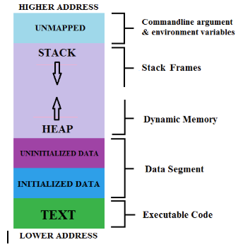
Memory
- Example memory
Not necessarily the same as what we are using for this class
Notice how data is separated from where you code is stored

Slide 5
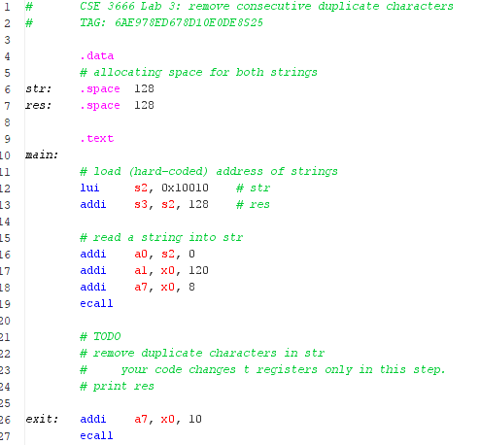
Memory Continued
Start of memory segment, directives after this are stored in your memory space of your program
Allocate 128 bytes in memory. “str” is an alias for the start of this location in memory.
In RARS simulator 0x10010000 is always the start of your memory. This makes this instruction equivalent to:
lui s2, %hi(str)
Since the base address is 0x10010000, we don’t need to load in the lower part of this address (it’s already 0)
Allocate 128 more bytes of space in memory. “res” is an alias for the start of this location in memory.
Equivalent to addi s3, s2, %lo(res) Since str and res share the same high address, no need to run separate lui command

Slide 6
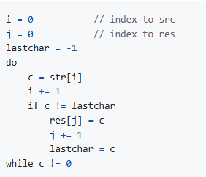
Psuedo-Code
Translating directly will work
Shortcuts are possible…
Think about any improvements that could be made in assembly

Slide 7
Important Resources
Discord (must join, change name to first and last, and set role): https://discord.gg/xE4fTGRS
Github Repo: https://github.uconn.edu/zhs04001/cse3666-2025spring
Lab Presentation Repo: https://github.com/Jacob-Gerow/CSE_3666

