Slide 1
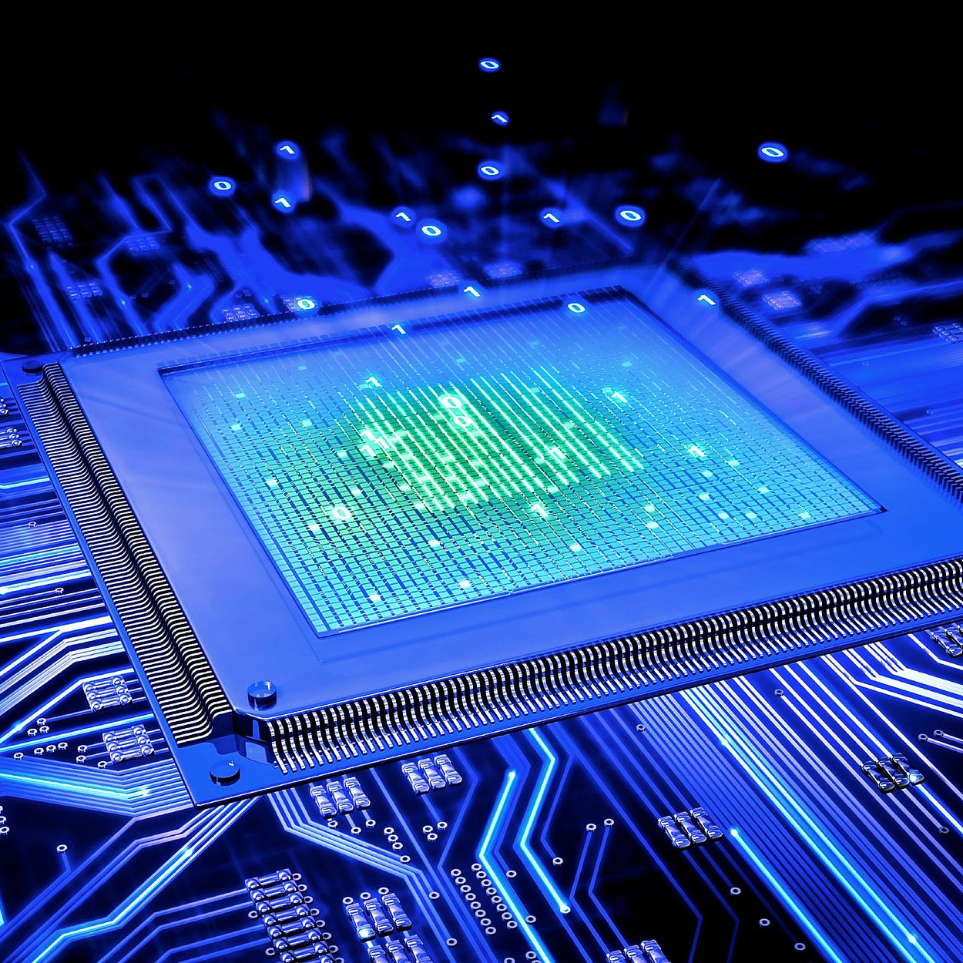
CSE3666-Introduction to Computer Architecture Lab 2
Reverse Bits

Slide 2
Extra Support
Jacob.gerow@uconn.edu
Find me in class discord
Office Hours: 11:15am-12:15pm Wednesday
BEACH (ITE 360) Drop-in Hours **Subject to change**:
Tuesday 6:00pm-8:00pm
Thursday 4:00pm-8:00pm
Friday 6:00pm-8:00pm

Slide 3
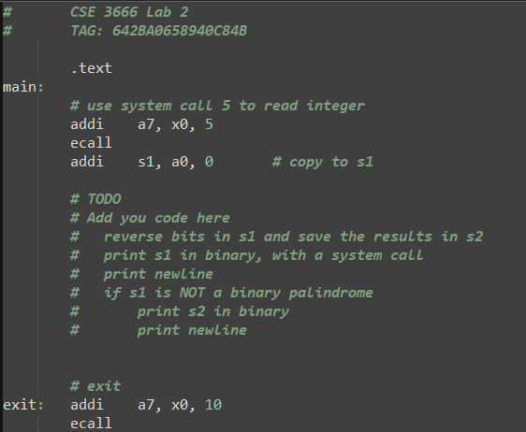
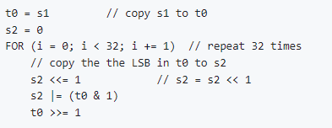

Slide 4
Palindromes
Bits are the same forward as they are reversed
8-bit palindromes examples
11000011
10100101
00011000
Remember you are working with 32 bits not 8
11001100100100000000100100110011

Slide 5
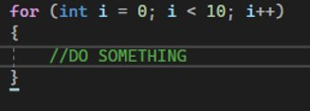
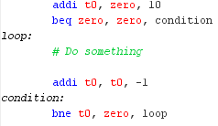
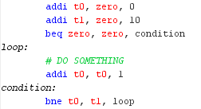
For Loop Examples
If the iterator does not need to be used
If the iterator needs to be utilized within the loop

Slide 6

BIT OPERTATIONS

Slide 7
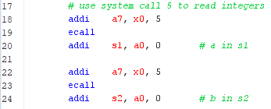
SYSTEM CALL
1. Syscall table: RISC-V Simulator -> Help -> Syscalls
2. Put integer in register a7 to specify syscall type
3. Follow syscall table to fill any additional information for the syscall
4. “ecall”
5. Follow syscall table to retrieve any information from the syscall

Slide 8
Other HINTS
The input system call expects a signed 2s complement number
1000 0000 0000 0000 0000 0000 0000 0000 is –2147483648
0100 0000 0000 0000 0000 0000 0000 0000 is 1073741824

Slide 9
Important Resources
Discord (must join, change name to first and last, and set role): https://discord.gg/xE4fTGRS
Github Repo: https://github.uconn.edu/zhs04001/cse3666-2025spring
Lab Presentation Repo: https://github.com/Jacob-Gerow/CSE_3666

