Slide 1

CSE 3666 - Introduction to Computer Architecture Lab 1
Find Greatest Common Divisor

Slide 2

My Background
Undergrad Senior in Computer Engineering
Spent last summer as Software Engineering Intern at Walmart
BEACH (ITE 360) Tutor
Third Time TA for this class
Jacob.gerow@uconn.edu
Find me in the discord
Office Hours: 11:15am-12:15pm Wednesday
BEACH (ITE 360) Drop-in Hours **Subject to change**:
Tuesday 6:00pm-8:00pm
Thursday 4:00pm-8:00pm
Friday 6:00pm-8:00pm

Slide 3
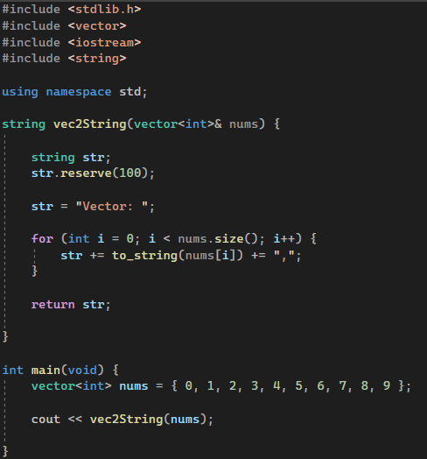
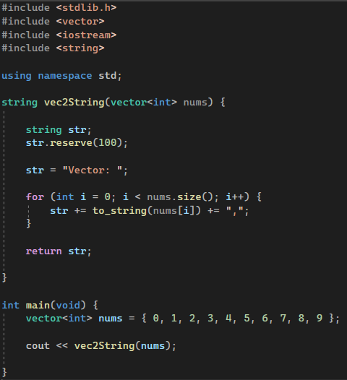
Why should I care about this class?
Separates self-taught programmers from university trained software engineers

Slide 4
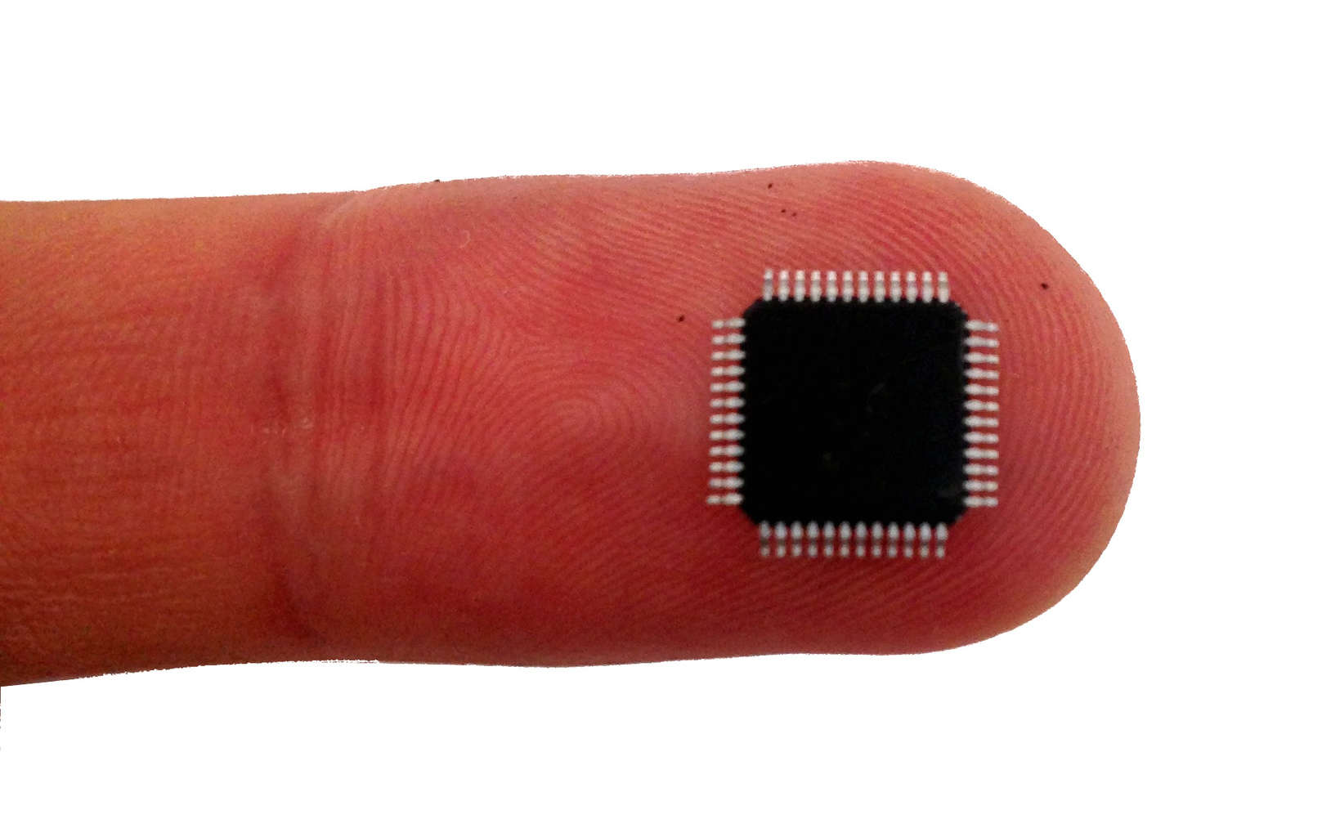
Microcontroller Programming
For CSE or CompE majors
Microcontrollers control embedded systems in cars, fridges, toasters, etc.
Very limited memory and execution power so programs must be efficient and use little memory

Slide 5
How are we learning?
Compiled Language Program Flow
Programming Language Code (C, C++, Go, etc.)
Assembler Language Code (x86, Arm, MIPS, RISC-V)
Binary
Compiler
Assembler
The type of assembler language to compile to depends on your computer's architecture.
In this class we will write RISC-V Assembly code
Your computer (very very likely) does not run RISC-V

Slide 6
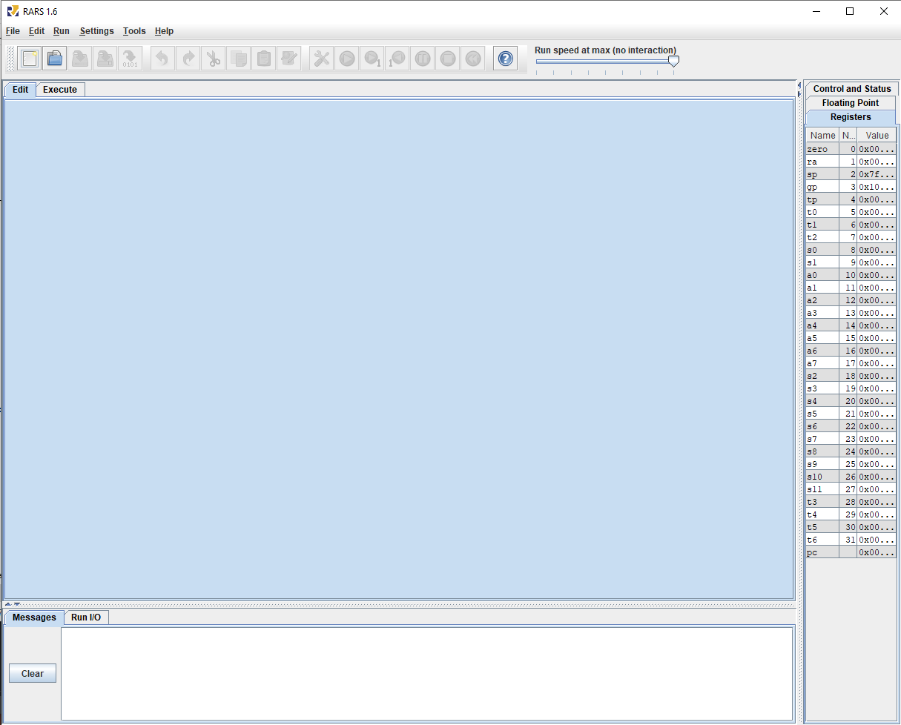
RISC-V Simulator (RARS)
RARS simulates RISC-V instructions on your machine for learning purposes of this class
RISC-V is open source and becoming increasingly popular
Do a quick google search on "RISC-V" and hit the news tab

Slide 7
How to Succeed in this class
DO NOT get behind, ask for help
You will not understand the current lecture if you did not understand the previous lecture
When you are confused about a subject meet with someone to clarify as soon as possible
Attend labs and understand the labs
Do not copy homework, but collaborate
Study the lecture slides

Slide 8

ChatGPT (and other AI Tools)
It is very clear when submitted code is from ChatGPT
ChatGPT is a useful tool but in this class will likely lead you astray
Your best resource is office hours

Slide 9
Important Resources
Discord (must join and set role): https://discord.gg/xE4fTGRS
Github Repo: https://github.uconn.edu/zhs04001/cse3666-2025spring

Slide 10
Psuedo Instructions
A psuedo instruction is an assembly instruction used in programming that is a shorthand for one or more basic instructions
Makes programming easier but obscures the minute details of what your machine is doing.
Example:
mv (stands for move, has copy functionality) is not a "real" RISC-V instruction but can be implemented with an add instruction
Complete Pseudo Instruction List: RISC-V Simulator -> Help -> Extended (pseudo)
In CSE 3666 Psuedo instructions are NOT allowed.
Submitting an assignment to the autograder with a psuedo instruction = 0 (can resubmit)
Points are taken off exams if psuedo instructions are used

Slide 11
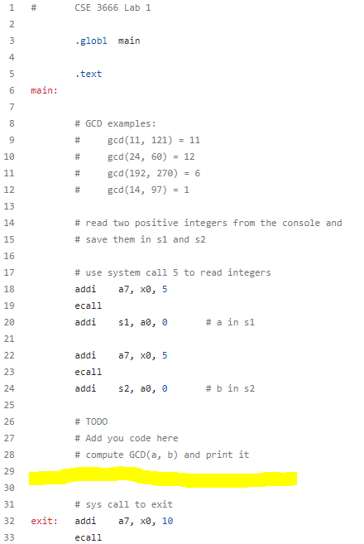
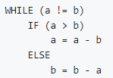
Lab 1 Rough Sketch
System call to print GCD

Slide 12
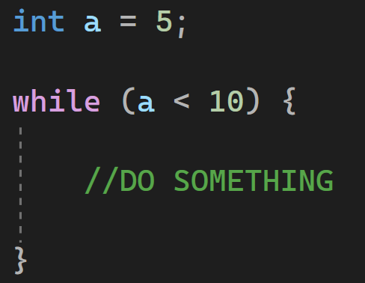
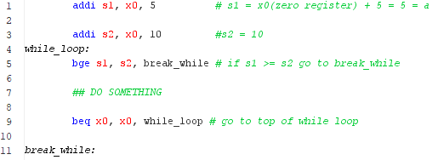
While Loop in Risc-V
C Code
RISC-V Assembly

Slide 13
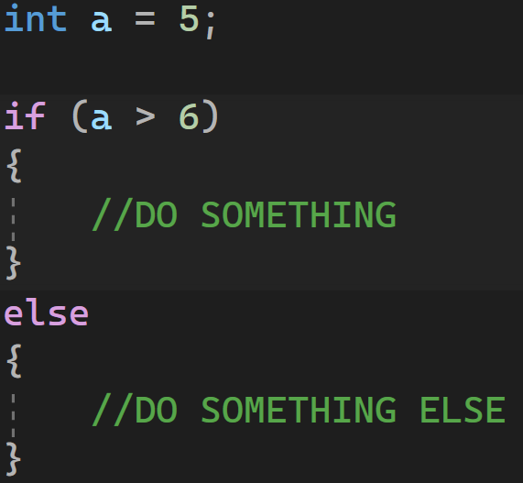
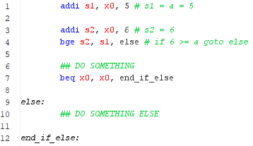
IF-Else Statement in RISC-V

Slide 14

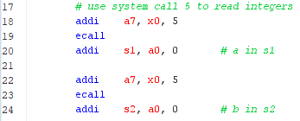
System Calls In RiSC-V
System Calls – Your program does not have the ability / access needed to perform some tasks. (Printing to the console is one we need in this class). A system call asks the operating system to do it for you.
OS
Syscall table: RISC-V Simulator -> Help -> Syscalls
Put integer in register a7 to specify syscall type
Follow syscall table to fill any additional information for the syscall
“ecall”
Follow syscall table to retrieve any information from the syscall
Dev

Slide 15

Register Conventions
sx registers – used for values you want to use long term
tx registers – used for temporary values
ax registers – used for argument values (to and from system calls, functions, etc.)
This will be gone over in more detail later in the course
Violation of these rules will not break your program, but it is more difficult for other engineers (and TAs) to understand.
When introducing new registers, comments stating the purpose of the register is also much appreciated

