Slide 1



















Scenario 1: Fracture Propagation
NASA’s
CEARUN rev4
$p_{0}, T_{0}, ε$
Thruster Parameters
Table 2
Debris Surface
$$T_{w}, θ$$
Momentum Transfer Model
$$σ_{n}, σ_{t}$$
$$reactant$$
Irwin’s Model
Determine Peak Stress
$p_{0} T_{0}$
$$r, φ$$
$$σ_{crit}$$
$M_{E}$,${ T}_{E}$,${ p}_{E}, ρ_{E}, a_{E}$
$$α_{n} α_{t}$$
Determine Flow Condition at Debris
$$σ_{max}$$
$$m_{mix}, μ_{mix}, γ_{mix}$$
Simons’ Plume Model
$$σ_{e}$$
Safety Margin
$$u, T,ρ,γ$$
Accommodation Coefficients
$$mass fractions$$
Safety Margin
$$Kn$$
Impingement Time
$$α_{e}$$
$$t$$
Determine Flow Regime for Impingement
$$T_{crit}$$
Energy Transfer Model
$$\dot{q}$$
Determine Temperature Rise
Adhesive Melting Temps
Plume Model
Impingement Model
Scenario 2: Adhesive Melting

Slide 2

















Scenario 1: Fracture Propagation
NASA’s
CEARUN rev4
$p_{0}, T_{0}, ε$
Thruster Parameters
Table 2
Debris Surface
$$T_{w}, θ$$
Momentum Transfer Model
$$σ_{n}, σ_{t}$$
$$reactant$$
Irwin’s Model
Determine Peak Stress
$p_{0} T_{0}$
$$r, φ$$
$$σ_{crit}$$
$M_{E}$,${ T}_{E}$,${ p}_{E}, ρ_{E}, a_{E}$
$$α_{n} α_{t}$$
Determine Flow Condition at Debris
$$σ_{max}$$
$$m_{mix}, μ_{mix}, γ_{mix}$$
Simons’ Plume Model
$$σ_{e}$$
Safety Margin
$$u, T,ρ,γ$$
Accommodation Coefficients
$$mass fractions$$
Safety Margin
$$Kn$$
Impingement Time
$$α_{e}$$
$$t$$
Determine Flow Regime for Impingement
$$T_{crit}$$
Energy Transfer Model
$$\dot{q}$$
Determine Temperature Rise
Adhesive Melting Temps
Plume Model
Impingement Model
Scenario 2: Adhesive Melting

Slide 3
Scenario 1: Fracture Propagation
NASA’s
CEARUN rev4
$p_{0}, T_{0}, ε$
Thruster Parameters
Table 2
Debris Surface
$$T_{w}, θ$$
Momentum Transfer Model
$$σ_{n}, σ_{t}$$
$$reactant$$
Irwin’s Model
Determine Peak Stress
$p_{0} T_{0}$
$$r, φ$$
$$σ_{crit}$$
$M_{E}$,${ T}_{E}$,${ p}_{E}, ρ_{E}, a_{E}$
$$α_{n} α_{t}$$
Determine Flow Condition at Debris
$$σ_{max}$$
$$m_{mix}, μ_{mix}, γ_{mix}$$
Simons’ Plume Model
$$σ_{e}$$
Safety Margin
$$u, T,ρ,γ$$
Accommodation Coefficients
$$mass fractions$$
Safety Margin
$$Kn$$
Impingement Time
$$α_{e}$$
$$t$$
Determine Flow Regime for Impingement
$$T_{crit}$$
Energy Transfer Model
$$\dot{q}$$
Determine Temperature Rise
Adhesive Melting Temps
Plume Model
Impingement Model
Scenario 2: Adhesive Melting

Slide 7
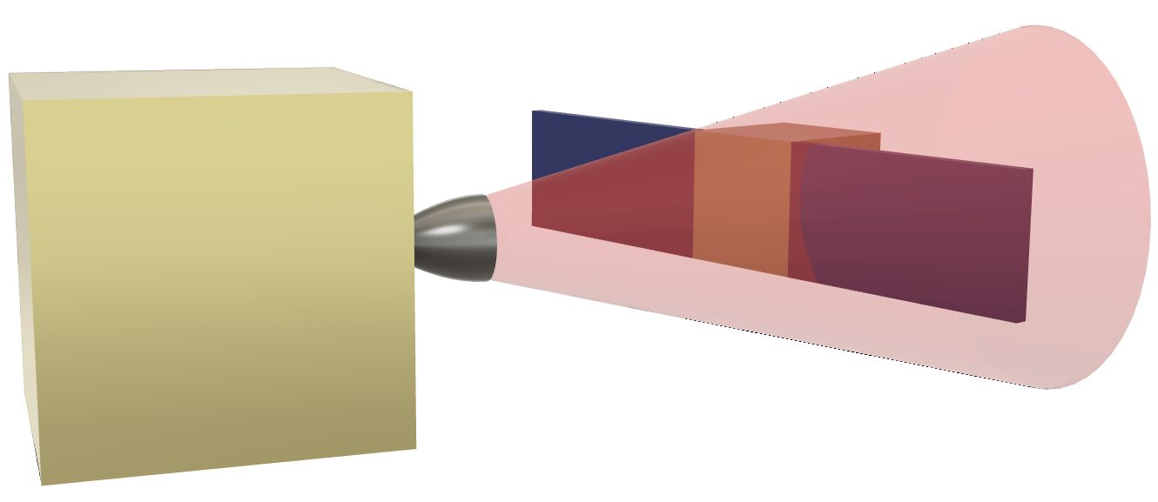
Tumbling Motion
Chaser Satellite
Debris Object
Plume Impingement

Slide 8
Tumbling Motion
Chaser Satellite
Debris Object
Plume Impingement
Distance d

Slide 10
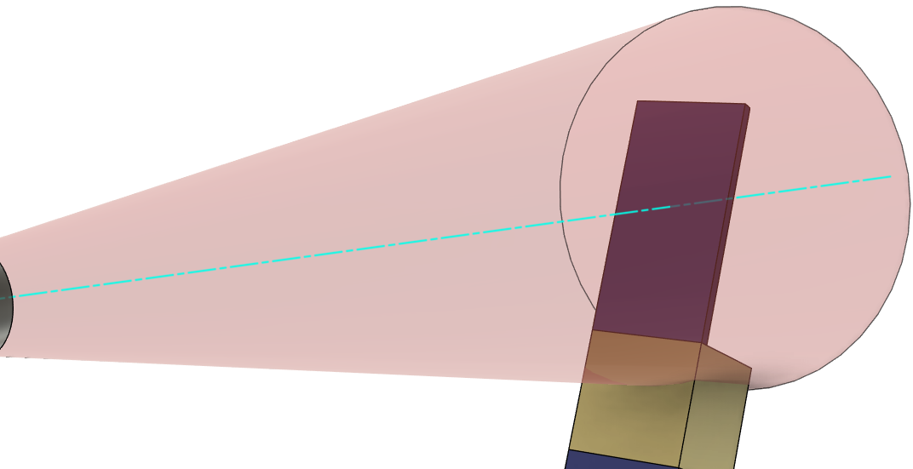






$$W$$
$$θ$$
$$L$$
$$Plume Centreline$$
$L$/2
$$Centre of Rotation$$

Slide 11
$$W$$
$$θ$$
$$L$$
$$Plume Centreline$$
$L$/2
$$Centre of Rotation$$

Slide 12
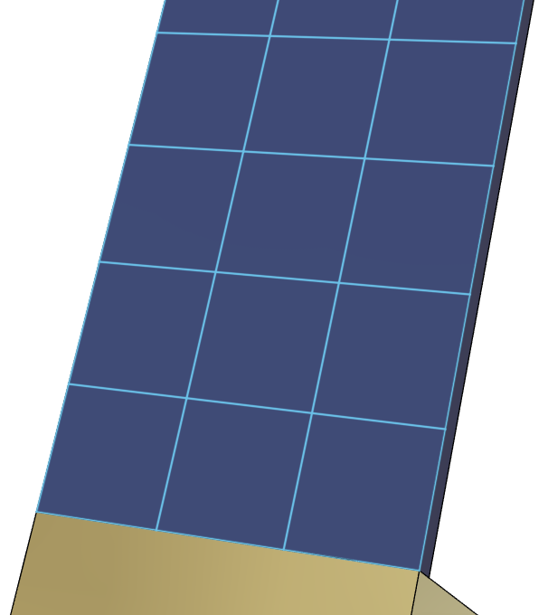


$$m$$
$$n$$

Slide 13


$$m$$
$$n$$
$$dn$$
$$dA$$

