Slide 1

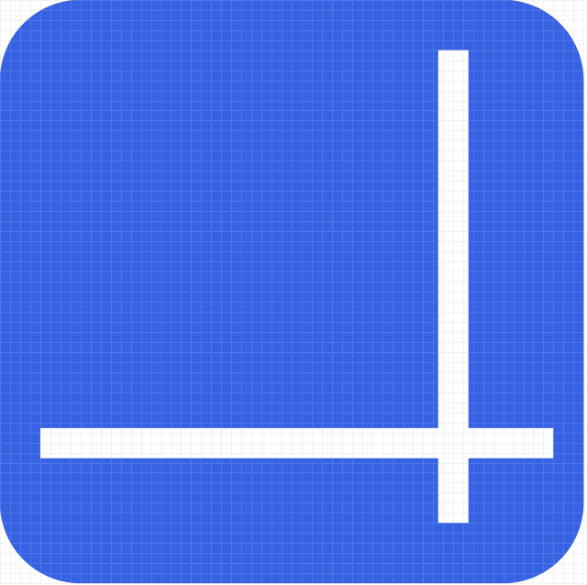
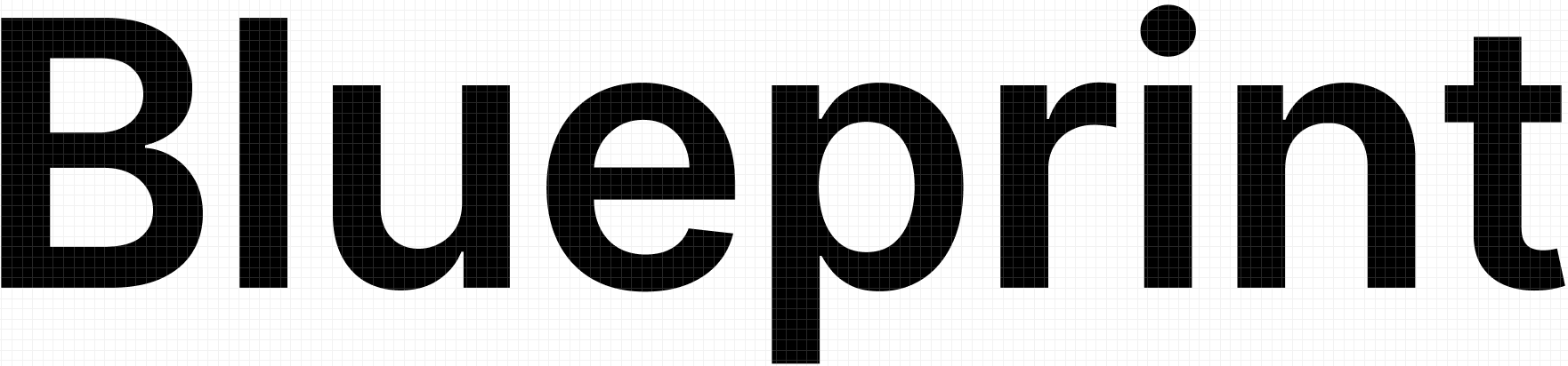
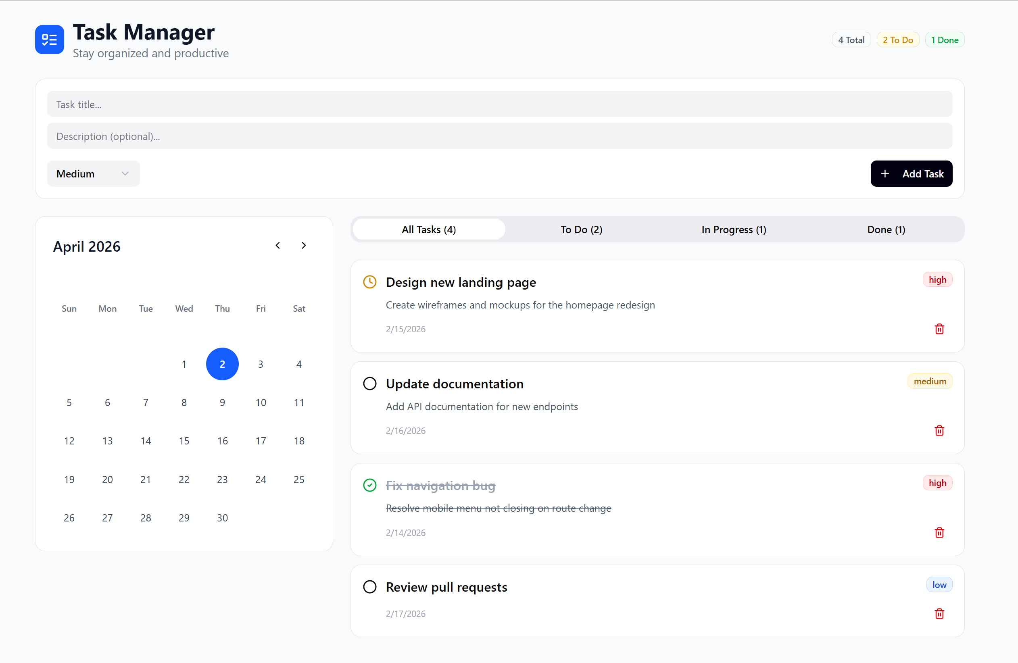
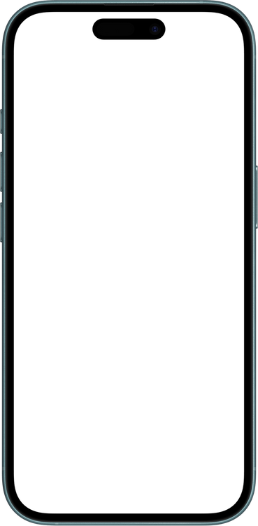
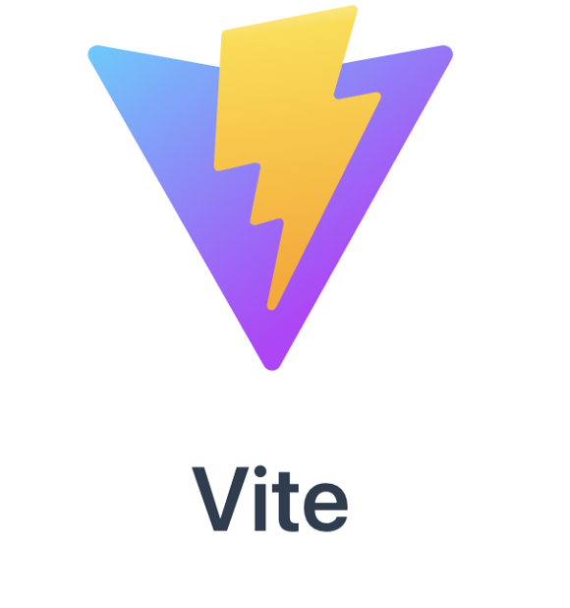
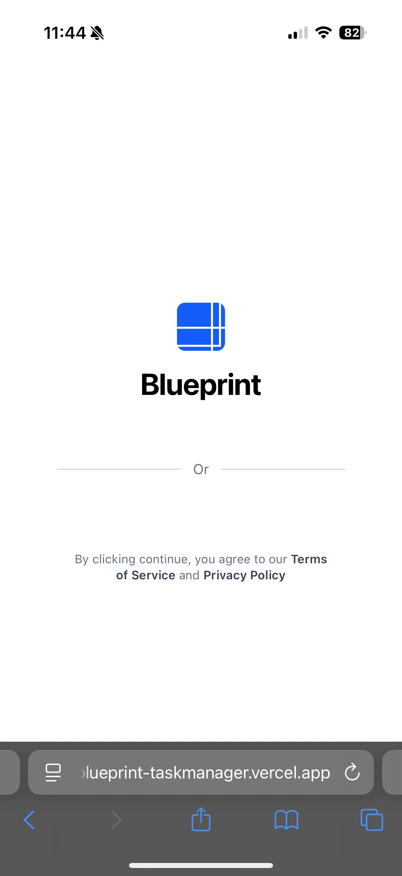
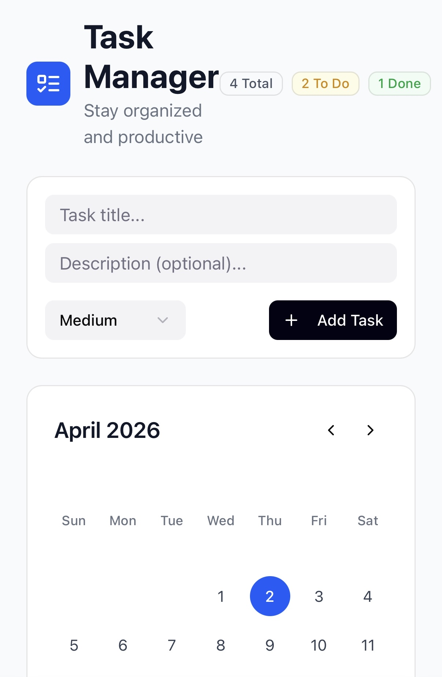


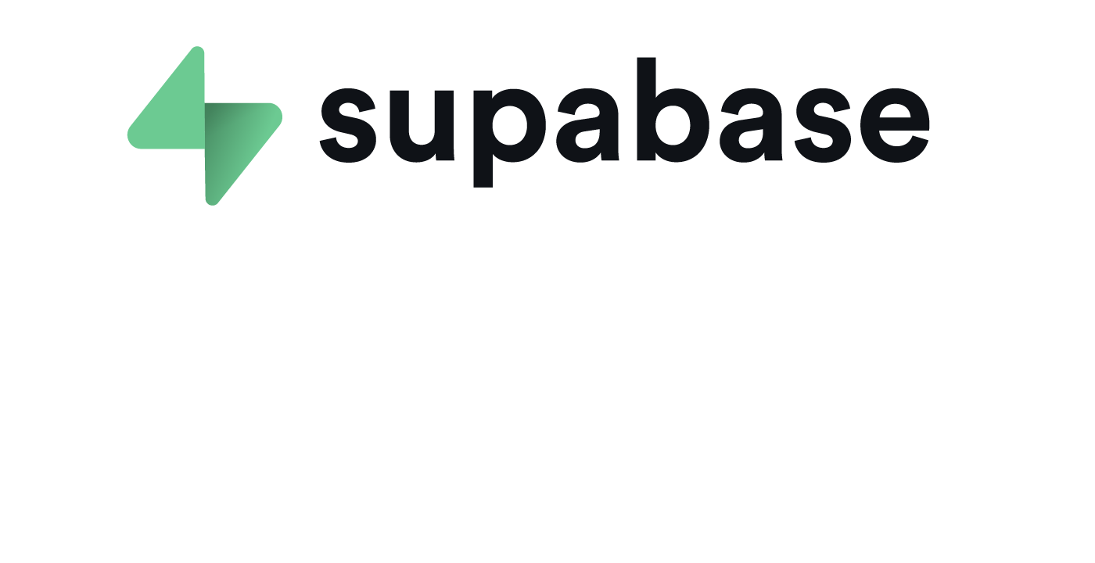

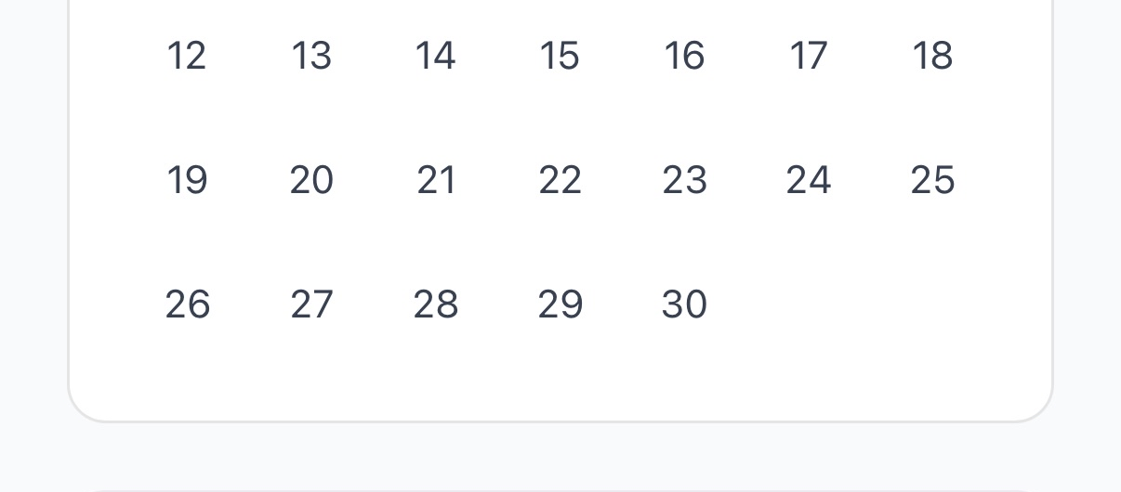
Blueprint
Isaac Trejo Mendoza, Jacob McPherson, Jeongha Park, Obadiah Sieg
Department Of Computer Science and Information Technology
Abstract
Design
Future Work
Group projects are hard. It can be difficult to track who is doing what and to cross-reference multiple sources of material from the start to the finish. This is where Blueprint comes in. Blueprint is a task management web application designed for as few as one person to as many as ten or twenty people. This is not an app for large corporations. It's not meant to be complicated. Blueprint is designed to be simple and easy to use, with an intuitive user interface that users will find enjoyable and encouraging as they work together to accomplish their goal. The app itself features a calendar to track due dates and compare user schedules, a task list with priorities from not important to major, and the ability to assign users to tasks while showing each user’s progress and the overall project completion as a whole. The goal of this project is to provide users, primarily students, with a simple, easy-to-use task management web application to tackle group projects and excel academically in their college careers as they work alongside one another.
Given enough time, Blueprint will not only be a simple, efficient web application for group projects, but it will also provide the motivation and encouragement students and others need to complete their projects via incentives such as special titles, user avatars, and pets that the users can earn with the experience they gain from every task completed. In a sense, we seek to “gamify” the group project experience to make it more fun and engaging, helping keep their project moving forward. Furthermore, we would like to add a functional chatbot that allows users to talk, seek guidance, and ultimately receive the advice they need to complete their project, so Blueprint can serve as the “one-stop shop” users are truly looking for. We would also like to provide more innovative tools such as advanced analytics and predictive scheduling so users can automatically gain the best times for their group to meet by simply inputting their schedules, the ability to integrate other sources the users might use such as GitHub, a collaborative white board or “Canvas Mode” the users can use to draw out plans and ideas for their project over a zoom call, and an enhanced resource management system that would allow the user to track the hardware for their projects, budget constraints, and gain a better overall view of their project. All of this may seem optimistic, but it would greatly encourage users, especially students, to engage with one another in an ever-disengaging world, where people communicate tonelessly through email, text messages, and group chats. With Blueprint, users will finally know how to complete their projects.
[Insert image of dashboard]
Fig 1. The homepage of Blueprint on PC.
Fig 2. The homepage of Blueprint on mobile.
Background
Technology
Blueprint was conceived by the names above as a solution to the usually frustrating and fragmented group projects that almost everyone in the academic world knows and loves. There are many group assignment apps out there, but many of them are complicated and difficult to use without the proper training. Moreover, they are usually far more complicated than what the average person needs. Therefore, we sought out to create a simple and easy-to-use web application that provides all the tools one person could need to create a group project, while keeping it highly flexible and responsible for what the user needs by providing multiple tools, such as the calendar, completion rate of the project, and task list mentioned above. This project is not just about giving users another way to list all their tasks and check a box beside each one as they complete it. Blueprint will provide users with a bird’s-eye view of their project, showing exactly what they need to do and when. Originally, this project was simply a way for each of us to see when it was best for us to meet. However, we quickly realized this was a recurring theme for everyone when they have to start a group project, so we thought the best project for this Innovation Experience would be Blueprint.
Fig 2. An add-on for React, seen below.
References
1. Vite. Edited by Evan You, 2024, https://vite.dev. Accessed 31 Mar. 2026. 2. React. Meta Platforms, 2024, https://react.dev. Accessed 31 Mar. 2026.
3. Supabase. Supabase, Inc., 2026, https://supabase.com. Accessed 31 Mar. 2026.
4. Vercel. Vercel Inc., 2026, https://vercel.com. Accessed 31 Mar. 2026.
Fig 3. React: implements the User Interface (UI).
Acknowledgements
Fig 4. The storage for all our users' information.
We would like to thank Dr. Karen Meisch for her support of the students in the College of Science, Technology, Engineering & Mathematics, along with Dr. Leong Lee for his support of the students in the Department of Computer Science and Information Technology.
Fig 5. Allows the website to be run and accessed.

