Slide 1
HealthCare System[HCS]
Software Engineering I (CS - 3365)
Class of Fall 2020
Group Project Requirement Analysis Design
Project Group: 23
Group Members:
Bibek Sitaula
Dylan Scott
Adib Shakib
Jacob Stahl

Slide 2
Table of Contents
Static Model
Interaction Model
Class Operation
Software Architecture
Database Table Design

Slide 3
1. Static Model
For Each Use Case Diagram

Slide 4
Classes for Log in use case
Log in
Employee (Staff, Nurse, Doctor, CEO)
<<business logic>> Healthcare system Manager
<<user interface>> Employee Interface
<<device interface>> Log in
<<entity>> Log in Credentials
- User Id
-User Password
Classes for Log out use case
Log out
Employee
<<business logic>> Healthcare system Manager
<<user interface>> Employee Interface
<<device interface>> Log out
<<entity>> Log out
-User Logout
Classes for Make appointment use case
Make Appointment
Staff
Patient
<<entity>> Patient Appointment
-Patient Name
-Doctor Name
-Date & Time
-Gender
-Date of Birth
<<user interaction>> Staff Interface
<<device interface>> Setup Appointment
<<User Interface>> Permission Credentials
-Yes/No
<<entity>> Doctor Availability
-Doctor Name
-Date
-Time
<<business logic>> Healthcare system Manager

Slide 5
Classes for Change appointment use case
Change Appointment
Staff
Patient
<<user interaction>> Staff Interface
<<device interface>> Change Appointment
<<entity>> Update Patient Appointment
-Patient Name
-Doctor Name
-Date & Time
-Gender
-Date of Birth
<<User Interface>> Permission Credentials
-Yes/No
<<entity>> Doctor Availability
-Date & Time
<<business logic>> Healthcare system Manager
Classes for Cancel appointment use case
Cancel Appointment
Staff
Patient
<<user interaction>> Staff Interface
<<device interface>> Cancel Appointment
<<entity>> Delete Appointment
-Patient Appointment
INFO
<<business logic>> Healthcare system Manager
<<entity>> Patient Appointment
-Patient Name
-Date & Time
-Doctor Name
-Gender
-Date of Birth
<<User Interface>> Permission Credentials
-Yes/No

Slide 6
Classes for Check-in patient use case
Check-in Patient
Staff
Patient
<<user interaction>> Staff Interface
<<device interface>> Patient Chart
-create
-update
<<User Interface>> Permission Credentials
-Yes/No
<<entity>> Delete Appointment
-Patient Appointment
<<entity>> Patient Chart
-Treatment Record
-Patient Information
-Doctor Name
-Measurement/Reason
-Treatment/Prescription
<<entity>> Payment Info
-Patient ID
-Name
-Date
-Amount
-Payment type
-Reference Number
<<entity>> Patient Information
-Address
-Phone Number
-SSN
-Health Insurance
<<business logic>> Healthcare system Manager
Classes for Pay medical fee use case
Pay medical fee
Staff, Patient
Bank
<<user interaction>> Staff Interface Patient Interface
<<device interface>> Card Reader
-Debit/Credit
<<entity>> Payment Info
-Patient ID
-Name
-Date
-Amount
-Payment type
-Reference Number
<<Device Interface>> Receipt Printer
-Payment Info
<<entity>> Patient Information
-Address
-Phone Number
-SSN
-Health Insurance
<<User Interface>> Permission Credentials
-Yes/No
<<proxy>> Bank Interface
<<business logic>> Healthcare system Manager

Slide 7
Classes for Update Measurement/Reason use case
Update Measurement/ Reason
Nurse
Patient
<<user interaction>> Nurse Interface
<<entity>> Update Measurement/
Reason
-Weight
-Height
-Blood Pressure
-Reason of visit
<<entity>> Patient Chart
-Treatment Record
-Patient Information
-Doctor Name
-Measurement/Reason
-Treatment/Prescription
<<User Interface>> Permission Credentials
-Yes/No
<<business logic>> Healthcare system Manager
Classes for Treat Patient use case
Treat Patient
Doctor
Patient
<<user interaction>> Doctor Interface
<<entity>> Patient Chart
-Treatment Record
-Patient Information
-Doctor Name
-Measurement/Reason
-Treatment/Prescription
<<User Interface>> Permission Credentials
-Yes/No
<<entity>> Treatment/Prescription
-Treatment content
-Prescription drugs
<<entity>> Patient Information
-Address
-Phone Number
-SSN
-Health Insurance
<<business logic>> Healthcare system Manager

Slide 8
Classes for View Report use case
View Report
CEO
<<business logic>> Healthcare system Manager
<<user interaction>> CEO Interface
<<User Interface>> Permission Credentials
-Yes/No
<<entity>> Daily Summary Reports
-Doctor Performance
-Doctor Name
-Amount Earned
<<Device Interface>> View Report
Classes for Generate Report use case
Generate Report
Timer
<<controls>> Timer
<<entity>> Daily Summary Reports
-Doctor Performance
-Doctor Name
-Amount Earned
<<business logic>> Healthcare system Manager
Classes for Clear No-Show Appointment use case
Clear No-Show
Appointment
Timer
<<controls>> Timer
<<business logic>> Healthcare system Manager
<<device interface>> Clear No-Show Appointment

Slide 9
2. Interaction Model
Communication Diagram for each Use Case Diagram

Slide 10
Communication Diagram For Log-In Use Case
A 1: login request
<<user Interface>>
:EmployeeInterface
Employee
A5.2: login conformed
A 1.1: login
request
A5.1: login
conformed
<<business logic>>
:HealthCareManager
A5: login
authorized
A2: login
authorize
A3: login conformation
<<device interface>>
:Login
A4: login conformed
<<entity>>
:login credentials
Communication Diagram For Log Out Use Case
A 1: logout request
<<user Interface>>
:EmployeeInterface
Employee
A5.2:
logout conformed
A5.1:
logout conformed
A 1.1:
logout request
<<business logic>>
:HealthCareManager
A5: logout
authorized
A2: logout
authorize
A3: logout conformation
<<device interface>>
:Logout
A4: logout conformed
<<entity>>
:logout

Slide 11
Communication Diagram For Make Appointment Use Case
A1: appointment request
<<user interaction>>
:StaffInterface
Staff
A7.1:appointment conformed
<<entity>>
:DoctorAvailability
A7:appointment
conformed
A1.1:
appointment request
A4.1:
appointment request
A4.2:
appointment conformed
<<User Interface>>
:Permission Credentials
-Yes/No
A3:permission granted
A4:appointment
<<business logic>>
:Healthcare system Manager
request
A2:permission request
A4.3:
appointment conformed
<<device interface>>
:SetupAppointment
A6:conform
patient details
A5:
request patient details
<<entity>>
:PatientAppointment
Communication Diagram For Change Appointment Use Case
A1: appointment change request
<<user interaction>>
:StaffInterface
Staff
A7.1:appointment change conformed
<<entity>>
:DoctorAvailability
A7:appointment
change conformed
A1.1:
appointment change request
A4.1:
appointment change request
A4.2:
appointment change conformed
<<User Interface>>
:Permission Credentials
-Yes/No
A3:permission granted
A4:appointment change request
A2:permission request
<<business logic>>
:HealthcareSystem Manager
A4.3:
appointment change conformed
<<device interface>>
:ChangeAppointment
A6:conform
patient details
A5:
update patient details
<<entity>>
:PatientAppointment

Slide 12
Communication Diagram For Cancel Appointment Use Case
A1: appointment cancel request
<<user interaction>>
:StaffInterface
A7.1:appointment
^{Staff} change <<entity>>
conformed :DeleteAppointment
A7:appointment
change conformed
A1.1:
appointment cancel request
A6.1:
appointment cancel request
A6.2:
appointment cancel conformed
<<User Interface>>
:Permission Credentials
-Yes/No
A3:permission granted
A6:appointment cancel request
A2:permission request
<<business logic>>
:HealthcareSystem Manager
A6.3:
appointment cancel conformed
<<device interface>>
:CancelAppointment
A5:conform
patient details
A4:get
patient details
<<entity>>
:PatientAppointment
Communication Diagram For Check-in Patient Use Case
A1:checkin request
<<user interaction>>
:Staff Interface
Staff
A14.2:checkin success
A14.1:checkin
success
A1.1:checkin
request
<<entity>>
:Patient Chart
A9:add
patient info to chart
A10:info
added
A5:appointment info conformed
A6:request
<<business logic>> _{create chart}
:Healthcare system Manager
<<entity>>
:Patient Appointment
A4:get appointment info
A11:patient chart created
<<device interface>>
:Patient Chart
-create/update
A13:appointment
deleted
A12:patient
appointment delete request
A8:patient
info conformed
A7:request
patient info
A3:permission granted
A2:permission request
<<User Interface>> Permission Credentials
-Yes/No
<<entity>>
:Delete Appointment
<<entity>>
:Patient Information

Slide 13

Communication Diagram For Pay Medical Fee Use Case(Card-Approved)
A1:request payment
A8:Authorize
aBank
A9:
[Approved] Reference number
A14.2:Payemnt success
<<user interaction>>
:Staff Interface
Staff
<<proxy>>
:BankInterface
A14.1Payment
Success:
A1.1:request
payment
A7:Authorize
card request
A10:card
approved
A3:patient conformed
A6:activate card reader
<<entity>>
:Patient Information
<<business logic>>
:Healthcare system Manager
<<device interface>>
:Card Reader
A2:request patient info
A4:request
bill
A11:Update payment
A5:
display bill
A5:permission granted
A12:Payment added
A4:permission request
A11.1:add payment
<<User Interface>>
:Permission Credentials
-Yes/No
<<entity>>
:Payment Info
A13:Print Receipt
<<Device Interface>>
:Receipt Printer
Communication Diagram For Pay Medical Fee Use Case(Card-Denied)
A1:request A10.3:New payment Card
A8:Authorize
aBank
A9:
[Denied] Reference number
A10.2:Card Denied
<<user interaction>>
:Staff Interface
Staff
<<proxy>>
:BankInterface
A10.2:Card
Denied
A1.1:request
payment
A7:Authorize
card request
A10:card
Denied
A3:patient conformed
A6:activate card reader
<<entity>>
:Patient Information
<<business logic>>
:Healthcare system Manager
<<device interface>>
:Card Reader
A10.1:Card Denied
A2:request patient info
A4:request
bill
A5:
display bill
A5:permission granted
A4:permission request
<<User Interface>>
:Permission Credentials
-Yes/No
<<entity>>
:Payment Info

Slide 14

Communication Diagram For Pay Medical Fee Use Case(Cash Payment)
A1:request
payment
<<user interaction>>
:Staff Interface
Staff
A10.2:Payemnt success
A10.1Payment
Success:
A1.1:request
payment
A3:patient conformed
A6:Cash Payment
<<entity>>
:Patient Information
<<business logic>>
:Healthcare system Manager
A2:request patient info
A4:request
bill
A7:Cash Authorized, aPatient
Update
Payment
A5:
display bill
A5:permission granted
A8:Payment
A4:permission request
added
A7.1:add payment
<<User Interface>>
:Permission Credentials
-Yes/No
<<entity>>
:Payment Info
A9:Print Receipt
<<Device Interface>>
:Receipt Printer
Communication Diagram For Update Measurement/Reason Use Case
A1.1: Enter Patient Name
<<user interaction>>
:Nurse Interface
Nurse
A8.3:Update Success
<<entity>>
:Patient Chart
A8.2:Update
Success
A1.2:Enter
Patient Name
A7:Add
Measurement/ Reason
A8:Added
Measurement/ Reason
<<User Interface>>
:Permission Credentials
-Yes/No
A3:permission granted
A4:Update
A2:permission request
<<business logic>>
:Healthcare system Manager
Chart
<<device interface>>
:Patient Chart
A8.1:Update Success
A6:Measurement/ Reason Updated
A5:Request Update
<<entity>>
:Update Measurement/Reason

Slide 15
Communication Diagram For Treat Patient Use Case
A1.1: Enter Patient Name
<<user interaction>>
:Doctor Interface
A8.3:Treatment
^{Doctor} Success
<<entity>>
:Patient Chart
A8.2:Treatment
Successful
A1.2:Enter
Patient Name
A7:Add
Treatment/ Prescription to chart
A8:Treatment
Successful
<<User Interface>>
:Permission Credentials
-Yes/No
A3:permission granted
A4:Update
A2:permission request
<<business logic>>
:Healthcare system Manager
Chart
<<device interface>>
:Patient Chart
A8.1:Treatmet Successful
A6:Added Treatment/ Prescription
A5:Add toTreatment/ Prescription
<<entity>>
:Treatment/Prescription
Communication Diagram For View Report Use Case
A1.1: Request Daily Reports
<<user interaction>>
:CEO Interface
CEO
A4.4:Report Access success
<<entity>>
:Daily Summary Reports
A4.3:Report
Access success
A1.2:
Request Daily Reports
A4.1:Report
Access
A4.1:Report
Access success
<<User Interface>>
:Permission Credentials
-Yes/No
A3:permission granted
A4:Show
A2:permission request
<<business logic>>
:Healthcare system Manager
Report
<<Device Interface>>
:View Report
A4.2:Report Access success

Slide 16
Communication Diagram For Generate Report Use Case
A1.1:Timer Input
<<controls>>
:Timer
Timer
A1.2:Timer
Input
A2:Generate & Store Report
<<business logic>>
:Healthcare system Manager
<<entity>>
:Daily Summary Reports
Communication Diagram For Clear No-Show Appointment Use Case
A1.1:Timer Input
<<controls>> Timer
Timer
A1.2:Timer
Input
A2:Clear No-Show
Appointment
<<business logic>>
Healthcare system Manager
<<entity>> Clear No-Show Appointment

Slide 17
3. Class Operations
Class Diagram For HealthCare System

Slide 18
Class Operation for Healthcare System(HCS)
<<User Interface>> EmployeeInterface
Employee_ID:int Employee_Name:String Employee_Position:String
+ validate(Employee): bool
<<Device Interface>> Login
+ employeeLogin():
<<Business Logic>> HealthSystemManager
Employee_ID: int Patient_ID: int Employee_Name: String patientName: String
+ validate(Employee): bool + validate(login): bool + employeeLogin() + appointment(Make, Change,Delete): void + deletePatientInfo() +permissionCredentials() +userLogout() + dailySummaryReports() + viewReports() + timer() + paymentInformation() + patientChart() + doctorAvailability()
<<Entity>> Login
User_Name: String User_Password: String
+ validate(login): bool
<<Entity>> Logout
+ conform(logout): bool
<<Entity>> PatientAppointment
doctorName(): String date(): int time(): int gender():String dateOfBirth(): String
+patientName(): String
<<Entity>> DoctorAvailability
doctorName(): String date(): int time(): int
<<Entity>> PaymentInformation
amount(): double paymentType(): String referenceNumber(): String
+ patientInformation() + date(): int
<<Entity>> UpdatePatientAppointment
doctorName(): String date(): int time(): int
+patientName(): String
<<Entity>> DeleteAppointment
doctorName(): String date(): int time(): int
+patientName(): String +deletePatientInfo()
<<User Interface>> PermissionCredentials
-
+ checkPermission(Employee): bool
<<Entity>> PatientChart
+ doctorName():String + treatmentRecord(): String + patientInformation() + updateMeasurementReason() + treatmentPrescription(): String
<<Entity>> PatientInformation
patientID(): int patientName(): String address(): String -email(): String phoneNumber(): int SSN(): int healthInsurance(): String
<<Device Interface>> Logout
+ userLogout():

Slide 19
<<Entity>> UpdateMeasurementReason
weight(): double height(): double bloodPressure(): double reasonOfVisit(): String
<<Entity>> TreatmentPrescription
-treatmentContent(): String -prescriptionDrugs(): String
<<Entity>> DailySummaryReports
- doctorPerformance(): int
+ doctorName():String +amount(): double
<<Device Interface>> ViewReport
+ displayDailySummaryReports()
<<Controls>> Timer
+ closintTime(time, date)
<<Entity>> ClearNoShowAppointment
+ clearPatientAppointment()
<<Device Interface>> CardReader
+ cardType(credit, debit)
<<Proxy>> BankInterface
+ authorize(cardNumber): int
<<Device Interface>> ReceiptPrinter
+ paymentInformation()

Slide 20
4. Design
Software Architecture For Healthcare System

Slide 22
5. Database Table Design
Database tables to store information about appointments, patient charts, payments, and reports in the healthcare system

Slide 23
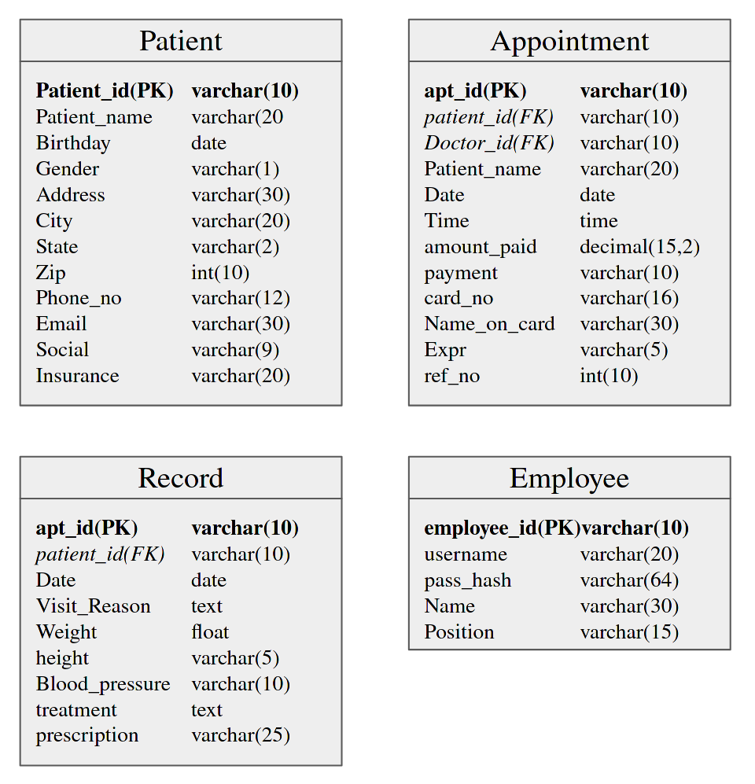

Slide 24
Thank You

