Slide 1
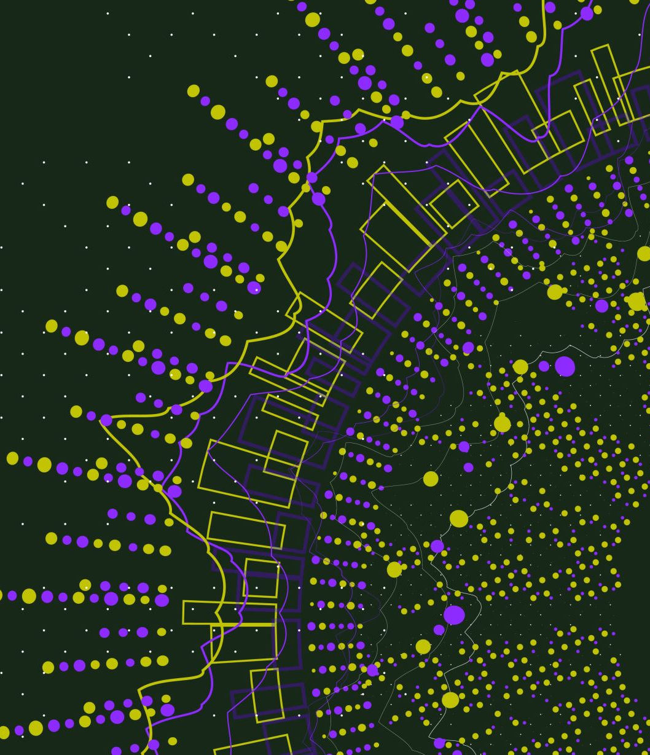
BIG DATA
Jacob Stenton
Formative Assignment

Slide 2
IDEA
I want to create a display that presents the “happiest”, and “saddest”, things that appear on social media in that day/hour.
Using sentiment analysis, I want to look at current trends in social media posts and find out where there related subject lies in a tier list of the happiest “things” to the saddest. This will be based on the amount of people that agree/disagree with said trend.
For example, after a football match you might see team “A”, who has just won, has a more positive sentiment analysis compared to team “B”. Here, we would see team A fans as the “happiest” and team “B” as the saddest

Slide 3
TECHNOLOGIES
Web scraping
Social media APIs
Sentiment analysis/Data processing
Graphic interface (probably a website)

Slide 4
ISSUES
Not sure how to scrape social media
Sentiment analysis???
How should the information be displayed?
Ethical stuff

