Slide 1
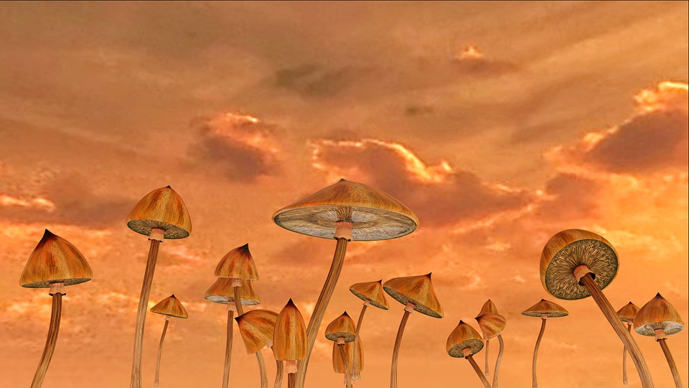
Mushroom Hunters
The Quest for Edible Mushrooms
Jacob McGraw, Julio Arciga

Slide 2
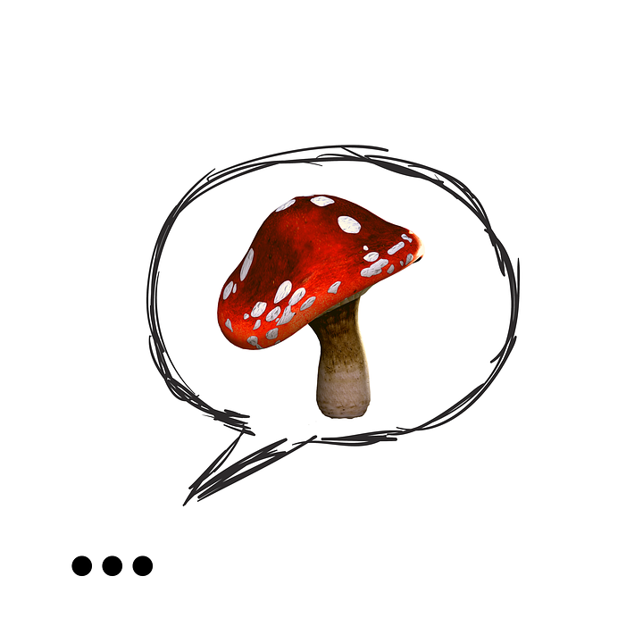
Data Cleaning
There were many steps needed to completely clean the dataset:
Gill attachment and veil type are all or almost completely the same observation
Stalk surface above and below and stalk color above and below are extremely similar, so we considered removing this feature

Slide 3
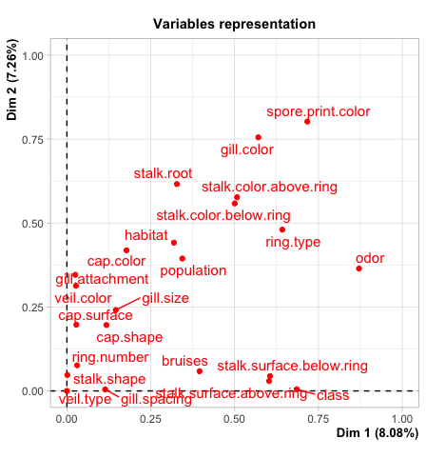
Data Exploration
The way we decided to perform variable selection was with Multiple correspondence analysis to analyze the data deeper…

Slide 4
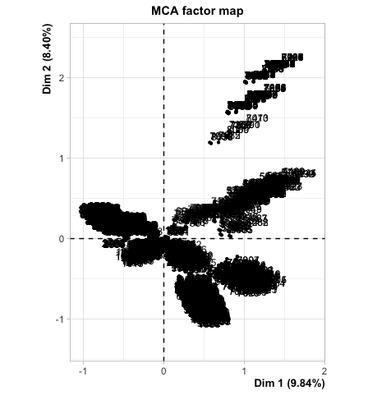
Data Exploration: Types of Poison
Another aspect of the mushrooms we tried to analyze was the type of poisonous mushrooms.

Slide 5
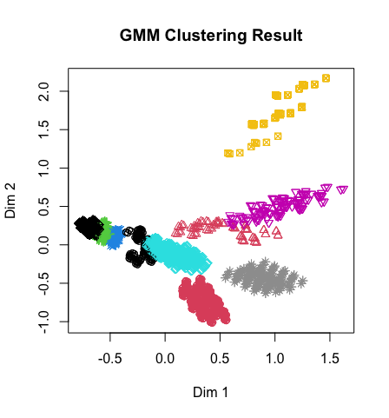
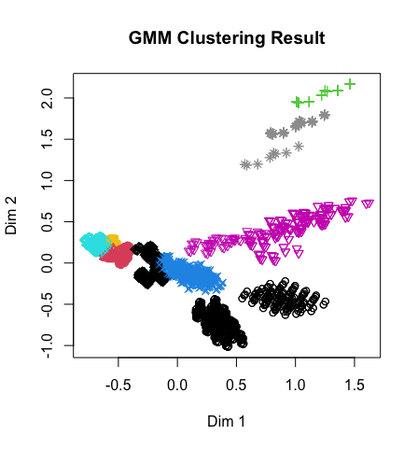
Clustering Algorithm Results: GMM
Clearly, the results do not converge

Slide 6
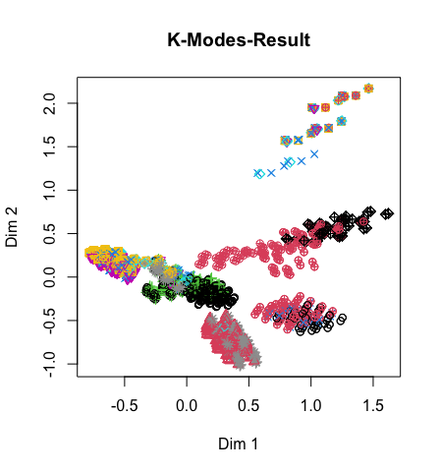
Clustering Algorithm: k-mediods
In k-mediods, the graph converges to a consistent shape, however the MCA clustering does not explain these clusters.

Slide 7
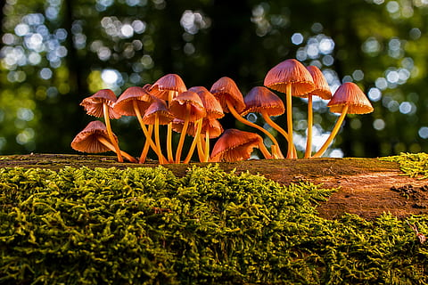
What’s in our poison clusters?
Bruises
Odorless
Close gill spacing
Broad gill size
Red gill
Clustered
Enlarging stalk shape
White veil color
Lives in waste
White spore color
Stalk surface is smooth

Slide 8
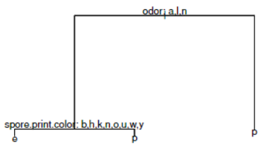
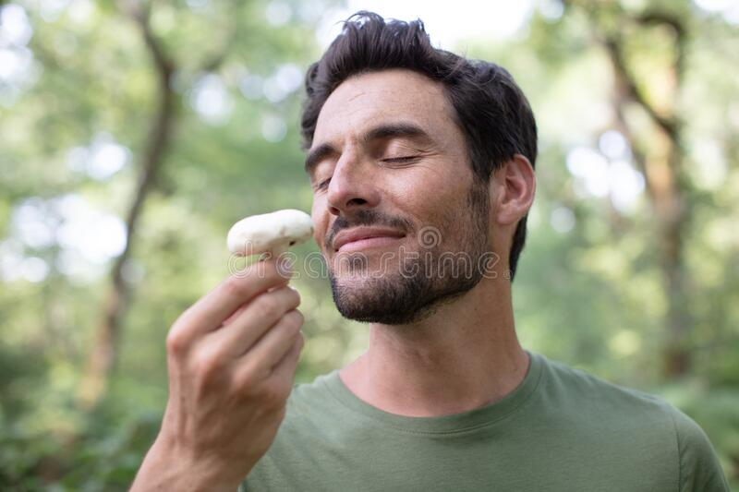
Odor:
a = almond
l = anise
n = none
c = creosote
y = fishy
f = foul
m = musty
p = pungent
s = spicy
Spore.print.color:
b = buff
k = black
n = brown
h = chocolate
o = orange
u = purple
w = white
y = yellow
r = green
 | Edible | Poison
Edible | 1418 | 20
Poison | 0 | 1406
99.30%

Slide 9
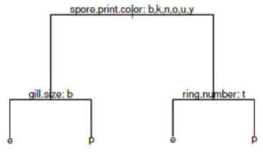
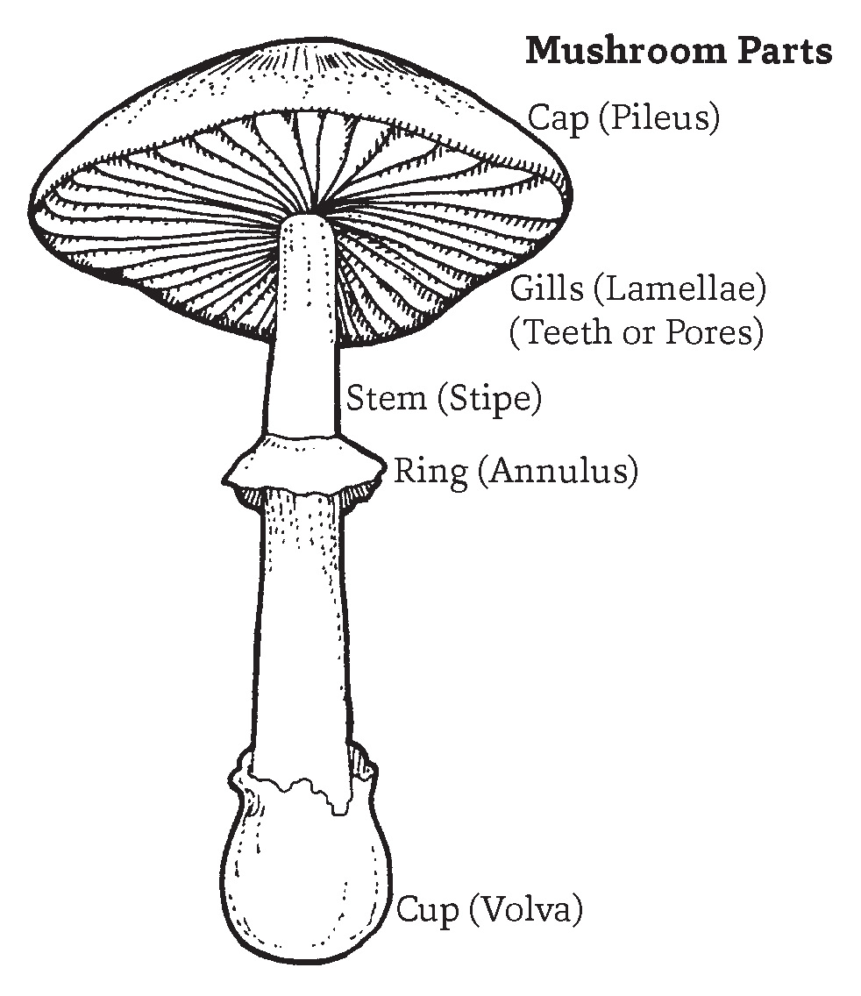
Spore.print.color:
b = buff
k = black
n = brown
o = orange
u = purple
y = yellow
h = chocolate
r = green
w = white
gill.size:
b = broad
n = narrow
ring.number:
t = two
o = one
n = none
95.14%
 | Edible | Poison
Edible | 1357 | 27
Poison | 111 | 1349

Slide 10
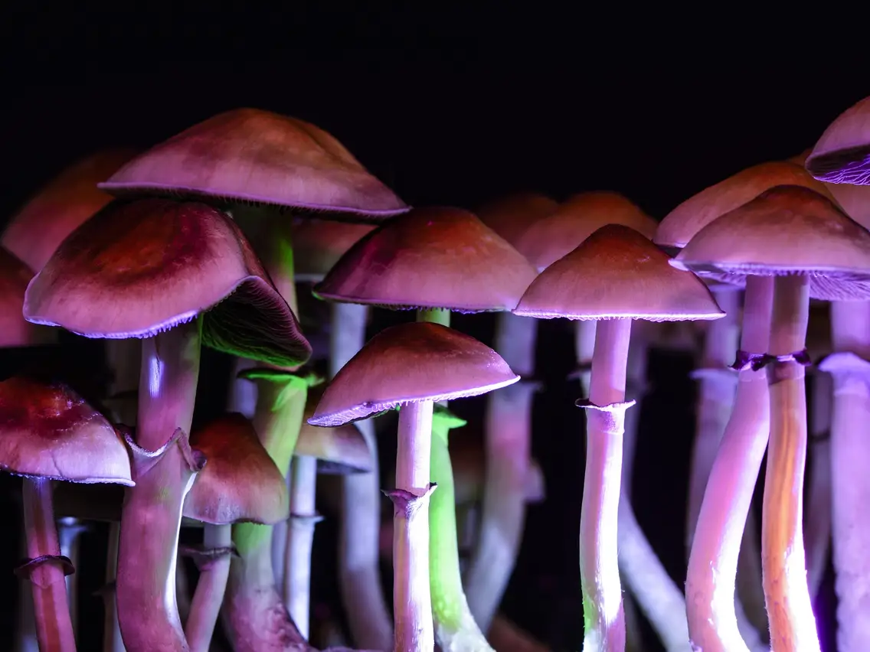
The quest of hunting mushrooms continues

Slide 11
References
Mushroom poisoning syndromes. North American Mycological Association. (n.d.). Retrieved May 6, 2022, from https://namyco.org/mushroom_poisoning_syndromes.php

