Slide 1


Predict the popularity of a TED Talk
CS522 Course Project
Name: Liu, Shijie
Professor: Liu, Xinlian
Date: 12/10/2018
Computer Science Department
Hood College of Frederick Maryland

Slide 2
Project analysis slide 2
Project Outline
Project Overview
PROJECT
Project Implementation
Lessons Learned & Future Work

Slide 3
Project analysis slide 2
Project Overview
Problem:
TED Conferences LLC is a media organization that posts talks online for free distribution under the slogan "ideas worth spreading." People could also organize their own local TEDx event.
How could TED filter which talk shall be published?
What could an organizer do to make their talk more popular?
Objectives:
What makes a popular TED Talk?
What are the most popular Topics that people like talk about?
Predict the popularity of an un-published TED Talk based on transcript.

Slide 4
Project analysis slide 3
Implementation
Data
Collection
Data Understanding
Data
Pre-Processing
Model
Building
Model
Selection
The Datasets being used for this project is being downloaded from Kaggle.
Using Exploratory data analysis(EDA) Technique to get a better understanding on the characteristics for existing attributes.
Handle missing values if there is any, normalize attributes upon needed, and add new attributes upon necessary.
Build various Classification Models using different Algorithms and train the model with training dataset.
Compare the performance and accuracy of different models and select the best Classification Model.

Slide 5
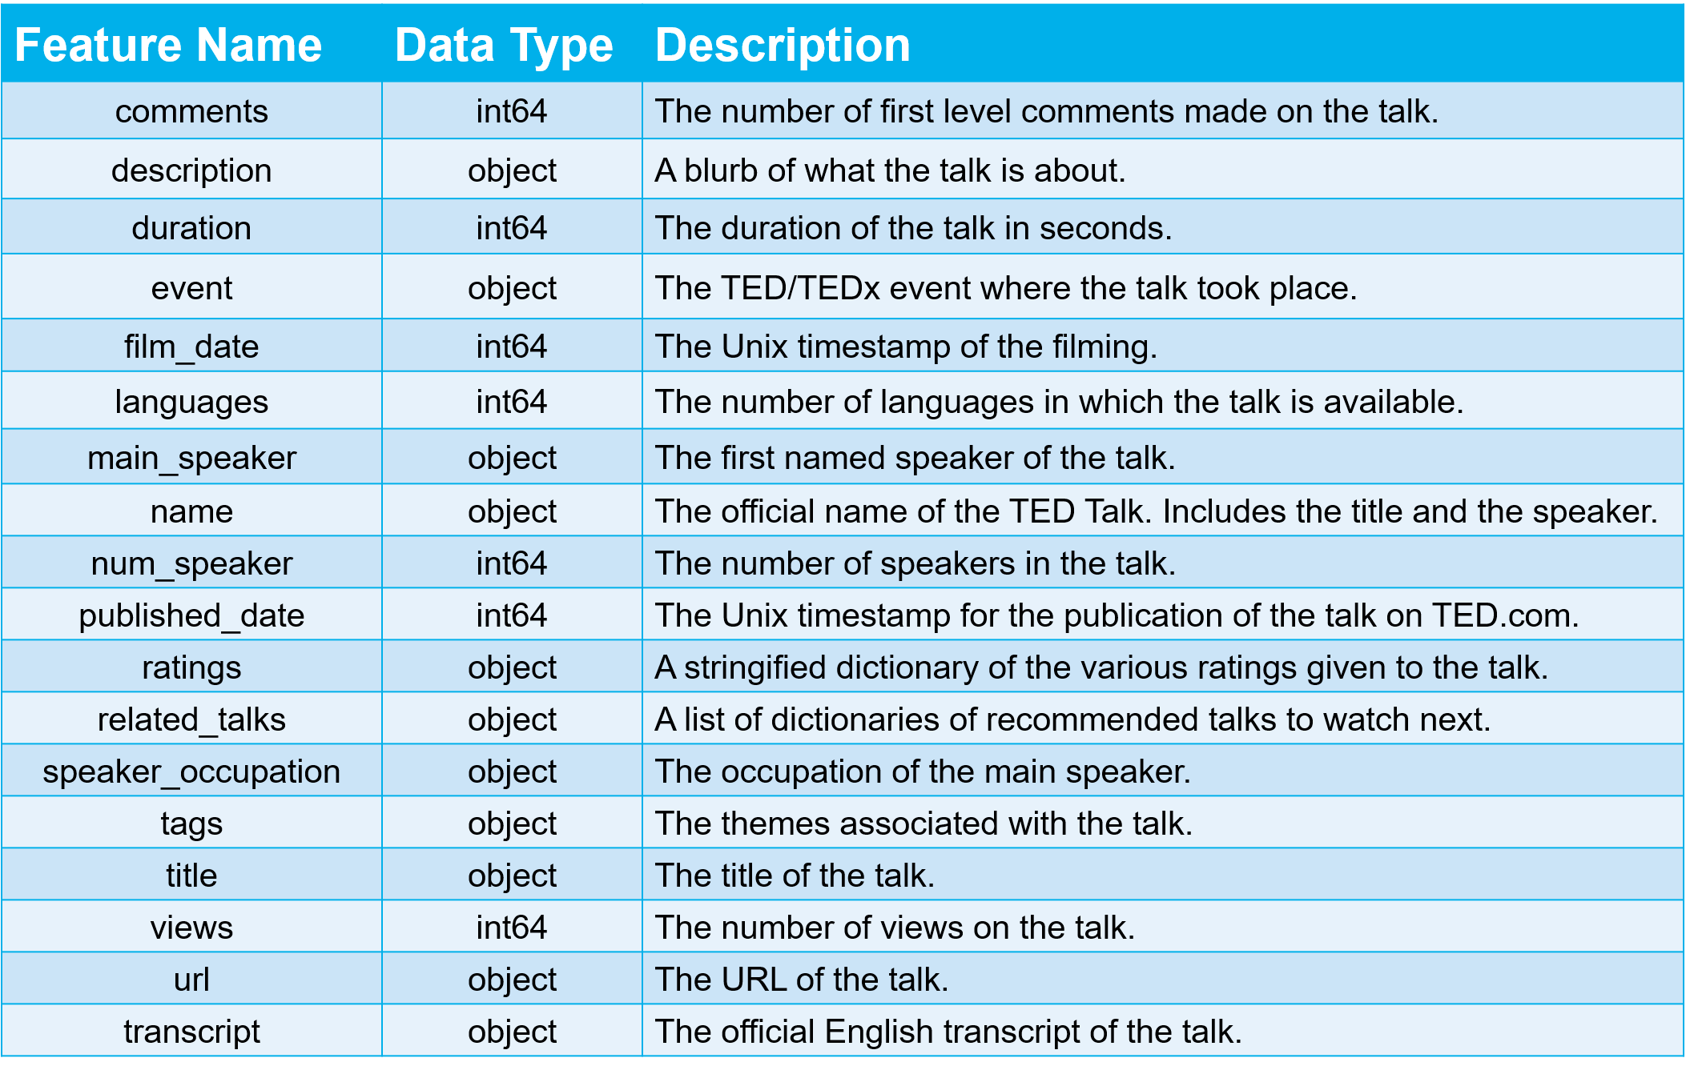
Project analysis slide 4
Data Collection
Data Source
https://www.kaggle.com/rounakbanik/ted-talks
TED Main
(2550 x 17)
TED Transcript
(2467 x 2)

Slide 6
Project analysis slide 5
Data Collection
TED Main- Example Data:
comments | description | duration | event | film_date | languages | main_speaker | name | num_speaker | published_date | ratings | related_talks | speaker_occupation | tags | title | url | views
4553 | Sir Ken Robinson makes an entertaining and pro... | 1164 | TED2006 | 1140825600 | 60 | Ken Robinson | Ken Robinson: Do schools kill creativity? | 1 | 1151367060 | [{'id': 7, 'name': 'Funny', 'count': 19645}, {... | [{'id': 865, 'hero': 'https://pe.tedcdn.com/im... | Author/educator | ['children', 'creativity', 'culture', 'dance',... | Do schools kill creativity? | https://www.ted.com/talks/ken_robinson_says_sc... | 47227110
TED Transcript -Example Data:
transcript | url
Good morning. How are you?(Laughter)It's been great, hasn't it? I've been blown away by the whole thing. In fact, I'm leaving.(Laughter)There have been three themes running through the conference which are relevant to what I want to talk about. One is the extraordinary evidence of human creativity in all of the presentations that we've had and in all of the people here. Just the variety of it and the range of it. The second is that it's put us in a place where we have no idea what's going to happen, in terms of the future. No idea how this may play out.I have an interest in education. Actually, what I find is everybody has an interest in education. Don't you? I find this very interesting. If you're at a dinner party, and you say you work in education — Actually, you're not often at dinner parties, frankly.(Laughter)If you work in education, you're not asked.(Laughter)And you're never asked back, curiously. That's strange to me. But if you are, and you say to somebody, you know, they say, "What do you do?" and you say you work in education, you can see the blood run from their face. They're like, "Oh my God," you know, "Why me?"(Laughter)"My one night out all week."(Laughter)But if you ask about their education, they pin you to the wall. Because it's one of those things that goes deep with people, am I right? Like religion, and money and other things. So I have a big interest in education, and I think we all do. We have a huge vested interest in it, partly because it's education that's meant to take us into this future that we can't grasp. If you think of it, children starting school this year will be retiring in 2065. Nobody has a clue, despite all the expertise that's been on parade for the past four days, what the world will look like in five years' time. And yet we're meant to be educating them for it. So the unpredictability, I think, is……… | https://www.ted.com/talks/ken_robinson_says_schools_kill_creativity

Slide 7
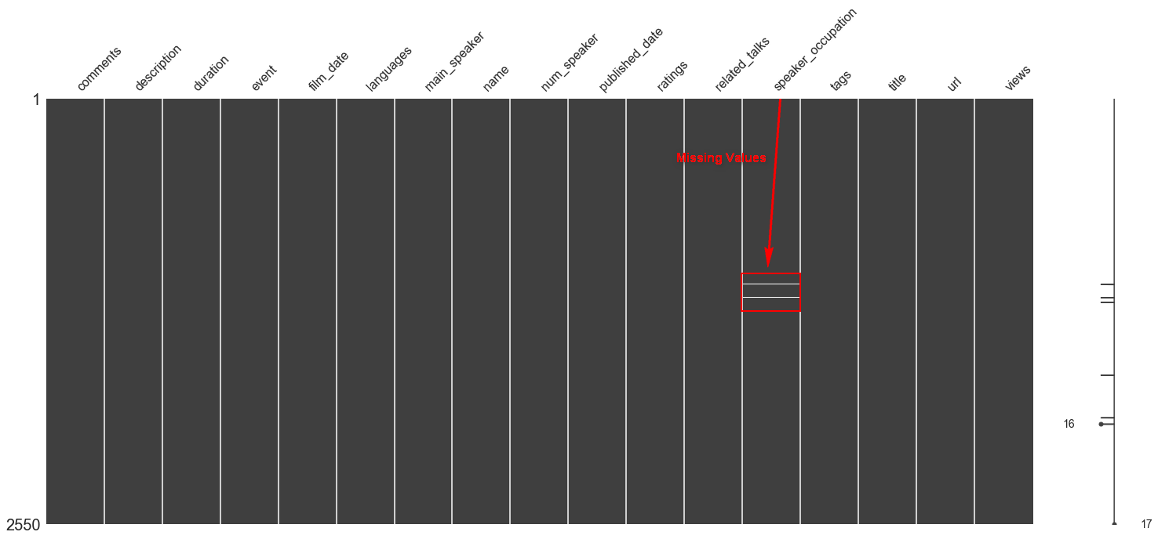
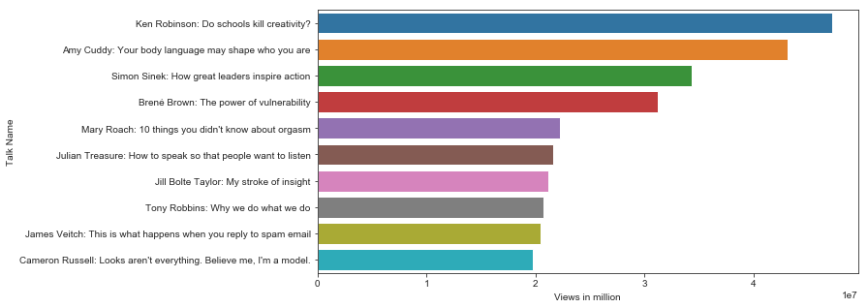
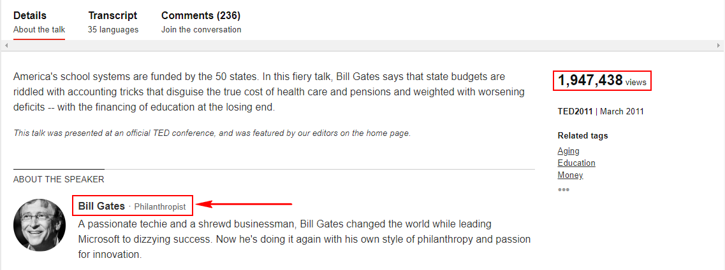
Project analysis slide 6
Data Understanding
Any Missing Values?
tedMain.speaker_occupation.fillna('UNKOWN', inplace=True)
Any outlier?

Slide 8
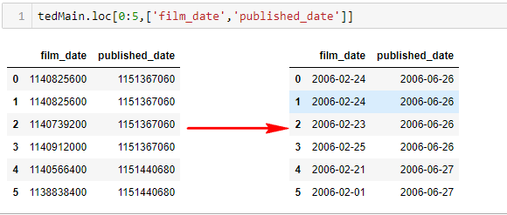
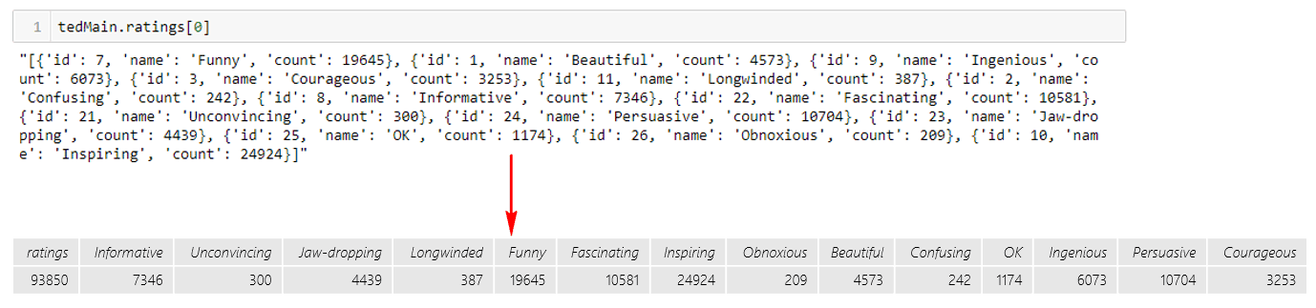
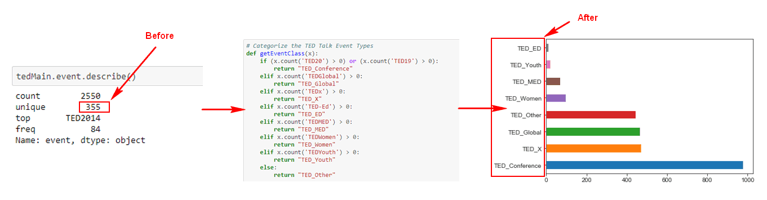
Project analysis slide 7
Data Pre-Processing
Data Normalization

Slide 9
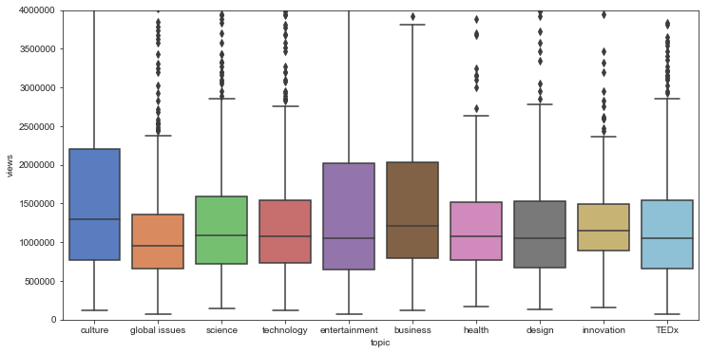
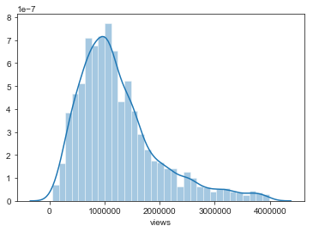
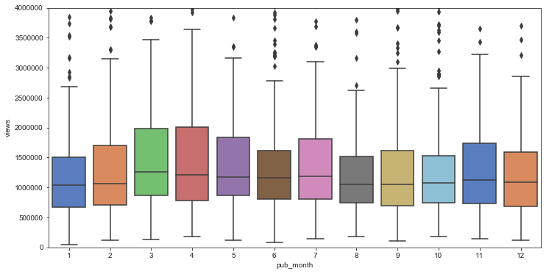
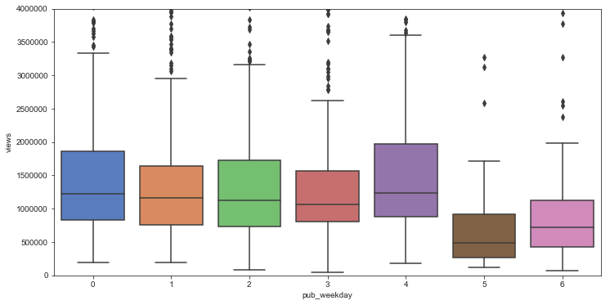
Project analysis slide 7
Data Pre-Processing
Data Visualization
Distribution of views
Views Per Topic
Views Per Publish Month
Views Per Publish Weekday

Slide 10
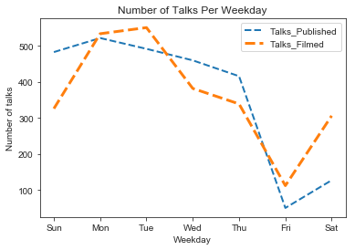
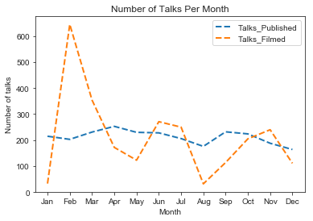
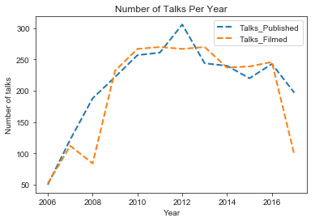
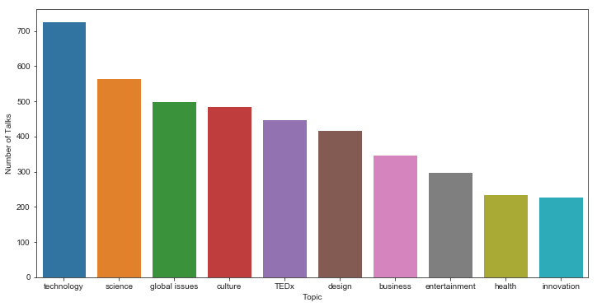
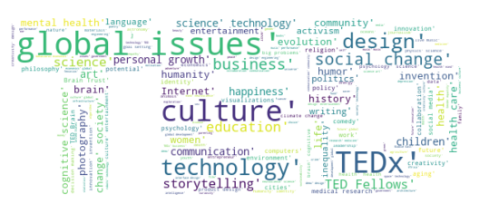
Project analysis slide 7
Data Pre-Processing
Data Visualization
Number of talks per weekday
Number of talks per month
Number of talks per year
Word Cloud based on tags
Number of talks per tag

Slide 11
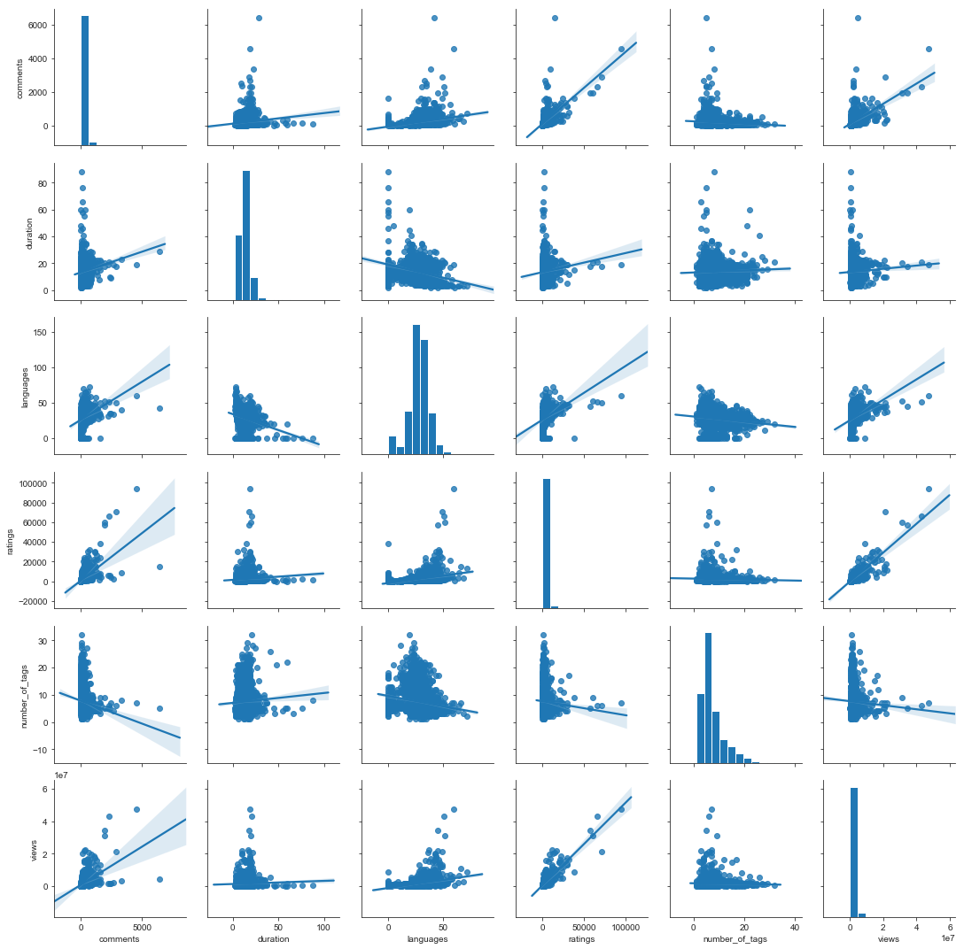
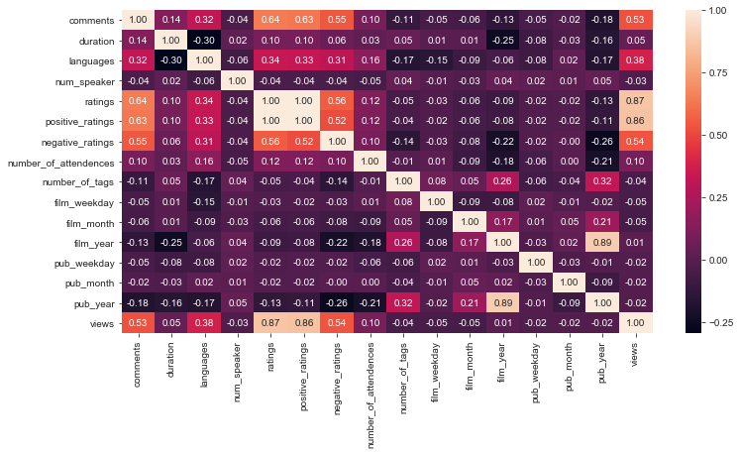
Project analysis slide 7
Data Pre-Processing
Data Correlation
Heatmap with selected features based on EDA
Regression visualization with selected features based on EDA

Slide 12
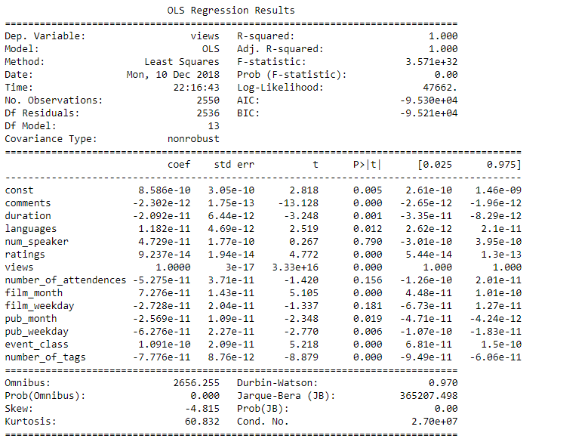
Project analysis slide 7
Model Building
Classification Model – ‘TED Main’
Classification Model – ‘TED Transcript’
Linear Regression Analysis
Merge Dataset
Text Cleanup
CountVectorizer
Data Partitioning
Classification Algorithm

Slide 13
Project analysis slide 7
Model Selection
Model Evaluation on Classification Model – ‘TED Main’
Train/Test Spilt
0.8 Train(2040) & 0.2 Test(510)
Classification Report | Precision | Recall | F1-Score | Support
False | 0.80 | 0.80 | 0.80 | 279
True | 0.75 | 0.75 | 0.75 | 231
Average/Total | 0.78 | 0.78 | 0.78 | 510
Classification Report | Precision | Recall | F1-Score | Support
False | 0.78 | 0.80 | 0.79 | 279
True | 0.75 | 0.74 | 0.74 | 231
Average/Total | 0.77 | 0.77 | 0.77 | 510
Confusion Matrix | Predicted
Actual | 1 | 0
1 | 222 | 57
0 | 57 | 174
Confusion Matrix | Predicted
Actual | 1 | 0
1 | 222 | 57
0 | 61 | 170
LogisticRegression
Apply RFE
Classification Report | Precision | Recall | F1-Score | Support
False | 0.77 | 0.72 | 0.74 | 279
True | 0.68 | 0.74 | 0.71 | 231
Average/Total | 0.73 | 0.73 | 0.73 | 510
Confusion Matrix | Predicted
Actual | 1 | 0
1 | 200 | 79
0 | 61 | 170
DecisionTreeClassifier
Classification Report | Precision | Recall | F1-Score | Support
False | 0.81 | 0.81 | 0.81 | 279
True | 0.77 | 0.77 | 0.77 | 231
Average/Total | 0.79 | 0.79 | 0.79 | 510
Classification Report | Precision | Recall | F1-Score | Support
False | 0.82 | 0.79 | 0.81 | 279
True | 0.76 | 0.79 | 0.77 | 231
Average/Total | 0.79 | 0.79 | 0.79 | 510
Confusion Matrix | Predicted
Actual | 1 | 0
1 | 227 | 52
0 | 54 | 177
Confusion Matrix | Predicted
Actual | 1 | 0
1 | 227 | 58
0 | 49 | 182
Apply Scaling
RandomForestClassifier

Slide 14
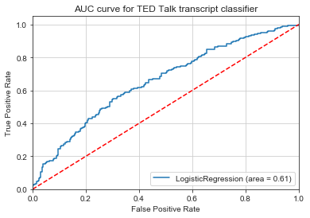
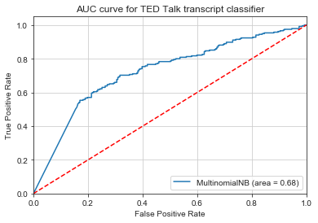
Project analysis slide 7
Model Selection
Model Evaluation on Classification Model – ‘TED Transcript’
Train/Test Spilt
0.8 Train(1973) & 0.2 Test(494)
Classification Report | Precision | Recall | F1-Score | Support
False | 0.64 | 0.56 | 0.60 | 259
True | 0.58 | 0.65 | 0.61 | 235
Average/Total | 0.61 | 0.61 | 0.60 | 494
Confusion Matrix | Predicted
Actual | 1 | 0
1 | 146 | 113
0 | 82 | 153
LogisticRegression
Classification Report | Precision | Recall | F1-Score | Support
False | 0.71 | 0.66 | 0.68 | 259
True | 0.65 | 0.70 | 0.67 | 235
Average/Total | 0.68 | 0.68 | 0.68 | 494
Confusion Matrix | Predicted
Actual | 1 | 0
1 | 170 | 89
0 | 70 | 165
MultinomialNB
Cross Validation
10-Fold Cross Validation
 | Logistic Regression | Multinomial NB
Mean Accuracy | 60 % | 65 %

Slide 15
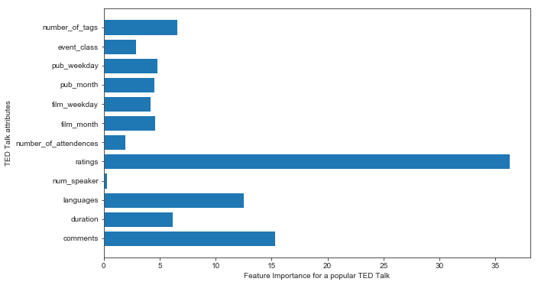
Project analysis slide 7
Conclusion
1 - What makes a popular TED Talk?
2 - What are the most popular Topics that people like talk about?
Top 5 features selected by RFE
(Recursive Feature Elimination)
Comments
Languages
Ratings
Published Weekday
Number of tags
Random Forest Classifier
Technology
Culture
Global Issues
Design
Social change
3 – Could the model predict the popularity of an TED Talk based on its transcript?
IT COULD! With a Prediction Accuracy of 68%.

Slide 16
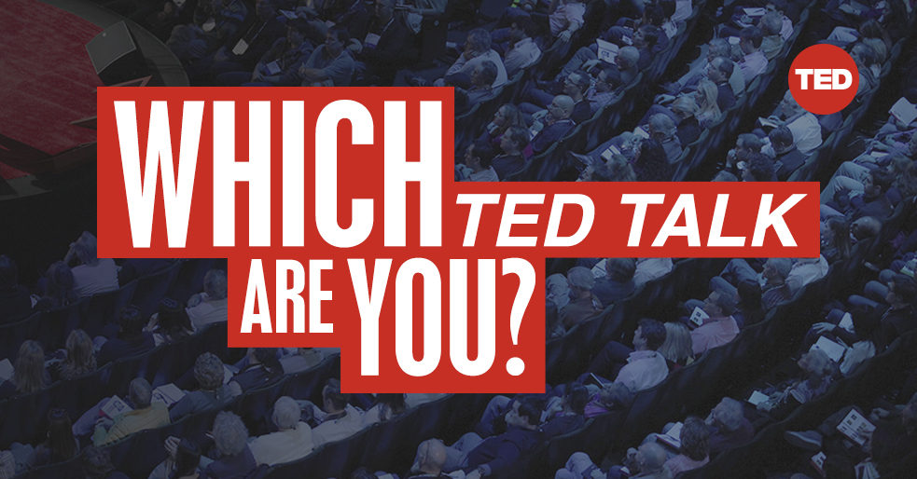
Project analysis slide 10
Future Work
Optimize the performance of Classification Models
There are two kinds of classification models being built for this project, one is being trained based on the selected features from TED main dataset and the other one is trained based on the plain transcript of a talk. Neither model has HIGH prediction accuracy.
Apply Topic Modeling on text features
In this project, there are some text features not being used while building the classification model, such as, title, description, and tags etc. due to time limitations. However, those features are actually more important.
Proposed Algorithm: Latent Dirichlet Allocation(LDA) is a popular algorithm for topic modeling with excellent implementations in the Python’s Gensim package.
Although the prediction accuracy depends on the dataset, planning further pre-pruning and post-post pruning to see if a better prediction accuracy can be obtained.

Slide 17
Thank You !
Q & A?

