Slide 1

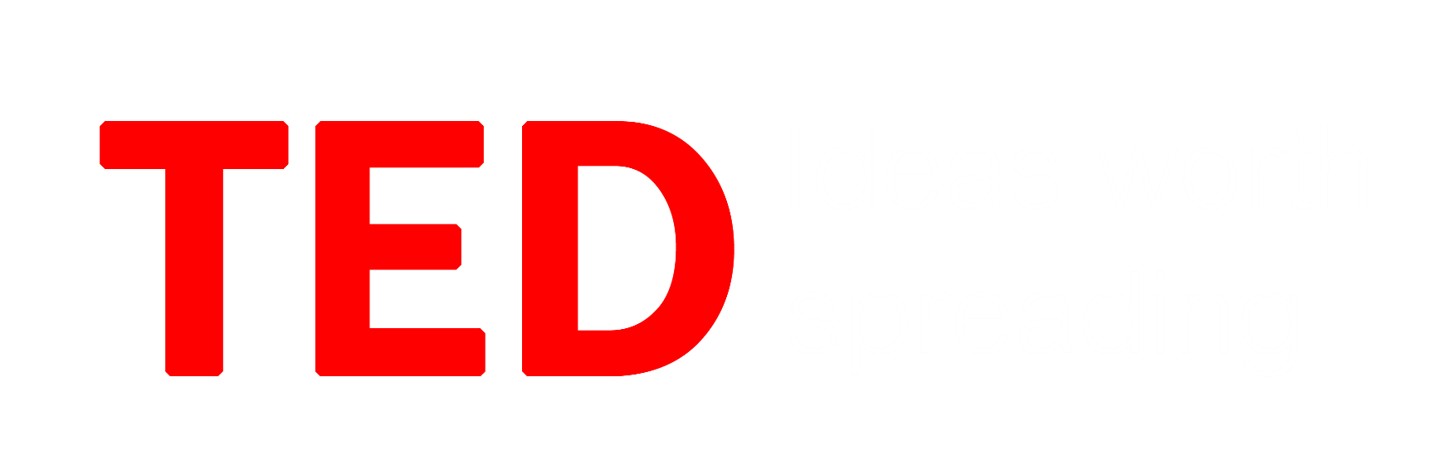
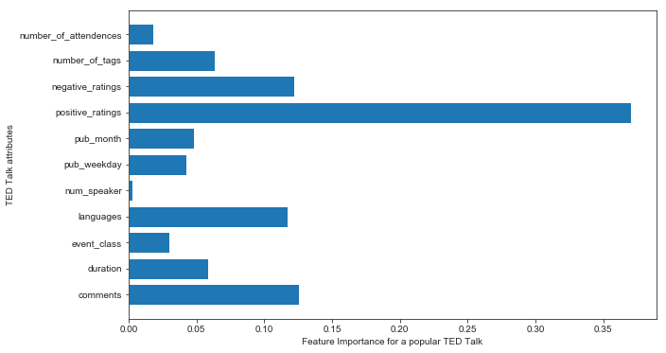
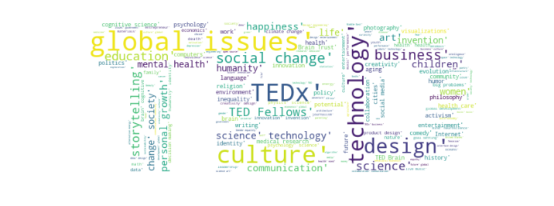
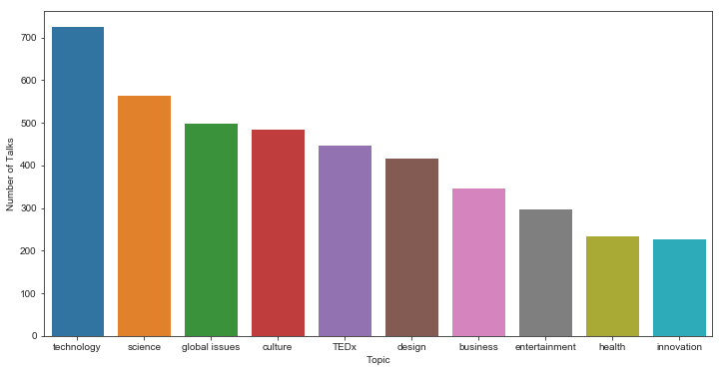
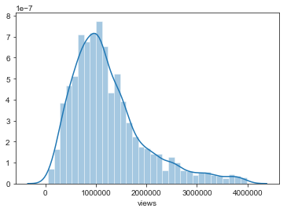
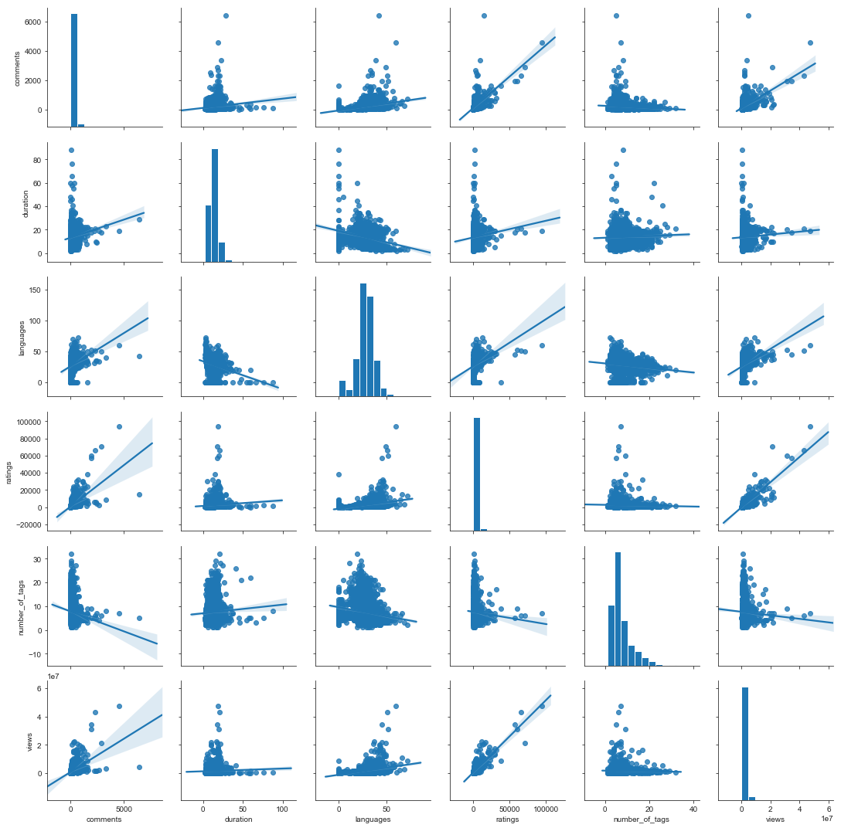
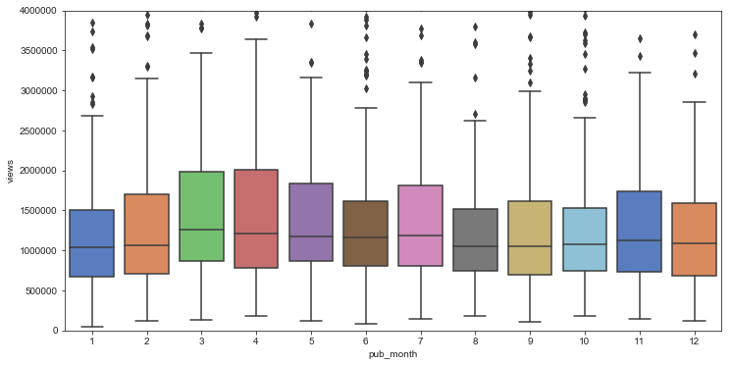
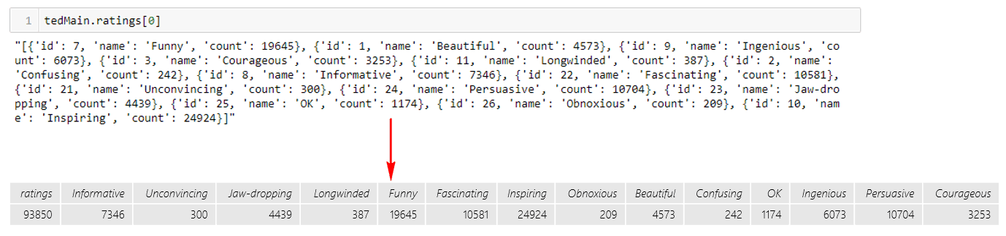
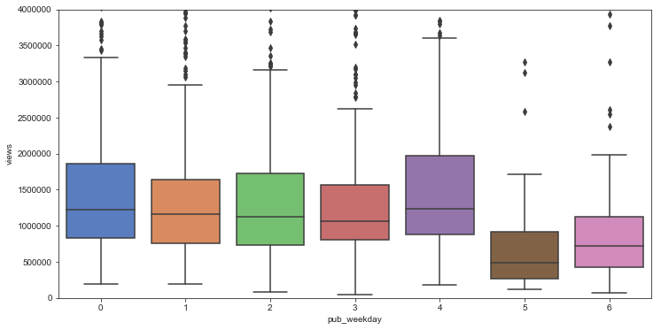
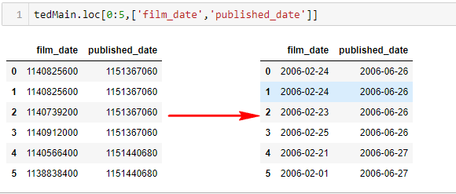
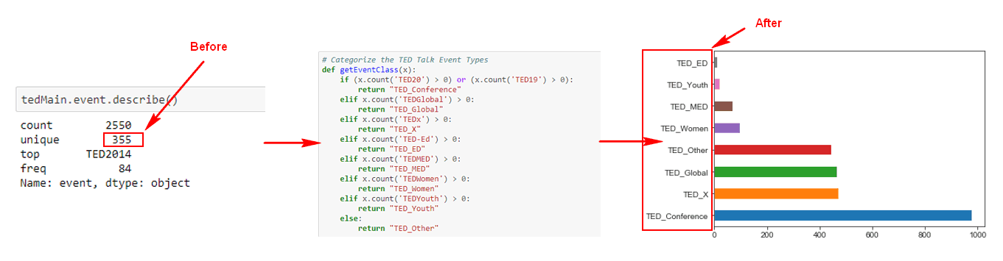
Predict the Popularity of a TED Talk
Liu, Shijie | Dr. Liu, Xinlian | Hood College of Frederick Maryland
Abstract
Dataset Description
Result
TED Talks (Technology, Entertainment, and Design) are being posted by TED Conference LLC for free on their website and YouTube Channel under the slogan of “ideas worth spreading”. TED Talk offers a wide range of topics within the research and practice of science and culture, often through storytelling. As well as, it has a variety of presenters, such as, Writer, Researcher, and Scientist. TED also give people the right to raise their own local TED X Event. Therefore, questions like, how could TED filter and determine which talk shall be published and what an organizer could do to make his/her talk more popular? In this project, I would like to apply Exploratory Data Analysis on all the available attributes and have a better understanding of what are the variables that could affect the popularity of a TED Talk. Also, applying Natural Language Processing technique on the TED Talk transcript. Then, I would like to train a classification model with algorithms that could predict the popularity of TED Talk.
Feature Name | Data Type | Description
comments | int64 | The number of first level comments made on the talk.
description | object | A blurb of what the talk is about.
duration | int64 | The duration of the talk in seconds.
event | object | The TED/TEDx event where the talk took place.
film_date | int64 | The Unix timestamp of the filming.
languages | int64 | The number of languages in which the talk is available.
main_speaker | object | The first named speaker of the talk.
name | object | The official name of the TED Talk. Includes the title and the speaker.
num_speaker | int64 | The number of speakers in the talk.
published_date | int64 | The Unix timestamp for the publication of the talk on TED.com.
ratings | object | A stringified dictionary of the various ratings given to the talk.
related_talks | object | A list of dictionaries of recommended talks to watch next.
speaker_occupation | object | The occupation of the main speaker.
tags | object | The themes associated with the talk.
title | object | The title of the talk.
views | int64 | The number of views on the talk.
url | object | The URL of the talk.
transcript | object | The official English transcript of the talk.
What makes a popular TED Talk?
Important features:
Ratings
Comments
Languages
Duration
Number of tags
Published weekday
Figure 7: Feature Importance of Random Forest Classifier
What are the most popular topics in TED Talk?
KEYWORDS: Exploratory Data Analysis, Visualization, Classification, Natural Language Processing
Techniques
Classification Algorithms:
Logistic Regression
Random Forest Classifier
Decision Tree Classifier
Multinomial Naïve Bayes
Classification Model Evaluation Metrics:
Prediction Accuracy
Confusion Matrix
Classification Report
Cross Validation
Implementation
Figure 8: Most Popular Topics via Word Cloud
Figure 9: TOP 10 popular topics
Sample Data
Predict the popularity of a TED Talk based on its transcript ?
Answer: Prediction Model based on Multinomial Naïve Bayes [2] algorithm is selected as a better model that has Prediction Accuracy of 68%.
TED Main Dataset- Sample Data:
Data
Collection
Data Understanding
Data
Pre-Processing
Model
Building
Model
Selection
comments | description | duration | event | film_date | languages | main_speaker | name | num_speaker | published_date | ratings | related_talks | speaker_occupation | tags | title | url | views
4553 | Sir Ken Robinson makes an entertaining and pro... | 1164 | TED2006 | 1140825600 | 60 | Ken Robinson | Ken Robinson: Do schools kill creativity? | 1 | 1151367060 | [{'id': 7, 'name': 'Funny', 'count': 19645}, {... | [{'id': 865, 'hero': 'https://pe.tedcdn.com/im... | Author/educator | ['children', 'creativity', 'culture', 'dance',... | Do schools kill creativity? | https://www.ted.com/talks/ken_robinson_says_sc... | 47227110
The Datasets being used for this project is being downloaded from Kaggle.
Using Exploratory data analysis(EDA) Technique to get a better understanding on the characteristics for existing attributes.
Handle missing values if there is any, normalize attributes upon needed, and add new attributes upon necessary.
Build various Classification Models using different Algorithms and train the model with training dataset.
Compare the performance and accuracy of different models and select the best Classification Model.
Future Work
Although this project has met its original objectives that it could identify those key features that contribute to the popularity of a TED talk and it could also predict the popularity based on transcript, but the features being used to train the classification model is limited and the prediction accuracy is lower than expected.
Future work will be carried out to understand why the prediction accuracy is lower and do further pre-tuning and post-tuning to enhance the classification model. Further, understanding the reality of all features and take full advantage of all available features while training the classification model, such as, title, description, and tags are not being used for this project, but those features are actually important contributors for TED Talk popularity. Consequently, future work would also be carried out to apply Topic Modeling algorithms to classify the topic class to a categorical value, the proposed algorithm is Latent Dirichlet allocation (LDA). [3]
Exploratory Data Analysis
TED Transcript Dataset- Sample Data:
transcript | url
Good morning. How are you?(Laughter)It's been great, hasn't it? I've been blown away by the whole thing. In fact, I'm leaving.(Laughter)There have been three themes running through the conference which are relevant to what I want to talk about. One is the extraordinary evidence of human creativity in all of the presentations that we've had and in all of the people here. Just the variety of it and the range of it. The second is that it's put us in a place where we have no idea what's going to happen, in terms of the future. No idea how this may play out.I have an interest in education. Actually, what I find is everybody has an interest in education. Don't you? I find this very interesting. If you're at a dinner party, and you say you work in education — Actually, you're not often at dinner parties, frankly.(Laughter)If you work in education, you're not asked.(Laughter)And you're never asked back, curiously. That's strange to me. But if you are, and you say to somebody, you know, they say, "What do you do?" and you say you work in education, you can see the blood run from their face. They're like, "Oh my God," you know, "Why me?"(Laughter)"My one night out all week."(Laughter)But if you ask about their education, they pin you to the wall. Because it's one of those things that …. | https://www.ted.com/talks/ken_robinson_says_schools_kill_creativity
Figure 4: Distribution of number of views for each talk
Acknowledgement & Reference
Data Preprocessing
This project is a course project for Data Mining at Hood College of Frederick, Maryland, during the Fall Semester of 2018. Firstly, I would like to thank Dr. Liu, Xianlian for giving us the fantastic opportunity that we can select our project topic by ourselves and the great guidance given through the entire semester. In addition, I would like to give thanks to my classmates and friends for providing suggestions on this project. Finally, I would like to express my deepest thanks and sincere appreciation to my family, girlfriend, and colleagues for their love, understanding, and support.
Figure 1: Convert ratings from string object to a matrix table
Figure 5: Boxplot for Publish Month and Views
[1] Wikipedia. 2018. Wikipedia: TED (conference). Retrieved from https://www.wikipedia.org.
[2] L. Jiang, Z. Cai & D. Wang. 2010. Improving Naive Bayes for Classification, International Journal of Computers and Applications, 32:3, 328-332, DOI: 10.2316/Journal.202.2010.3.202-2747
[3] Machine Learning Plus. 2018. Topic Modeling with Gensim (Python). Retrieved December 16, 2018 from https://www.machinelearningplus.com/nlp/topic-modeling-gensim-python/
Figure 2: Convert UNIX Timestamp to Human Date
Figure 3: Adding a Event Class Feature based on event
Figure 6: Boxplot for Publish Weekday and Views
Figure 4: Regression Visualization

