Slide 1

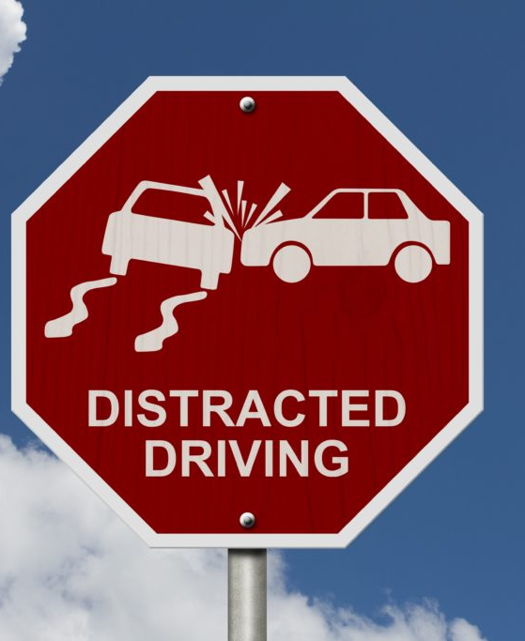
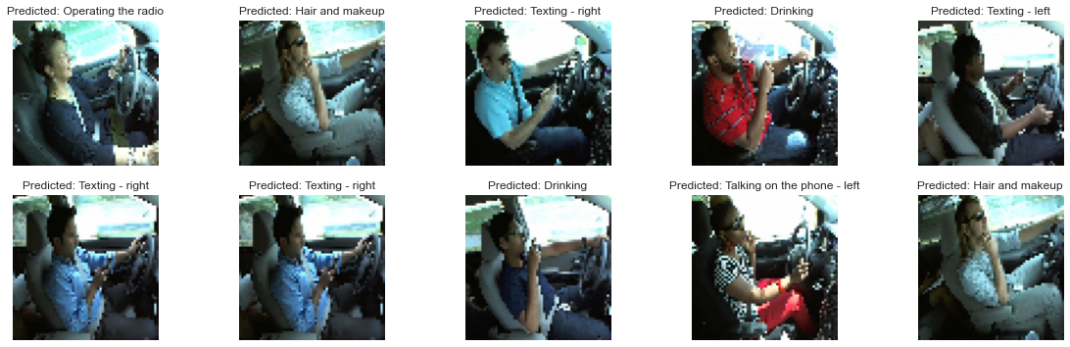
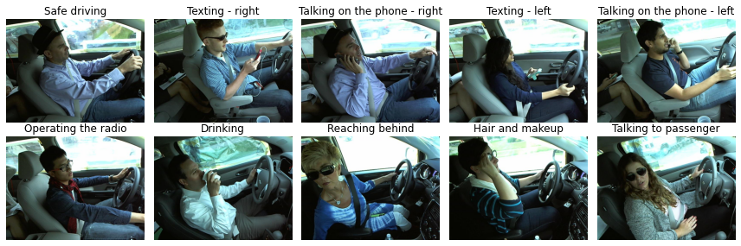
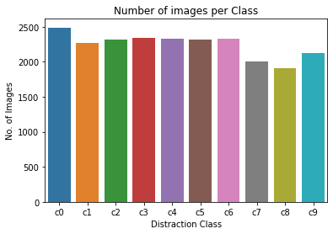
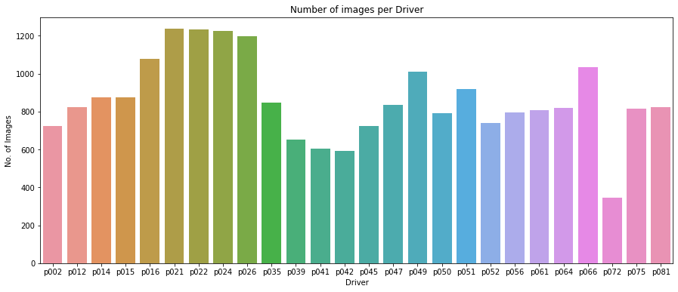
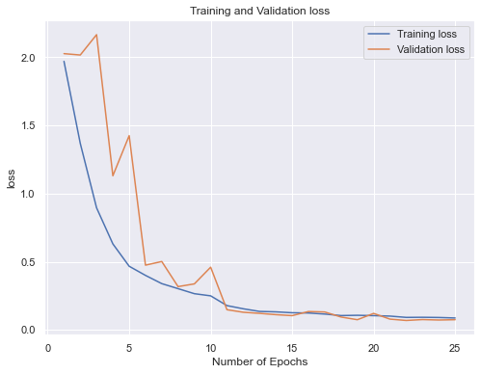
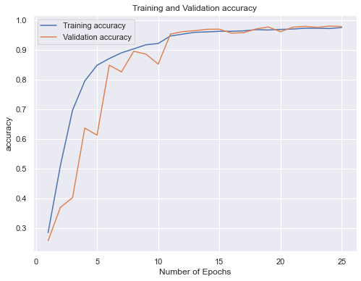
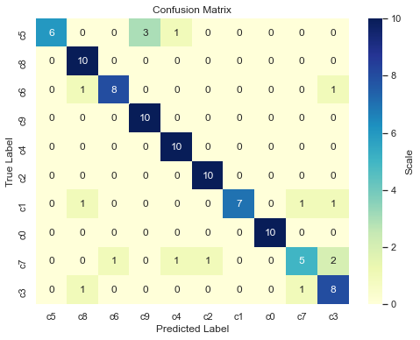
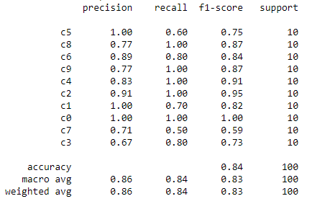
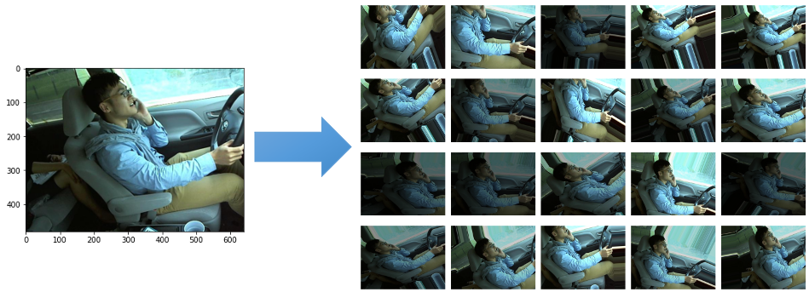
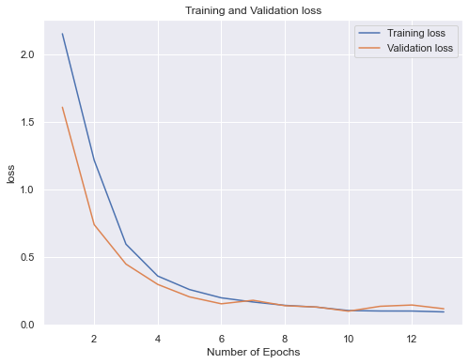
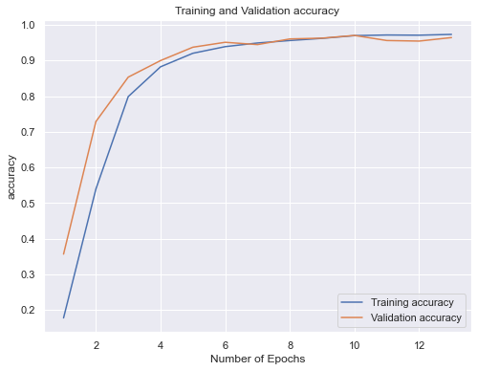
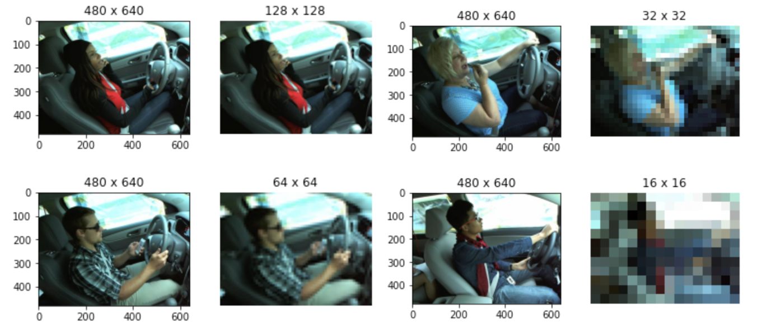
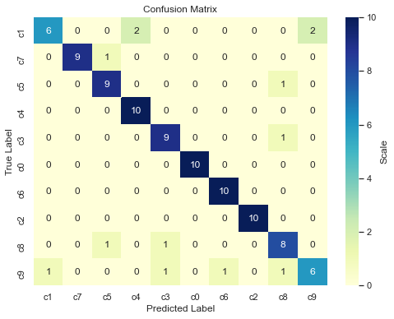
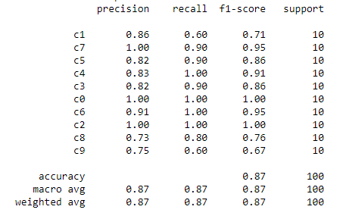
Distracted Driver Detection with Convolution Neural Network
Liu, Shijie | Dr. Liu, Xinlian | Computer Science | Hood College | Frederick, Maryland, USA | sl23@hood.edu
Abstract
Implementation
Conclusion & lessons learned
Dataset
Dataset Collection
Architectures
Convolution Neural Network from Scratch
Dataset Exploration
Dataset Spilt
Dataset pre-processing
Transfer learning with VGG-19 via fine-tuning
Evaluation
Loss
Accuracy
Confusion Matrix
Techniques
Image Data Generator
Transfer Learning
Image Data Augmentation
Dropout
Classification Report
Batch Normalization
Safety has become more and more important with the rapidly development of highway infrastructure around the world. With the assessment of road safety in 178 countries, the World Health Organization (WHO) had reported there are approximately 1.3 million people die each year on the world's roads, and between 20 and 50 million sustain non-fatal injuries [4]. According to National Highway Traffic Safety Administration (NHTSA), in 2018, over 2,800 people were killed and an estimated 400,000 were injured in crashes involving a distracted driver in the U.S [3]. The Centers Disease Control and Prevention (CDC) Transportation Safety also defined three types of distraction: eyes off the road as visual distraction, hands off the wheel as manual distraction, and minds off driving as cognitive distraction [1]. State Farm, an insurance company had collected a dataset of 2D dashboard camera images that are properly labeled with 9 distraction classes identified, and the dataset is available on Kaggle for competition [2]. Therefore, this project aims to build and train convolutional neural network models that can detect and classify distracted drivers, which includes a convnet from scratch and a fine-tuned VGG-19 network. Throughout this project, techniques like image augmentation, batch normalization, and dropout are used to overcome the overfitting issue. At end of the project, the best model can achieve 87% prediction accuracy with a small labeled dataset that the model never seen before.
CONCLUSION: After evaluated the results for all trainings and performance of trained models, it is clearly that a model had been trained and is capable to detect distracted drivers from a dash camera image. Figure below shows the prediction result from a group of sample images. Therefore, we can conclude convolution neural network is an efficient approach for image classification problem. The results show fine-tuned VGG-19 network outperforms the convnet from scratch under the same maximum training epochs, batch size, and same input eventually. But this is not always true. Without re-train the convnet base, the scratch network always beats the fine-tuned and it takes less time to train, so scratch network seems to be a better choice from cost performance respective. Just like other neural networks, overfitting issue is a challenge for this project due to limited data, but the combination of image data augmentation, batch normalization and dropout minimized the impact of overfitting.
ARCHITECTURES
KEYWORDS: Deep Learning, Computer Vision, Convolutional Neural Network, Transfer Learning, Feature Extraction, Fine tuning, Deep Neural Network, Image Augmentation, Batch Normalization, Distracted Driver
64x64x3
64x64x32
8x8x128
Dropout
Three common layers are used, convolution, pooling, and fully connected
Input layers accepts 64x64x3 input (RGB images)
Three convolution layers, with various number of filters. E.g. 32, 64, and 128; All convolution layers use relu activation function and 5x5 stride.
Each convolution layer has a following max pooling layer, which uses 2x2 pooling window.
Two fully connected dense layers are following flattening out, the last layer has 10 as number of output, which corresponds to number of classes to classify.
Data Description
32x32x64
16x16x128
256
10
State Farm Distracted Driver Detection dataset [2] has been chosen for this project. The dataset is only available for competition that all image metadata (creation dates) has been removed. Drivers included in this dataset have been separated to train and test data and one driver can only appear in one set of data, which ensures the test data are 100% unknown to the trained model when performing prediction. All image data are collected from 2D dashboard cameras that captures different distraction activities of the driver, such as texting, talking on the phone, drinking, and reaching behind, etc. Below is a list of classes this dataset supports:
Input layer
LESSONS LEARNED: Throughout this project, there are mistakes were made which leads to un-expect result. For example, horizontal_flip was set to True while using ImageDataGenerator, which misleads the neural network since there is separation among left and right for distraction classes. I also learned that fine-tuning a pre-trained model needs to be look at case by case, good result is not guaranteed without re-training the convnet base, even though it may work very well for object detection tasks. In this project, partial layers from the convnet base must be set for trainable, and experiments are needed for determining number of layers to be re-trained. Besides, I also learned the Dropout rate does not show linear impact on the performance. Among 0.2, 0.3, and 0.4, 0.3 shows the best result. Lastly, I learned that there is no best learning rate for all networks. For example, with the same number of training epochs, 0.01 works very well for the scratch version convnet, while 0.001 is a better choice for fine-tuned VGG-19 convnet.
Convolution layer
Max Pooling layer
Convolution Neural Network from Scratch
Fully connected dense layer
c0: safe driving
c1: texting - right
c2: talking on the phone - right
c3: texting - left
c4: talking on the phone - left
c5: operating the radio
c6: drinking
c7: reaching behind
c8: hair and makeup
c9: talking to passenger
VGG network architecture includes two variants, VGG-16 and VGG-19.
Original VGG-19 takes 224x224x3 input shape
Includes 16 convolution layers(3x3 stride), 5 max pooling layers(2x2 pooling window), and 3 fully connected layers(first two layers have 4096 outputs, while the last has 1000 outputs)
Replace three fully connected dense layers with two, which use 256 and 10 as output
Keep convolution and pooling layers as convnet base, but later layers will be kept trainable.
2x2x512
Dropout
Data
Collection
64x64x3
64x64x64
32x32x128
256
Data
Pre-Processing
Model
Building
Model
Selection
10
Handle missing values if there is any, normalize attributes upon needed, and add new attributes upon necessary.
16x16x256
8x8x512
4x4x512
FUTURE WORK
Data Exploration
Build various Classification Models using different Algorithms and train the model with training dataset.
Compare the performance and accuracy of different models and select the best Classification Model.
Input layer
Based on the outcome of this project, the initial objectives have been met. However, there are still areas can be explored. With regarding to Image augmentation, this project only used basic image manipulations, which can be extended to use Deep learning approaches, such as adversarial training, neural style transfer, and GAN (Generative adversarial networks) Data augmentation [7]. Another area can be improved is the training platform, instead of relying on the CPU of personally MacBook Pro, it can use the Extreme Science and Engineering Discovery Environment (XSEDE), which is supported by National Science Foundation grant number ACI-1548562. Specifically, it used the Bridges-2 system, which is supported by NSF award number ACI-1445606, at the Pittsburgh Supercomputing Center (PSC). [5, 6] Further, trained model can be deployed to real environment, input images captured from cameras, for real-time detection, only as experimental study since the model was trained on a competition dataset.
Convolution layer
Max Pooling layer
Fully connected dense layer
Fine-tuned VGG-19 Network
Evaluation
Sample image per distraction class
D: Dropout
BN: Batch Normalization
DA: Data Augmentation
LR: Learning Rate
LF: Layers frozen
Acknowledgement
Convolution Neural Network from Scratch
 | Training |  | Validation |  | Test
 | Loss | Accuracy | Loss | Accuracy | Loss | Accuracy
Base | 0.022 | 99.33% | 0.085 | 97.83% | 2.69 | 66.00%
Base + D(0.3) | 0.009 | 99.72% | 0.022 | 99.46% | 2.85 | 62.99%
Base + D(0.3) + BN | 0.051 | 99.81% | 0.041 | 99.62% | 0.903 | 75.00%
Base + D(0.3) + BN + DA | 0.207 | 94.98% | 0.422 | 87.03% | 0.664 | 81.00%
Base + D(0.2) + BN + DA | 0.148 | 96.50% | 0.221 | 94.11% | 0.858 | 75.00%
Base + D(0.4) + BN + DA | 0.343 | 91.52% | 0.487 | 85.69% | 0.762 | 74.00%
Base + D(0.3) + BN + DA + LR(0.01) | 0.087 | 97.55% | 0.074 | 97.88% | 0.683 | 84.00%
Base + D(0.3) + BN + DA + LR(0.001) | 0.199 | 95.12% | 0.32 | 90.02% | 0.804 | 75.00%
Base + D(0.3) + BN + DA + LR(0.0001) | 0.59 | 88.65% | 0.55 | 89.49% | 0.96 | 70.00%
Base + BN + DA + LR(0.01) | 0.0626 | 98.32% | 0.078 | 97.63% | 0.792 | 78.00%
This project was inspired by driving education classes from Greg Driving School. I also would like to express sincere thanks to Dr. Liu, Xinlian for his great guidance given through the semester under the pandemic situation. In addition, I would like to give thanks to Omar Aboul-Enein for sharing his project with the class and providing tips that helps me to accomplish my project. Last not the least, I would like to express my deepest thanks my wife, my whole family and colleagues for their love, understanding, and support.
Data Preprocessing
Image Augmentation
Fine-tuned VGG-19 Network
REFERENCE
Generates more data from existing data
Exposes more aspects of same data
Supports random on-the-fly transformation
 | Training |  | Validation |  | Test
 | Loss | Accuracy | Loss | Accuracy | Loss | Accuracy
Base | 0.013 | 99.88% | 0.083 | 97.46% | 2.42 | 54.00%
Base + D(0.3) | 0.092 | 97.11% | 0.071 | 98.12% | 2.11 | 46.99%
Base + D(0.3) + DA | 1.23 | 56.95% | 1.072 | 63.59% | 1.536 | 46.00%
Base + D(0.2) + DA | 1.186 | 58.52% | 1.073 | 63.39% | 1.735 | 39.00%
Base + D(0.4) + DA | 1.378 | 51.39% | 1.207 | 59.29% | 1.546 | 48.00%
Base + D(0.3) + DA + LR(0.01) | 1.807 | 33.25% | 1.745 | 35.07% | 1.678 | 30.00%
Base + D(0.3) + DA + LR(0.001) | 1.303 | 53.69% | 1.13 | 61.92% | 1.66 | 44.00%
Base + D(0.3) + DA + LR(0.0001) | 1.613 | 43.54% | 1.514 | 47.92% | 1.467 | 47.00%
Base + D(0.3) + DA + LR(0.0001) + LF(15) | 0.123 | 96.03% | 0.157 | 95.02% | 0.635 | 82.00%
Base + D(0.3) + DA + LR(0.00001) + LF(15) | 0.177 | 94.33% | 0.207 | 93.06% | 0.9843 | 70.00%
Base + D(0.3) + DA + LR(0.0001) + LF(10) | 0.092 | 97.32% | 0.115 | 96.43% | 0.623 | 87.00%
[1] Centers Disease Control and Prevention (CDC) Transportation Safety. Distracted Driving. https://www.cdc.gov/transportationsafety/Distracted_Driving/index.html
[2] State Farm Distracted Driver Detection. https://www.kaggle.com/c/state-farm-distracted-driver-detection/data
[3] National Highway Traffic Safety Administration. (April 2020) Traffic Safety Facts Research Note: Distracted Driving 2018external icon. Department of Transportation, Washington, DC: NHTSA. Accessed 18 August 202
[4] Global status report on road safety. World Health Organization. https://www.who.int/violence_injury_prevention/road_safety_status/report/en
[5] Towns, J., Cockerill, T., Dahan, M., Foster, I., Gaither, K., Grimshaw, A., Hazlewood, V., Lathrop, S., Lifka, D., Peterson, G.D., Roskies, R., Scott, J.R. and Wilkens-Diehr, N. 2014. XSEDE: Accelerating Scientific Discovery. Computing in Science & Engineering. 16(5):62-74. http://doi.ieeecomputersociety.org/10.1109/MCSE.2014.80.
[6] Nystrom, N. A., Levine, M. J., Roskies, R. Z., and Scott, J. R. 2015. Bridges: A Uniquely Flexible HPC Resource for New Communities and Data Analytics. In Proceedings of the 2015 Annual Conference on Extreme Science and Engineering Discovery Environment (St. Louis, MO, July 26-30, 2015). XSEDE15. ACM, New York, NY, USA. http://dx.doi.org/10.1145/2792745.2792775.
[7] Shorten, C., & Khoshgoftaar, T. M. (2019). A survey on Image Data Augmentation for Deep Learning. Journal of Big Data, 6(1). https://doi.org/10.1186/s40537-019-0197-0
Image Resizing
Reduces memory load by reducing the image size
Allows the batch size to be increased to speed up model training time
Keeps the original aspect ratio and preserves the feature information

