Slide 1
Burn Equity Index
Measuring Structural Burn-Care Access Inequity Across America
Challenge Area 3: Equitable Access
Team 15 | Jacob Tang · Madeline Rose Johnson · Yisihaq Yemiru · Mashfika
HeatMap Hackathon | American Burn Association · BData
Notes:
[MADELINE] [0:00 - 0:25] 25s
Good morning everyone. Picture this -- a child reaches for a pot on the stove. In that split second, everything changes. The question that matters most is: how quickly can that child reach specialized burn care? Today we'll show you that the answer depends almost entirely on where you live. I'm Madeline, and together with Jacob, we're presenting the Burn Equity Index.

Slide 2
The Problem: Access Is Not Equal
Burn care is one of the most regionalized specialties in medicine
Burn Centers (US)
Total Burn Beds
US Population
States with No Burn Center
136
2,080
331M
8
Hennepin County, MN
Kittson County, MN
Pop: 1.27 million | BEI: 0
Pop: 4,191 | BEI: 99.6
10 min to a verified burn center Direct access, full pediatric capability Multiple facilities within 30 min
8+ hours to nearest burn center No stabilization within 30 min Zero pediatric burn access
Notes:
[MADELINE] [0:25 - 1:10] 45s
There are only 136 verified burn centers and about 2,000 burn beds for 331 million Americans. Eight states have no burn center at all.
But the numbers only tell part of the story. In Hennepin county in Minneapolis, a burn patient reaches world-class care in 10 minutes. BEI score: zero. Perfect access. Now jump to Kittson County in the far northwest corner of the same state. But there, a burn patient faces an 8-hour journey, and the BEI is 99.6 -- nearly the worst score possible. That's the gap we set out to measure. Jacob, take us through how we did it.

Slide 3
Our Use Case: Equitable Access
Given where people live and where burn-care resources sit, how equitably is the system structured?
1
2
3
Quantify
Visualize
Act
Build a composite equity index at census-tract resolution across the entire United States.
Create an interactive dashboard for stakeholders to explore access from national to neighborhood level.
Identify high-burden communities and provide actionable, evidence- based recommendations.
Notes:
[JACOB] [1:10 - 1:45] 35s
Thanks, Madeline. I'm Jacob, and I led the technical build. Our primary use case is Equitable Access -- we're not predicting who gets burned or rating hospital quality. We're attempting to map structural inequity.
Three goals. First, quantify access with a burn index at census-tract resolution. Second, visualize it through an interactive dashboard anyone can use. Third, turn those findings into specific, actionable recommendations. Let me show you how the index works.

Slide 4
The Burn Equity Index
BEI = 100 × (0.25·S + 0.30·T + 0.20·P + 0.25·C)
Four pillars -- each captures a distinct dimension of structural access.
S
T
P
C
Supply Scarcity
Timely Access
Pediatric Access
Capacity Gap
Weight: 25%
Weight: 30%
Weight: 20%
Weight: 25%
How scarce is specialized burn-care supply nearby?
How long to reach definitive burn care?
Can children reach pediatric burn care?
Are there enough burn beds nearby?
0 = Best Access
100 = Worst Access
Notes:
[JACOB] [1:45 - 2:25] 40s
The BEI scores every census tract in the country from zero to a hundred. Zero means excellent structural access; a hundred means severe barriers.
It blends four pillars. S captures how scarce specialized supply is near a community. T -- our heaviest weight at 30 percent -- measures how long it takes to reach definitive care, including transfer pathways. P isolates pediatric access, because children need different facilities. And C looks at whether there are enough burn beds for the surrounding population. Each one is a distinct lens on the same system. Let me walk through the key ones.

Slide 5
S
Specialized Supply Scarcity (25%)
E2SFCA (Enhanced two-step floating catchment area Method)
Facility Capability Weights
How It Works (E2SFCA)
ABA-Verified Burn Center
1.00
1. Compute each facility's supply-to demand ratio (capability divided by nearby population).
2. For each tract, sum ratios of all reachable facilities.
3. Normalize nationally, then flip:
high value = scarce supply.
State-Designated Burn Center
0.85
Burn-Capable (Non-Verified)
0.50
Trauma-Only Stabilization
0.20
Distance Decay Function
≤ 30 min
1.00 Full access
31–60 min
0.60 Reduced
61–90 min
0.30 Marginal
> 90 min
0.00 Out of reach
Notes:
[JACOB] [2:25 - 2:55] 30s
Supply uses a two-step floating catchment area method. It's a well-established spatial accessibility framework, and here's how it works in plain terms.
Each facility gets a capability weight -- a verified burn center is 1.0, a trauma-only site is 0.20. We then look at how many people live within driving range, using a step-decay function: full weight within 30 minutes, partial out to 90, and zero beyond. For each tract, we add up the ratios of all hospitals it can reach. Then we normalize and flip, so a high score means scarce supply.

Slide 6
T
Timely Access Burden (30% -- Highest Weight)
Models the real-world tiered burn care system, not just distance to the nearest center.
A
Direct Path
B
Transfer Path
C
System Time
T(dir)
T(trans)
T(sys)
Drive from the tract to the nearest definitive burn center.
Drive to stabilization hospital, add 45-min transfer penalty, then transfer to burn center.
Whichever is faster - direct or stabilize-then-transfer.
Tier Penalty: Δ = max(0, T_stab − 30 min)
We also penalize tracts where even first-line stabilization is more than 30 minutes away. Final score: 75% system time + 25% tier penalty. This captures both the journey and the safety net.
Notes:
[JACOB] [2:55 - 3:45] 50s
This is our heaviest-weighted pillar, because in burn care, minutes matter. And what sets our approach apart is that we model how the system time works.
First We compute three pathways. Path A is direct -- just the drive time to the nearest burn center. Path B is the transfer route -- go to the nearest stabilization hospital, add a 45-minute structural transfer penalty, then continue to a definitive center. Path C picks whichever is faster.
On top of that, we add a tier penalty. If even your nearest emergency room is more than 30 minutes away, which compounds the problem. So the final score blends 75 percent system travel time with 25 percent tier penalty -- capturing both the journey and the safety net.

Slide 7
P
Pediatric Access Gap (20%)
C
Structural Capacity Gap (25%)
Same method as Supply, but using pediatric-capable facilities and child population.
Measures burn-bed adequacy relative to surrounding population, weighted by distance.
Pediatric ABA-Verified
1.00
Effective Beds = BURN_BEDS × u
Pediatric State-Designated
0.85
u = capacity utilization factor Baseline: u = 1.0 (structural) Sensitivity: u = 0.75 (conservative)
Peds Trauma + Burn Capable
0.60
Pediatric Stabilization Only
0.25
Why a separate pillar?
The national picture
Pediatric burns need different expertise and equipment. A community can have adult access but zero pediatric capability.
2,080 total US burn beds = 0.63 beds per 100,000 people Concentrated in urban corridors
Notes:
[JACOB] [3:45 - 4:20] 35s
The Pediatric pillar uses the same framework but calibrated for children -- weighting facilities by pediatric burn capability divided by the child population. We gave it its own pillar because a community might have decent adult access but nothing for kids.
Across the whole US, there are just 2,080 burn beds of which only 1,400 are pediatric-capable. And those beds cluster in urban centers, so rural communities are doubly disadvantaged: they're both far away and under-bedded.

Slide 8
Data Sources & Integration
Every source is public or challenge-provided -- fully reproducible
NIRD
US Census (ACS)
OpenStreetMap + Valhalla
635 facilities with burn designation and bed counts
84,000+ tract boundaries and population data
Real road-network travel times, not estimates
RUCA Codes
CDC SVI
FAA Airport Data
Rural-urban classification for every census tract
Social vulnerability overlay (kept outside core BEI)
Heliport locations for air- transport sensitivity
Notes:
[JACOB] [4:20 - 4:45] 25s
Every data source is either provided by the challenge or freely available. NIRD gives us 635 hospitals. Census provides tract-level population. We compute actual drive times using OpenStreetMap and a local Valhalla routing engine server, these are real road-network times, not straight-line guesses. We also layer in rural-urban classifications, social vulnerability data, and FAA airport records for our air-transport scenario.

Slide 9
What Does the Data Reveal?
From methodology to maps -- exploring the interactive dashboard
MN Tracts
MN Median BEI
High-Burden (BEI ≥ 80)
US Counties
1,505
23.0
155 tracts
3,144
Notes:
[MADELINE] [4:45 - 5:05] 20s
Now let me bring those numbers to life. We analyzed 1,505 tracts in Minnesota at full resolution and 3,144 counties across the entire US. Minnesota's median BEI is 23, which sounds pretty good -- but 155 tracts score above 80. Those are communities with serious structural barriers. Let's look at what that means on the map.

Slide 10
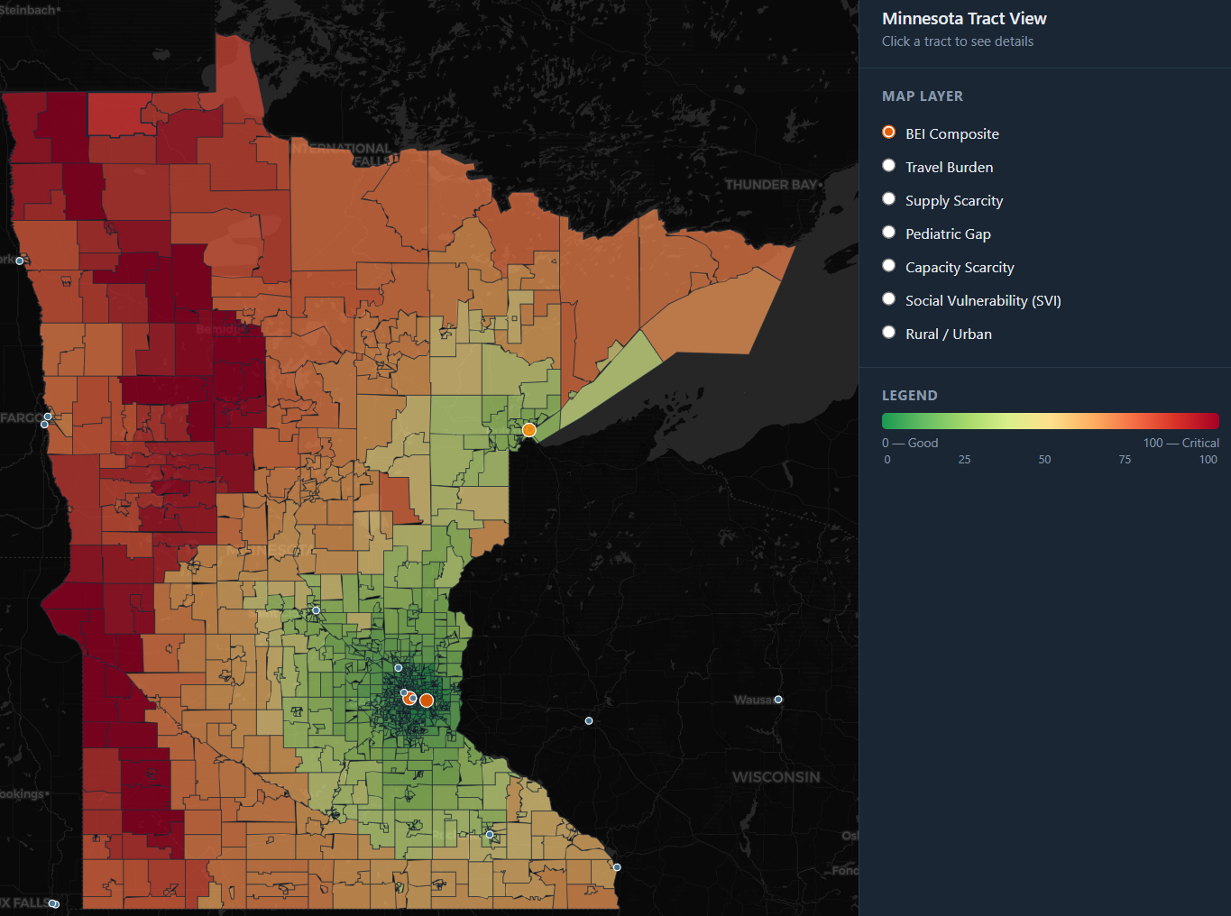
Minnesota: Burn Equity Index Map
Tract-level BEI scores | Interactive Dashboard
Twin Cities Metro
BEI: 0 -- 2 Multiple burn centers within 15 minutes 50%+ of MN population
Northwest MN
BEI: 90 -- 100 No burn center for hundreds of miles 8+ hour travel time
Notes:
[MADELINE] [5:05 - 5:40] 35s
Here's Minnesota, colored by BEI. The Twin Cities metro is green, near-zero scores, with half the state's population within minutes of a burn center. But look at the northwest corner. Deep Red. Scores above 90. Communities like Kittson, Roseau, and Marshall counties. No burn center for hundreds of miles. The transition isn't gradual, it drops off like a cliff.

Slide 11
Minnesota County Stories
Same state, vastly different realities
Best Access
Moderate Burden
Severe Burden
Hennepin County
Blue Earth County
Beltrami County
Minneapolis
Mankato
Bemidji
BEI: 0.0
BEI: 58.5
BEI: 90.4
10.6 min to burn center Direct access pathway All 4 pillars score 0.00 Pop: 1.27 million
88 min to burn center S: 1.00 T: 0.14 C: 1.00 Supply & capacity gaps Pop: 69,022
8+ hrs to burn center Transfer pathway only S, T, and C all maxed Pop: 46,274
Notes:
[MADELINE] [5:40 - 6:25] 45s
Here are three counties in minnesota
Hennepin -- Minneapolis. BEI: zero. You're 10 minutes from definitive care. Every pillar scores zero. That's what good access looks like.
Blue Earth -- Mankato. A university town, about 60,000 people. BEI: 58.5. You're an hour and a half from a burn center by road. The supply and capacity pillars are both maxed out -- there's simply nothing nearby. But the timely-access score is low because the drive is still feasible. A community like this can look fine on a map but is structurally underserved.
Beltrami -- Bemidji. BEI: 90.4. Eight hours to a burn center. Transfer pathway only. Supply, time, and capacity all maxed out. That is structural isolation.

Slide 12
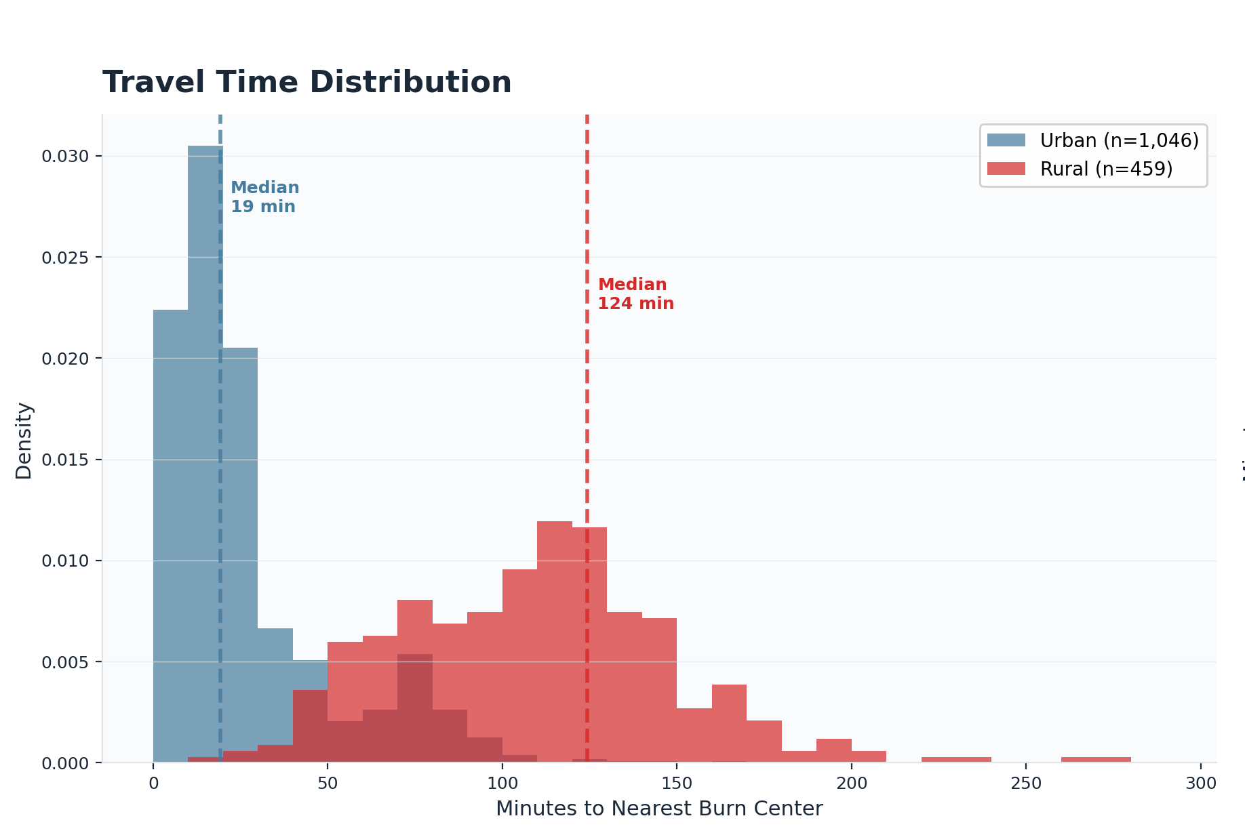
The Rural–Urban Divide
Median Travel Time
Urban:
19 min
Rural:
124 min
6.5x Longer
Rural residents travel 6.5 times farther to reach burn care.
30.5% of MN tracts are rural. Only 50.1% of Minnesotans can reach care in 30 min
Notes:
[MADELINE] [6:25 - 6:55] 30s
This chart shows the rural-urban divide. Urban Minnesotans: 19-minute median. Rural Minnesotans: 124 minutes -- over two hours, so half face even longer trips. A 6.5x gap within one state. And nearly a third of the state's tracts are classified as rural. For burns, where that first hour can determine whether a patient needs grafts or makes a full recovery, two hours changes outcomes.

Slide 13
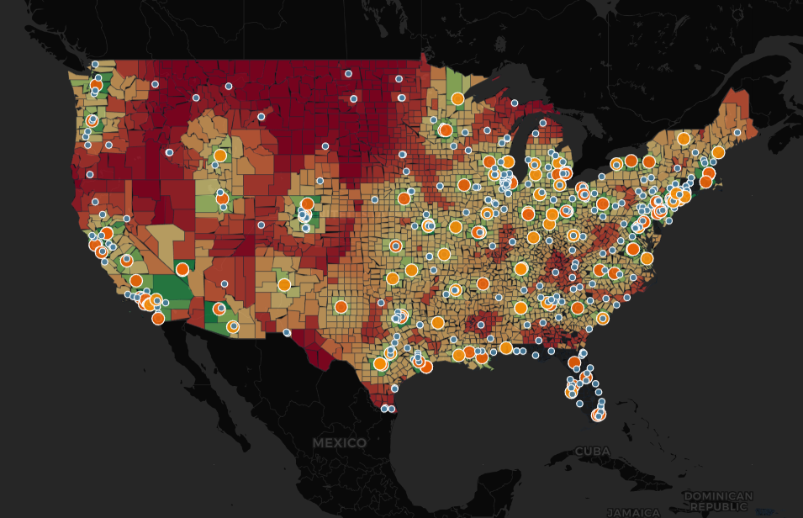
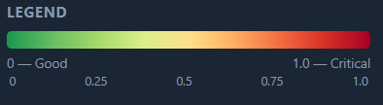
National: County-Level BEI Map
3,144 counties | 331 million Americans | Interactive Dashboard
Worst States (Avg BEI)
AK: 99.7 ND: 99.0 MT: 96.5 SD: 96.4 WY: 83.4 NV: 83.3
Best States (Avg BEI)
NJ: 10.0 RI: 29.5 MD: 29.8 MA: 31.0
8 States -- Zero Burn Centers
AK, DE, MS, MT, ND, NH, SD, WY
Notes:
[MADELINE] [6:55 - 7:30] 35s
Now the full country. The coasts light up green -- New Jersey, Maryland, Massachusetts all average below 31. The interior tells a different story. The Great Plains, the Mountain West, rural Deep South -- all high-burden. Alaska and North Dakota average above 99. Eight states have no burn center at all. If you're burned in Montana, the system requires you to leave the state. And these aren't empty places, Flathead County, Montana has 106,000 residents and a perfect hundred on BEI.

Slide 14
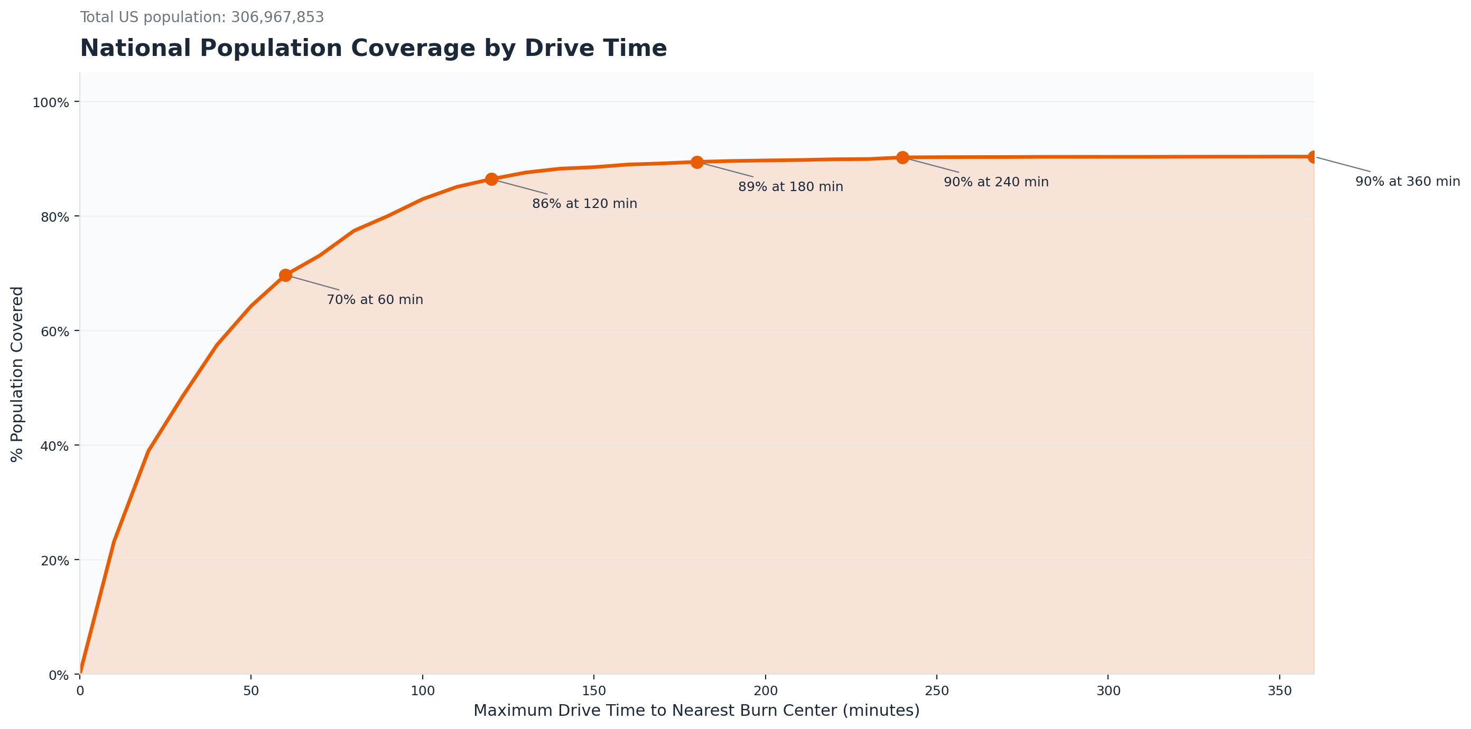
Coverage Gaps
Notes:
[MADELINE] [7:30 – 8:00] 30s
The coverage gap chart on shows 30% of Americans disproportionately in rural and tribal communities living more than 60 minutes from verified care. That matters clinically. The ABA's own referral guidelines stress timely transfer for major burns.

Slide 15
What Makes BEI Different
1
Tiered System Modeling
2
Multi-Scenario Transport
Models the real-world stabilize-then- transfer pathway with explicit transfer penalties and tier gap detection.
Ground-only baseline plus ground- plus-air sensitivity using FAA data. Published as scenario analysis.
3
Four-Pillar Composite
4
Interactive Dashboard
Supply, timeliness, pediatrics, and capacity each address a distinct clinical dimension. Fully transparent.
Any stakeholder can explore access patterns from national overview down to individual tracts.
Notes:
[JACOB] [8:00 - 8:35] 35s
Four things set the BEI apart. First, we model the real tiered care system - not just nearest-facility distance, but the full stabilize-and-transfer pathway with explicit penalties.
Second, we run multi-scenario transport. Ground-only as the reproducible baseline, plus a ground-plus-air sensitivity scenario built on real FAA infrastructure data.
Third, four pillars that each address a different clinical dimension. And fourth, an interactive dashboard that makes all of this accessible to anyone -- clinicians, planners, or the public.

Slide 16
Impact & Recommendations
From data to decisions
Telemedicine Triage
Referral
Strategic Facility Placement
Equitable Access
Deploy tele-burn consultation in high-BEI regions. Research shows 94% accuracy in remote surgical determination.
Use hotspot clusters to identify where new burn-capable facilities would have the greatest impact. NW Minnesota is a clear candidate.
Air Transport Investment
Referral
Policy Planning Tool
Equitable Access
Target air-ambulance resources where ground BEI exceeds 80 but air scenario shows 5+ point gain. Existing heliports are underused.
Integrate BEI into state health department planning and ABA verification processes. Open-source and fully reproducible.
Notes:
[JACOB] [8:35 - 9:20] 45s
So what do we do about it? Four recommendations.
First, telemedicine. For places like Beltrami County, a tele-burn consult can guide treatment remotely while the patient is in transit. Research already shows 94 percent accuracy in remote surgical assessment.
Second, facility placement. Our hotspot analysis pinpoints where a new burn-capable facility would close the biggest gaps. Northwest Minnesota stands out.
Third, air transport. Our sensitivity analysis identifies corridors where air access meaningfully improves BEI. Existing heliport infrastructure in those areas is underutilized.
And fourth, the BEI itself is a planning tool. It's open-source, reproducible, and ready for integration into state health departments and ABA frameworks. It can be updated as the landscape changes.

Slide 17
Limitations & Future Directions
National routing at county level
Masks variation within large rural counties. MN uses ideal tract-level routing. Full US tract-level needs a high-memory server.
Florida data gap
67 FL counties absent due to a routing batch error. Pipeline issue, not methodological -- the formula applies identically.
Air scenario is structural
An accessibility estimate, not an operational prediction. Real-time weather and dispatch are out of scope.
Static capacity model
Uses structural bed counts, not real-time occupancy. Live bed-census integration is a clear next step.
Next: Tract-level national routing | Real-time bed feeds | Temporal BEI | State health planning integration
Notes:
[JACOB] [9:20 - 9:50] 30s
We want to be upfront about limitations. National analysis is at county level and Minnesota uses full tract-level routing. Our air scenario and bed capacity is a structural estimate, not an operational forecast nor real-time.
Going forward: tract-level national routing, live bed census feeds, temporal BEI that captures seasonal patterns, and direct integration with state planning systems.

Slide 18
Every Minute Matters
The Burn Equity Index gives us a shared language to see, measure, and act on the structural gaps that separate 10 minutes from 10 hours.
Hennepin County
Same State
Kittson County
BEI: 0
10 min vs 8 hrs
BEI: 99.6
The gap is structural. Structure can be redesigned.
Notes:
[MADELINE] [9:50 - 10:45] 55s
Let me bring it home. Think back to that child at the stove. In Hennepin County, they're in a burn unit inside 10 minutes. In Kittson County -- same state -- it's an 8-hour journey.
We've measured every county in America, every census tract in Minnesota, and built an interactive tool anyone can use to explore it. The Burn Equity Index gives clinicians, planners, and policymakers a shared language for a problem that has been hard to see from any single vantage point.
The gap is structural and structure can be changed. A new facility, a telemedicine link, an air corridor -- each of those shifts the score, and each score represents real impact.

Slide 19
Thank You
Team 15 — Burn Equity Index — Challenge Area 3
JT
MR
YY
M
Jacob Tang
Madeline Rose Johnson
Yisihaq Yemiru
Mashfika
Technical Lead Pipeline & Methodology
Analytics & Presentation MS Data Science
Research & Data Integration
Analysis & Visualization
American Burn Association · BData · HealthcareMN · MinneAnalytics · University of Minnesota
Data: NIRD · US Census · OpenStreetMap · Valhalla · RUCA · CDC SVI · FAA
Interactive Dashboard Available
Notes:
[BOTH] [10:45 - 10:59] 14s
MADELINE: Thank you for your time.
JACOB: Thank you.

