Slide 1
GROUP 4 PROJECT
Presented By:
Andrew Pauley
Thomas Taglieri
Gwendalyn Werner
George Ward
Jacob Young

Slide 2
Designs?
Tiered Option
One Window Option
Window 1
Tic-Tac Toe
Connect 4
Play
Window 2
Window 3
Tic-Tac Toe
Connect 4
Color Selection
User Options
Avatar Selection
Game Mode

Slide 3
MOSCOW
MUST
SHOULD
COULD
WOULD
WONT
Display GUI
Rules/Help button
Dice Roll
Piece Color Section
Different Modes
Easter Eggs
Theme
Avatar Section
Display Scores
User Accounts
Tie Accounts to DB
Customize Dice
Animation for Dice
Animation Connect 4
Reset Button
Hint Button
Undo Moves

Slide 4
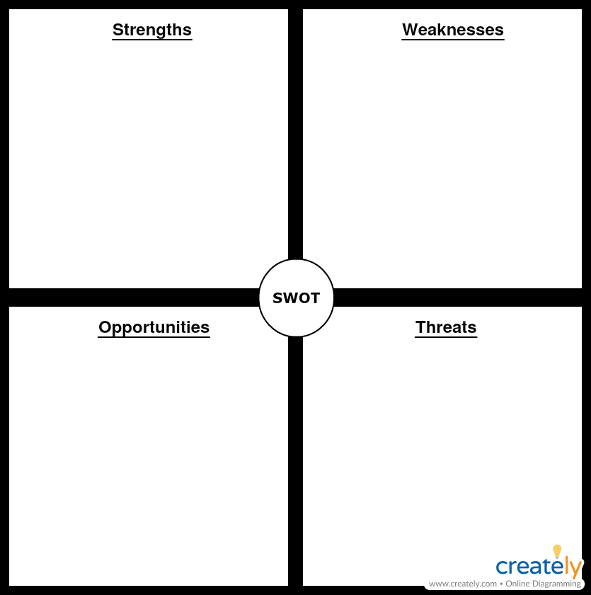
Easy to play
Very popular games
Unique play style
Creative techniques
Interesting idea
Other people might create
simpler versions.
Easy to emulate
Have the opportunity to give
people a simplistic game to play
in their free time.
Because the game is so
simplistic, we can add many
features to the game.
People could copy our game
Rules might be too simplistic
Very old game

