Slide 1
Abstractive Text Summarization
with a Modern Encoder-Decoder Transformer
Building a Seq2Seq Transformer from scratch with RoPE, SwiGLU, RMSNorm & Flash Attention
Jacob Ashoo
CSI-4130/5130: Artificial Intelligence | April 2026

Slide 2
The Challenge
Why Abstractive Summarization?
Extractive Summarization
Project Goal
Selects and copies existing sentences from the source. Limited to the original wording — cannot rephrase or generalize.
Build a modern Transformer from scratch
Incorporate state-of-the-art components from the LLM era into an encoder-decoder architecture for abstractive summarization.
• RoPE positional embeddings
• SwiGLU feed-forward networks
• Pre-layer RMSNorm
• Flash Attention
• Three-way weight tying
Abstractive Summarization
Generates novel sentences capturing the source meaning. Requires deep comprehension and fluent language generation.
Trained end-to-end on the Newsroom dataset — no pretraining, no fine-tuning.

Slide 3
Data Pipeline
Newsroom Dataset → Clean, Filtered, Tokenized
1
2
3
4
Text Cleaning
Abstractive Filtering
Deduplication
BPE Tokenization
▶
▶
▶
HTML unescape, URL/email removal, emoji stripping, whitespace normalization
Compression ratio 2–10, exclude extractive density bin
Test-first strategy via summaries library ensures no train/test leakage
Custom 50K-vocab tokenizer trained on the dataset, length-filtered: src 10–2000, tgt 1–1000 tokens
50,000
87000
2,000
1,000
BPE Vocab
Filtered Dataset
Max Source Tokens
Max Target Tokens

Slide 4
Model Architecture
~84M parameter Encoder-Decoder Transformer
Parameter | Value
d_model | 512
Encoder Layers | 8
Decoder Layers | 8
Attention Heads | 8
Head Dim | 64
FFN Hidden | 1,365
Vocab Size | 50,000
Dropout | 0.1
RoPE
Rotary embeddings encode relative positions directly into Q/K attention vectors. Applied to self-attention only — omitted from cross-attention.
SwiGLU FFN
Gated activation: SiLU(gate(x)) × up(x), then down projection. Hidden dim = 8/3 × d_model for optimal width.
Pre-RMSNorm
Normalize before each sub-layer, not after. Stabilizes gradients and simplifies residual flow.
Flash Attention
Fused SDPA kernel avoids materializing the N² attention matrix. O(N) memory, significant speedup.
Three-Way Weight Tying: Encoder embed = Decoder embed = Output projection. Single 50K × 512 matrix cuts ~51M parameters.

Slide 5
Training Setup
Distributed, Mixed-Precision, Compiled
128
Effective Batch Size
Infrastructure
4 × 2 GPUs × 16 accum steps
DDP + NCCL
2-GPU distributed training with model.no_sync() to suppress redundant allreduces
1e⁻⁴
Peak Learning Rate
torch.compile()
Cosine decay to 50% after 2K warmup
Fuses RMSNorm, SwiGLU, embedding ops for 20–30% throughput gain
Gradient Checkpointing
35K
Steps Trained
Recomputes activations in backward pass, reduces peak memory ~33%
Stopped early from 50K target
Streaming DataLoader
Iterable dataset, never loads full data into RAM. 10K shuffle buffer.
bf16
Mixed Precision
MLflow Tracking
All metrics and hyperparameters logged for reproducibility
No GradScaler needed (same exponent range)

Slide 6
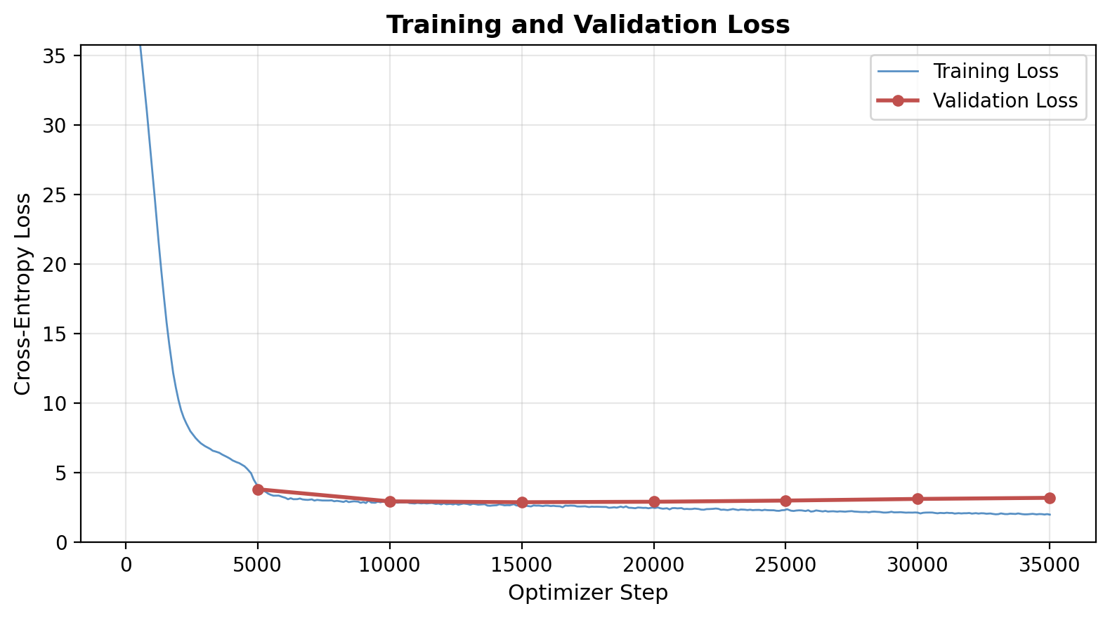
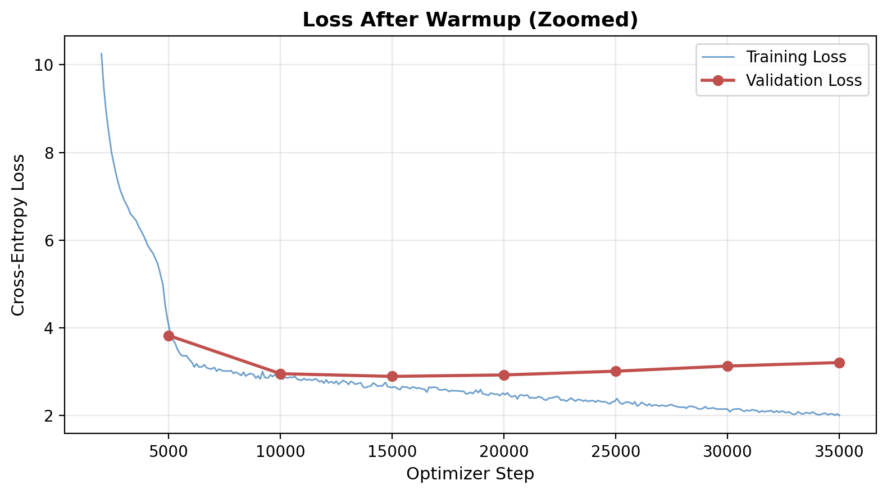
Training Results
Loss Curves Over 35,000 Steps
2.895
Step 15K
~2.0
↑ after 15K
Best Val Loss
Best Checkpoint
Final Train Loss
Val Loss Trend

Slide 7
Analysis
Understanding the Overfitting Pattern
Step | Val Loss | Trend
5,000 | 3.829 | ↓
10,000 | 2.957 | ↓
15,000 | 2.895 | ★ Best
20,000 | 2.929 | ↑
25,000 | 3.014 | ↑
30,000 | 3.131 | ↑
35,000 | 3.211 | ↑
High Capacity vs. Data
84M parameters provide more capacity than the filtered dataset can fully utilize. Aggressive quality filtering reduced training examples significantly.
Regularization Gap
Only dropout (0.1) and label smoothing (0.1) were used. No stochastic depth, R-Drop, or data augmentation.
Best Trade-off
Step 15K represents the optimal balance: the model has learned generalizable summarization patterns without yet memorizing training examples.
Training was stopped early at 35K steps (of 50K) once the overfitting trend was clear.

Slide 8
Conclusion & Future Work
What We Built
Next Steps
✓ End-to-end summarization system
✓ Modern Transformer from scratch
✓ Custom BPE tokenizer (50K)
✓ Full distributed training pipeline
✓ Best val loss: 2.895 at step 15K
✓ MLflow experiment tracking
▸ Stronger regularization
Stochastic depth, R-Drop, higher dropout
▸ Data augmentation
Backtranslation, paraphrase generation
▸ Pretraining + fine-tuning
Large unsupervised corpus first
▸ ROUGE & BERTScore evaluation
Beyond cross-entropy loss
▸ Beam search decoding
Length norm, repetition penalties
Thank you! — Questions?

