Slide 1
Credit Card Fraud Detection
By: Sal Russo, Jacob Hollander, & Jacob Avchen

Slide 2

Project Proposal
Utilize multiple machine learning modeling techniques to identify whether a credit card purchase is fraudulent or not fraudulent

Slide 3
Tools
Pandas for data acquisition & data cleaning
Matplotlib & Seaborn for data visualization
SciKit learn for machine learning modeling & scaling
Keras for Neural Network

Slide 4
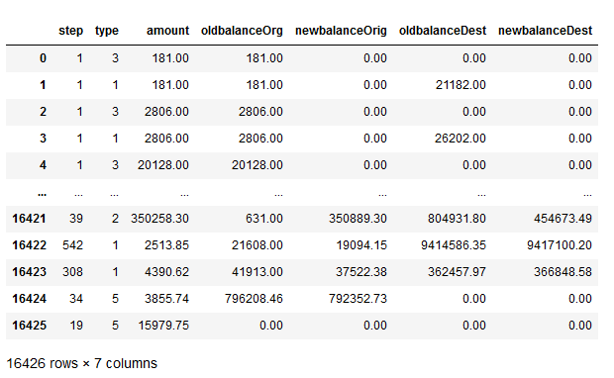
Our Dataset
Data is extracted from a csv file provided by Kaggle
Over 3 million transactions
Cut into snippets of equal cases of fraud & not fraud transactions
We used 7 variables to train the models. Because this data is generated and not sensitive user data, we don’t have to censor it using Principal Component Analysis.

Slide 5
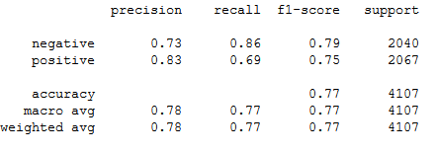
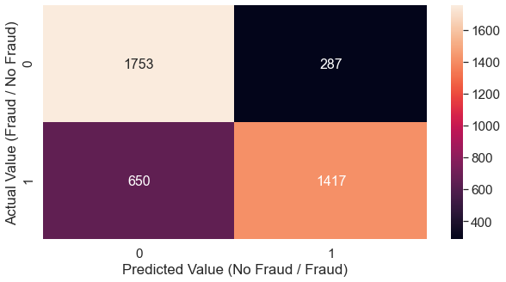
SVM
Tested a 75/25 train/test split of balanced fraud to not fraud transactions
Achieved a .772 Test Accuracy with the SVM Model
We had 287 cases of True Fraud, and 650 cases of falsely flagged Fraud.

Slide 6
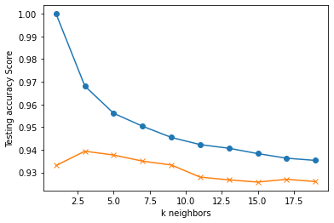
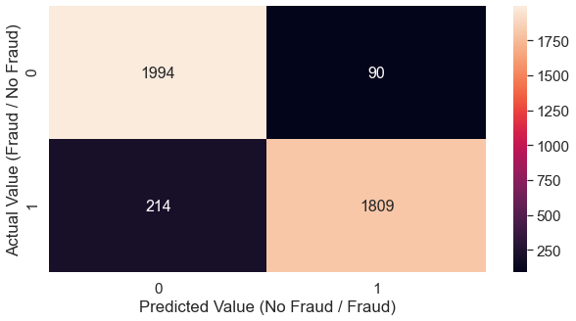
K Nearest Neighbors
Tested a 75/25 train/test split of balanced fraud to not fraud transactions
Plotted K1-K19
Closest accuracy was using K=17 at 0.936/0.927
Highest test accuracy was at K=5 with an accuracy of 0.938

Slide 7

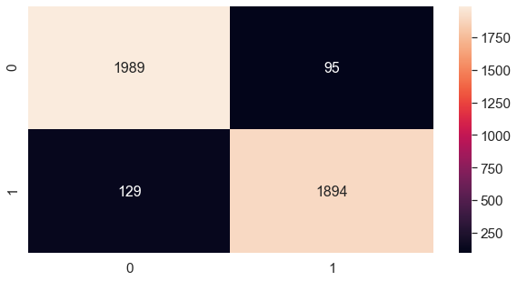
Neural Network
Our first Neural Model has a single hidden layer
We used all 7 values in our data
The model’s predictive accuracy rounded out to 94.5%
Compared to the actual values, the model returned 129 False Positive values and missed 95 cases of fraud out of 4107 points of data

Slide 8
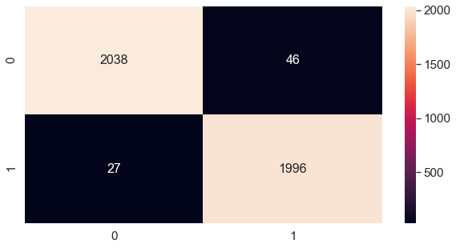
Deep Neural Network
Our second Neural Model has 2 hidden layers
We used the same distribution of data for both models
The Deep Model’s predictive accuracy rounded out to 98.2%
Compared to the actual values, the Deep Model returned 27 False Positives and missed 46 cases of fraud
This model was much more accurate than the first Neural Network, missing less than half the amount of cases of fraud

Slide 9
Comparison of Model Accuracies
 | SVM | K Nearest Neighbors | Logistic Regression | Neural Network | Deep Neural Network
Accuracy | 0.772 | 0.939 |  | 0.945 | 0.982
False Positives | 650 | 214 |  | 129 | 27
True Negatives | 287 | 90 |  | 95 | 46

Slide 10
Improvements/Limitations
Improvements
Limitations
Create a user interactive webpage to demonstrate our model
Better train our models to prioritize errors being false positives rather than true negatives
More effectively deal with an unbalanced dataset
Our features (V’s) came from sensitive information and therefore could not be backtracked to any values that would make sense to us

Slide 11
Thank You!
Questions?

