Slide 1

CSE 311: Foundations of Computing
Lecture 3: Digital Circuits

Slide 2
Review: Propositional Logic
Propositions
atomic propositions are T/F-valued variables
combined using logical connectives (not, and, or, etc.)
can be described by a truth table
shows the truth value of the proposition in
each combination of truth values of the atomic propositions
Logical equivalence
used to simplify logical expressions
First application
Simplifying English sentences
p | q | p ∧ q
T | T | T
T | F | F
F | T | F
F | F | F

Slide 3
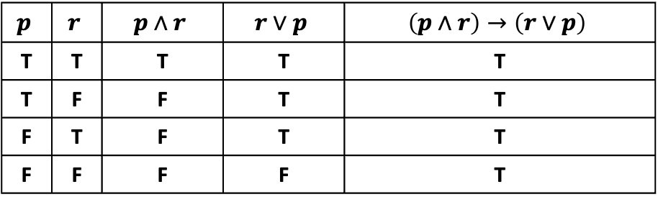
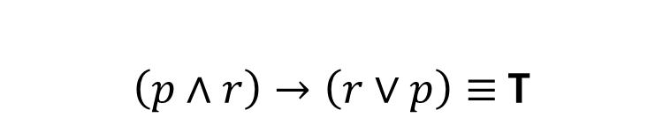
Truth Table to show tautology
(p ∧ r) → (r ∨ p)
$\left(p∧r\right)→\left(r∨p\right)≡$T
$$p$$ | $$r$$ | $$p∧r$$ | $$r∨p$$ | $$\left(p∧r\right)→\left(r∨p\right)$$
T | T | T | T | T
T | F | F | T | T
F | T | F | T | T
F | F | F | F | T

Slide 4
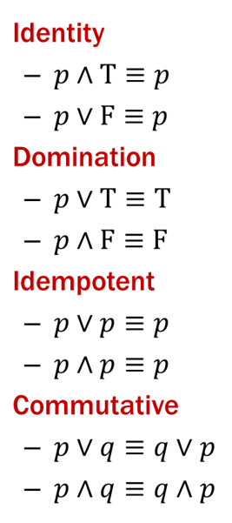
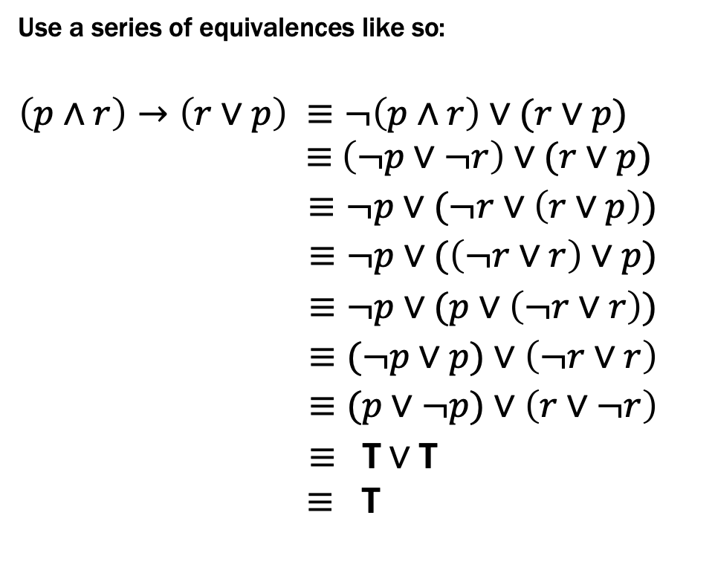
Logical Proofs of Equivalence
(p ∧ r) → (r ∨ p)
Use a series of equivalences like so:
$$\left(p∧r\right)→\left(r∨p\right) ≡¬\left(p∧r\right)∨(r∨p)$$
$≡$ $\left(¬p∨¬r\right)∨(r∨p)$
$≡¬p∨(¬r∨\left(r∨p\right))$
$≡¬p∨(\left(¬r∨r\right)∨p)$
$≡¬p∨(p∨\left(¬r∨r\right))$
$≡(¬p∨p)∨\left(¬r∨r\right)$
$≡(p∨¬p)∨\left(r∨¬r\right)$
$≡ \text{T}∨\text{T}$
$≡$ T
Law of Implication
De Morgan
Associative
Associative
Commutative
Associative
Commutative (twice)
Negation (twice)
Domination/Identity

Slide 5
Logical Proofs of Equivalence/Tautology
Not smaller than truth tables when there are only a few propositional variables...
...but usually much shorter than truth table proofs when there are many propositional variables
A big advantage will be that we can extend them to a more in-depth understanding of logic for which truth tables don’t apply.

Slide 6
Another key application: Digital Circuits
Computing With Logic
T corresponds to 1 or “high” voltage
F corresponds to 0 or “low” voltage
Gates
Take inputs and produce outputs (functions)
Several kinds of gates
Correspond to propositional connectives (most of them)

Slide 7



Circuits: AND, OR, NOT Gates
p | q | OUT
1 | 1 | 1
1 | 0 | 0
0 | 1 | 0
0 | 0 | 0
p | q | p ∧ q
T | T | T
T | F | F
F | T | F
F | F | F
AND Gate
p
q
AND
OUT
OR Gate
p | q | OUT
1 | 1 | 1
1 | 0 | 1
0 | 1 | 1
0 | 0 | 0
p | q | p ∨ q
T | T | T
T | F | T
F | T | T
F | F | F
p
q
OR
OUT
NOT Gate
p | OUT
1 | 0
0 | 1
p | ¬ p
T | F
F | T
p
NOT
OUT

Slide 8

Combinational Logic Circuits
p
NOT
AND
OUT
q
NOT
AND
r
s
OR
Values get sent along wires connecting gates

Slide 9

Combinational Logic Circuits
p
NOT
AND
OUT
q
NOT
AND
r
s
OR
Values get sent along wires connecting gates

Slide 10
Combinational Logic Circuits
p
AND
q
NOT
OR
OUT
r
AND
Wires can send one value to multiple gates!

Slide 11

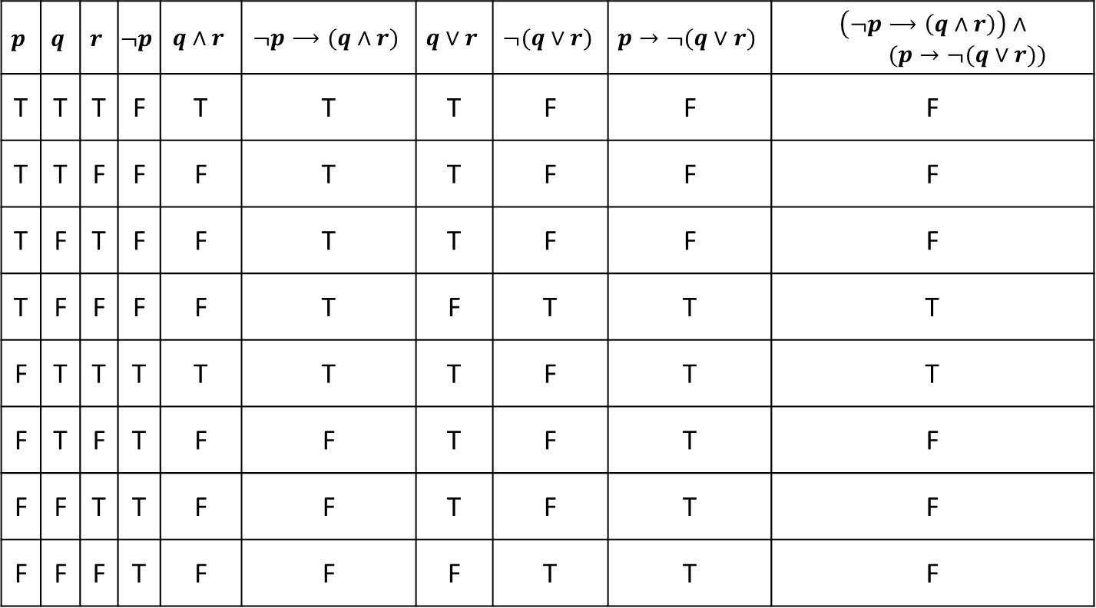
Combinational Logic Circuits
p
AND
q
NOT
OR
OUT
r
AND
Wires can send one value to multiple gates!
$$\left(p∧¬q \right)∨(¬q∧r)$$

Slide 12
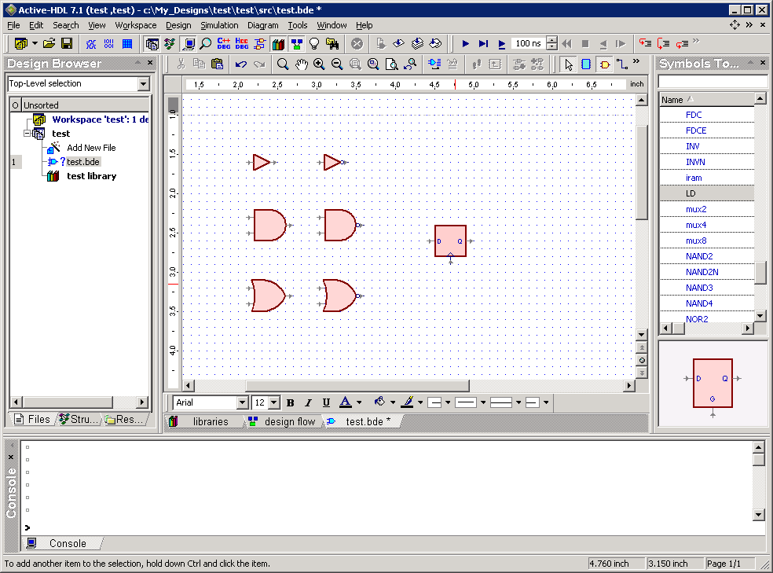
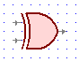

Other Useful Gates
NAND
$¬(p∧q)$
NOR
$¬(p∨q)$
XOR $p⊕q$
XNOR $p↔q$
p q out 0 0 1 0 1 1 1 0 1
1 1 0
p
q
out
p q out 0 0 1 0 1 0 1 0 0
1 1 0
p
out
q
p q out 0 0 0 0 1 1 1 0 1
1 1 0
p
q
out
p q out
0 0 1 0 1 0 1 0 0
1 1 1
p
q
out

Slide 13
Boolean Logic
Combinational Logic
output = F(input)
Sequential Logic
output_{t} = F(output_{t-1}, input_{t})
output dependent on history
concept of a time step (clock, t)
Covered in CSE 369

Slide 14
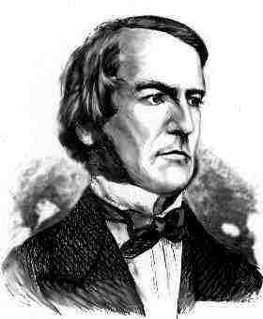
Boolean Logic
Combinational Logic
output = F(input)
Boolean Algebra: another notation for logic consisting of…
a set of elements B = {0, 1}
binary operations { + , • } (OR, AND)
and a unary operation { ’ } (NOT )

Slide 15
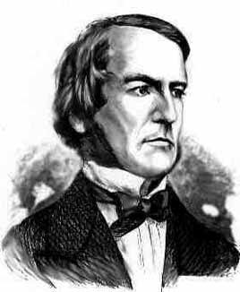
Boolean Algebra
Usual notation used in circuit design
Boolean algebra
a set of elements B containing {0, 1}
binary operations { + , • }
and a unary operation { ’ }
such that the following axioms hold:
For any a, b, c in B: 1. closure: a + b is in B a • b is in B 2. commutativity: a + b = b + a a • b = b • a 3. associativity: a + (b + c) = (a + b) + c a • (b • c) = (a • b) • c 4. distributivity: a + (b • c) = (a + b) • (a + c) a • (b + c) = (a • b) + (a • c) 5. identity: a + 0 = a a • 1 = a 6. complementarity: a + a’ = 1 a • a’ = 0
7. null: a + 1 = 1 a • 0 = 0
8. idempotency: a + a = a a • a = a
9. involution: (a’)’ = a

Slide 16

Proving Theorems
Using truth table:
For example, de Morgan’s Law:
X Y X’ Y’ (X + Y)’ X’ • Y’
(X + Y)’ = X’ • Y’ NOR is equivalent to AND with inputs complemented
0 0 1 1 1 1
0 1 1 0 0 0
1 0 0 1 0 0
1 1 0 0 0 0
(X • Y)’ = X’ + Y’ NAND is equivalent to OR with inputs complemented
X Y X’ Y’ (X • Y)’ X’ + Y’
0 0 1 1 1 1
0 1 1 0 1 1 1 0 0 1 1 1
1 1 0 0 0 0
More generally $\left(a+b+c+…\right)’=a’\text{•}b’\text{•}c^{′}\text{•}…$
$$\left(a\text{•}b\text{•}c\text{•}…\right)’=a’+b’+c^{′}+…$$

Slide 17
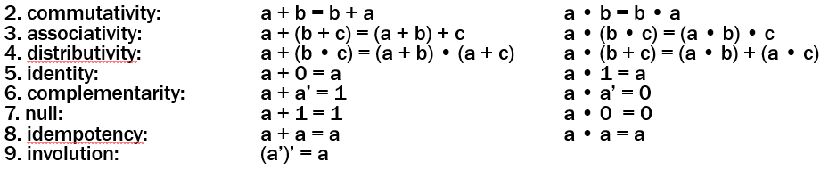
Proving Theorems
Using the laws of Boolean Algebra:
prove the “Uniting theorem”: X • Y + X • Y’ = X prove the “Absorption theorem”: X + X • Y = X
X • Y + X • Y’ =
X + X • Y =

Slide 18
Proving Theorems
Using the laws of Boolean Algebra:
prove the “Uniting theorem”: X • Y + X • Y’ = X prove the “Absorption theorem”: X + X • Y = X
distributivity
complementarity
identity
X • Y + X • Y’ = X • (Y + Y’)
= X • 1
= X
identity
distributivity
commutativity
null
identity
X + X • Y = X • 1 + X • Y
= X • (1 + Y)
= X • (Y + 1)
= X • 1
= X

Slide 19
A Combinational Logic Example
Sessions of Class:
We would like to compute the number of lectures or quiz sections remaining at the start of a given day of the week.
Inputs: Day of the Week, Lecture/Section flag
Output: Number of sessions left
Examples: Input: (Wednesday, Lecture) Output: 2
Input: (Monday, Section) Output: 1

Slide 20
Implementation in Software
public int classesLeftInMorning(int weekday, boolean isLecture) {
switch (weekday) {
case SUNDAY:
case MONDAY:
return isLecture ? 3 : 1;
case TUESDAY:
case WEDNESDAY:
return isLecture ? 2 : 1;
case THURSDAY:
return isLecture ? 1 : 1;
case FRIDAY:
return isLecture ? 1 : 0;
case SATURDAY:
return isLecture ? 0 : 0;
}
}

Slide 21
Implementation with Combinational Logic
Encoding:
How many bits for each input/output?
Binary number for weekday
One bit for each possible output
Weekday
isLecture
0
1
2
3

Slide 22
Defining Our Inputs!
Weekday Input:
Binary number for weekday
Sunday = 0, Monday = 1, …
We care about these in binary:
Weekday | Number | Binary
Sunday | 0 | (000)₂
Monday | 1 | (001)₂
Tuesday | 2 | (010)₂
Wednesday | 3 | (011)₂
Thursday | 4 | (100)₂
Friday | 5 | (101)₂
Saturday | 6 | (110)₂

Slide 23
Converting to a Truth Table!
Weekday |  | isLecture | c₀ | c₁ | c₂ | c₃
SUN | 000 | 0
SUN | 000 | 1
MON | 001 | 0
MON | 001 | 1
TUE | 010 | 0
TUE | 010 | 1
WED | 011 | 0
WED | 011 | 1
THU | 100 | -
FRI | 101 | 0
FRI | 101 | 1
SAT | 110 | -
- | 111 | -
case SUNDAY or MONDAY:
return isLecture ? 3 : 1;
case TUESDAY or WEDNESDAY:
return isLecture ? 2 : 1;
case THURSDAY:
return isLecture ? 1 : 1;
case FRIDAY:
return isLecture ? 1 : 0;
case SATURDAY:
return isLecture ? 0 : 0;

Slide 24
Converting to a Truth Table!
Weekday |  | isLecture | c₀ | c₁ | c₂ | c₃
SUN | 000 | 0 | 0 | 1 | 0 | 0
SUN | 000 | 1 | 0 | 0 | 0 | 1
MON | 001 | 0 | 0 | 1 | 0 | 0
MON | 001 | 1 | 0 | 0 | 0 | 1
TUE | 010 | 0 | 0 | 1 | 0 | 0
TUE | 010 | 1 | 0 | 0 | 1 | 0
WED | 011 | 0 | 0 | 1 | 0 | 0
WED | 011 | 1 | 0 | 0 | 1 | 0
THU | 100 | - | 0 | 1 | 0 | 0
FRI | 101 | 0 | 1 | 0 | 0 | 0
FRI | 101 | 1 | 0 | 1 | 0 | 0
SAT | 110 | - | 1 | 0 | 0 | 0
- | 111 | - | 1 | 0 | 0 | 0
case SUNDAY or MONDAY:
return isLecture ? 3 : 1;
case TUESDAY or WEDNESDAY:
return isLecture ? 2 : 1;
case THURSDAY:
return isLecture ? 1 : 1;
case FRIDAY:
return isLecture ? 1 : 0;
case SATURDAY:
return isLecture ? 0 : 0;

Slide 25
Truth Table to Logic (Part 1)
 | d₂d₁d₀ | L | c₀ | c₁ | c₂ | c₃
SUN | 000 | 0 | 0 | 1 | 0 | 0
SUN | 000 | 1 | 0 | 0 | 0 | 1
MON | 001 | 0 | 0 | 1 | 0 | 0
MON | 001 | 1 | 0 | 0 | 0 | 1
TUE | 010 | 0 | 0 | 1 | 0 | 0
TUE | 010 | 1 | 0 | 0 | 1 | 0
WED | 011 | 0 | 0 | 1 | 0 | 0
WED | 011 | 1 | 0 | 0 | 1 | 0
THU | 100 | - | 0 | 1 | 0 | 0
FRI | 101 | 0 | 1 | 0 | 0 | 0
FRI | 101 | 1 | 0 | 1 | 0 | 0
SAT | 110 | - | 1 | 0 | 0 | 0
- | 111 | - | 1 | 0 | 0 | 0
Let’s begin by finding an expression for c₃. To do this, we look at the rows where c₃ = 1 (true).

Slide 26
Truth Table to Logic (Part 1)
 | d₂d₁d₀ | L | c₀ | c₁ | c₂ | c₃
SUN | 000 | 0 | 0 | 1 | 0 | 0
SUN | 000 | 1 | 0 | 0 | 0 | 1
MON | 001 | 0 | 0 | 1 | 0 | 0
MON | 001 | 1 | 0 | 0 | 0 | 1
TUE | 010 | 0 | 0 | 1 | 0 | 0
TUE | 010 | 1 | 0 | 0 | 1 | 0
WED | 011 | 0 | 0 | 1 | 0 | 0
WED | 011 | 1 | 0 | 0 | 1 | 0
THU | 100 | - | 0 | 1 | 0 | 0
FRI | 101 | 0 | 1 | 0 | 0 | 0
FRI | 101 | 1 | 0 | 1 | 0 | 0
SAT | 110 | - | 1 | 0 | 0 | 0
- | 111 | - | 1 | 0 | 0 | 0
DAY == SUN && L == 1
DAY == MON && L == 1

Slide 27
Truth Table to Logic (Part 1)
 | d₂d₁d₀ | L | c₀ | c₁ | c₂ | c₃
SUN | 000 | 0 | 0 | 1 | 0 | 0
SUN | 000 | 1 | 0 | 0 | 0 | 1
MON | 001 | 0 | 0 | 1 | 0 | 0
MON | 001 | 1 | 0 | 0 | 0 | 1
TUE | 010 | 0 | 0 | 1 | 0 | 0
TUE | 010 | 1 | 0 | 0 | 1 | 0
WED | 011 | 0 | 0 | 1 | 0 | 0
WED | 011 | 1 | 0 | 0 | 1 | 0
THU | 100 | - | 0 | 1 | 0 | 0
FRI | 101 | 0 | 1 | 0 | 0 | 0
FRI | 101 | 1 | 0 | 1 | 0 | 0
SAT | 110 | - | 1 | 0 | 0 | 0
- | 111 | - | 1 | 0 | 0 | 0
d₂d₁d₀ == 000 && L == 1
d₂d₁d₀ == 001 && L == 1
Substituting DAY for the binary representation.

Slide 28
Truth Table to Logic (Part 1)
 | d₂d₁d₀ | L | c₀ | c₁ | c₂ | c₃
SUN | 000 | 0 | 0 | 1 | 0 | 0
SUN | 000 | 1 | 0 | 0 | 0 | 1
MON | 001 | 0 | 0 | 1 | 0 | 0
MON | 001 | 1 | 0 | 0 | 0 | 1
TUE | 010 | 0 | 0 | 1 | 0 | 0
TUE | 010 | 1 | 0 | 0 | 1 | 0
WED | 011 | 0 | 0 | 1 | 0 | 0
WED | 011 | 1 | 0 | 0 | 1 | 0
THU | 100 | - | 0 | 1 | 0 | 0
FRI | 101 | 0 | 1 | 0 | 0 | 0
FRI | 101 | 1 | 0 | 1 | 0 | 0
SAT | 110 | - | 1 | 0 | 0 | 0
- | 111 | - | 1 | 0 | 0 | 0
d₂ == 0 && d₁ == 0 && d₀ == 0 && L == 1
d₂ == 0 && d₁ == 0 && d₀ == 1 && L == 1
Splitting up the bits of the day; so, we can write a formula.

Slide 29
Truth Table to Logic (Part 1)
 | d₂d₁d₀ | L | c₀ | c₁ | c₂ | c₃
SUN | 000 | 0 | 0 | 1 | 0 | 0
SUN | 000 | 1 | 0 | 0 | 0 | 1
MON | 001 | 0 | 0 | 1 | 0 | 0
MON | 001 | 1 | 0 | 0 | 0 | 1
TUE | 010 | 0 | 0 | 1 | 0 | 0
TUE | 010 | 1 | 0 | 0 | 1 | 0
WED | 011 | 0 | 0 | 1 | 0 | 0
WED | 011 | 1 | 0 | 0 | 1 | 0
THU | 100 | - | 0 | 1 | 0 | 0
FRI | 101 | 0 | 1 | 0 | 0 | 0
FRI | 101 | 1 | 0 | 1 | 0 | 0
SAT | 110 | - | 1 | 0 | 0 | 0
- | 111 | - | 1 | 0 | 0 | 0
d₂’•d₁’•d₀’•L
Replacing with Boolean Algebra…
d₂’•d₁’•d₀•L

Slide 30
Truth Table to Logic (Part 1)
 | d₂d₁d₀ | L | c₀ | c₁ | c₂ | c₃
SUN | 000 | 0 | 0 | 1 | 0 | 0
SUN | 000 | 1 | 0 | 0 | 0 | 1
MON | 001 | 0 | 0 | 1 | 0 | 0
MON | 001 | 1 | 0 | 0 | 0 | 1
TUE | 010 | 0 | 0 | 1 | 0 | 0
TUE | 010 | 1 | 0 | 0 | 1 | 0
WED | 011 | 0 | 0 | 1 | 0 | 0
WED | 011 | 1 | 0 | 0 | 1 | 0
THU | 100 | - | 0 | 1 | 0 | 0
FRI | 101 | 0 | 1 | 0 | 0 | 0
FRI | 101 | 1 | 0 | 1 | 0 | 0
SAT | 110 | - | 1 | 0 | 0 | 0
- | 111 | - | 1 | 0 | 0 | 0
d₂’•d₁’•d₀’•L
d₂’•d₁’•d₀•L
How do we combine them?

Slide 31
Truth Table to Logic (Part 1)
 | d₂d₁d₀ | L | c₀ | c₁ | c₂ | c₃
SUN | 000 | 0 | 0 | 1 | 0 | 0
SUN | 000 | 1 | 0 | 0 | 0 | 1
MON | 001 | 0 | 0 | 1 | 0 | 0
MON | 001 | 1 | 0 | 0 | 0 | 1
TUE | 010 | 0 | 0 | 1 | 0 | 0
TUE | 010 | 1 | 0 | 0 | 1 | 0
WED | 011 | 0 | 0 | 1 | 0 | 0
WED | 011 | 1 | 0 | 0 | 1 | 0
THU | 100 | - | 0 | 1 | 0 | 0
FRI | 101 | 0 | 1 | 0 | 0 | 0
FRI | 101 | 1 | 0 | 1 | 0 | 0
SAT | 110 | - | 1 | 0 | 0 | 0
- | 111 | - | 1 | 0 | 0 | 0
d₂’•d₁’•d₀’•L
d₂’•d₁’•d₀•L
Either situation causes c₃ to be true. So, we “or” them.
c₃ = d₂’•d₁’•d₀’•L + d₂’•d₁’•d₀•L

Slide 32
Truth Table to Logic (Part 2)
 | d₂d₁d₀ | L | c₀ | c₁ | c₂ | c₃
SUN | 000 | 0 | 0 | 1 | 0 | 0
SUN | 000 | 1 | 0 | 0 | 0 | 1
MON | 001 | 0 | 0 | 1 | 0 | 0
MON | 001 | 1 | 0 | 0 | 0 | 1
TUE | 010 | 0 | 0 | 1 | 0 | 0
TUE | 010 | 1 | 0 | 0 | 1 | 0
WED | 011 | 0 | 0 | 1 | 0 | 0
WED | 011 | 1 | 0 | 0 | 1 | 0
THU | 100 | - | 0 | 1 | 0 | 0
FRI | 101 | 0 | 1 | 0 | 0 | 0
FRI | 101 | 1 | 0 | 1 | 0 | 0
SAT | 110 | - | 1 | 0 | 0 | 0
- | 111 | - | 1 | 0 | 0 | 0
c₃ = d₂’•d₁’•d₀’•L + d₂’•d₁’•d₀•L
Now, we do c₂.

Slide 33
Truth Table to Logic (Part 3)
 | d₂d₁d₀ | L | c₀ | c₁ | c₂ | c₃
SUN | 000 | 0 | 0 | 1 | 0 | 0
SUN | 000 | 1 | 0 | 0 | 0 | 1
MON | 001 | 0 | 0 | 1 | 0 | 0
MON | 001 | 1 | 0 | 0 | 0 | 1
TUE | 010 | 0 | 0 | 1 | 0 | 0
TUE | 010 | 1 | 0 | 0 | 1 | 0
WED | 011 | 0 | 0 | 1 | 0 | 0
WED | 011 | 1 | 0 | 0 | 1 | 0
THU | 100 | - | 0 | 1 | 0 | 0
FRI | 101 | 0 | 1 | 0 | 0 | 0
FRI | 101 | 1 | 0 | 1 | 0 | 0
SAT | 110 | - | 1 | 0 | 0 | 0
- | 111 | - | 1 | 0 | 0 | 0
Now, we do c₁:
c₃ = d₂’•d₁’•d₀’•L + d₂’•d₁’•d₀•L
c₂ = d₂’•d₁•d₀’•L + d₂’•d₁•d₀•L

Slide 34
Truth Table to Logic (Part 3)
 | d₂d₁d₀ | L | c₀ | c₁ | c₂ | c₃
SUN | 000 | 0 | 0 | 1 | 0 | 0
SUN | 000 | 1 | 0 | 0 | 0 | 1
MON | 001 | 0 | 0 | 1 | 0 | 0
MON | 001 | 1 | 0 | 0 | 0 | 1
TUE | 010 | 0 | 0 | 1 | 0 | 0
TUE | 010 | 1 | 0 | 0 | 1 | 0
WED | 011 | 0 | 0 | 1 | 0 | 0
WED | 011 | 1 | 0 | 0 | 1 | 0
THU | 100 | - | 0 | 1 | 0 | 0
FRI | 101 | 0 | 1 | 0 | 0 | 0
FRI | 101 | 1 | 0 | 1 | 0 | 0
SAT | 110 | - | 1 | 0 | 0 | 0
- | 111 | - | 1 | 0 | 0 | 0
Now, we do c₁:
d₂’•d₁’•d₀’•L’
d₂’•d₁’•d₀•L’
d₂’•d₁•d₀’•L’
d₂’•d₁•d₀•L’
???
d₂•d₁’•d₀•L
c₃ = d₂’•d₁’•d₀’•L + d₂’•d₁’•d₀•L
c₂ = d₂’•d₁•d₀’•L + d₂’•d₁•d₀•L

Slide 35
Truth Table to Logic (Part 3)
 | d₂d₁d₀ | L | c₀ | c₁ | c₂ | c₃
SUN | 000 | 0 | 0 | 1 | 0 | 0
SUN | 000 | 1 | 0 | 0 | 0 | 1
MON | 001 | 0 | 0 | 1 | 0 | 0
MON | 001 | 1 | 0 | 0 | 0 | 1
TUE | 010 | 0 | 0 | 1 | 0 | 0
TUE | 010 | 1 | 0 | 0 | 1 | 0
WED | 011 | 0 | 0 | 1 | 0 | 0
WED | 011 | 1 | 0 | 0 | 1 | 0
THU | 100 | - | 0 | 1 | 0 | 0
FRI | 101 | 0 | 1 | 0 | 0 | 0
FRI | 101 | 1 | 0 | 1 | 0 | 0
SAT | 110 | - | 1 | 0 | 0 | 0
- | 111 | - | 1 | 0 | 0 | 0
Now, we do c₁:
d₂’•d₁’•d₀’•L’
d₂’•d₁’•d₀•L’
d₂’•d₁•d₀’•L’
d₂’•d₁•d₀•L’
No matter what L is, we always say it’s 1. So, we don’t need L in the expression.
d₂•d₁’•d₀’
d₂•d₁’•d₀•L
c₃ = d₂’•d₁’•d₀’•L + d₂’•d₁’•d₀•L
c₂ = d₂’•d₁•d₀’•L + d₂’•d₁•d₀•L

Slide 36
Truth Table to Logic (Part 3)
 | d₂d₁d₀ | L | c₀ | c₁ | c₂ | c₃
SUN | 000 | 0 | 0 | 1 | 0 | 0
SUN | 000 | 1 | 0 | 0 | 0 | 1
MON | 001 | 0 | 0 | 1 | 0 | 0
MON | 001 | 1 | 0 | 0 | 0 | 1
TUE | 010 | 0 | 0 | 1 | 0 | 0
TUE | 010 | 1 | 0 | 0 | 1 | 0
WED | 011 | 0 | 0 | 1 | 0 | 0
WED | 011 | 1 | 0 | 0 | 1 | 0
THU | 100 | - | 0 | 1 | 0 | 0
FRI | 101 | 0 | 1 | 0 | 0 | 0
FRI | 101 | 1 | 0 | 1 | 0 | 0
SAT | 110 | - | 1 | 0 | 0 | 0
- | 111 | - | 1 | 0 | 0 | 0
Now, we do c₁:
d₂’•d₁’•d₀’•L’
d₂’•d₁’•d₀•L’
d₂’•d₁•d₀’•L’
d₂’•d₁•d₀•L’
No matter what L is, we always say it’s 1. So, we don’t need L in the expression.
d₂•d₁’•d₀’
d₂•d₁’•d₀•L
c₃ = d₂’•d₁’•d₀’•L + d₂’•d₁’•d₀•L
c₂ = d₂’•d₁•d₀’•L + d₂’•d₁•d₀•L
c₁ = d₂’•d₁’•d₀’•L’ + d₂’•d₁’•d₀•L’ + d₂’•d₁•d₀’•L’ + d₂’•d₁•d₀•L’ + d₂•d₁’•d₀’ + d₂•d₁’•d₀•L

Slide 37
Truth Table to Logic (Part 4)
 | d₂d₁d₀ | L | c₀ | c₁ | c₂ | c₃
SUN | 000 | 0 | 0 | 1 | 0 | 0
SUN | 000 | 1 | 0 | 0 | 0 | 1
MON | 001 | 0 | 0 | 1 | 0 | 0
MON | 001 | 1 | 0 | 0 | 0 | 1
TUE | 010 | 0 | 0 | 1 | 0 | 0
TUE | 010 | 1 | 0 | 0 | 1 | 0
WED | 011 | 0 | 0 | 1 | 0 | 0
WED | 011 | 1 | 0 | 0 | 1 | 0
THU | 100 | - | 0 | 1 | 0 | 0
FRI | 101 | 0 | 1 | 0 | 0 | 0
FRI | 101 | 1 | 0 | 1 | 0 | 0
SAT | 110 | - | 1 | 0 | 0 | 0
- | 111 | - | 1 | 0 | 0 | 0
c₁ = d₂’•d₁’•d₀’•L’ + d₂’•d₁’•d₀•L’ +
d₂’•d₁•d₀’•L’ + d₂’•d₁•d₀•L’ +
d₂•d₁’•d₀’ + d₂•d₁’•d₀•L
c₂ = d₂’•d₁•d₀’•L + d₂’•d₁•d₀•L
c₃ = d₂’•d₁’•d₀’•L + d₂’•d₁’•d₀•L
Finally, we do c₀:
d₂•d₁’•d₀•L’
d₂•d₁•d₀’
d₂•d₁•d₀

Slide 38
Truth Table to Logic (Part 4)
c₀ = d₂•d₁’•d₀•L’ + d₂•d₁•d₀’ + d₂•d₁•d₀
c₁ = d₂’•d₁’•d₀’•L’ + d₂’•d₁’•d₀•L’ + d₂’•d₁•d₀’•L’ + d₂’•d₁•d₀•L’ + d₂•d₁’•d₀’ + d₂•d₁’•d₀•L
c₂ = d₂’•d₁•d₀’•L + d₂’•d₁•d₀•L
c₃ = d₂’•d₁’•d₀’•L + d₂’•d₁’•d₀•L
Here’s c₃ as a circuit:
d₂
NOT
AND
d₁
NOT
OR
d₀
AND
NOT
L

Slide 39
Simplifying using Boolean Algebra
c3 = d2’•d1’•d0’•L + d2’•d1’•d0•L
= d2’•d1’•(d0’ + d0)•L
= d2’•d1’•1•L
= d2’•d1’•L
d2
NOT
AND
d1
NOT
L

Slide 40
Simplification using Boolean Algebra
uniting: 10. a • b + a • b’ = a 10D. (a + b) • (a + b’) = a
absorption: 11. a + a • b = a 11D. a • (a + b) = a 12. (a + b’) • b = a • b 12D. (a • b’) + b = a + b
factoring: 13. (a + b) • (a’ + c) = 13D. a • b + a’ • c = a • c + a’ • b (a + c) • (a’ + b)
consensus: 14. (a • b) + (b • c) + (a’ • c) = 14D. (a + b) • (b + c) • (a’ + c) = a • b + a’ • c (a + b) • (a’ + c)
de Morgan’s: 15. (a + b + ...)’ = a’ • b’ • ... 15D. (a • b • ...)’ = a’ + b’ + ...

