Slide 1
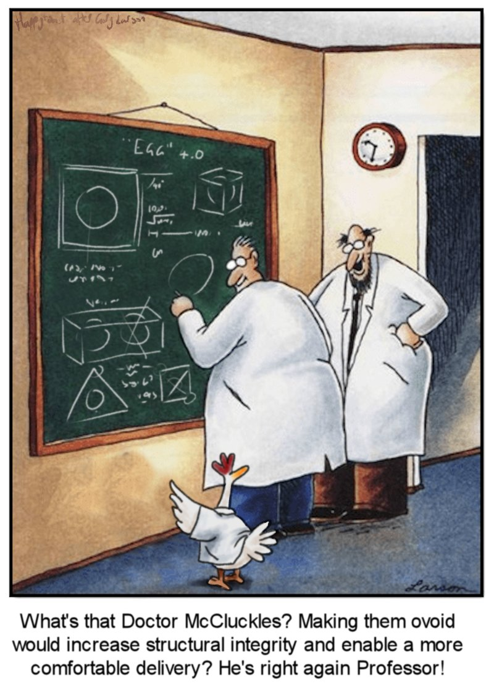
CSE 311: Foundations of Computing
Lecture 17: Structural Induction

Slide 2
Midterm
Midterm in class next Wednesday
Covers material up to ordinary induction (HW5)
Closed book, closed notes
will provide reference sheets
No calculators
arithmetic is intended to be straightforward
(only a small point deduction anyway)

Slide 3
Midterm
5 problems covering:
Propositional Logic
Including circuits / Boolean algebra / normal forms
Predicate Logic/English Translation
Modular arithmetic
Set theory
Induction
10 minutes per problem
write quickly, don’t get stuck on one problem
focus on the overall structure of the solution

Slide 4

CSE 311: Foundations of Computing
Lecture 17: Structural Induction

Slide 5
Last time: Structural Induction
How to prove ∀ 𝑥 ∈ 𝑆, 𝑃(𝑥) is true:
Base Case: Show that 𝑃(𝑢) is true for all specific elements 𝑢 of 𝑆 mentioned in the Basis step
Inductive Hypothesis: Assume that 𝑃 is true for some arbitrary values of each of the existing named elements mentioned in the Recursive step
Inductive Step: Prove that 𝑃(𝑤) holds for each of the new elements 𝑤 constructed in the Recursive step using the named elements mentioned in the Inductive Hypothesis
Conclude that ∀ 𝑥 ∈ 𝑆, 𝑃(𝑥)

Slide 6
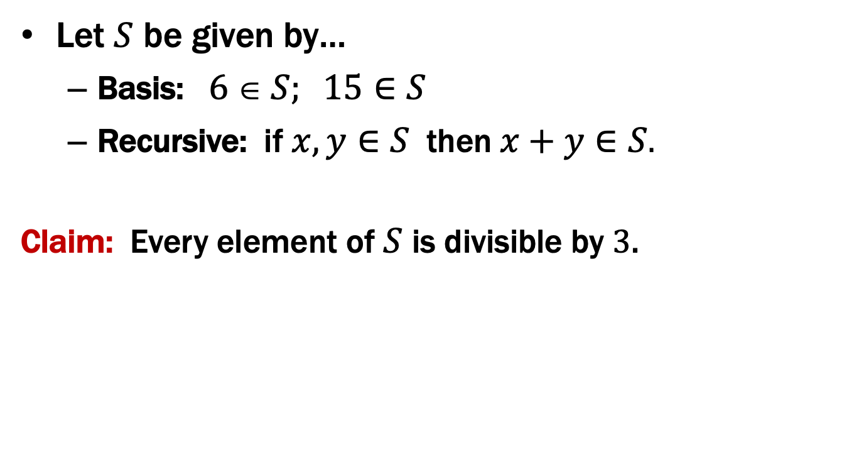
Last time: Using Structural Induction
Let $S$ be given by…
Basis: $6  S; 15∈S$
Recursive: if $x, y∈S$ then $x+y∈S$.
Claim: Every element of $S$ is divisible by 3.

Slide 7

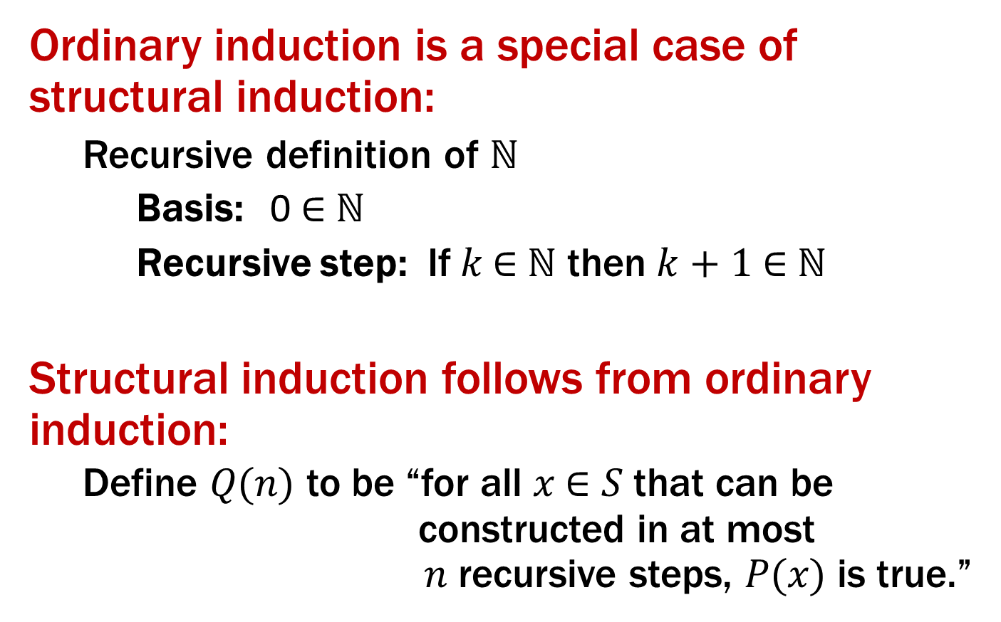
Claim: Every element of $S$ is divisible by 3.
1. Let P(x) be “3|x”. We prove that P(x) is true for all x ∈ S by structural induction.
2. Base Case: 3|6 and 3|15 so P(6) and P(15) are true
3. Inductive Hypothesis: Suppose that P(x) and P(y) are true for some arbitrary x,y ∈ S
4. Inductive Step: Goal: Show P(x+y)
Since P(x) is true, 3|x and so x=3m for some integer m and since P(y) is true, 3|y and so y=3n for some integer n. Therefore x+y=3m+3n=3(m+n) and thus 3|(x+y).
Hence P(x+y) is true.
5. Therefore by induction 3|x for all x ∈ S.
Basis: $6  S; 15∈S$
Recursive: if $x, y∈S$ then $x+y∈S$

Slide 8
Claim: Every element of $S$ is divisible by 3.
1. Let P(x) be “3|x”. We prove that P(x) is true for all x ∈ S by structural induction.
2. Base Case: 3|6 and 3|15 so P(6) and P(15) are true
3. Inductive Hypothesis: Suppose that P(x) and P(y) are true for some arbitrary x,y ∈ S
4. Inductive Step: Goal: Show P(x+y)
Since P(x) is true, 3|x and so x=3m for some integer m and since P(y) is true, 3|y and so y=3n for some integer n. Therefore x+y=3m+3n=3(m+n) and thus 3|(x+y).
Hence P(x+y) is true.
5. Therefore by induction 3|x for all x ∈ S.
Basis: $6  S; 15∈S$
Recursive: if $x, y∈S$ then $x+y∈S$

Slide 9
Claim: Every element of $S$ is divisible by 3.
1. Let P(x) be “3|x”. We prove that P(x) is true for all x ∈ S by structural induction.
2. Base Case: 3|6 and 3|15 so P(6) and P(15) are true
3. Inductive Hypothesis: Suppose that P(x) and P(y) are true for some arbitrary x,y ∈ S
4. Inductive Step: Goal: Show P(x+y)
Since P(x) is true, 3|x and so x=3m for some integer m and since P(y) is true, 3|y and so y=3n for some integer n. Therefore x+y=3m+3n=3(m+n) and thus 3|(x+y).
Hence P(x+y) is true.
5. Therefore by induction 3|x for all x ∈ S.
Basis: $6  S; 15∈S$
Recursive: if $x, y∈S$ then $x+y∈S$

Slide 10
Claim: Every element of $S$ is divisible by 3.
1. Let P(x) be “3|x”. We prove that P(x) is true for all x ∈ S by structural induction.
2. Base Case: 3|6 and 3|15 so P(6) and P(15) are true
3. Inductive Hypothesis: Suppose that P(x) and P(y) are true for some arbitrary x,y ∈ S
4. Inductive Step: Goal: Show P(x+y)
Since P(x) is true, 3|x and so x=3m for some integer m and since P(y) is true, 3|y and so y=3n for some integer n. Therefore x+y=3m+3n=3(m+n) and thus 3|(x+y).
Hence P(x+y) is true.
5. Therefore by induction 3|x for all x ∈ S.
Basis: $6  S; 15∈S$
Recursive: if $x, y∈S$ then $x+y∈S$

Slide 11
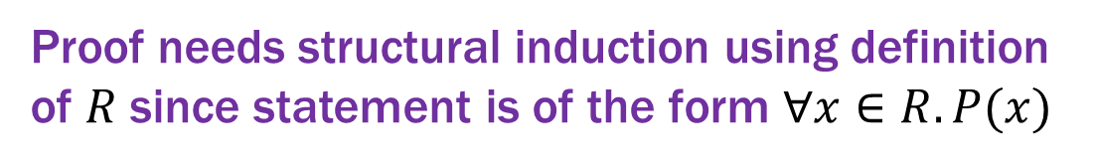
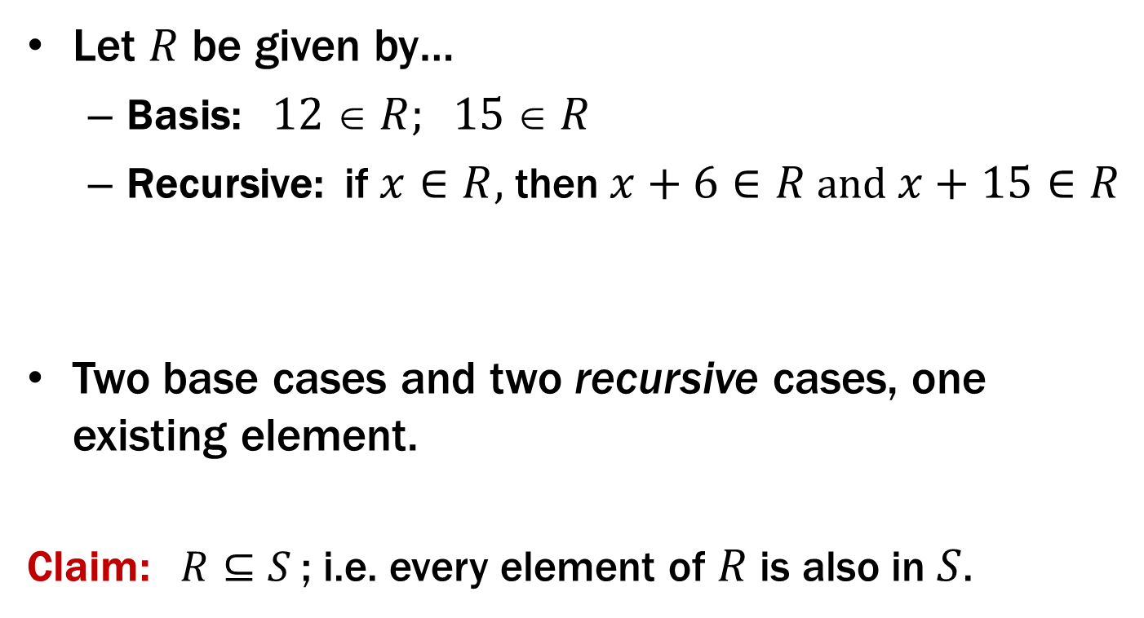
More Structural Induction
Let $R$ be given by…
Basis: $12  R; 15  R$
Recursive: if $x∈R$, then $x+6∈R$ and $x+15∈R$
Two base cases and two recursive cases, one existing element.
Claim: $R⊆S$; i.e. every element of $R$ is also in $S$.
Proof needs structural induction using definition of $R$ since statement is of the form $∀x∈R. P(x)$

Slide 12


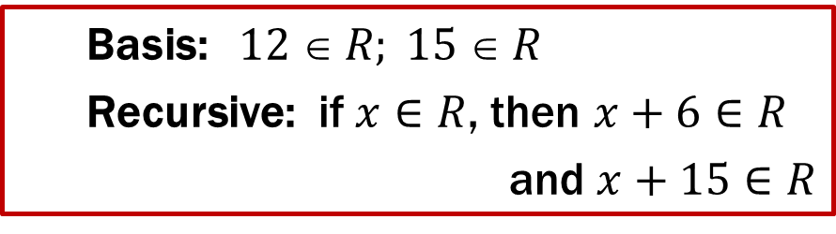
Claim: Every element of $R$ is in $S$. ($R⊆S$)
1. Let P(x) be “x ∈ S”. We prove that P(x) is true for all x ∈ R by structural induction.
2. Base Case: 15 ∈ S and 6 ∈ S so 6+6=12 ∈ S by recursive step of S.
So P(12) and P(15) are true.
3. Ind. Hyp: Suppose that P(x) is true for some arbitrary x ∈ R
4. Inductive Step: Goal: Show P(x+6) and P(x+15)
Since P(x) holds, we have x ∈ S. From the recursive step of S,
since 6 ∈ S we get x + 6 ∈ S, so P(x+6) is true, and since 15 ∈ S
we get x + 15 ∈ S, so P(x+15) is true.
5. Therefore P(x) (i.e., x ∈ S) for all x ∈ R by induction.
Basis: $6  S; 15∈S$
Recursive: if $x, y∈S$,
then $x+y∈S$
Basis: $12  R; 15  R$
Recursive: if $x∈R$, then $x+6∈R$
and $x+15∈R$

Slide 13

Claim: Every element of $R$ is in $S$. ($R⊆S$)
1. Let P(x) be “x ∈ S”. We prove that P(x) is true for all x ∈ R by structural induction.
2. Base Case: (12): 6 ∈ S so 6+6=12 ∈ S by definition of S, so P(12)
(15): 15 ∈ S, so P(15) is also true
3. Ind. Hyp: Suppose that P(x) is true for some arbitrary x ∈ R
4. Inductive Step: Goal: Show P(x+6) and P(x+15)
Since P(x) holds, we have x ∈ S. From the recursive step of S,
since 6 ∈ S we get x + 6 ∈ S, so P(x+6) is true, and since 15 ∈ S
we get x + 15 ∈ S, so P(x+15) is true.
5. Therefore P(x) (i.e., x ∈ S) for all x ∈ R by induction.
Basis: $6  S; 15∈S$
Recursive: if $x, y∈S$,
then $x+y∈S$
Basis: $12  R; 15  R$
Recursive: if $x∈R$, then $x+6∈R$
and $x+15∈R$

Slide 14
Claim: Every element of $R$ is in $S$. ($R⊆S$)
1. Let P(x) be “x ∈ S”. We prove that P(x) is true for all x ∈ R by structural induction.
2. Base Case: (12): 6 ∈ S so 6+6=12 ∈ S by definition of S, so P(12)
(15): 15 ∈ S, so P(15) is also true
3. Ind. Hyp: Suppose that P(x) is true for some arbitrary x ∈ R
4. Inductive Step: Goal: Show P(x+6) and P(x+15)
Since P(x) holds, we have x ∈ S. From the recursive step of S,
since 6 ∈ S we get x + 6 ∈ S, so P(x+6) is true, and since 15 ∈ S
we get x + 15 ∈ S, so P(x+15) is true.
5. Therefore P(x) (i.e., x ∈ S) for all x ∈ R by induction.
Basis: $6  S; 15∈S$
Recursive: if $x, y∈S$,
then $x+y∈S$
Basis: $12  R; 15  R$
Recursive: if $x∈R$, then $x+6∈R$
and $x+15∈R$

Slide 15
Claim: Every element of $R$ is in $S$. ($R⊆S$)
1. Let P(x) be “x ∈ S”. We prove that P(x) is true for all x ∈ R by structural induction.
2. Base Case: (12): 6 ∈ S so 6+6=12 ∈ S by definition of S, so P(12)
(15): 15 ∈ S, so P(15) is also true
3. Ind. Hyp: Suppose that P(x) is true for some arbitrary x ∈ R
4. Inductive Step: Goal: Show P(x+6) and P(x+15)
Since P(x) holds, we have x ∈ S. Since 6 ∈ S from the recursive
step of S, we get x + 6 ∈ S, so P(x+6) is true, and since 15 ∈ S
we get x + 15 ∈ S, so P(x+15) is true.
5. Therefore P(x) (i.e., x ∈ S) for all x ∈ R by induction.
Basis: $6  S; 15∈S$
Recursive: if $x, y∈S$,
then $x+y∈S$
Basis: $12  R; 15  R$
Recursive: if $x∈R$, then $x+6∈R$
and $x+15∈R$

Slide 16
Recursive Definitions
Recursively defined functions and sets are our mathematical models of code and the data it uses
recursively defined sets can be translated into Java classes
recursively defined functions can be translated into Java functions
some (but not all) can be written more cleanly as loops
Can now do proofs about CS-specific objects

Slide 17
Lists of Integers
Basis: nil ∈ List
Recursive step:
if L ∈ List and a ∈ ℤ,
then a :: L ∈ List
Examples:
nil []
1 :: nil [1]
2 :: 1 :: nil [2, 1]
3 :: 2 :: 1 :: nil [3, 2, 1]

Slide 18
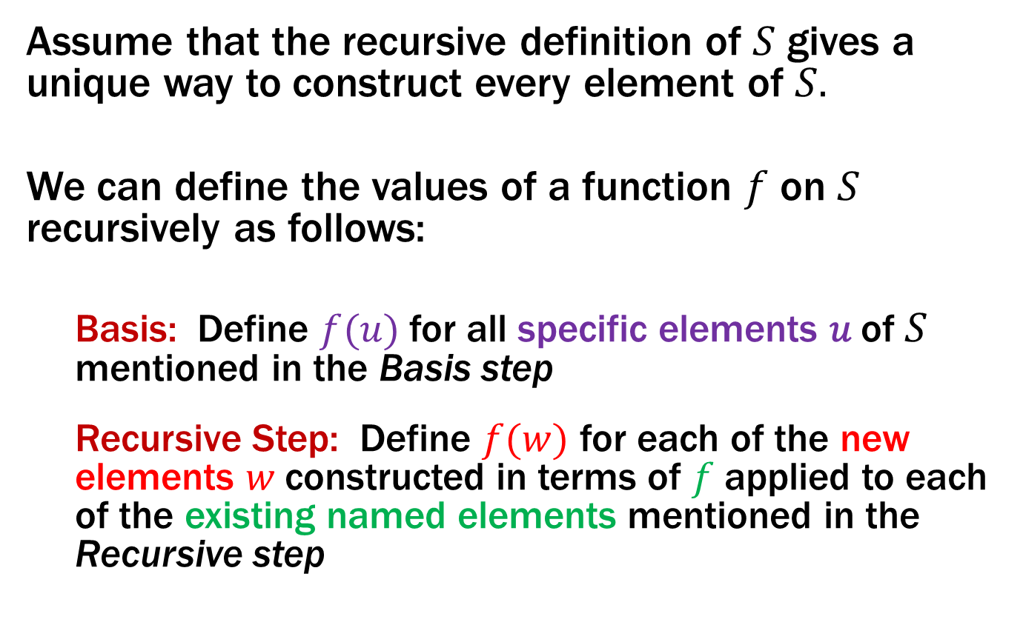
Functions on Recursively Defined Sets
Assume that the recursive definition of $S$ gives a unique way to construct every element of $S.$
We can define the values of a function $f$ on $S$ recursively as follows:
Basis: Define $f(u)$ for all specific elements 𝑢 of 𝑆 mentioned in the Basis step
Recursive Step: Define $f(w)$ for each of the new elements 𝑤 constructed in terms of $f$ applied to each of the existing named elements mentioned in the Recursive step

Slide 19
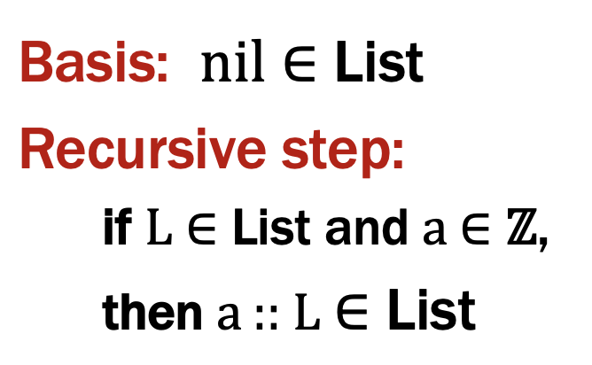
Functions on Lists
Length:
len(nil) := 0
len(a :: L) := len(L) + 1 for any L ∈ List and a ∈ ℤ
Concatenation:
concat(nil, R) := R for any R ∈ List
concat(a :: L, R) := a :: concat(L, R) for any L, R ∈ List and
any a ∈ ℤ
Notes:
These are defined by cases

Slide 20
Structural Induction
How to prove ∀ 𝑥 ∈ 𝑆, 𝑃(𝑥) is true:
Base Case: Show that 𝑃(𝑢) is true for all specific elements 𝑢 of 𝑆 mentioned in the Basis step
Inductive Hypothesis: Assume that 𝑃 is true for some arbitrary values of each of the existing named elements mentioned in the Recursive step
Inductive Step: Prove that 𝑃(𝑤) holds for each of the new elements 𝑤 constructed in the Recursive step using the named elements mentioned in the Inductive Hypothesis
Conclude that ∀ 𝑥 ∈ 𝑆, 𝑃(𝑥)

Slide 21
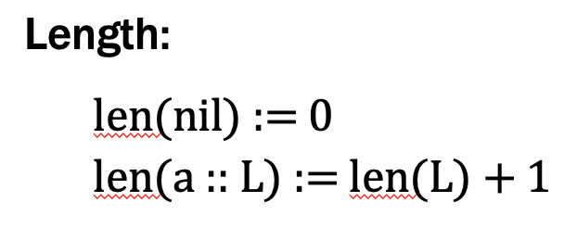
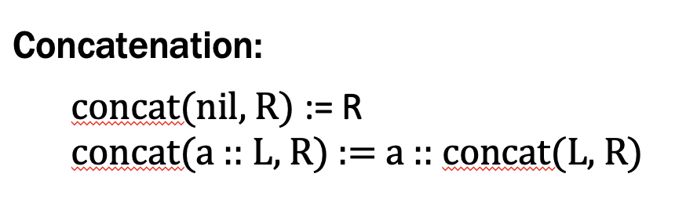
Claim: len(concat(L, R)) = len(L) + len(R) for all L, R ∈ List

Slide 22
Claim: len(concat(L, R)) = len(L) + len(R) for all L, R ∈ List
Let P(L) be “len(concat(L, R)) = len(L) + len(R) for all R ∈ List ” .
We prove P(L) for all L ∈ List by structural induction.

Slide 23
Claim: len(concat(L, R)) = len(L) + len(R) for all L, R ∈ List
Let P(L) be “len(concat(L, R)) = len(L) + len(R) for all R ∈ List ” .
We prove P(L) for all L ∈ List by structural induction.
Base Case (nil): Let R ∈ List be arbitrary. Then,

Slide 24
Claim: len(concat(L, R)) = len(L) + len(R) for all L, R ∈ List
Let P(L) be “len(concat(L, R)) = len(L) + len(R) for all R ∈ List ” .
We prove P(L) for all L ∈ List by structural induction.
Base Case (nil): Let R ∈ List be arbitrary. Then,
len(concat(nil, R)) = len(R) def of concat
= 0 + len(R)
= len(nil) + len(R) def of len
Since R was arbitrary, P(nil) holds.

Slide 25
Claim: len(concat(L, R)) = len(L) + len(R) for all L, R ∈ List
Let P(L) be “len(concat(L, R)) = len(L) + len(R) for all R ∈ List ” .
We prove P(L) for all L ∈ List by structural induction.
Base Case (nil): Let R ∈ List be arbitrary. Then, len(concat(nil, R)) = len(R) = 0 + len(R) = len(nil) + len(R), showing P(nil).
Inductive Hypothesis: Assume that P(L) is true for some arbitrary L ∈ List, i.e., len(concat(L, R)) = len(L) + len(R) for all R ∈ List.

Slide 26
Claim: len(concat(L, R)) = len(L) + len(R) for all L, R ∈ List
Let P(L) be “len(concat(L, R)) = len(L) + len(R) for all R ∈ List ” .
We prove P(L) for all L ∈ List by structural induction.
Base Case (nil): Let R ∈ List be arbitrary. Then, len(concat(nil, R)) = len(R) = 0 + len(R) = len(nil) + len(R), showing P(nil).
Inductive Hypothesis: Assume that P(L) is true for some arbitrary L ∈ List, i.e., len(concat(L, R)) = len(L) + len(R) for all R ∈ List.
Inductive Step: Goal: Show that P(a :: L) is true

Slide 27
Claim: len(concat(L, R)) = len(L) + len(R) for all L, R ∈ List
Let P(L) be “len(concat(L, R)) = len(L) + len(R) for all R ∈ List ” .
We prove P(L) for all L ∈ List by structural induction.
Base Case (nil): Let R ∈ List be arbitrary. Then, len(concat(nil, R)) = len(R) = 0 + len(R) = len(nil) + len(R), showing P(nil).
Inductive Hypothesis: Assume that P(L) is true for some arbitrary L ∈ List, i.e., len(concat(L, R)) = len(L) + len(R) for all R ∈ List.
Inductive Step: Goal: Show that P(a :: L) is true
Let R ∈ List be arbitrary. Then,

Slide 28
Claim: len(concat(L, R)) = len(L) + len(R) for all L, R ∈ List
Let P(L) be “len(concat(L, R)) = len(L) + len(R) for all R ∈ List ” .
We prove P(L) for all L ∈ List by structural induction.
Base Case (nil): Let R ∈ List be arbitrary. Then, len(concat(nil, R)) = len(R) = 0 + len(R) = len(nil) + len(R), showing P(nil).
Inductive Hypothesis: Assume that P(L) is true for some arbitrary L ∈ List, i.e., len(concat(L, R)) = len(L) + len(R) for all R ∈ List.
Inductive Step: Goal: Show that P(a :: L) is true
Let R ∈ List be arbitrary. Then, we can calculate
len(concat(a :: L, R)) = len(a :: concat(L, R)) def of concat
= 1 + len(concat(L, R)) def of len
= 1 + len(L) + len(R) IH
= len(a :: L) + len(R) def of len

Slide 29
Claim: len(concat(L, R)) = len(L) + len(R) for all L, R ∈ List
Let P(L) be “len(concat(L, R)) = len(L) + len(R) for all R ∈ List ” .
We prove P(L) for all L ∈ List by structural induction.
Base Case (nil): Let R ∈ List be arbitrary. Then, len(concat(nil, R)) = len(R) = 0 + len(R) = len(nil) + len(R), showing P(nil).
Inductive Hypothesis: Assume that P(L) is true for some arbitrary L ∈ List, i.e., len(concat(L, R)) = len(L) + len(R) for all R ∈ List.
Inductive Step: Goal: Show that P(a :: L) is true
Let R ∈ List be arbitrary. Then, we can calculate
len(concat(a :: L, R)) = len(a :: concat(L, R)) def of concat
= 1 + len(concat(L, R)) def of len
= 1 + len(L) + len(R) IH
= len(a :: L) + len(R) def of len
Since R was arbitrary, we have shown P(a :: L).
By induction, we have shown the claim holds for all L ∈ List.

Slide 30
Rooted Binary Trees
Basis: • is a rooted binary tree
Recursive step:
If and are rooted binary trees,
then also is a rooted binary tree.
T₁
T₂
T₂
T₁

Slide 31
Defining Functions on Rooted Binary Trees
size(•) := 1
size ( ) := 1 + size(T₁) + size(T₂)
height(•) := 0
height ( ) := 1 + max{height(T₁), height(T₂)}
T₁
T₂
T₁
T₂

Slide 32
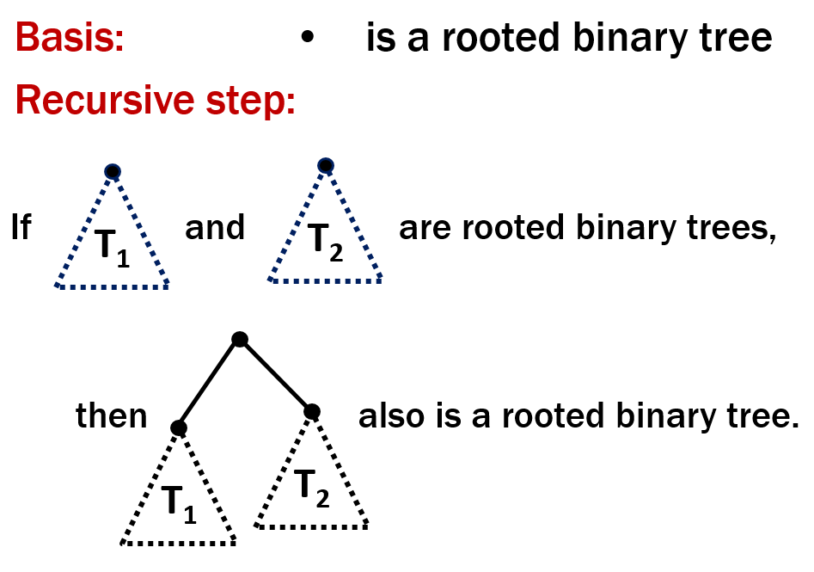
Last time: Structural Induction
How to prove ∀ 𝑥 ∈ 𝑆, 𝑃(𝑥) is true:
Base Case: Show that 𝑃(𝑢) is true for all specific elements 𝑢 of 𝑆 mentioned in the Basis step
Inductive Hypothesis: Assume that 𝑃 is true for some arbitrary values of each of the existing named elements mentioned in the Recursive step
Inductive Step: Prove that 𝑃(𝑤) holds for each of the new elements 𝑤 constructed in the Recursive step using the named elements mentioned in the Inductive Hypothesis
Conclude that ∀ 𝑥 ∈ 𝑆, 𝑃(𝑥)

Slide 33
Claim: For every rooted binary tree T, size(T) ≤ 2^{height(T) + 1} - 1

Slide 34
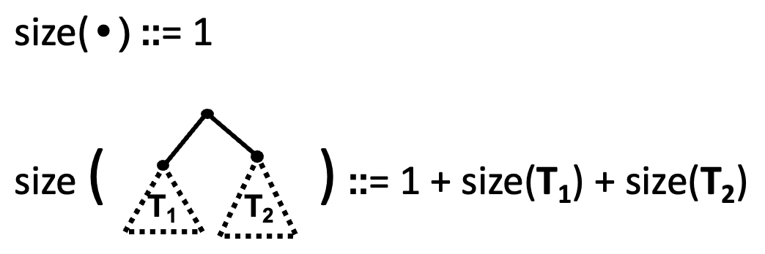
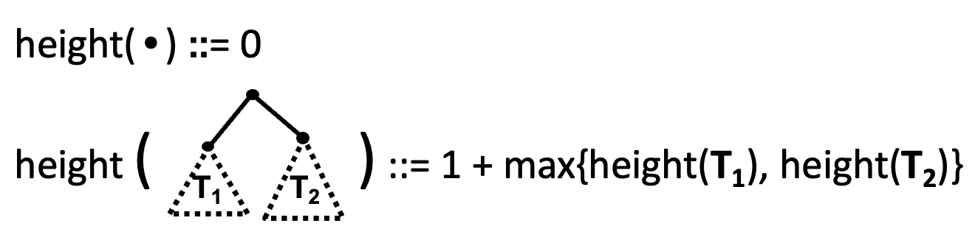
Claim: For every rooted binary tree T, size(T) ≤ 2^{height(T) + 1} - 1
1. Let P(T) be “size(T) ≤ 2^{height(T)+1}–1”. We prove P(T) for all rooted binary trees T by structural induction.
2. Base Case: size(•)=1, height(•)=0 and 1=2¹–1=2⁰⁺¹–1 so P(•) is true.
3. Inductive Hypothesis: Suppose that P(T₁) and P(T₂) are true for some rooted binary trees T₁ and T₂.
4. Inductive Step: Goal: Prove P( ).
By defn, size( ) =1+size(T₁)+size(T₂)
≤ 1+2^{height(T1)+1}–1+2^{height(T2)+1}-1 by IH for T₁ and T₂
≤ 2^{height(T1)+1}+2^{height(T2)+1}–1
≤ 2(2^{max(height(T1),height(T2))+1})–1
≤ 2(2^{height(} ⁾)–1 ≤ 2^{height( )+1} –1
which is what we wanted to show.
5. So, the P(T) is true for all rooted bin. trees by structural induction.

Slide 35
Claim: For every rooted binary tree T, size(T) ≤ 2^{height(T) + 1} - 1
1. Let P(T) be “size(T) ≤ 2^{height(T)+1}–1”. We prove P(T) for all rooted binary trees T by structural induction.
2. Base Case: size(•)=1, height(•)=0, and 2⁰⁺¹–1=2¹–1=1 so P(•) is true.
3. Inductive Hypothesis: Suppose that P(T₁) and P(T₂) are true for some rooted binary trees T₁ and T₂.
4. Inductive Step: Goal: Prove P( ).
By defn, size( ) =1+size(T₁)+size(T₂)
≤ 1+2^{height(T1)+1}–1+2^{height(T2)+1}-1 by IH for T₁ and T₂
≤ 2^{height(T1)+1}+2^{height(T2)+1}–1
≤ 2(2^{max(height(T1),height(T2))+1})–1
≤ 2(2^{height(} ⁾)–1 ≤ 2^{height( )+1} –1
which is what we wanted to show.
5. So, the P(T) is true for all rooted bin. trees by structural induction.

Slide 36
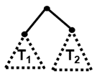
Claim: For every rooted binary tree T, size(T) ≤ 2^{height(T) + 1} - 1
1. Let P(T) be “size(T) ≤ 2^{height(T)+1}–1”. We prove P(T) for all rooted binary trees T by structural induction.
2. Base Case: size(•)=1, height(•)=0, and 2⁰⁺¹–1=2¹–1=1 so P(•) is true.
3. Inductive Hypothesis: Suppose that P(T₁) and P(T₂) are true for some rooted binary trees T₁ and T₂, i.e., size(T_{k}) ≤ 2^{height(Tk) + 1} – 1 for k=1,2
4. Inductive Step: Goal: Prove P( ).
By defn, size( ) =1+size(T₁)+size(T₂)
≤ 1+2^{height(T1)+1}–1+2^{height(T2)+1}-1 by IH for T₁ and T₂
≤ 2^{height(T1)+1}+2^{height(T2)+1}–1
≤ 2(2^{max(height(T1),height(T2))+1})–1
≤ 2(2^{height(} ⁾)–1 ≤ 2^{height( )+1} –1
which is what we wanted to show.
5. So, the P(T) is true for all rooted bin. trees by structural induction.

Slide 37
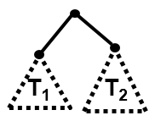

Claim: For every rooted binary tree T, size(T) ≤ 2^{height(T) + 1} - 1
1. Let P(T) be “size(T) ≤ 2^{height(T)+1}–1”. We prove P(T) for all rooted binary trees T by structural induction.
2. Base Case: size(•)=1, height(•)=0, and 2⁰⁺¹–1=2¹–1=1 so P(•) is true.
3. Inductive Hypothesis: Suppose that P(T₁) and P(T₂) are true for some rooted binary trees T₁ and T₂, i.e., size(T_{k}) ≤ 2^{height(Tk) + 1} – 1 for k=1,2
4. Inductive Step: Goal: Prove P( ).
size( ) ≤ 2^{height( )+1} – 1

Slide 38
Claim: For every rooted binary tree T, size(T) ≤ 2^{height(T) + 1} - 1
1. Let P(T) be “size(T) ≤ 2^{height(T)+1}–1”. We prove P(T) for all rooted binary trees T by structural induction.
2. Base Case: size(•)=1, height(•)=0, and 2⁰⁺¹–1=2¹–1=1 so P(•) is true.
3. Inductive Hypothesis: Suppose that P(T₁) and P(T₂) are true for some rooted binary trees T₁ and T₂, i.e., size(T_{k}) ≤ 2^{height(Tk) + 1} – 1 for k=1,2
4. Inductive Step: Goal: Prove P( ).
By def, size( ) =1+size(T₁)+size(T₂)
≤ 1+2^{height(T1)+1}–1+2^{height(T2)+1}-1 by IH for T₁ and T₂
= 2^{height(T1)+1}+2^{height(T2)+1}–1
≤ 2·max(2^{height(T1)+1,}2^{height(T2)+1})–1
≤ 2(2^{max(height(T1),height(T2))+1})–1
≤ 2(2^{height(} ⁾) – 1 ≤ 2^{height( )+1} – 1
which is what we wanted to show.
5. So, the P(T) is true for all rooted binary trees by structural induction.

Slide 39
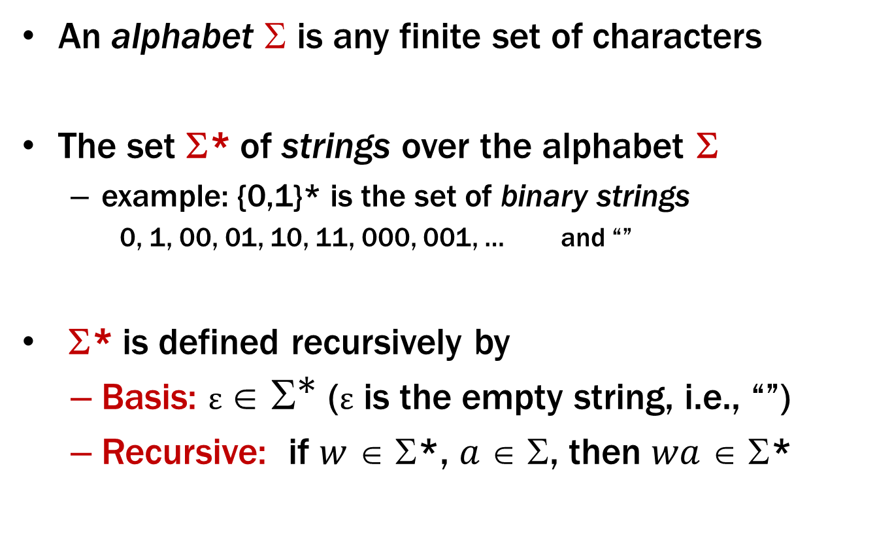
Strings
An alphabet $$ is any finite set of characters
The set Σ* of strings over the alphabet Σ
example: {0,1}* is the set of binary strings
0, 1, 00, 01, 10, 11, 000, 001, … and “”
Σ* is defined recursively by
Basis: $ε ∈ {\text{Σ}}^{\text{∗}}$ (ε is the empty string, i.e., “”)
Recursive: if $w$ ∈ Σ*, $a$ ∈ Σ, then $wa$ ∈ Σ*

Slide 40
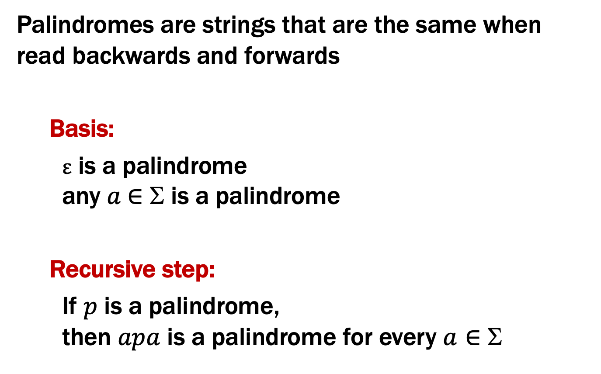
Palindromes
Palindromes are strings that are the same when read backwards and forwards
Basis:
ε is a palindrome any $a$∈ Σ is a palindrome
Recursive step:
If $p$ is a palindrome, then $apa$ is a palindrome for every $a∈$ Σ

Slide 41
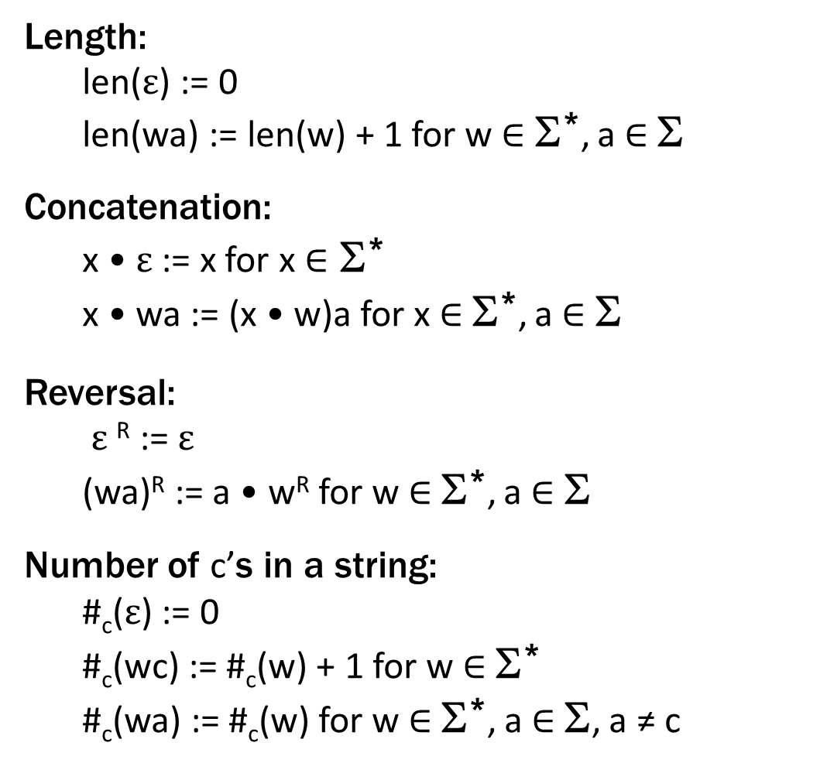
Functions on Recursively Defined Sets (on Σ*)
Length:
len($ε$) := 0
len(wa) := len(w) + 1 for w ∈ Σ*, a ∈ Σ
Concatenation:
x • $ε$ := x for x ∈ Σ*
x • wa := (x • w)a for x ∈ Σ*, a ∈ Σ
Reversal:
$ε$^{R} := $ε$
(wa)^{R} := a • w^{R} for w ∈ Σ*, a ∈ Σ
Number of c’s in a string:
#_{c}($ε$) := 0
#_{c}(wc) := #_{c}(w) + 1 for w ∈ Σ*
#_{c}(wa) := #_{c}(w) for w ∈ Σ*, a ∈ Σ, a ≠ c
separate cases for
c vs a ≠ c
Notes:
These are defined by cases

Slide 42
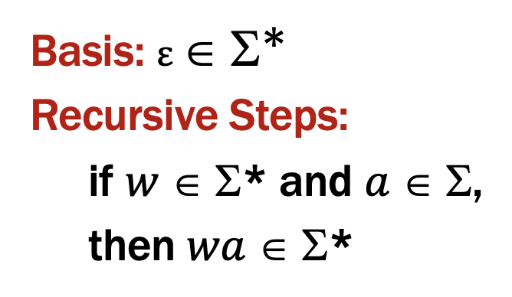
Last time: Structural Induction
How to prove ∀ 𝑥 ∈ 𝑆, 𝑃(𝑥) is true:
Base Case: Show that 𝑃(𝑢) is true for all specific elements 𝑢 of 𝑆 mentioned in the Basis step
Inductive Hypothesis: Assume that 𝑃 is true for some arbitrary values of each of the existing named elements mentioned in the Recursive step
Inductive Step: Prove that 𝑃(𝑤) holds for each of the new elements 𝑤 constructed in the Recursive step using the named elements mentioned in the Inductive Hypothesis
Conclude that ∀ 𝑥 ∈ 𝑆, 𝑃(𝑥)

Slide 43
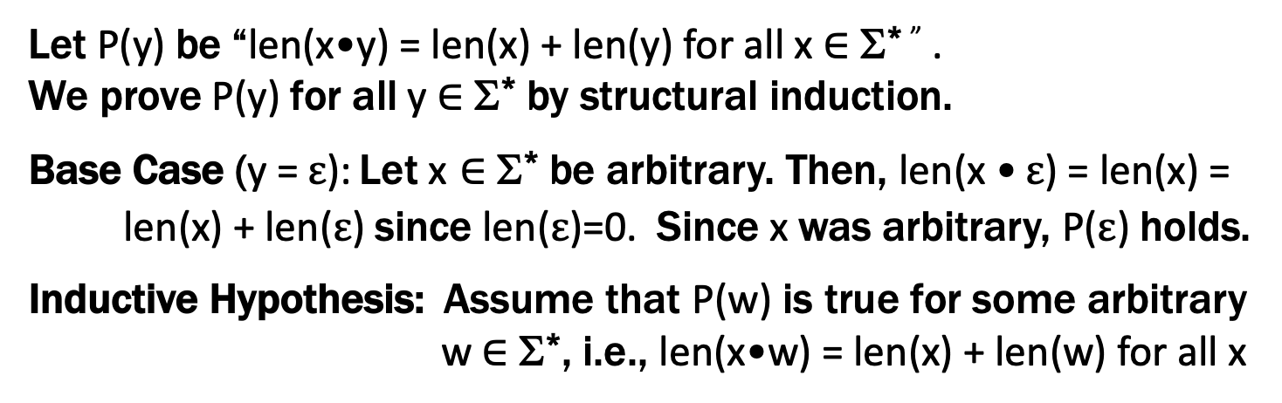
Claim: len(x•y) = len(x) + len(y) for all x,y ∈ Σ*
Let P(y) be “len(x•y) = len(x) + len(y) for all x ∈ Σ* ” .
We prove P(y) for all y ∈ Σ* by structural induction.
Base Case (y = $ε$): Let x ∈ Σ* be arbitrary. Then, len(x • $ε$) = len(x) =
len(x) + len($ε$) since len($ε$)=0. Since x was arbitrary, P($ε$) holds.
Inductive Hypothesis: Assume that P(w) is true for some arbitrary w ∈ Σ*, i.e., len(x•w) = len(x) + len(w) for all x

Slide 44
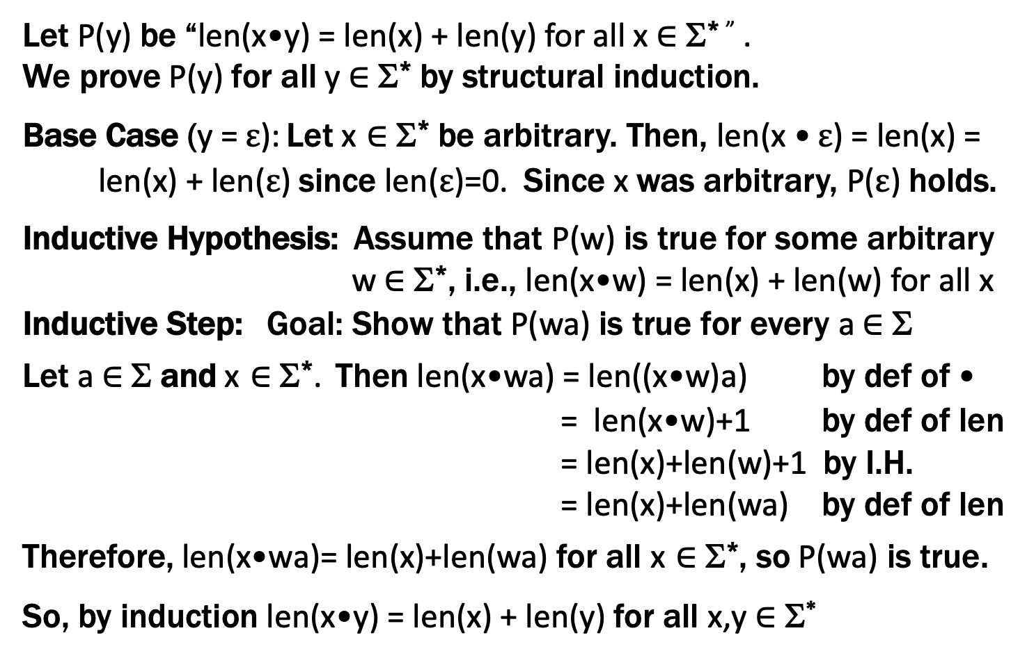
Claim: len(x•y) = len(x) + len(y) for all x,y ∈ Σ*
Does this look familiar?
Let P(y) be “len(x•y) = len(x) + len(y) for all x ∈ Σ* ” .
We prove P(y) for all y ∈ Σ* by structural induction.
Base Case (y = $ε$): Let x ∈ Σ* be arbitrary. Then, len(x • $ε$) = len(x) =
len(x) + len($ε$) since len($ε$)=0. Since x was arbitrary, P($ε$) holds.
Inductive Hypothesis: Assume that P(w) is true for some arbitrary w ∈ Σ*, i.e., len(x•w) = len(x) + len(w) for all x
Inductive Step: Goal: Show that P(wa) is true for every a ∈ Σ
Let a ∈ Σ and x ∈ Σ*. Then len(x•wa) = len((x•w)a) by def of •
= len(x•w)+1 by def of len
= len(x)+len(w)+1 by I.H.
= len(x)+len(wa) by def of len
Therefore, len(x•wa)= len(x)+len(wa) for all x ∈ Σ*, so P(wa) is true.
So, by induction len(x•y) = len(x) + len(y) for all x,y ∈ Σ*

