Slide 1
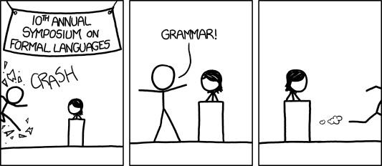
CSE 311: Foundations of Computing
Lecture 19: Context-Free Grammars
[Audience looks around]
“What is going on? There must be some context we’re missing”

Slide 2
Last class: Languages: Sets of Strings
Subsets of strings are called languages
Examples:
Σ* = All strings over alphabet Σ
Palindromes over Σ
Binary strings that don’t have a 0 after a 1
Binary strings with an equal # of 0’s and 1’s
Legal variable names in Java/C/C++
Syntactically correct Java/C/C++ programs
Valid English sentences

Slide 3
Last class: Regular Expressions
Regular expressions over Σ
Basis:
ε is a regular expression (could also include ∅)
a is a regular expression for any a ∈ Σ
Recursive step:
If A and B are regular expressions then so are:
A ∪ B
AB
A*

Slide 4
Last class: Regular Expression is a “pattern”
ε matches the empty string
a matches the one character string a
A ∪ B matches all strings that either A matches or B matches (or both)
AB matches all strings that have a first part that A matches followed by a second part that B matches
A* matches all strings that have any number of strings (even 0) that A matches, one after another
Yields a language = the set of strings matched by the regular expression

Slide 5
Last class: Examples
Regular Expression | Language
001* | {00, 001, 0011, 00111, …}
0*1* | {Binary strings with any number of 0s followed by any number of 1s}
(0 ∪ 1) 0 (0 ∪ 1) 0 | {0000, 1000, 0010, 1010}
(0*1*)* | {All binary strings}={0,1}*
(0 ∪ 1)* | {All binary strings}={0,1}*
(0 ∪ 1)* 0110 (0 ∪ 1)* | {All binary strings containing substring 0110}

Slide 6
Regular Expressions in Practice
Used to define the tokens of a programming language
legal variable names, keywords, etc.
Used in grep, a program that does pattern matching searches in UNIX/LINUX
We can use regular expressions in programs to process strings!

Slide 7
Regular Expressions in Java
Pattern p = Pattern.compile("a*b");
Matcher m = p.matcher("aaaaab");
boolean b = m.matches();
[01] a 0 or a 1 ^ start of string $ end of string
[0-9] any single digit \. period \, comma \- minus
. any single character
ab a followed by b (AB)
(a|b) a or b (A ∪ B) a? zero or one of a (A ∪ ε) a* zero or more of a A*
a+ one or more of a AA*
e.g. ^[\-+]?[0-9]*(\.|\,)?[0-9]+$
General form of decimal number e.g. 9.12 or -9,8 (Europe)

Slide 8
Examples
All binary strings that have an even # of 1’s

Slide 9
Examples
All binary strings that have an even # of 1’s
e.g., 0* (10*10*)*

Slide 10
Examples
All binary strings that have an even # of 1’s
All binary strings that don’t contain 101
e.g., 0* (10*10*)*
Notes:
Every pair of 1s are separated by 0 or 2+ 0s.
Alternatively, can take a state machine approach (0 union 11 union 100)* (empty union 1 union 10)

Slide 11
Examples
All binary strings that have an even # of 1’s
All binary strings that don’t contain 101
e.g., 0* (10*10*)*
e.g., 0* (1 ∪ 000*)* 0*
at least two 0s between 1s

Slide 12
Limitations of Regular Expressions
Not all languages can be specified by regular expressions
Even some easy things like
Palindromes
Strings with equal number of 0’s and 1’s
But also more complicated structures in programming languages
Matched parentheses
Properly formed arithmetic expressions
etc.

Slide 13
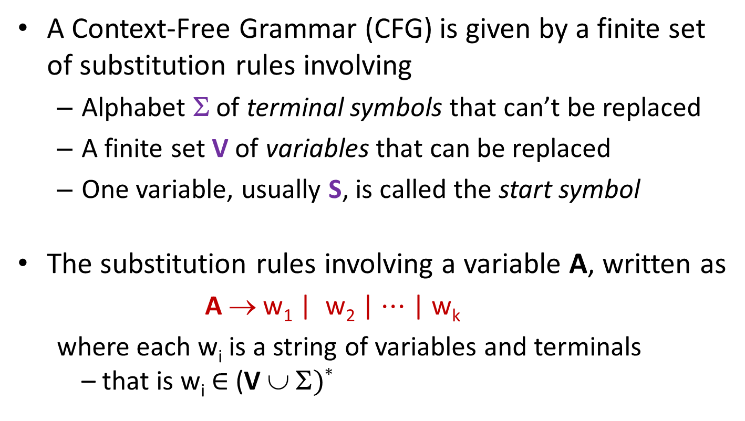
Context-Free Grammars
A Context-Free Grammar (CFG) is given by a finite set of substitution rules involving
Alphabet Σ of terminal symbols that can’t be replaced
A finite set V of variables that can be replaced
One variable, usually S, is called the start symbol
The substitution rules involving a variable A, written as
A → w₁ | w₂ | $⋯$ | w_{k}
where each w_{i} is a string of variables and terminals – that is w_{i} ∈ (V ∪ Σ)*

Slide 14
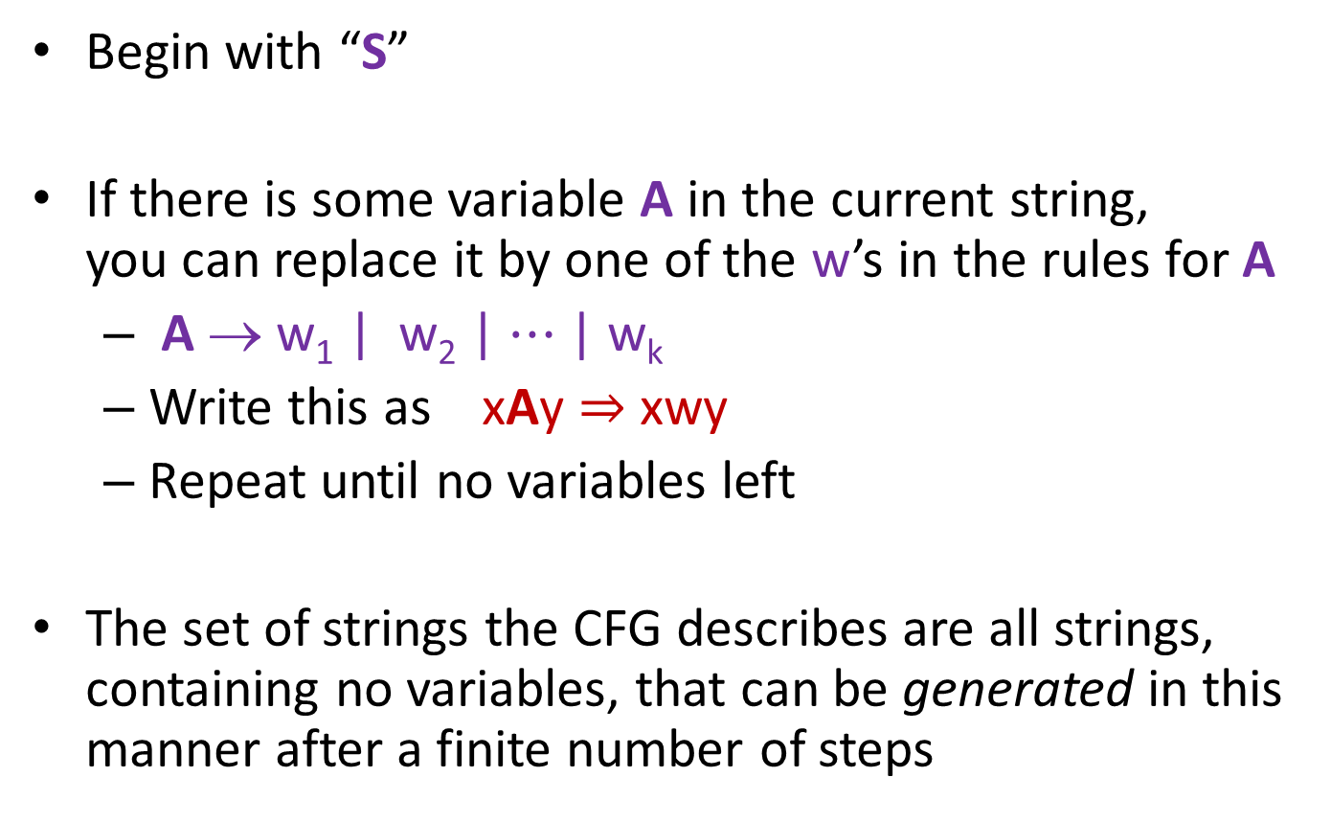
How CFGs generate strings
Begin with “S”
If there is some variable A in the current string, you can replace it by one of the w’s in the rules for A
A → w₁ | w₂ | $⋯$ | w_{k}
Write this as xAy ⇒ xwy
Repeat until no variables left
The set of strings the CFG describes are all strings, containing no variables, that can be generated in this manner after a finite number of steps
Notes:
Note that A can appear in x and y.

Slide 15
Example Context-Free Grammars
Example: S → 0S | S1 | ε

Slide 16
Example Context-Free Grammars
Example: S → 0S | S1 | ε
0*1*

Slide 17
Example Context-Free Grammars
Example: S → 0S | S1 | ε
Example: S → 0S0 | 1S1 | 0 | 1 | ε
0*1*

Slide 18
Example Context-Free Grammars
Example: S → 0S | S1 | ε
Example: S → 0S0 | 1S1 | 0 | 1 | ε
0*1*
The set of all binary palindromes

Slide 19

Example Context-Free Grammars
Grammar for $\left\{0^{n}1^{n}:n≥0\right\}$
(i.e., matching 0*1* but with same number of 0’s and 1’s)

Slide 20
Example Context-Free Grammars
Grammar for $\left\{0^{n}1^{n}:n≥0\right\}$
(i.e., matching 0*1* but with same number of 0’s and 1’s)
S → 0S1 | ε

Slide 21
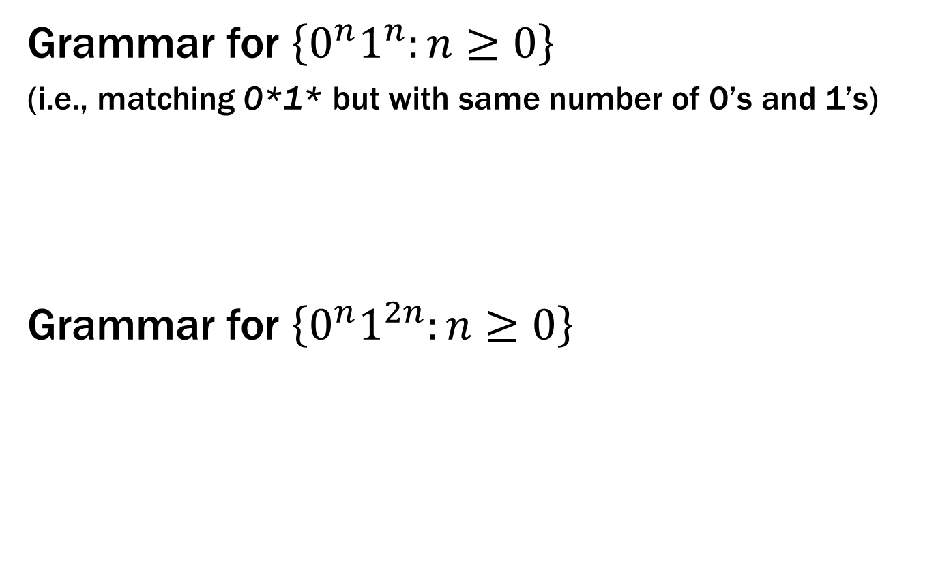
Example Context-Free Grammars
Grammar for $\left\{0^{n}1^{n}:n≥0\right\}$
(i.e., matching 0*1* but with same number of 0’s and 1’s)
Grammar for $\left\{0^{n}1^{2n}:n≥0\right\}$
S → 0S1 | ε

Slide 22
Example Context-Free Grammars
Grammar for $\left\{0^{n}1^{n}:n≥0\right\}$
(i.e., matching 0*1* but with same number of 0’s and 1’s)
Grammar for $\left\{0^{n}1^{2n}:n≥0\right\}$
S → 0S1 | ε
S → 0S11 | ε

Slide 23
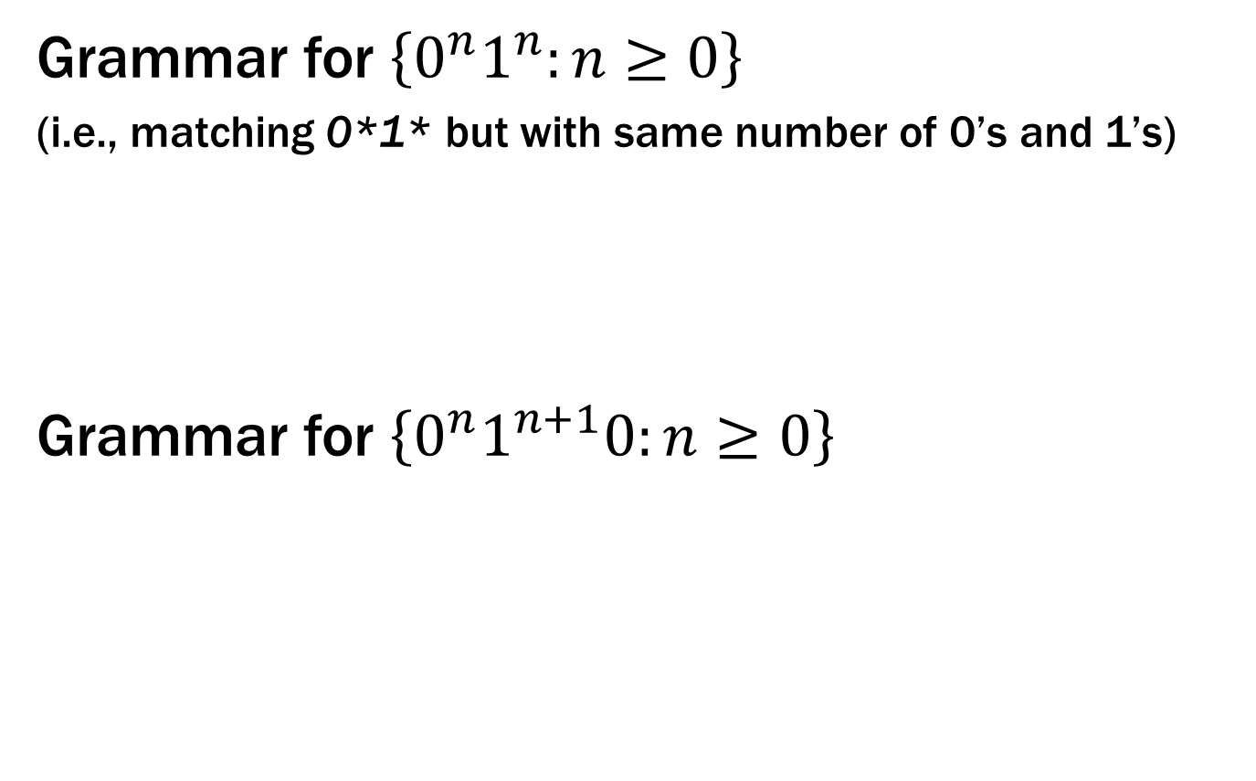
Example Context-Free Grammars
Grammar for $\left\{0^{n}1^{n}:n≥0\right\}$
(i.e., matching 0*1* but with same number of 0’s and 1’s)
Grammar for $\left\{0^{n}1^{n+1}0:n≥0\right\}$
S → 0S1 | ε

Slide 24
Example Context-Free Grammars
Grammar for $\left\{0^{n}1^{n}:n≥0\right\}$
(i.e., matching 0*1* but with same number of 0’s and 1’s)
Grammar for $\left\{0^{n}1^{n+1}0:n≥0\right\}$
S → 0S1 | ε
S → A 10
A → 0A1 | ε

Slide 25
Example Context-Free Grammars
Example: S → (S) | SS | ε

Slide 26
Example Context-Free Grammars
Example: S → (S) | SS | ε
The set of all strings of matched parentheses

Slide 27
Example Context-Free Grammars
Binary strings with equal numbers of 0s and 1s (not just 0^{n}1^{n}, also 0101, 0110, etc.)

Slide 28
Example Context-Free Grammars
Binary strings with equal numbers of 0s and 1s (not just 0^{n}1^{n}, also 0101, 0110, etc.)
S → SS | 0S1 | 1S0 | ε
An easy structural induction can show that everything generated by S has an equal # of 0s and 1s
Why does this generate all such strings?

Slide 29

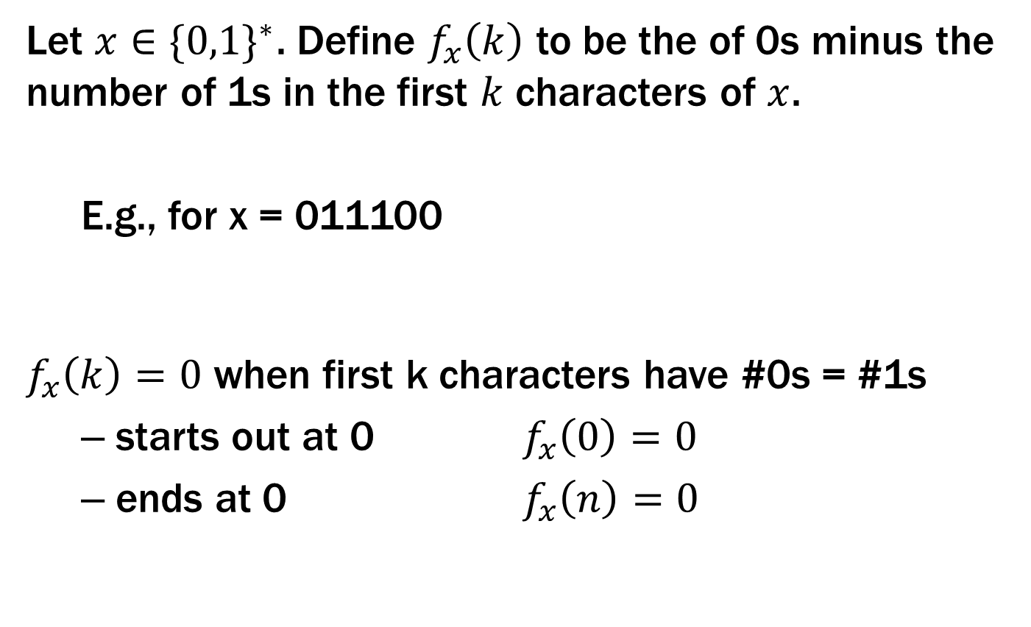
Example Context-Free Grammars
Let $x∈{\{0,1\}}^{∗}$. Define $f_{x}\left(k\right)$ to be the of 0s minus the number of 1s in the first $k$ characters of $x$.
E.g., for x = 011100
$f_{x}\left(k\right)=0$ when first k characters have #0s = #1s
starts out at 0 $f_{x}\left(0\right)=0$
ends at 0 $f_{x}\left(n\right)=0$
$$f$$
0 1 2 3 4 5 6

Slide 30
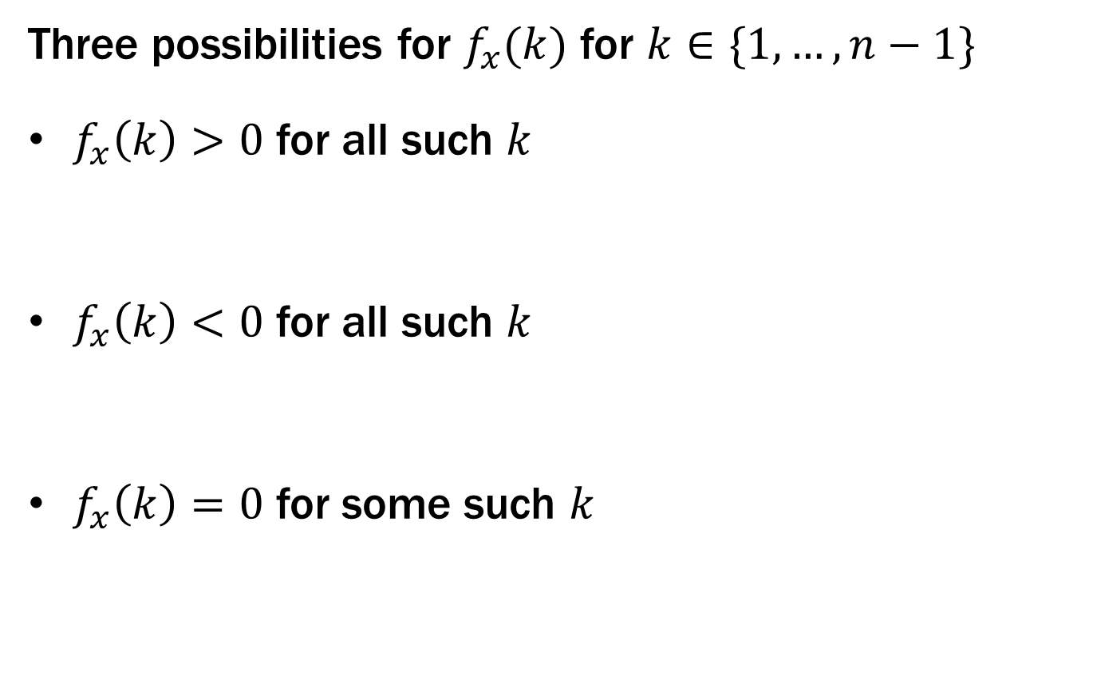
Example Context-Free Grammars
Three possibilities for $f_{x}(k)$ for $k∈\{1, …,n−1\}$
$f_{x}\left(k\right)>0$ for all such $k$
$f_{x}\left(k\right)<0$ for all such $k$
$f_{x}\left(k\right)=0$ for some such $k$
0 1 n-1 n
S → 0S1
0 1 n-1 n
S → 1S0
0 1 n-1 n
S → SS

Slide 31
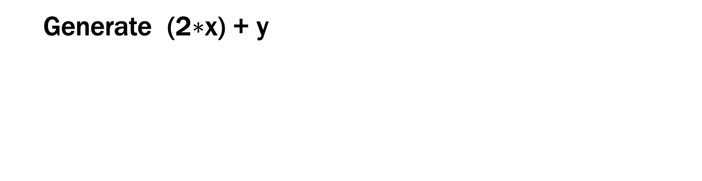
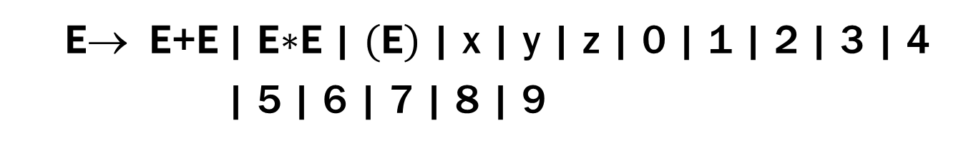
Simple Arithmetic Expressions
E→ E+E | E$∗$E | (E) | x | y | z | 0 | 1 | 2 | 3 | 4
| 5 | 6 | 7 | 8 | 9
Generate (2$∗$x) + y

Slide 32
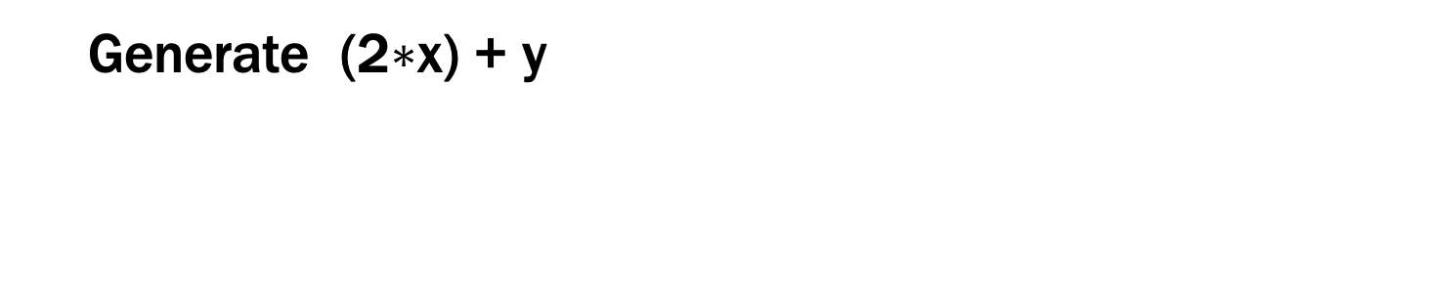
Simple Arithmetic Expressions
E→ E+E | E$∗$E | (E) | x | y | z | 0 | 1 | 2 | 3 | 4
| 5 | 6 | 7 | 8 | 9
Generate (2$∗$x) + y
E ⇒ E+E ⇒ (E)+E ⇒ (E$∗$E)+E ⇒ (2$∗$E)+E ⇒ (2$∗$x)+E ⇒ (2$∗$x)+y

Slide 33
Parse Trees
Suppose that grammar G generates a string x
A parse tree of x for G has
Root labeled S (start symbol of G)
The children of any node labeled A are labeled by symbols of w left-to-right for some rule A → w
The symbols of x label the leaves ordered left-to-right
S
S → 0S0 | 1S1 | 0 | 1 | ε
0
S
0
1
S
1
Parse tree of 01110
1

Slide 34
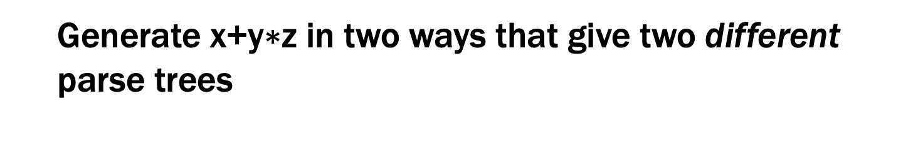
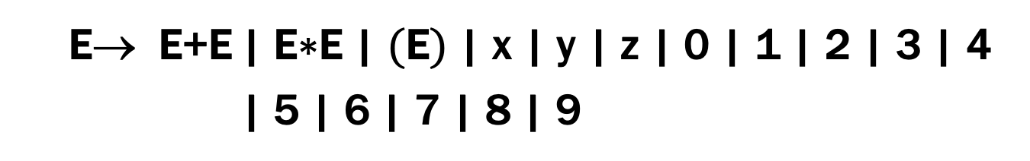
Simple Arithmetic Expressions
E→ E+E | E$∗$E | (E) | x | y | z | 0 | 1 | 2 | 3 | 4
| 5 | 6 | 7 | 8 | 9
Generate x+y$∗$z in two ways that give two different parse trees

Slide 35
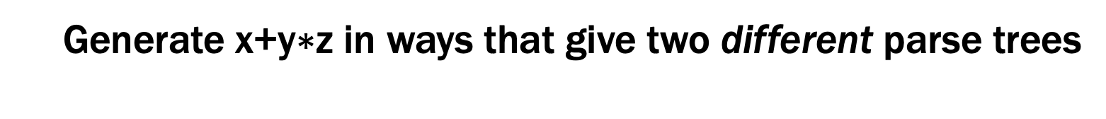
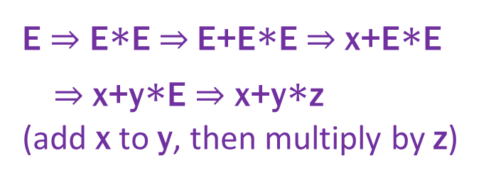
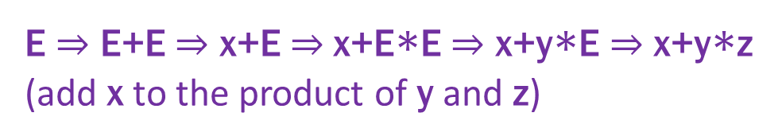
Simple Arithmetic Expressions
E→ E+E | E$∗$E | (E) | x | y | z | 0 | 1 | 2 | 3 | 4
| 5 | 6 | 7 | 8 | 9
Generate x+y$∗$z in ways that give two different parse trees
E
E ⇒ E+E ⇒ x+E ⇒ x+E$∗$E ⇒ x+y$∗$E ⇒ x+y$∗$z
(add x to the product of y and z)
E
+
E
E
x
E
E
E ⇒ E$∗$E ⇒ E+E$∗$E ⇒ x+E$∗$E
⇒ x+y$∗$E ⇒ x+y$∗$z
(add x to y, then multiply by z)
*
E
*
E
y
z
E
+
E
z
x
y

Slide 36
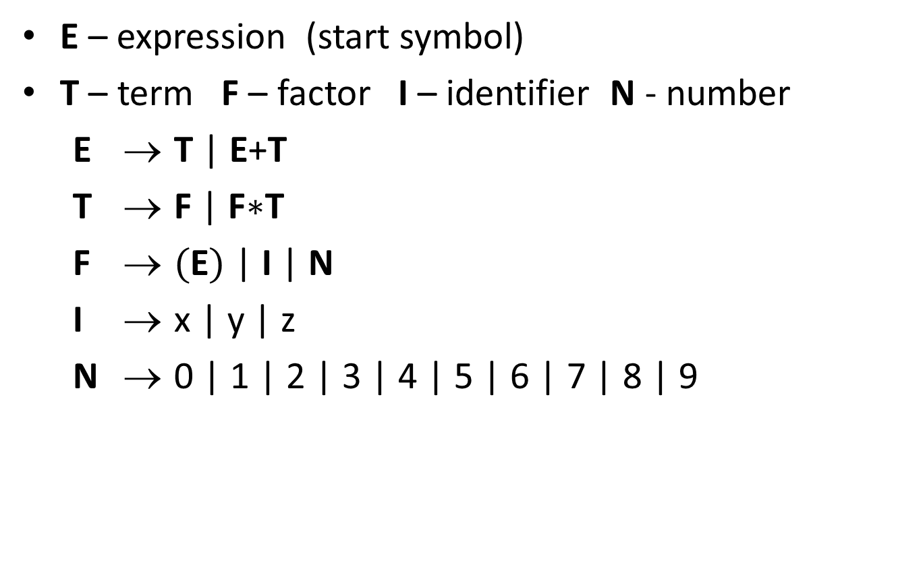
building precedence in simple arithmetic expressions
E – expression (start symbol)
T – term F – factor I – identifier N - number
E → T | E+T
T → F | F$∗$T
F → (E) | I | N
I → x | y | z
N → 0 | 1 | 2 | 3 | 4 | 5 | 6 | 7 | 8 | 9
No longer
allows:
E
E
*
E
E
+
E
z
x
y
Notes:
Children of T are only F or T, neither of which matches a “+”.

Slide 37
building precedence in simple arithmetic expressions
E – expression (start symbol)
T – term F – factor I – identifier N - number
E → T | E+T
T → F | F$∗$T
F → (E) | I | N
I → x | y | z
N → 0 | 1 | 2 | 3 | 4 | 5 | 6 | 7 | 8 | 9
E
T
F
*
T
?
+
x
y
z
Notes:
Children of T are only F or T, neither of which matches a “+”.

Slide 38
building precedence in simple arithmetic expressions
E – expression (start symbol)
T – term F – factor I – identifier N - number
E → T | E+T
T → F | F$∗$T
F → (E) | I | N
I → x | y | z
N → 0 | 1 | 2 | 3 | 4 | 5 | 6 | 7 | 8 | 9
Still
allows:
E
E
+
E
x
E
*
E
y
z
Notes:
Children of T are only F or T, neither of which matches a “+”.

Slide 39
building precedence in simple arithmetic expressions
E – expression (start symbol)
T – term F – factor I – identifier N - number
E → T | E+T
T → F | F$∗$T
F → (E) | I | N
I → x | y | z
N → 0 | 1 | 2 | 3 | 4 | 5 | 6 | 7 | 8 | 9
E
E
+
T
x
F
*
T
y
z
Notes:
Children of T are only F or T, neither of which matches a “+”.

Slide 40
CFGs and recursively-defined sets of strings
A CFG with the start symbol S as its only variable recursively defines the set of strings of terminals that S can generate
A CFG with more than one variable is a simultaneous recursive definition of the sets of strings generated by each of its variables
sometimes necessary to use more than one

Slide 41
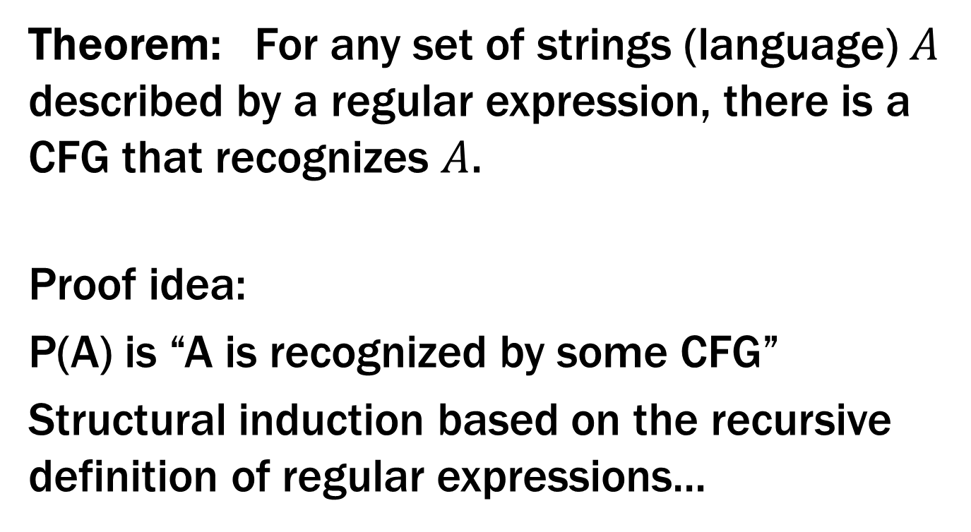
CFGs and regular expressions
Theorem: For any set of strings (language) $A$ described by a regular expression, there is a CFG that recognizes $A$.
Proof idea:
P(A) is “A is recognized by some CFG”
Structural induction based on the recursive definition of regular expressions...

Slide 42
Regular Expressions over Σ
Basis:
ɛ is a regular expression
a is a regular expression for any a ∈ Σ
Recursive step:
If A and B are regular expressions then so are:
A ∪ B
AB
A*

Slide 43

CFGs are more general than REs
CFG to match RE ε
S → ε
CFG to match RE a (for any $a$ ∈ Σ)
S → a

Slide 44
CFGs are more general than REs
Suppose CFG with start symbol S_{A} matches RE A CFG with start symbol S_{B} matches RE B
CFG to match RE A ∪ B
S → S_{A} | S_{B} + rules from original CFGs
CFG to match RE AB
S → S_{A} S_{B} + rules from original CFGs

Slide 45
CFGs are more general than REs
Suppose CFG with start symbol S_{A} matches RE A
CFG to match RE A* (= ε ∪ A ∪ AA ∪ AAA ∪ ... )
S → S_{A} S | ε + rules from CFG with S_{A}

Slide 46
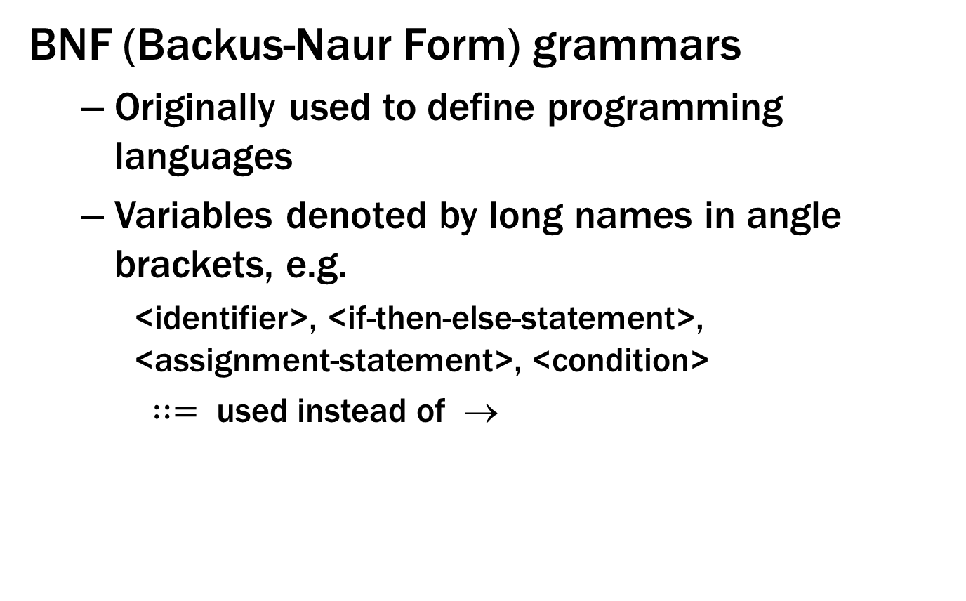
Backus-Naur Form (The same thing…)
BNF (Backus-Naur Form) grammars
Originally used to define programming languages
Variables denoted by long names in angle brackets, e.g.
<identifier>, <if-then-else-statement>, <assignment-statement>, <condition>
$∷=$ used instead of →

Slide 47
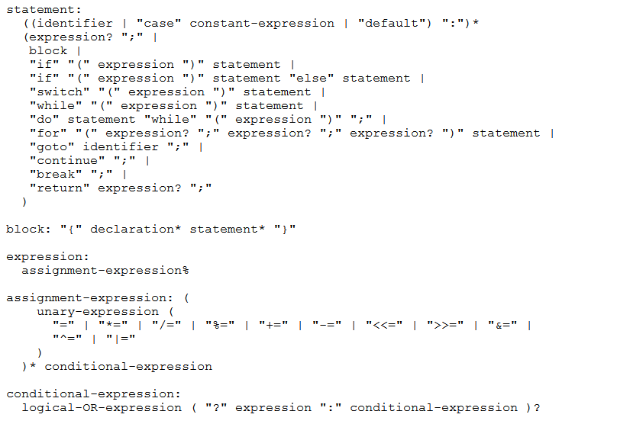
BNF for C

Slide 48
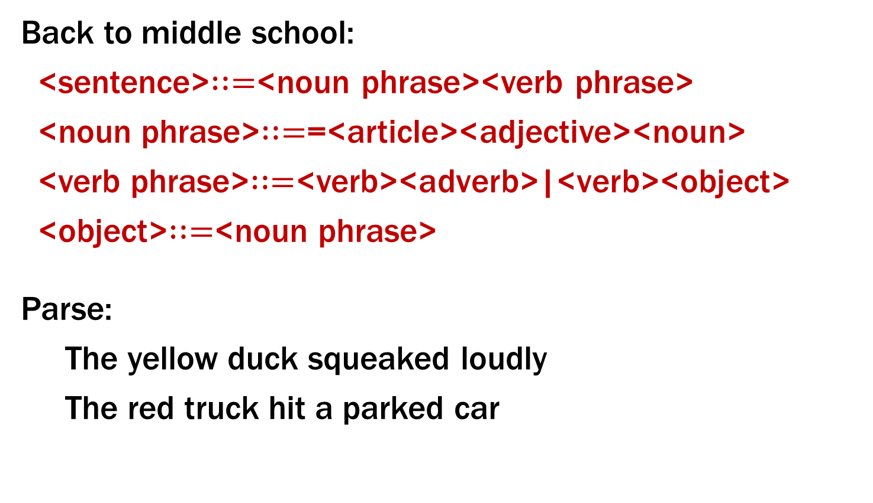
BNF for (Simple) English
Back to middle school:
<sentence>$∷=$<noun phrase><verb phrase>
<noun phrase>$∷=$=<article><adjective><noun>
<verb phrase>$∷=$<verb><adverb>|<verb><object>
<object>$∷=$<noun phrase>
Parse:
The yellow duck squeaked loudly
The red truck hit a parked car
Notes:
Issues about parse trees and meaning matter here also.

