Slide 1
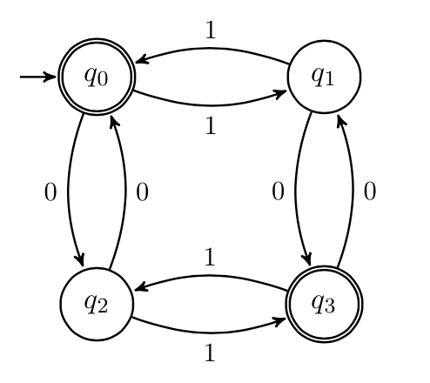
CSE 311: Foundations of Computing
Lecture 21: Directed Graphs, Finite State Machines

Slide 2
Last time: Relations
Let A and B be sets,
A binary relation from A to B is a subset of A × B
Let A be a set,
A binary relation on A is a subset of A × A

Slide 3
Last time: Properties of Relations
Let R be a relation on A.
R is reflexive iff (a,a) ∈ R for every a ∈ A
R is symmetric iff (a,b) ∈ R implies (b,a) ∈ R
R is antisymmetric iff (a,b) ∈ R and a ≠ b implies (b,a) $∉$ R
R is transitive iff (a,b)∈ R and (b,c)∈ R implies (a,c) ∈ R

Slide 4

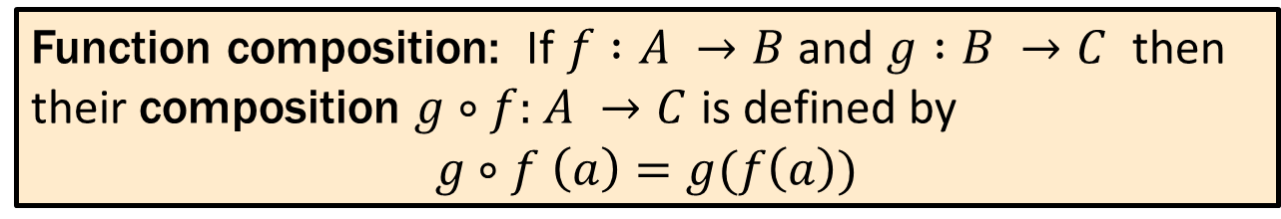
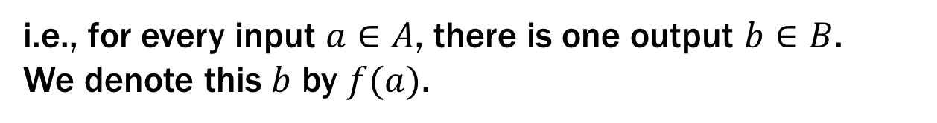
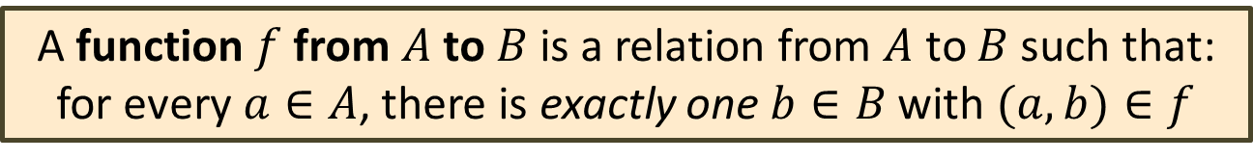
Functions
A function $f :A →B$ ($A$ as input and $B$ as output) is a special type of relation.
A function $f$from $A$ to $B$ is a relation from $A$ to $B$ such that:
for every $a∈A$, there is exactly one $b∈B$ with $(a,b)∈f$
i.e., for every input $a∈A$, there is one output $b∈B$.
We denote this $b$ by $f(a)$.
Function composition: If $f :A →B$ and $g :B →C$ then their composition $g∘f:$ $A →C$ is defined by
$$g∘f \left(a\right)=g(f\left(a\right))$$

Slide 5
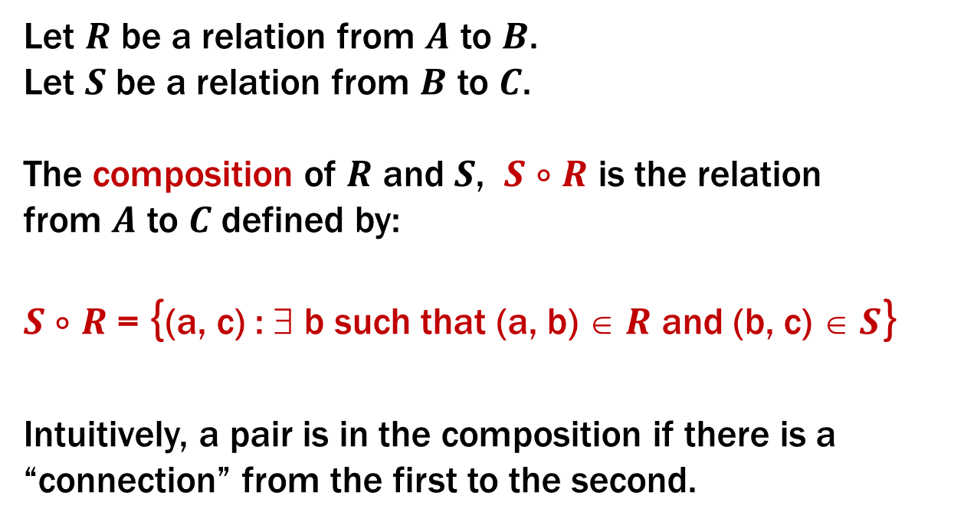
Composing Relations
Let $R$ be a relation from $A$ to $B$.
Let $S$ be a relation from $B$ to $C$.
The composition of $R$ and $S$, $S$ $∘$ $R$ is the relation
from $A$ to $C$ defined by:
$S$ $∘$ $R$ = {(a, c) : ∃ b such that (a, b) ∈ $R$ and (b, c) ∈ $S$}
Intuitively, a pair is in the composition if there is a “connection” from the first to the second.
The order of writing composition generalizes the function case

Slide 6
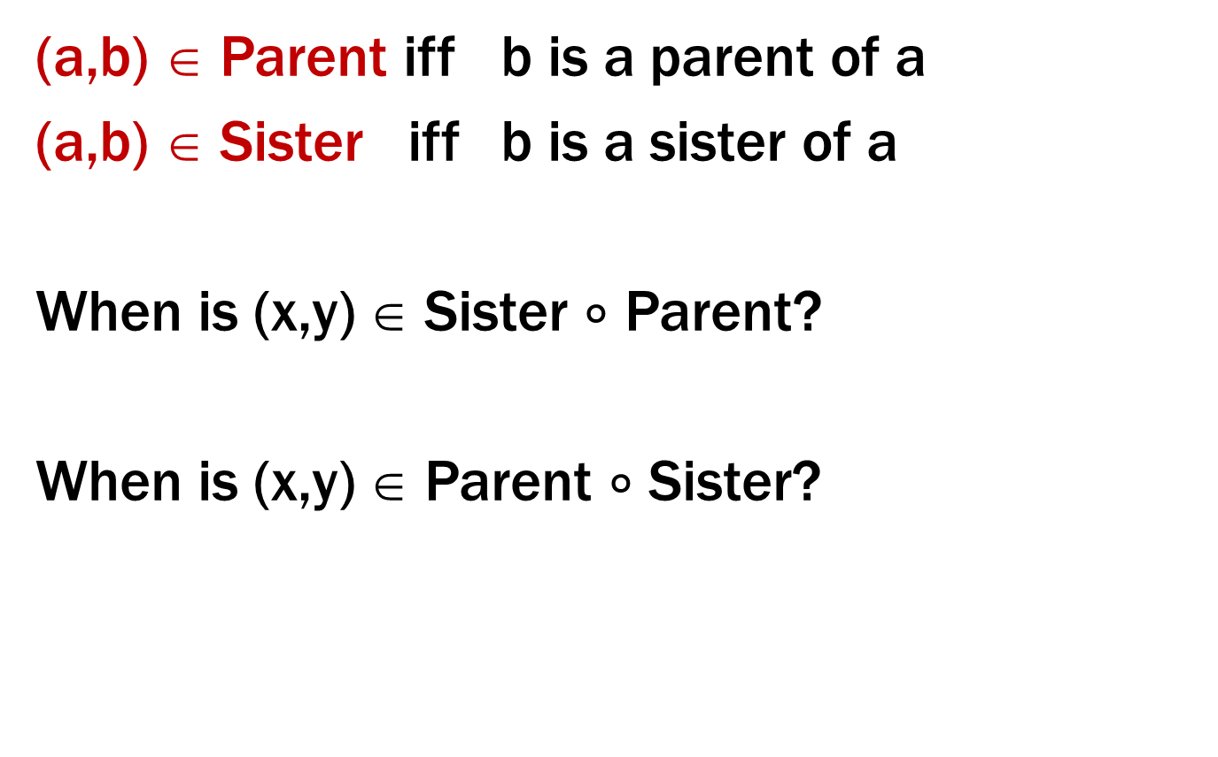
Examples
(a,b) ∈ Parent iff b is a parent of a
(a,b) ∈ Sister iff b is a sister of a
When is (x,y) ∈ Sister $∘$ Parent?
When is (x,y) ∈ Parent $∘$ Sister?
S $∘$ R = {(a, c) | ∃ b such that (a,b)∈ R and (b,c)∈ S}
Notes:
1. Aunt
2. Is it Parent? No, Parent cap HasSister

Slide 7
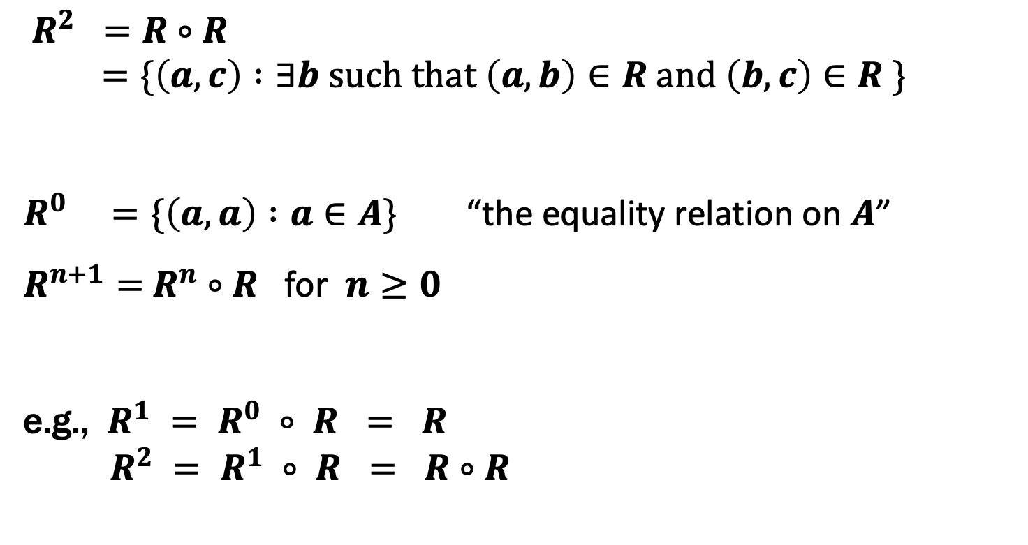
Powers of a Relation
$R^{2} =R∘R$
$=\{\left(a,c\right) :∃b such that \left(a,b\right)∈R and \left(b,c\right)∈R \}$
$R^{0} =\{\left(a,a\right) :a∈A\}$ “the equality relation on $A$”
$R^{n+1}=$ $R^{n}$ $∘$ $R$ for $n≥0$
e.g., $R^{1} = R^{0} ∘ R = R$
$R^{2} = R^{1} ∘ R = R∘R$

Slide 8
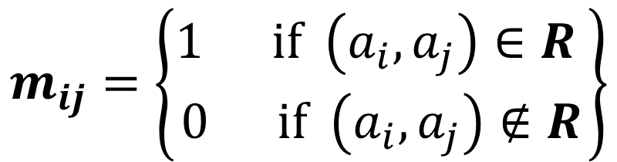
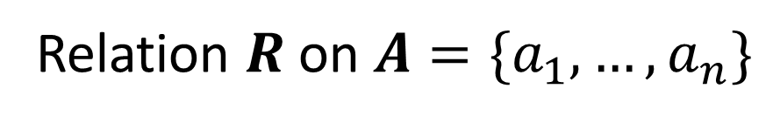
Matrix Representation
Relation $R$ on $A=\{a_{1},…, a_{n}\}$
$$m_{ij}=\left\{\begin{matrix}1 if \left(a_{i},a_{j}\right)∈R \\ 0 if \left(a_{i},a_{j}\right)∉R\end{matrix}\right\}$$
{ (1, 1), (1, 2), (1, 4), (2, 1), (2, 3), (3, 2), (3, 3), (4, 2), (4, 3) }
 | 1 | 2 | 3 | 4
1 | 1 | 1 | 0 | 1
2 | 1 | 0 | 1 | 0
3 | 0 | 1 | 1 | 0
4 | 0 | 1 | 1 | 0

Slide 9
Properties using matrix representation
1
1
reflexive
1
1
1
1
1
1
1
1
1
Same when rows & columns swapped
symmetric
1
0
0
0
0
No 1-1 pairs
0
1
1
anti-symmetric
0

Slide 10
Directed Graphs
V – vertices
E – edges, ordered pairs of vertices
G = (V, E)

Slide 11
Directed Graphs
V – vertices
E – edges (relation on vertices)
G = (V, E)
Path: v₀, v₁, …, v_{k} with each (v_{i}, v_{i+1}) in E

Slide 12
Directed Graphs
V – vertices
E – edges (relation on vertices)
G = (V, E)
Path: v₀, v₁, …, v_{k} with each (v_{i}, v_{i+1}) in E
Simple Path: none of v₀ , …, v_{k} repeated
Cycle: v₀= v_{k}
Simple Cycle: v₀= v_{k ,} none of v₁, …, v_{k} repeated

Slide 13
Directed Graphs
V – vertices
E – edges (relation on vertices)
G = (V, E)
Path: v₀, v₁, …, v_{k} with each (v_{i}, v_{i+1}) in E
Simple Path: none of v₀ , …, v_{k} repeated
Cycle: v₀= v_{k}
Simple Cycle: v₀= v_{k ,} none of v₁, …, v_{k} repeated

Slide 14
Directed Graphs
V – vertices
E – edges (relation on vertices)
G = (V, E)
Path: v₀, v₁, …, v_{k} with each (v_{i}, v_{i+1}) in E
Simple Path: none of v₀ , …, v_{k} repeated
Cycle: v₀= v_{k}
Simple Cycle: v₀= v_{k ,} none of v₁, …, v_{k} repeated

Slide 15
Representation of Relations
Directed Graph Representation (Digraph)
{(a, b), (a, a), (b, a), (c, a), (c, d), (c, e) (d, e) }
b
c
a
d
e

Slide 16
Representation of Relations
Directed Graph Representation (Digraph)
{(a, b), (a, a), (b, a), (c, a), (c, d), (c, e) (d, e) }
b
c
a
d
e

Slide 17
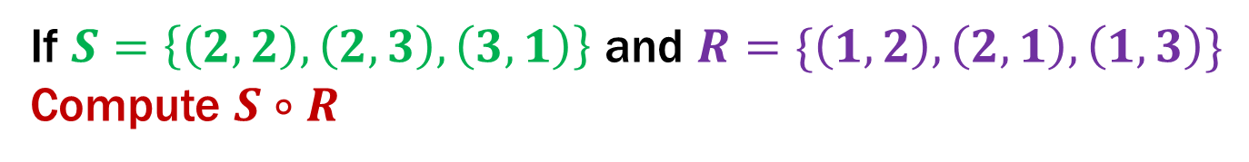
Relational Composition using Digraphs
If $S=\left\{\left(2,2\right), \left(2,3\right), \left(3,1\right)\right\}$ and $R=\{\left(1,2\right),\left(2,1\right),\left(1,3\right)\}$
Compute $S∘R$
2
2
1
1
3
3

Slide 18
Relational Composition using Digraphs
If $S=\left\{\left(2,2\right), \left(2,3\right), \left(3,1\right)\right\}$ and $R=\{\left(1,2\right),\left(2,1\right),\left(1,3\right)\}$
Compute $S∘R$
2
2
1
1
3
3

Slide 19
Relational Composition using Digraphs
If $S=\left\{\left(2,2\right), \left(2,3\right), \left(3,1\right)\right\}$ and $R=\{\left(1,2\right),\left(2,1\right),\left(1,3\right)\}$
Compute $S∘R$
2
2
1
1
3
3

Slide 20
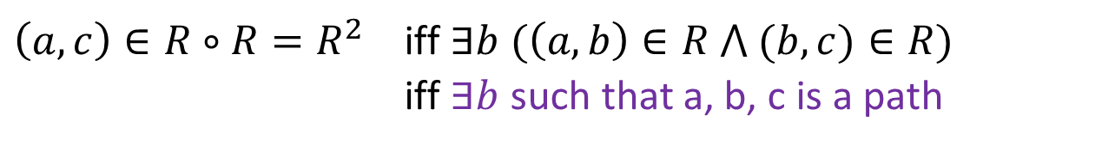
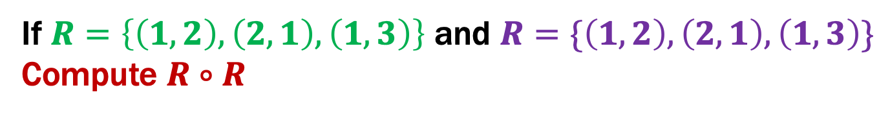
Relational Composition using Digraphs
If $R=\left\{\left(1,2\right), \left(2,1\right), \left(1,3\right)\right\}$ and $R=\{\left(1,2\right),\left(2,1\right),\left(1,3\right)\}$
Compute $R∘R$
2
2
1
1
3
3
$\left(a,c\right)∈{R∘R=R}^{2}$ iff $∃b (\left(a,b\right)∈R ⋀ (b,c)∈R)$
iff $∃b$ such that a, b, c is a path
Notes:
Any edge can be used either as the first step or the second step.

Slide 21
Relational Composition using Digraphs
If $R=\left\{\left(1,2\right), \left(2,1\right), \left(1,3\right)\right\}$ and $R=\{\left(1,2\right),\left(2,1\right),\left(1,3\right)\}$
Compute $R∘R$
2
2
1
1
3
3
$\left(a,c\right)∈{R∘R=R}^{2}$ iff $∃b (\left(a,b\right)∈R ⋀ (b,c)∈R)$
iff $∃b$ such that a, b, c is a path
Notes:
Any edge can be used either as the first step or the second step.

Slide 22
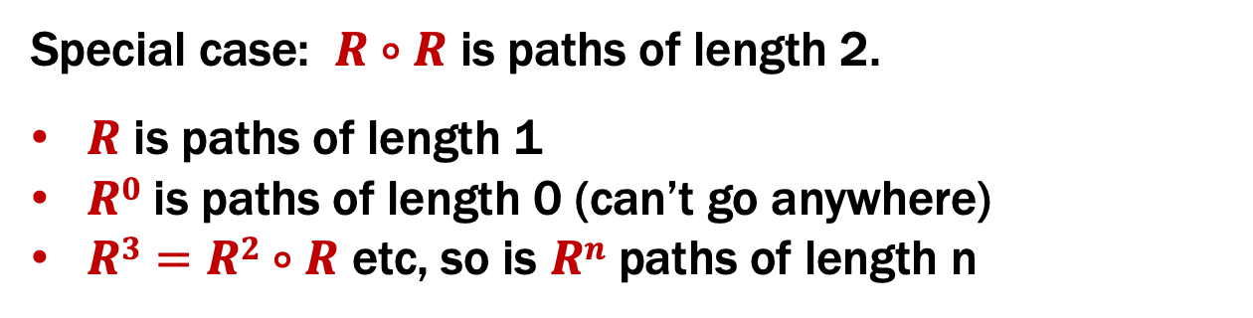
Relational Composition using Digraphs
If $R=\left\{\left(1,2\right), \left(2,1\right), \left(1,3\right)\right\}$ and $R=\{\left(1,2\right),\left(2,1\right),\left(1,3\right)\}$
Compute $R∘R$
2
2
1
1
3
3
Special case: $R∘R$ is paths of length 2.
$R$ is paths of length 1
$R0$ is paths of length 0 (can’t go anywhere)
$R3=R2∘R$ etc, so is $Rn$ paths of length n
Notes:
Any edge can be used either as the first step or the second step.

Slide 23
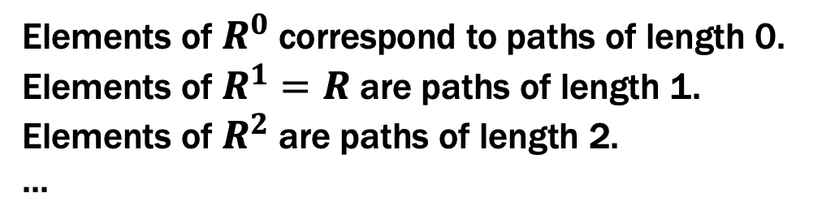
Paths in Graphs and Relations
Def: The length of a path in a graph is the number of edges in it (counting repetitions if edge used > once).
Elements of $R^{0}$ correspond to paths of length 0.
Elements of $R^{1}=R$ are paths of length 1.
Elements of $R^{2}$ are paths of length 2.
...

Slide 24
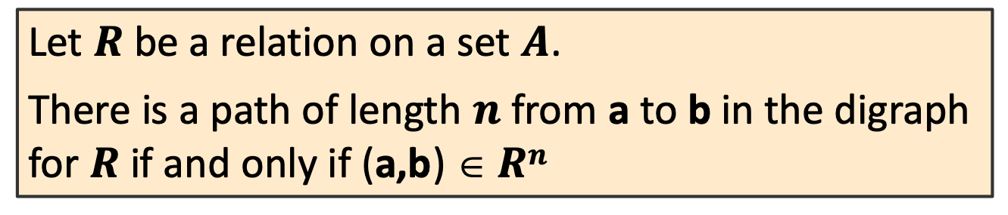
Paths in Graphs and Relations
Def: The length of a path in a graph is the number of edges in it (counting repetitions if edge used > once).
Let $R$ be a relation on a set $A$.
There is a path of length $n$ from a to b in the digraph for $R$ if and only if (a,b) $ Rn$

Slide 25
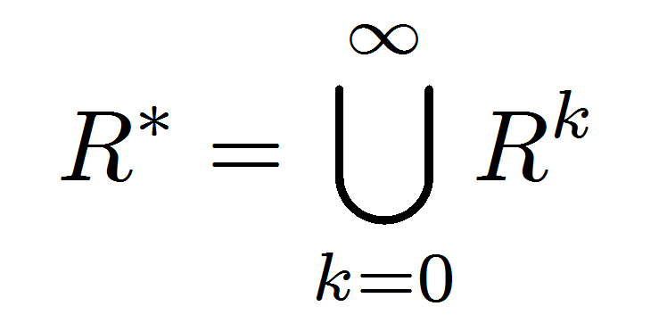
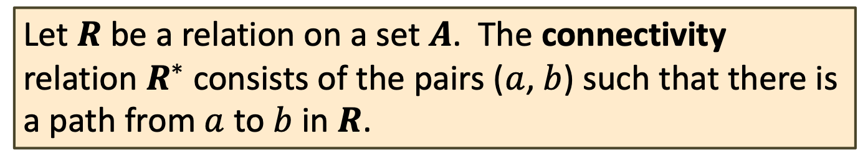

Connectivity In Graphs
Def: Two vertices in a graph are connected iff there is a path between them.
Let $R$ be a relation on a set $A$. The connectivity relation $R^{∗}$ consists of the pairs ($a$,$b$) such that there is a path from $a$ to $b$ in $R$.
Note: The Rosen book uses the wrong definition of this quantity.
What the Rosen defines (ignoring $k=0$) is usually called R⁺

Slide 26
How Properties of Relations show up in Graphs
Let R be a relation on A.
R is reflexive iff (a,a) ∈ R for every a ∈ A
R is symmetric iff (a,b) ∈ R implies (b, a)∈ R
R is antisymmetric iff (a,b) ∈ R and a ≠ b implies (b,a) $∉$ R
R is transitive iff (a,b)∈ R and (b, c)∈ R implies (a, c) ∈ R

Slide 27
How Properties of Relations show up in Graphs
Let R be a relation on A.
R is reflexive iff (a,a) ∈ R for every a ∈ A
at every node
R is symmetric iff (a,b) ∈ R implies (b, a)∈ R
or
R is antisymmetric iff (a,b) ∈ R and a ≠ b implies (b,a) $∉$ R
or
or
R is transitive iff (a,b)∈ R and (b, c)∈ R implies (a, c) ∈ R

Slide 28
Transitive-Reflexive Closure
Add the minimum possible number of edges to make the relation transitive and reflexive.

Slide 29
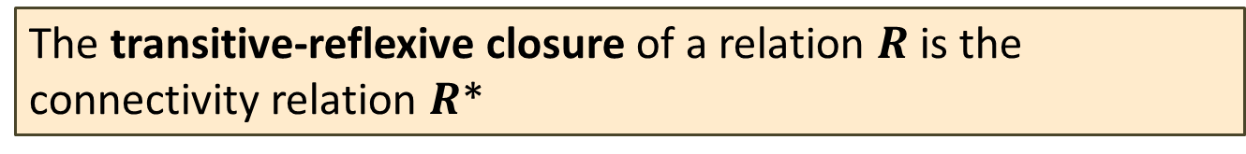
Transitive-Reflexive Closure
Relation with the minimum possible number of extra edges to make the relation both transitive and reflexive.
The transitive-reflexive closure of a relation $R$ is the connectivity relation $R$*

Slide 30
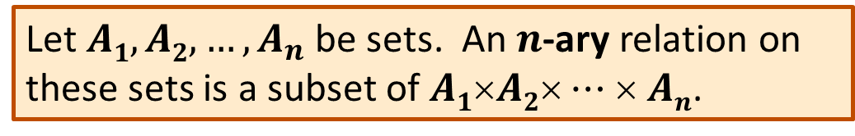
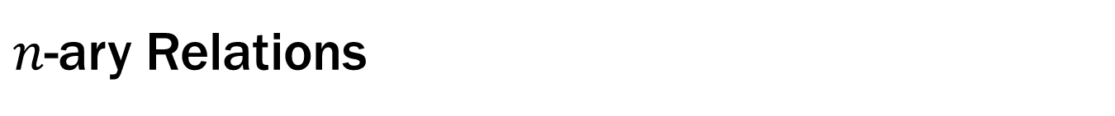
$n$-ary Relations
Let $A1, A2, …, A_{n}$ be sets. An $n$-ary relation on
these sets is a subset of $A1$×$A2$× $⋯$× $An$.

Slide 31
Relational Databases
STUDENT
Student_Name | ID_Number | Office | GPA
Knuth | 328012098 | 022 | 4.00
Von Neuman | 481080220 | 555 | 3.78
Russell | 238082388 | 022 | 3.85
Einstein | 238001920 | 022 | 2.11
Newton | 1727017 | 333 | 3.61
Karp | 348882811 | 022 | 3.98
Bernoulli | 2921938 | 022 | 3.21

Slide 32
Back to Languages

Slide 33
Selecting strings using labeled graphs as “machines”
Notes:
Example: 1101

Slide 34
Finite State Machines
The “double circle” means “the input is good if it ends here”
“Start here”
“If I get this symbol, follow the arrow…”
The circles are called “states”
We’re only in a single state at any point in time…

Slide 35
Which strings does this machine say are OK?

Slide 36
Which strings does this machine say are OK?
The set of all binary strings that end in 0

Slide 37
Finite State Machines
States
Transitions on input symbols
Start state and final states
The “language recognized” by the machine is the set of strings that reach a final state from the start
0
0
Old State | 0 | 1
s₀ | s₀ | s₁
s₁ | s₀ | s₂
s₂ | s₀ | s₃
s₃ | s₃ | s₃
s₀
1
s₁
1
s₂
1
s₃
0
0,1

Slide 38
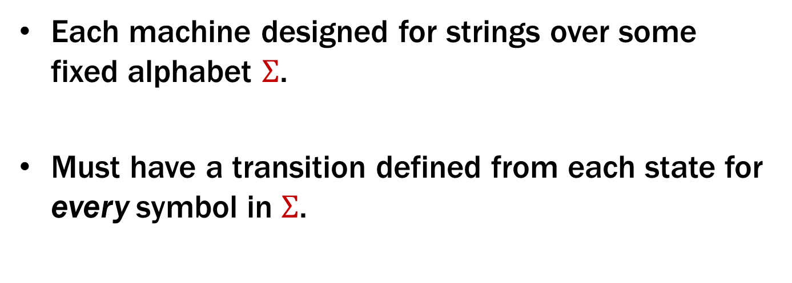
Finite State Machines
Each machine designed for strings over some fixed alphabet $Σ$.
Must have a transition defined from each state for every symbol in $Σ$.
0
0
Old State | 0 | 1
s₀ | s₀ | s₁
s₁ | s₀ | s₂
s₂ | s₀ | s₃
s₃ | s₃ | s₃
s₀
1
s₁
1
s₂
1
s₃
0
0,1

Slide 39
What language does this machine recognize?
0
0
Old State | 0 | 1
s₀ | s₀ | s₁
s₁ | s₀ | s₂
s₂ | s₀ | s₃
s₃ | s₃ | s₃
s₀
1
s₁
1
s₂
1
s₃
0
0,1

Slide 40
What language does this machine recognize?
The set of all binary strings that contain 111
or don’t end in 1
0
0
Old State | 0 | 1
s₀ | s₀ | s₁
s₁ | s₀ | s₂
s₂ | s₀ | s₃
s₃ | s₃ | s₃
s₀
1
s₁
1
s₂
1
s₃
0
0,1

