Slide 1
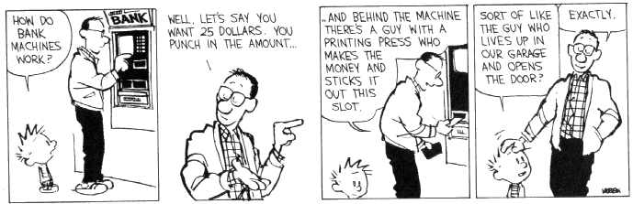
CSE 311: Foundations of Computing
Lecture 22: Finite State Machines

Slide 2
About the Midterm
We will release midterm grades at the end of the day today.
Preliminary information:
Median: 81 Average: 75 Standard Deviation: 19
Grade Distribution: 90+ 25% 80’s 29%
70’s 14% 60’s 11% 50’s 9% 40’s 7% <40 5%

Slide 3
Last class: Strings this machine says are OK?
The set of all binary strings that end in 0

Slide 4
Finite State Machines
States
Transitions on input symbols
Start state and final states
The “language recognized” by the machine is the set of strings that reach a final state from the start
0
0
Old State | 0 | 1
s₀ | s₀ | s₁
s₁ | s₀ | s₂
s₂ | s₀ | s₃
s₃ | s₃ | s₃
s₀
1
s₁
1
s₂
1
s₃
0
0,1

Slide 5
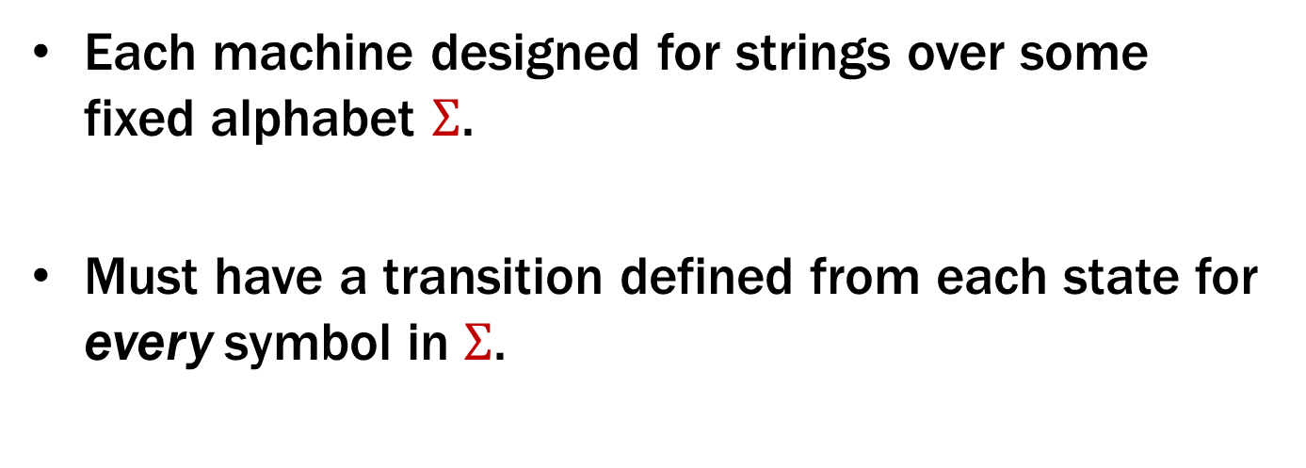
Finite State Machines
Each machine designed for strings over some fixed alphabet $Σ$.
Must have a transition defined from each state for every symbol in $Σ$.
0
0
Old State | 0 | 1
s₀ | s₀ | s₁
s₁ | s₀ | s₂
s₂ | s₀ | s₃
s₃ | s₃ | s₃
s₀
1
s₁
1
s₂
1
s₃
0
0,1

Slide 6
What language does this machine recognize?
0
0
Old State | 0 | 1
s₀ | s₀ | s₁
s₁ | s₀ | s₂
s₂ | s₀ | s₃
s₃ | s₃ | s₃
s₀
1
s₁
1
s₂
1
s₃
0
0,1

Slide 7
What language does this machine recognize?
The set of all binary strings that contain 111
or don’t end in 1
0
0
Old State | 0 | 1
s₀ | s₀ | s₁
s₁ | s₀ | s₂
s₂ | s₀ | s₃
s₃ | s₃ | s₃
s₀
1
s₁
1
s₂
1
s₃
0
0,1

Slide 8
Strings over {0, 1, 2}
M₁: Strings with an even number of 2’s
s₀
s₁
Notes:
What information are we going to keep track of in a state?

Slide 9
Strings over {0, 1, 2}
M₁: Strings with an even number of 2’s
2
0,1
0,1
s₀
s₁
2

Slide 10
State Machine Design Recipe
Given a language, how do you design a state machine for it?
Create states to remember enough
(about the portion of the input string that it has already seen)
to correctly answer “accept/reject” on the whole string after seeing the rest.
Add labeled edges to show how the memory (state) should be updated for each new symbol.
Notes:
What information are we going to keep track of in a state?

Slide 11
Strings over {0, 1, 2}
M₂: Strings where the sum of digits mod 3 is 0
Notes:
What information are we going to keep track of in a state?

Slide 12
Strings over {0, 1, 2}
M₂: Strings where the sum of digits mod 3 is 0
t₁
t₀
t₂
Notes:
What information are we going to keep track of in a state?

Slide 13
Strings over {0, 1, 2}
M₂: Strings where the sum of digits mod 3 is 0
0
t₁
1
1
0
2
2
0
t₀
2
t₂
1

Slide 14
What language does this machine recognize?
1
s₀
s₁
1
0
0
0
0
1
s₂
s₃
1

Slide 15
What language does this machine recognize?
1
s₀
s₁
1
0
0
0
0
1
s₂
s₃
1
The set of all binary strings with # of 1’s ≣ # of 0’s (mod 2)
(both are even or both are odd).
Can you think of a simpler description?

Slide 16
Strings over {0, 1, 2}
M₁: Strings with an even number of 2’s
M₂: Strings where the sum of digits mod 3 is 0
2
0,1
0,1
s₀
s₁
2
0
t₁
1
1
0
2
2
0
t₀
2
t₂
1

Slide 17
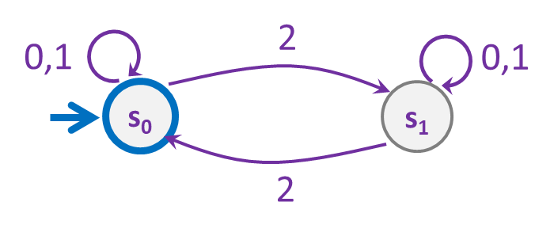
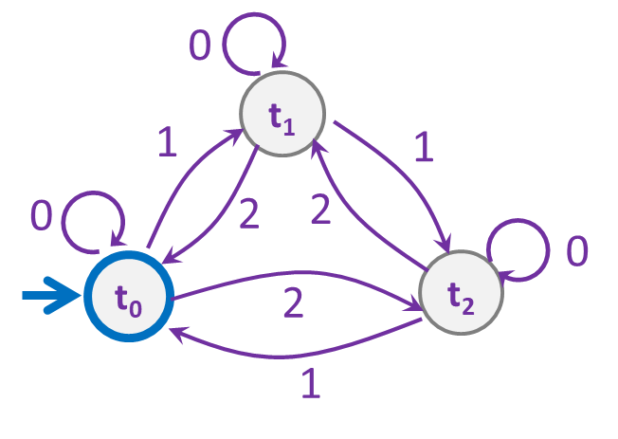
Strings over {0,1,2} w/ even number of 2’s and mod 3 sum 0
s₀t₀
s₁t₀
s₀t₁
s₁t₁
s₀t₂
s₁t₂

Slide 18
Strings over {0,1,2} w/ even number of 2’s and mod 3 sum 0
0
0
s₀t₀
s₁t₀
2
2
1
1
0
0
s₀t₁
2
2
s₁t₁
1
1
1
1
2
2
s₀t₂
s₁t₂
0
0

Slide 19
Strings over {0,1,2} w/ even number of 2’s OR mod 3 sum 0
0
0
s₀t₀
s₁t₀
2
2
1
1
0
0
s₀t₁
2
2
s₁t₁
1
1
1
1
2
2
s₀t₂
s₁t₂
0
0

Slide 20
The set of binary strings with a 1 in the 3rd position from the start
Notes:
Q: Keep track of what?

Slide 21
The set of binary strings with a 1 in the 3rd position from the start
R
0,1
0
s₀
0,1
s₁
0,1
s₂
1
A
0,1

Slide 22
The set of binary strings with a 1 in the 3rd position from the end
Notes:
Q: Keep track of what? (Last 3 digits)

Slide 23
3 bit shift register
“Remember the last three bits”
001
1
011
1
0
1
1
1
0
000
1
010
101
0
111
1
0
0
1
0
0
100
0
110

Slide 24
The set of binary strings with a 1 in the 3rd position from the end
0
1
0
1
0
1
0
1
00
01
10
11
1
1
1
1
0
0
0
0
001
1
011
1
0
1
1
1
0
000
1
010
101
0
111
1
0
0
1
0
0
100
0
110

Slide 25
The set of binary strings with a 1 in the 3rd position from the end
001
1
011
1
0
1
1
1
0
000
1
010
101
0
111
1
0
0
1
0
0
100
0
110

Slide 26
The beginning versus the end
R
0
0,1
s₀
0,1
s₁
0,1
s₂
1
A
0,1
001
1
011
1
0
1
1
1
0
000
1
010
101
0
111
1
0
0
0
1
0
100
0
110

Slide 27
Adding Output to Finite State Machines
So far, we have considered finite state machines that just accept/reject strings
called “Deterministic Finite Automata” or DFAs
Now we consider finite state machines with output
These are the kinds used as controllers

Slide 28


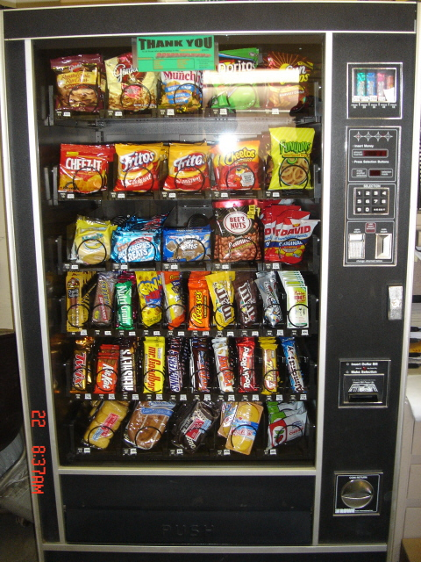
Vending Machine
Enter 15 cents in dimes or nickels
Press S or B for a candy bar

Slide 29
Vending Machine, v0.1
D
D
0
N
5
N
10
N, D
15
B, S
Basic transitions on N (nickel), D (dime), B (butterfinger), S (snickers)

Slide 30
Vending Machine, v0.2
0
D
N
15
D
D
B
0’ [B]
5
10
N
S
N
N
D
15’ [N]
B
S
N
0” [S]
D
Adding output to states: N – Nickel, S – Snickers, B – Butterfinger

Slide 31
Vending Machine, v1.0
B,S
0
D
N
15
B,S
D
B,S
B
D
B,S
D
N
S
N
0’ [B]
N
5
10
N
D
15’ [N]
B
N
S
D
B,S
N
N
0” [S]
D
B
15” [D]
S
D
Adding additional “unexpected” transitions to cover all symbols for each state

