Slide 1
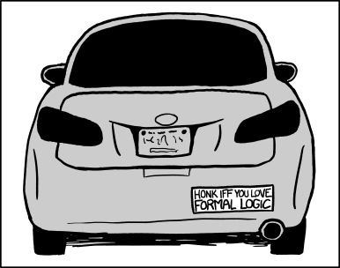
CSE 311: Foundations of Computing I
Lecture 1: Propositional Logic

Slide 2
What is logic and why do we need it?
Logic is a language, like English or Java, with its own
words and rules for combining words into sentences (syntax)
ways to assign meaning to words and sentences (semantics)
Why learn another language?
We know English and Java already?

Slide 3
Why not use English?
Turn right here…
We saw her duck
Buffalo buffalo Buffalo buffalo buffalo buffalo Buffalo buffalo
Natural languages can be unclear or imprecise
Does “right” mean the direction or now?
Does “duck” mean the animal or crouch down?
This means “Bison from Buffalo, that bison from Buffalo bully, themselves bully bison from Buffalo.

Slide 4
Why learn a new language?
We need a language of reasoning to
state sentences more precisely
state sentences more concisely
understand sentences more quickly
Formal logic has these properties

Slide 5
Propositions: building blocks of logic
A proposition is a statement that
is either true or false
is “well-formed”

Slide 6
Propositions: building blocks of logic
A proposition is a statement that
is either true or false
is “well-formed”
All cats are mammals
true
All mammals are cats
false

Slide 7
Are These Propositions?
2 + 2 = 5
x + 2 = 5389, where x is my PIN number
Akjsdf!
Who are you?
Every positive even integer can be written as the sum of two primes.
This is a proposition. It’s okay for propositions to be false.
This is a proposition. We don’t need to know what x is.
Not a proposition because it’s gibberish.
This is a question which means it doesn’t have a truth value.
This is a proposition. We don’t know if it’s true or false, but we know it’s one of them!

Slide 8
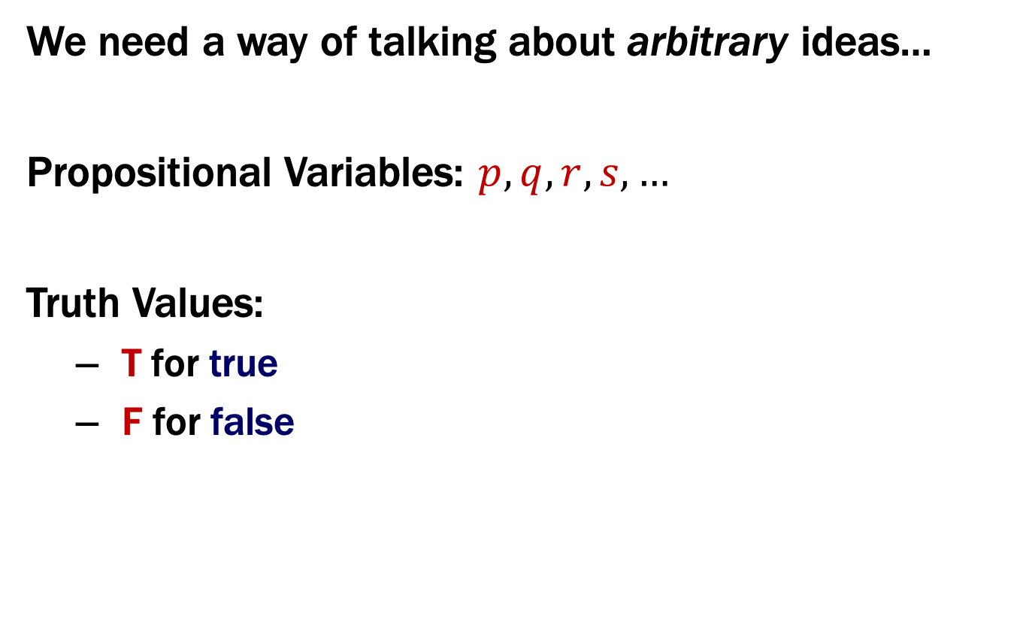
Propositions
We need a way of talking about arbitrary ideas…
Propositional Variables: $p, q, r, s,…$
Truth Values:
T for true
F for false

Slide 9
Familiar from Java
Java boolean represents a truth value
constants true and false
variables hold unknown values
Operators that calculate new truth values from given ones
unary: not (!)
binary: and (&&), or (||)

Slide 10
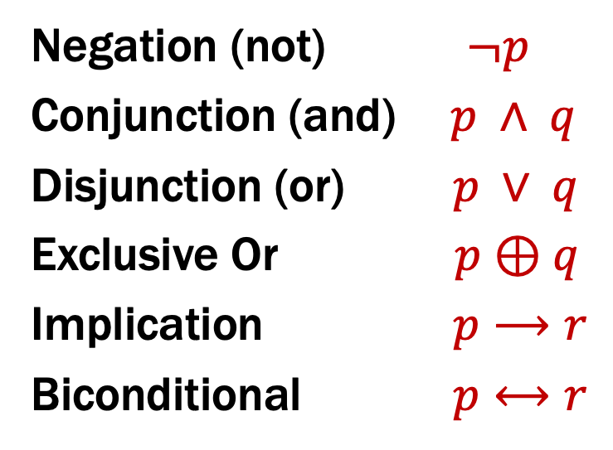
Logical Connectives
Negation (not) $¬p$
Conjunction (and) $p ∧ q$
Disjunction (or) $p ∨ q$
Exclusive Or $p⊕q$
Implication $p⟶r$
Biconditional $p⟷r$

Slide 11
Some Truth Tables
p | ¬p
T
F
p | q | p ∧ q
T | T
T | F
F | T
F | F
p | q | p ∨ q
T | T
T | F
F | T
F | F
p | q | p ⊕ q
T | T
T | F
F | T
F | F

Slide 12
Some Truth Tables
p | ¬p
T | F
F | T
p | q | p ∧ q
T | T | T
T | F | F
F | T | F
F | F | F
p | q | p ∨ q
T | T | T
T | F | T
F | T | T
F | F | F
p | q | p ⊕ q
T | T | F
T | F | T
F | T | T
F | F | F
Logic forces us to distinguish ∨ from ⊕

Slide 13
Implication
“If it’s raining, then I have my umbrella”
It’s useful to think of implications as promises. That is “Did I lie?”
p | r | p → r
T | T | T
T | F | F
F | T | T
F | F | T
 | It’s raining | It’s not raining
I have my umbrella
I do not have my umbrella

Slide 14
Implication
“If it’s raining, then I have my umbrella”
It’s useful to think of implications as promises. That is “Did I lie?”
The only lie is when:
(a) It’s raining AND
(b) I don’t have my umbrella
p | r | p → r
T | T | T
T | F | F
F | T | T
F | F | T
 | It’s raining | It’s not raining
I have my umbrella | No | No
I do not have my umbrella | Yes | No

Slide 15
Implication
“If the Seahawks won, then I was at the game.”
What’s the one scenario where I lied?
p | r | p → r
T | T | T
T | F | F
F | T | T
F | F | T
 | I was at the game | I wasn’t at the game
Seahawks won
Seahawks lost

Slide 16
Implication
“If the Seahawks won, then I was at the game.”
What’s the one scenario where I lied?
p | r | p → r
T | T | T
T | F | F
F | T | T
F | F | T
 | I was at the game | I wasn’t at the game
Seahawks won | Ok | I lied
Seahawks lost | Ok | Ok

Slide 17
Implication
“If it’s raining, then I have my umbrella”
Are these true?
2 + 2 = 4 → earth is a planet
2 + 2 = 5 → 26 is prime
Implication is not a causal relationship!
p | r | p → r
T | T | T
T | F | F
F | T | T
F | F | T
The fact that these are unrelated doesn’t make the statement false! “2 + 2 = 4” is true; “earth is a planet” is true. T→ T is true. So, the statement is true.
Again, these statements may or may not be related. “2 + 2 = 5” is false; so, the implication is true. (Whether 26 is prime or not is irrelevant).

Slide 18
$$p→r$$
(1) “I have collected all 151 Pokémon if I am a Pokémon master”
(2) “I have collected all 151 Pokémon only if I am a Pokémon master”

Slide 19
$$p→r$$
(1) “I have collected all 151 Pokémon if I am a Pokémon master”
(2) “I have collected all 151 Pokémon only if I am a Pokémon master”
These sentences are implications in opposite directions:
“Pokémon masters have all 151 Pokémon”
“People who have 151 Pokémon are Pokémon masters”
So, the implications are:
If I am a Pokémon master, then I have collected all 151 Pokémon.
If I have collected all 151 Pokémon, then I am a Pokémon master.

Slide 20
$$p→r$$
p | r | p → r
T | T | T
T | F | F
F | T | T
F | F | T
Implication:
p implies r
whenever p is true r must be true
if p then r
r if p
p only if r
p is sufficient for r
r is necessary for p

Slide 21

Biconditional: $p↔r$
p if and only if r (p iff r)
p implies r and r implies p
p is necessary and sufficient for r
p | r | p ↔ r
T | T | T
T | F | F
F | T | F
F | F | T

Slide 22
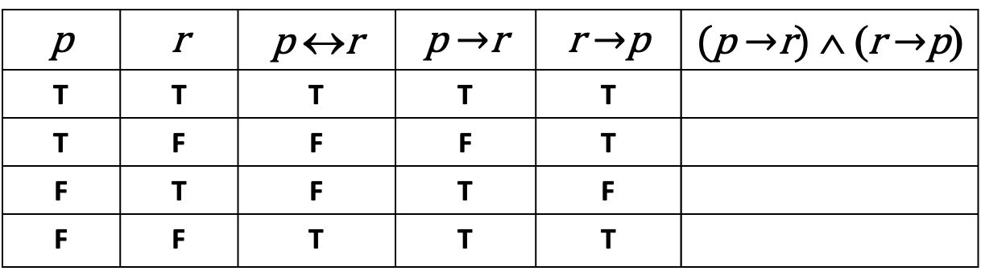
Biconditional: $p↔r$
p if and only if r (p iff r)
p implies r and r implies p
p is necessary and sufficient for r
p | r | p ↔r | p $→$r | r $→$p | (p $→$r) ∧ (r $→$p)
T | T | T | T | T
T | F | F | F | T
F | T | F | T | F
F | F | T | T | T

Slide 23
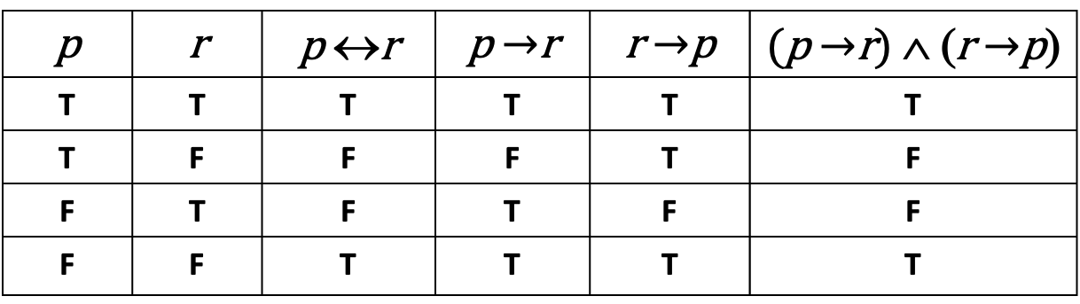
Biconditional: $p↔r$
p if and only if r (p iff r)
p implies r and r implies p
p is necessary and sufficient for r
p | r | p ↔r | p $→$r | r $→$p | (p $→$r) ∧ (r $→$p)
T | T | T | T | T | T
T | F | F | F | T | F
F | T | F | T | F | F
F | F | T | T | T | T

Slide 24
A Compound Proposition
“Garfield has black stripes if he is an orange cat and likes lasagna, and he is an orange cat or does not like lasagna”
We’d like to understand what this proposition means.
Notes:
Practical example: “Show the notification to the user if it’s their second login or they’ve used the it for two weeks and haven’t tried the new feature unless they did use other new feature.”

Slide 25
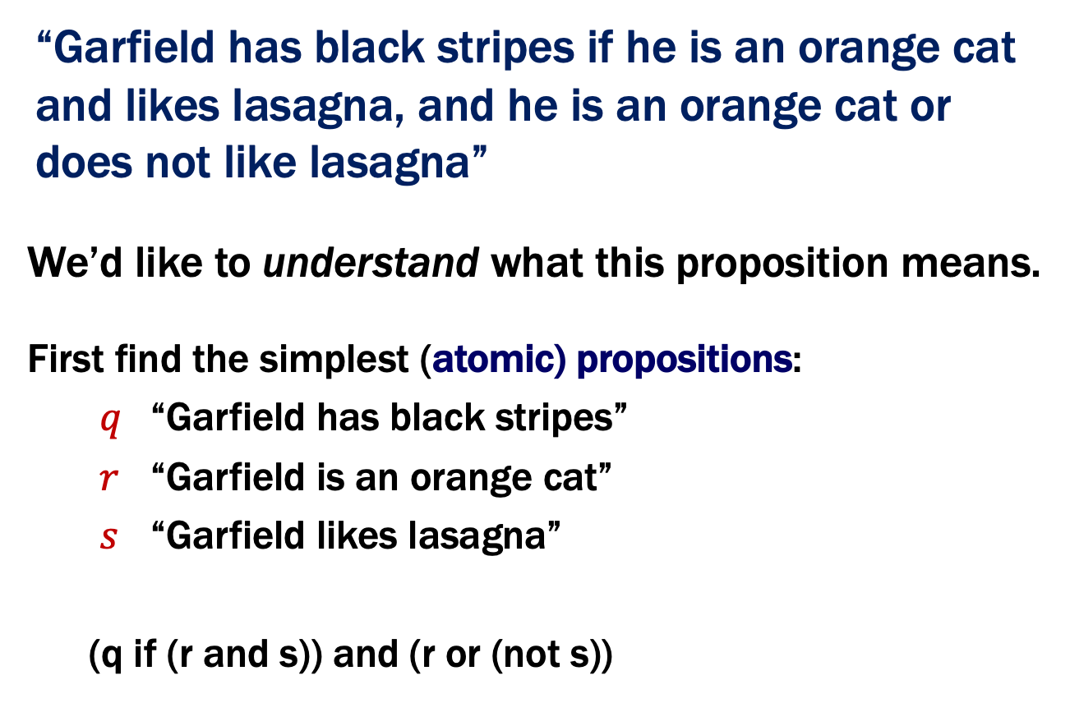
A Compound Proposition
“Garfield has black stripes if he is an orange cat and likes lasagna, and he is an orange cat or does not like lasagna”
We’d like to understand what this proposition means.
First find the simplest (atomic) propositions:
$q$ “Garfield has black stripes”
$r$ “Garfield is an orange cat”
$s$ “Garfield likes lasagna”
(q if (r and s)) and (r or (not s))
Notes:
NOTE: how important that comma is

Slide 26
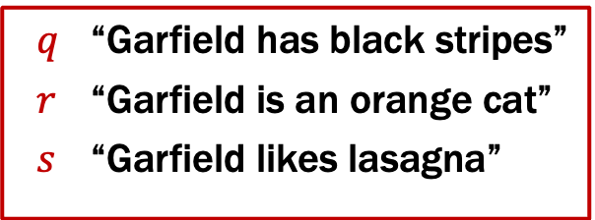
Logical Connectives
Negation (not) $¬p$
Conjunction (and) $p ∧ q$
Disjunction (or) $p ∨ q$
Exclusive Or $p⊕q$
Implication $p⟶r$
Biconditional $p⟷r$
$q$ “Garfield has black stripes”
$r$ “Garfield is an orange cat”
$s$ “Garfield likes lasagna”
“Garfield has black stripes if he is an orange cat and likes lasagna, and he is an orange cat or does not like lasagna”
(q if (r and s)) and (r or (not s))

Slide 27

Logical Connectives
Negation (not) $¬p$
Conjunction (and) $p ∧ q$
Disjunction (or) $p ∨ q$
Exclusive Or $p⊕q$
Implication $p⟶r$
Biconditional $p⟷r$
$q$ “Garfield has black stripes”
$r$ “Garfield is an orange cat”
$s$ “Garfield likes lasagna”
“Garfield has black stripes if he is an orange cat and likes lasagna, and he is an orange cat or does not like lasagna”
(q if (r and s)) and (r or (not s))
((r $∧$ s) $⟶$ q) $∧$ (r $∨$ $¬$s)

Slide 28
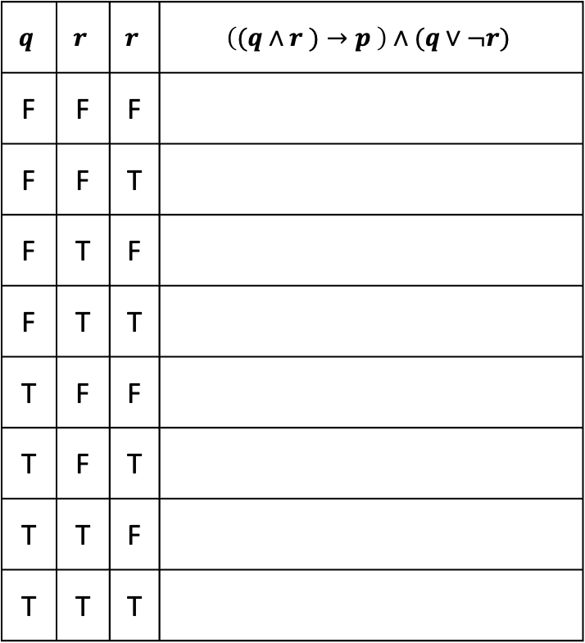
Analyzing the Garfield Sentence with a Truth Table
$$q$$ | $$r$$ | $$r$$ | $$\left((q∧r )→p \right)∧(q∨¬r)$$
F | F | F
F | F | T
F | T | F
F | T | T
T | F | F
T | F | T
T | T | F
T | T | T

Slide 29
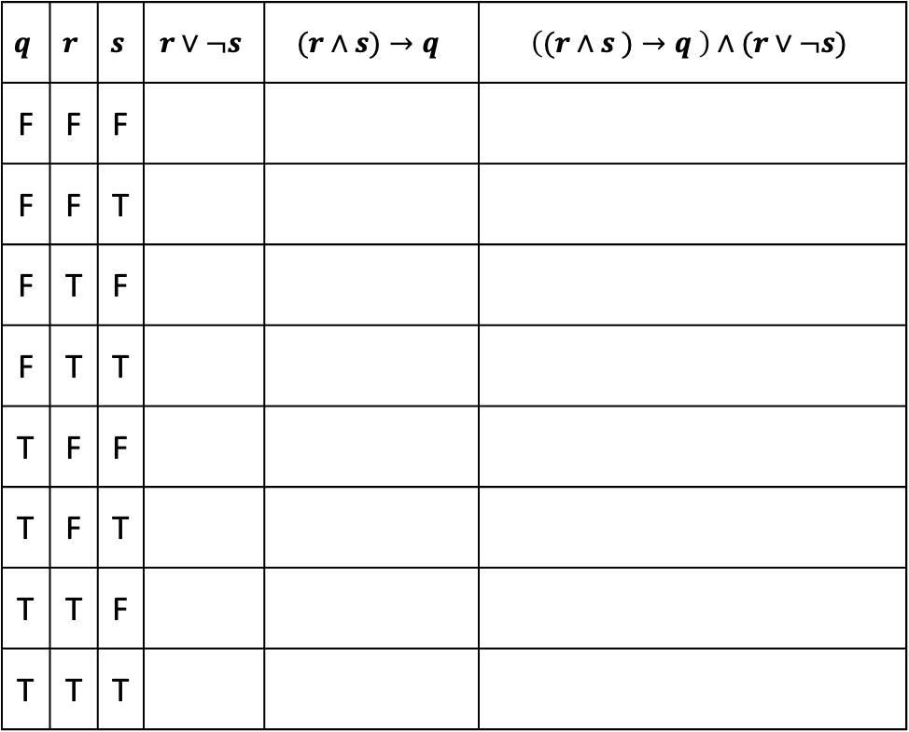
Analyzing the Garfield Sentence with a Truth Table
$$q$$ | $$r$$ | $$s$$ | $$r∨¬s$$ | $$(r∧s)→q$$ | $$\left((r∧s )→q \right)∧(r∨¬s)$$
F | F | F
F | F | T
F | T | F
F | T | T
T | F | F
T | F | T
T | T | F
T | T | T

Slide 30
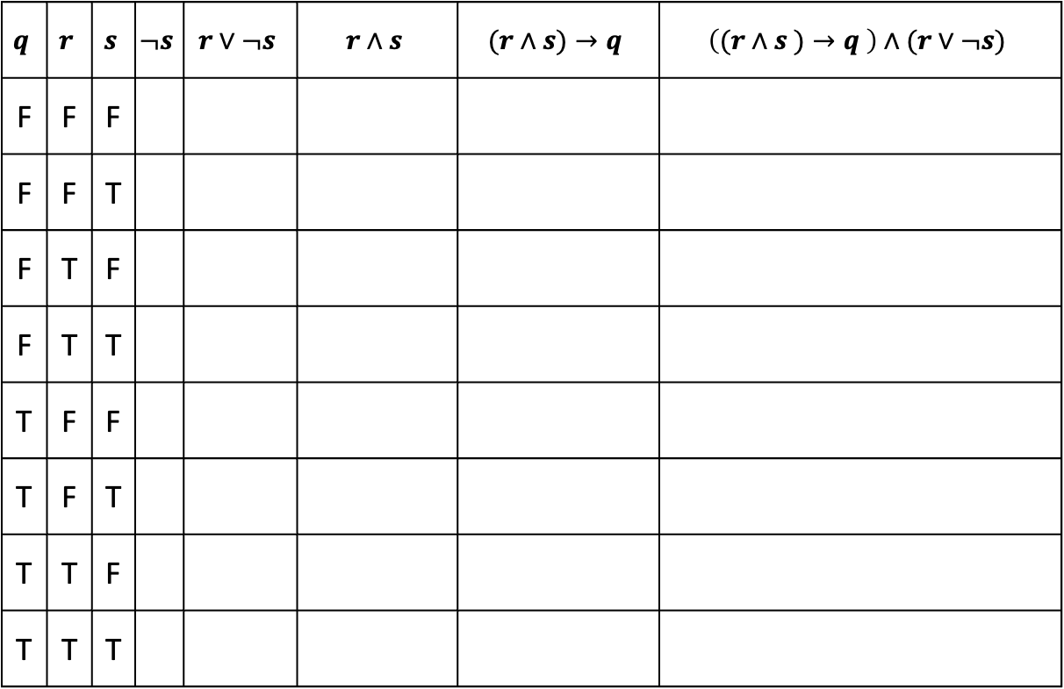
Analyzing the Garfield Sentence with a Truth Table
$$q$$ | $$r$$ | $$s$$ | $$¬s$$ | $$r∨¬s$$ | $$r∧s$$ | $$(r∧s)→q$$ | $$\left((r∧s )→q \right)∧(r∨¬s)$$
F | F | F
F | F | T
F | T | F
F | T | T
T | F | F
T | F | T
T | T | F
T | T | T

Slide 31
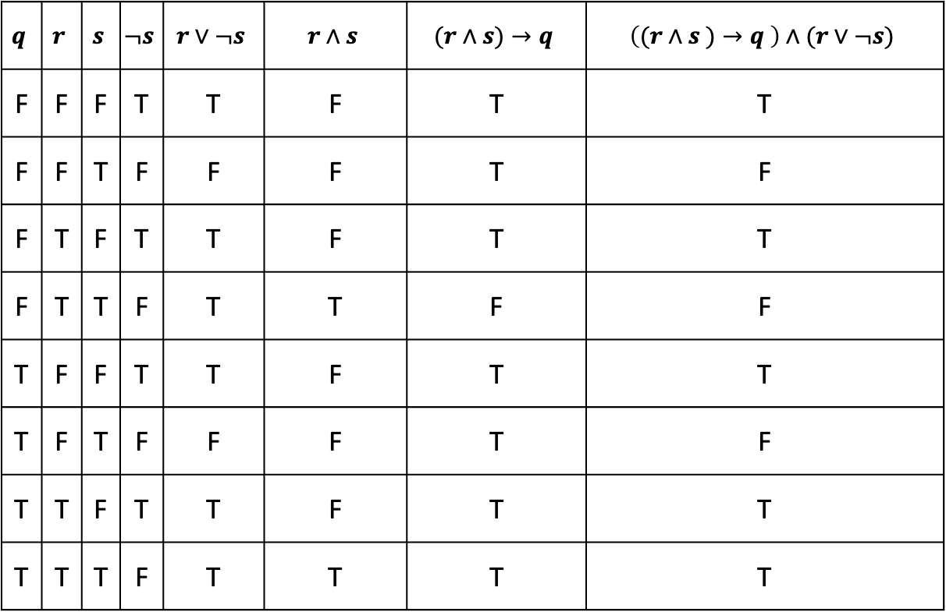
Analyzing the Garfield Sentence with a Truth Table
$$q$$ | $$r$$ | $$s$$ | $$¬s$$ | $$r∨¬s$$ | $$r∧s$$ | $$(r∧s)→q$$ | $$\left((r∧s )→q \right)∧(r∨¬s)$$
F | F | F | T | T | F | T | T
F | F | T | F | F | F | T | F
F | T | F | T | T | F | T | T
F | T | T | F | T | T | F | F
T | F | F | T | T | F | T | T
T | F | T | F | F | F | T | F
T | T | F | T | T | F | T | T
T | T | T | F | T | T | T | T
Notes:
From our earlier example, the Ts would tell us when to show the notification

Slide 32
Study Groups
Recall from the syllabus:
collaboration is encouraged
but you must write your solution on your own
Will send out a form to fill out if you want to be matched with other students into a study group
form should be coming tomorrow
match based on available time & frequency
about 4 people per group

Slide 33

A first application of logic
“If I were to ask you out, would your answer to that question be the same as your answer to this one?”
Notes:
If he says no, his answer to the other question is different, so it’s yes.

Slide 34
Why not use Java?
What does this code do:
public static boolean mystery(int x) {
for (int r = 2; r < x; r++) {
for (int q = 2; q < x; q++) {
if (r*q == x)
return false;
}
}
}
return x > 1;
}
Determines if x is a prime number
Programming languages can be verbose
Notes:
The code says how it computes whether x is a prime number not just what it returns.

