Slide 1
CSE 311: Foundations of Computing
Lecture 2: More Logic, Equivalence & Digital Circuits

Slide 2
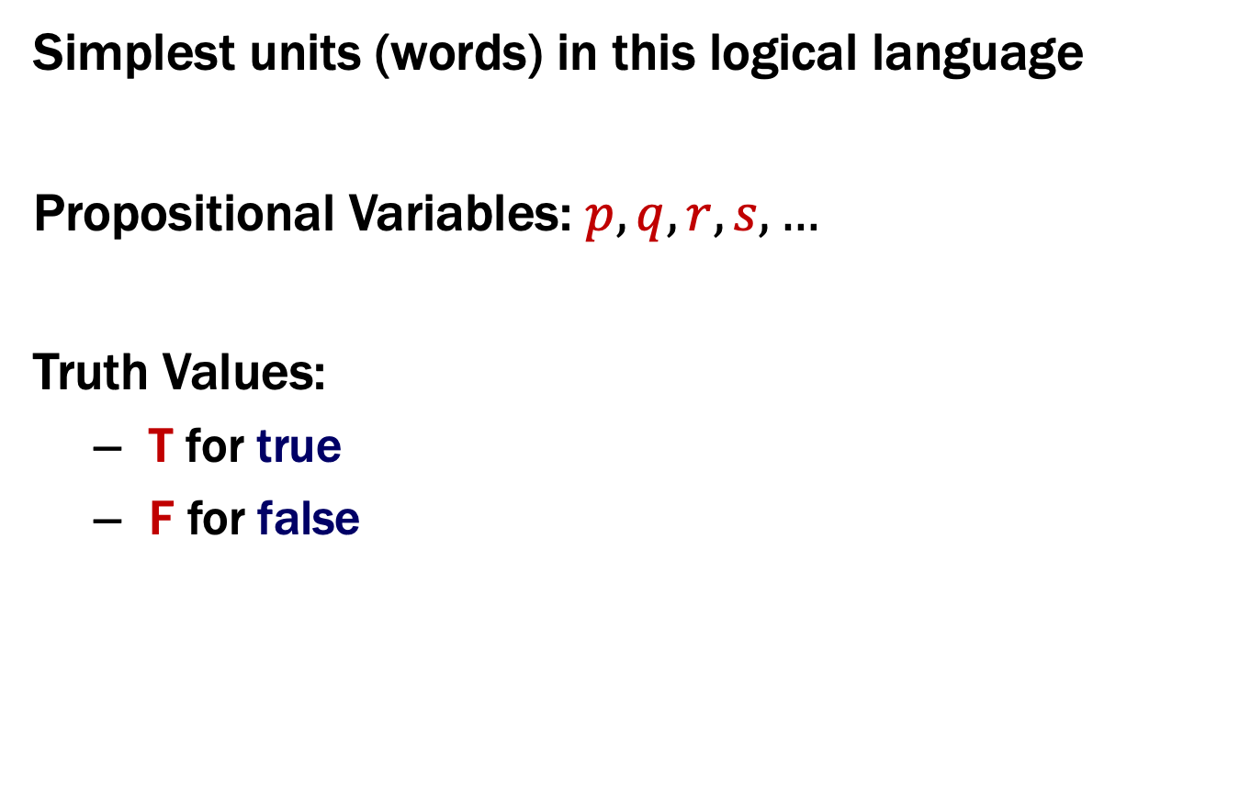
Last class: Atomic Propositions
Simplest units (words) in this logical language
Propositional Variables: $p, q, r, s,…$
Truth Values:
T for true
F for false

Slide 3
Last class: Some Connectives & Truth Tables
Negation (not)
Conjunction (and)
p | ¬p
T | F
F | T
p | q | p ∧ q
T | T | T
T | F | F
F | T | F
F | F | F
Disjunction (or)
Exclusive Or
p | q | p ∨ q
T | T | T
T | F | T
F | T | T
F | F | F
p | q | p ⊕ q
T | T | F
T | F | T
F | T | T
F | F | F

Slide 4
Last class: Implication
“If it’s raining, then I have my umbrella”
In English, we can also write
“I have my umbrella if it’s raining.”
p | r | p → r
T | T | T
T | F | F
F | T | T
F | F | T
Notes:
F when premise is F is called “and”

Slide 5
$$p→r$$
p | r | p → r
T | T | T
T | F | F
F | T | T
F | F | T
Implication:
p implies r
whenever p is true r must be true
if p then r
r if p
p only if r
p is sufficient for r
r is necessary for p

Slide 6

Biconditional: $p↔r$
p if and only if r (p iff r)
p implies r and r implies p
p is necessary and sufficient for r
p | r | p ↔ r
T | T | T
T | F | F
F | T | F
F | F | T

Slide 7

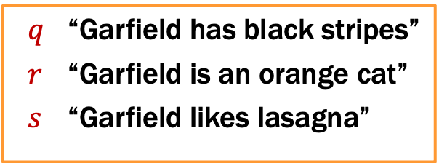
Back to Garfield...
$q$ “Garfield has black stripes”
$r$ “Garfield is an orange cat”
$s$ “Garfield likes lasagna”
“Garfield has black stripes if he is an orange cat and likes lasagna, and he is an orange cat or does not like lasagna”
(q if (r and s)) and (r or (not s))
(q “if” (r $∧$ s)) $∧$ (r $∨$ $¬$s)

Slide 8

Back to Garfield...
$q$ “Garfield has black stripes”
$r$ “Garfield is an orange cat”
$s$ “Garfield likes lasagna”
“Garfield has black stripes if he is an orange cat and likes lasagna, and he is an orange cat or does not like lasagna”
(q if (r and s)) and (r or (not s))
(q “if” (r $∧$ s)) $∧$ (r $∨$ $¬$s)
((r $∧$ s)$⟶$q) $∧$ (r $∨$ $¬$s)

Slide 9
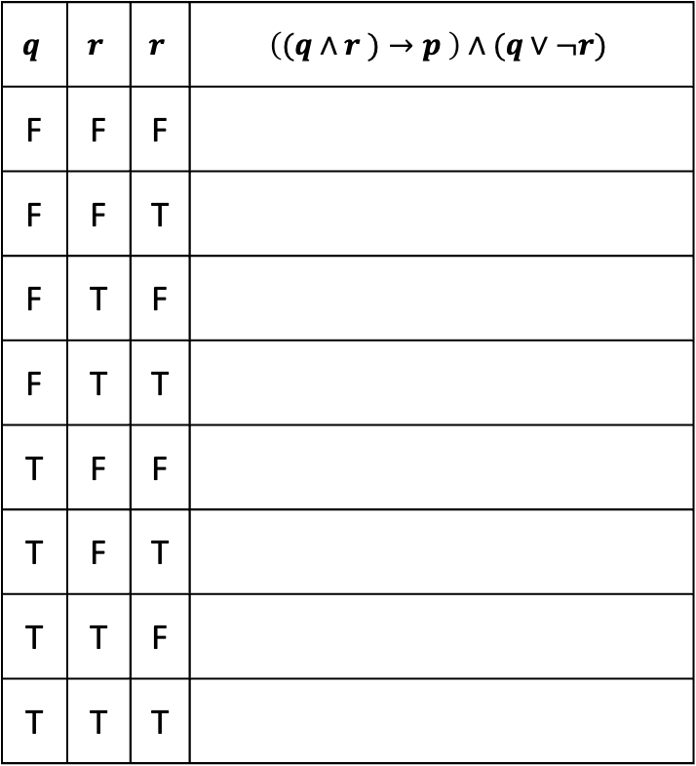
Analyzing the Garfield Sentence with a Truth Table
$$q$$ | $$r$$ | $$r$$ | $$\left((q∧r )→p \right)∧(q∨¬r)$$
F | F | F
F | F | T
F | T | F
F | T | T
T | F | F
T | F | T
T | T | F
T | T | T

Slide 10
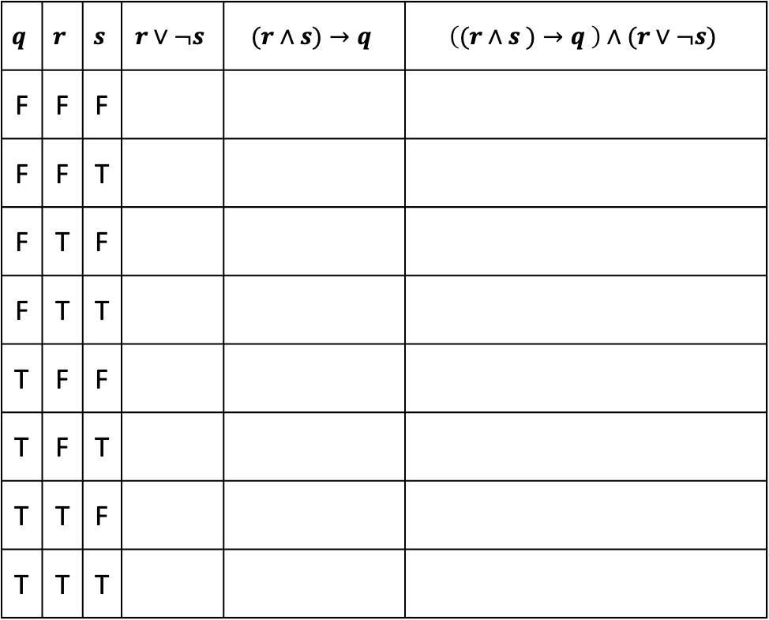
Analyzing the Garfield Sentence with a Truth Table
$$q$$ | $$r$$ | $$s$$ | $$r∨¬s$$ | $$(r∧s)→q$$ | $$\left((r∧s )→q \right)∧(r∨¬s)$$
F | F | F
F | F | T
F | T | F
F | T | T
T | F | F
T | F | T
T | T | F
T | T | T

Slide 11
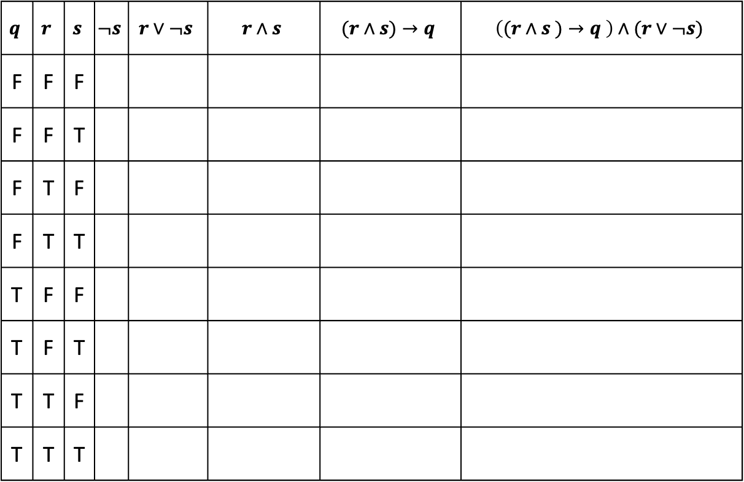
Analyzing the Garfield Sentence with a Truth Table
$$q$$ | $$r$$ | $$s$$ | $$¬s$$ | $$r∨¬s$$ | $$r∧s$$ | $$(r∧s)→q$$ | $$\left((r∧s )→q \right)∧(r∨¬s)$$
F | F | F
F | F | T
F | T | F
F | T | T
T | F | F
T | F | T
T | T | F
T | T | T

Slide 12
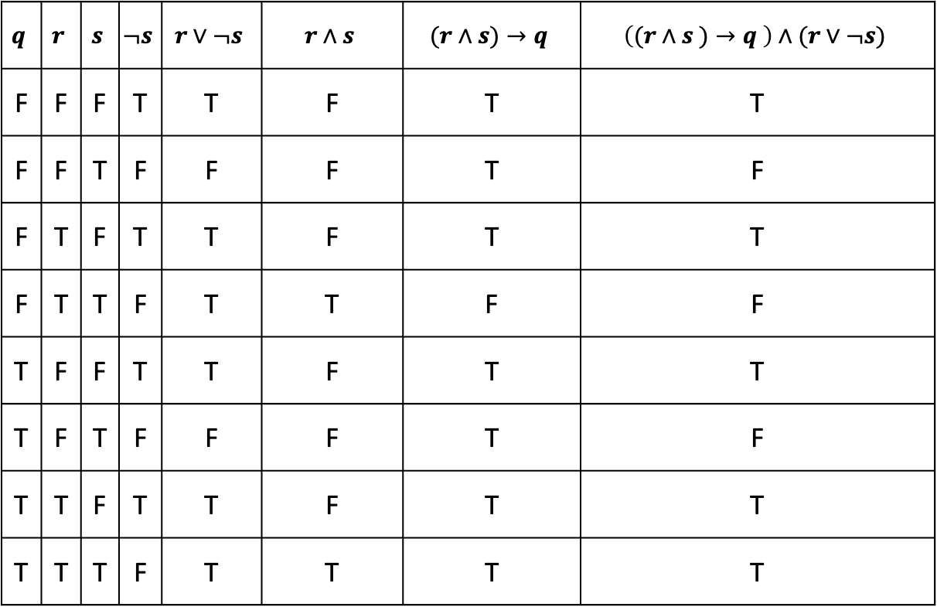
Analyzing the Garfield Sentence with a Truth Table
$$q$$ | $$r$$ | $$s$$ | $$¬s$$ | $$r∨¬s$$ | $$r∧s$$ | $$(r∧s)→q$$ | $$\left((r∧s )→q \right)∧(r∨¬s)$$
F | F | F | T | T | F | T | T
F | F | T | F | F | F | T | F
F | T | F | T | T | F | T | T
F | T | T | F | T | T | F | F
T | F | F | T | T | F | T | T
T | F | T | F | F | F | T | F
T | T | F | T | T | F | T | T
T | T | T | F | T | T | T | T
Notes:
If we know q = r = T, then we can see that the expression is T even without knowing s

Slide 13
Converse, Contrapositive
Implication:
p → r
Converse:
r → p
Contrapositive:
¬r → ¬p
Inverse:
¬p → ¬r
Consider
p: x is divisible by 2
r: x is divisible by 4
p → r
r → p
¬r → ¬p
¬p → ¬r

Slide 14
Converse, Contrapositive
Implication:
p → r
Converse:
r → p
Contrapositive:
¬r → ¬p
Inverse:
¬p → ¬r
Consider
p: x is divisible by 2
r: x is divisible by 4
 | Divisible By 2 | Not Divisible By 2
Divisible By 4
Not Divisible By 4
p → r
r → p
¬r → ¬p
¬p → ¬r

Slide 15
Converse, Contrapositive
Implication:
p → r
Converse:
r → p
Contrapositive:
¬r → ¬p
Inverse:
¬p → ¬r
Consider
p: x is divisible by 2
r: x is divisible by 4
 | Divisible By 2 | Not Divisible By 2
Divisible By 4 | 4,8,12,... | Impossible
Not Divisible By 4 | 2,6,10,... | 1,3,5,...
p → r
r → p
¬r → ¬p
¬p → ¬r
Notes:
p=T is first column, r=T is first row

Slide 16
Converse, Contrapositive
Implication:
p → r
Converse:
r → p
Contrapositive:
¬r → ¬p
Inverse:
¬p → ¬r
Consider
p: x is divisible by 2
r: x is divisible by 4
 | Divisible By 2 | Not Divisible By 2
Divisible By 4 | 4,8,12,... | Impossible
Not Divisible By 4 | 2,6,10,... | 1,3,5,...
p → r | F
r → p | T
¬r → ¬p | F
¬p → ¬r | T

Slide 17
Converse, Contrapositive
Implication:
p → r
Converse:
r → p
Contrapositive:
¬r → ¬p
Inverse:
¬p → ¬r
How do these relate to each other?
p | r | p → r | r → p | ¬p | ¬r | ¬p → ¬r | ¬r → ¬p
T | T
T | F
F | T
F | F

Slide 18
Converse, Contrapositive
Implication:
p → r
Converse:
r → p
Contrapositive:
¬r → ¬p
Inverse:
¬p → ¬r
An implication and it’s contrapositive have the same truth value!
p | r | p → r | r → p | ¬p | ¬r | ¬p → ¬r | ¬r → ¬p
T | T | T | T | F | F | T | T
T | F | F | T | F | T | T | F
F | T | T | F | T | F | F | T
F | F | T | T | T | T | T | T

Slide 19
Application: Digital Circuits
Computing With Logic
T corresponds to 1 or “high” voltage
F corresponds to 0 or “low” voltage
Gates
Take inputs and produce outputs (functions)
Several kinds of gates
Correspond to propositional connectives (most of them)

Slide 20



Last class: AND, OR, NOT Gates
p | q | OUT
1 | 1 | 1
1 | 0 | 0
0 | 1 | 0
0 | 0 | 0
p | q | p ∧ q
T | T | T
T | F | F
F | T | F
F | F | F
AND Gate
p
q
AND
OUT
OR Gate
p | q | OUT
1 | 1 | 1
1 | 0 | 1
0 | 1 | 1
0 | 0 | 0
p | q | p ∨ q
T | T | T
T | F | T
F | T | T
F | F | F
p
q
OR
OUT
NOT Gate
p | OUT
1 | 0
0 | 1
p | ¬ p
T | F
F | T
p
NOT
OUT

Slide 21

Combinational Logic Circuits
p
NOT
AND
OUT
q
NOT
AND
r
s
OR
Values get sent along wires connecting gates

Slide 22

Combinational Logic Circuits
p
NOT
AND
OUT
q
NOT
AND
r
s
OR
Values get sent along wires connecting gates

Slide 23
Combinational Logic Circuits
p
AND
q
NOT
OR
OUT
r
AND
Wires can send one value to multiple gates!

Slide 24

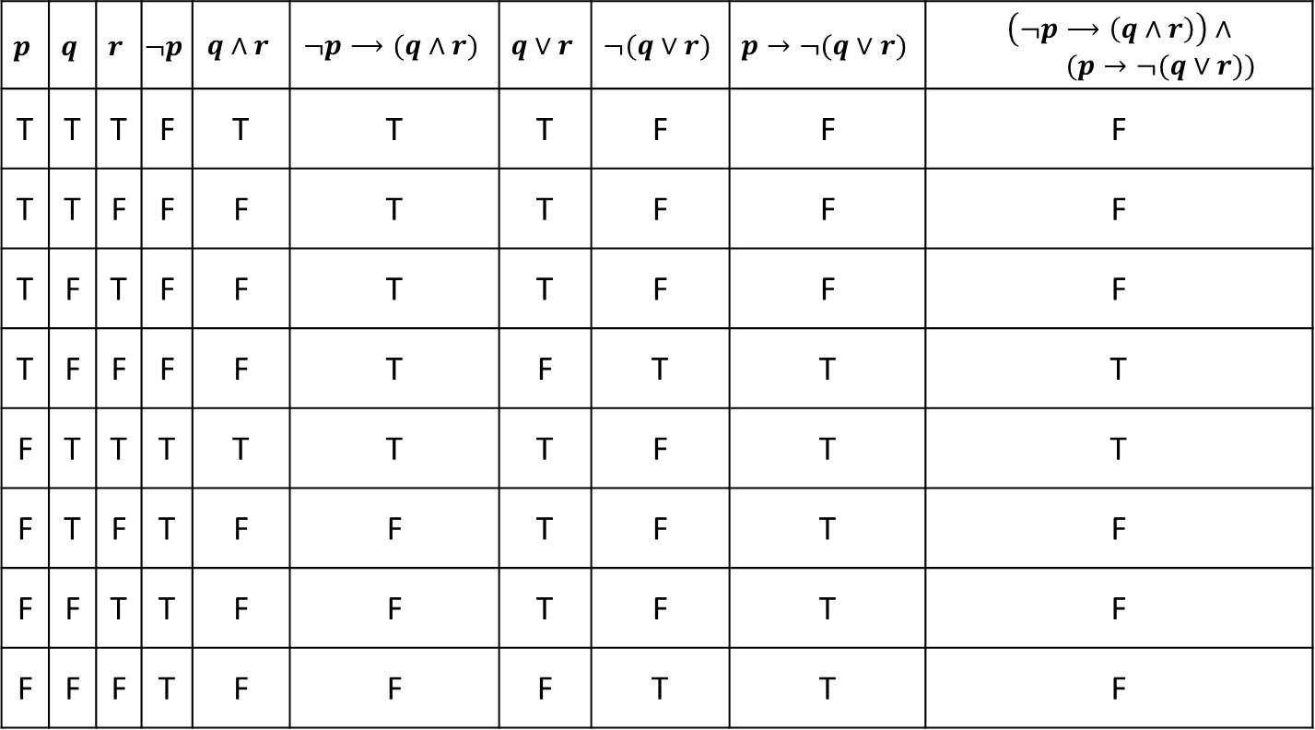
Combinational Logic Circuits
p
AND
q
NOT
OR
OUT
r
AND
Wires can send one value to multiple gates!
$$\left(p∧¬q \right)∨(¬q∧r)$$

Slide 25
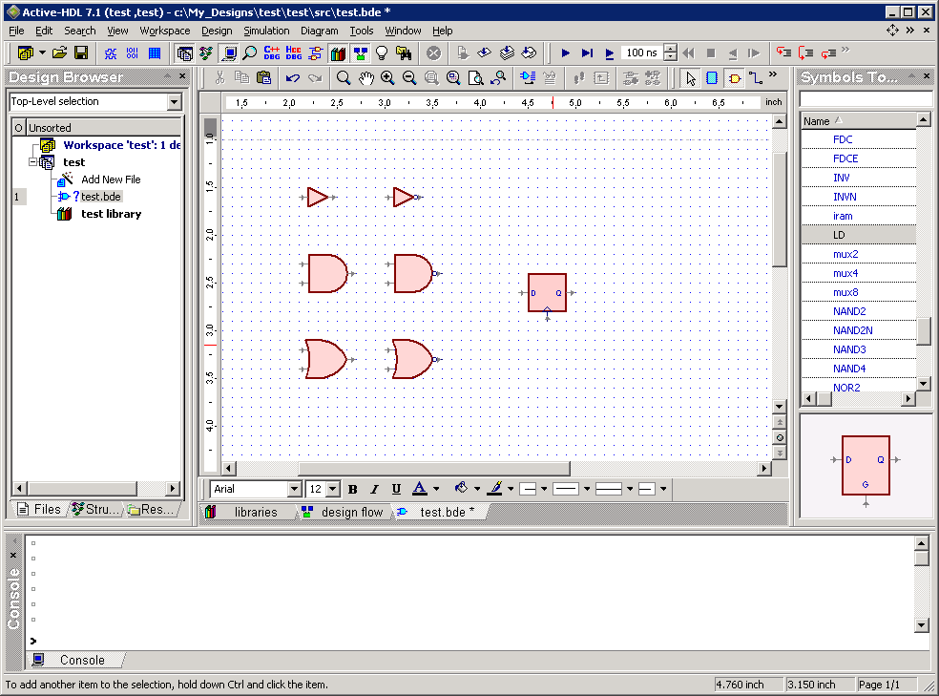
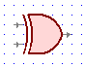

Other Useful Gates
NAND
$¬(p∧q)$
NOR
$¬(p∨q)$
XOR $p⊕q$
XNOR $p↔q$
p q out 0 0 1 0 1 1 1 0 1
1 1 0
p
q
out
p q out 0 0 1 0 1 0 1 0 0
1 1 0
p
out
q
p q out 0 0 0 0 1 1 1 0 1
1 1 0
p
q
out
p q out
0 0 1 0 1 0 1 0 0
1 1 1
p
q
out

Slide 26
Tautologies!
Terminology: A compound proposition is a…
Tautology if it is always true
Contradiction if it is always false
Contingency if it can be either true or false
p ∨ ¬p
p ⊕ p
(p → r) ∧ p

Slide 27
Tautologies!
Terminology: A compound proposition is a…
Tautology if it is always true
Contradiction if it is always false
Contingency if it can be either true or false
p ∨ ¬p
p ⊕ p
(p → r) ∧ p
This is a tautology. It’s called the “law of the excluded middle”.
If p is true, then p ∨ ¬p is true. If p is false, then p ∨ ¬p is true.
This is a contradiction. It’s always false no matter what truth value p takes on.
This is a contingency. When p=T, r=T, (T → T)∧T is true.
When p=T, r=F, (T → F)∧T is false.

Slide 28
Logical Equivalence
A = B means A and B are identical “strings”:
p ∧ r = p ∧ r
p ∧ r ≠ r ∧ p

Slide 29
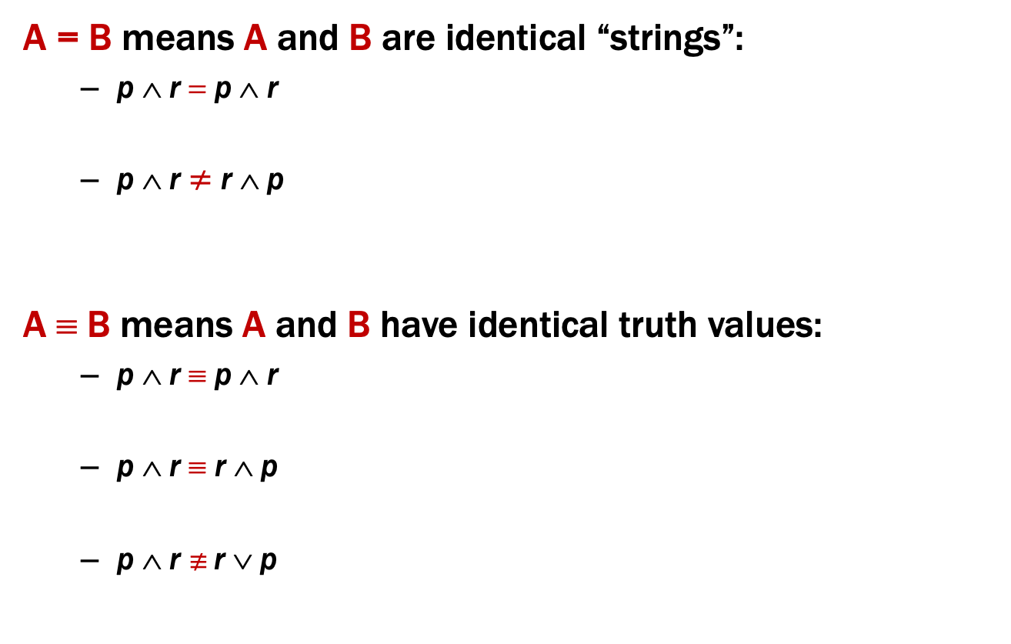
Logical Equivalence
A = B means A and B are identical “strings”:
p ∧ r = p ∧ r
p ∧ r ≠ r ∧ p
A ≡ B means A and B have identical truth values:
p ∧ r ≡ p ∧ r
p ∧ r ≡ r ∧ p
p ∧ r $≢$ r ∨ p
These are equal, because they are character-for-character identical.
These are NOT equal, because they are different sequences of characters. They “mean” the same thing though.

Slide 30
Logical Equivalence
A = B means A and B are identical “strings”:
p ∧ r = p ∧ r
p ∧ r ≠ r ∧ p
A ≡ B means A and B have identical truth values:
p ∧ r ≡ p ∧ r
p ∧ r ≡ r ∧ p
p ∧ r $≢$ r ∨ p
These are equal, because they are character-for-character identical.
These are NOT equal, because they are different sequences of characters. They “mean” the same thing though.
Two formulas that are equal also are equivalent.
These two formulas have the same truth table!
When p=T and r=F, p ∧ r is false, but p ∨ r is true!

Slide 31
A ↔ B vs. A ≡ B
A ↔ B is a proposition that may be true or false depending on the truth values of A and B.
A ≡ B is an assertion over all possible truth values that A and B always have the same truth values.
A ≡ B and (A ↔ B) ≡ T have the same meaning
as does “A ↔ B is a tautology”

Slide 32
Logical Equivalence A ≡ B
A ≡ B is an assertion that two propositions A and B always have the same truth values.
A ≡ B and (A ↔ B) ≡ T have the same meaning.
p ∧ r ≡ r ∧ p
p | r | p ∧ r | r ∧ p | (p ∧ r) ↔ (r ∧ p)
T | T | T | T | T
T | F | F | F | T
F | T | F | F | T
F | F | F | F | T

