Slide 1
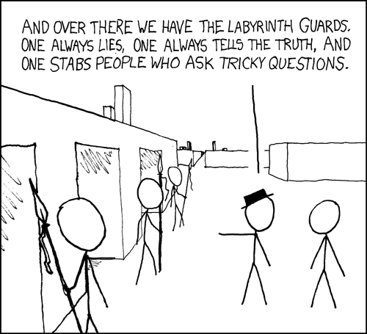
CSE 311: Foundations of Computing
Lecture 3: Digital Circuits & Equivalence

Slide 2
Review: Propositional Logic
Propositions
atomic propositions are T/F-valued variables
combined using logical connectives (not, and, or, etc.)
can be described by a truth table
shows the truth value of the proposition in
each combination of truth values of the atomic propositions
Applications
understanding complex English sentences
modeling the input/output behavior of circuits
(more to come)
p | q | p ∧ q
T | T | T
T | F | F
F | T | F
F | F | F

Slide 3
Last class: Logical Equivalence A ≡ B
A ≡ B is an assertion that two propositions A and B always have the same truth values.
p ∧ r ≡ r ∧ p
p | r | p ∧ r | r ∧ p
T | T | T | T
T | F | F | F
F | T | F | F
F | F | F | F

Slide 4
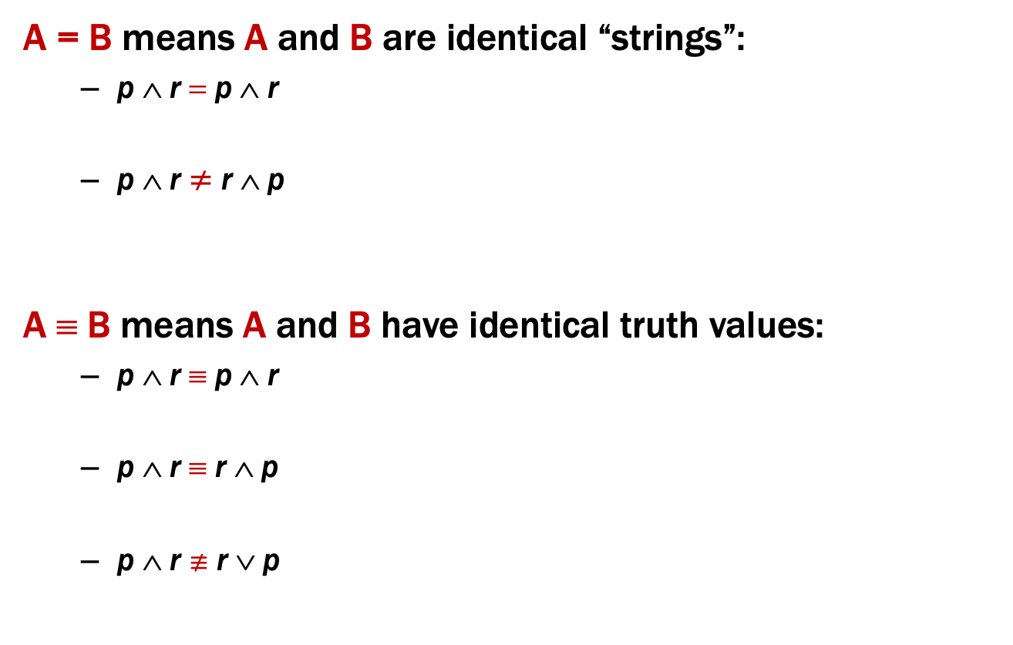
Last class: Logical Equivalence A ≡ B
A = B means A and B are identical “strings”:
p ∧ r = p ∧ r
p ∧ r ≠ r ∧ p
A ≡ B means A and B have identical truth values:
p ∧ r ≡ p ∧ r
p ∧ r ≡ r ∧ p
p ∧ r $≢$ r ∨ p

Slide 5

Last class: Logical Equivalence A ≡ B
A ≡ B is an assertion that two propositions A and B always have the same truth values.
A ≡ B and (A ↔ B) ≡ T have the same meaning.
p ∧ r ≡ r ∧ p
p | r | p ∧ r | r ∧ p | (p ∧ r) ↔ (r ∧ p)
T | T | T | T | T
T | F | F | F | T
F | T | F | F | T
F | F | F | F | T
p ∧ r $≢$ r ∨ p
When p=T and r=F, p ∧ r is false, but r ∨ p is true

Slide 6
De Morgan’s Laws
¬(p ∧ r) ≡ ¬p ∨ ¬r
¬(p ∨ r) ≡ ¬p ∧ ¬r
Negate the statement:
“My code compiles or there is a bug.”
To negate the statement, ask “when is the original statement false”.
It’s false when not(my code compiles) AND not(there is a bug).
Translating back into English, we get:
My code doesn’t compile and there is not a bug.

Slide 7
De Morgan’s Laws
Example: ¬(p ∧ r) ≡ ¬p ∨ ¬r
p | r | ¬p | ¬r | ¬p ∨ ¬r | p ∧ r | ¬(p ∧ r)
T | T | F | F | F | T | F
T | F | F | T | T | F | T
F | T | T | F | T | F | T
F | F | T | T | T | F | T

Slide 8
De Morgan’s Laws
¬(p ∧ r) ≡ ¬p ∨ ¬r
¬(p ∨ r) ≡ ¬p ∧ ¬r
if (!(front != null && value > front.data)) {
front = new ListNode(value, front);
} else {
ListNode current = front;
while (current.next != null && current.next.data < value))
current = current.next;
current.next = new ListNode(value, current.next);
}

Slide 9
De Morgan’s Laws
¬(p ∧ r) ≡ ¬p ∨ ¬r
¬(p ∨ r) ≡ ¬p ∧ ¬r
!(front != null && value > front.data)
≡
front == null || value <= front.data

Slide 10
Law of Implication
p → r ≡ ¬p ∨ r
p | r | p → r | ¬ p | ¬ p ∨ r
T | T
T | F
F | T
F | F

Slide 11
Law of Implication
p → r ≡ ¬p ∨ r
p | r | p → r | ¬ p | ¬ p ∨ r
T | T | T | F | T
T | F | F | F | F
F | T | T | T | T
F | F | T | T | T

Slide 12
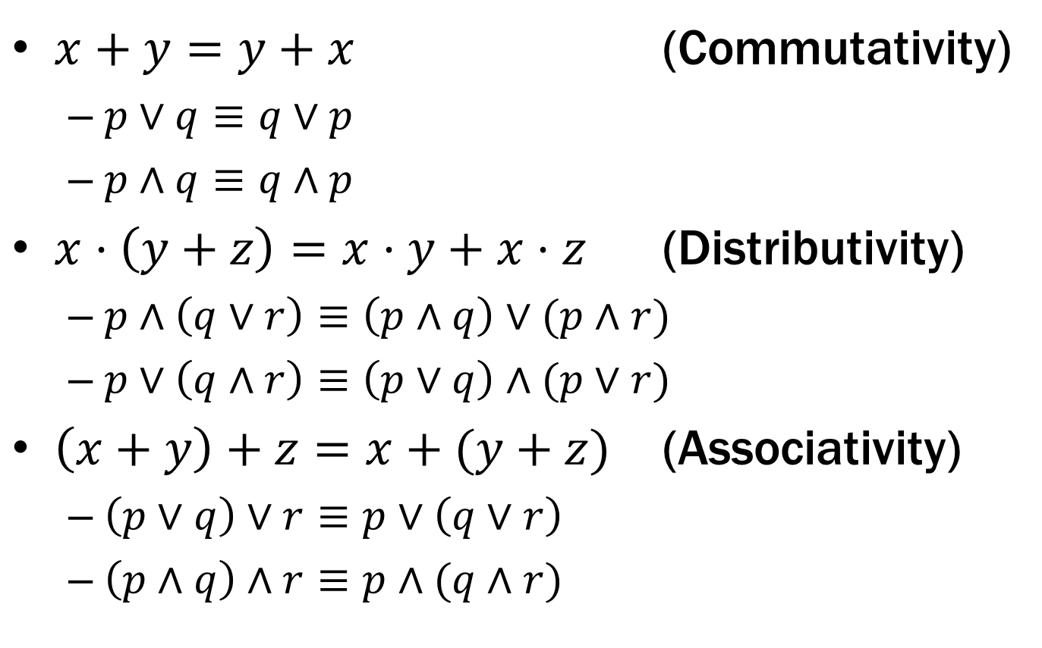

Some Familiar Properties of Arithmetic
$x+y=y+x$ (Commutativity)
$p∨q≡q∨p$
$p∧q≡q∧p$
$x⋅\left(y+z\right)=x⋅y+x⋅z$ (Distributivity)
$p∧\left(q∨r\right)≡\left(p∧q\right)∨(p∧r)$
$p∨\left(q∧r\right)≡\left(p∨q\right)∧(p∨r)$
$\left(x+y\right)+z=x+(y+z)$ (Associativity)
$\left(p∨q\right)∨r≡p∨\left(q∨r\right)$
$\left(p∧q\right)∧r≡p∧(q∧r)$

Slide 13
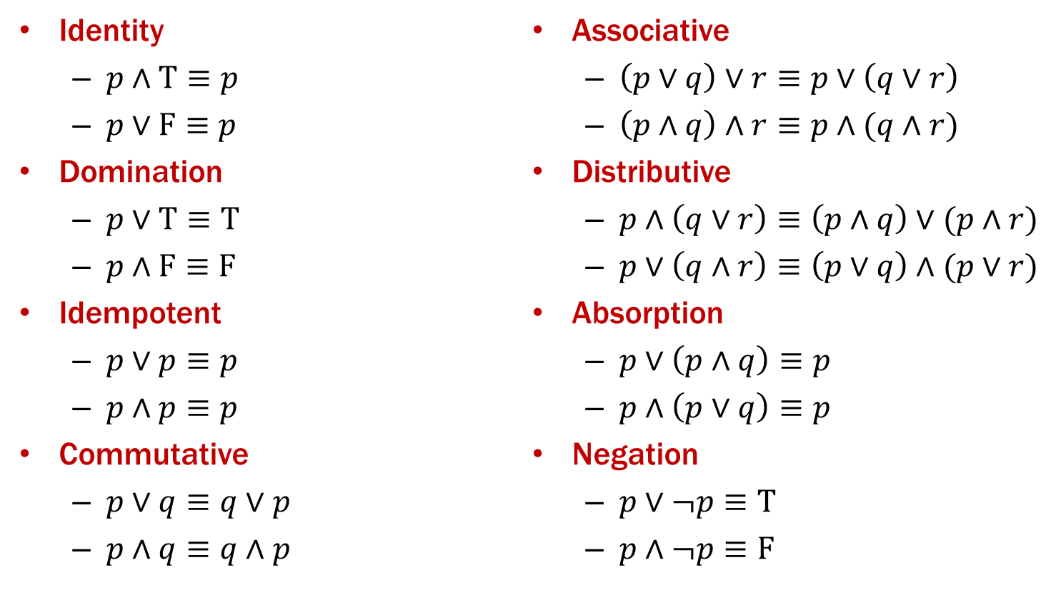
Important Equivalences

Slide 14

Some Familiar Properties of Arithmetic
$x⋅1=x$ (Identity)
$x+0=x$
$x⋅0=0$ (Domination)

Slide 15
Important Equivalences

Slide 16
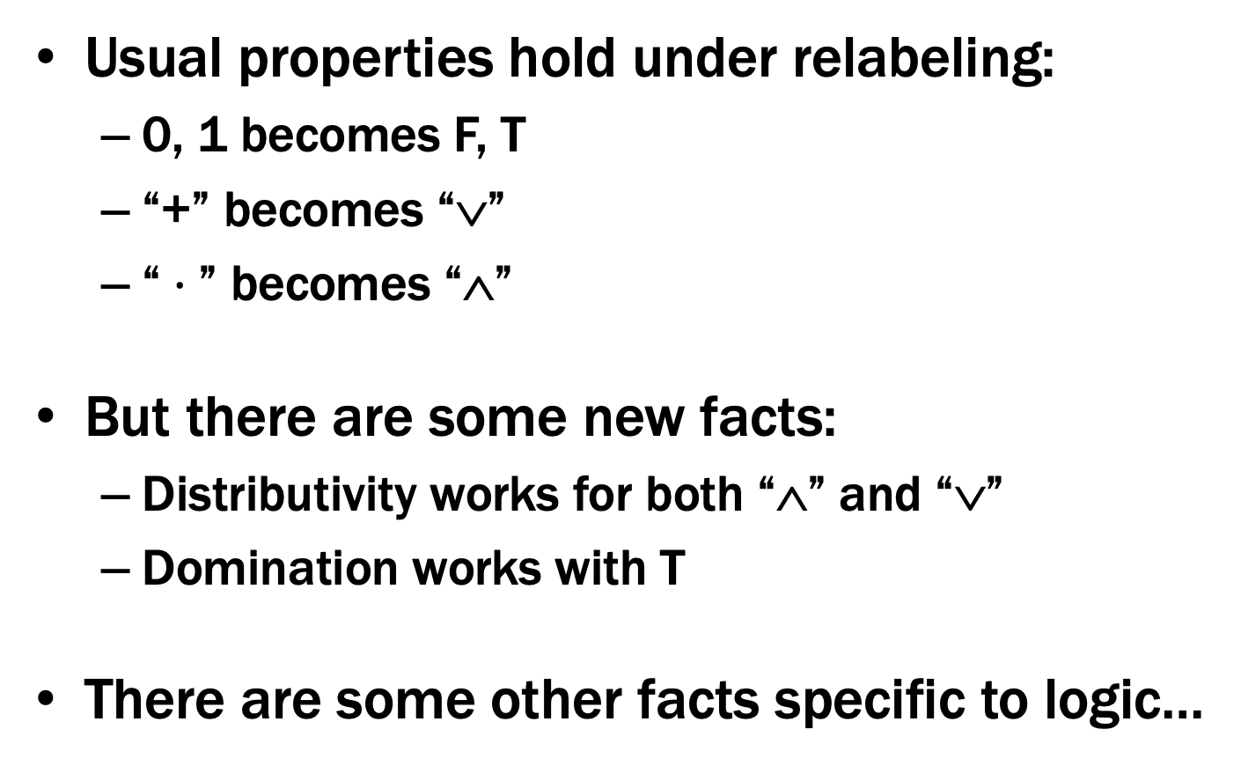
Some Familiar Properties of Arithmetic
Usual properties hold under relabeling:
0, 1 becomes F, T
“+” becomes “∨”
“$⋅$” becomes “∧”
But there are some new facts:
Distributivity works for both “∧” and “∨”
Domination works with T
There are some other facts specific to logic…

Slide 17
Important Equivalences

Slide 18
Important Equivalences

Slide 19
Using Equivalences
Note that p, q, and r can be any propositions (not just atomic propositions)
Ex: (r → s) ∧ (¬t) ≡ (¬t) ∧ (r → s)
apply commutativity: p ∧ q ≡ q ∧ p with p := r → s and q := ¬t

Slide 20

One more easy equivalence
Double Negation
$$p ≡ ➢ ➢ p$$
p | ¬ p | ¬ ¬ p
T | F | T
F | T | F

Slide 21
Understanding logic and circuits
When do two logic formulas mean the same thing?
When do two circuits compute the same function?
What logical properties can we infer from other ones?

Slide 22
Basic rules of reasoning and logic
Working with logical formulas
Simplification
Testing for equivalence
Applications
Query optimization
Search optimization and caching
Artificial Intelligence
Program verification

Slide 23
Computing Equivalence
Given two propositions, can we write an algorithm to determine if they are equivalent?
What is the runtime of our algorithm?

Slide 24
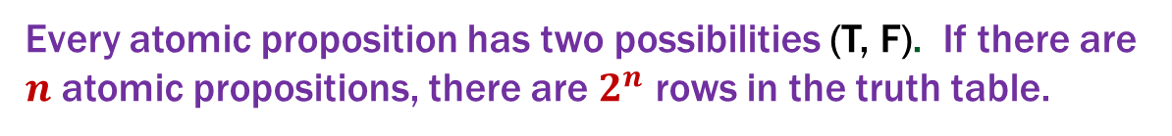
Computing Equivalence
Given two propositions, can we write an algorithm to determine if they are equivalent?
Yes! Generate the truth tables for both propositions and check if they are the same for every entry.
What is the runtime of our algorithm?
Every atomic proposition has two possibilities (T, F). If there are $n$ atomic propositions, there are $2^{n}$ rows in the truth table.

Slide 25
Another approach: Logical Proofs
To show A is equivalent to B
Apply a series of logical equivalences to sub-expressions to convert A to B
To show A is a tautology
Apply a series of logical equivalences to sub-expressions to convert A to T

Slide 26

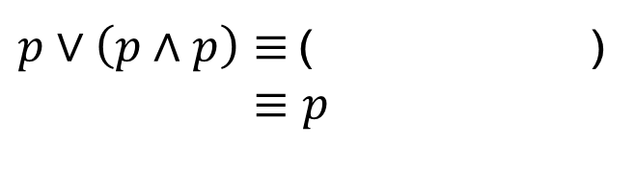
Another approach: Logical Proofs
To show A is equivalent to B
Apply a series of logical equivalences to sub-expressions to convert A to B
Example:
Let A be “$p∨(p∧p)$”, and B be “$p$”.
Our general proof looks like:
$p∨\left(p∧p\right)≡$( )
$≡p$

Slide 27
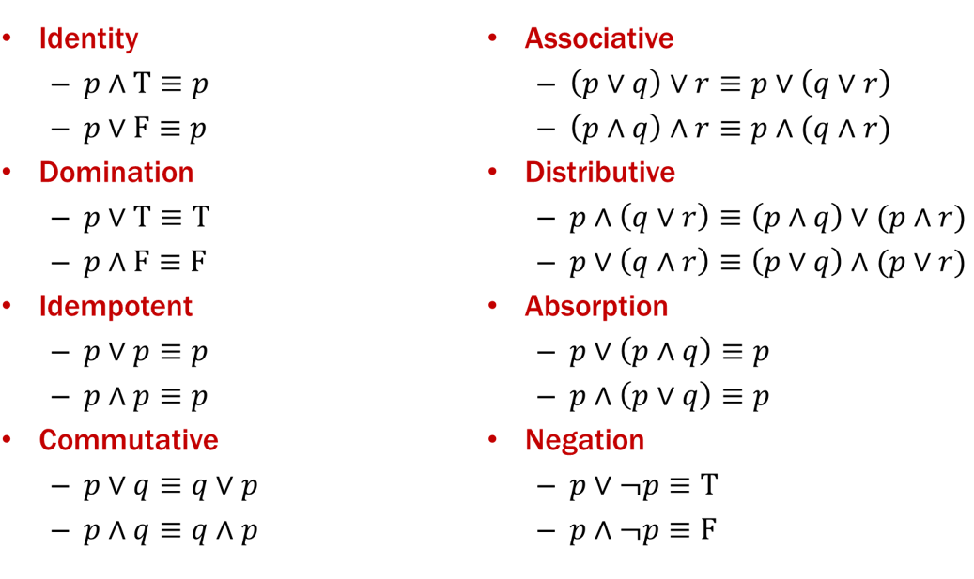
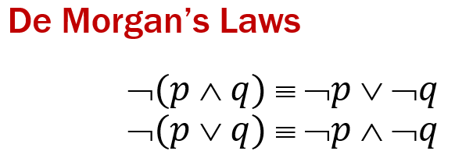
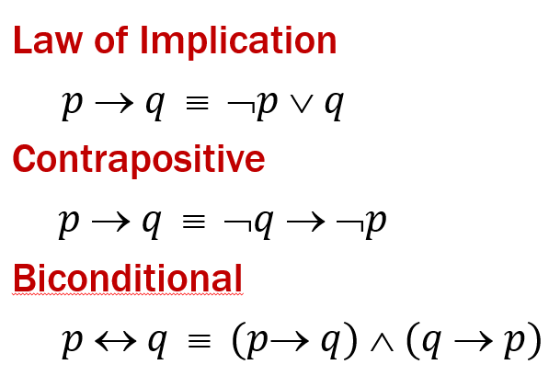
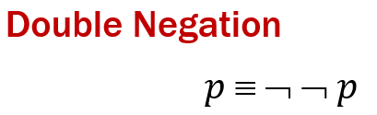
Another approach: Logical Proofs
Example:
Let A be “$p∨(p∧p)$”, and B be “$p$”.
Our general proof looks like:
$p∨\left(p∧p\right)≡$( )
$≡p$

Slide 28

Logical Proofs
Example:
Let A be “$p∨(p∧p)$”, and B be “$p$”.
Our general proof looks like:
$$p∨p$$
$p∨\left(p∧p\right)≡$( )
$≡p$
Idempotent
Idempotent

Slide 29


Logical Proofs
To show A is a tautology
Apply a series of logical equivalences to sub-expressions to convert A to T
Example:
Let A be “$¬p∨(p∨p)$”.
Our general proof looks like:
$¬p∨\left(p∨p\right)≡$( )
$≡$( )
$≡$ T

Slide 30
Logical Proofs
Example:
Let A be “$¬p∨(p∨p)$”.
Our general proof looks like:
$¬p∨\left(p∨p\right)≡$( )
$≡$( )
$≡$ T

Slide 31



Logical Proofs
Example:
Let A be “$¬p∨(p∨p)$”.
Our general proof looks like:
$$¬p∨p$$
$¬p∨\left(p∨p\right)≡$( )
$≡$ ( )
$≡$ T
Idempotent
$$p∨¬p$$
Commutative
Negation

Slide 32
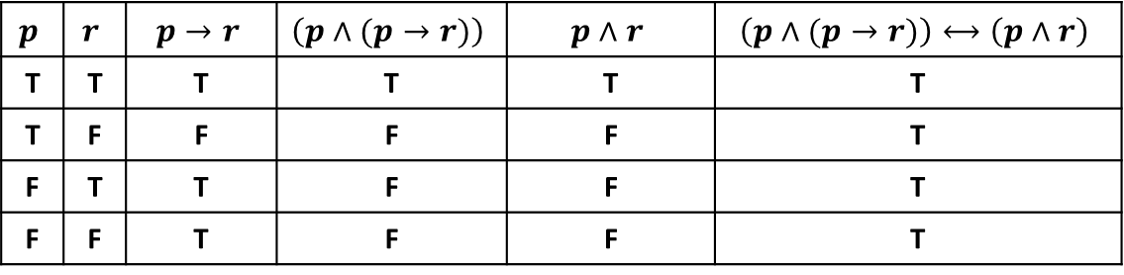
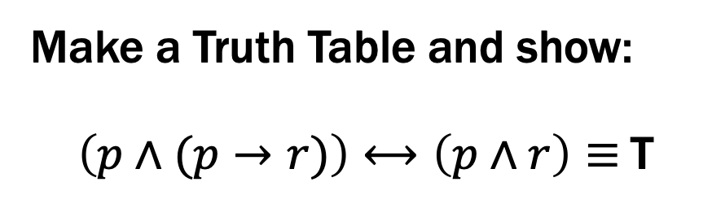
Prove these propositions are equivalent: Option 1
Prove: p ∧ (p → r) ≡ p ∧ r
Make a Truth Table and show:
$\left(p∧(p→r)\right)⟷\left(p∧r\right)≡$T
$$p$$ | $$r$$ | $$p→r$$ | $$\left(p∧(p→r)\right)$$ | $$p∧r$$ | $$\left(p∧(p→r)\right)⟷\left(p∧r\right)$$
T | T | T | T | T | T
T | F | F | F | F | T
F | T | T | F | F | T
F | F | T | F | F | T

Slide 33

Prove these propositions are equivalent: Option 2
Prove: p ∧ (p → r) ≡ p ∧ r
$$p∧\left(p→r\right)≡$$
$≡$
$≡$
$≡$
$≡p∧r$

Slide 34
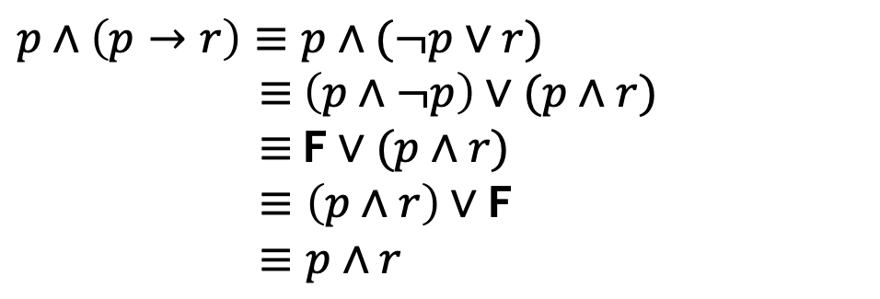
Prove these propositions are equivalent: Option 2
Prove: p ∧ (p → r) ≡ p ∧ r
$$p∧\left(p→r\right)≡p∧(¬p∨r)$$
$≡$ $\left(p∧¬p\right)∨(p∧r)$
$≡$ F $∨(p∧r)$
$≡\left(p∧r\right)∨$F
$≡p∧r$
Law of Implication
Distributive
Negation
Commutative
Identity

Slide 35
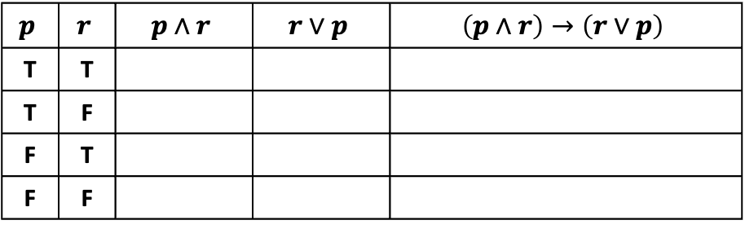
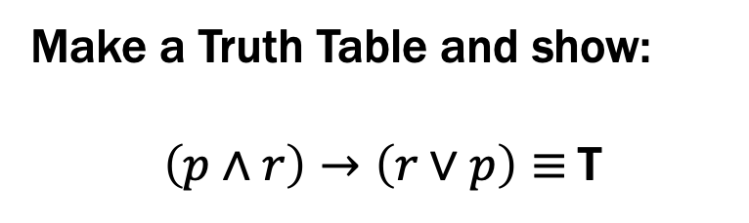
Prove this is a Tautology: Option 1
(p ∧ r) → (r ∨ p)
Make a Truth Table and show:
$\left(p∧r\right)→\left(r∨p\right)≡$T
$$p$$ | $$r$$ | $$p∧r$$ | $$r∨p$$ | $$\left(p∧r\right)→\left(r∨p\right)$$
T | T
T | F
F | T
F | F

Slide 36
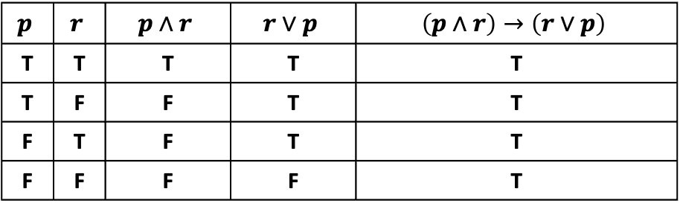
Prove this is a Tautology: Option 1
(p ∧ r) → (r ∨ p)
Make a Truth Table and show:
$\left(p∧r\right)→\left(r∨p\right)≡$T
$$p$$ | $$r$$ | $$p∧r$$ | $$r∨p$$ | $$\left(p∧r\right)→\left(r∨p\right)$$
T | T | T | T | T
T | F | F | T | T
F | T | F | T | T
F | F | F | F | T

Slide 37
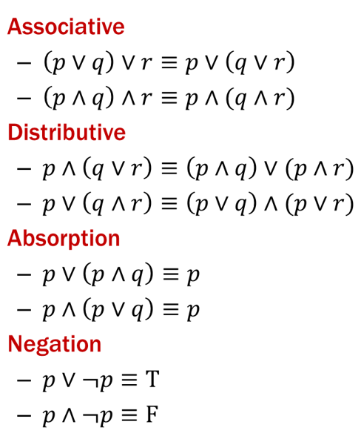
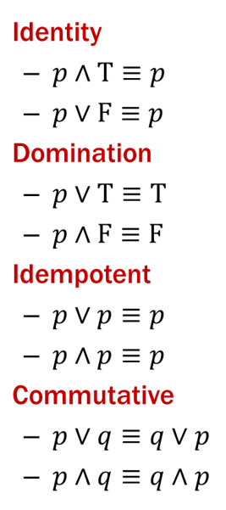

Prove this is a Tautology: Option 2
(p ∧ r) → (r ∨ p)
Use a series of equivalences like so:
$$\left(p∧r\right)→\left(r∨p\right) ≡$$
$≡$
$≡$
$≡$
$≡$
$≡$
$≡$
$≡$
$≡$ T

Slide 38
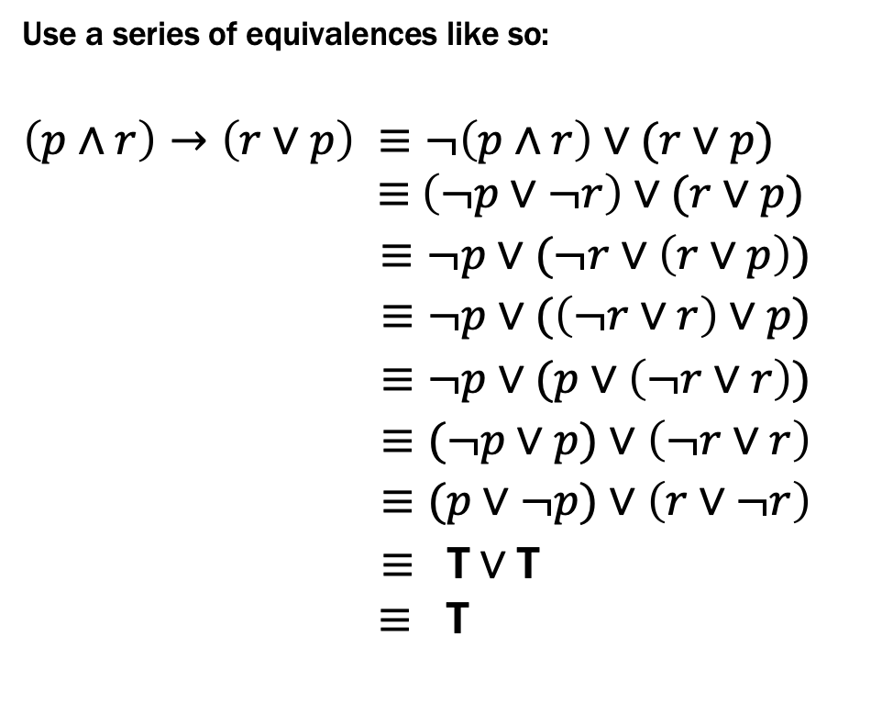
Prove this is a Tautology: Option 2
(p ∧ r) → (r ∨ p)
Use a series of equivalences like so:
$$\left(p∧r\right)→\left(r∨p\right) ≡¬\left(p∧r\right)∨(r∨p)$$
$≡$ $\left(¬p∨¬r\right)∨(r∨p)$
$≡¬p∨(¬r∨\left(r∨p\right))$
$≡¬p∨(\left(¬r∨r\right)∨p)$
$≡¬p∨(p∨\left(¬r∨r\right))$
$≡(¬p∨p)∨\left(¬r∨r\right)$
$≡(p∨¬p)∨\left(r∨¬r\right)$
$≡ \text{T}∨\text{T}$
$≡$ T
Law of Implication
De Morgan
Associative
Associative
Commutative
Associative
Commutative (twice)
Negation (twice)
Domination/Identity

Slide 39
Logical Proofs of Equivalence/Tautology
Not smaller than truth tables when there are only a few propositional variables...
...but usually much shorter than truth table proofs when there are many propositional variables
A big advantage will be that we can extend them to a more in-depth understanding of logic for which truth tables don’t apply.

