Slide 1

CSE 311: Foundations of Computing
Lecture 4: Boolean Algebra, Circuits, Canonical Forms

Slide 2
Last Time: Proofs of Equivalence
To show A is equivalent to B
Apply a series of logical equivalences to sub-expressions to convert A to B
To show A is a tautology
Apply a series of logical equivalences to sub-expressions to convert A to T

Slide 3
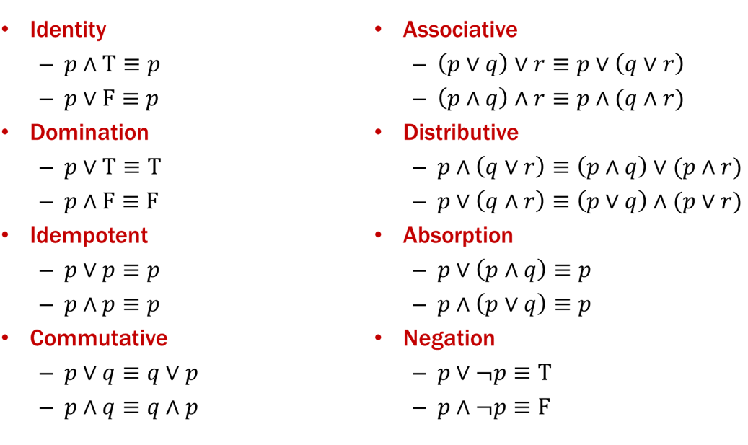
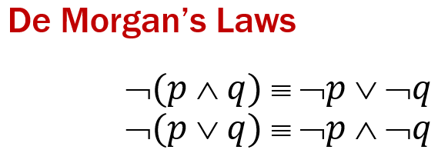
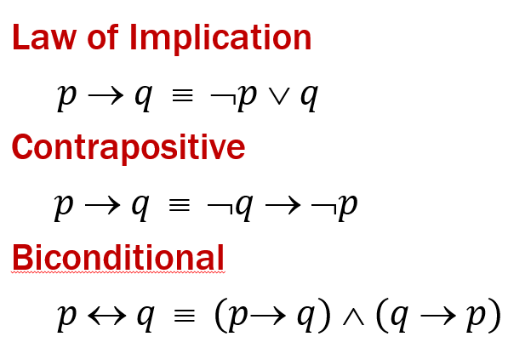
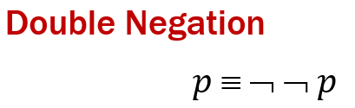
Logical Proofs
Example:
Let A be “$¬p∨(p∨p)$”.
Our general proof looks like:
$¬p∨\left(p∨p\right)≡$( )
$≡$( )
$≡$ T

Slide 4
Logical Proofs
Example:
Let A be “$¬p∨(p∨p)$”.
Our general proof looks like:
$$¬p∨p$$
$¬p∨\left(p∨p\right)≡$( )
$≡$ ( )
$≡$ T
Idempotent
$$p∨¬p$$
Commutative
Negation

Slide 5
Prove these propositions are equivalent
Prove: p ∧ (p → r) ≡ p ∧ r
$$p∧\left(p→r\right)≡$$
$≡$
$≡$
$≡$
$≡p∧r$

Slide 6
Prove these propositions are equivalent
Prove: p ∧ (p → r) ≡ p ∧ r
$$p∧\left(p→r\right)≡p∧(¬p∨r)$$
$≡$ $\left(p∧¬p\right)∨(p∧r)$
$≡$ F $∨(p∧r)$
$≡\left(p∧r\right)∨$F
$≡p∧r$
Law of Implication
Distributive
Negation
Commutative
Identity

Slide 7
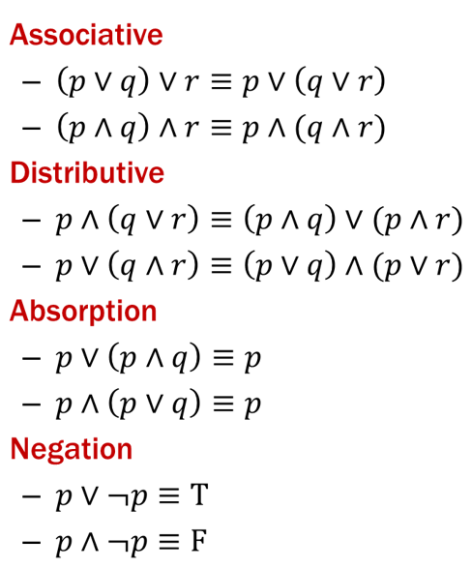
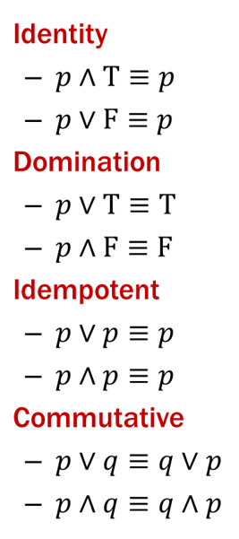
Prove this is a Tautology: Option 1
(p ∧ r) → (r ∨ p)
Use a series of equivalences like so:
$$\left(p∧r\right)→\left(r∨p\right) ≡$$
$≡$
$≡$
$≡$
$≡$
$≡$
$≡$
$≡$
$≡$ T

Slide 8
Prove this is a Tautology: Option 1
(p ∧ r) → (r ∨ p)
Use a series of equivalences like so:
$$\left(p∧r\right)→\left(r∨p\right) ≡¬\left(p∧r\right)∨(r∨p)$$
$≡$ $\left(¬p∨¬r\right)∨(r∨p)$
$≡¬p∨(¬r∨\left(r∨p\right))$
$≡¬p∨(\left(¬r∨r\right)∨p)$
$≡¬p∨(p∨\left(¬r∨r\right))$
$≡(¬p∨p)∨\left(¬r∨r\right)$
$≡(p∨¬p)∨\left(r∨¬r\right)$
$≡ \text{T}∨\text{T}$
$≡$ T
Law of Implication
De Morgan
Associative
Associative
Commutative
Associative
Commutative (twice)
Negation (twice)
Domination/Identity

Slide 9
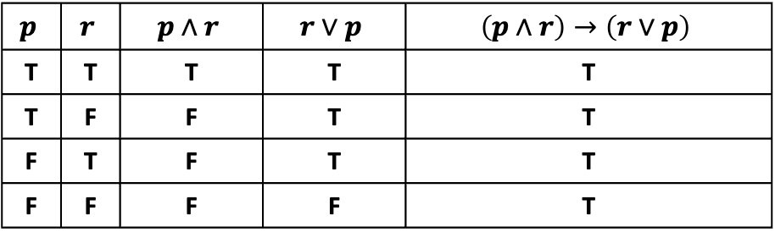
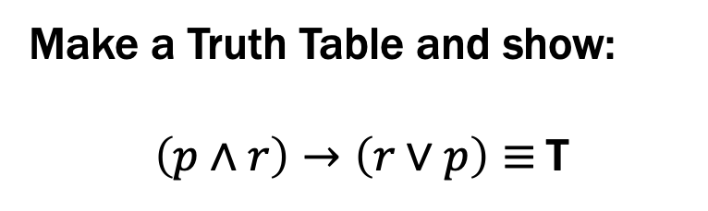
Prove this is a Tautology: Option 2
(p ∧ r) → (r ∨ p)
Make a Truth Table and show:
$\left(p∧r\right)→\left(r∨p\right)≡$T
$$p$$ | $$r$$ | $$p∧r$$ | $$r∨p$$ | $$\left(p∧r\right)→\left(r∨p\right)$$
T | T | T | T | T
T | F | F | T | T
F | T | F | T | T
F | F | F | F | T

Slide 10
Boolean Logic
Combinational Logic
output = F(input)
Sequential Logic
output_{t} = F(output_{t-1}, input_{t})
output dependent on history
concept of a time step (clock, t)

Slide 11
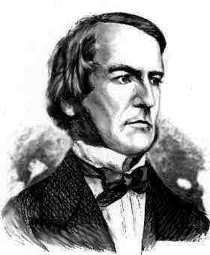
Boolean Logic
Combinational Logic
output = F(input)
Boolean Algebra: another notation for logic consisting of…
a set of elements B = {0, 1}
binary operations { + , • } (OR, AND)
and a unary operation { ’ } (NOT )

Slide 12
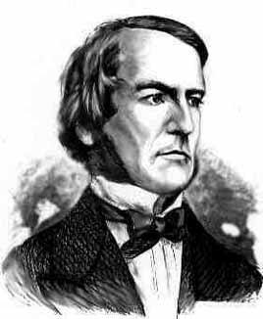
Boolean Algebra
Usual notation used in circuit design
Boolean algebra
a set of elements B containing {0, 1}
binary operations { + , • }
and a unary operation { ’ }
such that the following axioms hold:
For any a, b, c in B: 1. closure: a + b is in B a • b is in B 2. commutativity: a + b = b + a a • b = b • a 3. associativity: a + (b + c) = (a + b) + c a • (b • c) = (a • b) • c 4. distributivity: a + (b • c) = (a + b) • (a + c) a • (b + c) = (a • b) + (a • c) 5. identity: a + 0 = a a • 1 = a 6. complementarity: a + a’ = 1 a • a’ = 0
7. null: a + 1 = 1 a • 0 = 0
8. idempotency: a + a = a a • a = a
9. involution: (a’)’ = a

Slide 13
A Combinational Logic Example
Sessions of Class:
We would like to compute the number of lectures or quiz sections remaining at the start of a given day of the week.
Inputs: Day of the Week, Lecture/Section flag
Output: Number of sessions left
Examples: Input: (Wednesday, Lecture) Output: 2
Input: (Monday, Section) Output: 1

Slide 14
Implementation in Software
public int classesLeftInMorning(int weekday, boolean isLecture) {
switch (weekday) {
case SUNDAY:
case MONDAY:
return isLecture ? 3 : 1;
case TUESDAY:
case WEDNESDAY:
return isLecture ? 2 : 1;
case THURSDAY:
return isLecture ? 1 : 1;
case FRIDAY:
return isLecture ? 1 : 0;
case SATURDAY:
return isLecture ? 0 : 0;
}
}

Slide 15
Implementation with Combinational Logic
Encoding:
How many bits for each input/output?
Binary number for weekday
One bit for each possible output
Weekday
isLecture
0
1
2
3

Slide 16
Defining Our Inputs!
Weekday Input:
Binary number for weekday
Sunday = 0, Monday = 1, …
We care about these in binary:
Weekday | Number | Binary
Sunday | 0 | (000)₂
Monday | 1 | (001)₂
Tuesday | 2 | (010)₂
Wednesday | 3 | (011)₂
Thursday | 4 | (100)₂
Friday | 5 | (101)₂
Saturday | 6 | (110)₂

Slide 17
Converting to a Truth Table!
Weekday |  | isLecture | c₀ | c₁ | c₂ | c₃
SUN | 000 | 0
SUN | 000 | 1
MON | 001 | 0
MON | 001 | 1
TUE | 010 | 0
TUE | 010 | 1
WED | 011 | 0
WED | 011 | 1
THU | 100 | -
FRI | 101 | 0
FRI | 101 | 1
SAT | 110 | -
- | 111 | -
case SUNDAY or MONDAY:
return isLecture ? 3 : 1;
case TUESDAY or WEDNESDAY:
return isLecture ? 2 : 1;
case THURSDAY:
return isLecture ? 1 : 1;
case FRIDAY:
return isLecture ? 1 : 0;
case SATURDAY:
return isLecture ? 0 : 0;

Slide 18
Converting to a Truth Table!
Weekday |  | isLecture | c₀ | c₁ | c₂ | c₃
SUN | 000 | 0 | 0 | 1 | 0 | 0
SUN | 000 | 1 | 0 | 0 | 0 | 1
MON | 001 | 0 | 0 | 1 | 0 | 0
MON | 001 | 1 | 0 | 0 | 0 | 1
TUE | 010 | 0 | 0 | 1 | 0 | 0
TUE | 010 | 1 | 0 | 0 | 1 | 0
WED | 011 | 0 | 0 | 1 | 0 | 0
WED | 011 | 1 | 0 | 0 | 1 | 0
THU | 100 | - | 0 | 1 | 0 | 0
FRI | 101 | 0 | 1 | 0 | 0 | 0
FRI | 101 | 1 | 0 | 1 | 0 | 0
SAT | 110 | - | 1 | 0 | 0 | 0
- | 111 | - | 1 | 0 | 0 | 0
case SUNDAY or MONDAY:
return isLecture ? 3 : 1;
case TUESDAY or WEDNESDAY:
return isLecture ? 2 : 1;
case THURSDAY:
return isLecture ? 1 : 1;
case FRIDAY:
return isLecture ? 1 : 0;
case SATURDAY:
return isLecture ? 0 : 0;

Slide 19
Truth Table to Logic (Part 1)
 | d₂d₁d₀ | L | c₀ | c₁ | c₂ | c₃
SUN | 000 | 0 | 0 | 1 | 0 | 0
SUN | 000 | 1 | 0 | 0 | 0 | 1
MON | 001 | 0 | 0 | 1 | 0 | 0
MON | 001 | 1 | 0 | 0 | 0 | 1
TUE | 010 | 0 | 0 | 1 | 0 | 0
TUE | 010 | 1 | 0 | 0 | 1 | 0
WED | 011 | 0 | 0 | 1 | 0 | 0
WED | 011 | 1 | 0 | 0 | 1 | 0
THU | 100 | - | 0 | 1 | 0 | 0
FRI | 101 | 0 | 1 | 0 | 0 | 0
FRI | 101 | 1 | 0 | 1 | 0 | 0
SAT | 110 | - | 1 | 0 | 0 | 0
- | 111 | - | 1 | 0 | 0 | 0
Let’s begin by finding an expression for c₃. To do this, we look at the rows where c₃ = 1 (true).

Slide 20
Truth Table to Logic (Part 1)
 | d₂d₁d₀ | L | c₀ | c₁ | c₂ | c₃
SUN | 000 | 0 | 0 | 1 | 0 | 0
SUN | 000 | 1 | 0 | 0 | 0 | 1
MON | 001 | 0 | 0 | 1 | 0 | 0
MON | 001 | 1 | 0 | 0 | 0 | 1
TUE | 010 | 0 | 0 | 1 | 0 | 0
TUE | 010 | 1 | 0 | 0 | 1 | 0
WED | 011 | 0 | 0 | 1 | 0 | 0
WED | 011 | 1 | 0 | 0 | 1 | 0
THU | 100 | - | 0 | 1 | 0 | 0
FRI | 101 | 0 | 1 | 0 | 0 | 0
FRI | 101 | 1 | 0 | 1 | 0 | 0
SAT | 110 | - | 1 | 0 | 0 | 0
- | 111 | - | 1 | 0 | 0 | 0
DAY == SUN && L == 1
DAY == MON && L == 1

Slide 21
Truth Table to Logic (Part 1)
 | d₂d₁d₀ | L | c₀ | c₁ | c₂ | c₃
SUN | 000 | 0 | 0 | 1 | 0 | 0
SUN | 000 | 1 | 0 | 0 | 0 | 1
MON | 001 | 0 | 0 | 1 | 0 | 0
MON | 001 | 1 | 0 | 0 | 0 | 1
TUE | 010 | 0 | 0 | 1 | 0 | 0
TUE | 010 | 1 | 0 | 0 | 1 | 0
WED | 011 | 0 | 0 | 1 | 0 | 0
WED | 011 | 1 | 0 | 0 | 1 | 0
THU | 100 | - | 0 | 1 | 0 | 0
FRI | 101 | 0 | 1 | 0 | 0 | 0
FRI | 101 | 1 | 0 | 1 | 0 | 0
SAT | 110 | - | 1 | 0 | 0 | 0
- | 111 | - | 1 | 0 | 0 | 0
d₂d₁d₀ == 000 && L == 1
d₂d₁d₀ == 001 && L == 1
Substituting DAY for the binary representation.

Slide 22
Truth Table to Logic (Part 1)
 | d₂d₁d₀ | L | c₀ | c₁ | c₂ | c₃
SUN | 000 | 0 | 0 | 1 | 0 | 0
SUN | 000 | 1 | 0 | 0 | 0 | 1
MON | 001 | 0 | 0 | 1 | 0 | 0
MON | 001 | 1 | 0 | 0 | 0 | 1
TUE | 010 | 0 | 0 | 1 | 0 | 0
TUE | 010 | 1 | 0 | 0 | 1 | 0
WED | 011 | 0 | 0 | 1 | 0 | 0
WED | 011 | 1 | 0 | 0 | 1 | 0
THU | 100 | - | 0 | 1 | 0 | 0
FRI | 101 | 0 | 1 | 0 | 0 | 0
FRI | 101 | 1 | 0 | 1 | 0 | 0
SAT | 110 | - | 1 | 0 | 0 | 0
- | 111 | - | 1 | 0 | 0 | 0
d₂ == 0 && d₁ == 0 && d₀ == 0 && L == 1
d₂ == 0 && d₁ == 0 && d₀ == 1 && L == 1
Splitting up the bits of the day; so, we can write a formula.

Slide 23
Truth Table to Logic (Part 1)
 | d₂d₁d₀ | L | c₀ | c₁ | c₂ | c₃
SUN | 000 | 0 | 0 | 1 | 0 | 0
SUN | 000 | 1 | 0 | 0 | 0 | 1
MON | 001 | 0 | 0 | 1 | 0 | 0
MON | 001 | 1 | 0 | 0 | 0 | 1
TUE | 010 | 0 | 0 | 1 | 0 | 0
TUE | 010 | 1 | 0 | 0 | 1 | 0
WED | 011 | 0 | 0 | 1 | 0 | 0
WED | 011 | 1 | 0 | 0 | 1 | 0
THU | 100 | - | 0 | 1 | 0 | 0
FRI | 101 | 0 | 1 | 0 | 0 | 0
FRI | 101 | 1 | 0 | 1 | 0 | 0
SAT | 110 | - | 1 | 0 | 0 | 0
- | 111 | - | 1 | 0 | 0 | 0
d₂’•d₁’•d₀’•L
Replacing with Boolean Algebra…
d₂’•d₁’•d₀•L

Slide 24
Truth Table to Logic (Part 1)
 | d₂d₁d₀ | L | c₀ | c₁ | c₂ | c₃
SUN | 000 | 0 | 0 | 1 | 0 | 0
SUN | 000 | 1 | 0 | 0 | 0 | 1
MON | 001 | 0 | 0 | 1 | 0 | 0
MON | 001 | 1 | 0 | 0 | 0 | 1
TUE | 010 | 0 | 0 | 1 | 0 | 0
TUE | 010 | 1 | 0 | 0 | 1 | 0
WED | 011 | 0 | 0 | 1 | 0 | 0
WED | 011 | 1 | 0 | 0 | 1 | 0
THU | 100 | - | 0 | 1 | 0 | 0
FRI | 101 | 0 | 1 | 0 | 0 | 0
FRI | 101 | 1 | 0 | 1 | 0 | 0
SAT | 110 | - | 1 | 0 | 0 | 0
- | 111 | - | 1 | 0 | 0 | 0
d₂’•d₁’•d₀’•L
d₂’•d₁’•d₀•L
How do we combine them?

Slide 25
Truth Table to Logic (Part 1)
 | d₂d₁d₀ | L | c₀ | c₁ | c₂ | c₃
SUN | 000 | 0 | 0 | 1 | 0 | 0
SUN | 000 | 1 | 0 | 0 | 0 | 1
MON | 001 | 0 | 0 | 1 | 0 | 0
MON | 001 | 1 | 0 | 0 | 0 | 1
TUE | 010 | 0 | 0 | 1 | 0 | 0
TUE | 010 | 1 | 0 | 0 | 1 | 0
WED | 011 | 0 | 0 | 1 | 0 | 0
WED | 011 | 1 | 0 | 0 | 1 | 0
THU | 100 | - | 0 | 1 | 0 | 0
FRI | 101 | 0 | 1 | 0 | 0 | 0
FRI | 101 | 1 | 0 | 1 | 0 | 0
SAT | 110 | - | 1 | 0 | 0 | 0
- | 111 | - | 1 | 0 | 0 | 0
d₂’•d₁’•d₀’•L
d₂’•d₁’•d₀•L
Either situation causes c₃ to be true. So, we “or” them.
c₃ = d₂’•d₁’•d₀’•L + d₂’•d₁’•d₀•L

Slide 26
Truth Table to Logic (Part 2)
 | d₂d₁d₀ | L | c₀ | c₁ | c₂ | c₃
SUN | 000 | 0 | 0 | 1 | 0 | 0
SUN | 000 | 1 | 0 | 0 | 0 | 1
MON | 001 | 0 | 0 | 1 | 0 | 0
MON | 001 | 1 | 0 | 0 | 0 | 1
TUE | 010 | 0 | 0 | 1 | 0 | 0
TUE | 010 | 1 | 0 | 0 | 1 | 0
WED | 011 | 0 | 0 | 1 | 0 | 0
WED | 011 | 1 | 0 | 0 | 1 | 0
THU | 100 | - | 0 | 1 | 0 | 0
FRI | 101 | 0 | 1 | 0 | 0 | 0
FRI | 101 | 1 | 0 | 1 | 0 | 0
SAT | 110 | - | 1 | 0 | 0 | 0
- | 111 | - | 1 | 0 | 0 | 0
c₃ = d₂’•d₁’•d₀’•L + d₂’•d₁’•d₀•L
Now, we do c₂.

Slide 27
Truth Table to Logic (Part 3)
 | d₂d₁d₀ | L | c₀ | c₁ | c₂ | c₃
SUN | 000 | 0 | 0 | 1 | 0 | 0
SUN | 000 | 1 | 0 | 0 | 0 | 1
MON | 001 | 0 | 0 | 1 | 0 | 0
MON | 001 | 1 | 0 | 0 | 0 | 1
TUE | 010 | 0 | 0 | 1 | 0 | 0
TUE | 010 | 1 | 0 | 0 | 1 | 0
WED | 011 | 0 | 0 | 1 | 0 | 0
WED | 011 | 1 | 0 | 0 | 1 | 0
THU | 100 | - | 0 | 1 | 0 | 0
FRI | 101 | 0 | 1 | 0 | 0 | 0
FRI | 101 | 1 | 0 | 1 | 0 | 0
SAT | 110 | - | 1 | 0 | 0 | 0
- | 111 | - | 1 | 0 | 0 | 0
Now, we do c₁:
c₃ = d₂’•d₁’•d₀’•L + d₂’•d₁’•d₀•L
c₂ = d₂’•d₁•d₀’•L + d₂’•d₁•d₀•L

Slide 28
Truth Table to Logic (Part 3)
 | d₂d₁d₀ | L | c₀ | c₁ | c₂ | c₃
SUN | 000 | 0 | 0 | 1 | 0 | 0
SUN | 000 | 1 | 0 | 0 | 0 | 1
MON | 001 | 0 | 0 | 1 | 0 | 0
MON | 001 | 1 | 0 | 0 | 0 | 1
TUE | 010 | 0 | 0 | 1 | 0 | 0
TUE | 010 | 1 | 0 | 0 | 1 | 0
WED | 011 | 0 | 0 | 1 | 0 | 0
WED | 011 | 1 | 0 | 0 | 1 | 0
THU | 100 | - | 0 | 1 | 0 | 0
FRI | 101 | 0 | 1 | 0 | 0 | 0
FRI | 101 | 1 | 0 | 1 | 0 | 0
SAT | 110 | - | 1 | 0 | 0 | 0
- | 111 | - | 1 | 0 | 0 | 0
Now, we do c₁:
d₂’•d₁’•d₀’•L’
d₂’•d₁’•d₀•L’
d₂’•d₁•d₀’•L’
d₂’•d₁•d₀•L’
???
d₂•d₁’•d₀•L
c₃ = d₂’•d₁’•d₀’•L + d₂’•d₁’•d₀•L
c₂ = d₂’•d₁•d₀’•L + d₂’•d₁•d₀•L

Slide 29
Truth Table to Logic (Part 3)
 | d₂d₁d₀ | L | c₀ | c₁ | c₂ | c₃
SUN | 000 | 0 | 0 | 1 | 0 | 0
SUN | 000 | 1 | 0 | 0 | 0 | 1
MON | 001 | 0 | 0 | 1 | 0 | 0
MON | 001 | 1 | 0 | 0 | 0 | 1
TUE | 010 | 0 | 0 | 1 | 0 | 0
TUE | 010 | 1 | 0 | 0 | 1 | 0
WED | 011 | 0 | 0 | 1 | 0 | 0
WED | 011 | 1 | 0 | 0 | 1 | 0
THU | 100 | - | 0 | 1 | 0 | 0
FRI | 101 | 0 | 1 | 0 | 0 | 0
FRI | 101 | 1 | 0 | 1 | 0 | 0
SAT | 110 | - | 1 | 0 | 0 | 0
- | 111 | - | 1 | 0 | 0 | 0
Now, we do c₁:
d₂’•d₁’•d₀’•L’
d₂’•d₁’•d₀•L’
d₂’•d₁•d₀’•L’
d₂’•d₁•d₀•L’
No matter what L is, we always say it’s 1. So, we don’t need L in the expression.
d₂•d₁’•d₀’
d₂•d₁’•d₀•L
c₃ = d₂’•d₁’•d₀’•L + d₂’•d₁’•d₀•L
c₂ = d₂’•d₁•d₀’•L + d₂’•d₁•d₀•L

Slide 30
Truth Table to Logic (Part 3)
 | d₂d₁d₀ | L | c₀ | c₁ | c₂ | c₃
SUN | 000 | 0 | 0 | 1 | 0 | 0
SUN | 000 | 1 | 0 | 0 | 0 | 1
MON | 001 | 0 | 0 | 1 | 0 | 0
MON | 001 | 1 | 0 | 0 | 0 | 1
TUE | 010 | 0 | 0 | 1 | 0 | 0
TUE | 010 | 1 | 0 | 0 | 1 | 0
WED | 011 | 0 | 0 | 1 | 0 | 0
WED | 011 | 1 | 0 | 0 | 1 | 0
THU | 100 | - | 0 | 1 | 0 | 0
FRI | 101 | 0 | 1 | 0 | 0 | 0
FRI | 101 | 1 | 0 | 1 | 0 | 0
SAT | 110 | - | 1 | 0 | 0 | 0
- | 111 | - | 1 | 0 | 0 | 0
Now, we do c₁:
d₂’•d₁’•d₀’•L’
d₂’•d₁’•d₀•L’
d₂’•d₁•d₀’•L’
d₂’•d₁•d₀•L’
No matter what L is, we always say it’s 1. So, we don’t need L in the expression.
d₂•d₁’•d₀’
d₂•d₁’•d₀•L
c₃ = d₂’•d₁’•d₀’•L + d₂’•d₁’•d₀•L
c₂ = d₂’•d₁•d₀’•L + d₂’•d₁•d₀•L
c₁ = d₂’•d₁’•d₀’•L’ + d₂’•d₁’•d₀•L’ + d₂’•d₁•d₀’•L’ + d₂’•d₁•d₀•L’ + d₂•d₁’•d₀’ + d₂•d₁’•d₀•L

Slide 31
Truth Table to Logic (Part 4)
 | d₂d₁d₀ | L | c₀ | c₁ | c₂ | c₃
SUN | 000 | 0 | 0 | 1 | 0 | 0
SUN | 000 | 1 | 0 | 0 | 0 | 1
MON | 001 | 0 | 0 | 1 | 0 | 0
MON | 001 | 1 | 0 | 0 | 0 | 1
TUE | 010 | 0 | 0 | 1 | 0 | 0
TUE | 010 | 1 | 0 | 0 | 1 | 0
WED | 011 | 0 | 0 | 1 | 0 | 0
WED | 011 | 1 | 0 | 0 | 1 | 0
THU | 100 | - | 0 | 1 | 0 | 0
FRI | 101 | 0 | 1 | 0 | 0 | 0
FRI | 101 | 1 | 0 | 1 | 0 | 0
SAT | 110 | - | 1 | 0 | 0 | 0
- | 111 | - | 1 | 0 | 0 | 0
c₁ = d₂’•d₁’•d₀’•L’ + d₂’•d₁’•d₀•L’ +
d₂’•d₁•d₀’•L’ + d₂’•d₁•d₀•L’ +
d₂•d₁’•d₀’ + d₂•d₁’•d₀•L
c₂ = d₂’•d₁•d₀’•L + d₂’•d₁•d₀•L
c₃ = d₂’•d₁’•d₀’•L + d₂’•d₁’•d₀•L
Finally, we do c₀:
d₂•d₁’•d₀•L’
d₂•d₁•d₀’
d₂•d₁•d₀

Slide 32



Truth Table to Logic (Part 4)
c₀ = d₂•d₁’•d₀•L’ + d₂•d₁•d₀’ + d₂•d₁•d₀
c₁ = d₂’•d₁’•d₀’•L’ + d₂’•d₁’•d₀•L’ + d₂’•d₁•d₀’•L’ + d₂’•d₁•d₀•L’ + d₂•d₁’•d₀’ + d₂•d₁’•d₀•L
c₂ = d₂’•d₁•d₀’•L + d₂’•d₁•d₀•L
c₃ = d₂’•d₁’•d₀’•L + d₂’•d₁’•d₀•L
Here’s c₃ as a circuit:
d₂
NOT
AND
d₁
NOT
OR
d₀
AND
NOT
L

Slide 33
Boolean Algebra
Usual notation used in circuit design
Boolean algebra
a set of elements B containing {0, 1}
binary operations { + , • }
and a unary operation { ’ }
such that the following axioms hold:
For any a, b, c in B: 1. closure: a + b is in B a • b is in B 2. commutativity: a + b = b + a a • b = b • a 3. associativity: a + (b + c) = (a + b) + c a • (b • c) = (a • b) • c 4. distributivity: a + (b • c) = (a + b) • (a + c) a • (b + c) = (a • b) + (a • c) 5. identity: a + 0 = a a • 1 = a 6. complementarity: a + a’ = 1 a • a’ = 0
7. null: a + 1 = 1 a • 0 = 0
8. idempotency: a + a = a a • a = a
9. involution: (a’)’ = a

Slide 34
Simplification using Boolean Algebra
uniting: 10. a • b + a • b’ = a 10D. (a + b) • (a + b’) = a
absorption: 11. a + a • b = a 11D. a • (a + b) = a 12. (a + b’) • b = a • b 12D. (a • b’) + b = a + b
factoring: 13. (a + b) • (a’ + c) = 13D. a • b + a’ • c = a • c + a’ • b (a + c) • (a’ + b)
consensus: 14. (a • b) + (b • c) + (a’ • c) = 14D. (a + b) • (b + c) • (a’ + c) = a • b + a’ • c (a + b) • (a’ + c)
de Morgan’s: 15. (a + b + ...)’ = a’ • b’ • ... 15D. (a • b • ...)’ = a’ + b’ + ...

Slide 35
Simplifying using Boolean Algebra
c3 = d2’•d1’•d0’•L + d2’•d1’•d0•L
= d2’•d1’•(d0’ + d0)•L
= d2’•d1’•1•L
= d2’•d1’•L
d2
NOT
AND
d1
NOT
L

Slide 36
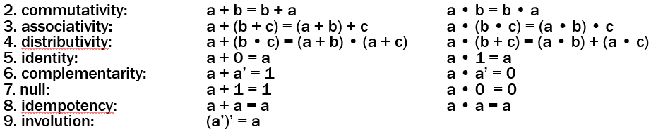
Proving Theorems
Using the laws of Boolean Algebra:
prove the Uniting theorem: X • Y + X • Y’ = X prove the Absorption theorem: X + X • Y = X
X • Y + X • Y’ =
X + X • Y =

Slide 37
Proving Theorems
Using the laws of Boolean Algebra:
prove the Uniting theorem: X • Y + X • Y’ = X prove the Absorption theorem: X + X • Y = X
distributivity
complementarity
identity
X • Y + X • Y’ = X • (Y + Y’)
= X • 1
= X
identity
distributivity
commutativity
null
identity
X + X • Y = X • 1 + X • Y
= X • (1 + Y)
= X • (Y + 1)
= X • 1
= X

Slide 38
Proving Theorems
Using truth table:
For example, de Morgan’s Law:
X Y X’ Y’ (X + Y)’ X’ • Y’
(X + Y)’ = X’ • Y’ NOR is equivalent to AND with inputs complemented
0 0 1 1 1 1
0 1 1 0 0 0
1 0 0 1 0 0
1 1 0 0 0 0
(X • Y)’ = X’ + Y’ NAND is equivalent to OR with inputs complemented
X Y X’ Y’ (X • Y)’ X’ + Y’
0 0 1 1 1 1
0 1 1 0 1 1 1 0 0 1 1 1
1 1 0 0 0 0

